Slide 1

iCode
DAY 3
EMPOWERING FUTURE INNOVATORS
<exact title text>
<bullets, prose, or code block — verbatim>
1

Slide 2
iCode
DAY 3
EMPOWERING FUTURE INNOVATORS
VR Creator - Day 3
Base Defense · 1990 → 2009 · Tower Defense Era
2

Slide 3
iCode
DAY 3
EMPOWERING FUTURE INNOVATORS
A whole genre — invented by modders
• Rampart (1990) — hybrid first attempt. Castle walls + cannonballs.
• Warcraft III custom maps (2002–2007) — the entire genre invented by players tweaking someone else's game.
• Plants vs Zombies (2009) — mainstream breakout. 6 million copies in a year.
• Bloons / Kingdom Rush — mobile-era boom. Still going.
• Every tower defense game you've played traces back to a Warcraft III modder.
3

Slide 4
iCode
DAY 3
EMPOWERING FUTURE INNOVATORS
Yesterday → Today
• Day 2 — Loops + intro Functions. for loops, named blocks of code.
• Day 3 — Lists + Deeper Functions. Same for-loop shape, new things to loop over.
• Today's two new ideas: a list is a collection of things. A deeper function scans a list and returns something useful.
4

Slide 5
iCode
DAY 3
EMPOWERING FUTURE INNOVATORS
The 5-day arc
• Day 1 ✓ Pong — Vars + Conditions
• Day 2 ✓ Pac-Man — Loops + Functions
• Day 3 ← Base Defense — Lists + Deeper Functions
• Day 4 Fighter — Objects + State
• Day 5 Escape Room — Showcase
5

Slide 6
iCode
DAY 3
EMPOWERING FUTURE INNOVATORS
Today: Lists + Deeper Functions
• Lists — a collection of things your code can remember, walk through, add to, or remove from.
• Deeper Functions — functions that scan lists, return something useful, and chain into each other.
6

Slide 7
iCode
DAY 3
EMPOWERING FUTURE INNOVATORS
GDScript list ops — two things change
Python
GDScript
list = []
list.remove(x)
len(list)
var list = []
list.erase(x)
list.size()
7

Slide 8
iCode
DAY 3
EMPOWERING FUTURE INNOVATORS
Pre-coding setup
8

Slide 9
iCode
DAY 3
EMPOWERING FUTURE INNOVATORS
Walk A — Open the Day 3 project
Open the Base Defense project. You know how. Do it like yesterday.
9

Slide 10
iCode
DAY 3
EMPOWERING FUTURE INNOVATORS
Walk B — Open main.gd
Open main.gd in the Script editor. Same as always.
10

Slide 11
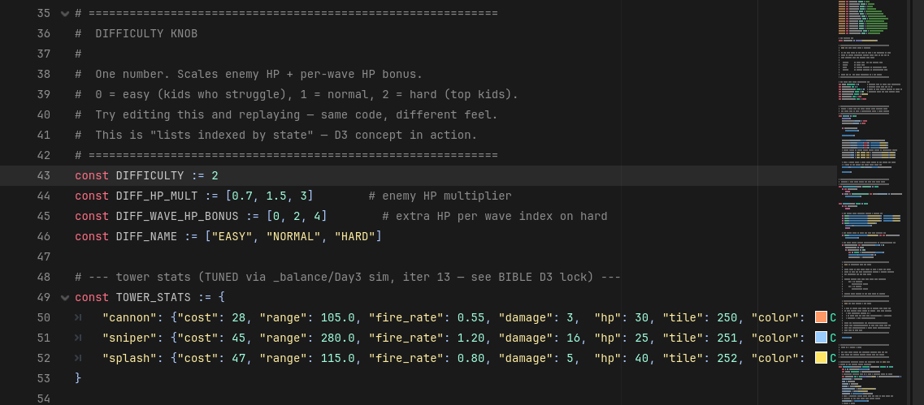
iCode
DAY 3
EMPOWERING FUTURE INNOVATORS
Near the top of main.gd, there's a const DIFFICULTY := 2. This one number changes how hard the whole game is.
11

Slide 12
iCode
DAY 3
EMPOWERING FUTURE INNOVATORS
Walk DK — What this number controls
• 0 = Easy — enemies have less HP.
• 1 = Medium — standard HP.
• 2 = Hard — full HP (what you're coding on).
• Change one number → the whole game runs at a different difficulty. You'll try this in a personalization session later.
12

Slide 13
iCode
DAY 3
EMPOWERING FUTURE INNOVATORS
Lesson chunks
13

Slide 14
iCode
DAY 3
EMPOWERING FUTURE INNOVATORS
Reminder: there are millions of right answers
• The examples on the LEFT of TODO slides are one way.
• Your way is valid if it runs.
14

Slide 15
iCode
DAY 3
EMPOWERING FUTURE INNOVATORS
List
15

Slide 16
iCode
DAY 3
EMPOWERING FUTURE INNOVATORS
A list = things in order
• A grocery list holds items in order. You can add an item, remove one, or walk through all of them.
• In code: a list holds values. You can .append(), .erase(), and loop through them.
16

Slide 17
iCode
DAY 3
EMPOWERING FUTURE INNOVATORS
A list in GDScript
var fruits: Array = [] # empty list
fruits.append("apple") # add to the end
fruits.append("banana")
print(fruits.size()) # prints: 2
fruits.erase("apple") # remove by value
print(fruits.size()) # prints: 1
17

Slide 18
iCode
DAY 3
EMPOWERING FUTURE INNOVATORS
Lists are everywhere in games
• All the active enemies on screen → a list.
• All the towers the player has placed → a list.
• Inventory items, quests, bullet projectiles — all lists.
18

Slide 19
iCode
DAY 3
EMPOWERING FUTURE INNOVATORS
In our game: enemies and towers
• enemies — every enemy currently walking toward your base.
• towers — every tower the player has placed.
• Both start empty []. They grow as the game runs.
19

Slide 20
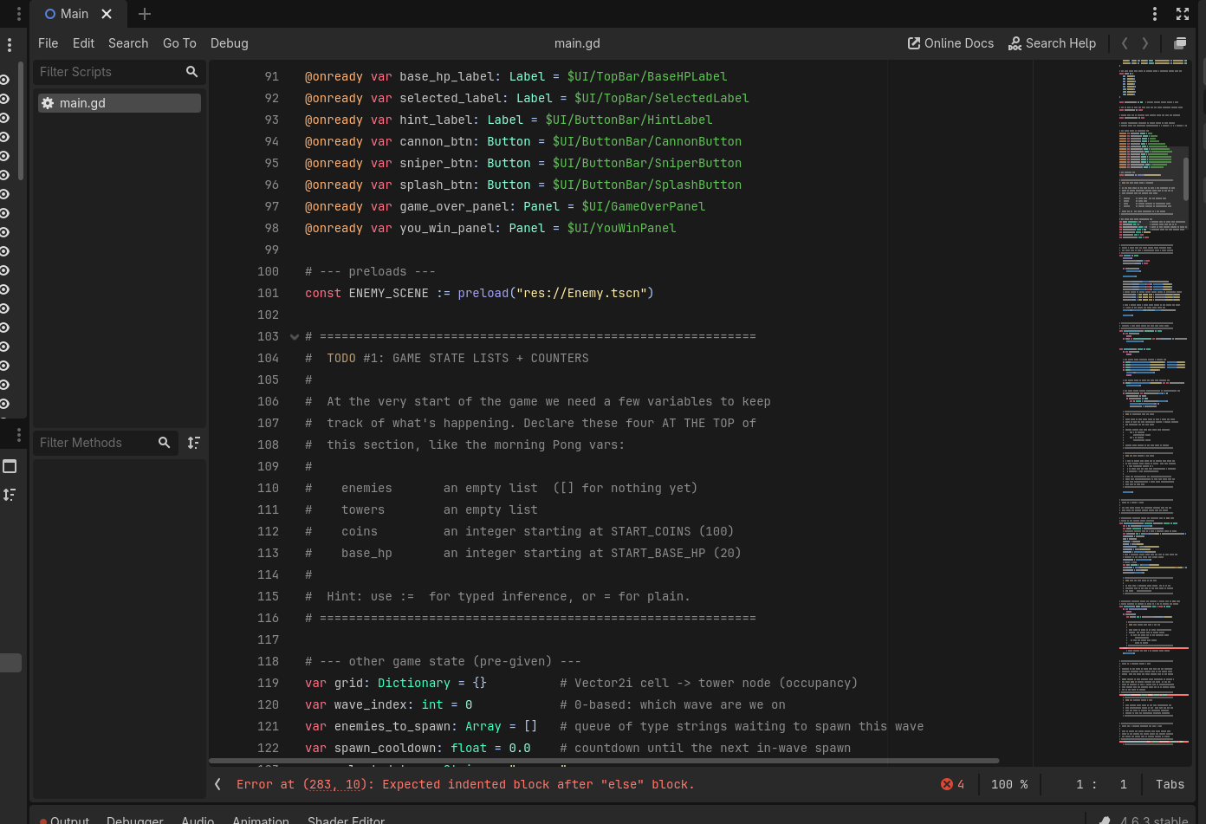
iCode
DAY 3
EMPOWERING FUTURE INNOVATORS
At the # TODO #1 marker near the top of main.gd, after the preloads.
20

Slide 21
iCode
DAY 3
EMPOWERING FUTURE INNOVATORS
What you're about to write
# var enemies: Array = [] (empty list)
# var towers: Array = [] (empty list)
# var coins: int = START_COINS
# var base_hp: int = START_BASE_HP
• What: Four variable declarations — two empty lists, two integer counters.
• Why: Without these, the game has nowhere to store enemies, towers, or score.
• How: Array = [] makes an empty list. int = START_COINS sets a typed integer to the starting constant.
This is one approach — yours works if it runs.
21

Slide 22
iCode
DAY 3
EMPOWERING FUTURE INNOVATORS
TODO #1 — Declare game state variables
SYNTAX
WRITE THIS
var items: Array = []
var name := value
const NAME := value
# var enemies: Array = [] (empty list)
# var towers: Array = [] (empty list)
# var coins: int = START_COINS
# var base_hp: int = START_BASE_HP
Detailed instructions are in your code file, right next to this TODO.
22

Slide 23
iCode
DAY 3
EMPOWERING FUTURE INNOVATORS
Personalization #1
• Want more starting coins? Find const START_COINS near the top of main.gd.
• Change the number. Run the game. How does it feel with 500 coins vs 50?
• Low on time? Skip this and keep going. Finished early? This is for you.
23

Slide 24
iCode
DAY 3
EMPOWERING FUTURE INNOVATORS
Adding to lists and removing from them
• Last chunk: you declared the lists.
• This chunk: you wire the game so enemies appear in the list when they spawn, and disappear from it when they die.
24

Slide 25
iCode
DAY 3
EMPOWERING FUTURE INNOVATORS
.append() — add an item to the end
var scores: Array = []
scores.append(10)
scores.append(20)
# scores is now [10, 20]
25

Slide 26
iCode
DAY 3
EMPOWERING FUTURE INNOVATORS
.erase() — remove an item by value
var scores: Array = [10, 20, 30]
scores.erase(20)
# scores is now [10, 30]
26

Slide 27
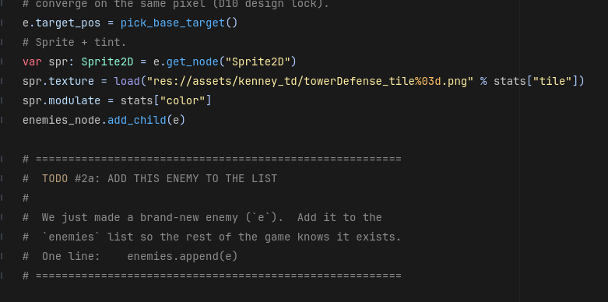
iCode
DAY 3
EMPOWERING FUTURE INNOVATORS
One line at the bottom of spawn_enemy(). After the enemy is built, add it to the list.
27

Slide 28
iCode
DAY 3
EMPOWERING FUTURE INNOVATORS
What you're about to write
# add e to the enemies list: enemies.append(e)
• What: One line — append the new enemy to enemies.
• Why: Without this, spawned enemies never enter the list. The game loop can't see them.
• How: enemies.append(e) — e is the enemy node just built above your hole.
This is one approach — yours works if it runs.
28

Slide 29
iCode
DAY 3
EMPOWERING FUTURE INNOVATORS
TODO #2a — Add enemy to list
SYNTAX
WRITE THIS
items.append(item)
# add e to the enemies list: enemies.append(e)
Detailed instructions are in your code file, right next to this TODO.
29

Slide 30
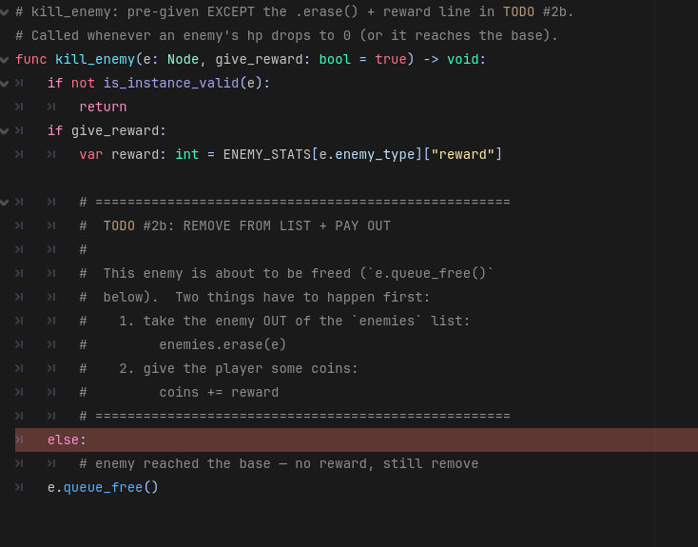
iCode
DAY 3
EMPOWERING FUTURE INNOVATORS
Two holes inside kill_enemy(): one in the reward branch (erase + pay out), one in the no-reward branch (erase only).
30

Slide 31
iCode
DAY 3
EMPOWERING FUTURE INNOVATORS
What you're about to write
# reward branch (enemy killed by tower):
# remove e from enemies: enemies.erase(e)
# add reward to coins: coins += reward
# no-reward branch (enemy reached the base):
# remove e from enemies: enemies.erase(e)
• What: Two holes — both erase e from the list. The reward branch also pays out coins.
• Why: Without the erase, dead enemies stay in the list forever. The wave never ends.
• How: enemies.erase(e) removes by value. coins += reward adds the payout.
This is one approach — yours works if it runs.
31

Slide 32
iCode
DAY 3
EMPOWERING FUTURE INNOVATORS
TODO #2b — Remove enemy from list
SYNTAX
WRITE THIS
items.erase(item)
x += amount
# reward branch (enemy killed by tower):
# remove e from enemies: enemies.erase(e)
# add reward to coins: coins += reward
# no-reward branch (enemy reached the base):
# remove e from enemies: enemies.erase(e)
Detailed instructions are in your code file, right next to this TODO.
32

Slide 33
iCode
DAY 3
EMPOWERING FUTURE INNOVATORS
The game loop — move everything, every frame
• Every frame, the game needs to: step each enemy forward, tick each tower.
• You have a list of enemies. You have a list of towers.
• Two for loops — one for each list.
33

Slide 34
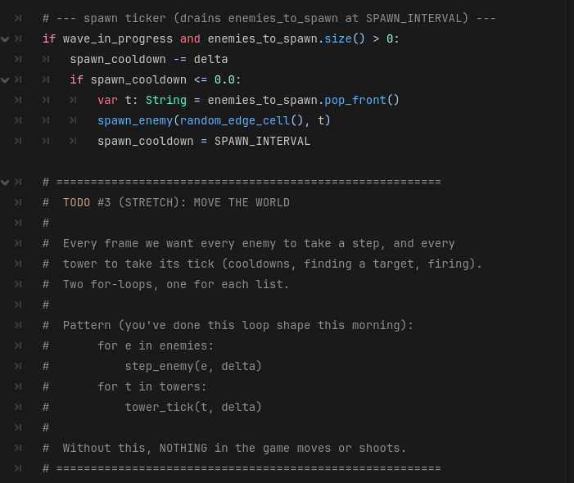
iCode
DAY 3
EMPOWERING FUTURE INNOVATORS
Inside _process(delta), after the spawn ticker. This code runs every frame.
34

Slide 35
iCode
DAY 3
EMPOWERING FUTURE INNOVATORS
What you're about to write
# for each e in enemies: call step_enemy(e, delta)
# for each t in towers: call tower_tick(t, delta)
• What: Two for-loops — move every enemy, tick every tower.
• Why: Without this, nothing on screen moves. The game is frozen.
• How: step_enemy(e, delta) and tower_tick(t, delta) are pre-given helpers. You write the loops.
This is one approach — yours works if it runs.
35

Slide 36
iCode
DAY 3
EMPOWERING FUTURE INNOVATORS
TODO #3 — Move the world each frame
SYNTAX
WRITE THIS
for item in collection:
do_something(item)
# for each e in enemies: call step_enemy(e, delta)
# for each t in towers: call tower_tick(t, delta)
Detailed instructions are in your code file, right next to this TODO.
36

Slide 37
iCode
DAY 3
EMPOWERING FUTURE INNOVATORS
Run the game. Press Space. Wave 1 spawns — enemies walk in.
37

Slide 38
iCode
DAY 3
EMPOWERING FUTURE INNOVATORS
Packaging a loop in a function
• You just wrote for e in enemies: step_enemy(e, delta) directly.
• The Final Challenge code needs the same loop — but passing in a different list.
• move_all(enemy_list, delta) is a function that takes any list and loops it.
38

Slide 39
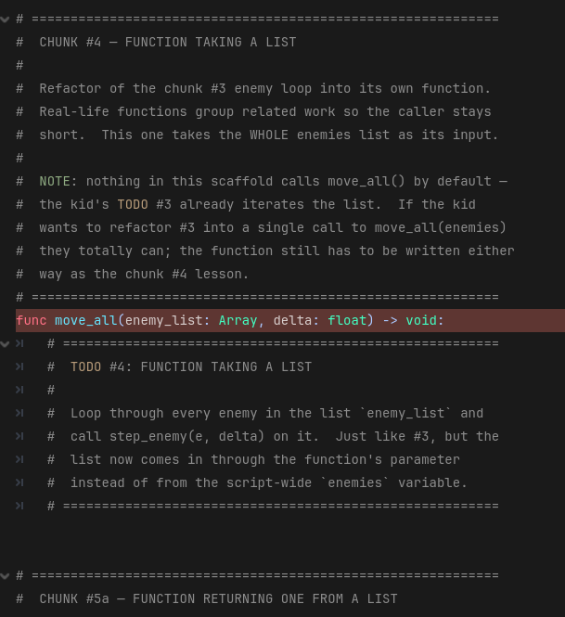
iCode
DAY 3
EMPOWERING FUTURE INNOVATORS
Inside func move_all(enemy_list, delta). The function signature is pre-given; you write the body.
39

Slide 40
iCode
DAY 3
EMPOWERING FUTURE INNOVATORS
What you're about to write
# for each e in enemy_list: call step_enemy(e, delta)
• What: One line — loop the parameter list, step each enemy.
• Why: The FC (endless mode) calls move_all() with its own list. Same loop, different input.
• How: enemy_list is the parameter (not enemies). step_enemy(e, delta) is pre-given.
This is one approach — yours works if it runs.
40

Slide 41
iCode
DAY 3
EMPOWERING FUTURE INNOVATORS
TODO #4 — Write `move_all()` body
SYNTAX
WRITE THIS
for item in collection:
do_something(item)
func name(param):
use(param)
# for each e in enemy_list: call step_enemy(e, delta)
Detailed instructions are in your code file, right next to this TODO.
41

Slide 42
iCode
DAY 3
EMPOWERING FUTURE INNOVATORS
Personalization #2 — Flip the difficulty knob
• Find const DIFFICULTY := 2 near the top of main.gd.
• Change to 0 (easy) or 1 (medium). Run the game. Feel the difference.
• Change it back to 2 when you're done experimenting.
• Low on time? Skip this and keep going. Finished early? This is for you.
42

Slide 43
iCode
DAY 3
EMPOWERING FUTURE INNOVATORS
Functions that SEARCH a list and return an answer
• So far: functions that do things (step_enemy) or loop lists (move_all).
• New: a function that scans the enemies list and hands back one result.
• get_nearest_enemy_in_range() — scans all enemies, returns the closest one in range (or null).
43

Slide 44
iCode
DAY 3
EMPOWERING FUTURE INNOVATORS
Before you write: what does this need to DO?
• Tower has a position and a range. There are N enemies on the map.
• Goal: find which enemy is closest to the tower AND within its range.
• Available: enemies list, pos (tower position), tower_range, pos.distance_to(e.position).
44

Slide 45
iCode
DAY 3
EMPOWERING FUTURE INNOVATORS
How would YOU design this?
• How do you find the closest thing in a list?
• What do you need to track as you walk through the list?
• When you arrive at the TODO, try your own approach first.
45

Slide 46
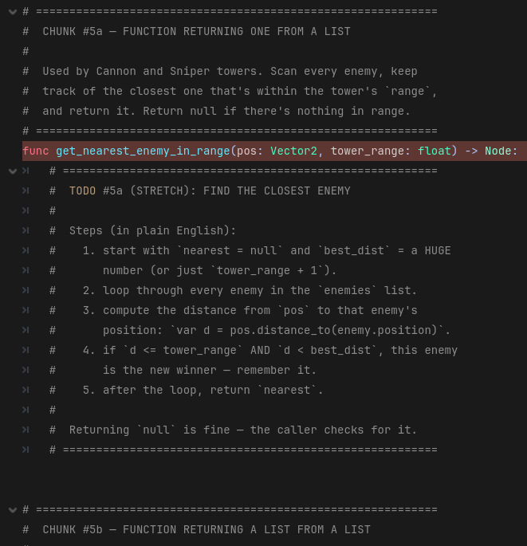
iCode
DAY 3
EMPOWERING FUTURE INNOVATORS
Inside the function body. nearest = null and best_dist = tower_range + 1 are pre-given above your hole.
46

Slide 47
iCode
DAY 3
EMPOWERING FUTURE INNOVATORS
What you're about to write
# for each e in enemies:
# compute d = pos.distance_to(e.position)
# if d <= tower_range and d < best_dist:
# set nearest = e
# set best_dist = d
• What: Walk the enemies list; update nearest and best_dist when you find a closer in-range enemy.
• Why: Towers need to know WHO to shoot. This function finds the answer.
• How: best_dist starts just outside range — the first in-range enemy automatically beats it.
This is one approach — yours works if it runs.
47

Slide 48
iCode
DAY 3
EMPOWERING FUTURE INNOVATORS
TODO #5a — Find nearest enemy in range
SYNTAX
WRITE THIS
for item in collection:
do_something(item)
if condition:
do_this
if a or b:
do_this
object.property
# for each e in enemies:
# compute d = pos.distance_to(e.position)
# if d <= tower_range and d < best_dist:
# set nearest = e
# set best_dist = d
Detailed instructions are in your code file, right next to this TODO.
48

Slide 49
iCode
DAY 3
EMPOWERING FUTURE INNOVATORS
Splash towers need ALL enemies in range
• Cannon/Sniper: one target. get_nearest_enemy_in_range() returns ONE enemy.
• Splash: hits everyone nearby. Need ALL enemies within radius.
• get_enemies_in_radius() — scans enemies, returns a list of all within radius.
49

Slide 50
iCode
DAY 3
EMPOWERING FUTURE INNOVATORS
Before you write: what does this need to DO?
• Goal: return a new list containing every enemy within radius of pos.
• Available: enemies list, pos, radius, pos.distance_to(e.position).
• Pattern you know: var result := [] → loop → conditional .append() → return result.
50

Slide 51
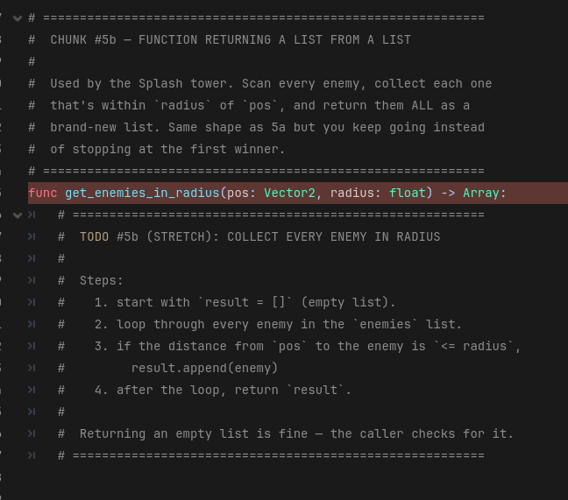
iCode
DAY 3
EMPOWERING FUTURE INNOVATORS
The whole function body — you write it all. The function signature is pre-given.
51

Slide 52
iCode
DAY 3
EMPOWERING FUTURE INNOVATORS
What you're about to write
# var result: Array = []
# for each e in enemies:
# if pos.distance_to(e.position) <= radius:
# result.append(e)
# return result
• What: Build and return a new list of every enemy within radius.
• Why: The Splash tower needs this list to fire at everyone in range.
• How: Start with an empty list, loop enemies, append those in range, return.
This is one approach — yours works if it runs.
52

Slide 53
iCode
DAY 3
EMPOWERING FUTURE INNOVATORS
TODO #5b — Collect enemies in radius
SYNTAX
WRITE THIS
var items: Array = []
for item in collection:
do_something(item)
items.append(item)
return
if condition:
do_this
# var result: Array = []
# for each e in enemies:
# if pos.distance_to(e.position) <= radius:
# result.append(e)
# return result
Detailed instructions are in your code file, right next to this TODO.
53

Slide 54
iCode
DAY 3
EMPOWERING FUTURE INNOVATORS
Towers can now find targets
Run the game. Enemies walk — towers don't fire yet (that's chunk #6). But the targeting logic is live.
54

Slide 55
iCode
DAY 3
EMPOWERING FUTURE INNOVATORS
Tower tick: pick a target and fire
• tower_tick(t, delta) runs once per tower per frame.
• Cooldown handling is pre-given. Your job: pick the right finder, call it, fire if something was found.
• Cannon + Sniper → single target. Splash → list of targets.
55

Slide 56
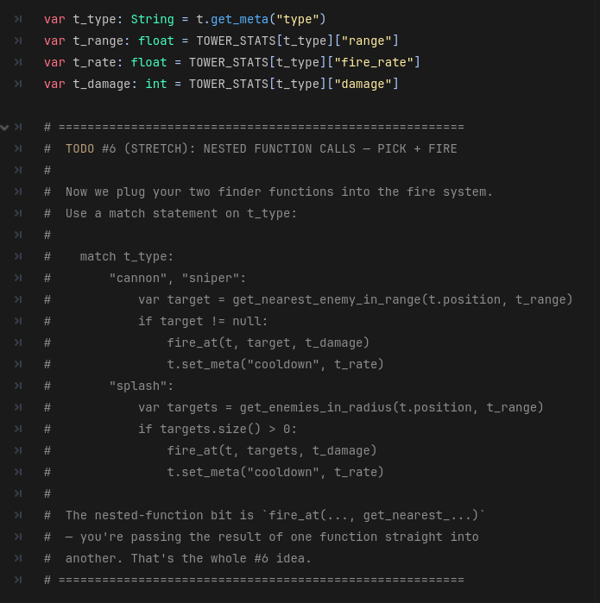
iCode
DAY 3
EMPOWERING FUTURE INNOVATORS
Inside tower_tick(), there's a match t_type: block. You fill the two branches: \"cannon\", \"sniper\": and \"splash\":.
56

Slide 57
iCode
DAY 3
EMPOWERING FUTURE INNOVATORS
match — like a multi-way if
match tower_type:
"cannon":
fire_cannon()
"sniper":
fire_sniper()
"splash":
fire_splash()
57

Slide 58
iCode
DAY 3
EMPOWERING FUTURE INNOVATORS
What you're about to write — \"cannon\", \"sniper\": branch
# var target = get_nearest_enemy_in_range(t.position, t_range)
# if target != null:
# call fire_at(t, target, t_damage)
# reset cooldown: t.set_meta("cooldown", t_rate)
• What: Find one target; if found, fire and reset the cooldown.
• Why: Without this, Cannon and Sniper towers never shoot.
• How: t.position, t_range, t_damage, t_rate are already unpacked above your hole.
This is one approach — yours works if it runs.
58

Slide 59
iCode
DAY 3
EMPOWERING FUTURE INNOVATORS
TODO #6a — Cannon + Sniper: find target and fire
SYNTAX
func name(param) -> ReturnType:
return value
if condition:
do_this
function_name()
WRITE THIS
# var target = get_nearest_enemy_in_range(t.position, t_range)
# if target != null:
# call fire_at(t, target, t_damage)
# reset cooldown: t.set_meta("cooldown", t_rate)
Detailed instructions are in your code file, right next to this TODO.
59

Slide 60
iCode
DAY 3
EMPOWERING FUTURE INNOVATORS
What you're about to write — \"splash\": branch
# var targets = get_enemies_in_radius(t.position, t_range)
# if targets.size() > 0:
# call fire_at(t, targets, t_damage)
# reset cooldown: t.set_meta("cooldown", t_rate)
• What: Collect a list of targets in the splash radius; if any found, fire at all of them.
• Why: Without this, Splash towers never shoot.
• How: fire_at handles lists and single nodes — pass targets directly.
This is one approach — yours works if it runs.
60

Slide 61
iCode
DAY 3
EMPOWERING FUTURE INNOVATORS
TODO #6b — Splash: collect targets and fire
SYNTAX
WRITE THIS
func name(param) -> ReturnType:
return value
items.size()
if condition:
do_this
function_name()
# var targets = get_enemies_in_radius(t.position, t_range)
# if targets.size() > 0:
# call fire_at(t, targets, t_damage)
# reset cooldown: t.set_meta("cooldown", t_rate)
Detailed instructions are in your code file, right next to this TODO.
61

Slide 62
iCode
DAY 3
EMPOWERING FUTURE INNOVATORS
Run the game. Place a tower. Watch it shoot.
62

Slide 63
iCode
DAY 3
EMPOWERING FUTURE INNOVATORS
Personalization #3 — Tune your tower stats
• Find const TOWER_STATS near the top of main.gd.
• Change the damage, range, or fire_rate for any tower. Run it. Does it feel better?
• Try making a super-slow cannon that one-shots everything. Or a tiny-range rapid-fire sniper.
• Low on time? Skip this and keep going. Finished early? This is for you.
63

Slide 64
iCode
DAY 3
EMPOWERING FUTURE INNOVATORS
How does the game know a wave ended?
• A wave is over when: no enemies are alive AND no enemies are queued to spawn.
• Check: enemies.size() == 0 and enemies_to_spawn.size() == 0.
• Then: advance wave_index. Check if more waves remain. Win or start the next.
64

Slide 65
iCode
DAY 3
EMPOWERING FUTURE INNOVATORS
Before you write: what does this need to DO?
• Goal: when the wave is done, advance the wave counter. Call you_win() or start_next_wave().
• Available: wave_in_progress, enemies, enemies_to_spawn, wave_index, WAVES, you_win(), start_next_wave().
• Condition: wave_in_progress must be true AND both lists must be empty.
65

Slide 66
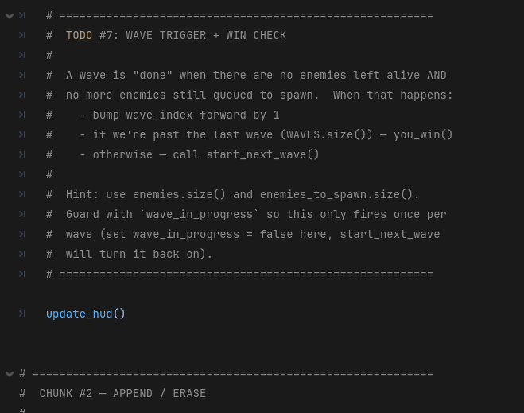
iCode
DAY 3
EMPOWERING FUTURE INNOVATORS
In _process(delta), after the spawn ticker block. Runs every frame.
66

Slide 67
iCode
DAY 3
EMPOWERING FUTURE INNOVATORS
What you're about to write
# if wave_in_progress and enemies.size() == 0 and enemies_to_spawn.size() == 0:
# set wave_in_progress to false
# add 1 to wave_index
# if wave_index >= WAVES.size():
# call you_win()
# else:
# call start_next_wave()
• What: Detect when a wave ends, advance the counter, win or loop.
• Why: Without this, the game never advances past wave 1.
• How: WAVES.size() is the total number of waves. wave_index >= WAVES.size() means all waves done.
This is one approach — yours works if it runs.
67

Slide 68
iCode
DAY 3
EMPOWERING FUTURE INNOVATORS
TODO #7 — Wave advance and win check
SYNTAX
if condition:
do_this
items.size()
x += amount
function_name()
WRITE THIS
# if wave_in_progress and enemies.size() == 0 and enemies_to_spawn.size() == 0:
# set wave_in_progress to false
# add 1 to wave_index
# if wave_index >= WAVES.size():
# call you_win()
# else:
# call start_next_wave()
Detailed instructions are in your code file, right next to this TODO.
68

Slide 69
iCode
DAY 3
EMPOWERING FUTURE INNOVATORS
Run the game. Survive all 8 waves. The YOU WIN panel appears.
69

Slide 70
iCode
DAY 3
EMPOWERING FUTURE INNOVATORS
Personalization #4 — Edit the wave list
• Find const WAVES near the top of main.gd. It's a list of lists.
• Each entry is [count, type] — e.g. [5, \"grunt\"] spawns 5 grunts.
• Add a wave. Change counts. Swap types. Make wave 1 send 50 grunts for chaos.
• Low on time? Skip this and keep going. Finished early? This is for you.
70

Slide 71
iCode
DAY 3
EMPOWERING FUTURE INNOVATORS
Final Challenge — Endless Mode
• Open endless_mode.gd — a separate script with #@todo holes.
• When all holes are filled: open main.gd, flip ENDLESS_MODE to true, and run.
• Enemies spawn forever, getting harder each wave.
• Boss wave is an optional extra if you want a harder challenge.
71

Slide 72
iCode
DAY 3
EMPOWERING FUTURE INNOVATORS
You already know how to do this.
• Each TODO in endless_mode.gd mirrors a chunk you wrote this morning.
• FC-1 ← Chunk #3 (for loops — step enemies + towers)
• FC-2 ← Chunk #4 (move_all — loop a parameter list)
• FC-3 ← Chunk #5b (collect list, return it)
• FC-4 ← Chunk #7 (wave counter + win check pattern)
72

Slide 73
iCode
DAY 3
EMPOWERING FUTURE INNOVATORS
Final Challenge — all holes
• | FC | Mirrors | Syntax | Write this (comments) | |---|---|---|---| | FC-1 endless_tick(delta) | Chunk #3 | for_in | # for e in enemies: step_enemy(e, delta) / # for t in towers: tower_tick(t, delta) | | FC-2 move_all_endless(list, delta) | Chunk #4 | for_in, func_param | # for e in enemy_list: step_enemy(e, delta) | | FC-3 get_in_radius_endless(pos, r) | Chunk #5b | list_init, for_in, list_append, return | # var r := [] / # for e in enemies: if dist <= radius: r.append(e) / # return r | | FC-4 check_wave_end() | Chunk #7 | if, list_size, plus_eq, func_call | # if wave_in_progress and enemies.size()==0: / # wave_in_progress=false / wave_index+=1 / # if wave_index>=WAVES.size(): you_win() / else: next_wave() |
73

Slide 74
iCode
DAY 3
EMPOWERING FUTURE INNOVATORS
Take it home
Turn your Base Defense game into a real Windows .exe — no Godot needed.
74

Slide 75
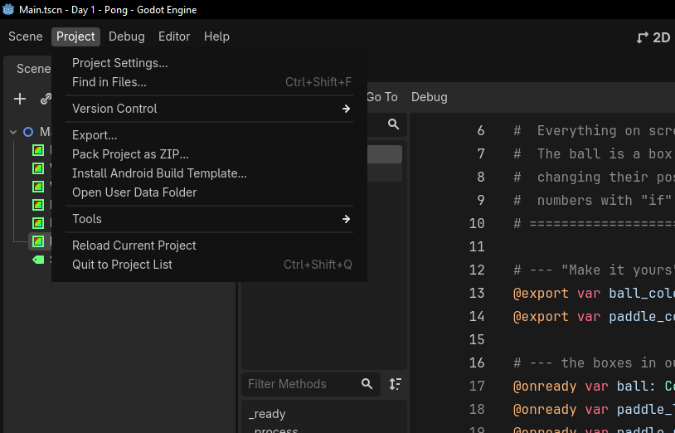
iCode
DAY 3
EMPOWERING FUTURE INNOVATORS
In the top menu bar, click Project, then Export…
75

Slide 76
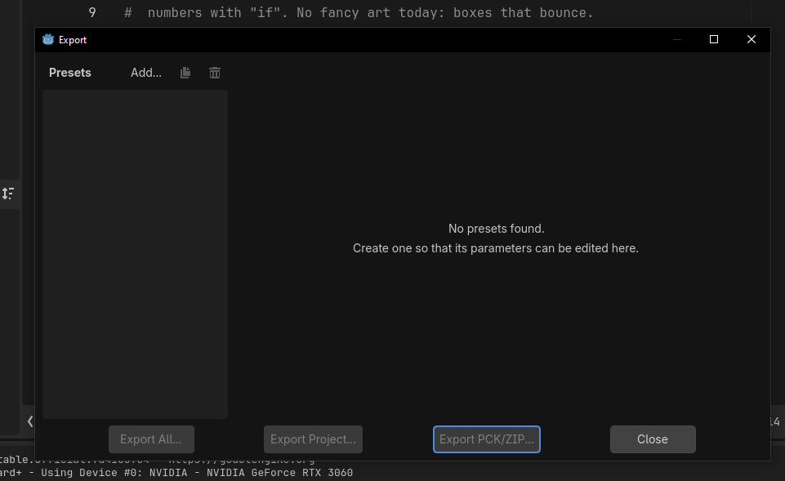
iCode
DAY 3
EMPOWERING FUTURE INNOVATORS
The Export window opens. Click Add… at the top to add a target.
76

Slide 77
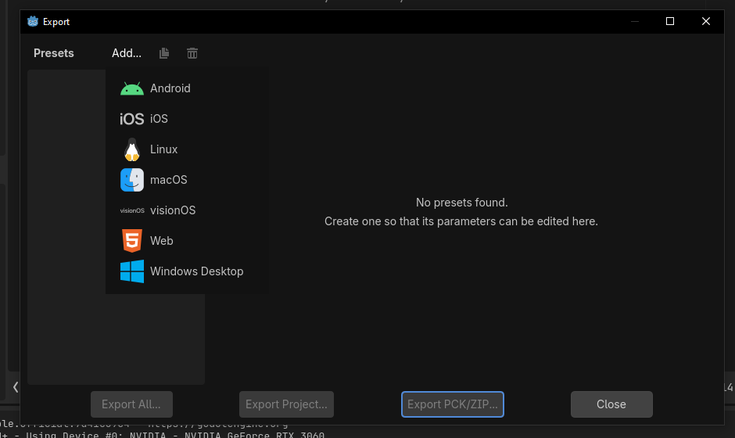
iCode
DAY 3
EMPOWERING FUTURE INNOVATORS
From the list, pick Windows Desktop.
77

Slide 78
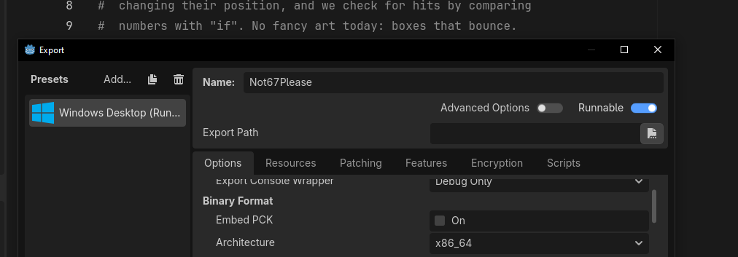
iCode
DAY 3
EMPOWERING FUTURE INNOVATORS
Godot adds a Windows Desktop preset. Leave options as-is — Runnable on, Architecture x86_64.
78

Slide 79
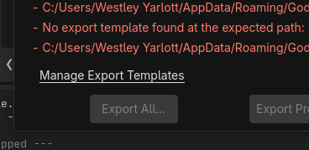
iCode
DAY 3
EMPOWERING FUTURE INNOVATORS
If you see 'No export template found', click Manage Export Templates.
79

Slide 80
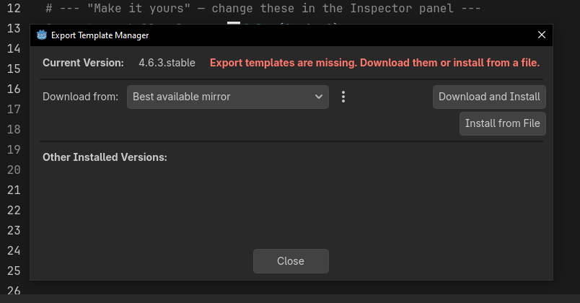
iCode
DAY 3
EMPOWERING FUTURE INNOVATORS
Click Download and Install. Let it finish, then close.
80

Slide 81
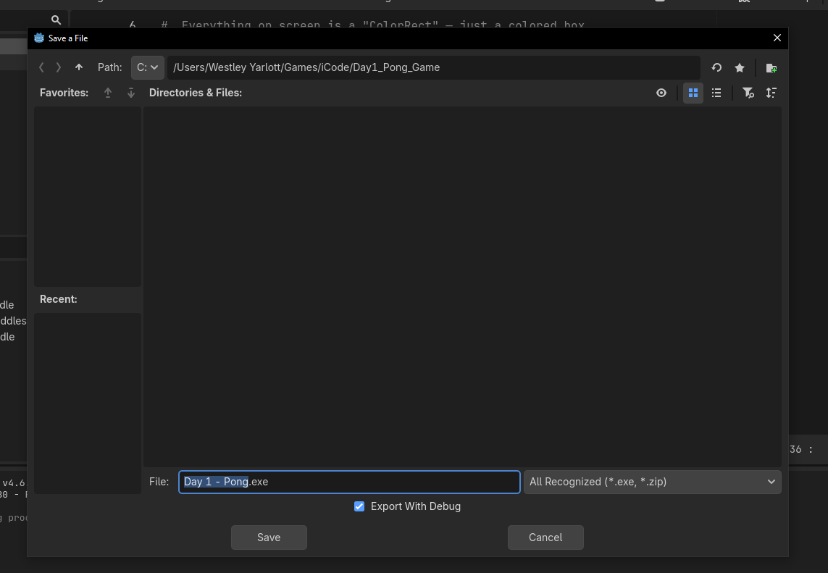
iCode
DAY 3
EMPOWERING FUTURE INNOVATORS
Click Export Project, type a name (e.g. Day 3 - Base Defense), pick your folder, and click Save.
81

Slide 82
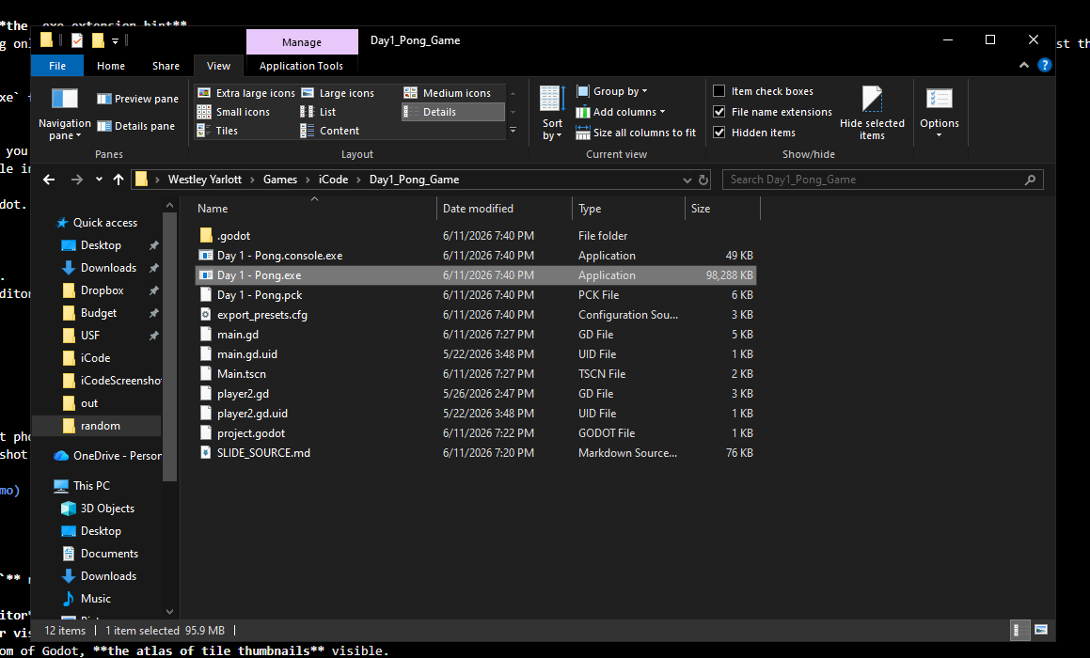
iCode
DAY 3
EMPOWERING FUTURE INNOVATORS
Godot writes your .exe plus a .pck data file. Double-click the .exe — your game runs with no Godot needed. Keep the two files together.
82

Slide 83
iCode
DAY 3
EMPOWERING FUTURE INNOVATORS
Tomorrow: build a fighter
Late 1990s. Street Fighter era. We go deep on objects — code that knows what it IS and what it can DO.
83

