Slide 1

iCode
DAY 1
EMPOWERING FUTURE INNOVATORS
<exact title text>
<bullets, prose, or code block — verbatim>
1

Slide 2
iCode
DAY 1
EMPOWERING FUTURE INNOVATORS
VR Creator - Day 1
Pong · 1972 · Atari
2

Slide 3
iCode
DAY 1
EMPOWERING FUTURE INNOVATORS
Why Pong mattered
• 1972, Atari. One of the first video games you could play in public.
• Dead simple — two paddles, one ball. Anyone got it in seconds. That simplicity is why it spread.
• Launched the whole arcade industry; 3 years later 'Home Pong' put a video game on the family TV for the first time.
• Proved games could be a business. Pac-Man, Mario, your living-room console — all trace back here.
3

Slide 4
iCode
DAY 1
EMPOWERING FUTURE INNOVATORS
The 5-day arc
• 1972 — Pong (today, highlighted)
• 1980 — Pac-Man
• 1990s — Tower / Base Defense
• late 1990s — Fighter
• 2020s — Racing
4

Slide 5
iCode
DAY 1
EMPOWERING FUTURE INNOVATORS
A quick history of VR
• The dream is old — VR headsets go back to the 1960s, but they were huge, blurry, and wildly expensive.
• 2012: the Oculus Rift made VR cheap and good enough to be real. Now standalone headsets (Quest) need no PC at all.
• VR = the screen wraps all the way around you. You don't look at the game — you're inside it.
5

Slide 6
iCode
DAY 1
EMPOWERING FUTURE INNOVATORS
Today's concepts
• Variables — values that can change.
• Conditions — if / else, and comparing numbers.
6

Slide 7
iCode
DAY 1
EMPOWERING FUTURE INNOVATORS
GDScript is Python with two small differences
Code
Two-column visual diagram. Left column header "Python" (blue), right column header "GDScript" (green). Two rows with a connecting arrow between each pair: Left: `x = 5` → Right: `var x = 5` with callout box around `var` in iCode red, label: "one extra word" Left: `def update():` → Right: `func update():` with callout box around `func` in iCode red, label: "different keyword"
7

Slide 8
iCode
DAY 1
EMPOWERING FUTURE INNOVATORS
Pre-coding setup
"Open the project. Open the script. Run it. Read the errors."
8

Slide 9
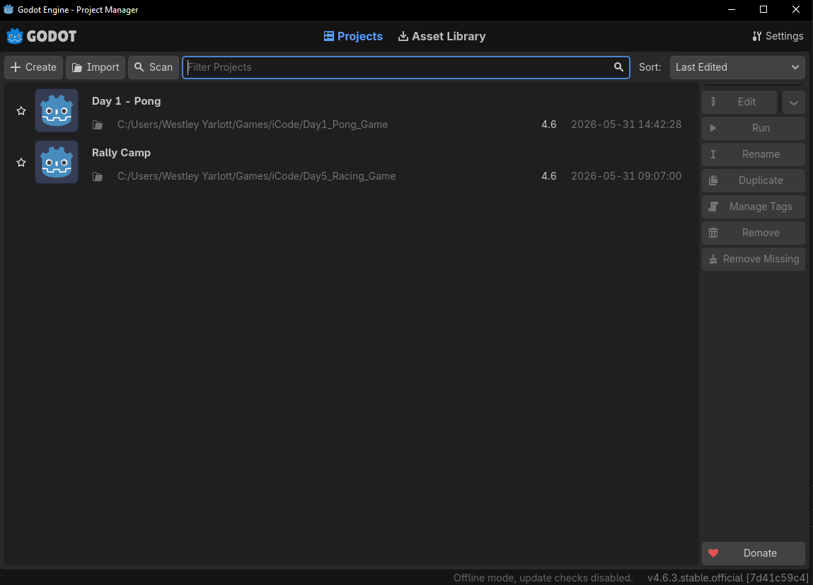
iCode
DAY 1
EMPOWERING FUTURE INNOVATORS
Launch Godot 4. The Project Manager window opens. Find the Import button at the top-right.
9

Slide 10
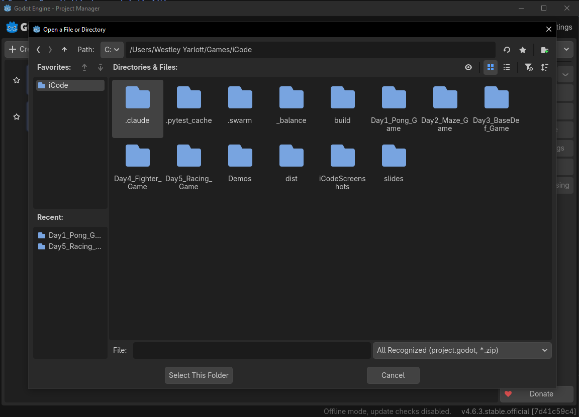
iCode
DAY 1
EMPOWERING FUTURE INNOVATORS
Click the Import button at the top-right of the Project Manager.
10

Slide 11
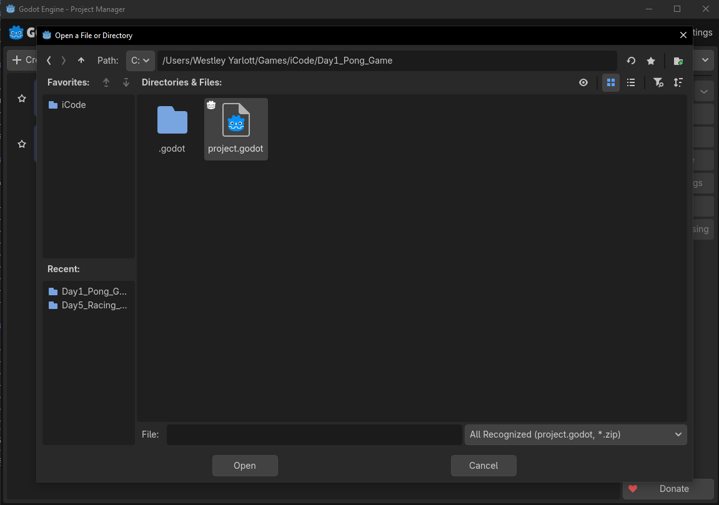
iCode
DAY 1
EMPOWERING FUTURE INNOVATORS
In the file browser, open the Day1_Pong_Game folder and click project.godot to select it.
11

Slide 12
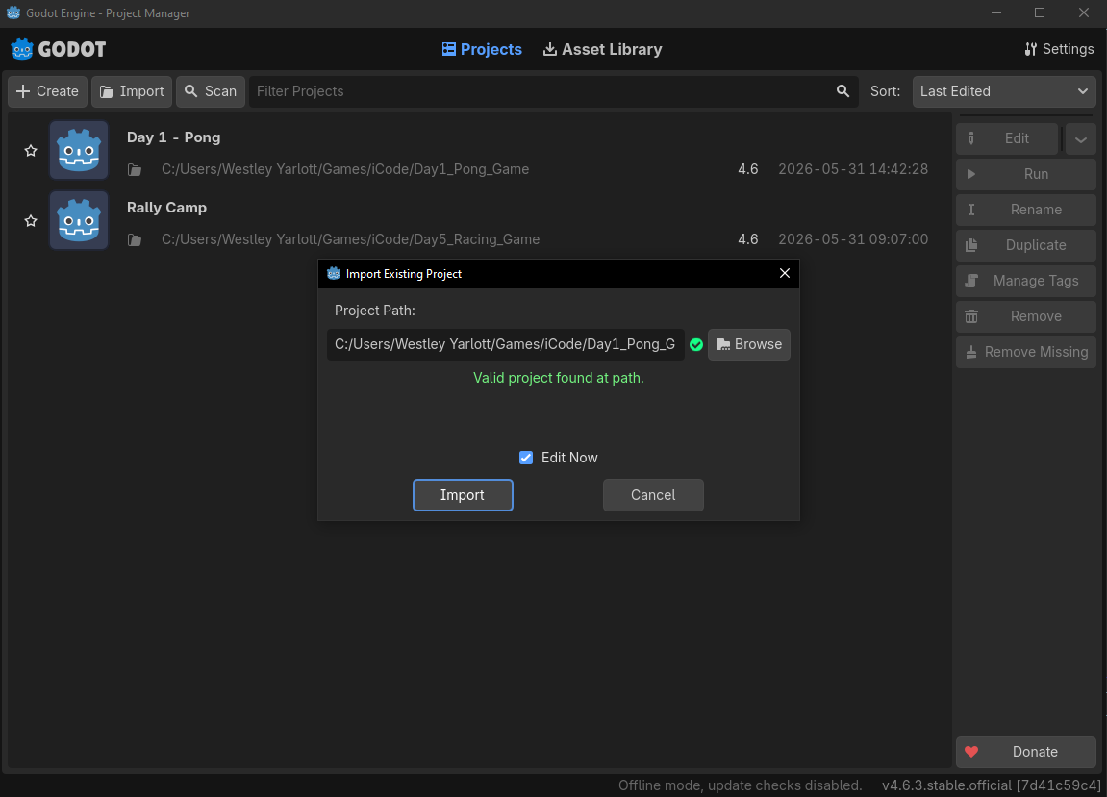
iCode
DAY 1
EMPOWERING FUTURE INNOVATORS
Godot asks to confirm. Click Import & Edit.
12

Slide 13
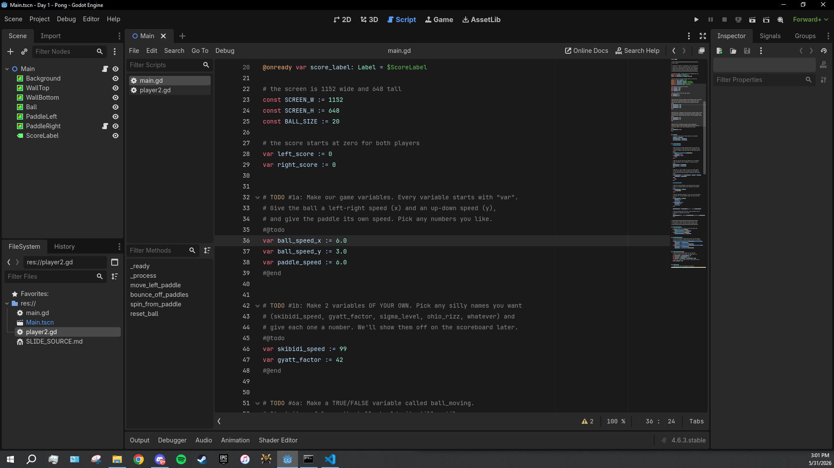
iCode
DAY 1
EMPOWERING FUTURE INNOVATORS
Godot imports the project (first time takes a few seconds) and the editor opens. You're in.
13

Slide 14
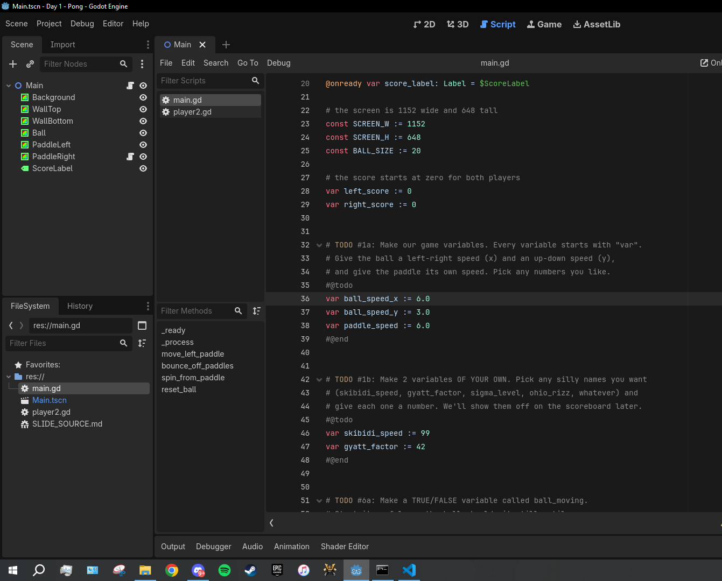
iCode
DAY 1
EMPOWERING FUTURE INNOVATORS
Look at the FileSystem panel (bottom-left). Find the file named main.gd.
14

Slide 15
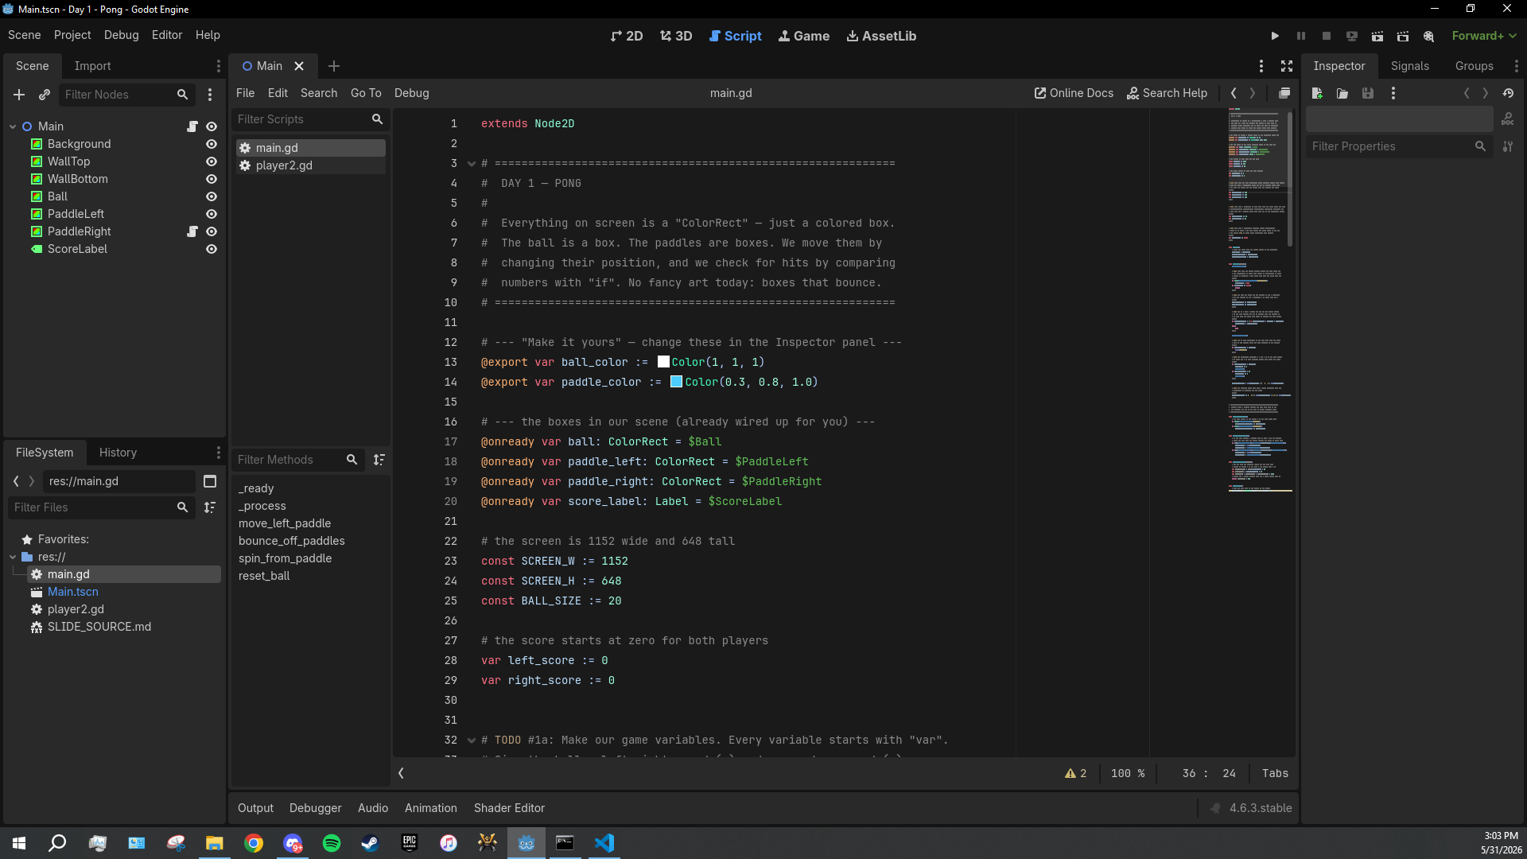
iCode
DAY 1
EMPOWERING FUTURE INNOVATORS
Hover main.gd, then double-click to open it.
15

Slide 16
iCode
DAY 1
EMPOWERING FUTURE INNOVATORS
Lesson chunks
"Eight holes to fill. We'll fill them in order."
16

Slide 17
iCode
DAY 1
EMPOWERING FUTURE INNOVATORS
Variable
(just the word, very large, centred on slide)
17

Slide 18
iCode
DAY 1
EMPOWERING FUTURE INNOVATORS
What does variable mean?
"What does vary mean?"
18

Slide 19
iCode
DAY 1
EMPOWERING FUTURE INNOVATORS
vary = something that can change
19

Slide 20
iCode
DAY 1
EMPOWERING FUTURE INNOVATORS
V in variable → VALUE that can CHANGE
20

Slide 21
iCode
DAY 1
EMPOWERING FUTURE INNOVATORS
The cookie jar
CookiesInJar = 0
21

Slide 22
iCode
DAY 1
EMPOWERING FUTURE INNOVATORS
A week later…
CookiesInJar = 8
22

Slide 23
iCode
DAY 1
EMPOWERING FUTURE INNOVATORS
You eat 3 cookies.
"What is CookiesInJar now?"
23

Slide 24
iCode
DAY 1
EMPOWERING FUTURE INNOVATORS
A variable is a VALUE that can CHANGE across time.
24

Slide 25
iCode
DAY 1
EMPOWERING FUTURE INNOVATORS
How does a video game use variables?
25

Slide 26
iCode
DAY 1
EMPOWERING FUTURE INNOVATORS
Pong's variables
• How fast is the ball moving left/right? → ball_speed_x
• How fast is the ball moving up/down? → ball_speed_y
• How fast does the paddle move? → paddle_speed
• Every frame, these numbers decide how fast everything goes.
26

Slide 27
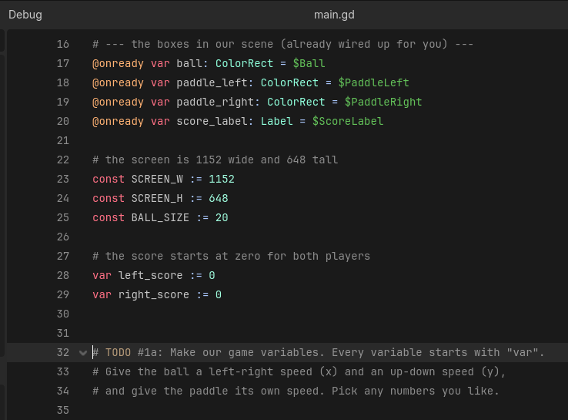
iCode
DAY 1
EMPOWERING FUTURE INNOVATORS
Right below the score, between #@todo and #@end, you'll add three variables of your own.
27

Slide 28
iCode
DAY 1
EMPOWERING FUTURE INNOVATORS
#1): SYNTAX FOR: TODO #1 Declare a variable: var name := value For numbers (integers): var score := 0 For decimal numbers (floats): var speed := 6.0 Examples: var ball_speed_x := 6.0 var lives := 3 var player_name := "Alex" ← text uses quotes # TODO #1 # declare a variable for ball left-right speed (pick a number) # declare a variable for ball up-down speed (pick a number) # declare a variable for paddle speed (pick a number)
Pattern (board example):
SYNTAX FOR: TODO #1
Declare a variable:
var name := value
For numbers (integers):
var score := 0
For decimal numbers (floats):
var speed := 6.0
Examples:
var ball_speed_x := 6.0
var lives := 3
var player_name := "Alex" ← text uses quotes
28

Slide 29
iCode
DAY 1
EMPOWERING FUTURE INNOVATORS
Press the F5 key on your keyboard. (Or click the Play ▶ button in the top-right toolbar.)
29

Slide 30
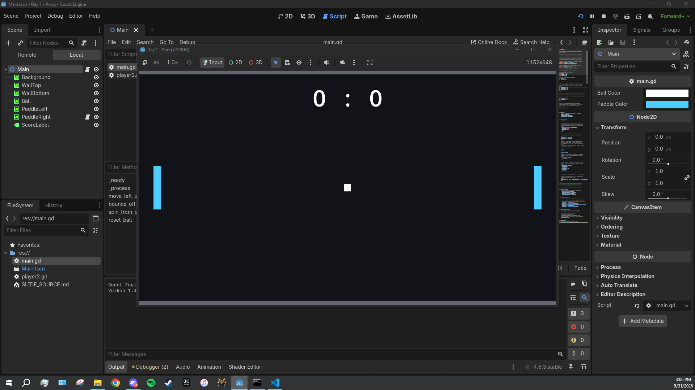
iCode
DAY 1
EMPOWERING FUTURE INNOVATORS
A new window pops up, 1152 × 648 pixels. Dark background, two cyan paddles. The ball will be frozen at the centre until chunk #6b — that's normal.
30

Slide 31
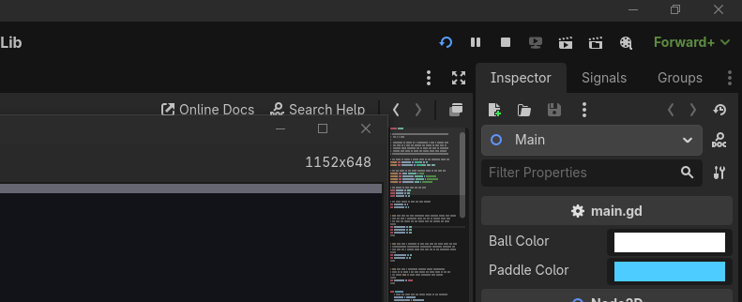
iCode
DAY 1
EMPOWERING FUTURE INNOVATORS
Close the game window, OR press F8 in the editor to stop it.
31

Slide 32
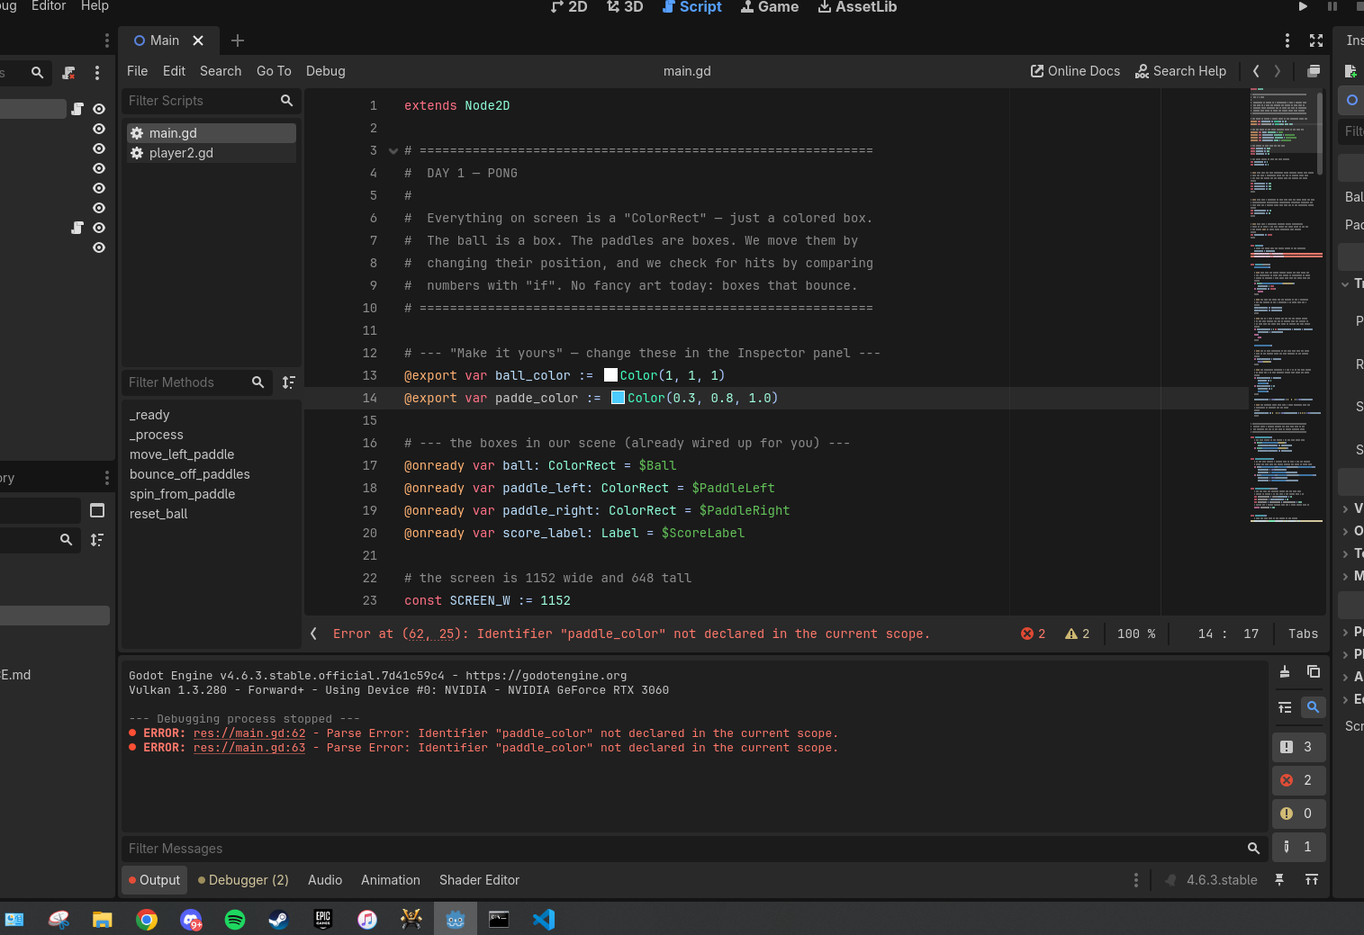
iCode
DAY 1
EMPOWERING FUTURE INNOVATORS
If your game window doesn't open after F5, look at the Output panel at the bottom of the editor. That's where errors print.
32

Slide 33
iCode
DAY 1
EMPOWERING FUTURE INNOVATORS
Step D.2 — Three errors you WILL hit
• Parse Error: Expected ':' after \"if\" condition. → you forgot the colon at the end of an if line.
• Identifier \"ball_speedy\" not declared in the current scope. → typo in a variable name (probably missing the _x or _y).
• Expected indented block. → the line after if ...: is not indented (use Tab or 4 spaces).
33

Slide 34
iCode
DAY 1
EMPOWERING FUTURE INNOVATORS
Naming your variables
34

Slide 35
iCode
DAY 1
EMPOWERING FUTURE INNOVATORS
Code doesn't care what you call a variable.
"The name is for YOU."
35

Slide 36
iCode
DAY 1
EMPOWERING FUTURE INNOVATORS
Programmers go SILLY on purpose
• foobar and bazinga are decades-old programmer jokes — built right into real codebases.
• Even Claude (the AI in your editor) types nonsense words like fligerbigitibetting when it's just thinking out loud.
• Making code feel personal makes it more fun to read AND more fun to write.
36

Slide 37
iCode
DAY 1
EMPOWERING FUTURE INNOVATORS
Both work — pick your favourite
var score := 0
37

Slide 38
iCode
DAY 1
EMPOWERING FUTURE INNOVATORS
What's the funniest variable name you can think of?
38

Slide 39
iCode
DAY 1
EMPOWERING FUTURE INNOVATORS
Your code, your names.
39

Slide 40
iCode
DAY 1
EMPOWERING FUTURE INNOVATORS
Real game studios do this every day
"Codebases are full of inside jokes, pet names, and references hidden in variable names. It's part of the culture."
40

Slide 41
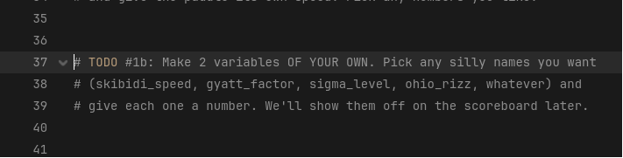
iCode
DAY 1
EMPOWERING FUTURE INNOVATORS
Right below your chunk #1a variables, you've got another #@todo block waiting for two more — names of your choosing.
41

Slide 42
iCode
DAY 1
EMPOWERING FUTURE INNOVATORS
#2): SYNTAX FOR: TODO #2 Same as TODO #1 — declare a variable: var name := value Name rules: Examples: var skibidi_speed := 99 var ohio_rizz := 7 var gyatt_factor := 42 # TODO #2 # declare a variable with a silly name (your choice) # declare a second variable with another silly name (your choice)
Pattern (board example):
SYNTAX FOR: TODO #2
Same as TODO #1 — declare a variable:
var name := value
Name rules:
- lowercase, underscores between words
- no spaces, no hyphens
- can be as silly as you want
Examples:
var skibidi_speed := 99
var ohio_rizz := 7
var gyatt_factor := 42
42

Slide 43
iCode
DAY 1
EMPOWERING FUTURE INNOVATORS
Boolean
43

Slide 44
iCode
DAY 1
EMPOWERING FUTURE INNOVATORS
A variable with only TWO possible values.
44

Slide 45
iCode
DAY 1
EMPOWERING FUTURE INNOVATORS
Those two values: true or false.
"No numbers. No text. Just yes or no."
45

Slide 46
iCode
DAY 1
EMPOWERING FUTURE INNOVATORS
Boolean = a YES/NO switch.
46

Slide 47
iCode
DAY 1
EMPOWERING FUTURE INNOVATORS
The light switch
light_on = true
47

Slide 48
iCode
DAY 1
EMPOWERING FUTURE INNOVATORS
Flip it.
light_on = false
48

Slide 49
iCode
DAY 1
EMPOWERING FUTURE INNOVATORS
Is the light in this room on right now?
"True or false?"
49

Slide 50
iCode
DAY 1
EMPOWERING FUTURE INNOVATORS
A boolean is a true/false switch. Like a light switch.
50

Slide 51
iCode
DAY 1
EMPOWERING FUTURE INNOVATORS
Games are full of yes/no switches
• Is the player alive? is_alive
• Is the game paused? is_paused
• Is the door locked? door_locked
• All booleans.
51

Slide 52
iCode
DAY 1
EMPOWERING FUTURE INNOVATORS
Today in Pong: is the ball moving yet?
"That's a boolean. We'll call it ball_moving."
52

Slide 53
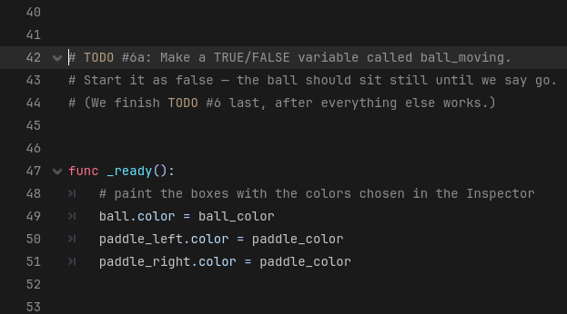
iCode
DAY 1
EMPOWERING FUTURE INNOVATORS
Just below your variables from #1b, there's a #@todo block for one boolean.
53

Slide 54
iCode
DAY 1
EMPOWERING FUTURE INNOVATORS
#3): SYNTAX FOR: TODO #3 Declare a boolean (true/false variable): var name := true var name := false Examples: var is_alive := true var door_locked := false var ball_moving := false # TODO #3 # declare a true/false variable called ball_moving # start it as false (ball is frozen until Space is pressed)
Pattern (board example):
SYNTAX FOR: TODO #3
Declare a boolean (true/false variable):
var name := true
var name := false
Examples:
var is_alive := true
var door_locked := false
var ball_moving := false
54

Slide 55
iCode
DAY 1
EMPOWERING FUTURE INNOVATORS
if statement
55

Slide 56
iCode
DAY 1
EMPOWERING FUTURE INNOVATORS
An if runs a block of code ONLY WHEN something is true.
56

Slide 57
iCode
DAY 1
EMPOWERING FUTURE INNOVATORS
The shape
if [something is true]:
do this
and this
57

Slide 58
iCode
DAY 1
EMPOWERING FUTURE INNOVATORS
What is indentation?
• Notice how some lines are shifted to the right?
• That shift is called indentation. In GDScript (and Python), it's not decorative — it tells the computer which lines belong to which rule.
58

Slide 59
iCode
DAY 1
EMPOWERING FUTURE INNOVATORS
Think of it as an invisible box
if score > 5: ← OPENS the box (blue/highlighted)
┌─────────────────────────────────────────┐
│ print("winning") ← LINE 1 (inside) │
│ do_something() ← LINE 2 (inside) │
└─────────────────────────────────────────┘
print("done") ← LINE 3 (ALWAYS runs, outside the box)
59

Slide 60
iCode
DAY 1
EMPOWERING FUTURE INNOVATORS
Condition is TRUE → box opens
Same diagram as S065b, but with annotations:
60

Slide 61
iCode
DAY 1
EMPOWERING FUTURE INNOVATORS
Condition is FALSE → box stays closed
Same diagram, different annotations:
61

Slide 62
iCode
DAY 1
EMPOWERING FUTURE INNOVATORS
What happens without indentation?
if score > 5: ← the if
print("winning") ← NOT indented → NOT inside the box
print("done") ← NOT indented → also not inside the box
62

Slide 63
iCode
DAY 1
EMPOWERING FUTURE INNOVATORS
The box rule applies to EVERYTHING
• Every if: opens a box
• Every func ...: opens a box
• Every for ... in ...: opens a box
• Every else: opens a box
• Anything followed by a colon `:` opens a box. What's indented under it is inside.
63

Slide 64
iCode
DAY 1
EMPOWERING FUTURE INNOVATORS
CHECK: Which lines run when the if is TRUE?
if health > 0: ← condition = TRUE
line 1: print("alive")
line 2: take_damage()
line 3: move_player()
64

Slide 65
iCode
DAY 1
EMPOWERING FUTURE INNOVATORS
CHECK: Which line ALWAYS runs?
if is_paused:
line 1: freeze_enemies()
line 2: show_menu()
line 3: update_timer()
65

Slide 66
iCode
DAY 1
EMPOWERING FUTURE INNOVATORS
CHECK: Nested boxes — what runs?
if has_key:
line 1: print("you have the key")
if door_locked:
line 2: print("door unlocked!")
line 3: print("you're inside")
line 4: print("game continues")
66

Slide 67
iCode
DAY 1
EMPOWERING FUTURE INNOVATORS
IF you're hungry → eat.
Real life is full of if rules.
67

Slide 68
iCode
DAY 1
EMPOWERING FUTURE INNOVATORS
IF you finish your veggies → you get dessert.
"What if you DIDN'T finish?"
68

Slide 69
iCode
DAY 1
EMPOWERING FUTURE INNOVATORS
if is a rule that only fires when its condition is true.
"Otherwise: nothing."
69

Slide 70
iCode
DAY 1
EMPOWERING FUTURE INNOVATORS
Every game runs on if checks. Every. Single. Frame.
• if button pressed → jump
• if enemy near → attack
• if health = 0 → game over
70

Slide 71
iCode
DAY 1
EMPOWERING FUTURE INNOVATORS
Today in Pong:
"IF the player has NOT pressed Space yet → freeze the ball. Use return to skip the rest of the frame."
71

Slide 72
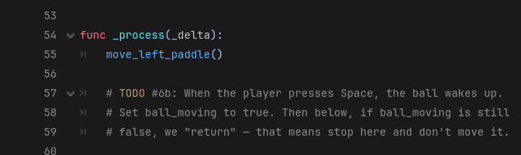
iCode
DAY 1
EMPOWERING FUTURE INNOVATORS
Inside the _process function, near the top.
72

Slide 73
iCode
DAY 1
EMPOWERING FUTURE INNOVATORS
#4): SYNTAX FOR: TODO #4 Check if a key was pressed (one frame): if Input.is_key_pressed(KEY_SPACE): Flip a boolean: variable = true Stop the rest of the function: return Check if boolean is false: if variable == false: # TODO #4 # if Space is pressed: # set ball_moving to true # if ball_moving is false: # return (skip the rest of _process this frame)
Pattern (board example):
SYNTAX FOR: TODO #4
Check if a key was pressed (one frame):
if Input.is_key_pressed(KEY_SPACE):
Flip a boolean:
variable = true
Stop the rest of the function:
return
Check if boolean is false:
if variable == false:
73

Slide 74
iCode
DAY 1
EMPOWERING FUTURE INNOVATORS
It works! The ball waits for Space.
Press F5. The ball sits frozen at the centre until you tap Space. Then it moves.
74

Slide 75
iCode
DAY 1
EMPOWERING FUTURE INNOVATORS
Input is an object
Input.is_key_pressed(KEY_SPACE)
# ↑ ↑
# object verb (ask Input to check a key)
75

Slide 76
iCode
DAY 1
EMPOWERING FUTURE INNOVATORS
There is no ONE right answer in code.
• For any problem in programming, there are thousands — sometimes MILLIONS — of valid solutions.
• The examples on the left side of TODO slides are one way. Your way is just as valid if it works.
• What matters: does it run? does it do what you wanted? If yes — it's correct.
76

Slide 77
iCode
DAY 1
EMPOWERING FUTURE INNOVATORS
Updating a variable
We already know var makes a variable. Now we UPDATE one — read the current value, do some math, put the new value back.
77

Slide 78
iCode
DAY 1
EMPOWERING FUTURE INNOVATORS
#5): SYNTAX FOR: TODO #5 Long form (always works): x = x + amount Shortcut (same thing, shorter): x += amount Both are valid — use whichever you prefer. Examples: ball.position.x = ball.position.x + ball_speed_x ball.position.x += ball_speed_x ← same result # TODO #5 # add ball_speed_x to ball.position.x # add ball_speed_y to ball.position.y
Pattern (board example):
SYNTAX FOR: TODO #5
Long form (always works):
x = x + amount
Shortcut (same thing, shorter):
x += amount
Both are valid — use whichever you prefer.
Examples:
ball.position.x = ball.position.x + ball_speed_x
ball.position.x += ball_speed_x ← same result
78

Slide 79
iCode
DAY 1
EMPOWERING FUTURE INNOVATORS
The ball moves now
Press F5, then Space. The ball drifts off the right side of the screen. That's expected — TODO #6 catches it.
79

Slide 80
iCode
DAY 1
EMPOWERING FUTURE INNOVATORS
if / else
80

Slide 81
iCode
DAY 1
EMPOWERING FUTURE INNOVATORS
else is the OTHERWISE branch.
"When the if is NOT true → run the else block instead."
81

Slide 82
iCode
DAY 1
EMPOWERING FUTURE INNOVATORS
if / else = two paths. ONE always runs.
82

Slide 83
iCode
DAY 1
EMPOWERING FUTURE INNOVATORS
Fork in the road
Sign reads: IF it's daytime → go left. ELSE → go right.
83

Slide 84
iCode
DAY 1
EMPOWERING FUTURE INNOVATORS
IF it's raining → umbrella.
"ELSE → ?"
84

Slide 85
iCode
DAY 1
EMPOWERING FUTURE INNOVATORS
One of the two paths ALWAYS runs.
85

Slide 86
iCode
DAY 1
EMPOWERING FUTURE INNOVATORS
Two-outcome checks are everywhere
• if you have the key → open the door, else → it stays locked
• if HP > 0 → take damage, else → game over
• if input pressed → move, else → idle
86

Slide 87
iCode
DAY 1
EMPOWERING FUTURE INNOVATORS
Today in Pong:
"IF the ball hit the top OR bottom wall → flip its vertical speed. ELSE → let it keep going."
87

Slide 88
iCode
DAY 1
EMPOWERING FUTURE INNOVATORS
What are the borders?
var upper_border = 0 # top of screen
var lower_border = SCREEN_H - BALL_SIZE # = 648 - 20 = 628
88

Slide 89
iCode
DAY 1
EMPOWERING FUTURE INNOVATORS
Why subtract BALL_SIZE?
y = 628 → ball top-left at 628
ball bottom-right at 648 ← just touching the wall ✓
y = 648 → ball has already gone OFF the screen ✗
89

Slide 90
iCode
DAY 1
EMPOWERING FUTURE INNOVATORS
Math figures it out for you.
• Instead of guessing 628, we wrote SCREEN_H - BALL_SIZE.
• If you change the screen size, or the ball size, the border updates automatically — you don't touch it.
• This is why game developers use math: one formula that works for any size, any speed, any screen.
• You'll need this kind of thinking later this week. Keep it in mind.
90

Slide 91
iCode
DAY 1
EMPOWERING FUTURE INNOVATORS
#6): SYNTAX FOR: TODO #6 Named border variables (pre-fill these): var upper_border = 0 var lower_border = SCREEN_H - BALL_SIZE Check two conditions at once: if A or B: Flip the vertical speed: ball_speed_y = -ball_speed_y When neither condition is true: else: pass # TODO #6 var upper_border = 0 var lower_border = SCREEN_H - BALL_SIZE # if ball.position.y < upper_border OR > lower_border: # flip ball_speed_y (negate it) # else: # pass
Pattern (board example):
SYNTAX FOR: TODO #6
Named border variables (pre-fill these):
var upper_border = 0
var lower_border = SCREEN_H - BALL_SIZE
Check two conditions at once:
if A or B:
Flip the vertical speed:
ball_speed_y = -ball_speed_y
When neither condition is true:
else:
pass
91

Slide 92
iCode
DAY 1
EMPOWERING FUTURE INNOVATORS
The ball bounces
Press F5, then Space. The ball ricochets off the top and bottom walls now. It still flies off the LEFT and RIGHT sides — TODO #8 fixes that.
92

Slide 93
iCode
DAY 1
EMPOWERING FUTURE INNOVATORS
if — without an else
Same if from chunk #6b. This time we use it WITHOUT an else. If the check fails → nothing happens (no else, no other path).
93

Slide 94
iCode
DAY 1
EMPOWERING FUTURE INNOVATORS
#7): SYNTAX FOR: TODO #7 Check if ball passed right edge: if ball.position.x > SCREEN_W: Print a message to the Output panel: print("your message here") # TODO #7 # if ball.position.x is past the right edge (SCREEN_W): # print("point!")
Pattern (board example):
SYNTAX FOR: TODO #7
Check if ball passed right edge:
if ball.position.x > SCREEN_W:
Print a message to the Output panel:
print("your message here")
94

Slide 95
iCode
DAY 1
EMPOWERING FUTURE INNOVATORS
See the () after print?
95

Slide 96
iCode
DAY 1
EMPOWERING FUTURE INNOVATORS
'point!' shows up
Press F5. Let the ball go past the right edge. Look at the Output panel — point! prints.
96

Slide 97
iCode
DAY 1
EMPOWERING FUTURE INNOVATORS
Comparison operators
97

Slide 98
iCode
DAY 1
EMPOWERING FUTURE INNOVATORS
> and <
• > means GREATER THAN
• < means LESS THAN
98

Slide 99
iCode
DAY 1
EMPOWERING FUTURE INNOVATORS
Use them inside if
if score > 5:
print("winning")
99

Slide 100
iCode
DAY 1
EMPOWERING FUTURE INNOVATORS
The rollercoaster
YOU MUST BE THIS TALL → 48 inches
100

Slide 101
iCode
DAY 1
EMPOWERING FUTURE INNOVATORS
You're 50 inches tall.
"Can you ride? What's the check? your_height > 48 — true or false?"
101

Slide 102
iCode
DAY 1
EMPOWERING FUTURE INNOVATORS
> and < let if compare two numbers.
102

Slide 103
iCode
DAY 1
EMPOWERING FUTURE INNOVATORS
Games are constantly comparing numbers
• is score > high score?
• is health < 20%?
• is enemy distance < 100 pixels?
• is timer == 0?
103

Slide 104
iCode
DAY 1
EMPOWERING FUTURE INNOVATORS
Today in Pong:
"Is the ball past the right edge? (ball.x > SCREEN_W) → left player scores. Past the left edge? (ball.x < 0) → right player scores."
104

Slide 105
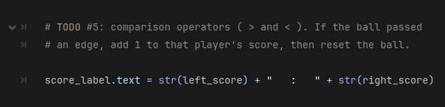
iCode
DAY 1
EMPOWERING FUTURE INNOVATORS
Same area you put the print(\"point!\") test. We're upgrading it to real scoring.
105

Slide 106
iCode
DAY 1
EMPOWERING FUTURE INNOVATORS
#8): SYNTAX FOR: TODO #8 Check if ball passed right edge: if ball.position.x > SCREEN_W: Check if ball passed left edge: if ball.position.x < 0: Add 1 to a score variable: left_score += 1 Reset the ball to centre: reset_ball() # TODO #8 # if ball passed the right edge (> SCREEN_W): # add 1 to left_score # call reset_ball() # if ball passed the left edge (< 0): # add 1 to right_score # call reset_ball()
Pattern (board example):
SYNTAX FOR: TODO #8
Check if ball passed right edge:
if ball.position.x > SCREEN_W:
Check if ball passed left edge:
if ball.position.x < 0:
Add 1 to a score variable:
left_score += 1
Reset the ball to centre:
reset_ball()
106

Slide 107
iCode
DAY 1
EMPOWERING FUTURE INNOVATORS
The scoreboard counts!
Press F5, then Space. Score a point past either edge. The number at the top of the screen jumps up.
107

Slide 108
iCode
DAY 1
EMPOWERING FUTURE INNOVATORS
Personalization Break — Make it yours
• The ball bounces and scoring works. Pause and make this Pong YOURS:
• • Change ball_speed_x and ball_speed_y — how fast do you want it?
• • Change paddle_speed — is it too slow? Too fast?
• • Change ball/paddle colour in the Inspector (click Main node → Ball Color)
• Save (Ctrl+S) and run (F5) after each change.
108

Slide 109
iCode
DAY 1
EMPOWERING FUTURE INNOVATORS
Remember your silly variables from TODO #2?
Time to put them ON SCREEN. But there's one problem — the scoreboard only holds text, and your variables are numbers. We need to convert them.
109

Slide 110
iCode
DAY 1
EMPOWERING FUTURE INNOVATORS
str() — turns a number into text
str(99) # → "99" (the number 99 as text)
str(skibidi_speed) # → "99" (whatever value the variable holds)
110

Slide 111
iCode
DAY 1
EMPOWERING FUTURE INNOVATORS
Joining text pieces with +
"Speed: " + str(skibidi_speed) # → "Speed: 99"
"★ " + str(gyatt_factor) + " ★" # → "★ 42 ★"
111

Slide 112
iCode
DAY 1
EMPOWERING FUTURE INNOVATORS
Appending with +=
score_label.text += " ★ " + str(skibidi_speed)
# reads: "stick this onto the end of whatever's already there"
112

Slide 113
iCode
DAY 1
EMPOWERING FUTURE INNOVATORS
#9): SYNTAX FOR: TODO #9 Convert number to text: str(your_variable) Join text pieces: "label: " + str(variable) Append to existing scoreboard text: score_label.text += " more text here" Full example: score_label.text += " ★ " + str(skibidi_speed) # TODO #9 # append your first silly variable to score_label.text # (use str() to convert it, + to join with a label) # also append your second silly variable # add decorations (stars, emojis, text) if you want
Pattern (board example):
SYNTAX FOR: TODO #9
Convert number to text:
str(your_variable)
Join text pieces:
"label: " + str(variable)
Append to existing scoreboard text:
score_label.text += " more text here"
Full example:
score_label.text += " ★ " + str(skibidi_speed)
113

Slide 114
iCode
DAY 1
EMPOWERING FUTURE INNOVATORS
Your variables, live on the scoreboard
Run it. The scoreboard now shows your silly variables right next to the score. Have your neighbour read theirs out loud.
114

Slide 115
iCode
DAY 1
EMPOWERING FUTURE INNOVATORS
Make it yours — Personalization Sessions
More ways to make this Pong YOUR Pong. Pick any, in any order.
115

Slide 116
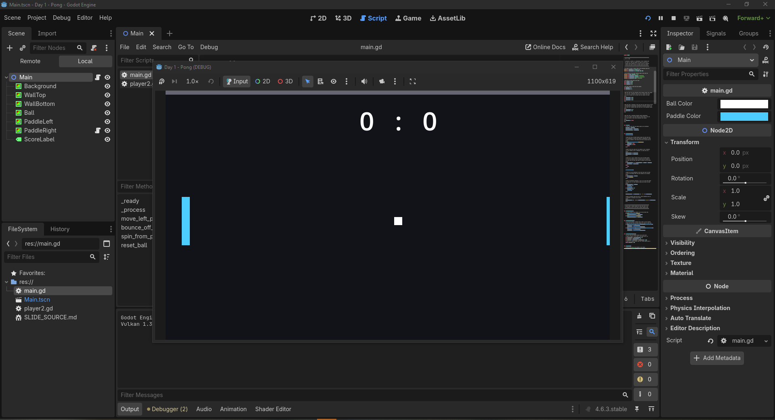
iCode
DAY 1
EMPOWERING FUTURE INNOVATORS
Run the game, then look at the Inspector on the right. Ball Color and Paddle Color are right there — click a swatch, pick any colour, then Save (Ctrl+S) and run (F5).
116

Slide 117
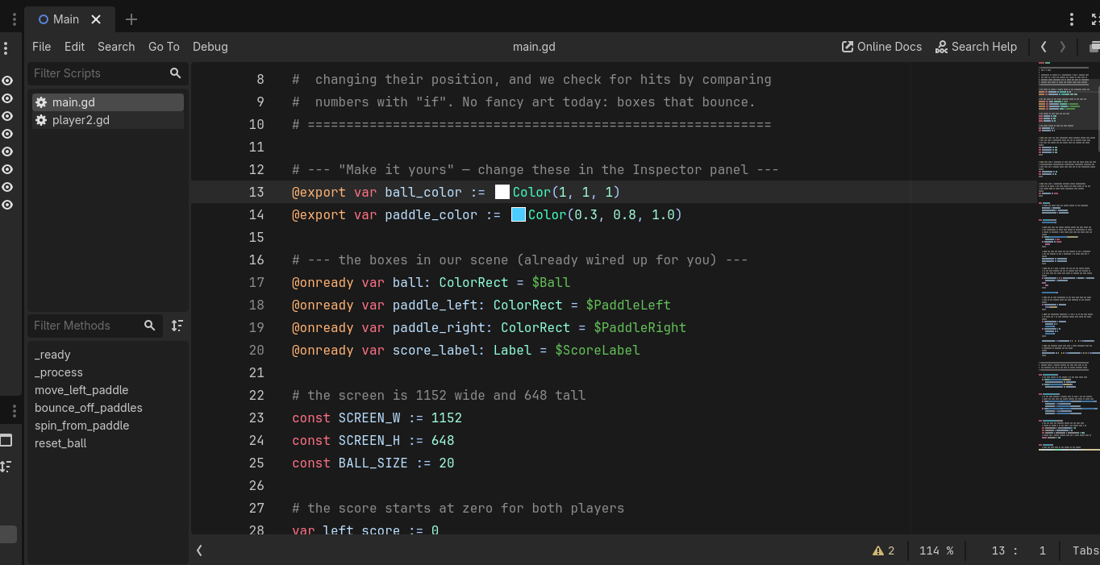
iCode
DAY 1
EMPOWERING FUTURE INNOVATORS
At the top of main.gd, two lines define them: @export var ball_color and @export var paddle_color. The magic word @export is what makes a variable show up in the Inspector.
117

Slide 118
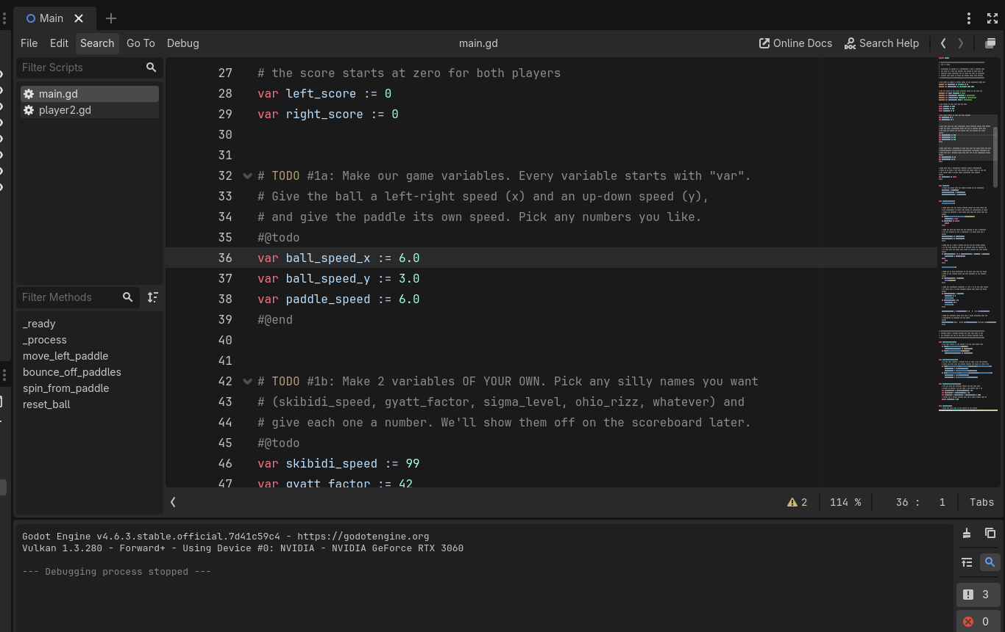
iCode
DAY 1
EMPOWERING FUTURE INNOVATORS
In main.gd, find your TODO #2 variables. Rename them to something even funnier. Then find TODO #9 (the scoreboard) and update the name there too — they must match.
118

Slide 119
iCode
DAY 1
EMPOWERING FUTURE INNOVATORS
Final Challenge — make Pong 2-player
• Open player2.gd (it's on the PaddleRight node). Two TODOs inside:
• FC-1 — comment out the AI (right paddle plays itself → should sit still)
• FC-2 — add I/K key movement for a real second player
• FC-3 (bonus) — random ball respawn angle with randf_range()
• You already did every piece this morning. Give it a whirl.
119

Slide 120
iCode
DAY 1
EMPOWERING FUTURE INNOVATORS
FC-1 ← mirrors: reading code Comment out a line: # put a # at the start of each AI line Ctrl+K with lines selected = toggle comment FC-2 ← mirrors: TODO #4 (if + key input) Check if a key is held: if Input.is_key_pressed(KEY_I): if Input.is_key_pressed(KEY_K): Move up / down: position.y -= paddle_speed ← up position.y += paddle_speed ← down # FC-1: comment out ALL 5 AI lines in _process # (select them, Ctrl+K, or # each line manually) # the right paddle should now sit still # FC-2 # if I key is pressed: # move paddle UP (subtract paddle_speed from position.y) # if K key is pressed: # move paddle DOWN (add paddle_speed to position.y)
Pattern (board example):
FC-1 ← mirrors: reading code
Comment out a line:
# put a # at the start of each AI line
Ctrl+K with lines selected = toggle comment
FC-2 ← mirrors: TODO #4 (if + key input)
Check if a key is held:
if Input.is_key_pressed(KEY_I):
if Input.is_key_pressed(KEY_K):
Move up / down:
position.y -= paddle_speed ← up
position.y += paddle_speed ← down
120

Slide 121
iCode
DAY 1
EMPOWERING FUTURE INNOVATORS
FC-3 ← mirrors: TODO #1 (variables) + rand function Define angle bounds (constants): const ANGLE_MIN := -45.0 const ANGLE_MAX := 45.0 Pick a random angle each respawn: var angle = randf_range(ANGLE_MIN, ANGLE_MAX) Convert to x/y speed: ball_speed_x = cos(deg_to_rad(angle)) 6.0 ball_speed_y = sin(deg_to_rad(angle)) 6.0
Pattern (board example):
FC-3 ← mirrors: TODO #1 (variables) + rand function
Define angle bounds (constants):
const ANGLE_MIN := -45.0
const ANGLE_MAX := 45.0
Pick a random angle each respawn:
var angle = randf_range(ANGLE_MIN, ANGLE_MAX)
Convert to x/y speed:
ball_speed_x = cos(deg_to_rad(angle)) * 6.0
ball_speed_y = sin(deg_to_rad(angle)) * 6.0
121

Slide 122
iCode
DAY 1
EMPOWERING FUTURE INNOVATORS
Day 1 assets: none
Day 1 used zero imported art. Every visible thing on screen was a ColorRect — a coloured box drawn by code. From Day 2 on, we bring in real art with Kenney.nl asset packs.
122

Slide 123
iCode
DAY 1
EMPOWERING FUTURE INNOVATORS
Take it home
Turn your Pong into a real Windows program — a .exe you can run on any PC, no Godot needed. Show your family tonight.
123

Slide 124
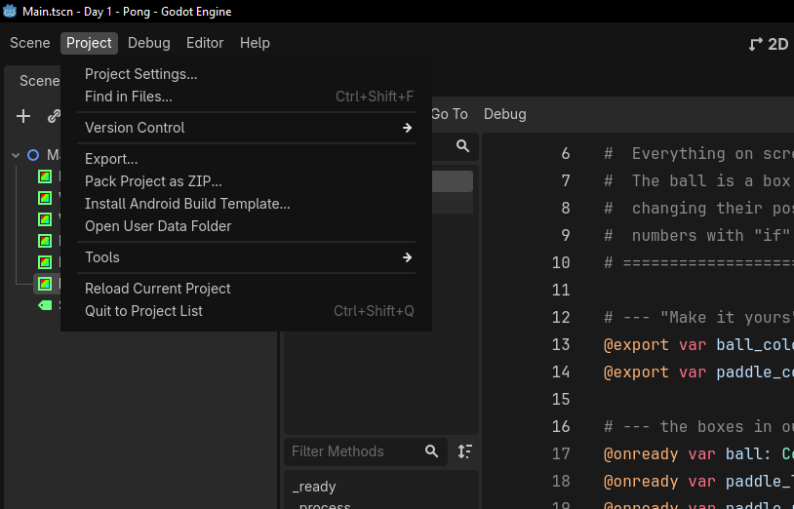
iCode
DAY 1
EMPOWERING FUTURE INNOVATORS
In the top menu bar, click Project, then Export…
124

Slide 125
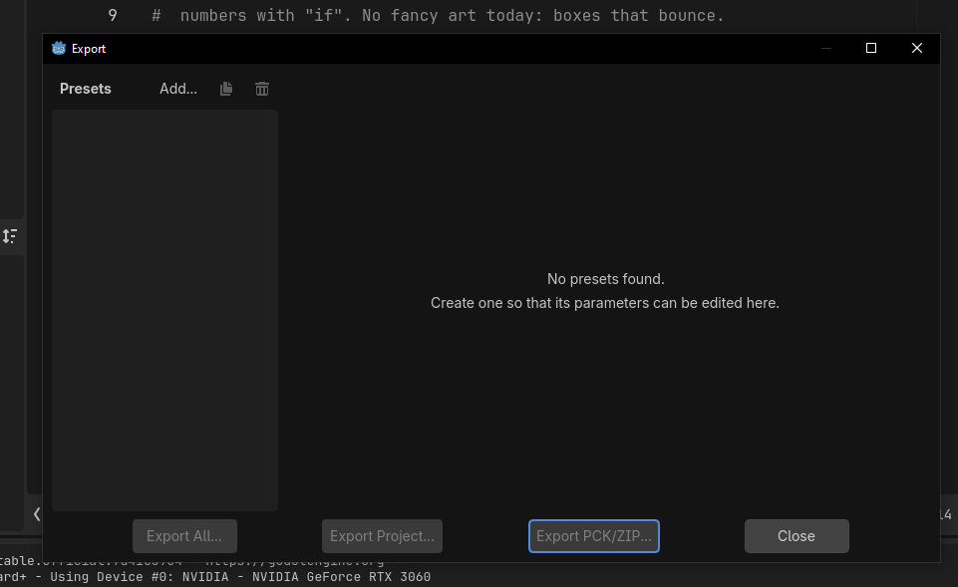
iCode
DAY 1
EMPOWERING FUTURE INNOVATORS
The Export window opens. It's empty the first time — click Add… at the top to add a target.
125

Slide 126
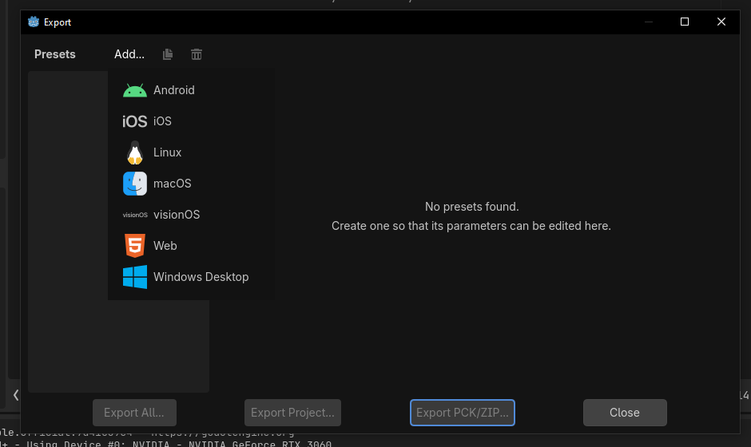
iCode
DAY 1
EMPOWERING FUTURE INNOVATORS
From the list, pick Windows Desktop — that's the kind of program Windows PCs run.
126

Slide 127
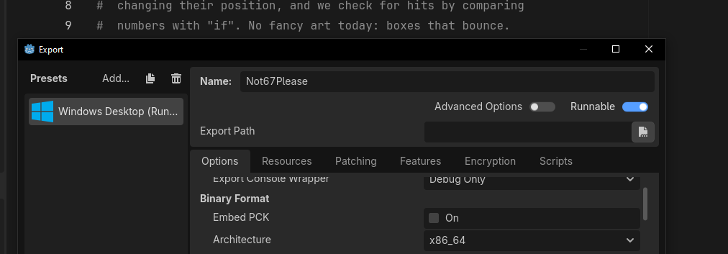
iCode
DAY 1
EMPOWERING FUTURE INNOVATORS
Godot adds a Windows Desktop preset on the left. Leave the options as they are — Runnable on, Architecture x86_64.
127

Slide 128
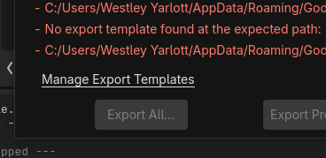
iCode
DAY 1
EMPOWERING FUTURE INNOVATORS
The first time on a new PC you may see a red 'No export template found' message. Click Manage Export Templates to fix it.
128

Slide 129
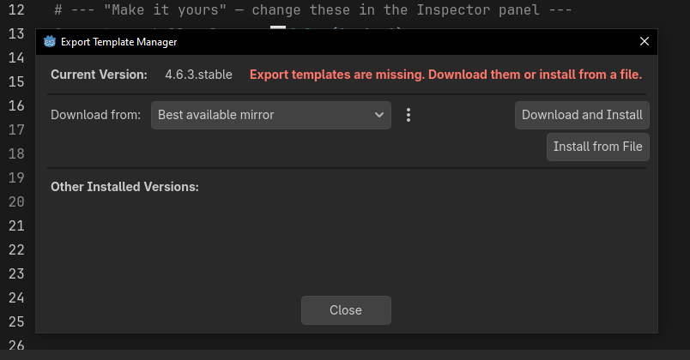
iCode
DAY 1
EMPOWERING FUTURE INNOVATORS
In the Export Template Manager, click Download and Install. Let it finish, then close. (One-time setup per computer.)
129

Slide 130
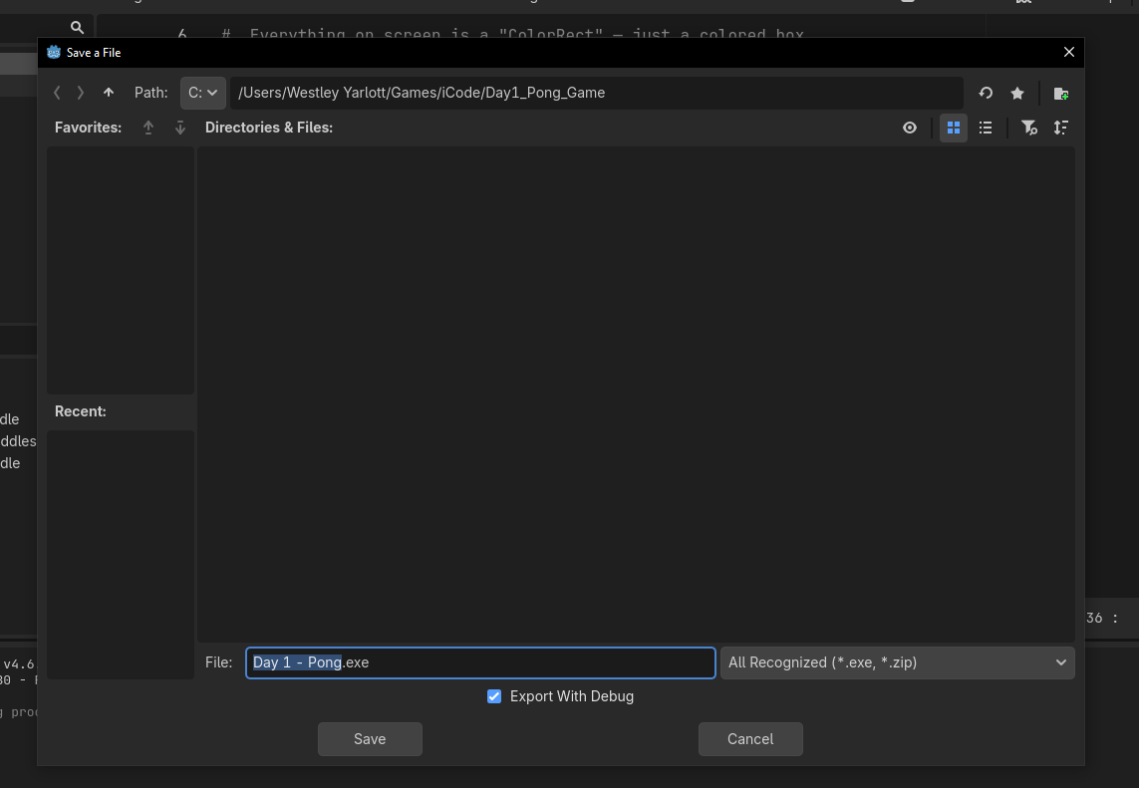
iCode
DAY 1
EMPOWERING FUTURE INNOVATORS
Click Export Project, type a name (e.g. Day 1 - Pong), pick your folder, and click Save. Godot builds your game.
130

Slide 131
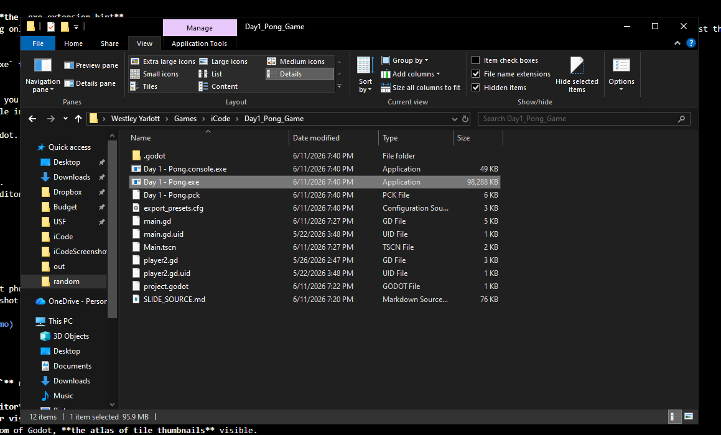
iCode
DAY 1
EMPOWERING FUTURE INNOVATORS
Godot writes Day 1 - Pong.exe plus a .pck data file into your folder. Double-click the .exe — your Pong runs with no Godot needed. Keep the two files together.
131

Slide 132
iCode
DAY 1
EMPOWERING FUTURE INNOVATORS
It's really yours now
Copy that folder to a USB stick or send it to a friend. It runs on any Windows PC. You built and shipped a real game on day one.
132

Slide 133
iCode
DAY 1
EMPOWERING FUTURE INNOVATORS
Tomorrow: Pac-Man
1980. The next leap. We trade coloured rectangles for tiles — and learn loops and functions to bring a whole maze to life.
133

