Slide 1

iCode
DAY 1
EMPOWERING FUTURE INNOVATORS
VR Creator - Day 1
Pong · 1972 · Atari
2

Slide 2
iCode
DAY 1
EMPOWERING FUTURE INNOVATORS
Why Pong mattered
• 1972, Atari. One of the first video games you could play in public.
• Dead simple — two paddles, one ball. Anyone got it in seconds. That simplicity is why it spread.
• Launched the whole arcade industry; 3 years later 'Home Pong' put a video game on the family TV for the first time.
• Proved games could be a business. Pac-Man, Mario, your living-room console — all trace back here.
3

Slide 3
iCode
DAY 1
EMPOWERING FUTURE INNOVATORS
The 5-day arc
• 1972 — Pong (today, highlighted)
• 1980 — Pac-Man
• 1990s — Tower / Base Defense
• late 1990s — Fighter
• 2020s — Racing
4

Slide 4
iCode
DAY 1
EMPOWERING FUTURE INNOVATORS
A quick history of VR
• The dream is old — VR headsets go back to the 1960s, but they were huge, blurry, and wildly expensive.
• 2012: the Oculus Rift made VR cheap and good enough to be real. Now standalone headsets (Quest) need no PC at all.
• VR = the screen wraps all the way around you. You don't look at the game — you're inside it.
5

Slide 5
iCode
DAY 1
EMPOWERING FUTURE INNOVATORS
Today's concepts
• Variables — values that can change.
• Conditions — if / else, and comparing numbers.
6

Slide 6
iCode
DAY 1
EMPOWERING FUTURE INNOVATORS
GDScript is Python with two small differences
Python
GDScript
x = 5
def update():
pass
var x = 5
func update():
pass
7

Slide 7
iCode
DAY 1
EMPOWERING FUTURE INNOVATORS
Pre-coding setup
"Open the project. Open the script. Run it. Read the errors."
8

Slide 8
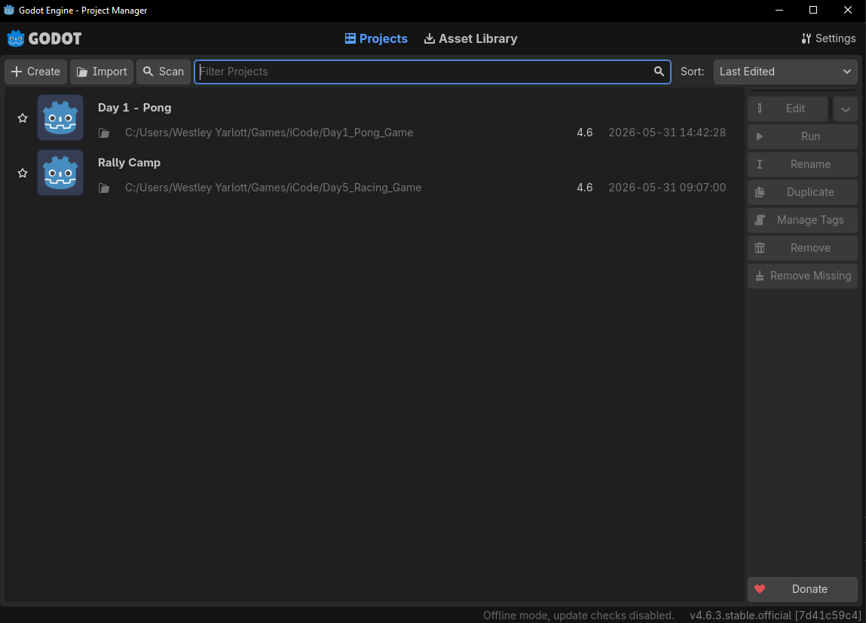
iCode
DAY 1
EMPOWERING FUTURE INNOVATORS
Launch Godot 4. The Project Manager window opens. Find the Import button at the top-right.
9

Slide 9
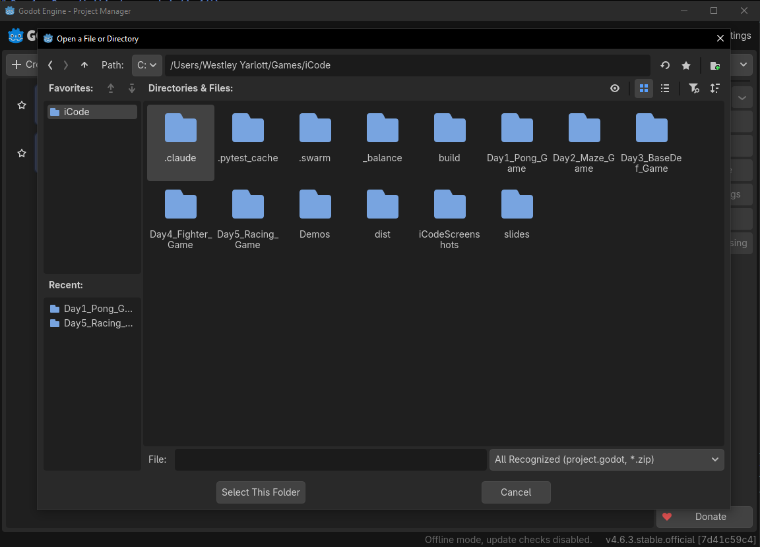
iCode
DAY 1
EMPOWERING FUTURE INNOVATORS
Click the Import button at the top-right of the Project Manager.
10

Slide 10
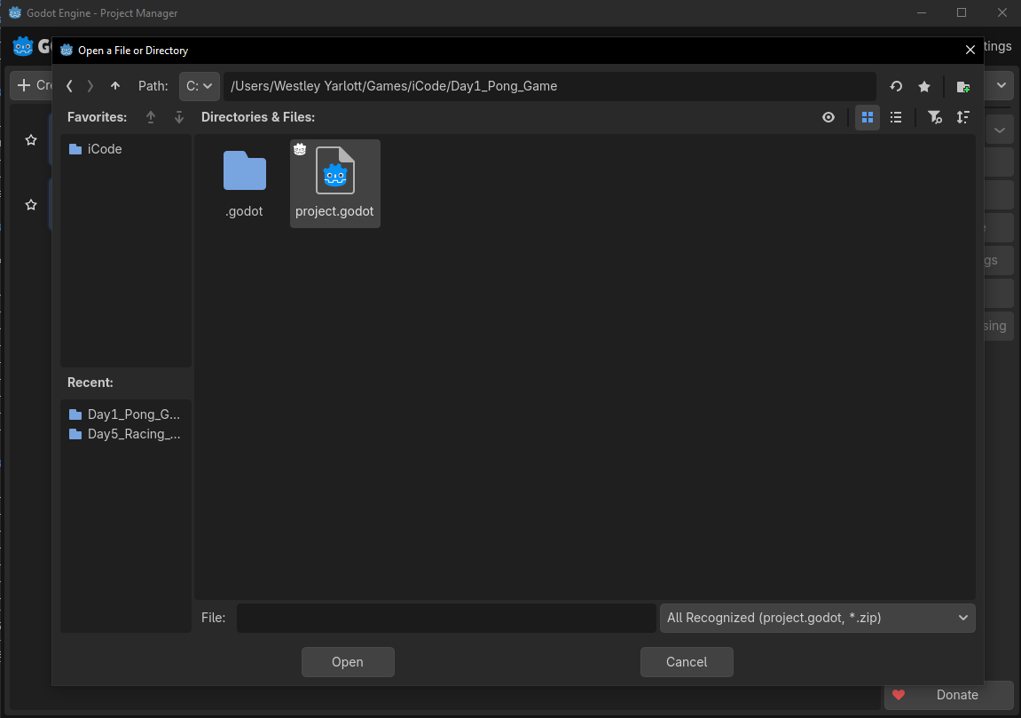
iCode
DAY 1
EMPOWERING FUTURE INNOVATORS
In the file browser, open the Day1_Pong_Game folder and click project.godot to select it.
11

Slide 11
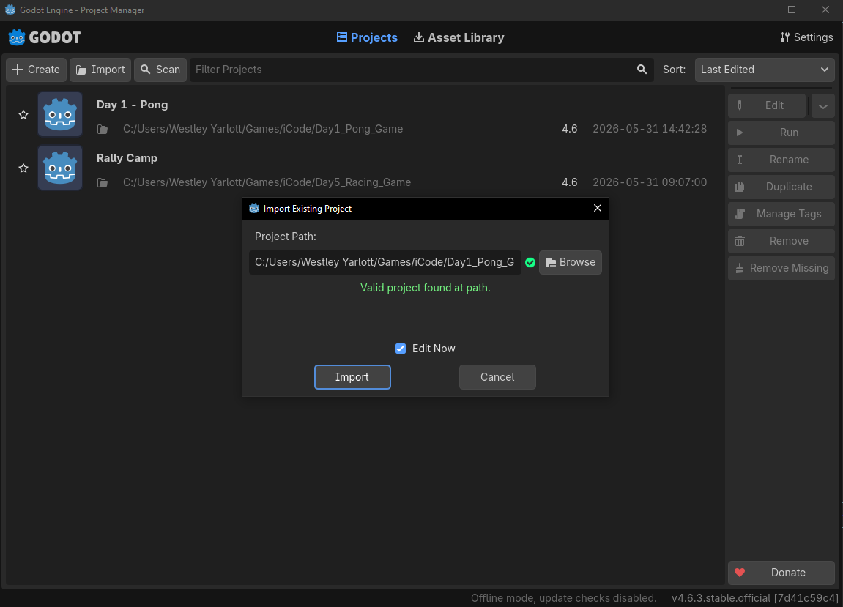
iCode
DAY 1
EMPOWERING FUTURE INNOVATORS
Godot asks to confirm. Click Import & Edit.
12

Slide 12
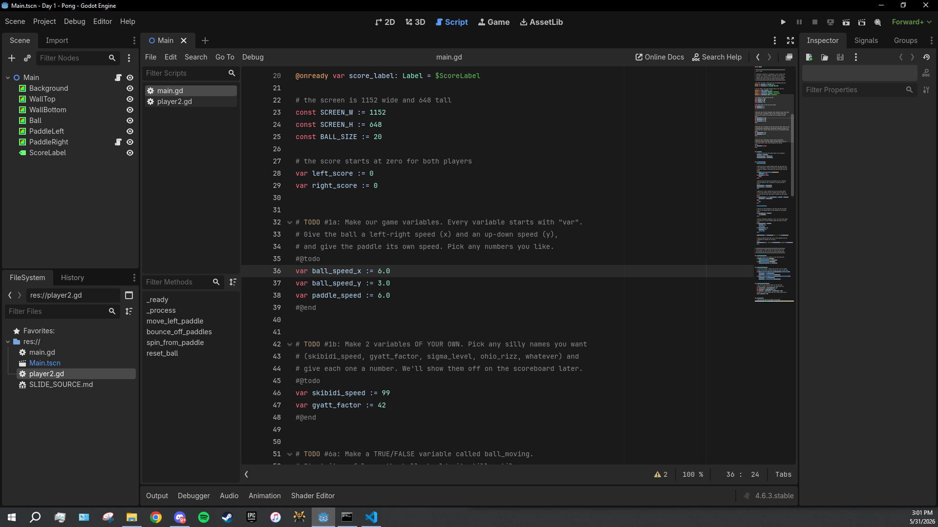
iCode
DAY 1
EMPOWERING FUTURE INNOVATORS
Godot imports the project (first time takes a few seconds) and the editor opens. You're in.
13

Slide 13
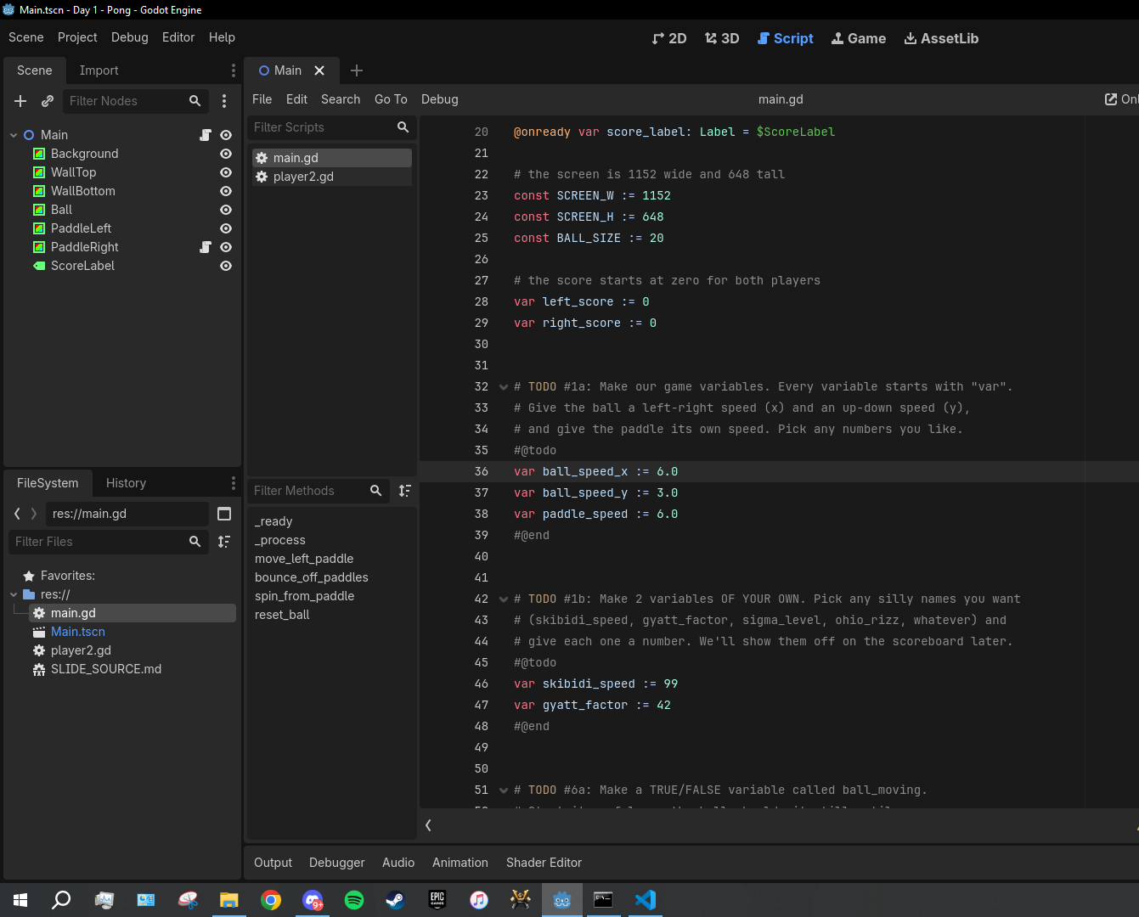
iCode
DAY 1
EMPOWERING FUTURE INNOVATORS
Look at the FileSystem panel (bottom-left). Find the file named main.gd.
14

Slide 14
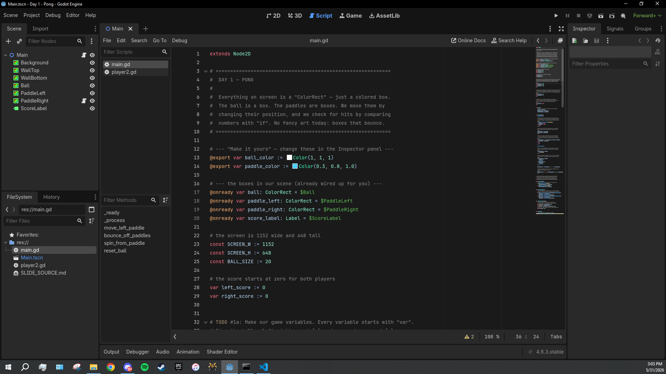
iCode
DAY 1
EMPOWERING FUTURE INNOVATORS
Hover main.gd, then double-click to open it.
15

Slide 15
iCode
DAY 1
EMPOWERING FUTURE INNOVATORS
Lesson chunks
"Eight holes to fill. We'll fill them in order."
16

Slide 16
iCode
DAY 1
EMPOWERING FUTURE INNOVATORS
Variable
(just the word, very large, centred on slide)
17

Slide 17
iCode
DAY 1
EMPOWERING FUTURE INNOVATORS
What does variable mean?
"What does vary mean?"
18

Slide 18
iCode
DAY 1
EMPOWERING FUTURE INNOVATORS
vary = something that can change
19

Slide 19
iCode
DAY 1
EMPOWERING FUTURE INNOVATORS
V in variable → VALUE that can CHANGE
20

Slide 20
iCode
DAY 1
EMPOWERING FUTURE INNOVATORS
The cookie jar
CookiesInJar = 0
21

Slide 21
iCode
DAY 1
EMPOWERING FUTURE INNOVATORS
A week later…
CookiesInJar = 8
22

Slide 22
iCode
DAY 1
EMPOWERING FUTURE INNOVATORS
You eat 3 cookies.
"What is CookiesInJar now?"
23

Slide 23
iCode
DAY 1
EMPOWERING FUTURE INNOVATORS
A variable is a VALUE that can CHANGE across time.
24

Slide 24
iCode
DAY 1
EMPOWERING FUTURE INNOVATORS
How does a video game use variables?
25

Slide 25
iCode
DAY 1
EMPOWERING FUTURE INNOVATORS
Pong's variables
• How fast is the ball moving left/right? → ball_speed_x
• How fast is the ball moving up/down? → ball_speed_y
• How fast does the paddle move? → paddle_speed
• Every frame, these numbers decide how fast everything goes.
26

Slide 26
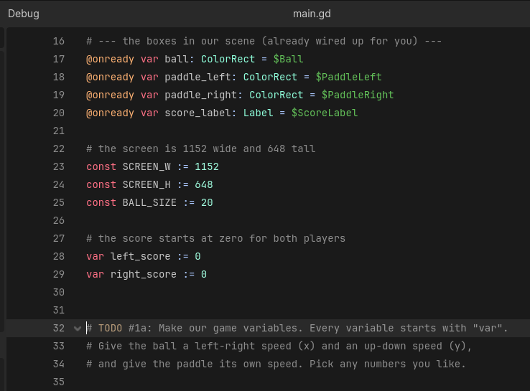
iCode
DAY 1
EMPOWERING FUTURE INNOVATORS
Right below the score, between #@todo and #@end, you'll add three variables of your own.
27

Slide 27
iCode
DAY 1
EMPOWERING FUTURE INNOVATORS
What you're about to write
var ball_speed_x := 6.0
var ball_speed_y := 3.0
var paddle_speed := 6.0
• What: Three variables — left-right ball speed, up-down ball speed, and paddle speed.
• Why: Without these, the ball has no speed. It can't move. Every moving thing in Pong needs a number.
• How: var name := value makes a new variable. The := sets the starting value. Pick any numbers you like.
This is one approach — yours works if it runs.
28

Slide 28
iCode
DAY 1
EMPOWERING FUTURE INNOVATORS
TODO #1 — Create your game variables
SYNTAX
WRITE THIS
var score := 0
var lives := 3
var speed := 6.0
# ball left-right speed (5=slow, 15=super fast)
# ball up-down speed (5=slow, 15=super fast)
# paddle speed (5=slow, 15=super fast)
Detailed instructions are in your code file, right next to this TODO.
29

Slide 29
iCode
DAY 1
EMPOWERING FUTURE INNOVATORS
Press the F5 key on your keyboard. (Or click the Play ▶ button in the top-right toolbar.)
30

Slide 30
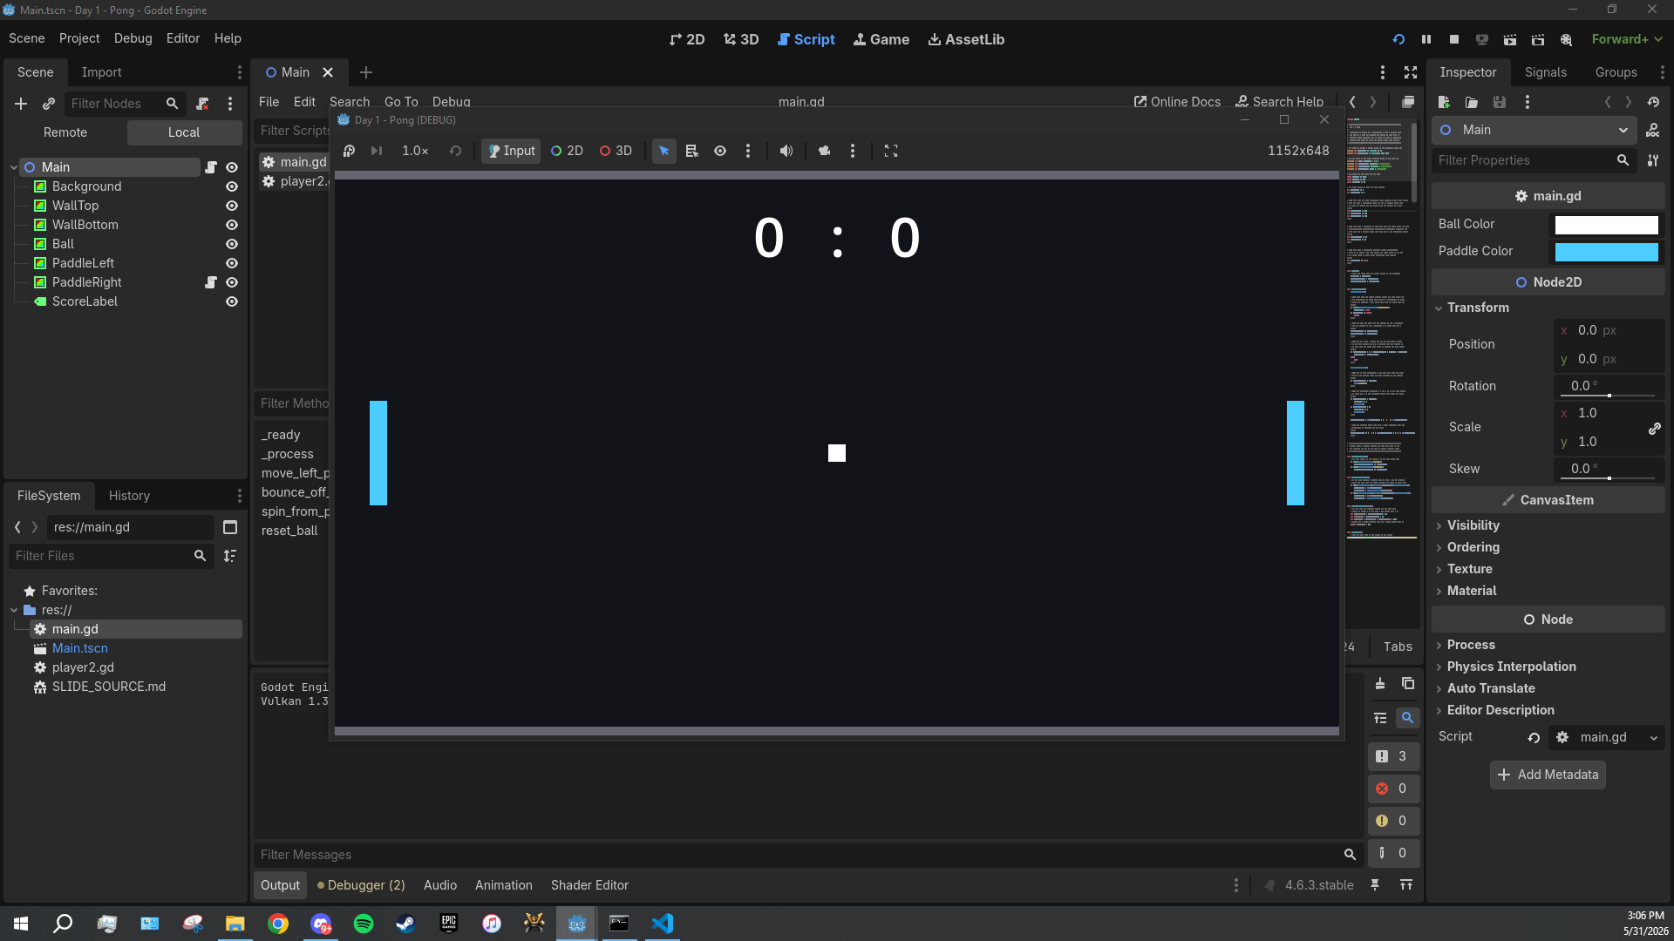
iCode
DAY 1
EMPOWERING FUTURE INNOVATORS
A new window pops up, 1152 × 648 pixels. Dark background, two cyan paddles. The ball will be frozen at the centre until chunk #6b — that's normal.
31

Slide 31
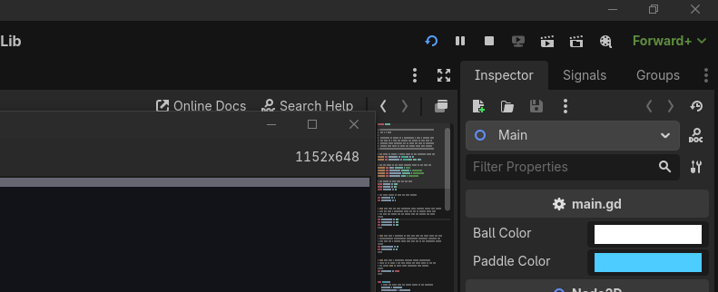
iCode
DAY 1
EMPOWERING FUTURE INNOVATORS
Close the game window, OR press F8 in the editor to stop it.
32

Slide 32
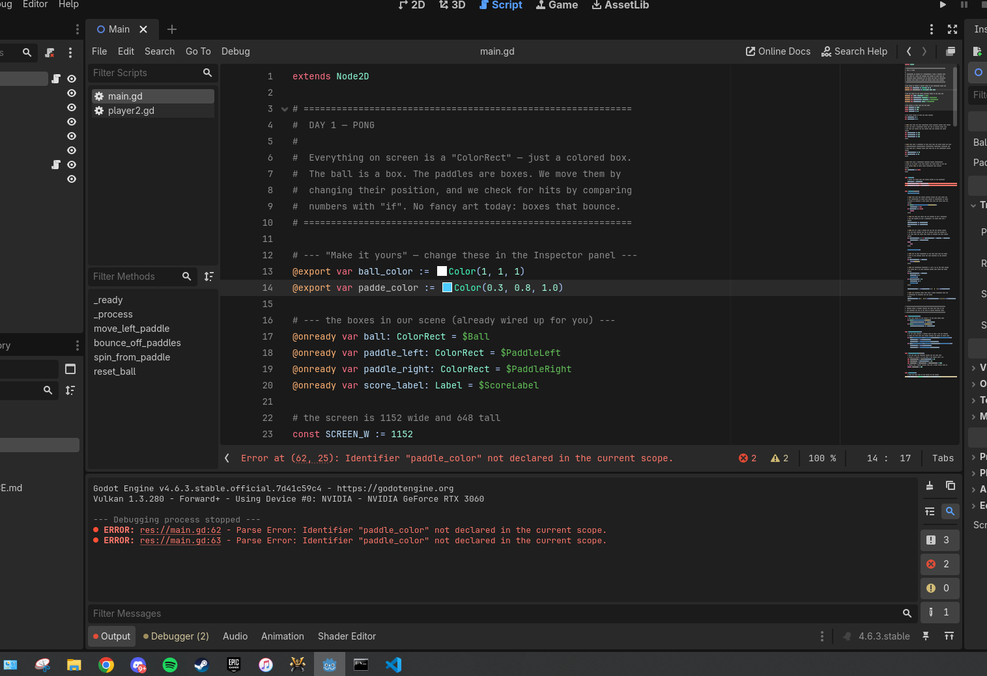
iCode
DAY 1
EMPOWERING FUTURE INNOVATORS
If your game window doesn't open after F5, look at the Output panel at the bottom of the editor. That's where errors print.
33

Slide 33
iCode
DAY 1
EMPOWERING FUTURE INNOVATORS
Step D.2 — Three errors you WILL hit
• Parse Error: Expected ':' after \"if\" condition. → you forgot the colon at the end of an if line.
• Identifier \"ball_speedy\" not declared in the current scope. → typo in a variable name (probably missing the _x or _y).
• Expected indented block. → the line after if ...: is not indented (use Tab or 4 spaces).
34

Slide 34
iCode
DAY 1
EMPOWERING FUTURE INNOVATORS
Naming your variables
35

Slide 35
iCode
DAY 1
EMPOWERING FUTURE INNOVATORS
Code doesn't care what you call a variable.
"The name is for YOU."
36

Slide 36
iCode
DAY 1
EMPOWERING FUTURE INNOVATORS
Programmers go SILLY on purpose
• foobar and bazinga are decades-old programmer jokes — built right into real codebases.
• Even Claude (the AI in your editor) types nonsense words like fligerbigitibetting when it's just thinking out loud.
• Making code feel personal makes it more fun to read AND more fun to write.
37

Slide 37
iCode
DAY 1
EMPOWERING FUTURE INNOVATORS
Both work — pick your favourite
var score := 0
38

Slide 38
iCode
DAY 1
EMPOWERING FUTURE INNOVATORS
What's the funniest variable name you can think of?
39

Slide 39
iCode
DAY 1
EMPOWERING FUTURE INNOVATORS
Your code, your names.
40

Slide 40
iCode
DAY 1
EMPOWERING FUTURE INNOVATORS
Real game studios do this every day
"Codebases are full of inside jokes, pet names, and references hidden in variable names. It's part of the culture."
41

Slide 41
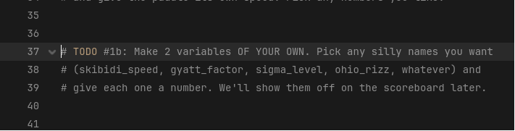
iCode
DAY 1
EMPOWERING FUTURE INNOVATORS
Right below your chunk #1a variables, you've got another #@todo block waiting for two more — names of your choosing.
42

Slide 42
iCode
DAY 1
EMPOWERING FUTURE INNOVATORS
What you're about to write
var skibidi_speed := 99
var gyatt_factor := 42
• What: Two variables — names are 100% your choice. Numbers too.
• Why: You'll display them on the scoreboard in TODO #9. Pick something that'll make your neighbour laugh.
• How: Same var name := value as before. Name rules: lowercase, underscores, no spaces.
This is one approach — yours works if it runs.
43

Slide 43
iCode
DAY 1
EMPOWERING FUTURE INNOVATORS
TODO #2 — Your own variables
SYNTAX
WRITE THIS
var skibidi_speed := 99
var ohio_rizz := 7
var gyatt_factor := 42
# silly variable name #1 (your choice)
# silly variable name #2 (your choice)
Detailed instructions are in your code file, right next to this TODO.
44

Slide 44
iCode
DAY 1
EMPOWERING FUTURE INNOVATORS
Boolean
45

Slide 45
iCode
DAY 1
EMPOWERING FUTURE INNOVATORS
A variable with only TWO possible values.
46

Slide 46
iCode
DAY 1
EMPOWERING FUTURE INNOVATORS
Those two values: true or false.
"No numbers. No text. Just yes or no."
47

Slide 47
iCode
DAY 1
EMPOWERING FUTURE INNOVATORS
Boolean = a YES/NO switch.
48

Slide 48
iCode
DAY 1
EMPOWERING FUTURE INNOVATORS
The light switch
light_on = true
49

Slide 49
iCode
DAY 1
EMPOWERING FUTURE INNOVATORS
Flip it.
light_on = false
50

Slide 50
iCode
DAY 1
EMPOWERING FUTURE INNOVATORS
Is the light in this room on right now?
"True or false?"
51

Slide 51
iCode
DAY 1
EMPOWERING FUTURE INNOVATORS
A boolean is a true/false switch. Like a light switch.
52

Slide 52
iCode
DAY 1
EMPOWERING FUTURE INNOVATORS
Games are full of yes/no switches
• Is the player alive? is_alive
• Is the game paused? is_paused
• Is the door locked? door_locked
• All booleans.
53

Slide 53
iCode
DAY 1
EMPOWERING FUTURE INNOVATORS
Today in Pong: is the ball moving yet?
"That's a boolean. We'll call it ball_moving."
54

Slide 54
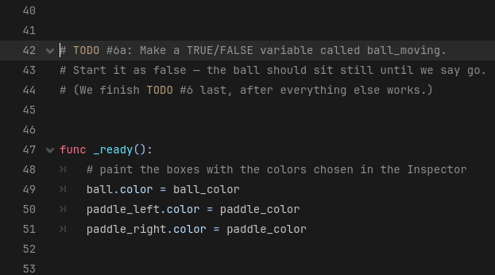
iCode
DAY 1
EMPOWERING FUTURE INNOVATORS
Just below your variables from #1b, there's a #@todo block for one boolean.
55

Slide 55
iCode
DAY 1
EMPOWERING FUTURE INNOVATORS
What you're about to write
var ball_moving := false
• What: One variable — a true/false switch called ball_moving.
• Why: The ball needs to freeze until Space is pressed. This flag is the on/off switch.
• How: Same var name := value — the value is just true or false instead of a number.
This is one approach — yours works if it runs.
56

Slide 56
iCode
DAY 1
EMPOWERING FUTURE INNOVATORS
TODO #3 — Make a boolean
SYNTAX
WRITE THIS
var is_alive := true
var door_locked := false
var ball_moving := false
# a true/false variable called ball_moving
# start it as false
Detailed instructions are in your code file, right next to this TODO.
57

Slide 57
iCode
DAY 1
EMPOWERING FUTURE INNOVATORS
if statement
58

Slide 58
iCode
DAY 1
EMPOWERING FUTURE INNOVATORS
An if runs a block of code ONLY WHEN something is true.
59

Slide 59
iCode
DAY 1
EMPOWERING FUTURE INNOVATORS
The shape
if [something is true]:
do this
and this
60

Slide 60
iCode
DAY 1
EMPOWERING FUTURE INNOVATORS
What is indentation?
• Notice how some lines are shifted to the right?
• That shift is called indentation. In GDScript (and Python), it's not decorative — it tells the computer which lines belong to which rule.
61

Slide 61
iCode
DAY 1
EMPOWERING FUTURE INNOVATORS
Think of it as an invisible box
if score > 5: ← OPENS the box (blue/highlighted)
┌─────────────────────────────────────────┐
│ print("winning") ← LINE 1 (inside) │
│ do_something() ← LINE 2 (inside) │
└─────────────────────────────────────────┘
print("done") ← LINE 3 (ALWAYS runs, outside the box)
62

Slide 62
iCode
DAY 1
EMPOWERING FUTURE INNOVATORS
[ MISSING: d1_box_open.png ]
Condition is TRUE → box opens
63

Slide 63
iCode
DAY 1
EMPOWERING FUTURE INNOVATORS
[ MISSING: d1_box_closed.png ]
Condition is FALSE → box stays closed
64

Slide 64
iCode
DAY 1
EMPOWERING FUTURE INNOVATORS
What happens without indentation?
if score > 5: ← the if
print("winning") ← NOT indented → NOT inside the box
print("done") ← NOT indented → also not inside the box
65

Slide 65
iCode
DAY 1
EMPOWERING FUTURE INNOVATORS
The box rule applies to EVERYTHING
• Every if: opens a box
• Every func ...: opens a box
• Every for ... in ...: opens a box
• Every else: opens a box
• Anything followed by a colon `:` opens a box. What's indented under it is inside.
66

Slide 66
iCode
DAY 1
EMPOWERING FUTURE INNOVATORS
Quiz: Which lines run when the if is TRUE?
if health > 0: ← condition = TRUE
line 1
line 2
line 3
67

Slide 67
iCode
DAY 1
EMPOWERING FUTURE INNOVATORS
Quiz: Which line ALWAYS runs?
if is_paused:
line 1
line 2
line 3
68

Slide 68
iCode
DAY 1
EMPOWERING FUTURE INNOVATORS
Quiz: Nested boxes — what runs?
if true:
line 1
if false:
line 2
line 3
line 4
69

Slide 69
iCode
DAY 1
EMPOWERING FUTURE INNOVATORS
IF you're hungry → eat.
Real life is full of if rules.
70

Slide 70
iCode
DAY 1
EMPOWERING FUTURE INNOVATORS
IF you finish your veggies → you get dessert.
"What if you DIDN'T finish?"
71

Slide 71
iCode
DAY 1
EMPOWERING FUTURE INNOVATORS
if is a rule that only fires when its condition is true.
"Otherwise: nothing."
72

Slide 72
iCode
DAY 1
EMPOWERING FUTURE INNOVATORS
Every game runs on if checks. Every. Single. Frame.
• if button pressed → jump
• if enemy near → attack
• if health = 0 → game over
73

Slide 73
iCode
DAY 1
EMPOWERING FUTURE INNOVATORS
Today in Pong:
"IF the player has NOT pressed Space yet → freeze the ball. Use return to skip the rest of the frame."
74

Slide 74
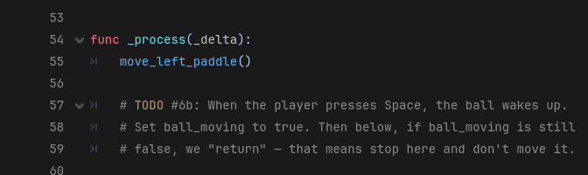
iCode
DAY 1
EMPOWERING FUTURE INNOVATORS
Inside the _process function, near the top.
75

Slide 75
iCode
DAY 1
EMPOWERING FUTURE INNOVATORS
What you're about to write
if Input.is_key_pressed(KEY_SPACE):
ball_moving = true
if ball_moving == false:
return
• What: Two if checks — one listens for Space, one freezes the ball.
• Why: The ball should wait. Without the return, it starts moving the moment the game opens.
• How: Input.is_key_pressed(KEY_SPACE) asks 'is Space held right now?' return stops the rest of the function.
This is one approach — yours works if it runs.
76

Slide 76
iCode
DAY 1
EMPOWERING FUTURE INNOVATORS
TODO #4 — Space key + ball freeze
SYNTAX
WRITE THIS
if Input.is_key_pressed(KEY_SPACE):
variable = true
if variable == false:
return
# if Space is pressed:
# set ball_moving to true
# if ball_moving is false:
# return
Detailed instructions are in your code file, right next to this TODO.
77

Slide 77
iCode
DAY 1
EMPOWERING FUTURE INNOVATORS
It works! The ball waits for Space.
Press F5. The ball sits frozen at the centre until you tap Space. Then it moves.
78

Slide 78
iCode
DAY 1
EMPOWERING FUTURE INNOVATORS
Input is an object
Input.is_key_pressed(KEY_SPACE)
# ↑ ↑
# object verb (ask Input to check a key)
79

Slide 79
iCode
DAY 1
EMPOWERING FUTURE INNOVATORS
There is no ONE right answer in code.
• For any problem in programming, there are thousands — sometimes MILLIONS — of valid solutions.
• The examples on the left side of TODO slides are one way. Your way is just as valid if it works.
• What matters: does it run? does it do what you wanted? If yes — it's correct.
80

Slide 80
iCode
DAY 1
EMPOWERING FUTURE INNOVATORS
Updating a variable
We already know var makes a variable. Now we UPDATE one — read the current value, do some math, put the new value back.
81

Slide 81
iCode
DAY 1
EMPOWERING FUTURE INNOVATORS
What you're about to write
ball.position.x += ball_speed_x
ball.position.y += ball_speed_y
• What: Two lines — move the ball left-right, and up-down, every frame.
• Why: Without this, the ball just sits there. This is the only reason anything moves.
• How: += reads the current value, adds the speed, and puts the result back. Long form x = x + speed also works.
This is one approach — yours works if it runs.
82

Slide 82
iCode
DAY 1
EMPOWERING FUTURE INNOVATORS
TODO #5 — Move the ball
SYNTAX
WRITE THIS
x = x + amount
x += amount
ball.position.x += ball_speed_x
# add ball_speed_x to ball.position.x
# add ball_speed_y to ball.position.y
Detailed instructions are in your code file, right next to this TODO.
83

Slide 83
iCode
DAY 1
EMPOWERING FUTURE INNOVATORS
The ball moves now
Press F5, then Space. The ball drifts off the right side of the screen. That's expected — TODO #6 catches it.
84

Slide 84
iCode
DAY 1
EMPOWERING FUTURE INNOVATORS
if / else
85

Slide 85
iCode
DAY 1
EMPOWERING FUTURE INNOVATORS
else is the OTHERWISE branch.
"When the if is NOT true → run the else block instead."
86

Slide 86
iCode
DAY 1
EMPOWERING FUTURE INNOVATORS
if / else = two paths. ONE always runs.
87

Slide 87
iCode
DAY 1
EMPOWERING FUTURE INNOVATORS
Fork in the road
Sign reads: IF it's daytime → go left. ELSE → go right.
88

Slide 88
iCode
DAY 1
EMPOWERING FUTURE INNOVATORS
IF it's raining → umbrella.
"ELSE → ?"
89

Slide 89
iCode
DAY 1
EMPOWERING FUTURE INNOVATORS
One of the two paths ALWAYS runs.
90

Slide 90
iCode
DAY 1
EMPOWERING FUTURE INNOVATORS
Two-outcome checks are everywhere
• if you have the key → open the door, else → it stays locked
• if HP > 0 → take damage, else → game over
• if input pressed → move, else → idle
91

Slide 91
iCode
DAY 1
EMPOWERING FUTURE INNOVATORS
Today in Pong:
"IF the ball hit the top OR bottom wall → flip its vertical speed. ELSE → let it keep going."
92

Slide 92
iCode
DAY 1
EMPOWERING FUTURE INNOVATORS
What are the borders?
var upper_border = 0 # top of screen
var lower_border = SCREEN_H - BALL_SIZE # = 648 - 20 = 628
93

Slide 93
iCode
DAY 1
EMPOWERING FUTURE INNOVATORS
Why subtract BALL_SIZE?
y = 628 → ball top-left at 628
ball bottom-right at 648 ← just touching the wall ✓
y = 648 → ball has already gone OFF the screen ✗
94

Slide 94
iCode
DAY 1
EMPOWERING FUTURE INNOVATORS
Math figures it out for you.
• Instead of guessing 628, we wrote SCREEN_H - BALL_SIZE.
• If you change the screen size, or the ball size, the border updates automatically — you don't touch it.
• This is why game developers use math: one formula that works for any size, any speed, any screen.
• You'll need this kind of thinking later this week. Keep it in mind.
95

Slide 95
iCode
DAY 1
EMPOWERING FUTURE INNOVATORS
What you're about to write
var upper_border = 0
var lower_border = SCREEN_H - BALL_SIZE
if ball.position.y < upper_border
or ball.position.y > lower_border:
ball_speed_y = -ball_speed_y
else:
pass
• What: Named border variables + an if/else that bounces the ball off the top and bottom.
• Why: Without this, the ball drifts off screen. The or checks both walls in one line.
• How: Negating speed (-ball_speed_y) flips its direction. else: pass means 'otherwise do nothing'.
This is one approach — yours works if it runs.
96

Slide 96
iCode
DAY 1
EMPOWERING FUTURE INNOVATORS
TODO #6 — Wall bounce
SYNTAX
WRITE THIS
var upper_border = 0
var lower_border = SCREEN_H - BALL_SIZE
if A or B:
ball_speed_y = -ball_speed_y
else:
pass
var upper_border = 0
var lower_border = SCREEN_H - BALL_SIZE
# if ball.position.y < upper_border
# or ball.position.y > lower_border:
# flip ball_speed_y (negate it)
# else:
# pass
Detailed instructions are in your code file, right next to this TODO.
97

Slide 97
iCode
DAY 1
EMPOWERING FUTURE INNOVATORS
The ball bounces
Press F5, then Space. The ball ricochets off the top and bottom walls now. It still flies off the LEFT and RIGHT sides — TODO #8 fixes that.
98

Slide 98
iCode
DAY 1
EMPOWERING FUTURE INNOVATORS
if — without an else
Same if from chunk #6b. This time we use it WITHOUT an else. If the check fails → nothing happens (no else, no other path).
99

Slide 99
iCode
DAY 1
EMPOWERING FUTURE INNOVATORS
What you're about to write
if ball.position.x > SCREEN_W:
print("point!")
• What: One if check — if the ball went past the right edge, print a message.
• Why: This is a 'does the if even work?' test before adding real scoring in TODO #8.
• How: print() sends text to the Output panel at the bottom of Godot. Great for debugging.
This is one approach — yours works if it runs.
100

Slide 100
iCode
DAY 1
EMPOWERING FUTURE INNOVATORS
TODO #7 — Print 'point!'
SYNTAX
WRITE THIS
if ball.position.x > SCREEN_W:
print("your message here")
# if ball.position.x is past SCREEN_W:
# print("point!")
Detailed instructions are in your code file, right next to this TODO.
101

Slide 101
iCode
DAY 1
EMPOWERING FUTURE INNOVATORS
See the () after print?
• The () after a name means it's a function — a bundle of code someone already wrote.
• print() is a function that came with GDScript. Someone wrote it so we don't have to.
• We'll learn to write our OWN functions on Day 2.
• reset_ball() (below) is another pre-written function you'll use soon.
102

Slide 102
iCode
DAY 1
EMPOWERING FUTURE INNOVATORS
'point!' shows up
Press F5. Let the ball go past the right edge. Look at the Output panel — point! prints.
103

Slide 103
iCode
DAY 1
EMPOWERING FUTURE INNOVATORS
Comparison operators
104

Slide 104
iCode
DAY 1
EMPOWERING FUTURE INNOVATORS
> and <
• > means GREATER THAN
• < means LESS THAN
105

Slide 105
iCode
DAY 1
EMPOWERING FUTURE INNOVATORS
Use them inside if
if score > 5:
print("winning")
106

Slide 106
iCode
DAY 1
EMPOWERING FUTURE INNOVATORS
The rollercoaster
YOU MUST BE THIS TALL → 48 inches
107

Slide 107
iCode
DAY 1
EMPOWERING FUTURE INNOVATORS
You're 50 inches tall.
"Can you ride? What's the check? your_height > 48 — true or false?"
108

Slide 108
iCode
DAY 1
EMPOWERING FUTURE INNOVATORS
> and < let if compare two numbers.
109

Slide 109
iCode
DAY 1
EMPOWERING FUTURE INNOVATORS
Games are constantly comparing numbers
• is score > high score?
• is health < 20%?
• is enemy distance < 100 pixels?
• is timer == 0?
110

Slide 110
iCode
DAY 1
EMPOWERING FUTURE INNOVATORS
Today in Pong:
"Is the ball past the right edge? (ball.x > SCREEN_W) → left player scores. Past the left edge? (ball.x < 0) → right player scores."
111

Slide 111
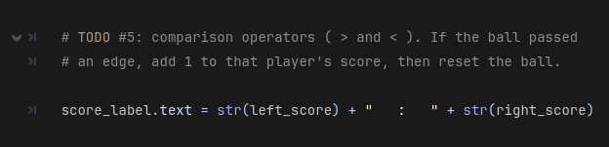
iCode
DAY 1
EMPOWERING FUTURE INNOVATORS
Same area you put the print(\"point!\") test. We're upgrading it to real scoring.
112

Slide 112
iCode
DAY 1
EMPOWERING FUTURE INNOVATORS
What you're about to write
if ball.position.x > SCREEN_W:
left_score += 1
reset_ball()
if ball.position.x < 0:
right_score += 1
reset_ball()
• What: Two if blocks — one for each edge. Ball exits right → left player scores. Ball exits left → right player scores.
• Why: TODO #7 just printed text. This upgrades it to real scoring with the counter you set up in TODO #1.
• How: reset_ball() is pre-written for you — it moves the ball back to centre. += 1 adds one point.
This is one approach — yours works if it runs.
113

Slide 113
iCode
DAY 1
EMPOWERING FUTURE INNOVATORS
TODO #8 — Real scoring
SYNTAX
WRITE THIS
left_score += 1
reset_ball()
if ball.position.x > SCREEN_W:
...
if ball.position.x < 0:
...
# if ball passed right edge (> SCREEN_W):
# add 1 to left_score
# call reset_ball()
# if ball passed left edge (< 0):
# add 1 to right_score
# call reset_ball()
Detailed instructions are in your code file, right next to this TODO.
114

Slide 114
iCode
DAY 1
EMPOWERING FUTURE INNOVATORS
The scoreboard counts!
Press F5, then Space. Score a point past either edge. The number at the top of the screen jumps up.
115

Slide 115
iCode
DAY 1
EMPOWERING FUTURE INNOVATORS
Personalization Break — Make it yours
• The ball bounces and scoring works. Pause and make this Pong YOURS:
• • Change ball_speed_x and ball_speed_y — how fast do you want it?
• • Change paddle_speed — is it too slow? Too fast?
• • Change ball/paddle colour in the Inspector (click Main node → Ball Color)
• Save (Ctrl+S) and run (F5) after each change.
116

Slide 116
iCode
DAY 1
EMPOWERING FUTURE INNOVATORS
Remember your silly variables from TODO #2?
Time to put them ON SCREEN. But there's one problem — the scoreboard only holds text, and your variables are numbers. We need to convert them.
117

Slide 117
iCode
DAY 1
EMPOWERING FUTURE INNOVATORS
str() — turns a number into text
str(99) # → "99" (the number 99 as text)
str(skibidi_speed) # → "99" (whatever value the variable holds)
118

Slide 118
iCode
DAY 1
EMPOWERING FUTURE INNOVATORS
Joining text pieces with +
"Speed: " + str(skibidi_speed) # → "Speed: 99"
"★ " + str(gyatt_factor) + " ★" # → "★ 42 ★"
119

Slide 119
iCode
DAY 1
EMPOWERING FUTURE INNOVATORS
Appending with +=
score_label.text += " ★ " + str(skibidi_speed)
# reads: "stick this onto the end of whatever's already there"
120

Slide 120
iCode
DAY 1
EMPOWERING FUTURE INNOVATORS
What you're about to write
score_label.text += " ★ " + str(skibidi_speed) + " ★ " + str(gyatt_factor)
• What: One line that appends your silly variables onto the scoreboard text.
• Why: Your variables from TODO #2 have been sitting there doing nothing. Now they show up live in the game.
• How: str() converts a number to text. + joins text pieces. += adds to what's already on the scoreboard.
This is one approach — yours works if it runs.
121

Slide 121
iCode
DAY 1
EMPOWERING FUTURE INNOVATORS
TODO #9 — Scoreboard personalisation
SYNTAX
WRITE THIS
str(your_variable)
"label: " + str(variable)
score_label.text += " more text"
score_label.text += " ★ " + str(x)
# append first silly var to score_label.text
# use str() to convert it, + to join with a label
# append second silly var too
# add stars, emojis, labels if you want
Detailed instructions are in your code file, right next to this TODO.
122

Slide 122
iCode
DAY 1
EMPOWERING FUTURE INNOVATORS
Your variables, live on the scoreboard
Run it. The scoreboard now shows your silly variables right next to the score. Have your neighbour read theirs out loud.
123

Slide 123
iCode
DAY 1
EMPOWERING FUTURE INNOVATORS
Make it yours — Personalization Sessions
More ways to make this Pong YOUR Pong. Pick any, in any order.
124

Slide 124
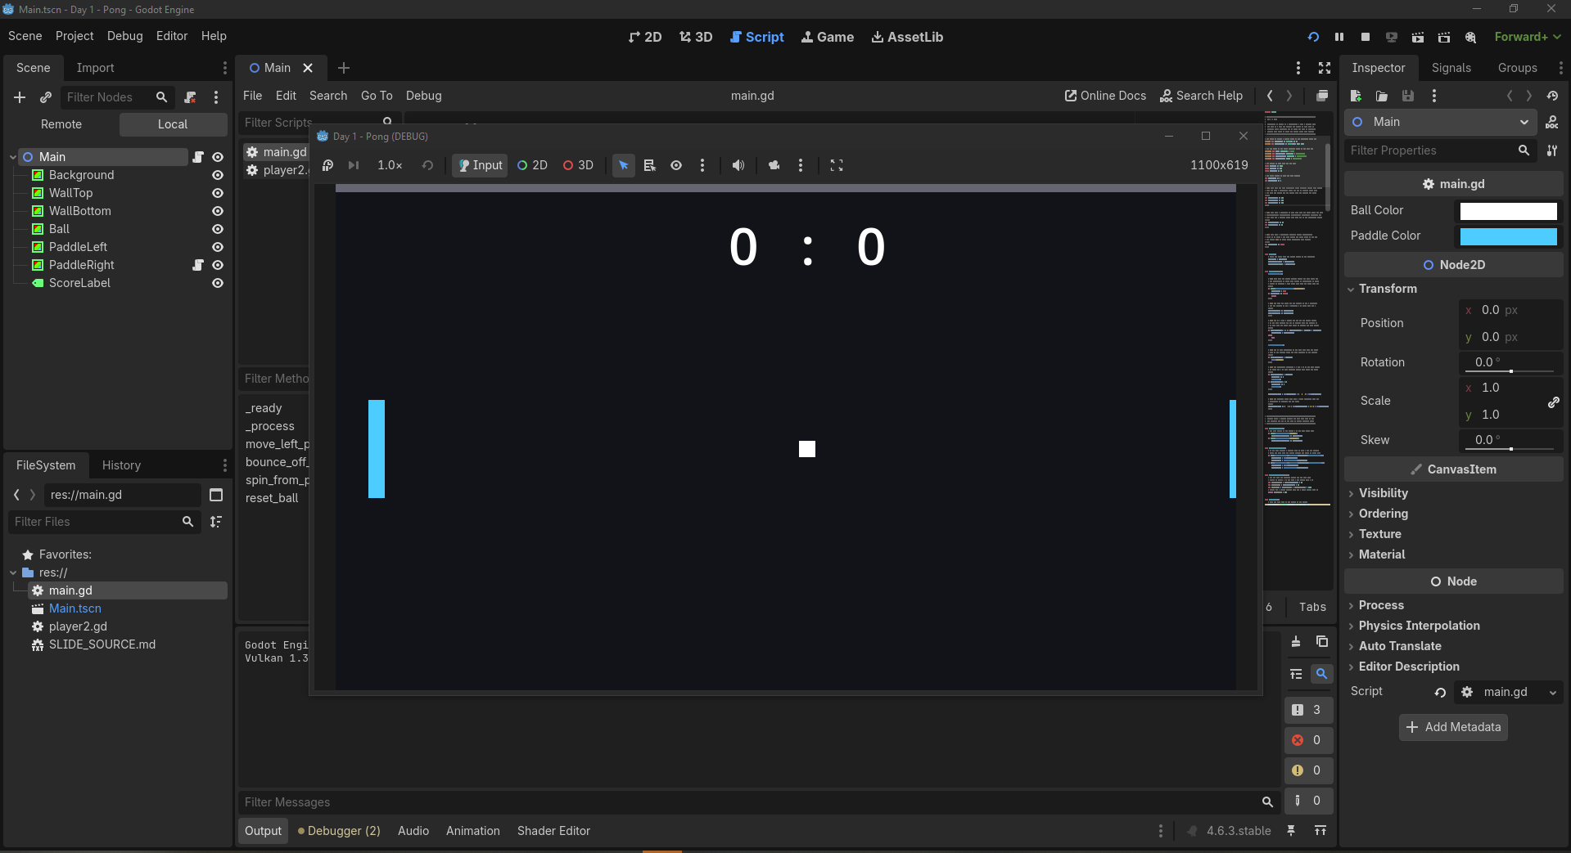
iCode
DAY 1
EMPOWERING FUTURE INNOVATORS
Run the game, then look at the Inspector on the right. Ball Color and Paddle Color are right there — click a swatch, pick any colour, then Save (Ctrl+S) and run (F5).
125

Slide 125
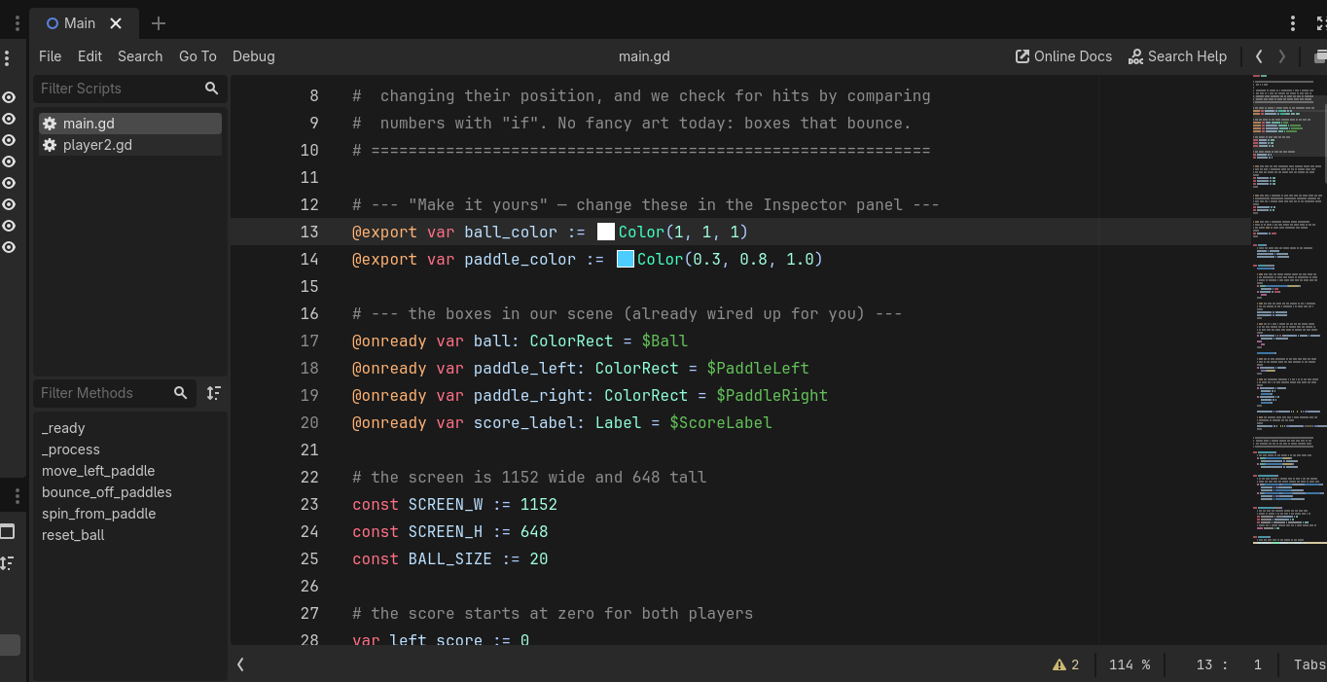
iCode
DAY 1
EMPOWERING FUTURE INNOVATORS
At the top of main.gd, two lines define them: @export var ball_color and @export var paddle_color. The magic word @export is what makes a variable show up in the Inspector.
126

Slide 126
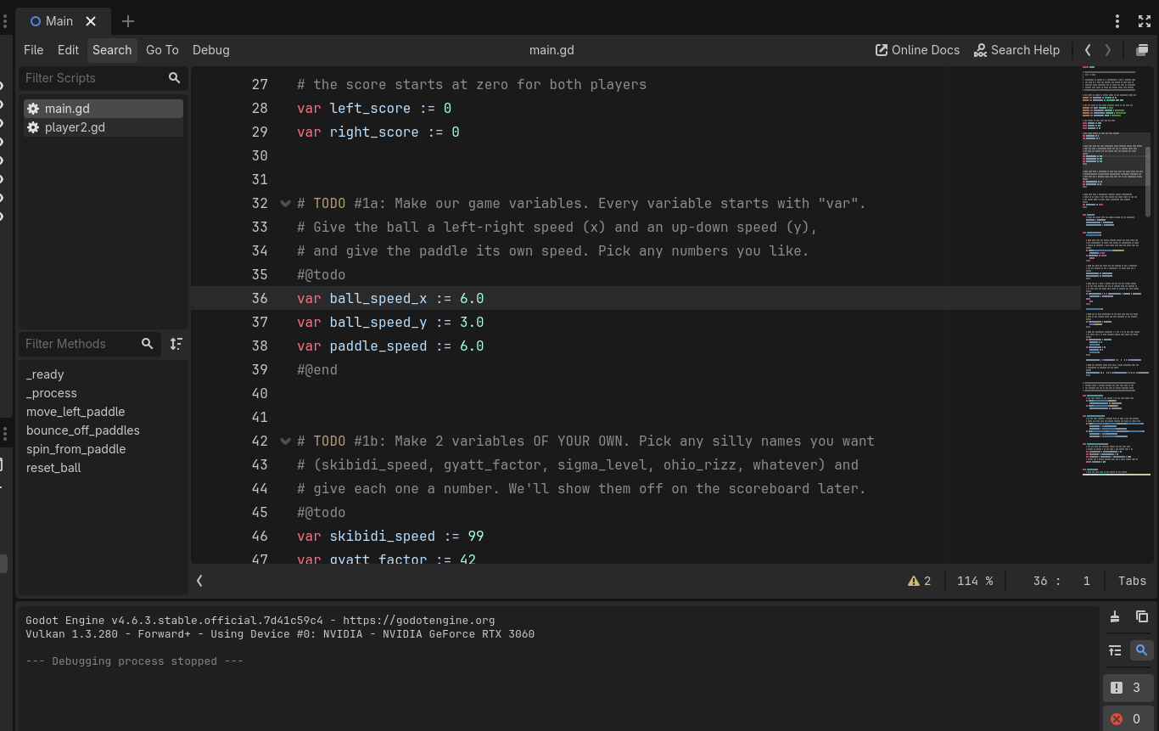
iCode
DAY 1
EMPOWERING FUTURE INNOVATORS
In main.gd, find your TODO #2 variables. Rename them to something even funnier. Then find TODO #9 (the scoreboard) and update the name there too — they must match.
127

Slide 127
iCode
DAY 1
EMPOWERING FUTURE INNOVATORS
Final Challenge — make Pong 2-player
• Open player2.gd (it's on the PaddleRight node). Two TODOs inside:
• FC-1 — comment out the AI (right paddle plays itself → should sit still)
• FC-2 — add I/K key movement for a real second player
• FC-3 (bonus) — random ball respawn angle with randf_range()
• You already did every piece this morning. Give it a whirl.
128

Slide 128
iCode
DAY 1
EMPOWERING FUTURE INNOVATORS
FC-1 + FC-2 — AI off, real player on
SYNTAX
WRITE THIS
# FC-1 — comment out (Ctrl+K)
# put # at start of each AI line
if Input.is_key_pressed(KEY_I):
position.y -= paddle_speed
if Input.is_key_pressed(KEY_K):
position.y += paddle_speed
# FC-1: comment out ALL 5 AI lines
# (select + Ctrl+K, or add # manually)
# paddle should now sit still
# FC-2: add I/K key movement
# if I key pressed → move UP
# if K key pressed → move DOWN
Detailed instructions are in your code file, right next to this TODO.
129

Slide 129
iCode
DAY 1
EMPOWERING FUTURE INNOVATORS
FC-3 (Bonus) — Random ball respawn angle
SYNTAX
WRITE THIS
const ANGLE_MIN := -45.0
const ANGLE_MAX := 45.0
var angle = randf_range(ANGLE_MIN, ANGLE_MAX)
ball_speed_x = cos(deg_to_rad(angle)) * 6.0
ball_speed_y = sin(deg_to_rad(angle)) * 6.0
# in reset_ball(), after position reset:
# define ANGLE_MIN and ANGLE_MAX constants
# pick a random angle with randf_range()
# convert to x speed using cos(deg_to_rad())
# convert to y speed using sin(deg_to_rad())
Detailed instructions are in your code file, right next to this TODO.
130

Slide 130
iCode
DAY 1
EMPOWERING FUTURE INNOVATORS
Day 1 assets: none
Day 1 used zero imported art. Every visible thing on screen was a ColorRect — a coloured box drawn by code. From Day 2 on, we bring in real art with Kenney.nl asset packs.
131

Slide 131
iCode
DAY 1
EMPOWERING FUTURE INNOVATORS
Take it home
Turn your Pong into a real Windows program — a .exe you can run on any PC, no Godot needed. Show your family tonight.
132

Slide 132
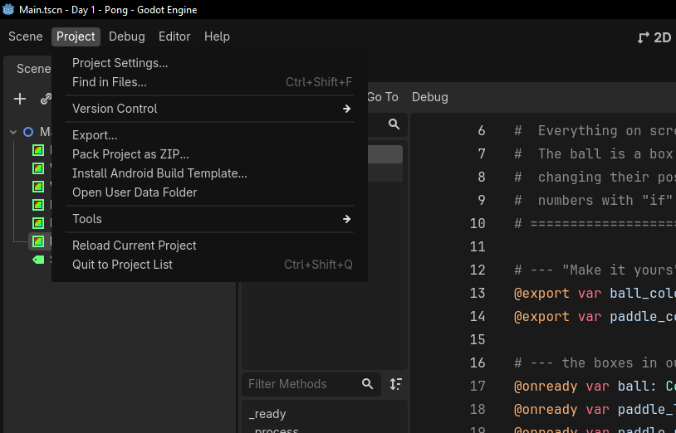
iCode
DAY 1
EMPOWERING FUTURE INNOVATORS
In the top menu bar, click Project, then Export…
133

Slide 133
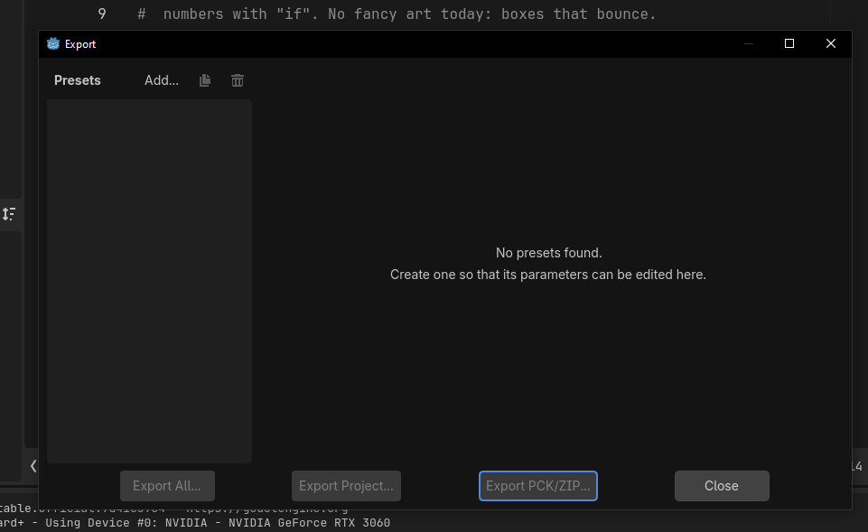
iCode
DAY 1
EMPOWERING FUTURE INNOVATORS
The Export window opens. It's empty the first time — click Add… at the top to add a target.
134

Slide 134
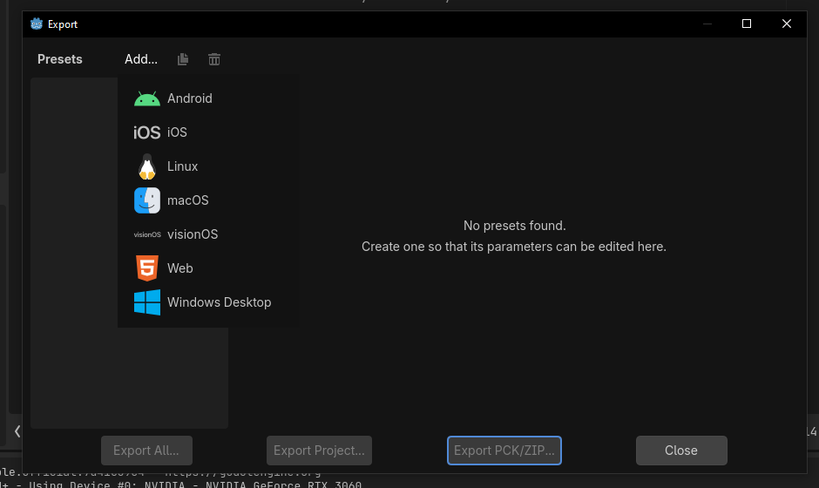
iCode
DAY 1
EMPOWERING FUTURE INNOVATORS
From the list, pick Windows Desktop — that's the kind of program Windows PCs run.
135

Slide 135
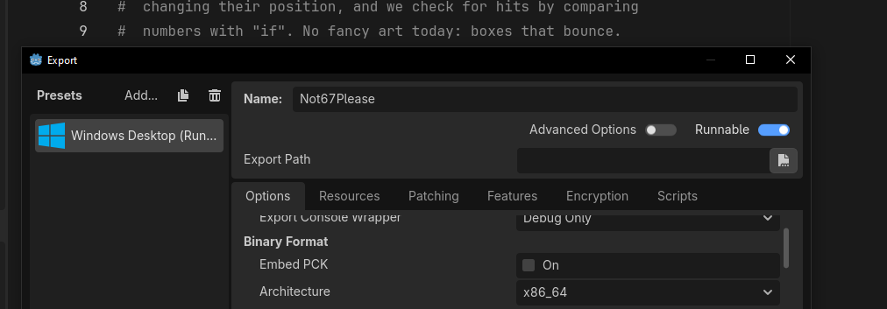
iCode
DAY 1
EMPOWERING FUTURE INNOVATORS
Godot adds a Windows Desktop preset on the left. Leave the options as they are — Runnable on, Architecture x86_64.
136

Slide 136
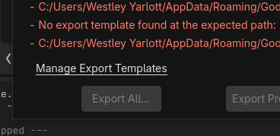
iCode
DAY 1
EMPOWERING FUTURE INNOVATORS
The first time on a new PC you may see a red 'No export template found' message. Click Manage Export Templates to fix it.
137

Slide 137
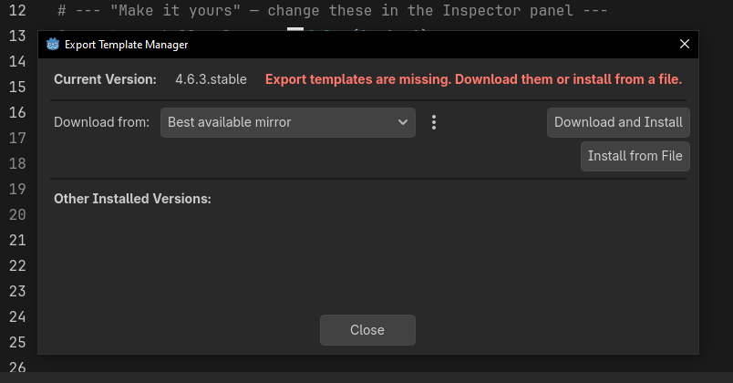
iCode
DAY 1
EMPOWERING FUTURE INNOVATORS
In the Export Template Manager, click Download and Install. Let it finish, then close. (One-time setup per computer.)
138

Slide 138
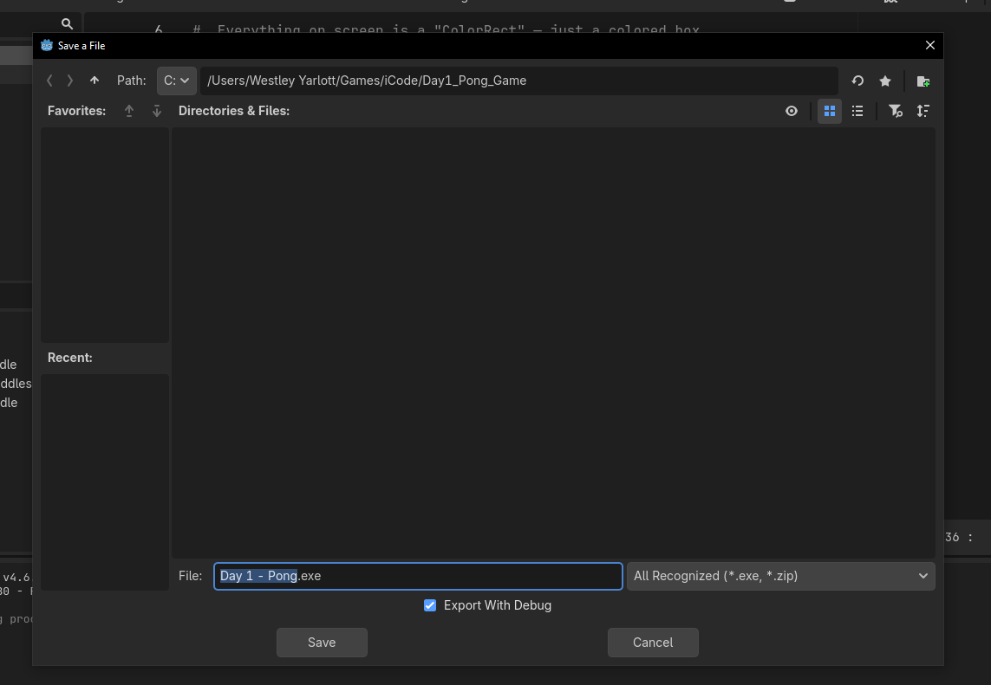
iCode
DAY 1
EMPOWERING FUTURE INNOVATORS
Click Export Project, type a name (e.g. Day 1 - Pong), pick your folder, and click Save. Godot builds your game.
139

Slide 139
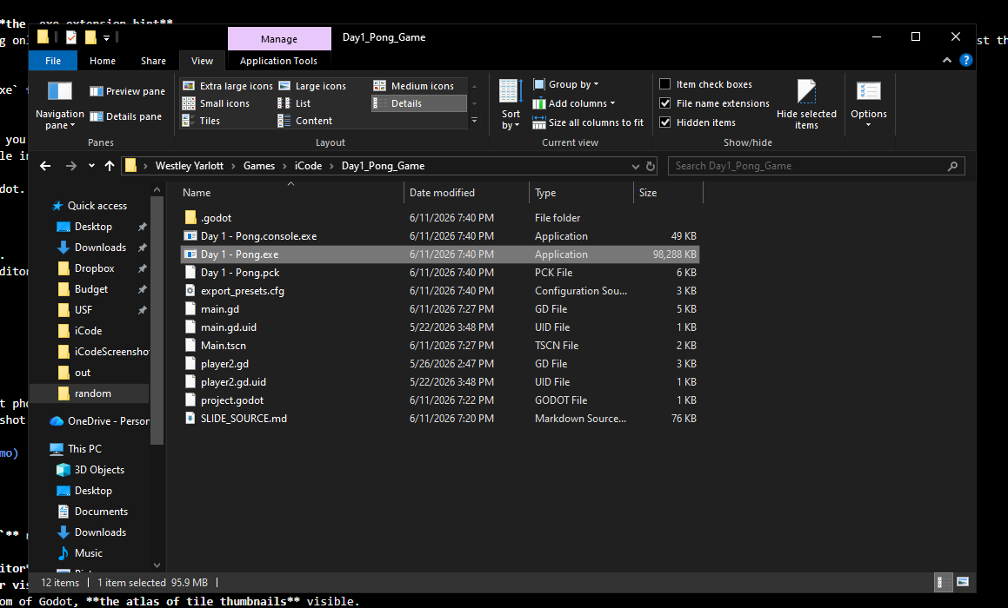
iCode
DAY 1
EMPOWERING FUTURE INNOVATORS
Godot writes Day 1 - Pong.exe plus a .pck data file into your folder. Double-click the .exe — your Pong runs with no Godot needed. Keep the two files together.
140

Slide 140
iCode
DAY 1
EMPOWERING FUTURE INNOVATORS
It's really yours now
Copy that folder to a USB stick or send it to a friend. It runs on any Windows PC. You built and shipped a real game on day one.
141

Slide 141
iCode
DAY 1
EMPOWERING FUTURE INNOVATORS
Tomorrow: Pac-Man
1980. The next leap. We trade coloured rectangles for tiles — and learn loops and functions to bring a whole maze to life.
142

