Slide 1

iCode
DAY 4
EMPOWERING FUTURE INNOVATORS
Day 4 — 2-Player Fighter · 1999 · Smash Bros Era
1

Slide 2
iCode
DAY 4
EMPOWERING FUTURE INNOVATORS
Why fighters matter
• 1984: Karate Champ — two-player on one screen, invented the genre.
• 1992: Street Fighter II goes to arcades — quarter-eating, combos, characters with personalities.
• 1999: Super Smash Bros — stock lives, platform stages, no health bars, four players. Chaos perfected.
• 2D fighters are the petri dish where character stats, state machines, and hitboxes were invented.
2

Slide 3
iCode
DAY 4
EMPOWERING FUTURE INNOVATORS
Yesterday → Today
• D3: Functions + Lists — every enemy is a dict in a list; functions scan it every frame.
• D4: Objects + State — every fighter is an object that remembers its own HP and knows what it's doing right now.
• Shift: from "a list of dicts" → "a class that gives each fighter its own memory."
3

Slide 4
iCode
DAY 4
EMPOWERING FUTURE INNOVATORS
5-day arc
• D1: Variables + Conditions — Racer
• D2: Loops + Functions (intro) — Maze
• D3: Functions (deep) + Lists — Base Defense
• D4: Objects + State — Fighter ← you are here
• D5: No new code — Showcase
4

Slide 5
iCode
DAY 4
EMPOWERING FUTURE INNOVATORS
Two new ideas today
• OBJECTS — a fighter that remembers its own stats and handles its own damage.
• STATE — a fighter that knows what it's doing right now (idle / walk / jump / attack / hit / dead).
5

Slide 6
iCode
DAY 4
EMPOWERING FUTURE INNOVATORS
GDScript uses extends instead of inheriting from object, and func instead of def — everything else transfers directly to Python.
Pattern (board example):
# Python
class Panda:
def __init__(self):
self.hp = 100
def take_damage(self, n):
self.hp -= n
p = Panda()
p.take_damage(10)
6

Slide 7
iCode
DAY 4
EMPOWERING FUTURE INNOVATORS
Pre-coding setup
7

Slide 8
iCode
DAY 4
EMPOWERING FUTURE INNOVATORS
Open the Day 4 project
• Open the Day 4 Fighter project the same way you did yesterday.
8

Slide 9
iCode
DAY 4
EMPOWERING FUTURE INNOVATORS
Open Day 4 — hint
• Godot launcher → Import → navigate to Day4_Fighter_Game/project.godot → Import & Edit
9

Slide 10
iCode
DAY 4
EMPOWERING FUTURE INNOVATORS
Open player.gd
• Open player.gd in the script editor — this is where most of today's chunks live.
10

Slide 11
iCode
DAY 4
EMPOWERING FUTURE INNOVATORS
Open player.gd — hint
• FileSystem panel (lower-left) → player.gd → double-click → Script editor opens.
11

Slide 12
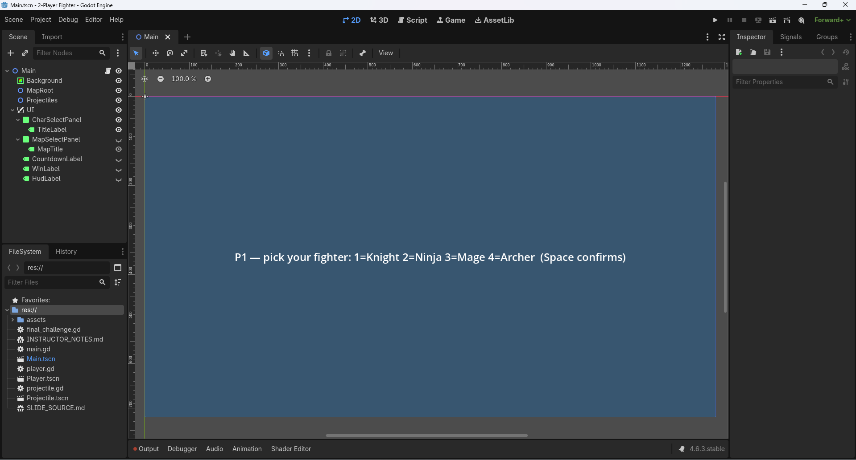
iCode
DAY 4
EMPOWERING FUTURE INNOVATORS
The menus already work
12

Slide 13
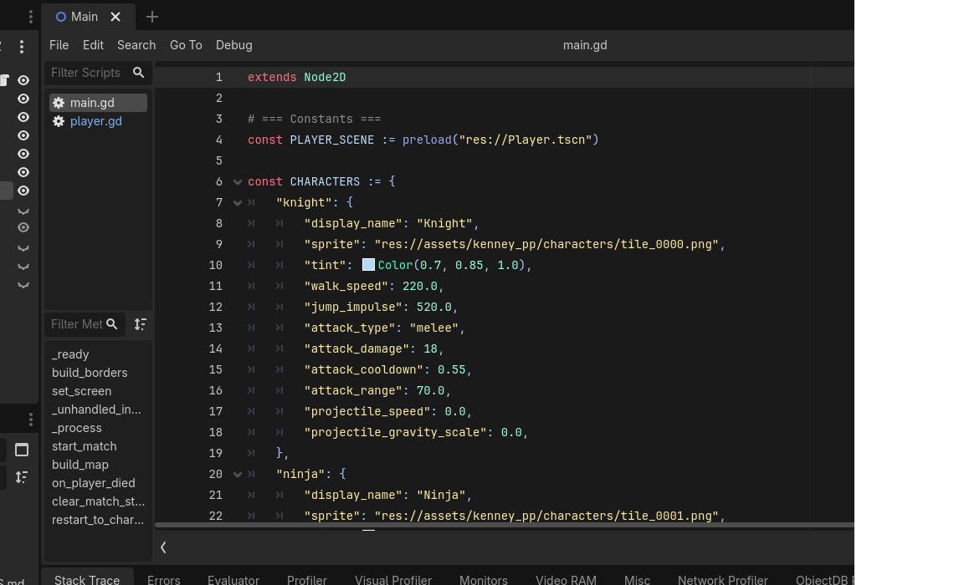
iCode
DAY 4
EMPOWERING FUTURE INNOVATORS
The CHARACTERS dict
13

Slide 14
iCode
DAY 4
EMPOWERING FUTURE INNOVATORS
11 properties per character
• display_name — shown in char-select panel
• sprite — path to the Kenney sprite PNG
• tint — Color(R, G, B) tint applied via Modulate
• walk_speed — pixels/second horizontal movement
• jump_impulse — upward velocity on jump
• attack_type — "melee" or "projectile"
• attack_damage — HP removed per hit
• attack_cooldown — seconds between attacks
• attack_range — melee reach in pixels
• projectile_speed — speed of fired projectile
• projectile_gravity_scale — how fast projectile falls
14

Slide 15
iCode
DAY 4
EMPOWERING FUTURE INNOVATORS
Each character is a dict. Each fighter will be an object.
• Right now: characters are dicts — plain data, no behaviour.
• Today: the Player class gets the same property names — so each Player object owns its own copy of those values.
• When setup() runs, it copies from the dict into the object. Knight's walk_speed → self.walk_speed.
15

Slide 16
iCode
DAY 4
EMPOWERING FUTURE INNOVATORS
Meet the pandas
16

Slide 17
iCode
DAY 4
EMPOWERING FUTURE INNOVATORS
OBJECT
An object is a thing in code that remembers its own data.
17

Slide 18
iCode
DAY 4
EMPOWERING FUTURE INNOVATORS
Blueprint vs panda
• Class = the blueprint. Describes what kind of data a panda has. Written once.
• Instance = one actual panda, created from that blueprint. Has its own copy of every property.
• Three pandas on screen → three instances. One blueprint → the Panda class.
18

Slide 19
iCode
DAY 4
EMPOWERING FUTURE INNOVATORS
Properties + Methods
• Property = a piece of data the object remembers. hp, hunger, personality.
• Method = something the object can do. eat(), take_damage(), die().
• Every instance has its own property values — but shares the same methods.
19

Slide 20
iCode
DAY 4
EMPOWERING FUTURE INNOVATORS
Quick check
• Panda A: hp = 80, hunger = 30.
• P1 attacks Panda A → take_damage(15) → Panda A hp = 65.
• Does Panda B's hp change?
• Answer: No. Each instance has its own hp. Damage to A doesn't touch B.
20

Slide 21
iCode
DAY 4
EMPOWERING FUTURE INNOVATORS
Panda class in GDScript
class Panda:
var hp := 100
var hunger := 0
var personality := "lazy"
func take_damage(amount):
hp -= amount
if hp <= 0:
die()
func die():
print(personality, " panda fainted")
21

Slide 22
iCode
DAY 4
EMPOWERING FUTURE INNOVATORS
7 panda personalities
• lazy — sits around, minimal movement
• playful — chases other pandas
• aggressive — attacks on sight
• nervous — runs away
• hungry — seeks bamboo
• sleepy — falls asleep mid-fight
• sneezy — random sneeze knocks back nearby pandas
22

Slide 23
iCode
DAY 4
EMPOWERING FUTURE INNOVATORS
Objects everywhere in games
• Every enemy is an object — its own HP, position, and AI state.
• Every bullet is an object — its own speed, direction, and damage.
• Every item on the ground is an object — its own type and pickup range.
• The game loop just calls methods on them: enemy.update(delta), bullet.move(delta).
23

Slide 24
iCode
DAY 4
EMPOWERING FUTURE INNOVATORS
One class. Two fighters.
• One Player class (in player.gd).
• Instantiated twice — once for P1, once for P2.
• Each instance has its own hp, state, position, and character stats.
• They share the same methods: take_damage(), attack(), set_state().
24

Slide 25
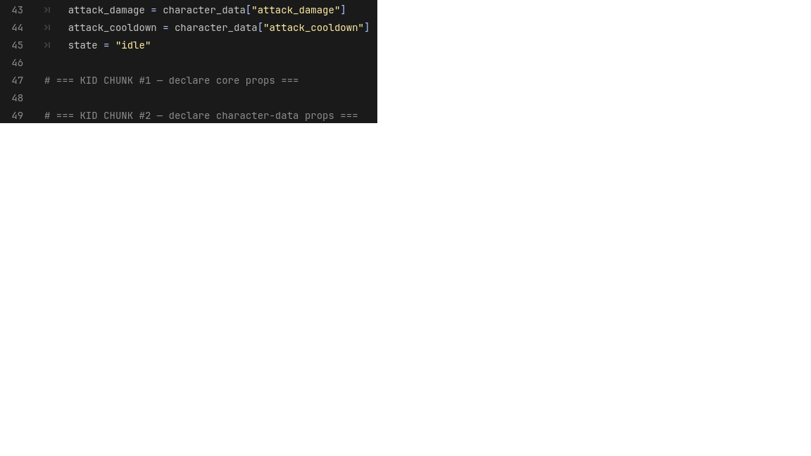
iCode
DAY 4
EMPOWERING FUTURE INNOVATORS
Where you'll type it — player.gd:48-52
25

Slide 26
iCode
DAY 4
EMPOWERING FUTURE INNOVATORS
Declare the three things every Player needs to remember about itself: hp (start at 100), max_hp (also 100, for the HP bar), and facing (start at 1 = looking right).
Pattern (board example):
Where in your code (Godot):
# Panda analogy:
class Panda:
var hp := 100
var max_hp := 100
var facing := 1
26

Slide 27
iCode
DAY 4
EMPOWERING FUTURE INNOVATORS
No visible payoff yet
Chunk #1 adds properties the game will use — but nothing appears on screen until chunk #4. Keep going.
27

Slide 28
iCode
DAY 4
EMPOWERING FUTURE INNOVATORS
Run the game — confirm no errors
• Run the game and confirm it opens without errors.
28

Slide 29
iCode
DAY 4
EMPOWERING FUTURE INNOVATORS
Walk C — hint
• Press F5 → "Set Main Scene?" → Select Current → game window opens.
• Press F8 to stop.
29

Slide 30
iCode
DAY 4
EMPOWERING FUTURE INNOVATORS
Game didn't open? Find the error.
• Game didn't open? Find the error.
30

Slide 31
iCode
DAY 4
EMPOWERING FUTURE INNOVATORS
Walk D — hint
• Output panel (bottom) → look for red text or a blue underlined line number.
• Click the blue line number → jumps to the error in the script.
• Fix the typo → Ctrl+S → F5 again.
31

Slide 32
iCode
DAY 4
EMPOWERING FUTURE INNOVATORS
Remember what KIND of panda it is
Every fighter has different stats — Knight hits hard, Ninja moves fast. Those differences live in the CHARACTERS dict. Now we pull them into the object.
32

Slide 33
iCode
DAY 4
EMPOWERING FUTURE INNOVATORS
Dict → setup() → object vars
• The CHARACTERS dict in main.gd holds raw stat values for each character.
• setup(char_key, player_num) runs once when a fighter spawns — it reads the dict and copies values into self properties.
• After setup(), the fighter knows its own walk_speed, attack_damage, etc. — no more looking up the dict.
33

Slide 34
iCode
DAY 4
EMPOWERING FUTURE INNOVATORS
Quick check
• P1 picks Knight (walk_speed: 220.0). P2 picks Ninja (walk_speed: 310.0).
• After setup() runs for each fighter, what is p1.walk_speed? What is p2.walk_speed?
• Answer: p1.walk_speed = 220.0, p2.walk_speed = 310.0. Independent copies.
34

Slide 35

iCode
DAY 4
EMPOWERING FUTURE INNOVATORS
Where you'll type it — player.gd:54-61
35

Slide 36
iCode
DAY 4
EMPOWERING FUTURE INNOVATORS
Declare five more properties — walk_speed, jump_impulse, attack_type, attack_damage, attack_cooldown — with Knight's stats as defaults (see main.gd:6-59 CHARACTERS[\"knight\"]). setup() overwrites them with the picked character's stats.
Pattern (board example):
Where in your code (Godot):
# In main.gd CHARACTERS["knight"]:
"walk_speed": 220.0,
"jump_impulse": 540.0,
"attack_type": "melee",
"attack_damage": 15,
"attack_cooldown": 0.5,
36

Slide 37
iCode
DAY 4
EMPOWERING FUTURE INNOVATORS
Teach the panda how to lose HP
Properties store data. Methods make the object do something. Now we write the fighter's first method.
37

Slide 38
iCode
DAY 4
EMPOWERING FUTURE INNOVATORS
A method changes an object's own data
class Panda:
var hunger := 50
func feed():
hunger -= 10
print("Panda ate. Hunger now:", hunger)
38

Slide 39
iCode
DAY 4
EMPOWERING FUTURE INNOVATORS
Pieces already in the file
• hp — the property you declared in chunk #1.
• max_hp — also from chunk #1; used to compute HP bar fill ratio.
• hit_flash_timer — pre-given float; set it to 0.2 to trigger a flash effect.
• set_state(new_state) — pre-given stub (chunk #5 fills it); call it with "hit".
• die() — pre-given method; call it when hp hits zero.
• $HPBar — pre-given node; set scale.x = hp / max_hp to shrink the bar.
39

Slide 40
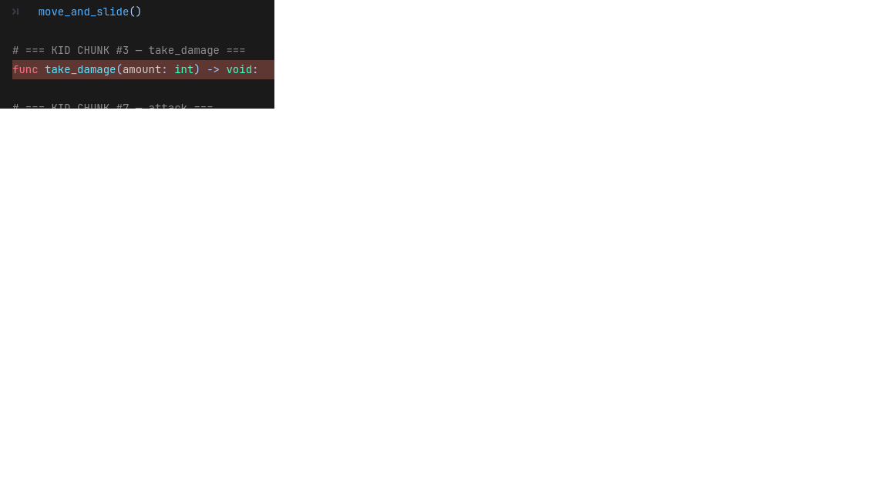
iCode
DAY 4
EMPOWERING FUTURE INNOVATORS
Where you'll type it — player.gd:167-176
40

Slide 41
iCode
DAY 4
EMPOWERING FUTURE INNOVATORS
Subtract amount from hp, set hit_flash_timer to 0.2, switch state to \"hit\", shrink the HP bar to match the new hp/max_hp ratio, and call die() if hp dropped to zero.
Pattern (board example):
Where in your code (Godot):
# Panda analogy:
func take_damage(amount):
hp -= amount
hit_flash_timer = 0.2
set_state("hit")
$HPBar.scale.x = hp / max_hp
if hp <= 0:
die()
41

Slide 42
iCode
DAY 4
EMPOWERING FUTURE INNOVATORS
Time to spawn two of them
The Player class exists. The properties are declared. Now we create two instances — one for each player — and put them in the scene.
42

Slide 43
iCode
DAY 4
EMPOWERING FUTURE INNOVATORS
Panda.new() × 2
# Two independent instances from one blueprint
var panda_a = Panda.new()
var panda_b = Panda.new()
panda_a.hp = 80 # only A changes
print(panda_b.hp) # still 100 — B is unaffected
43

Slide 44
iCode
DAY 4
EMPOWERING FUTURE INNOVATORS
In Godot: PLAYER_SCENE.instantiate()
• Panda.new() in plain GDScript = PLAYER_SCENE.instantiate() in Godot.
• Both create a fresh copy of the blueprint.
• After instantiate(), call add_child() to put it in the scene tree, then setup() to load character data.
44

Slide 45
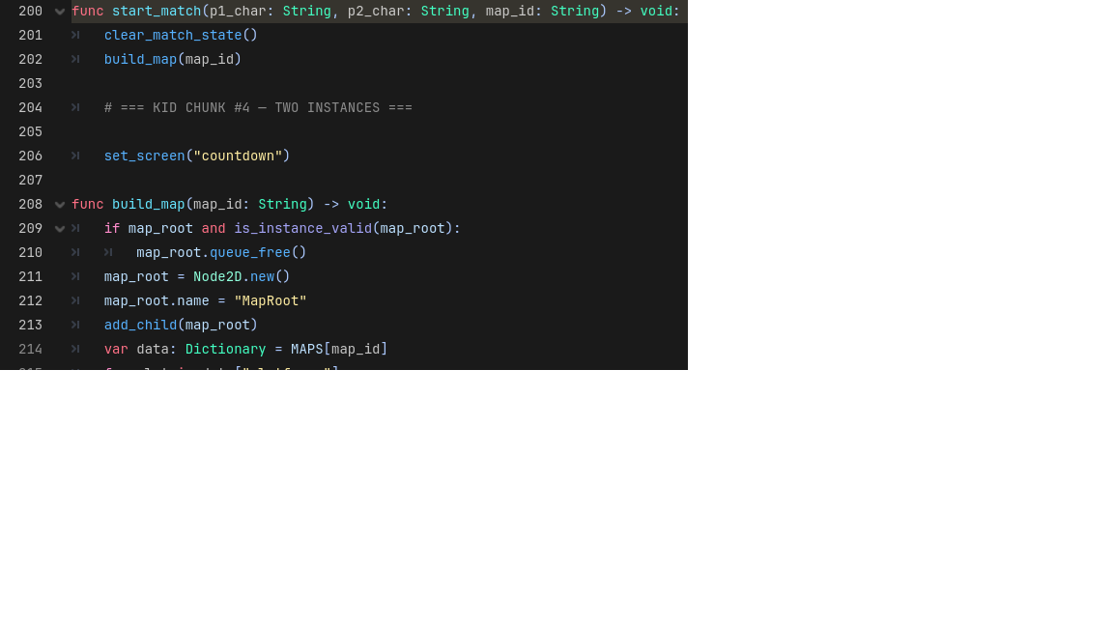
iCode
DAY 4
EMPOWERING FUTURE INNOVATORS
Where you'll type it — main.gd:205-212
45

Slide 46
iCode
DAY 4
EMPOWERING FUTURE INNOVATORS
Instantiate the Player scene twice — once for Player 1, once for Player 2. Add each to the tree and call setup() — Player 1 at Vector2(200, 500), Player 2 at Vector2(1080, 500).
Pattern (board example):
Where in your code (Godot):
# Panda analogy:
var panda_a = Panda.new()
add_child(panda_a)
var panda_b = Panda.new()
add_child(panda_b)
46

Slide 47
iCode
DAY 4
EMPOWERING FUTURE INNOVATORS
Objects can change mode.
47

Slide 48
iCode
DAY 4
EMPOWERING FUTURE INNOVATORS
What does the light know?
48

Slide 49
iCode
DAY 4
EMPOWERING FUTURE INNOVATORS
STATE
A state is a mode — one string that tells the object what it's doing right now.
49

Slide 50
iCode
DAY 4
EMPOWERING FUTURE INNOVATORS
State controls behavior
| State | What the light does | |-------|-------------------| | "red" | Cars must stop. Pedestrians walk. | | "yellow" | Cars slow down. No new pedestrians. | | "green" | Cars go. Pedestrians wait. |
50

Slide 51
iCode
DAY 4
EMPOWERING FUTURE INNOVATORS
States change on events
• Timer runs out → "red" → "green"
• Timer runs out → "green" → "yellow"
• Timer runs out → "yellow" → "red"
• A state machine: a set of states + the rules for switching between them.
51

Slide 52
iCode
DAY 4
EMPOWERING FUTURE INNOVATORS
State machine in GDScript
class TrafficLight:
var state := "red"
func tick(delta):
match state:
"red":
cars_must_stop()
"yellow":
cars_slow_down()
"green":
cars_go()
func set_state(new_state):
if new_state == state:
return
state = new_state
52

Slide 53
iCode
DAY 4
EMPOWERING FUTURE INNOVATORS
Quick check
• Traffic light is "red". A pedestrian presses the crossing button.
• set_state("green") is called.
• What happens? What is state after the call?
• Answer: state becomes "green". On next tick(), cars_go() runs instead of cars_must_stop().
53

Slide 54
iCode
DAY 4
EMPOWERING FUTURE INNOVATORS
Your fighter's 6 states
• "idle" → stand still; press move → "walk"; press jump → "jump"
• "walk" → move; release → "idle"; jump key → "jump"
• "jump" → rising; velocity flips → "fall"
• "fall" → falling; land → "idle"
• "attack" → swing/fire; timer done → "idle" (pre-given)
• "hit" → flash; timer done → "idle" (pre-given)
• "dead" → terminal; no transitions out (pre-given)
54

Slide 55
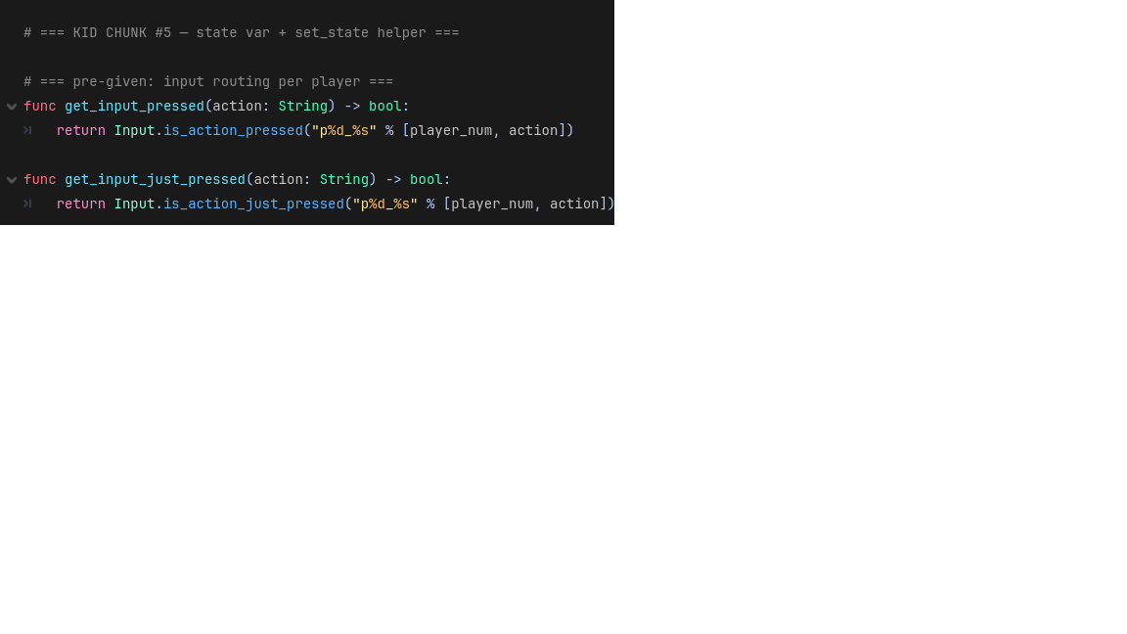
iCode
DAY 4
EMPOWERING FUTURE INNOVATORS
Where you'll type it — player.gd:63-72
55

Slide 56
iCode
DAY 4
EMPOWERING FUTURE INNOVATORS
Declare state (start at \"idle\"). In set_state(new_state): return if it matches the current state, otherwise print new_state and update state.
Pattern (board example):
Where in your code (Godot):
# Traffic light analogy:
var state := "red"
func set_state(new_state):
if new_state == state:
return
print(new_state)
state = new_state
56

Slide 57
iCode
DAY 4
EMPOWERING FUTURE INNOVATORS
No new visible payoff
State is declared. But nothing reacts to it yet — chunk #6 fills the branches. Keep going.
57

Slide 58
iCode
DAY 4
EMPOWERING FUTURE INNOVATORS
Use the state — make the panda behave per state
The state string exists. Now write the rules: what does each state DO every frame?
58

Slide 59
iCode
DAY 4
EMPOWERING FUTURE INNOVATORS
match state: — six branches
• _physics_process(delta) runs every frame (~60×/second).
• Inside it: match state: checks the current state string.
• Six branches: "idle", "walk", "jump", "fall", "attack", "hit".
• Each branch runs ONLY when the fighter is in that state.
59

Slide 60
iCode
DAY 4
EMPOWERING FUTURE INNOVATORS
What's written vs what you write
• Pre-given (gray):
• The match state: dispatcher itself
• Velocity application (gravity, horizontal movement)
• attack branch (full — you wrote attack() in chunk #7)
• hit branch (full — uses hit_flash_timer)
• dead branch (full — freezes the fighter)
• You write (red — 4 holes):
• Inside "idle": when to switch to "walk" and "jump"
• Inside "walk": when to switch to "idle" and "jump"
• Inside "jump": when to switch to "fall"
• Inside "fall": when to switch to "idle"
60

Slide 61
iCode
DAY 4
EMPOWERING FUTURE INNOVATORS
get_move_direction() helper
# Pre-given helper — already in player.gd
func get_move_direction() -> float:
var left = Input.is_action_pressed("p%d_left" % player_num)
var right = Input.is_action_pressed("p%d_right" % player_num)
return float(right) - float(left)
# Returns: -1.0 (left), 0.0 (still), 1.0 (right)
61

Slide 62
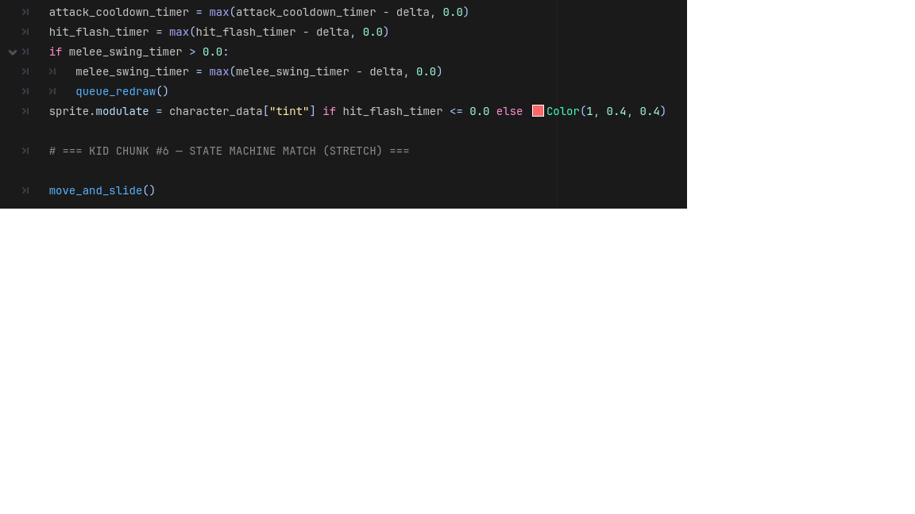
iCode
DAY 4
EMPOWERING FUTURE INNOVATORS
The full state machine — your four holes
62

Slide 63
iCode
DAY 4
EMPOWERING FUTURE INNOVATORS
We know idle exists — inside the idle branch: switch to \"walk\" when get_move_direction() is non-zero, and switch to \"jump\" (with upward velocity.y) when jump is pressed on the floor.
Pattern (board example):
Where in your code (Godot):
# Traffic light: red → green on button press
if button_pressed:
set_state("green")
# Idle exits:
if get_move_direction() != 0:
set_state("walk")
if jump_pressed and is_on_floor():
velocity.y = -jump_impulse
set_state("jump")
63

Slide 64
iCode
DAY 4
EMPOWERING FUTURE INNOVATORS
Inside the walk branch: when get_move_direction() is zero, switch back to \"idle\". When jump is pressed on the floor, set velocity.y = -jump_impulse and switch to \"jump\".
Pattern (board example):
Where in your code (Godot):
# Walk exits — symmetric to idle:
if get_move_direction() == 0:
set_state("idle")
if jump_pressed and is_on_floor():
velocity.y = -jump_impulse
set_state("jump")
64

Slide 65
iCode
DAY 4
EMPOWERING FUTURE INNOVATORS
Inside the jump branch: when velocity.y > 0 (upward velocity has run out), switch to \"fall\".
Pattern (board example):
Where in your code (Godot):
# Jumped up — now falling:
if velocity.y > 0:
set_state("fall")
65

Slide 66
iCode
DAY 4
EMPOWERING FUTURE INNOVATORS
When is_on_floor() is true, the player has landed — switch back to \"idle\".
Pattern (board example):
Where in your code (Godot):
# Landed:
if is_on_floor():
set_state("idle")
66

Slide 67
iCode
DAY 4
EMPOWERING FUTURE INNOVATORS
Make the attack DO something
Fighters can move. Now make the attack key actually deal damage.
67

Slide 68
iCode
DAY 4
EMPOWERING FUTURE INNOVATORS
match attack_type: — two branches
• attack_type is "melee" or "projectile" (set by chunk #2 / setup()).
• Inside attack(): match attack_type: branches once — melee hits the nearby opponent directly; projectile fires a scene instance.
• Same match pattern as the state machine — one string decides what happens.
68

Slide 69
iCode
DAY 4
EMPOWERING FUTURE INNOVATORS
Pieces already in the file
• attack_cooldown_timer — pre-given float; set to attack_cooldown to start the cooldown.
• melee_swing_timer — pre-given float; set to 0.15 to trigger the swing rectangle draw.
• queue_redraw() — pre-given Godot call; redraws the swing rectangle.
• get_opponent() — pre-given method; returns the other Player node (or null if dead).
• spawn_projectile() — pre-given method; fires a Projectile scene in the facing direction.
69

Slide 70
iCode
DAY 4
EMPOWERING FUTURE INNOVATORS
The same check with named booleans: three readable lines instead of one unreadable wall. If it breaks, you know which condition failed.
Pattern (board example):
# BAD — one wicked one-liner:
if abs(opponent.pos.x - pos.x) < rng \
and abs(opponent.pos.y - pos.y) < 40 \
and sign(opponent.pos.x - pos.x) == facing:
opponent.take_damage(dmg)
70

Slide 71
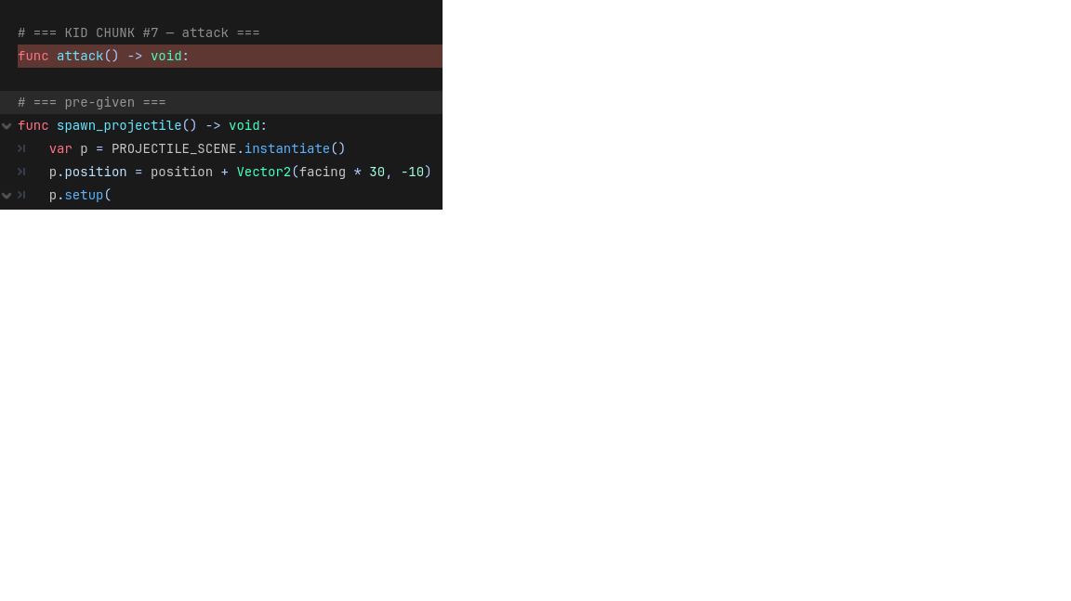
iCode
DAY 4
EMPOWERING FUTURE INNOVATORS
Where you'll type it — player.gd:178-199
71

Slide 72
iCode
DAY 4
EMPOWERING FUTURE INNOVATORS
Start the cooldown: attack_cooldown_timer = attack_cooldown. Then match attack_type: — \"melee\": set melee_swing_timer = 0.15, call queue_redraw(), get the opponent with get_opponent(). return if they're null or already dead. Compute to_opp = opponent.position - position. Two lines are pre-given in your code (in_range and same_height — both use abs()). You write: var facing_opponent = sign(to_opp.x) == facing. Then if in_range and facing_opponent and same_height: opponent.take_damage(attack_damage). \"projectile\": call spawn_projectile().
Pattern (board example):
Where in your code (Godot):
# Named booleans — the good way:
var in_range = abs(to_opp.x) < attack_range # pre-given
var same_height = abs(to_opp.y) < 40.0 # pre-given
var facing_opponent = sign(to_opp.x) == facing # YOU write this
if in_range and facing_opponent and same_height: # YOU write this
opponent.take_damage(attack_damage)
72

Slide 73
iCode
DAY 4
EMPOWERING FUTURE INNOVATORS
Make it yours
73

Slide 74
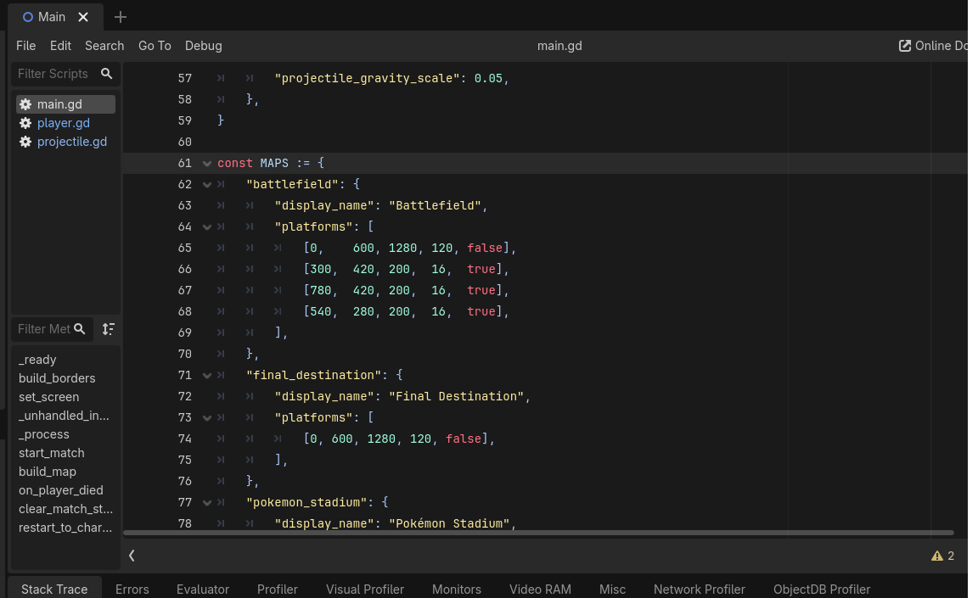
iCode
DAY 4
EMPOWERING FUTURE INNOVATORS
Beat 5 — Add a fifth map
74

Slide 75
iCode
DAY 4
EMPOWERING FUTURE INNOVATORS
Done with beats? Take on the Final Challenge.
Invent a 5th fighter: custom stats, custom sprite, custom attack. Then fight your friend with it.
75

Slide 76
iCode
DAY 4
EMPOWERING FUTURE INNOVATORS
Final Challenge — Invent Your Own Fighter
76

Slide 77
iCode
DAY 4
EMPOWERING FUTURE INNOVATORS
What you unlock
• Build a 5th playable character with whatever stats, sprite, and attack type you want.
• Give them a custom attack: invent the behavior — projectile burst, screen shake, freeze, anything.
• Play it against your friend in the map you built in Beat 5.
77

Slide 78
iCode
DAY 4
EMPOWERING FUTURE INNOVATORS
You already know how to do this
• FC-1 ← chunks #1 + #2 (property declarations → a fresh stats dict)
• FC-2 ← chunk #4 (hook a new instance into the existing system)
• FC-3 ← chunks #6 + #7 (add a new match branch + invent attack behavior)
• Every FC hole is a reword of something you wrote this morning.
78

Slide 79
iCode
DAY 4
EMPOWERING FUTURE INNOVATORS
FC enable — step 1
• FileSystem → final_challenge.gd → double-click.
• Find const CUSTOM_CHARACTER := { at the top.
• This is your character's stats dict — currently empty placeholders.
79

Slide 80
iCode
DAY 4
EMPOWERING FUTURE INNOVATORS
FC enable — step 2
• Open main.gd _ready().
• Add: CHARACTERS["custom"] = CUSTOM_CHARACTER
• Open player.gd attack().
• Add a "custom": branch in the match attack_type: block.
• Save all three files → F5.
80

Slide 81
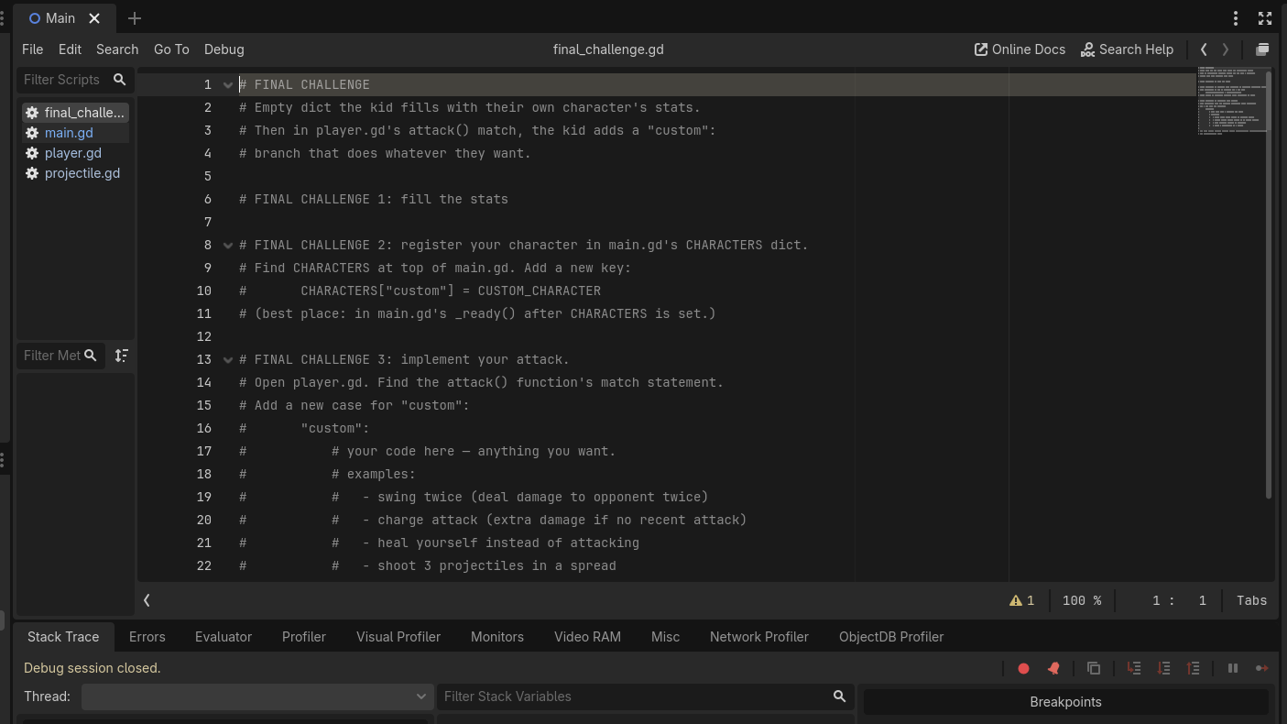
iCode
DAY 4
EMPOWERING FUTURE INNOVATORS
Fill the CUSTOM_CHARACTER dict with stats for your fighter. Pick a sprite from assets/kenney_pp/characters/ (try tile_0004.png and up). Set attack_type to \"custom\" so your FC-3 branch handles it.
Pattern (board example):
Where in your code (Godot):
# Mirror of chunks #1 + #2:
const CUSTOM_CHARACTER := {
"display_name": "MyFighter",
"sprite": "res://assets/kenney_pp/characters/tile_0004.png",
"tint": Color(1, 1, 1),
"walk_speed": 250.0,
"jump_impulse": 540.0,
"attack_type": "custom",
"attack_damage": 12,
"attack_cooldown": 0.6,
"attack_range": 0.0,
"projectile_speed": 0.0,
"projectile_gravity_scale": 0.0,
}
81

Slide 82
iCode
DAY 4
EMPOWERING FUTURE INNOVATORS
Register your character in main.gd so the game knows about it. Add it to the keys array and update the char-select label to show key 5.
Pattern (board example):
# In main.gd _ready(), after CHARACTERS dict:
CHARACTERS["custom"] = CUSTOM_CHARACTER
# In _unhandled_input keys array:
var keys = ["knight","ninja","mage","archer","custom"]
# Update char-select label to include:
# "5 = MyFighter"
82

Slide 83
iCode
DAY 4
EMPOWERING FUTURE INNOVATORS
Add a \"custom\": branch to the match attack_type block in player.gd attack(). Invent any behavior — double damage, projectile burst, screen shake, knockback. Use get_opponent(), spawn_projectile(), and take_damage() as building blocks.
Pattern (board example):
Where in your code (Godot):
# In player.gd attack(), inside match attack_type:
"custom":
# Invent anything:
# — spawn_projectile() fires forward
# — opponent.take_damage(attack_damage * 2)
# — call set_state("attack") again
# — get_opponent() and push them back
pass # replace with your idea
83

Slide 84
iCode
DAY 4
EMPOWERING FUTURE INNOVATORS
More ideas — stats
• Max walk_speed before clipping through walls: ~800. Above 1000 = chaos.
• jump_impulse = 1000 → moon jump.
• attack_cooldown = 0.05 → machine gun attacks.
• attack_damage = 99 → one-punch.
• Combine: slow + high damage = tank. Fast + low damage = glass cannon.
84

Slide 85
iCode
DAY 4
EMPOWERING FUTURE INNOVATORS
More ideas — attack behavior
• Two projectiles: call spawn_projectile() twice with a tiny delay trick.
• Area burst: opponent.take_damage(attack_damage) without checking in_range — always hits if facing.
• Boomerang: set projectile_gravity_scale to a negative value in the dict.
• Self-heal: instead of damaging the opponent, call hp = min(hp + 10, max_hp).
• Taunt: call set_state("attack") without dealing damage — wastes the opponent's dodge.
85

Slide 86
iCode
DAY 4
EMPOWERING FUTURE INNOVATORS
Objects + State. Two big ideas.
• OBJECT — a thing in code that remembers its own data and can do things. Every fighter is one Player object with its own hp, walk_speed, and state.
• STATE — a mode that changes the object's behavior every frame. Six states: idle, walk, jump, fall, attack, hit/dead.
• Together: a fighter that knows what it is AND what it's doing. That's a game character.
86

Slide 87
iCode
DAY 4
EMPOWERING FUTURE INNOVATORS
Tomorrow: Day 5
No new code. Play what you built across four days, show it off, and take it home.
87

Slide 88
iCode
DAY 4
EMPOWERING FUTURE INNOVATORS
Export time
Instructor will run the export for you. You leave with a .zip that runs on any Windows PC — no Godot needed.
88

