Slide 1
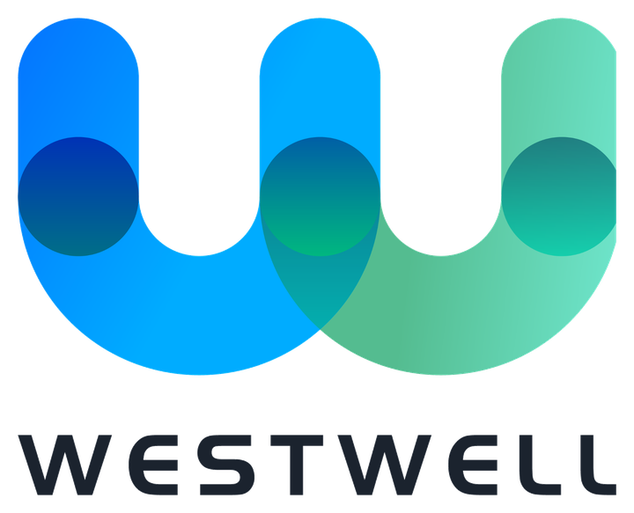
ReeWell
Multi-modular Intelligent Dispatch & Management Platform
for Smart, Green and Autonomous Ports
Make a Well Change.
June 2026

Slide 2
Today's Agenda
From the operational challenge to measurable, deployable value.
01
02
03
04
The Challenge
The Platform
Architecture
The Value
Why today's port operations hit a ceiling.
One AI platform across the whole yard.
System layers and scenario engines.
Proven, quantified, low-risk to deploy.
Fragmented fleets
Unified control
Modular base
Throughput lift
Manual scheduling
World-model AI
Dual-engine
24/7 autonomy

Slide 3
SECTION 01
The Challenge
Why today's port operations hit a ceiling.

Slide 4
Where Port Operations Hit a Ceiling
Three structural gaps that cap throughput today.
01
02
03
Mixed Fleets
Manual Scheduling
No Foresight
Manned and unmanned trucks from many brands run on separate systems that do not talk to each other.
Dispatchers plan by experience; plans cannot adapt in real time to congestion or breakdowns.
Teams react after problems happen, with no way to test a plan before it hits the ground.
→ Idle equipment & blind spots
→ Lost throughput at peaks
→ Costly trial-and-error

Slide 5
Platform Architecture · System View
One modular base; an AI tool-chain across the full operating flow.
ReeWell Platform · AI tool-chain optimizing the full port operating flow
WellFMS
WellYMS
WellSmart
WellSimtec
WellEMS
Digital Brain
Fleet Management
Yard Management
AI Scheduling
Simulation
Energy Mgmt
3D Twin
Standard onboarding of manned/unmanned, multi-brand vehicles under one control.
Storage, stacking and slotting managed down to the vehicle and location.
Real-time, dynamic whole-yard scheduling — the platform core.
High-fidelity digital twin to validate plans before execution.
Energy and carbon visibility turned into measurable savings.
Live monitoring, real-time alerts and history replay.
Core Algorithms & Models
Unified Scheduling
Path Planning
Global coordination of horizontal & vertical, manned & unmanned transport.
Space-time consistent global and local path planning.
Hymala Logistics Large-Model Matrix
Foundation models underpinning whole-yard coordination across all transport types

Slide 6
Scenario Architecture · Dual Engines
In-port operations × cross-border supply chain, in one closed loop.
End-to-end production, transport and supply-chain management
Production · Input
Joint output: plans · supply · adjustments
Supply-chain · Output
Production Plan
Cross-border
tempo & exceptions
customs · trade
Resource Dispatch
Data in
Plan out
¥
SC Finance
equipment · vehicles
ReeWell
Link
LOOPO
credit · factoring
In-port operations control
Cross-border transport mgmt
Inventory
Risk & Data
raw · finished · yard
Information & command linkage
control · insight
AI boost
WellSmart · Full-element AI scheduling base
Big Data
Simulation
AI Agents
Tempo Scheduling

Slide 7
Proven, Quantified Value
Outcomes from live international deployments.
30%
24/7
12
Throughput Lift
Autonomy
Live Ports
Crane-to-yard cycle efficiency in mixed manned/unmanned fleets.
Continuous unmanned operation under live AI scheduling.
Deployments across three continents, and counting.
Figures are deployment placeholders; production decks must cite source and boundary.

Slide 8
From Pilot to Full Autonomy
A staged, low-risk deployment path.
Assess
Scale
Survey yard, fleet and integration points.
Expand to the full yard under unified scheduling.
1
2
3
4
Pilot
Autonomy
Deploy on one lane with humans in the loop.
24/7 unmanned operation with AI foresight.
Each stage delivers value on its own — no big-bang cutover required.

Slide 9
Smarter, Greener, Autonomous Ports
Make a Well Change.

