Slide 1

Analysis of Childcare Costs Across the U.S.
Understanding Regional Disparities and Socioeconomic Impacts
By: Westyn Hilliard
Notes:
Hey everyone. My name is Westyn Hilliard, and today I’ll be presenting an analysis of childcare costs across the U.S. Our focus will be on understanding regional disparities and the socioeconomic impacts of these costs, especially in relation to labor force participation and affordability for families. Let’s dive into the key findings and recommendations.

Slide 2
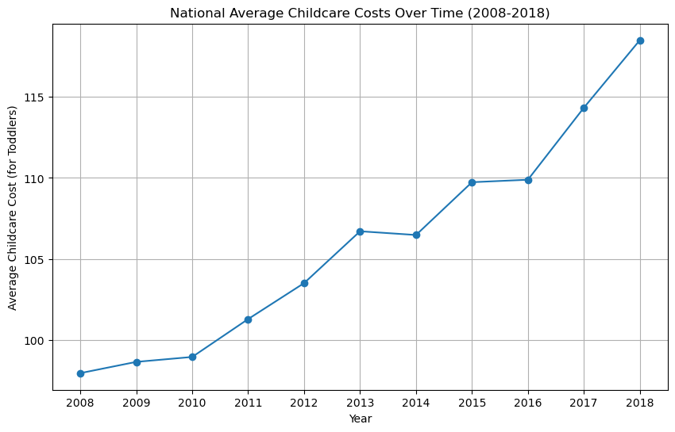
National Overview
Childcare costs have increased by 21.01% over the last decade.
Notes:
As we begin, let’s look at the national trend. Over the past decade, childcare costs have increased by 21.01%. This significant rise places additional financial strain on families, impacting household budgets and financial planning. To fully grasp these trends, we’ll next explore how costs vary across different regions.

Slide 3
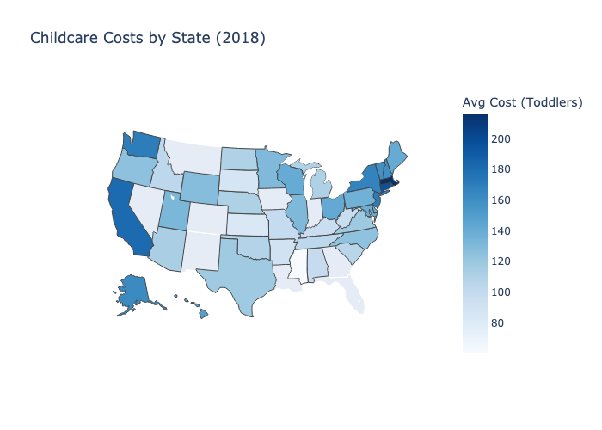
Regional Disparities
Childcare costs are highest in the Northeast and West Coast, exceeding $15,000 annually, while Midwest and Southern states generally have lower costs.
Notes:
Here, we see the disparities in childcare costs across the United States. This map highlights that states in the Northeast and on the West Coast, such as California and New York, generally have the highest childcare costs, often exceeding $15,000 per year. In contrast, states in the Midwest and South have more affordable childcare options, with average costs between $8,000 and $10,000 annually. These regional disparities underline the need for targeted policies to address the varying financial pressures faced by families across the country. By understanding these regional differences, we can better tailor solutions to areas where families need the most support.

Slide 4
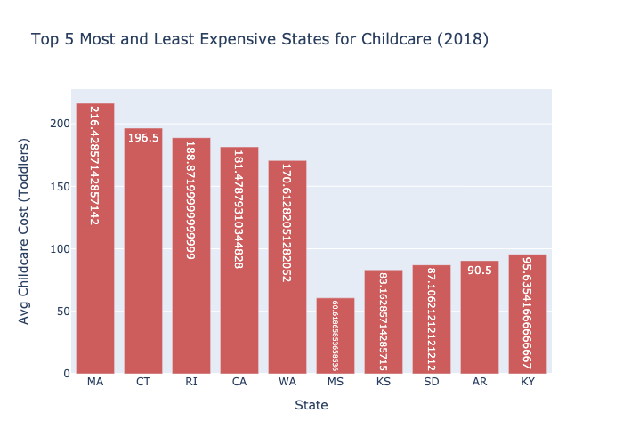
Most and Least
Childcare costs range significantly across states, with the highest costs observed in the Northeast and the lowest in the Midwest and South.
Notes:
This chart displays the top 5 most and least expensive states for childcare in 2018. As we can see, Massachusetts and Connecticut top the list with average annual childcare costs exceeding $190 for toddlers, making them some of the most financially burdensome states for families. On the other end, states like Mississippi, Kansas, and South Dakota have relatively low childcare costs, averaging below $90. This wide range demonstrates how location significantly influences the affordability of childcare, highlighting the need for region-specific policy interventions to support families in high-cost states. This all leads me to ask the question, why do certain states have higher or lower costs? Cost of Living? State Policies? Income levels?

Slide 5
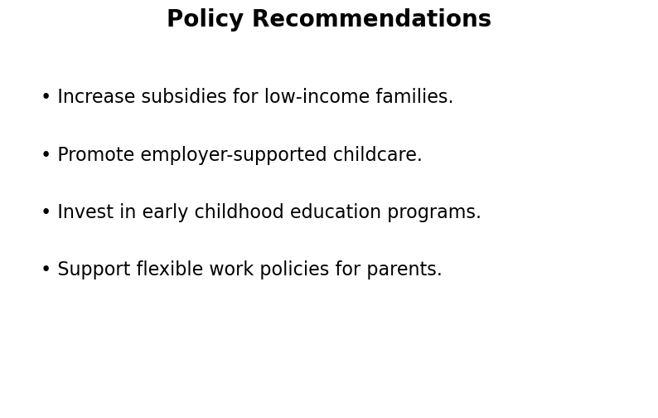
Implementing these policies can help make childcare more affordable, support working families, and improve overall access to quality child care services.
Notes:
To address these challenges, we recommend an approach. First, increasing subsidies for low-income families can reduce financial barriers. Second, promoting employer-supported childcare helps working parents balance their roles. Third, investing in early childhood education programs ensures quality and affordable options for all. Finally, encouraging flexible work policies allows parents to stay engaged in the workforce without compromising on childcare needs. Together, these strategies can make childcare more accessible and supportive of family needs.

Slide 6
Conclusion
Childcare costs vary significantly across regions, with a clear impact on income levels and labor force participation. Addressing these disparities is crucial for supporting working families and improving access to quality childcare.
Invest in programs that support working families and improve childcare affordability.
Notes:
In conclusion, it’s clear that childcare costs vary significantly by region and have profound impacts on both family well-being and workforce participation. By investing in targeted policies and support programs, we can make childcare more affordable and accessible. This will not only ease financial strain on families but also foster a more inclusive and productive workforce. Thank you for your time, and I encourage each of you to support policies that prioritize affordable childcare.

