Slide 1
Applied Data Science Capstone by IBM / Coursera Starbucks Locations Worldwide

Slide 2
Table of Content
Introduction
Data
Methodology
Analysis
Results and Discussion
Conclusion Text

Slide 3
Introduction
Starbucks started as a roaster and retailer of whole bean and ground coffee, tea and spices with a single store in Seattle’s Pike Place Market in 1971.
The company now operates more than 24,000 retail stores in 70 countries.
We will try to find the pattern of Starbucks Stores' locations. And figure out how that can inspire us.

Slide 4
Data
This dataset includes a record for every Starbucks or subsidiary store location currently in operation as of February 2017.
This data was from kaggle.
The original data was scraped from the Starbucks store locator webpage by Github user chrismeller.

Slide 5
Business problems
Find the city and the country with the most starbucks.
Explore how starbucks distributed worldwide and in China.

Slide 6
Methodology
Collect location data using Foursquare
Descriptive data analysis
Geospatial data visualization using folium.

Slide 7
Results

Slide 8
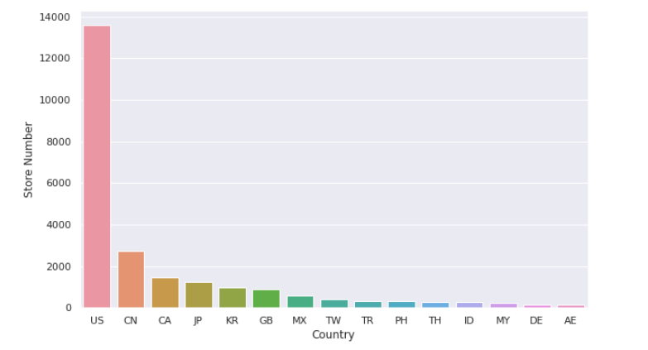
Top 15 countries with most Starbucks

Slide 9
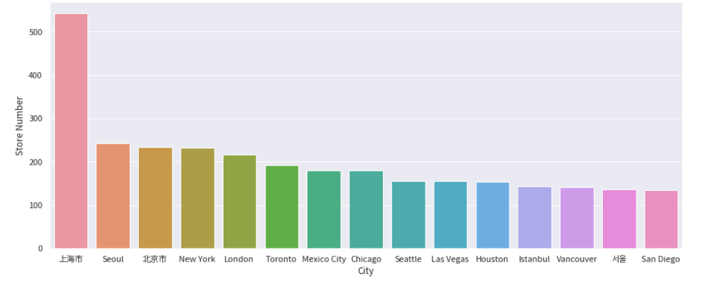
Top 15 citiess with most Starbucks

Slide 10
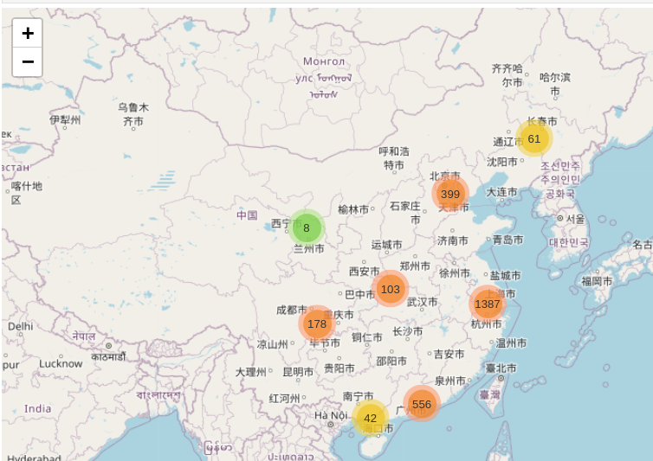
Starbucks in China

Slide 11
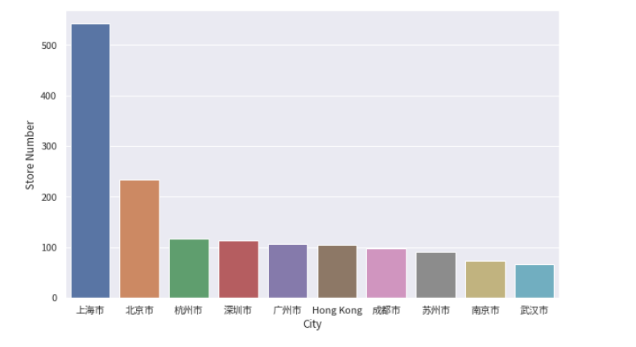
Top 10 cities with most Starbucks in China

Slide 12
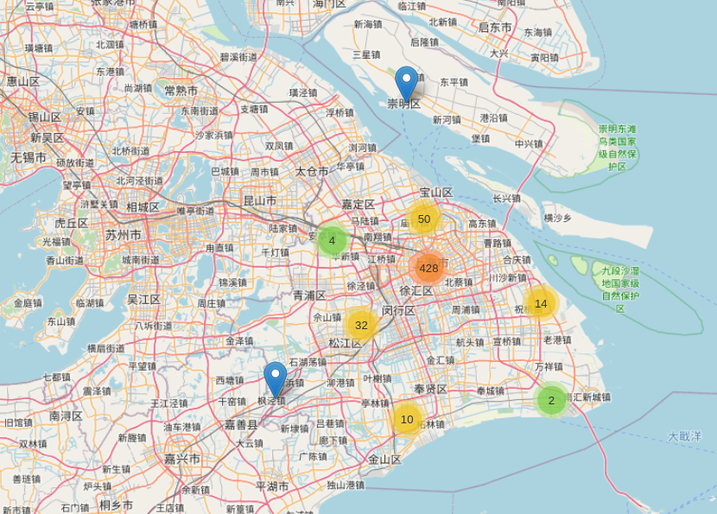
Starbucks’ Distribution in Shanghai

Slide 13
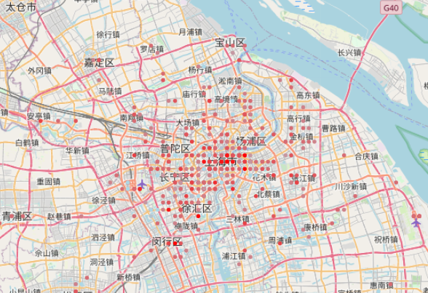
The lighter the color is, the later the store set.

Slide 14
Results and Disscussion

Slide 15
Distribution worldwide
The countries with most Starbucks are : United States, China, Canada, Japan, Korean, United Kingdom.
While United States has ten thousands more Starbucks than China.
The cities with most Starbucks are : Shanghai, Seoul, Beijing, New York. London, Toronto, Mexico City, Chicago, Seattle.
Top 3 cities are all Asian cities, despite the fact that United States has the most Starbucks in total.

Slide 16
Starbucks in China
Starbucks in China mostly distributed at the most developed province and cities, Including Shanghai, Beijing, Guangzhou, Chongqing, Hangzhou etc.
Relatively there are only a few of Starbucks in middle China, western China and northern China.
The amount of Starbucks in top 5 cities consists of half of the Chinese Starbucks

Slide 17
Starbucks in Shanghai
Starbucks in Shanghai mostly located at the very center of the city while only a small amount of starbucks at the periferal area.
Starbucks in Shanghai also started from the very center of the city and expanded to other areas.

Slide 18
Conclusion

Slide 19
Conclusion
Starbucks are usually opened in the most prosperous countries and cities in the world
China's economic development is very unbalanced

Slide 20
Thanks!

