Slide 1

Where should I buy an AirBnb?

Slide 2
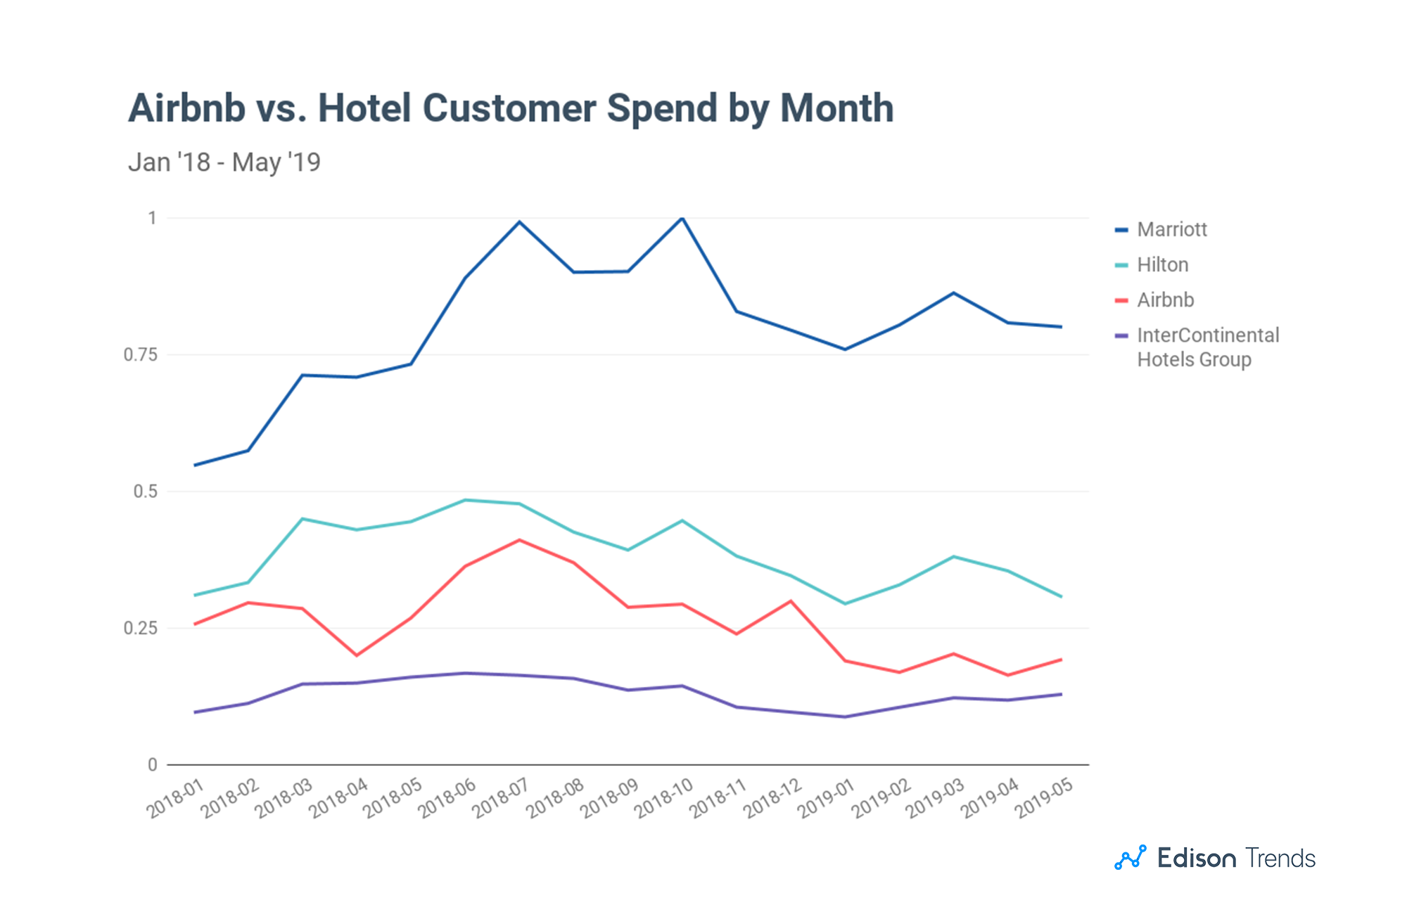
Notes:
Airbnb-vs-hotels

Slide 3
Project Details
Dataset - New York City Airbnb Listings Data
Goal - Find contributors to AirBnb Revenue
Target Demographics - Potential Airbnb Hosts
Methodology - Use Statistical Modeling to find determinants of AirBnb revenue

Slide 4
Our Findings
Determinants of Revenue, by significance
Bed Type
House Type
Cleanliness
Accommodations
New York Boroughs by Revenue
Manhattan
Queens
Other Boroughs

Slide 5




Workflow

Slide 6
Calculating AirBnb Revenue
Revenue = Price * Occupancy Rate
Occupancy Rate = Days occupied / Days available
Days occupied = Number of Stays * Average Length of Stay
Number of Stays = Review Quantity / Rate of Reviews

Slide 7
Data cleaning
Variables dropped due to multicollinearity: Number of Beds, Reviews by categories
Variables dropped due to missing values: Availability_365, Neighbourhood
Removed outliers from price (5%) and reviews per month (15%) data
Categorical Variables with counts of less than 100 were removed

Slide 8
Final Price Model
PRICE ~ Sq_feet + Manhattan + EntireHouse_vs_Shared + Bedrooms
R² = 0.457 | coef | std err | t | P-value
Intercept | 43.4387 | 7.413 | 5.86 | 0.000
Square feet | 0.0256 | 0.007 | 3.784 | 0.000
Manhattan dum | 32.1764 | 5.900 | 5.454 | 0.000
Entire House dum | 73.0694 | 6.471 | 11.292 | 0.000
Bedrooms | 19.8412 | 4.469 | 4.439 | 0.000

Slide 9
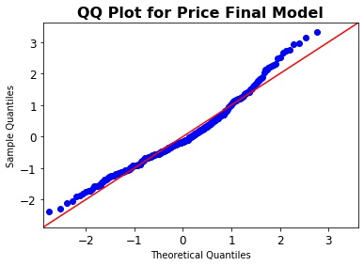
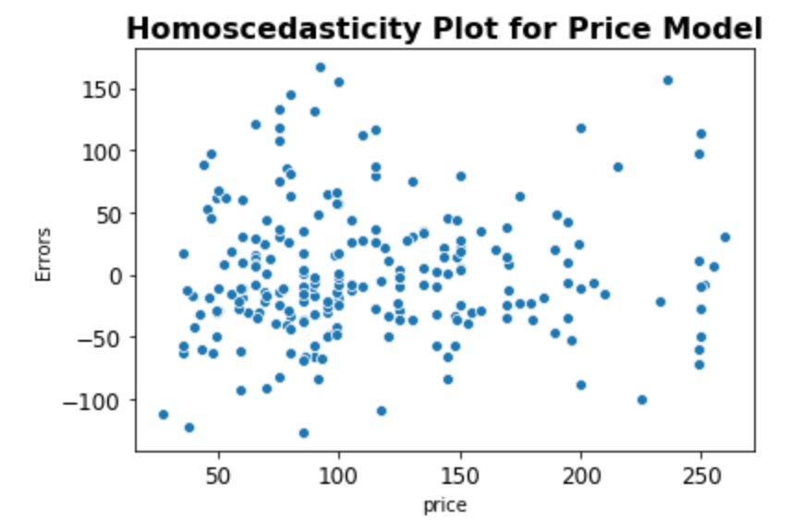
Model Characteristics

Slide 10
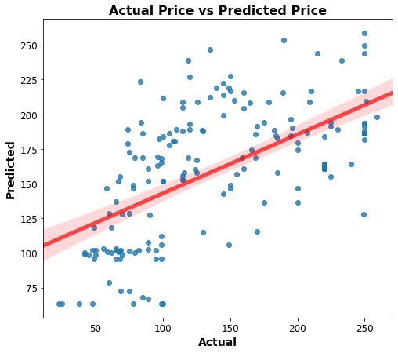
Forecast accuracy
Train dataset: NYC Airbnb data
Test dataset: LA Airbnb data
MSE train: 5 201.556
MSE test: 6 031.005

Slide 11
REVIEWS(norm) ~ Instant_Book + Manhattan + Brooklyn + Rating + APTvsHotel + HOUSEvsHotel + EntireHouse_vs_Shared + Bedrooms
R² = 0.517 | coef | std err | t | P-value
Intercept | -1.5548 | 0.044 | -35.590 | 0.000
Instant booking | 0.0167 | 0.008 | 2.143 | 0.032
Manhattan dum | 0.6888 | 0.012 | 57.190 | 0.000
Brooklyn dum | 0.1721 | 0.011 | 15.006 | 0.000
Rating | 0.0052 | 0.000 | 12.292 | 0.000
Apt. vs Hotel dum | -0.2840 | 0.013 | -22.567 | 0.000
House vs Hotel dum | -0.2215 | 0.018 | -12.448 | 0.000
Bedrooms | 0.3622 | 0.006 | 61.047 | 0.000
Entire House vs Shared | 1.0902 | 0.008 | 139.036 | 0.000

Slide 12
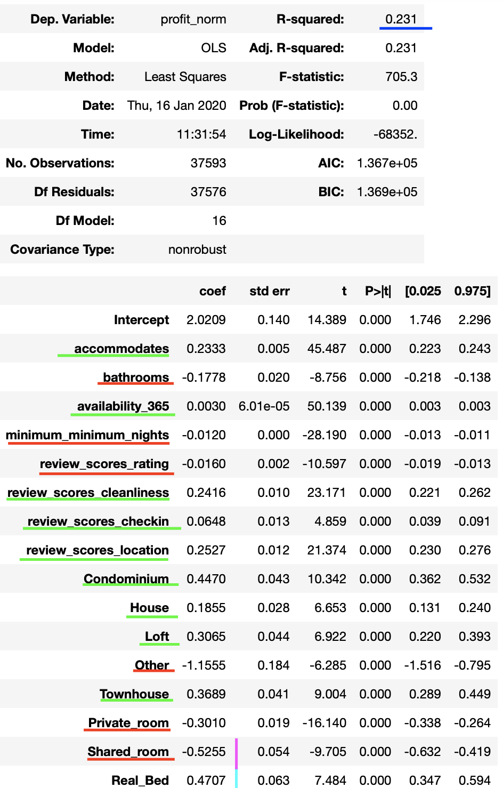
Contributing Factors to Revenue
R-Squared - 0.231
Positive Revenue Determinants
Real Bed over Futon and Pull Out
Condos over Houses and Apartments
Location and Cleanliness
Negative Revenue Determinants
Sharing a House
Bathrooms

Slide 13
Actionable Insights
A maximally profitable AirBnb would have the following characteristics:
Condominium
In Manhattan
Real Bed
Cleanliness
Many Rooms

Slide 14
Future Work
We gathered data on revenue not profit
An a large apartment in Manhattan would bring in a lot of revenue, but the cost of rent on the property would outweigh it
In the future, we would add in rent data to calculate profit
Profit = Airbnb Revenue - Rent

