Slide 1
RESEARCH PROGRESS REPORT
Dynamic Power Cables for Floating Offshore Wind
+ an XGBoost regression on real data
Three cable papers in depth, and an initial machine-learning regression
Group Seminar · 2026-07-09

Slide 2
OVERVIEW · PROGRESS SINCE THE LAST SEMINAR (JUN 5)
Two parts: three cable papers, and a first model
Context: the review paper (B-1) was presented last time. This report covers three cable papers in more depth, plus an initial predictive model.
1
Part 1 · Ocean Engineering
2
Part 2 · Machine-learning practice
Three cable papers, each on two slides (summary + reflection)
An initial regression on real wind–wave data
B-9 Beier — the fatigue-analysis method
B-4 Zhao — cable configuration (lazy vs double wave)
B-3 Janocha — reference cable models + workflow
Together: the method, shape and inputs to build an OrcaFlex fatigue study
First predictive model after the EDA step
Real buoy data from a California wind-energy area
Main work so far: data cleaning and algorithm setup
The same workflow can later use OrcaFlex fatigue data
02

Slide 3
PART 1 · OCEAN ENGINEERING
Three papers combine into one plan
B-9
B-4
B-3
THE METHOD
+
THE CONFIGURATION
+
THE REFERENCE CABLE
Beier et al. (2023)
Zhao et al. (2021)
Janocha et al. (2024)
How to compute fatigue — a 4-step workflow, no UFLEX required
Which cable shape — lazy-wave vs double-wave, copper strain-life
Which cable design — open 33/66/132 kV models + UFLEX→OrcaFlex flow
Method + configuration + reference cable = the inputs and procedure to build an OrcaFlex fatigue model, then apply machine learning to it.
03

Slide 4
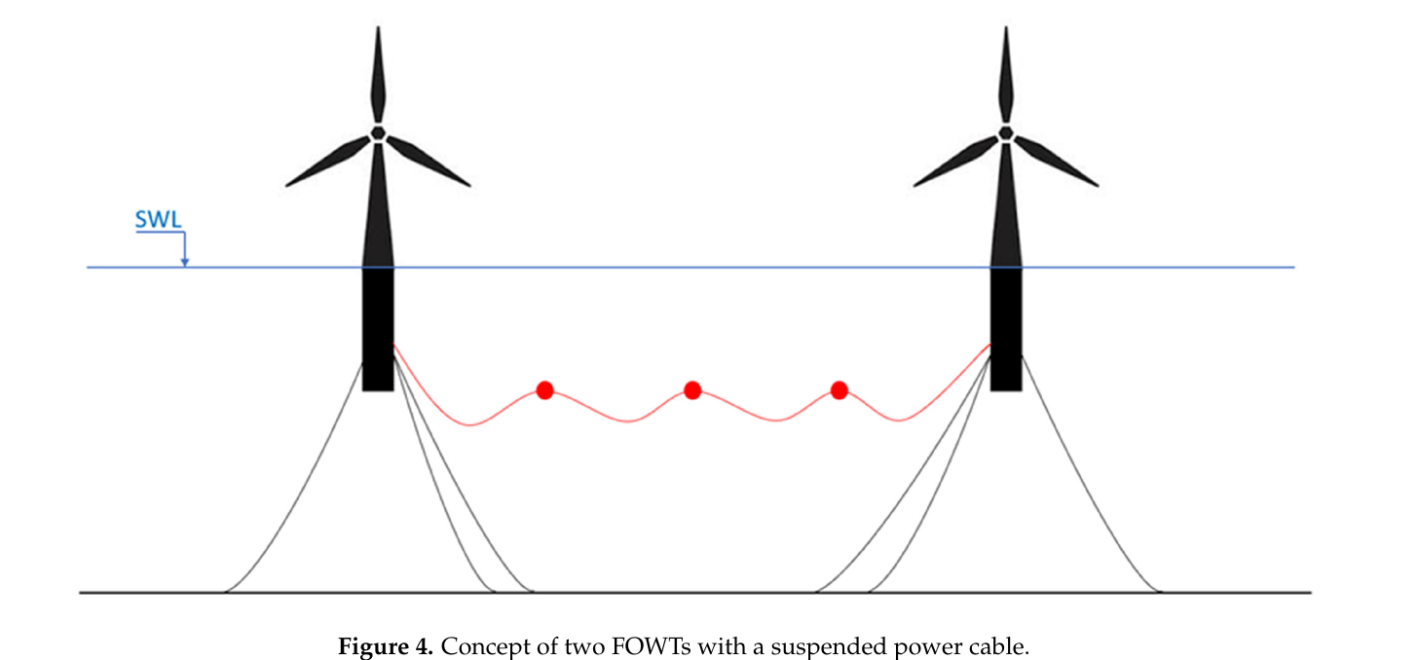
PAPER 1 · BEIER ET AL. (2023) · JMSE · B-9 — CONTENT SUMMARY
B-9 · Fatigue analysis — what the paper does
Dimension | Content
Objective | Fatigue life of a suspended inter-array cable between two FOWTs — without needing UFLEX
Case & conditions | 1260 m cable, 3 buoyancy modules; North Sea, 320 m depth; OC3-Hywind 5 MW; ~25 sea states
Method & tools | OrcaFlex (global) + a simplified stress-factor method; rainflow + Miner (steel S-N)
Key steps | OrcaFlex → T, C; σ = Kt·T + Kc·C; rainflow → Miner → life; compared vs UFLEX
Key results | Min life ≈ 70,000 yr; bending dominates; hot spots at hang-off & buoys; copper fails first; Kc up to +218% conservative
Fig. 4 — a suspended inter-array cable between two floating wind turbines
Source: Beier et al. (2023), JMSE 11(6):1254
04

Slide 5
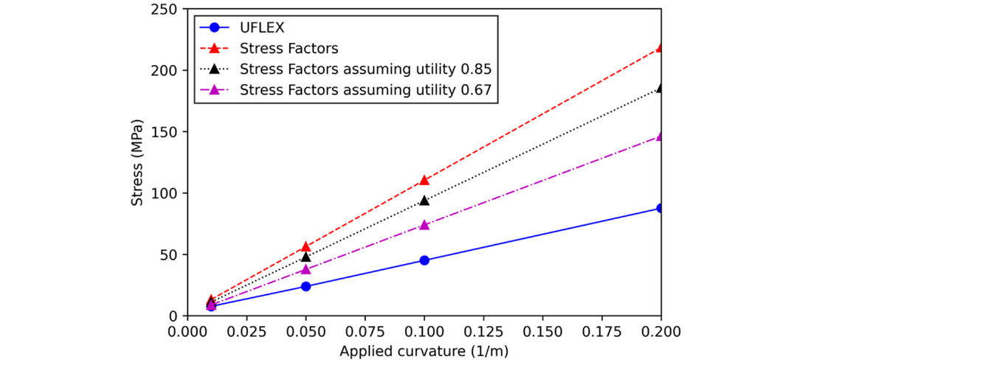
PAPER 1 · BEIER ET AL. (2023) · B-9 — REFLECTION & IMPLICATIONS
B-9 · What it means for the research
Aspect | Point
Strength | A complete, reproducible fatigue workflow that needs no UFLEX (not available in our lab)
Limitation | Kc is conservative — up to +218% under bending — so predicted life is over-safe / over-designed
Key insight | The linear σ = Kt·T + Kc·C ignores wire stick-slip non-linearity → bias under large loads
Value to my work | A validated 4-step procedure and a reference setup to reproduce directly in OrcaFlex
Link to next step | The +218% conservatism is a concrete target for an ML correction (load → true stress)
Fig. 12 — the simplified stress factors overshoot UFLEX under curvature (the +218% gap)
Source: Beier et al. (2023), JMSE 11(6):1254
05

Slide 6
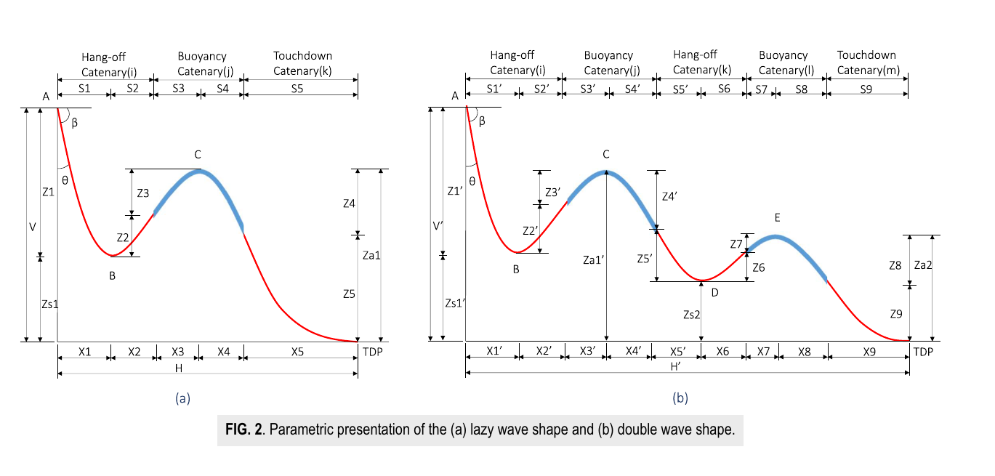
PAPER 2 · ZHAO ET AL. (2021) · AIP ADVANCES · B-4 — CONTENT SUMMARY
B-4 · Cable configuration — what the paper does
Dimension | Content
Objective | Compare lazy-wave vs double-wave configurations for a shallow-water FOWT export cable
Case & conditions | Shallow water (below 50 m); dynamic export (umbilical) cable
Method & tools | Fully-coupled aero-hydro-servo-elastic model in SIMO/RIFLEX; copper strain-life (Coffin–Manson)
Key steps | Parametrise the double-wave; static → dynamic (T, C) → fatigue; compare the two configs
Key results | Bending moment dominates fatigue; the double-wave outperforms the lazy-wave; its second arc is critical
Fig. 2 — the two configurations: (a) lazy-wave and (b) double-wave
Source: Zhao et al. (2021), AIP Advances 11, 035302
06

Slide 7
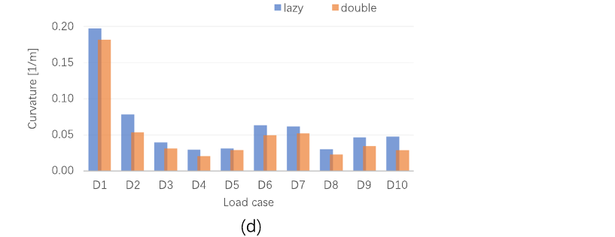
PAPER 2 · ZHAO ET AL. (2021) · B-4 — REFLECTION & IMPLICATIONS
B-4 · What it means for the research
Aspect | Point
Strength | Introduces the double-wave + a fully-coupled comparison; locates the critical spot (second arc)
Limitation | Results are specific to shallow water and one floater type; not yet generalised
Key insight | The material sets the method — copper uses strain-life (Coffin–Manson), steel uses S-N
Value to my work | Adds a configuration dimension + copper-vs-steel labelling for a future surrogate model
Link to next step | Configuration and material become extra inputs in the load-case design
Fig. 6(d) — TDP curvature: the double-wave is ≤ the lazy-wave across load cases
Source: Zhao et al. (2021), AIP Advances 11, 035302
07

Slide 8
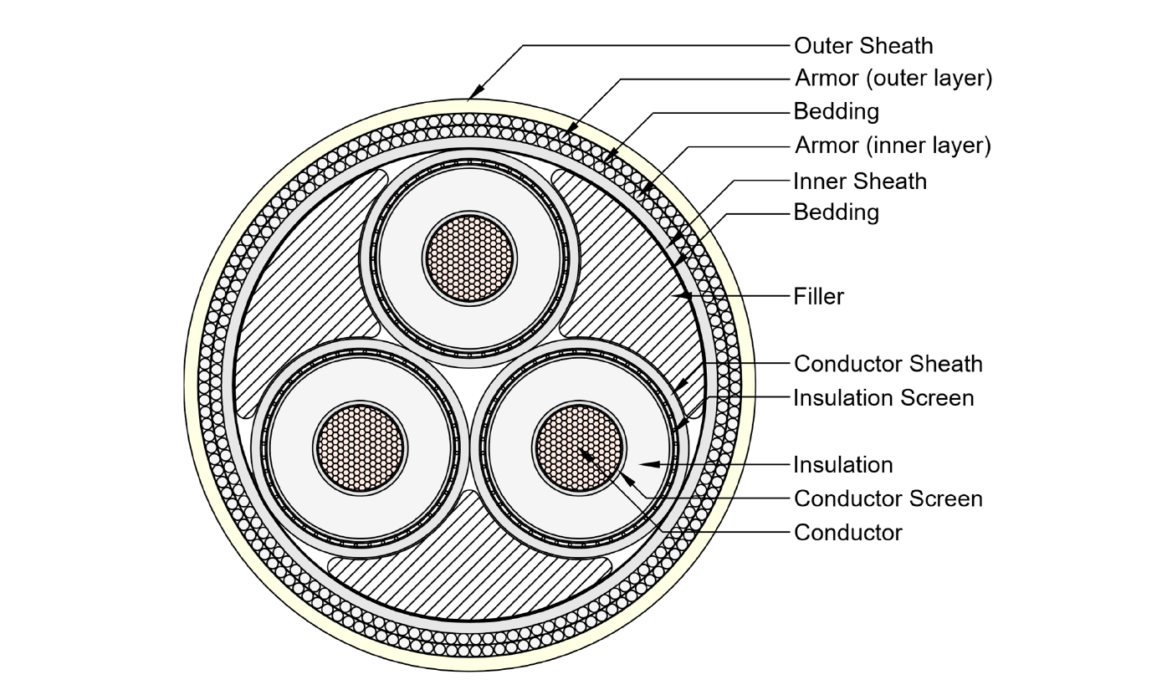
PAPER 3 · JANOCHA ET AL. (2024) · SUSTAINABILITY · B-3 — CONTENT SUMMARY
B-3 · Reference cable models — what the paper does
Dimension | Content
Objective | Develop three open baseline cable designs (33/66/132 kV) with a full property database
Case & conditions | OC3 5 MW spar, lazy-wave; static, dynamic (extreme) and simplified fatigue analyses
Method & tools | UFLEX v2.8.9 (local cross-section) → OrcaFlex v11.3a (coupled global response)
Key steps | Design 3 cross-sections → UFLEX stiffness database → OrcaFlex response; with vs without cable
Key results | Cable barely affects FOWT motion; the design sustains representative loads; lazy-wave performs well
Fig. 1 — a dynamic power cable's layer composition (labelled)
Source: Janocha et al. (2024), Sustainability 16, 2899
08

Slide 9
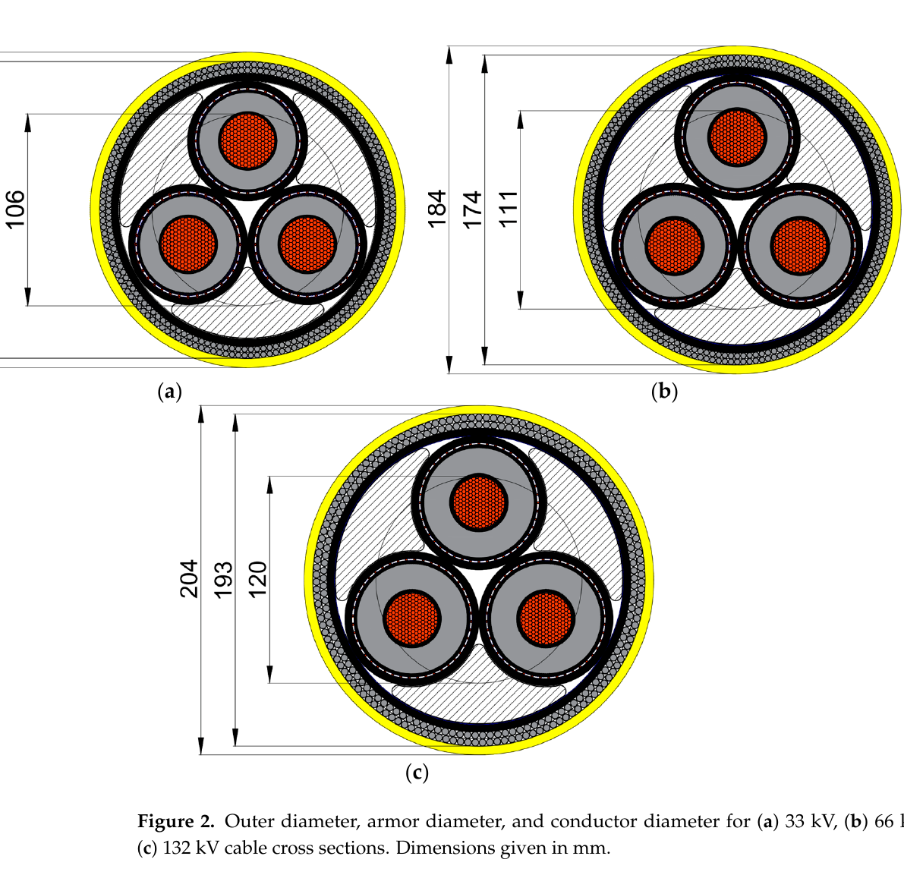
PAPER 3 · JANOCHA ET AL. (2024) · B-3 — REFLECTION & IMPLICATIONS
B-3 · What it means for the research
Aspect | Point
Strength | Ready-made, standardised, reproducible reference cables — a shared baseline for comparison
Limitation | Uses a simplified fatigue check and a single lazy-wave layout; local fatigue not resolved
Key insight | A public baseline was missing; now different studies can be compared on the same cable
Value to my work | Concrete cable parameters + the exact UFLEX→OrcaFlex recipe to follow in-house
Link to next step | Directly reproducible in OrcaFlex v11.3a with the OC3 5 MW turbine (our tools)
Fig. 2 — the three open reference cables: 33 / 66 / 132 kV
Source: Janocha et al. (2024), Sustainability 16, 2899
09

Slide 10
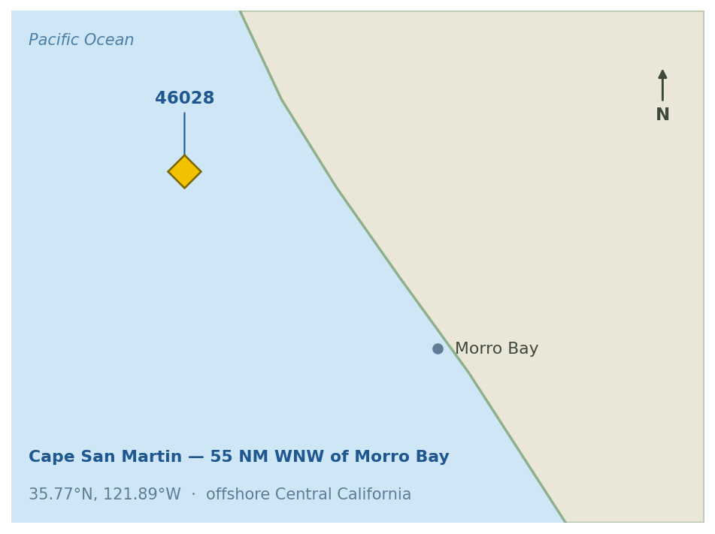
PART 2 · MACHINE-LEARNING PRACTICE
Wind & wave data at a California wind-energy area
PURPOSE
DATA (real, public)
PIPELINE
First predictive model after EDA
Explore what predicts wave height
NDBC buoy 46028 · Cape San Martin — 55 NM WNW of Morro Bay, CA (35.77°N, 121.89°W); a California floating-wind lease area
Cleaning: 99/999 marked as missing → 104k rows reduced to 34k usable
Inputs: wind speed, gust, direction, pressure, month
Target: wave height Hs (m)
Clean & merge two years
↓
Train / test split (75 / 25)
DATA-BUOY LOCATION
↓
GridSearchCV (4-fold) to tune
↓
XGBoost regressor
↓
Evaluate (R², RMSE) + explain
Stage: preliminary / exploratory — main effort so far: data cleaning and setting up the algorithm.
Data source (NDBC): https://www.ndbc.noaa.gov/download_data.php?filename=46028h2025.txt.gz&dir=data/historical/stdmet/
10

Slide 11
PART 2 · CODE WALKTHROUGH
The XGBoost workflow, step by step
1
Load 2 NDBC files (2024 + 2025)
KEY CODE
↓
pd.read_csv(f, na_values=[99,999,9999])
— mark 99 / 999 as missing
df.dropna(subset=FEATURES+[TARGET])
— drop rows that have any gap
train_test_split(X, y, test_size=0.25)
— hold out 25% as the exam set
GridSearchCV(XGBRegressor(), grid, cv=4)
— auto-tune hyper-params by 4-fold CV
r2_score(y_te, model.predict(X_te))
— score on data the model never saw
2
Clean: 99 / 999 → missing · merge · drop rows → 34k
↓
3
Define X = wind, gust, dir, pressure, month · y = Hs
↓
4
Train / test split (75 / 25)
↓
5
GridSearchCV (4-fold) → best hyper-parameters
↓
6
Fit XGBoost → predict on the test set
↓
7
Evaluate R², RMSE + parity / importance / PDP plots
The same workflow is reused unchanged when the target later becomes OrcaFlex fatigue damage.
11

Slide 12
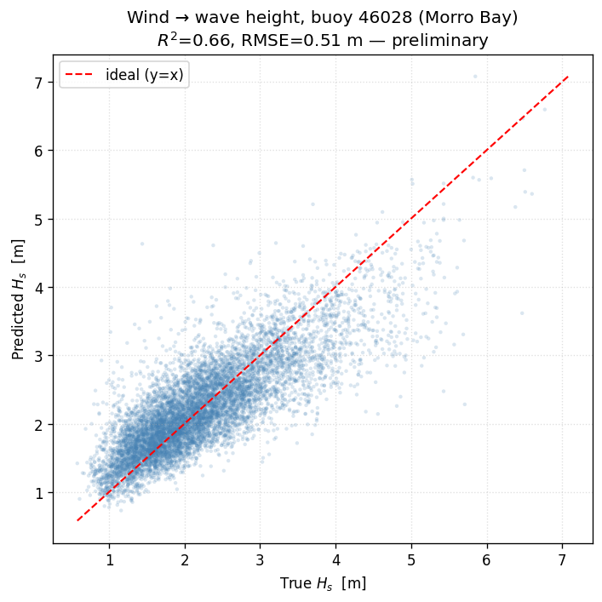
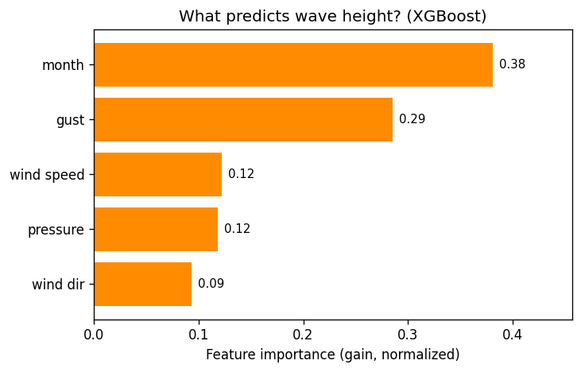
PART 2 · RESULT (1/2) — ACCURACY AND DRIVERS
Preliminary result — R² ≈ 0.66
Reading it: points near the diagonal mean accurate prediction (R² 0.66). The bars rank the inputs — month (season) and gust rank above the instantaneous wind speed.
12

Slide 13
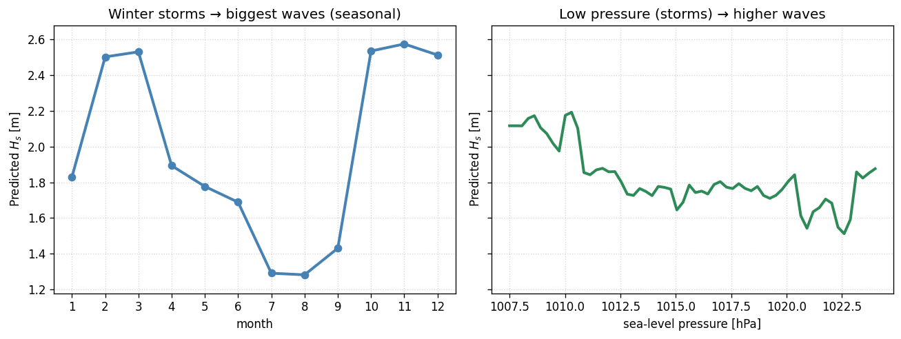
PART 2 · RESULT (2/2) — WHAT THE MODEL SUGGESTS
Wave height follows the seasons and storms
Interpretation
Wave height is highest in winter and at low pressure — i.e. during storms.
Season and gust rank above the instantaneous wind speed. Open-ocean waves include swell that travels from distant storms, so wave height is only partly tied to the local wind at that moment.
Next step: replace the target (wave height) with fatigue damage computed in OrcaFlex.
These curves show how the prediction changes with one input at a time (others held fixed).
13

Slide 14
SUMMARY & NEXT STEPS
Summary and next steps
Covered in this report
Next steps
Three cable papers: method, configuration, reference models
First predictive model on real California wind-site buoy data
Preliminary R² ≈ 0.66; captures the seasonal and storm-driven wave pattern
Workflow ready to reuse on fatigue data
Build an OrcaFlex model using the B-3 reference cable
Generate a fatigue dataset with the B-9 method
Train the same XGBoost workflow on that fatigue data
Deep-read B-3 and B-4; later move to time-series models
14

Slide 15
APPENDIX · KEY PHYSICS FORMULAS (1/2)
Formulas behind the papers — loads & geometry
Formula | Brief explanation | Paper
σ = Kt·T + Kc·C | Turn tension T and curvature C into local stress σ via stress factors Kt, Kc | B-9
M = EI · κ | Bending moment M = flexural rigidity EI × curvature κ | B-9 · B-3
κ = 1 / R , MBR = 1 / κmax | Curvature = 1 / bending radius R; MBR is the smallest radius the cable may reach | B-9 · B-4
z = a·(cosh(x/a) − 1) | Free-hanging catenary shape; a = F / Q (horizontal force ÷ wet weight per length) | B-4
κ = 1 / [a·cosh²(x/a)] , F = a·Q = const | Catenary curvature; the horizontal tension stays constant along the line | B-4
Notation: T tension · C/κ curvature · σ stress · ε strain · EI bending stiffness · R radius · MBR minimum bending radius · Q wet weight per length.
15

Slide 16
APPENDIX · KEY PHYSICS FORMULAS (2/2)
Formulas behind the papers — fatigue
Formula | Brief explanation | Paper
Rainflow counting | Reduce an irregular stress history into (amplitude, number-of-cycles) load cycles | B-9 · B-4
N · (Δσ)^m = a (S-N curve) | Steel armour: cycles-to-failure N vs stress range Δσ (m, a are material constants) | B-9
Δε/2 = (σ′f /E)(2N)^b + ε′f (2N)^c | Coffin–Manson strain-life for the copper conductor: elastic + plastic strain terms | B-4
D = Σ (ni / Ni) ≥ 1 (Miner / P-M) | Cumulative damage = Σ(applied cycles ÷ allowable cycles); reaches 1 at failure | B-9 · B-4 · B-3
Fatigue life = Tref / D | Life = a reference period divided by the damage accumulated over that period | all three
Notation: N cycles to failure · ni applied cycles · Δσ stress range · Δε strain range · σ′f, ε′f, b, c, m, a material constants · D damage.
16

