Slide 1
SEMINAR
20260605
Ocean Engineering Section
Dynamic Power Cables for Floating Offshore Wind Turbines
From literature review to a research direction
Roadmap
1. Field overview → 2. Accessible directions → 3. Our feasible path → 4. Beier 2023 → 5. Beyond Beier
Presenter
Diao Jingyu

Slide 2
Field Overview — Six Research Areas
Cerik & Huang, Ocean Engineering 311 (2024) — a review of the last ~20 years
# | Research Area | Key Question | State of the Art | Accessible to us?
1 | Mechanical properties | Stiffness, stick-slip nonlinearity? | Bending hysteresis quantified (Hu 2022; Ménard 2023) | ❌ needs bending rig
2 | Failure mechanisms | Why does it fail? | Fretting, water tree, biofouling — identified separately | ❌ needs FEA / electrical lab
3 | Fatigue analysis | How long can it last? | 4-step workflow standardised (global → local → rainflow → Miner) | ✅ global half
4 | Experimental studies | Where do test data come from? | Vendors hold the data; public datasets are scarce | ❌ needs full-scale rig
5 | Local (cross-section) analysis | Internal stress distribution? | RVE / beam / homogenisation strategies mature | ❌ needs UFLEX / Helica
6 | Global load analysis | Overall response of the whole cable? | OrcaFlex dominates; OpenFAST + MoorDyn now open-source | ✅ our core tool
Filter result → next slide
Only areas 3 (global half) and 6 are accessible. On P3 we zoom into these two areas and split them into 4 active sub-directions.
P2 / 9 · Ocean Engineering

Slide 3
Zoom in — 4 Sub-directions Within Accessible Areas
Expanding P2's Area 3 (Fatigue, global half) + Area 6 (Global analysis)
P2: 6 areas → filter by tools → Area 3 + Area 6 kept → below: 4 active sub-directions in the literature
# | Sub-direction | From P2 | Representative Work | Tools
1 | Configuration studies | Area 6 | Schnepf 2023; Beier 2024 (semi-sub vs spar) | OrcaFlex / OpenFAST
2 | Platform–cable global coupling | Area 6 | Sobhaniasl 2020; Hall 2021 | OrcaFlex / OpenFAST + MoorDyn
3 | Full fatigue workflow | Area 3 | Beier 2023 (→ P5); Bakken 2019 | OrcaFlex + UFLEX / Helica
4 | Configuration optimization | Area 6 | Rentschler 2019, 2020 | OrcaFlex + GA
Research gaps from §5 most relevant to us
• Gap A — Linearization in global-local linking: σ = Kt·T + Kc·C ignores stick-slip nonlinearity.
• Gap B — Novel / deep-water configurations: fully suspended, W-shape, floater-type effects under-studied.
• Gap C — Project-specific designs: no rapid-screening tool for early-stage exploration.
P3 / 9 · Ocean Engineering

Slide 4
Our Feasible Path — OrcaFlex + AI
Lab: OrcaFlex + Rhino + PC | Personal direction: AI algorithms
① Tool-gate filter
② AI entry points (question bank)
Direction | We have | We lack | Feasible?
① Configuration | OrcaFlex, Rhino | — | ✅
② Coupling | OrcaFlex (6 DOF) | — | ✅
③ Fatigue | OrcaFlex | UFLEX | ⚠️ → P4
④ Optimization | OrcaFlex + Python | — | ✅
Candidate | Gap | AI role
A. Bending Kc correction | A | Supervised / PINN
B. OrcaFlex surrogate | C | NN surrogate
C. Configuration optimization | B | Bayesian opt. / RL
D. Floater × sea-state sweep | B | Active learning
Funnel conclusion
Feasible research route = OrcaFlex global simulation + AI algorithms.
Entry into the literature: gaps A (linking), B (configurations), C (rapid screening).
Next slide: Beier 2023 — proof that fatigue analysis is possible without UFLEX.
P4 / 9 · Ocean Engineering

Slide 5
Beier et al. (2023) — Fatigue with Simplified Stress Factors
Inter-array cable between two FOWTs | OC3-Hywind 5 MW | North Sea, 320 m | JMSE 11(7)
Setup
★ Key innovation
Simplified analytical stress factors —
no UFLEX needed at preliminary design.
• Kt (copper) = 232.3 kPa/kN — matches UFLEX exactly
• Kc — up to 218% conservative for bending
• Cable: 1260 m, fully suspended, 3 buoys @ 300 m
• Location: 61°N North Sea, 320 m depth
• Load cases: 30 sea states × 6 directions = 180 OrcaFlex runs
• Spectra: Torsethaugen (waves), NPD (wind)
4-step fatigue workflow
Key findings
• Step 1 — UFLEX: nonlinear M(κ)
• Step 2 — OrcaFlex: global T(t), C(t)
• Step 3 — Stress factors Kt, Kc: σ(t) = Kt·T + Kc·C
• Step 4 — Rainflow + Miner: fatigue damage
• Min fatigue life: ≈ 7 × 10⁴ years (≫ 25-year design life)
• Critical locations: hang-off + buoy attachment points
• Failure mode: copper conductor first
• Dominant driver: bending (not axial tension)
• Marine growth (EOL): ≈ 10% life reduction
Why this matters for us
Beier proves a complete fatigue analysis is feasible with OrcaFlex alone. The 218% bending conservatism is the exact opening for our AI work (→ P5).
P5 / 9 · Ocean Engineering

Slide 6
Research Directions Beyond Beier (2023)
Six extensions, all reachable with OrcaFlex + AI
# | Direction | Still open | Our extension
1 | Bending Kc accuracy | True Kc still needs UFLEX | AI surrogate from literature data — most direct
2 | Floater type | TLP, barge untouched | Multi-floater sampling
3 | Configuration variants | Lazy / W-shape; buoy layout | Bayesian opt. / RL
4 | Environmental coverage | Other locations; misaligned wind/wave | Active learning on hi-dim space
5 | Workflow acceleration | Each design = full re-sim | NN surrogate (~1000× faster)
6 | Beyond fatigue | Installation, ULS, full coupling | OrcaFlex direct; AI for UQ
★ Most promising next step
Combine direction 1 + 5 — train an NN on Beier-style OrcaFlex outputs to (a) correct bending Kc
and (b) act as a surrogate for new designs. Discussion: which direction fits the group's research line?
P6 / 9 · Ocean Engineering

Slide 7
PART II — AI
Mini Project — Purpose, Data & Pipeline
Why this project · what data we use · how the code flows
Purpose
Code logic flowchart
• Step 0 of the AI half of our cable-research funnel.
• Build the pipeline (Pandas time-series → corr → curve) we'll reuse on OrcaFlex T(t), C(t) later.
• Practice on public wind data first; cable surrogate (CNN-GRU) comes next.
Start
Input · T1.csv (50,460 × 5)
Read CSV → DatetimeIndex
missing > 5%?
yes
ffill / drop
Dataset background
no
Item | Value
Source | Kaggle — Wind Turbine SCADA Dataset (public)
Turbine | Single onshore unit, Turkey
Year | 2018, full year
Sampling | 10-min interval
Size | 50,460 rows × 5 columns
Columns | wind speed, power, theoretical, wind dir
Quality | 0 % missing values
Resample 10-min → 1-day
24-h rolling (center=True)
corr() + power-curve scatter
Output · PNG @ 150 DPI
End
Legend ● Start / End ■ Process ◆ Decision ▱ Input / Output
P7 / 9 · AI Part

Slide 8
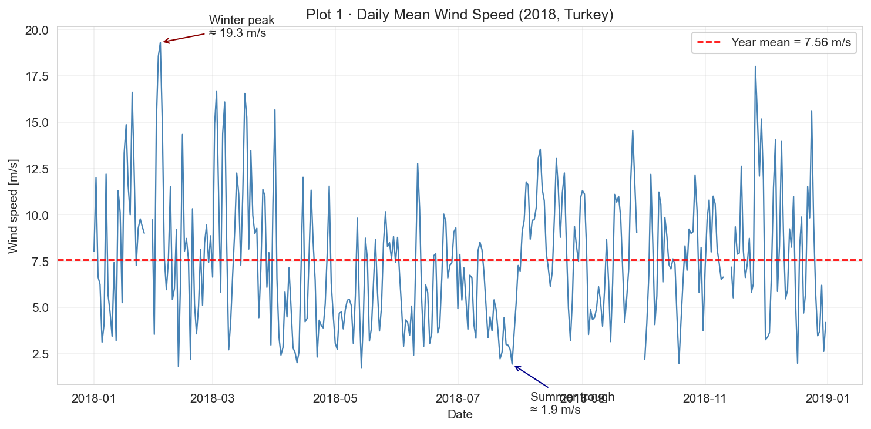
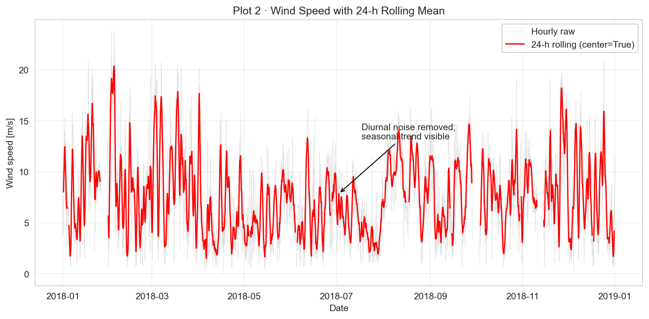
PART II — AI
EDA Findings (1/2) — Time-Series Views
Plot 1 daily mean wind · Plot 2 24-h rolling smoothing
Plot 1 · Daily mean wind speed
Plot 2 · 24-h rolling mean
• Year mean = 7.56 m/s (dashed red line on plot).
• Winter peak ~10 m/s (Nov-Feb); summer trough ~4 m/s (Jun-Aug).
• Take-away: annual output strongly winter-skewed.
• window = 24 (one diurnal cycle), center=True (no phase lag).
• Hourly noise removed; seasonal trend visible (red line).
• Take-away: use this curve to flag sensor drift or long calm spells.
★ Next slide: Plot 3 (correlation) + Plot 4 (power curve).
P8 / 9 · AI Part

Slide 9
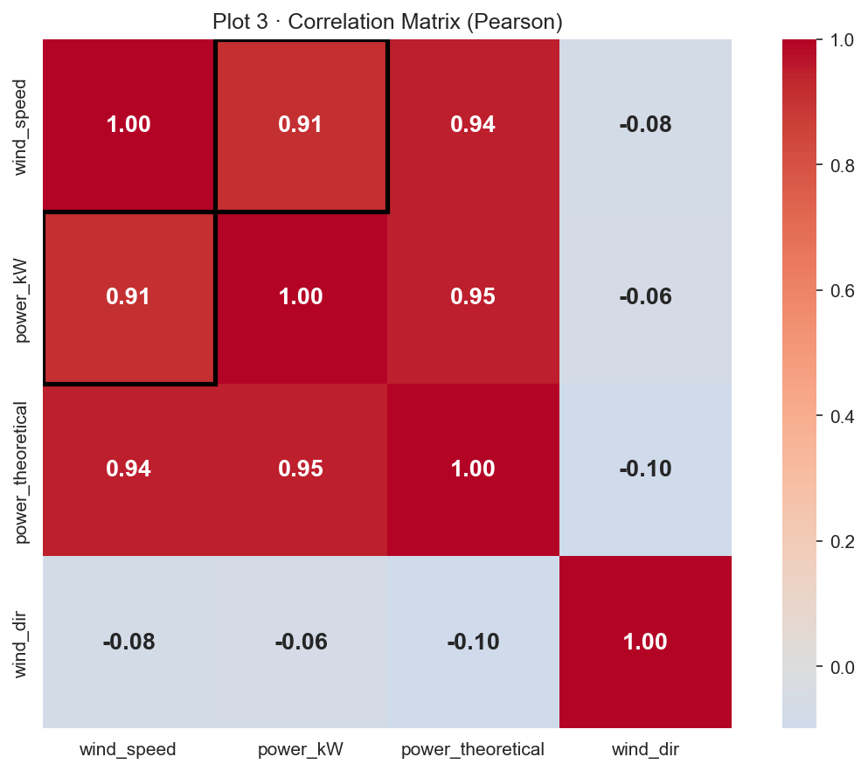
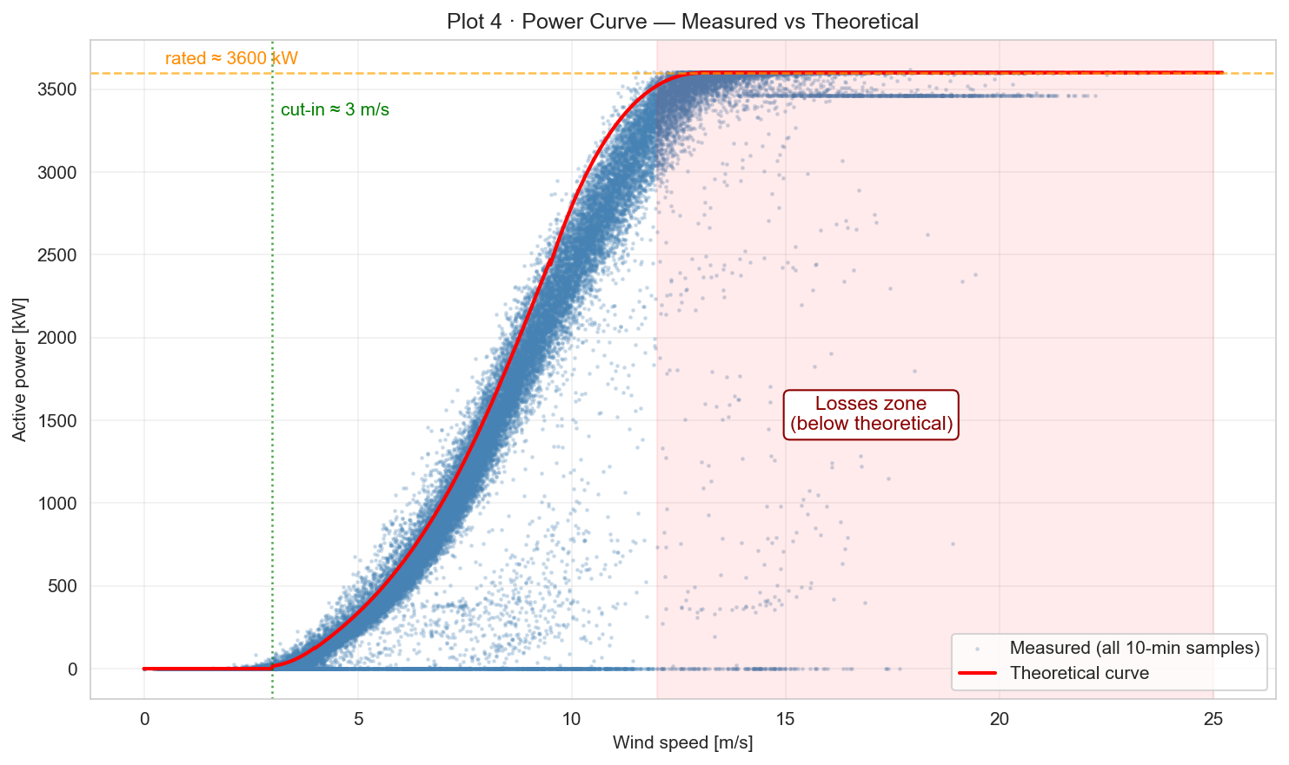
PART II — AI
EDA Findings (2/2) — Statistical & Curve Views
Plot 3 correlation matrix · Plot 4 power curve
Plot 3 · Correlation matrix (Pearson)
Plot 4 · Power curve (measured vs theoretical)
• wind_speed ↔ power_kW = 0.91 (boxed cell on plot).
• wind_dir correlations ≈ 0 — yaw control makes direction irrelevant.
• Take-away: wind speed is THE dominant predictor.
• Cubic rise 3-12 m/s; saturation at rated 3600 kW.
• Red-shaded zone above 12 m/s: many points below theoretical → losses.
• Take-away: losses zone = curtailment / faults, future modelling target.
★ Tonight's deliverable: a clean, narrated EDA — same template will be reused on OrcaFlex T(t), C(t) outputs.
P9 / 9 · AI Part

