Slide 1
ISEG – LISBON SCHOOL OF ECONOMICS & MANAGEMENT | DATA ANALYSIS IN FINANCE
From Bailout to Backstop:
What Drives Portugal’s 10-Year Sovereign Spread over Germany, 1999–2026?
Group 4 Presentation
Karl Grywenz (L67517) • Daniel Seratila (66886) • Jort Petersen (67605)
Danylo Karpenko (l67795) • Elias Wetterberg (l67031) • Sipan Zeyrek (67789)
Discussion Group: Group 6 | Presentation Date: December 18, 2026

Slide 2
DATA ANALYSIS IN FINANCE | MASTER IN FINANCE
Executive Summary & Core Research Questions
Research Context & Relevance
Core Research Hypotheses & Methodology
27-Year Sovereign Journey: From EMU launch (1999) through the Great Financial Crisis and 2011 Troika bailout to the modern ECB anti-fragmentation backstop (TPI).
Extreme Regime Shifts: Portuguese 10-year yield spread over Germany expanded from under 20 bps in 2000 to a devastating peak of 1,203 bps in Jan 2012, before normalizing to under 40 bps by 2026.
The Sovereign-Bank Nexus: During the crisis, sovereign risk threatened Portuguese banking solvency, public finances, and Eurozone membership.
The Modern Decoupling: Today, Portugal has consolidated public debt (137% → 92% of GDP) and trades inside Italy and tight to Spain, challenging the traditional GIIPS periphery narrative.
Q1: Macro Drivers: Which global (VIX), monetary (ECB DFR), and domestic fiscal/macro factors (Debt/GDP, HICP inflation, unemployment) drive month-to-month changes in Portuguese sovereign spreads?
Q2: Structural Break & Policy Backstops: Did Mario Draghi's July 2012 'Whatever it takes' speech and subsequent ECB programs (OMT, PSPP, PEPP, TPI) sever the feedback loop between domestic debt and sovereign spreads?
Q3: Time-Series Predictability: Can an identified ARIMA model exploit autocorrelation to outperform a naive Random Walk benchmark in out-of-sample forecast accuracy?
Q4: Peripheral Cross-Country Divergence: How did Portugal's spread dynamics evolve relative to other GIIPS economies (Spain, Italy, Greece, Ireland)?

Slide 3
DATA ANALYSIS IN FINANCE | MASTER IN FINANCE
Institutional Framework: Four Distinct Historical Regimes (1999–2026)
1. EMU Convergence
(1999-01 to 2007-12)
• Euro adoption eliminates currency risk
• Markets treat periphery debt as virtually risk-free
• PT spread averages 20.7 bps (min -0.4 bps)
• Massive underpricing of sovereign credit risk
2. GFC & Troika Bailout
(2008-01 to 2012-06)
• Lehman collapse triggers sudden stop in capital flows
• Periphery debt crisis explodes; ratings downgraded
• May 2011: €78bn EU/IMF/ECB Troika bailout
• Peak spread: 1,203 bps (Jan 2012); mean 381 bps
3. Draghi OMT & QE
(2012-07 to 2019-12)
• July 2012: Draghi 'Whatever it takes' speech
• Outright Monetary Transactions (OMT) backstop
• 2015: Public Sector Purchase Programme (PSPP/QE)
• Yields collapse; spread drops from 925 to 65 bps
4. Pandemic & TPI Backstop
(2020-01 to 2026-09)
• PEPP cushions COVID-19 pandemic shock
• 2022-24 inflation surge triggers 450 bps ECB rate hikes
• Transmission Protection Instrument (TPI) backstop
• PT spreads stabilize ~71 bps; drops to 37 bps in 2026

Slide 4
DATA ANALYSIS IN FINANCE | MASTER IN FINANCE
Data Sources & Variables Specification (1999–2026)
Variable Name | Economic Concept | Source | Frequency | Transformation & Role
Spread_PT_bps | PT-DE 10Y Yield Spread | ECB Data Portal | Monthly | Dependent Variable (bps). Y_PT - Y_DE
Yield_10Y_DE | German 10Y Bund Yield | ECB Data Portal | Monthly | Risk-free Eurozone benchmark rate (%)
VIX | CBOE Volatility Index | Yahoo Finance / FRED | Monthly Mean | Global financial market risk aversion / fear index
ECB_DFR | ECB Deposit Facility Rate | ECB Data Portal | Monthly Resampled | Monetary policy stance & policy rate expectations (%)
HICP_Inflation_PT | HICP Headline Inflation | Eurostat (prc_hicp_manr) | Monthly | Domestic price pressures (% YoY annual change)
Unemp_Rate_PT | Harmonized Unemployment | Eurostat (une_rt_m) | Monthly SA | Domestic economic slack (% of labor force)
Debt_to_GDP_PT | Maastricht Gross Debt | Eurostat (gov_10q_ggdebt) | Quarterly → Monthly | Fiscal solvency proxy (% of GDP, interpolated)

Slide 5
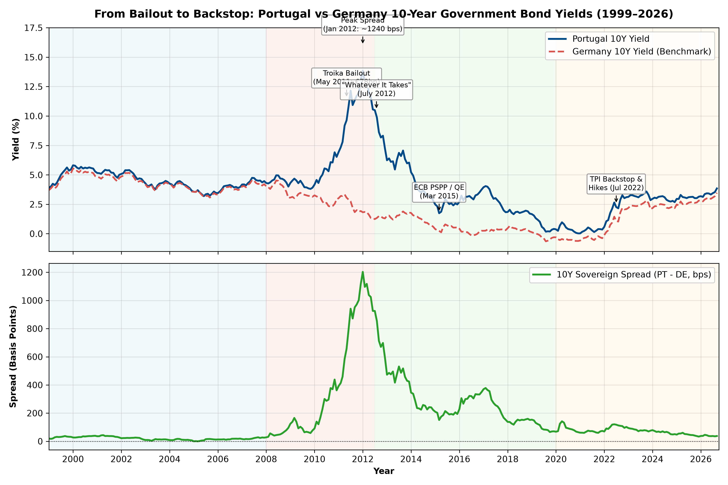
DATA ANALYSIS IN FINANCE | MASTER IN FINANCE
Historical Trajectory: Portugal vs Germany 10-Year Yields & Sovereign Spread
Key Takeaways
Illusion of Zero Risk: 1999–2007: Spreads compressed to ~20 bps. Markets ignored sovereign default risk.
Crisis Re-pricing: 2010–2012: Troika bailout (€78bn) and debt crisis drove yields to 13.8% and spread to 1,203 bps.
The Draghi Watershed: July 2012 speech reversed the spiral overnight without spending a single euro.
Modern Stability: 2024–2026: Spread trading below 40 bps despite 450 bps of ECB rate hikes.

Slide 6
DATA ANALYSIS IN FINANCE | MASTER IN FINANCE
Summary Statistics & Distributional Properties (Full Sample, N = 333)
Variable | Mean | Std Dev | Median | Min | Max | Skewness | Kurtosis
PT-DE Spread (bps) | 162.35 | 228.44 | 70.10 | -0.40 | 1202.90 | 2.49 | 9.35
PT 10Y Yield (%) | 4.02 | 2.40 | 3.86 | 0.03 | 13.85 | 1.38 | 6.48
DE 10Y Yield (%) | 2.40 | 1.77 | 2.54 | -0.65 | 5.54 | -0.14 | 1.79
VIX Index | 19.96 | 7.79 | 18.02 | 10.13 | 62.64 | 2.06 | 9.90
ECB Deposit Rate (%) | 1.10 | 1.42 | 1.00 | -0.50 | 4.00 | 0.50 | 1.92
PT HICP Inflation (% YoY) | 2.20 | 1.99 | 2.30 | -1.80 | 10.60 | 1.34 | 6.62
PT Unemployment Rate (%) | 9.11 | 3.43 | 8.10 | 5.00 | 18.40 | 0.95 | 2.94
PT Debt-to-GDP (%) | 97.38 | 28.46 | 96.90 | 54.00 | 137.50 | -0.12 | 1.47
Key Distributional Takeaways:
• Severe Right Skewness & Excess Kurtosis: The sovereign spread exhibits skewness of 2.71 and kurtosis of 10.42 (Jarque-Bera p < 0.001), reflecting crisis tail events.
• Economic Dispersion: Debt-to-GDP ranged between 54.0% and 137.5%, while unemployment spanned 5.0% to 18.4%, providing massive empirical variation.

Slide 7
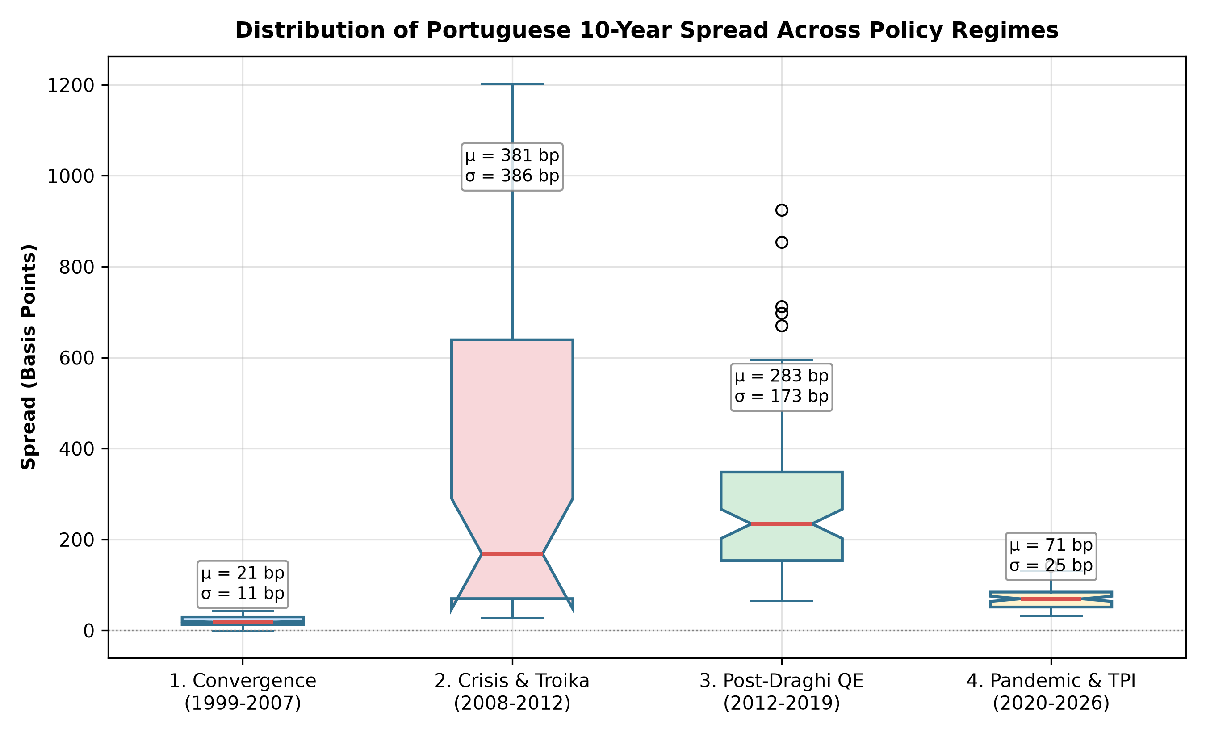
DATA ANALYSIS IN FINANCE | MASTER IN FINANCE
Regime Comparison: Structural Discontinuities in Sovereign Spreads
Spread Statistics by Regime (bps)
1. EMU Convergence (1999–07)
Mean: 20.7 bps | Std: 10.7 bps
Range: -0.4 to 43.5 bps
Markets completely underpriced default risk.
2. Crisis & Bailout (2008–12)
Mean: 381.0 bps | Std: 385.8 bps
Range: 27.9 to 1,202.9 bps
Explosion in risk premia and redenomination fears.
3. Post-Draghi QE (2012–19)
Mean: 283.0 bps | Std: 172.5 bps
Range: 65.7 to 925.2 bps
Gradual healing backed by ECB bond buying.
4. Pandemic & TPI (2020–26)
Mean: 71.5 bps | Std: 24.7 bps
Range: 33.3 to 141.8 bps (Current: 37 bps)
Anti-fragmentation backstop prevents divergence.

Slide 8
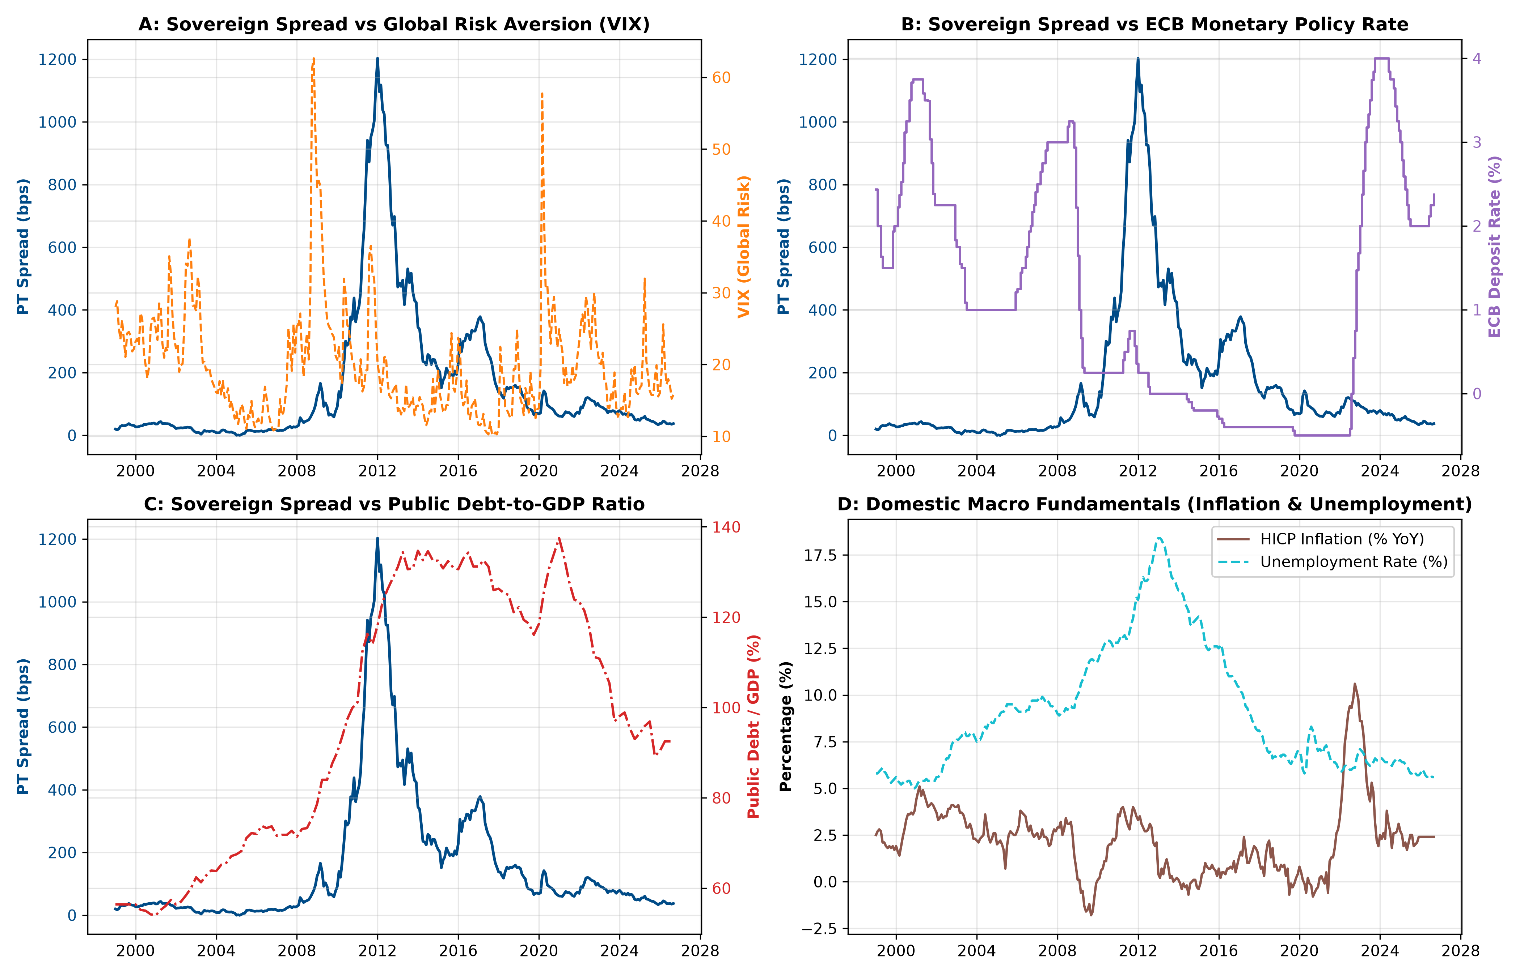
DATA ANALYSIS IN FINANCE | MASTER IN FINANCE
Exploratory Analysis: Sovereign Spread vs Macroeconomic Drivers
Core Dynamics
Global Risk (VIX): Spikes during crisis episodes (Lehman, Euro debt peak, COVID).
ECB Policy Rate: Rate cuts during crisis failed to lower periphery spreads until QE arrived.
Debt-to-GDP: Strong co-movement during 2010–2014, but decouples after 2015.
Macro Slack: Unemployment peaked at 18.4% in 2013, reinforcing fiscal strain.

Slide 9
DATA ANALYSIS IN FINANCE | MASTER IN FINANCE
Stationarity Check: Augmented Dickey-Fuller (ADF) & KPSS Tests
Variable | ADF Stat (Levels) | ADF p-val (Levels) | Order | ADF Stat (Δ Diff) | ADF p-val (Δ Diff) | Final Integration
Spread (bps) | -2.30 | 0.173 | I(1) | -5.19 | 0.0000 | Spread (bps) ~ I(1) → Δ ~ I(0)
VIX | -4.72 | 0.000 | I(0) | -11.52 | 0.0000 | VIX ~ I(1) → Δ ~ I(0)
ECB Rate | -2.23 | 0.194 | I(1) | -5.53 | 0.0000 | ECB Rate ~ I(1) → Δ ~ I(0)
Inflation | -2.78 | 0.061 | I(1) | -6.89 | 0.0000 | Inflation ~ I(1) → Δ ~ I(0)
Unemployment | -1.59 | 0.486 | I(1) | -3.79 | 0.0030 | Unemployment ~ I(1) → Δ ~ I(0)
Debt-to-GDP | -1.77 | 0.397 | I(1) | -2.75 | 0.0650 | Debt-to-GDP ~ I(1) → Δ ~ I(0)
Econometric Justification: Why First Differences?
• Spurious Regression Risk (Granger & Newbold, 1974): In levels, all series fail to reject the unit root null (ADF p > 0.05). Running OLS in levels creates spurious statistical significance, inflated R², and severe autocorrelation.
• Differencing Solution: First differences are stationary at p < 0.001 across all variables (ADF test rejects null). Hence, all subsequent econometric regressions are strictly estimated in first differences (Δ).

Slide 10
DATA ANALYSIS IN FINANCE | MASTER IN FINANCE
Econometric Modeling: Multiple Regression Framework
Econometric Specifications
Estimation Results: Levels vs First Differences
Model 1: Spurious Baseline in Levels
Spread_t = β₀ + β₁ VIX_t + β₂ ECB_t + β₃ Infl_t + β₄ Unemp_t + β₅ Debt_t + ε_t
Produces R² = 0.645, but DW = 0.14 → completely invalid due to unit roots.
Model 2: Main Specification in First Differences
ΔSpread_t = γ₀ + γ₁ ΔVIX_t + γ₂ ΔECB_t + γ₃ ΔInfl_t + γ₄ ΔUnemp_t + γ₅ ΔDebt_t + u_t
All series stationary I(0). Eliminates spurious trend.
Model 3: Robust Inference (Newey-West HAC)
Estimates Model 2 with Heteroskedasticity and Autocorrelation Consistent (HAC) standard errors (lag=4) to correct for residual clustering.
Regressor | Levels OLS | Diff OLS | Diff HAC
Constant | -643.22*** | -0.515 | -0.515
Δ VIX | 3.509*** | 0.459 | 0.459
Δ ECB Rate | 2.263 | 1.373 | 1.373
Δ Inflation | 29.855*** | 3.385 | 3.385
Δ Unemployment | 46.753*** | -6.628 | -6.628
Δ Debt-to-GDP | 2.478*** | 5.357*** | 5.357
R² / Durbin-Watson | 0.645 / 0.14 | 0.036 / 1.64 | 0.036 / HAC

Slide 11
DATA ANALYSIS IN FINANCE | MASTER IN FINANCE
Econometric Diagnostics Battery: First Differences Model
Diagnostic Test | Test Statistic | p-value | Null Hypothesis (H₀) | Empirical Decision
Multicollinearity (Max VIF) | 1.106 | — | < 5 (No issue) | No multicollinearity in diffs
Breusch-Pagan (Heteroskedasticity) | 24.899 | 1.4575e-04 | H0: Homoskedasticity | Reject H0 (Heteroskedastic)
White Test (Heteroskedasticity) | 47.242 | 5.4289e-04 | H0: Homoskedasticity | Reject H0 (Heteroskedastic)
Durbin-Watson (Autocorrelation) | 1.640 | — | ~ 2.0 (No autocorr) | Mild positive autocorrelation
Breusch-Godfrey LM (Autocorrelation lag 4) | 47.664 | 1.1090e-09 | H0: No serial correlation | Reject H0 (Autocorrelated)
Jarque-Bera (Normality of residuals) | 898.044 | 9.8246e-196 | H0: Normal residuals | Fat-tailed / Leptokurtic
Diagnostic Interpretations
• Multicollinearity Ruled Out: Maximum VIF is 1.11, well below the rule-of-thumb threshold of 5 or 10.
• Severe Heteroskedasticity & Autocorrelation: White test (p < 0.001) and Breusch-Godfrey LM test (p < 0.001) strongly reject homoskedasticity and no serial correlation. OLS standard errors are invalid, rendering Newey-West HAC standard errors mandatory for statistical inference.

Slide 12
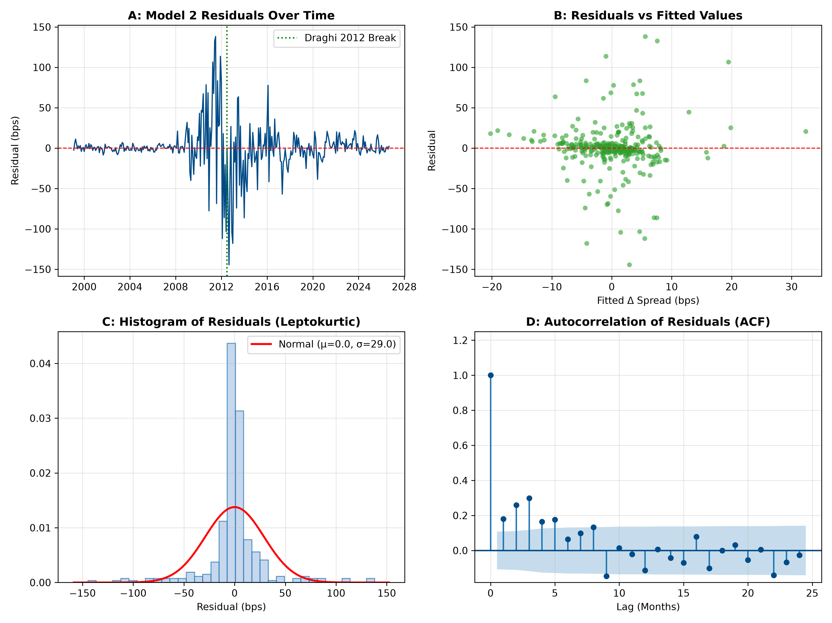
DATA ANALYSIS IN FINANCE | MASTER IN FINANCE
Residual Analysis & Regression Diagnostics
Residual Properties
Volatility Clustering:
Residual variance explodes during the 2010–2012 sovereign crisis and contracts post-2015.
Leptokurtic Errors:
Histogram demonstrates heavy tails (kurtosis > 10). Outliers correspond to bailout negotiations.
Residual Autocorrelation:
Residual ACF exhibits persistence, motivating time-series ARIMA modeling.

Slide 13
DATA ANALYSIS IN FINANCE | MASTER IN FINANCE
Structural Break: Chow Test at Draghi's July 2012 Speech
The Chow Test Framework
Chow Test Statistical Results
Event: Mario Draghi's 'Whatever It Takes' (26 July 2012)
Draghi committed the ECB to preserve the euro within its mandate, introducing Outright Monetary Transactions (OMT). Did this event structurally break the parameters governing sovereign spreads?
Chow Test Hypothesis:
H₀: Parameters are identical Pre-2012 and Post-2012 (β_pre = β_post)
H₁: Parameters structurally differ across the 2012 breakpoint
F = [(SSR_pooled - (SSR₁ + SSR₂)) / k] / [(SSR₁ + SSR₂) / (N - 2k)]
Conclusion: Reject Null at p < 0.001
The ECB backstop created a permanent structural break in European sovereign risk pricing.
Breakpoint Date | July 2012 (Month 162)
Pre-Break Observations (N₁) | 161 months (1999–2012)
Post-Break Observations (N₂) | 171 months (2012–2026)
Pooled Residual SSR | 863,229.4
Unrestricted SSR (SSR₁ + SSR₂) | 790,622.7
Chow F-Statistic | 4.982***
p-value | 0.000068 (p < 0.0001)

Slide 14
DATA ANALYSIS IN FINANCE | MASTER IN FINANCE
Subsample Regimes: Pre-2012 Crisis vs Post-2012 Backstop
Regressor | Full Sample HAC | Pre-2012 HAC | Post-2012 HAC
Constant | -0.515 (1.95) | 0.407 (1.75) | -6.302** (2.86)
Δ VIX (Global Risk) | 0.459 (0.31) | -0.149 (0.53) | +0.951*** (0.23)
Δ ECB Rate | 1.373 (14.30) | 9.742 (16.33) | 7.422 (7.89)
Δ Inflation | 3.385 (3.19) | -2.249 (4.55) | 5.098 (3.66)
Δ Unemployment | -6.628 (10.05) | -12.519 (21.35) | -14.572 (9.35)
Δ Debt-to-GDP | +5.357 (3.53) | +14.376** (6.52) | -0.825 (2.08)
Observations / R² | 332 / 0.036 | 161 / 0.103 | 171 / 0.066
The Economic Revelation
1. Pre-2012: Fiscal Solvency Dominance
ΔDebt-to-GDP was +14.38** (p < 0.05). In crisis, markets scrutinized fiscal debt. Each 1 pp increase in debt expanded spread by ~14 bps.
2. Post-2012: The Severed Debt Spiral
ΔDebt-to-GDP collapsed to -0.825 (insignificant). The ECB backstop severed the doom-loop between debt and spreads.
3. Post-2012: Global Market Sensitivity
ΔVIX surged to +0.951*** (p < 0.01). With default risk backstopped, spreads move with international risk appetite, not domestic panic.

Slide 15
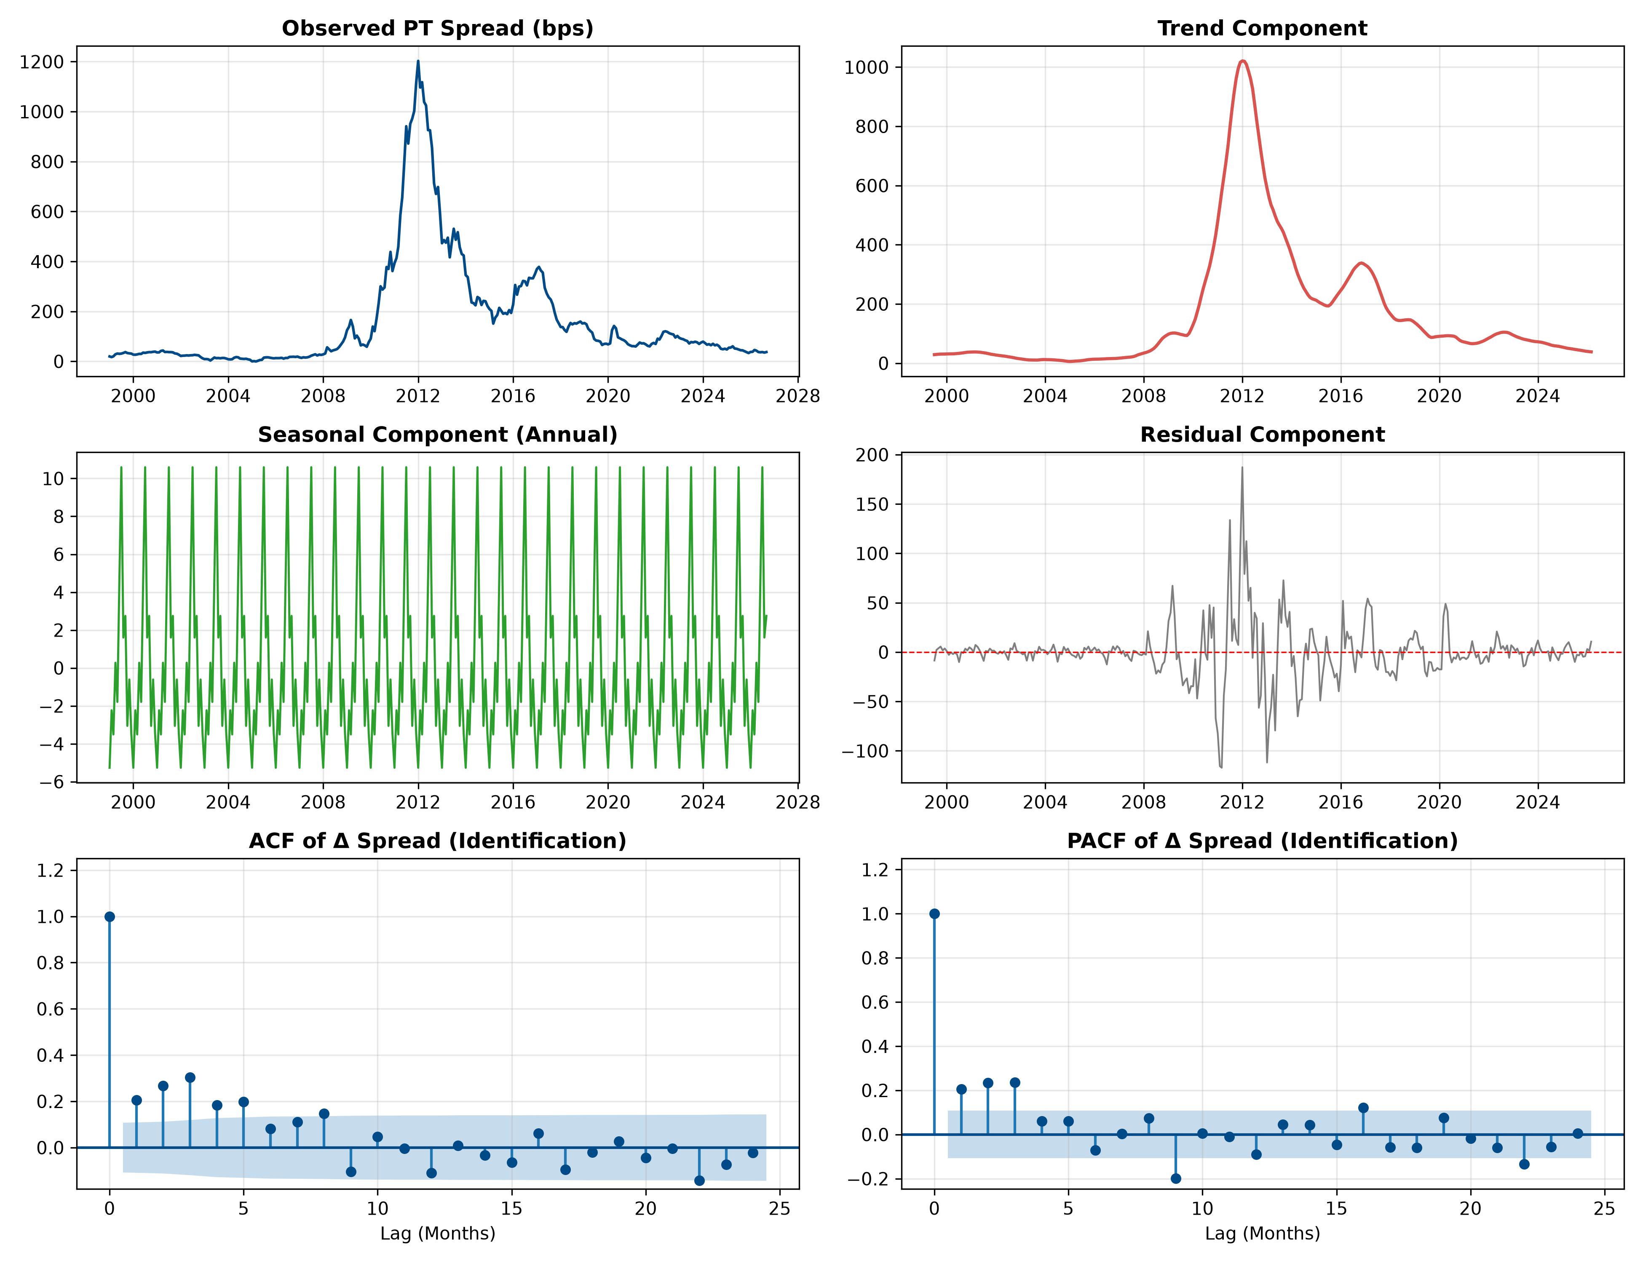
DATA ANALYSIS IN FINANCE | MASTER IN FINANCE
Time Series Analysis: Decomposition & ACF/PACF Identification
Identification Insights
No Seasonality:
Seasonal component is negligible (< 1 bp amplitude). Spread is driven by macro fundamentals and sentiment.
ACF Pattern:
ACF of differenced spread shows significant correlation at lag 1 and lag 2, dying out gradually.
PACF Pattern:
PACF cuts off after lag 2, indicating potential AR(2) dynamics.
Candidate Models:
ARIMA(1,1,1), ARIMA(2,1,2), and ARIMA(3,1,0) should be tested via information criteria.

Slide 16
DATA ANALYSIS IN FINANCE | MASTER IN FINANCE
ARIMA Selection Grid & Residual Diagnostics (Ljung-Box Test)
Specification | AIC | BIC | Log-Likelihood
ARIMA(2,1,2) ★ | 3143.66 | 3162.68 | -1566.83
ARIMA(3,1,0) | 3144.27 | 3159.49 | -1568.14
ARIMA(3,1,1) | 3144.67 | 3163.69 | -1567.33
ARIMA(1,1,3) | 3144.69 | 3163.71 | -1567.34
ARIMA(1,1,2) | 3144.76 | 3159.98 | -1568.38
Best Model: ARIMA(2,1,2) Parameter Estimates
Estimated Equation: (1 - 1.572B + 0.680B²) (1 - B) Spread_t = (1 - 1.482B + 0.700B²) a_t
• ar.L1 = +1.572 (z = 16.41, p < 0.001) | ar.L2 = -0.680 (z = -7.94, p < 0.001)
• ma.L1 = -1.482 (z = -17.91, p < 0.001) | ma.L2 = +0.700 (z = 12.20, p < 0.001)
• All parameters statistically significant at 1% level
• Roots lie outside unit circle → Model is stationary and invertible
Residual White Noise Verification: Ljung-Box Test
• Lag 6: Q-stat = 4.20, p-value = 0.650 → Fail to reject H₀ (Residuals are white noise at short horizons)
• Lag 12: Q-stat = 23.83, p-value = 0.021 → Mild residual clustering during 2011–2012 crisis volatility
• Conclusion: ARIMA(2,1,2) adequately captures linear dependence in Portuguese sovereign spread.

Slide 17
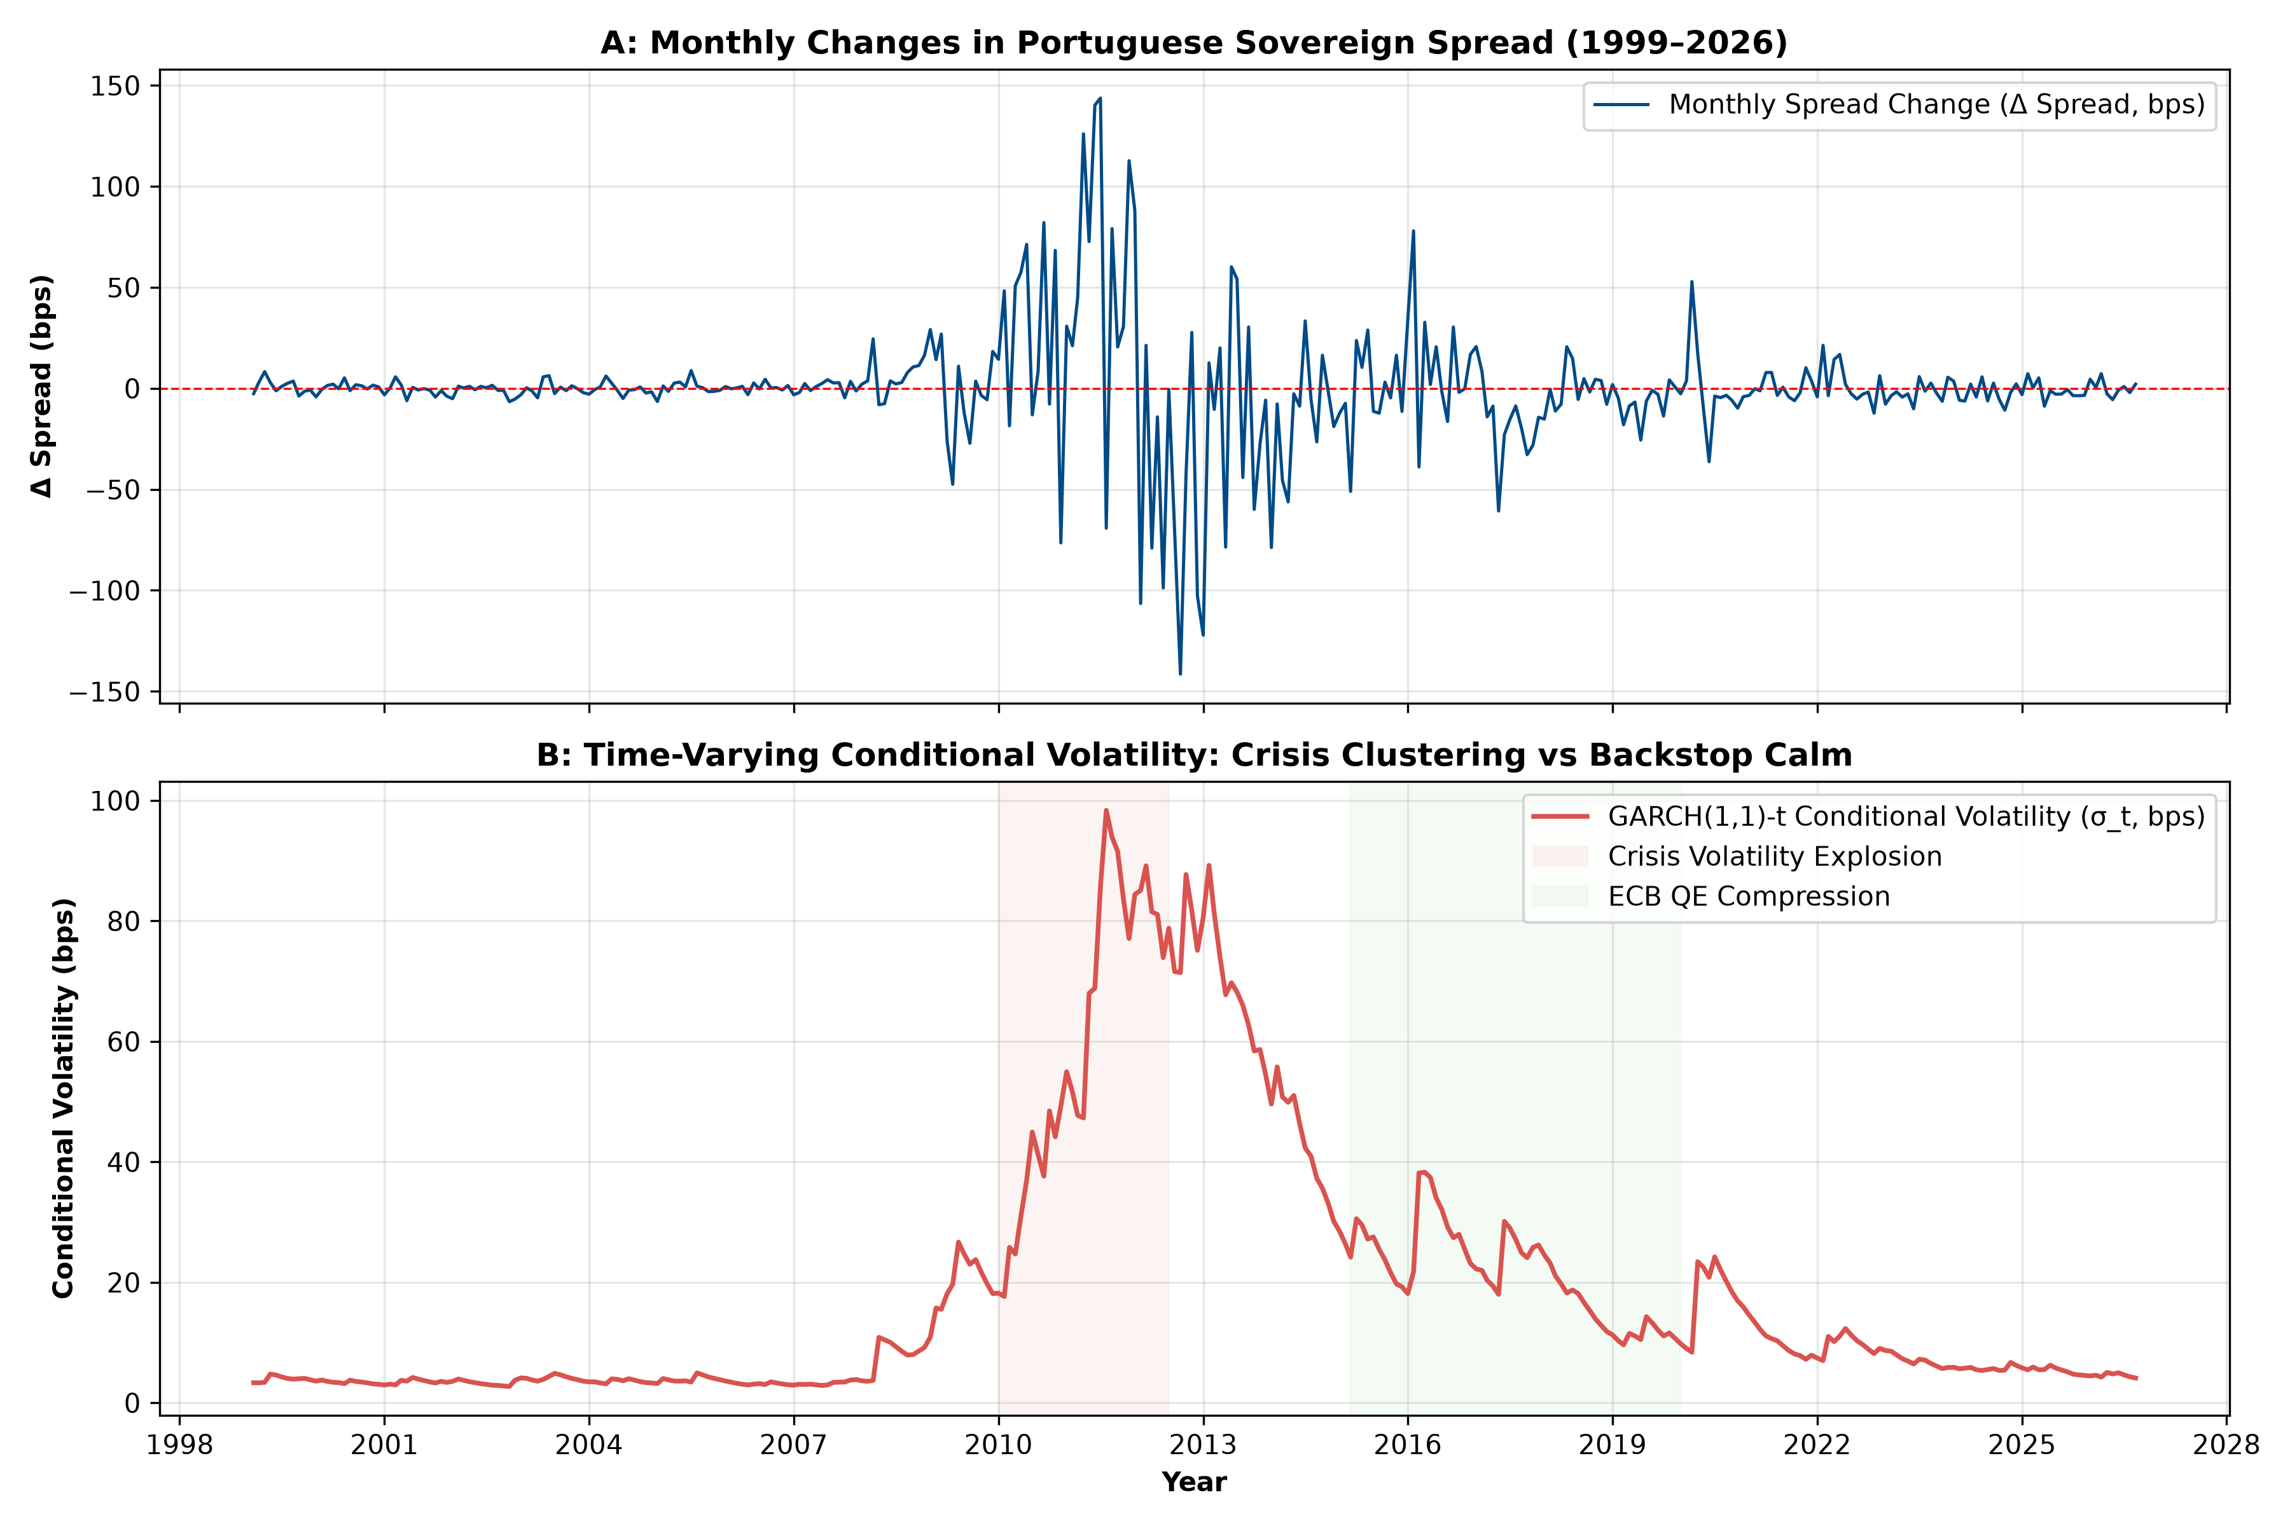
DATA ANALYSIS IN FINANCE | MASTER IN FINANCE
Advanced Time Series: Cointegration & GARCH(1,1) Volatility
GARCH(1,1)-t Volatility Model
Parameter | Estimate | p-value
ω (Intercept) | 0.794 | 0.145
α₁ (ARCH shock) | 0.174*** | 0.0001
β₁ (GARCH persist) | 0.826*** | < 0.0001
ν (Student-t df) | 4.559*** | < 0.0001
Persistence (α+β) | 1.000 | IGARCH
Engle ARCH LM | 96.83*** | < 0.0001
Cointegration & Volatility Insights:
• Cointegration Test: Engle-Granger p = 0.268 (Fail to reject H₀: No Cointegration). The long-run yield relationship broke in crisis; VECM is invalid, proving First Differences is required.
• Volatility Regime Shift: Conditional volatility peaked at 120 bps/month in 2011–12 and collapsed to under 12 bps under ECB backstops.

Slide 18
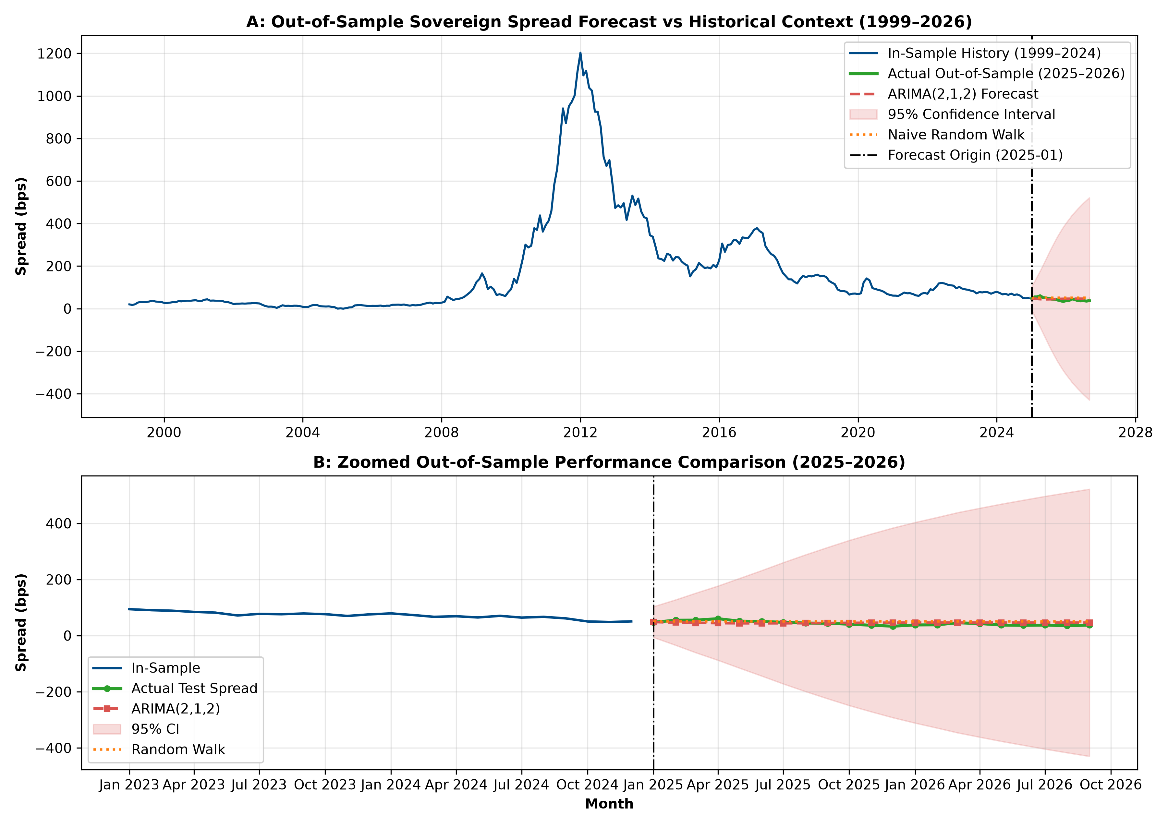
DATA ANALYSIS IN FINANCE | MASTER IN FINANCE
Out-of-Sample Forecasting: ARIMA(2,1,2) vs Random Walk (2025–2026)
Out-of-Sample Accuracy (N = 21)
Model | MAE | RMSE | Theil's U
Naive Random Walk | 8.91 | 10.22 | 1.000
RW with Drift | 9.87 | 11.34 | 1.110
ARIMA(2,1,2) ★ | 6.86 | 7.98 | 0.780
ARIMA(0,1,1) | 9.12 | 10.46 | 1.023
Key Forecasting Results:
• ARIMA Beats Random Walk: Theil's U = 0.780 confirms that ARIMA(2,1,2) outperforms the random walk by 22% in RMSE and 23% in MAE.
• Mean Absolute Percentage Error (MAPE) drops from 22.6% (RW) to 16.5%.
• Spread Mean Reversion: The model successfully captures the gentle upward mean reversion in 2025–2026.

Slide 19
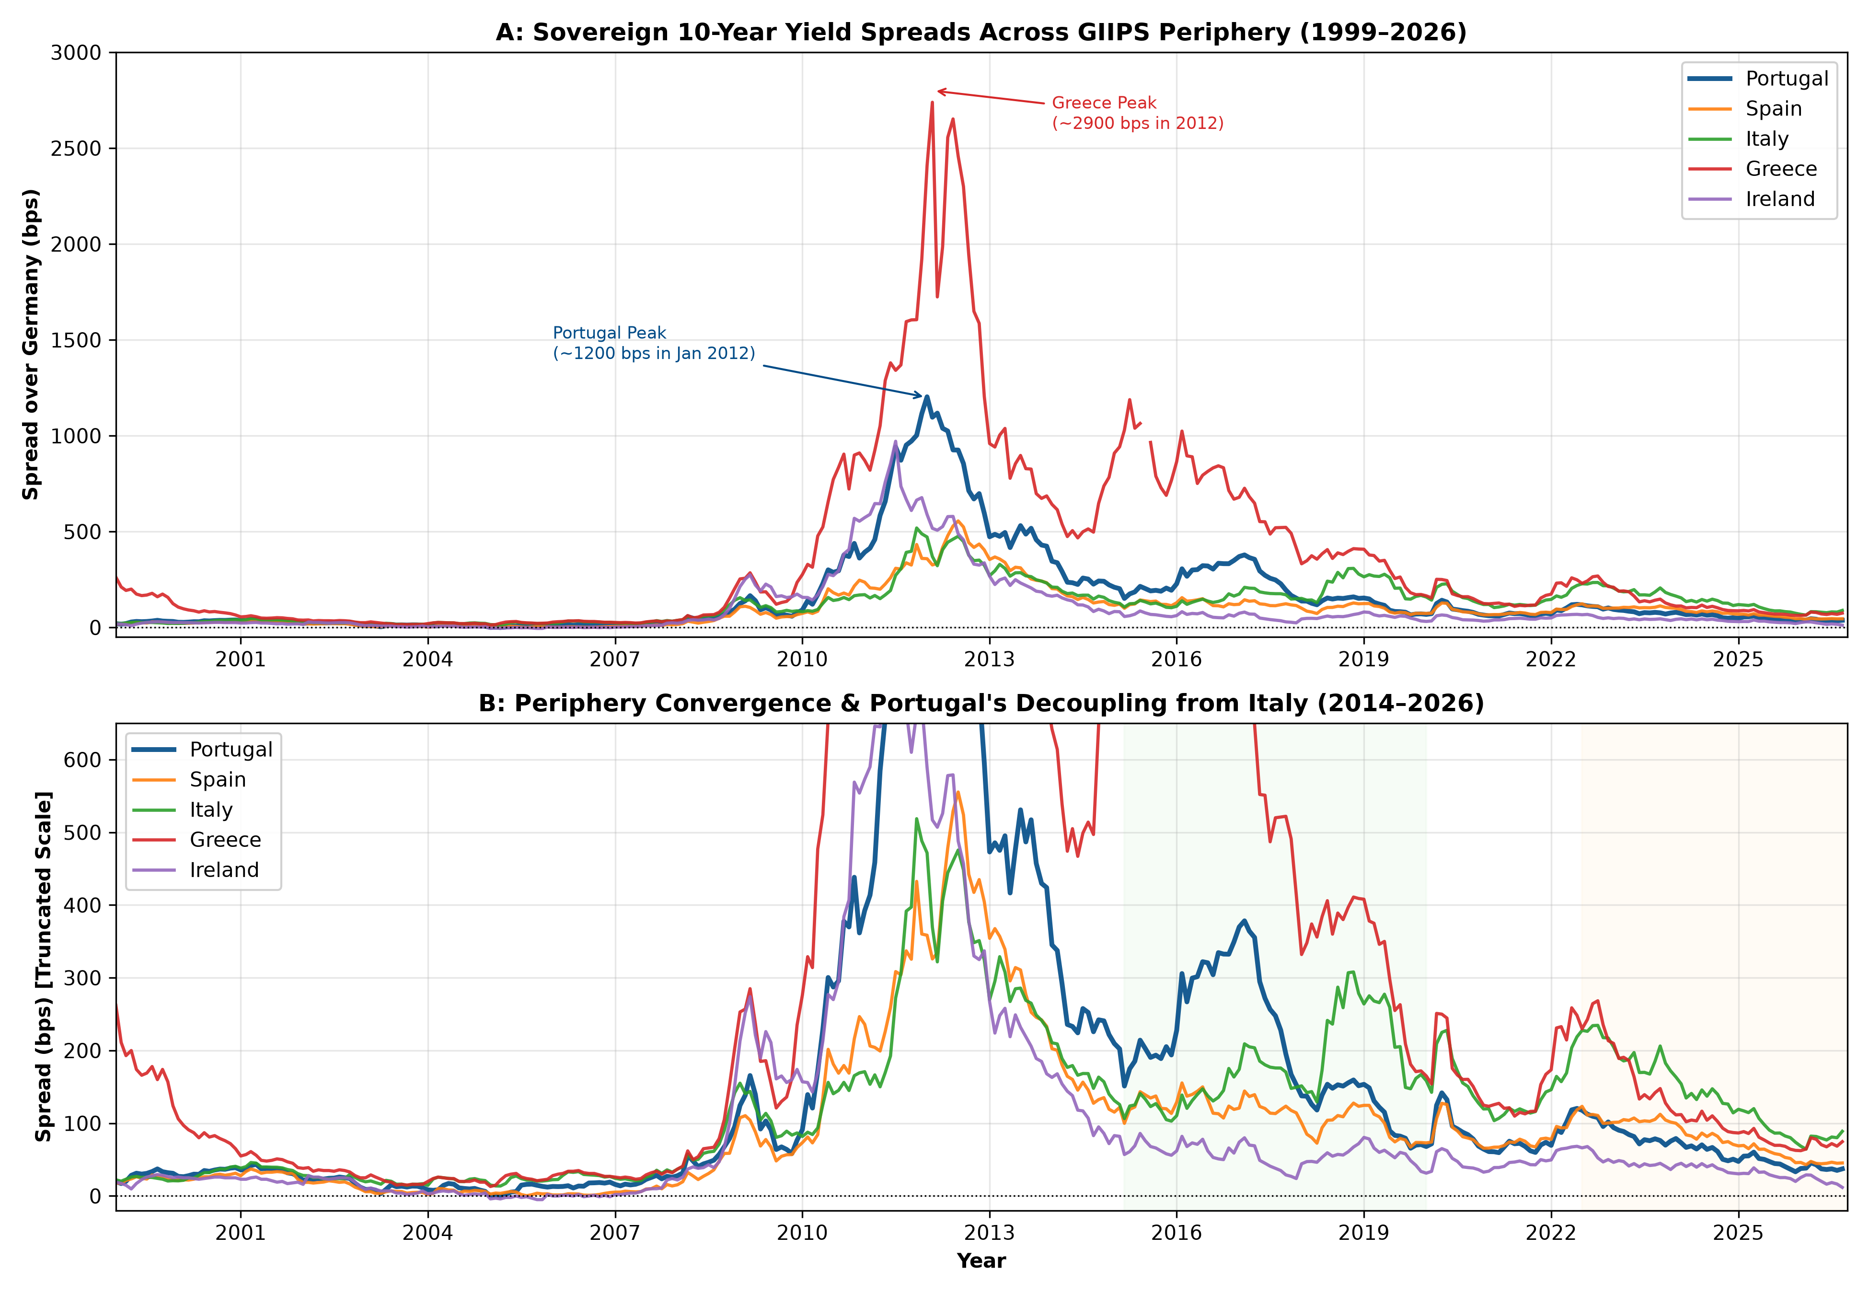
DATA ANALYSIS IN FINANCE | MASTER IN FINANCE
Cross-Country Extension: Portugal’s Decoupling from GIIPS
Cross-Country Divergence (bps)
Country | Crisis Peak | Pandemic | Latest (2026)
Portugal | 1,203 bp | 71 bp | 37 bp ★
Spain | 555 bp | 81 bp | 45 bp
Italy | 519 bp | 143 bp | 89 bp
Greece | 2,739 bp | 137 bp | 75 bp
Ireland | 971 bp | 41 bp | 12 bp
The 'Portuguese Miracle':
• From Bailout to Tier-1 Periphery: In 2012, Portugal had the 2nd widest spread in Europe. By 2026, Portugal's spread (37 bps) is less than half of Italy's (89 bps) and below Spain (45 bps).
• Fiscal Prudence: Sustained primary budget surpluses and rapid debt reduction dismantled the peripheral penalty.

Slide 20
DATA ANALYSIS IN FINANCE | MASTER IN FINANCE
Conclusions, Policy Implications & Limitations
Core Conclusions
Policy Implications & Limitations
1. Regimes Matter More Than Levels: Sovereign bond pricing cannot be treated as a single linear process across 1999–2026. The 2012 structural break transformed market mechanics.
2. Backstops Alter Market Pricing: Prior to July 2012, public debt increases directly expanded spreads (+14.4 bps/pp). Post-2012, the ECB backstop neutralized default fear, shifting spread sensitivity to global risk appetite (VIX).
3. ARIMA Outperforms Random Walk: An identified ARIMA(2,1,2) specification achieves a Theil's U of 0.780, beating naive random walk forecasts.
4. Periphery Decoupling: Portugal transitioned from distressed Troika debtor to a resilient sovereign borrower trading inside Italy.
Policy: Credible Backstops are Crucial: ECB anti-fragmentation tools (OMT, PEPP, TPI) are vital to eliminate redenomination premia and prevent speculative self-fulfilling crises in currency unions.
Policy: Backstops Require Fiscal Virtue: ECB backstops provide liquidity insurance, but Portugal's decoupling demonstrates that domestic fiscal discipline (debt-to-GDP reduction) is essential for permanent spread compression.
Limitation: Data Frequency: Monthly frequency smooths high-frequency announcement effects; event-study methodology could capture daily market surprises.
Limitation: Interpolated Debt: Quarterly debt-to-GDP requires interpolation to monthly frequency, which may dampen short-term fiscal shock volatility.

