Slide 1
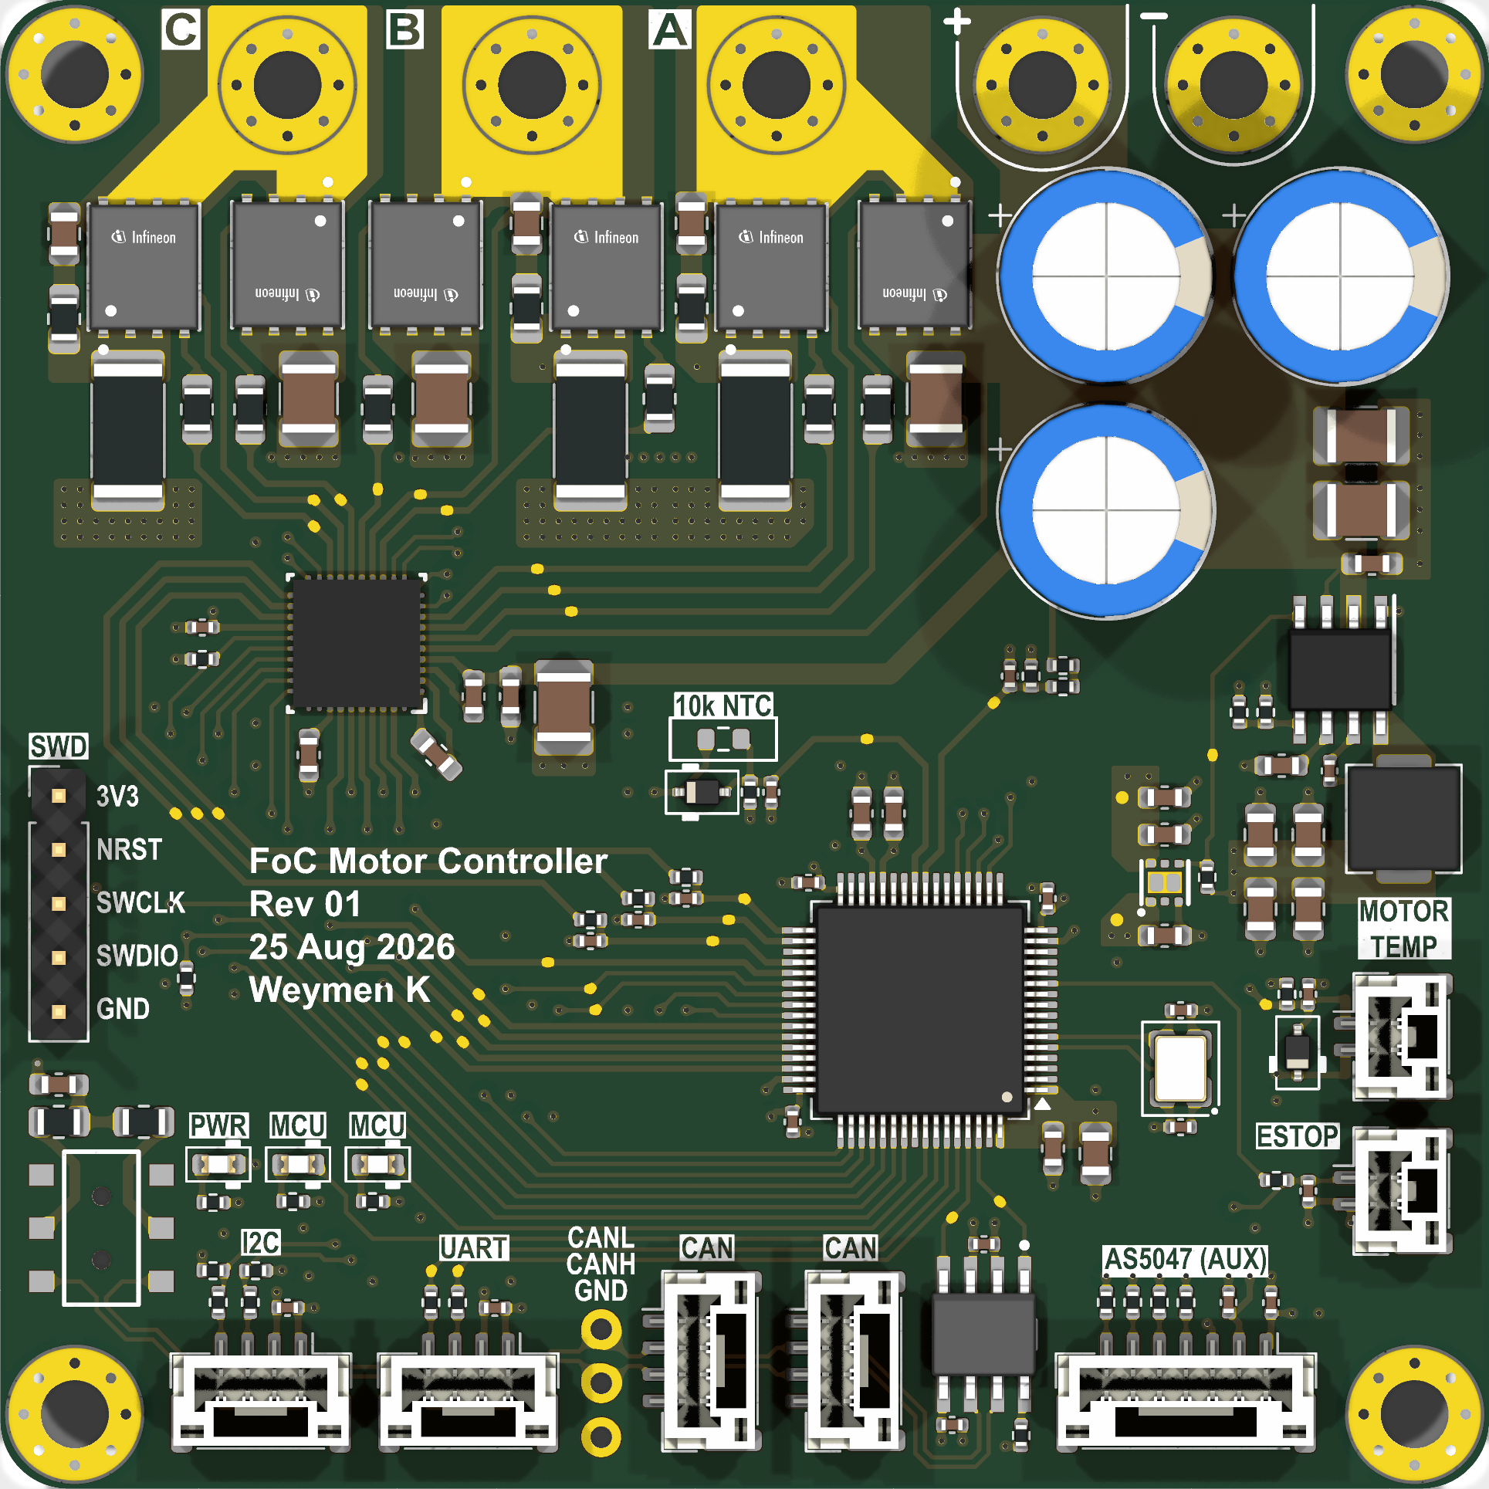
FOC motor controller, Rev 1
Single-axis sensored FOC, 12S bus, one per joint of a QDD robot leg. 70 x 70 mm, 6 layers.
Phase outputs A/B/C
Bolt-on pads to the MN601-S windings.
Bus input +/-
12S, 56 V max, TVS clamp only.
3-phase bridge
6x ISC030N10NM6, 100 V, 3.0 mΩ max, TDSON-8.
Low-side shunts
3x 3 mΩ 2512, Kelvin net ties, ±27.5 A FS.
DRV8323S gate driver
IDRIVE 1/2 A, 3x CSA G=20, VDS/OCP faults, SPI.
DC link
3x 100 µF/100 V + 12x 4.7 µF X7R.
Encoder (B.Cu, behind)
AS5047P 14-bit, SPI, on the rotor axis.
SWD
3V3, NRST, SWCLK, SWDIO, GND.
STM32G431RB
170 MHz. TIM1 centre-aligned 25 kHz, ADC injected at the counter peak.
CAN-FD
TCAN1044A, 2 connectors for daisy-chain.

Slide 2
Back-simulation for bench correlation
Three LTspice decks built from the Rev 1 netlist, the DRV8323 / TIM1 settings in firmware, and the motor constants the firmware measured (MN601-S: R 98 mΩ, Ld 7.9 µH, Lq 11.0 µH, λ 1.389 mV·s, 14 pole pairs).
Operating point: 30 V / 5 A, the KA3005P limit. 25 kHz centre-aligned, 200 ns dead time, IDRIVE code 15, CSA G = 20.
Scope: each deck predicts a waveform the DHO804 (70 MHz, 12-bit) can capture. A 10x probe model (150 nH ground lead, 12 pF tip, 70 MHz) is included where it changes what the scope shows.
Every result is a .meas in the log, not a cursor reading. MOSFET model: behavioural VDMOS fit of the ISC030N10NM6, checked against the datasheet (Rds(on) 2.55 mΩ, Qg 55 nC, Qgd 9.6 nC, plateau 4.6 V).
Left out on purpose: IDRIVE / dead-time sweeps, thermal, ISR budget. They can't be checked one-to-one on this bench.

Slide 3
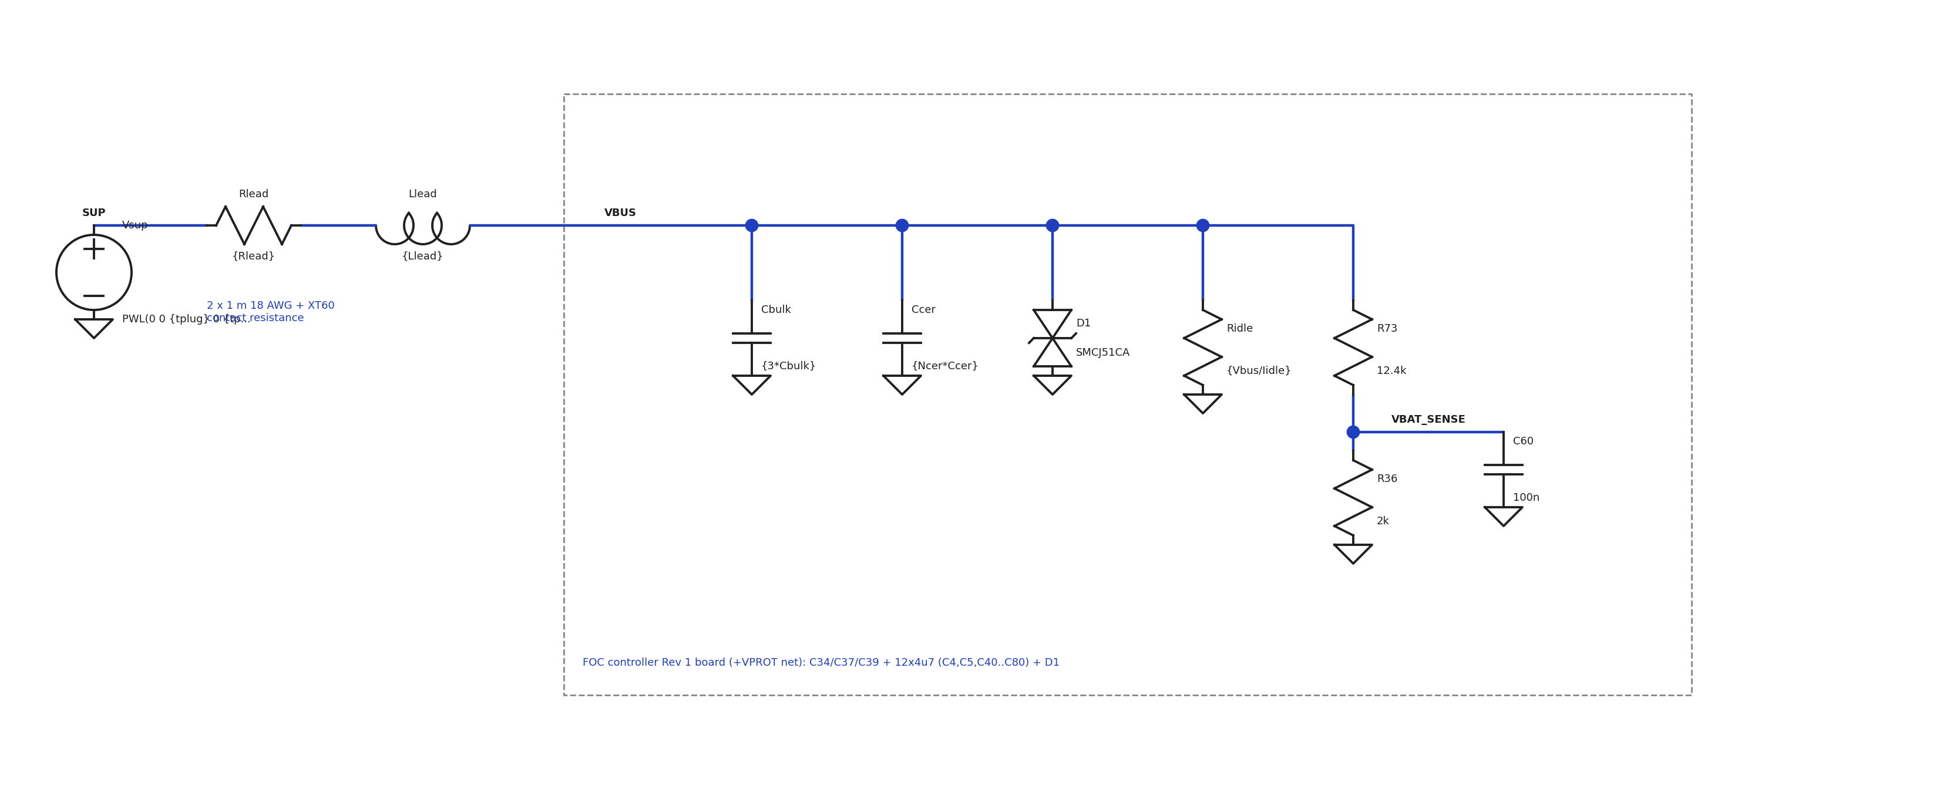
Sim 1 · Hot-plug: circuit
Vsup
30 V step, 50 ns edge: XT60 into a live supply.
Leads
60 mΩ; Llead stepped 0.5 / 2 µH.
Bulk
3x 100 µF, ESR stepped 0.03 / 0.3 Ω.
D1 SMCJ51CA
VBR min 56.7 V, Rd 1.4 Ω.
Ceramics
12x 4.7 µF X7R, derated to 2.4 µF each at 30 V.
VBAT_SENSE
12.4k / 2k, 100 nF, τ = 172 µs. Feeds the firmware OV check.

Slide 4
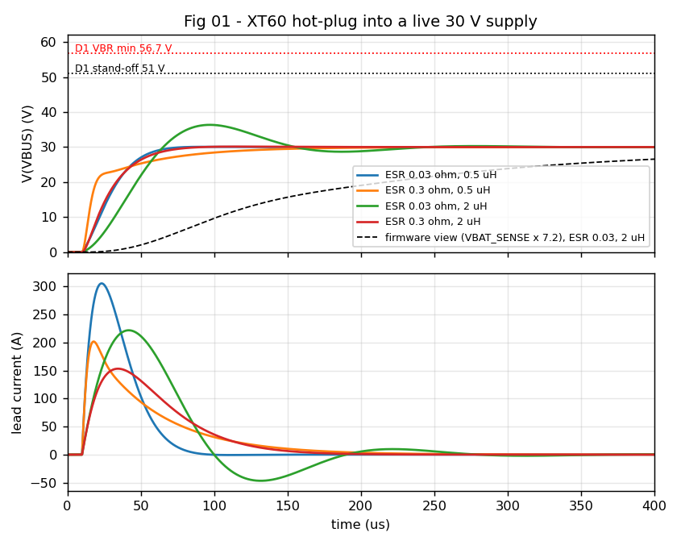
Sim 1 · Hot-plug: result
D1 thresholds
Stand-off 51 V, VBR min 56.7 V. Not reached in any case; D1 never conducts.
Overshoot 36.3 V (+21 %)
Only with low-ESR bulk and 2 µH leads, ringing at 5.6 kHz. With 0.3 Ω ESR the lead LC is overdamped: 30.1 V.
Firmware view
VBAT_SENSE x 7.2. The 172 µs filter hides the transient from the OV check.
Lead current 150-300 A peak
Bounded by the model: ideal source, no contact arc. Real peak is set by the supply's output ESR.

Slide 5
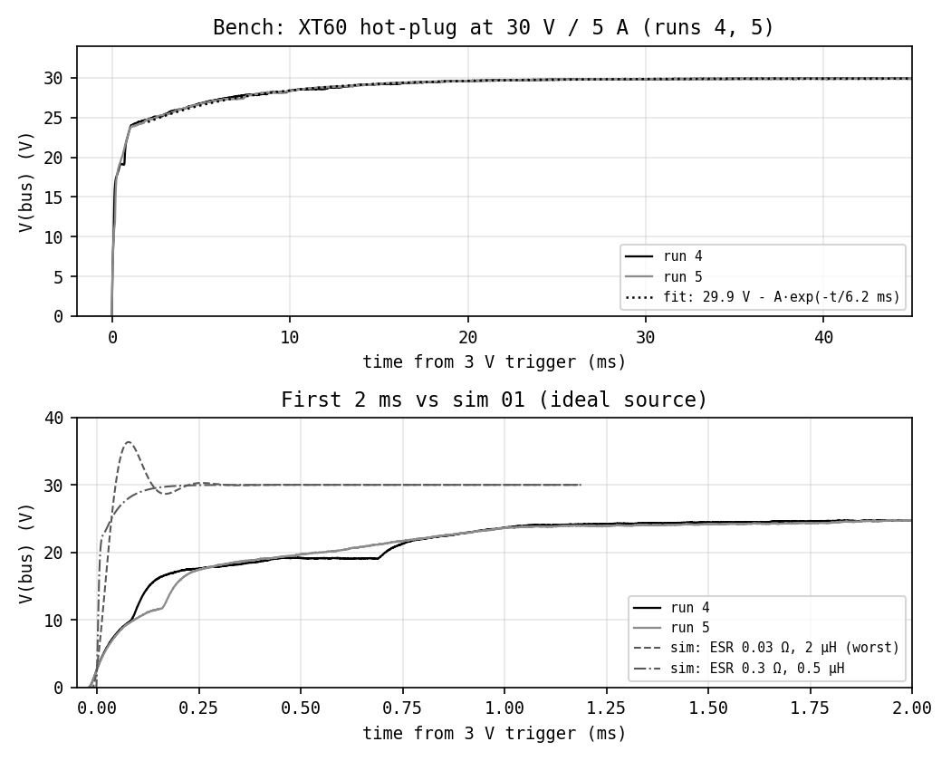
Sim 1 · Hot-plug: bench vs sim
compared with: 01_hot_plug.asc (deck 01 at 30 V, ideal source)
Peak 30.15 V
No overshoot, no ring. Runs 4 and 5 agree within 0.1 V after 1 ms.
CV recovery
Exponential to 29.9 V, τ = 6.2 / 6.8 ms (runs 4 / 5).
Charge sharing, first 1 ms
Supply output cap dumps into the ~360 µF bus: 0 to 23.3 V in 1 ms.
Sim 01 assumed an ideal source
30 V in 50 µs, 36.3 V worst case. The KA3005P can't slew that fast, so the overshoot case does not occur on this bench.
Bench, first 2 ms
XT60 make-break steps during insertion, then 24 V at 1 ms.

Slide 6
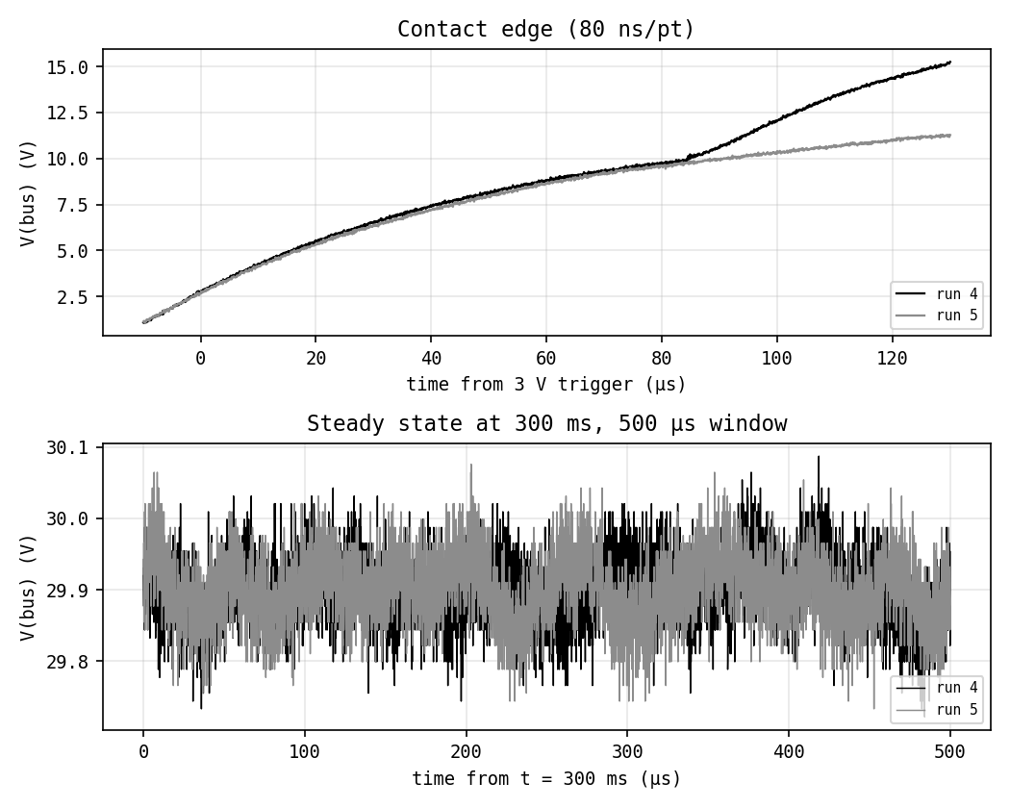
Sim 1 · Hot-plug: contact edge and steady state
Contact edge 0.12 V/µs
About 42 A into 360 µF, set by lead R/L and the supply's output impedance. Runs split at 85 µs: pin make-break.
Steady state 29.90 V
≤ 0.37 V p-p at 5 V/div, mostly the scope noise floor. Real ripple needs AC coupling at 50 mV/div.
Setup
DHO804 CH1, 10x probe, spring ground on C34, 3 V rising single trigger, 50 ms/div, 10 Mpts (80 ns/pt). Runs 1-3 discarded: the ground spring sat on flux residue and gave ±5 V steps.

Slide 7
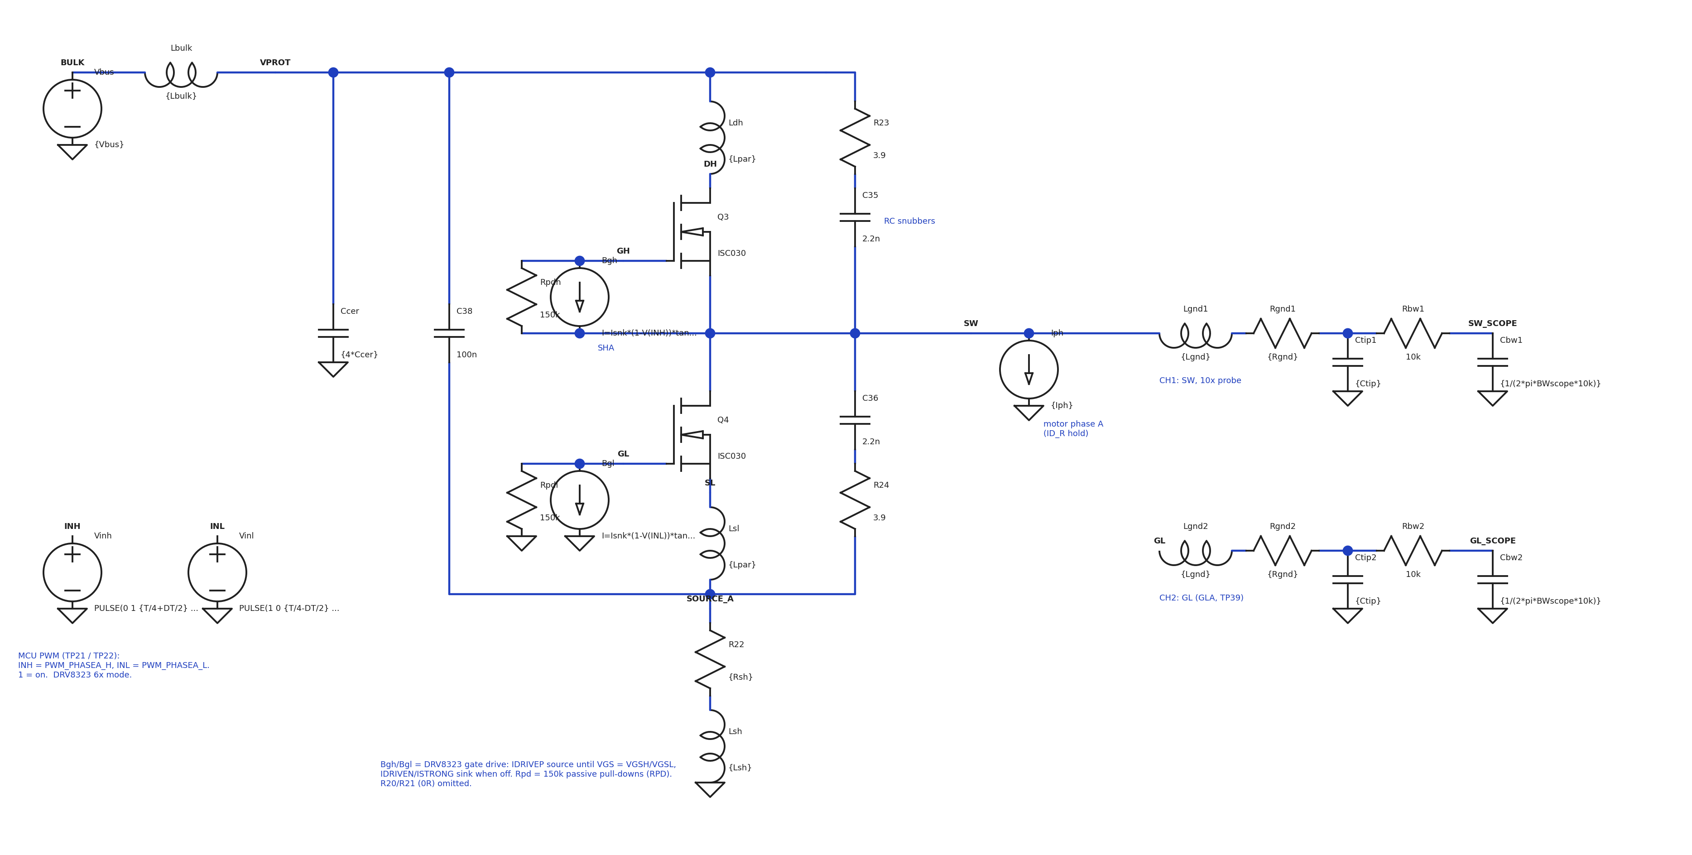
Sim 2 · Half-bridge switching: circuit
Q3 / Q4
ISC030 VDMOS fit, 0.5 nH per lead.
RC snubbers
3.9 Ω + 2.2 nF across each FET.
DRV8323 model
B-sources: 1 A source to VGS 11 V, 2 A sink, 150 kΩ RPD.
10x probe model
150 nH, 20 Ω, 12 pF tip, 70 MHz pole.
Phase current
Stepped +5 / -2.5 A (ID_R hold, phases A and B/C). L/R = 96 µs >> edge.
TIM1 CH1/CH1N
25 kHz, 50 %, 200 ns dead time.
R22 shunt
3 mΩ + 0.6 nH. C38 100 nF bypasses the leg above it.

Slide 8
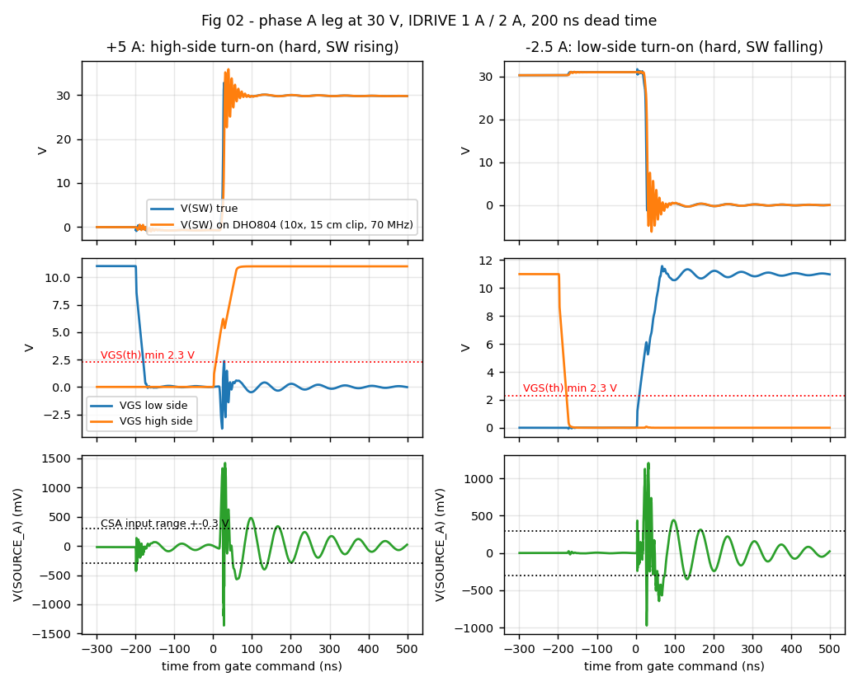
Sim 2 · Half-bridge switching: result
Hard edge, +5 A
HS turn-on, 5.5 ns 10-90 %, 4.4 V/ns. (-2.5 A: LS turn-on, 4.3 ns, 5.6 V/ns.)
Probe artefact
15 cm clip shows -6.2 V; true undershoot -2.5 V. Use the spring tip.
Ringing
~500 MHz with 0.5 nH/lead, above the 70 MHz BW. Vds peak 38.6 V.
Dead time
200 ns; SW sits at -0.76 V on the LS body diode.
Shunt node
±1.4 V at the edges; back inside the CSA ±0.3 V range in ~0.5 µs.
Miller VGS
2.36 V on the off LS FET, VGS(th) min 2.3 V. Marginal at code 15.

Slide 9
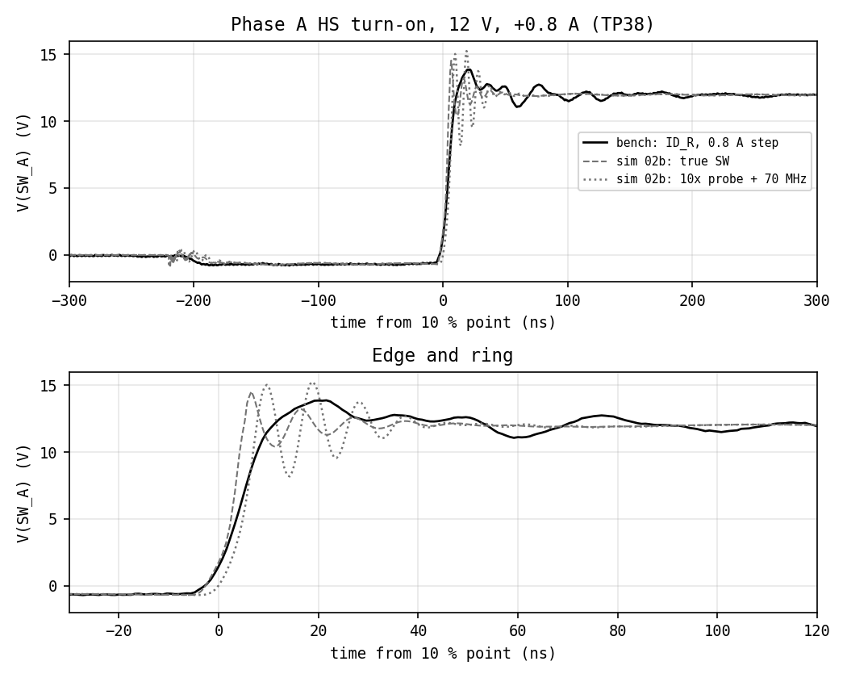
Sim 2 · Half-bridge switching: bench vs sim
compared with: 02b_leg_12V_bench.asc (deck 02 at 12 V, +0.8 / -0.4 A)
Dead time 200 ns at -0.71 V
LS body diode conducts: current out of the leg, as modelled (sim -0.66 V).
Sim overshoot +2.6 V true, +3.3 V via probe
Pessimistic: 0.5 nH/lead and a 15 cm clip model; the bench used the spring tip.
Bench peak 13.87 V (+1.87 V)
Ring decays within ~150 ns. Fit Lpar to this next.
Slow wobble ~20 MHz
Not in the sim: a larger loop (bulk caps through the supply leads), lumped as 10 nH in the deck.
Rise 8.8 ns, 1.09 V/ns
= √(7.0² + 5²): the sim's 7.0 ns edge through the 70 MHz scope. Probe-model trace: 9.0 ns.

Slide 10
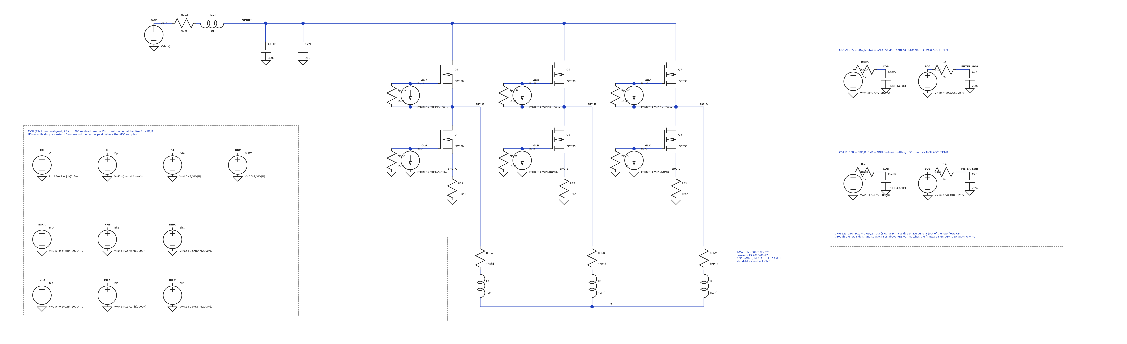
Sim 3 · 5 A standstill hold: circuit
PI on I_A (as RUN ID_R)
fc 1 kHz, feed-forward start. dA = 0.5+2u/3, dB = dC = 0.5-u/3.
3 legs
Centre-aligned 25 kHz, 200 ns dead time.
DRV8323 CSA model
G 20, VREF/2, tSET 600 ns, clipped 0.25-3.05 V; 56 Ω / 2.2 nF to the ADC.
MN601-S (firmware ID)
R 98 mΩ, L = (Ld+Lq)/2 = 9.44 µH, star.

Slide 11
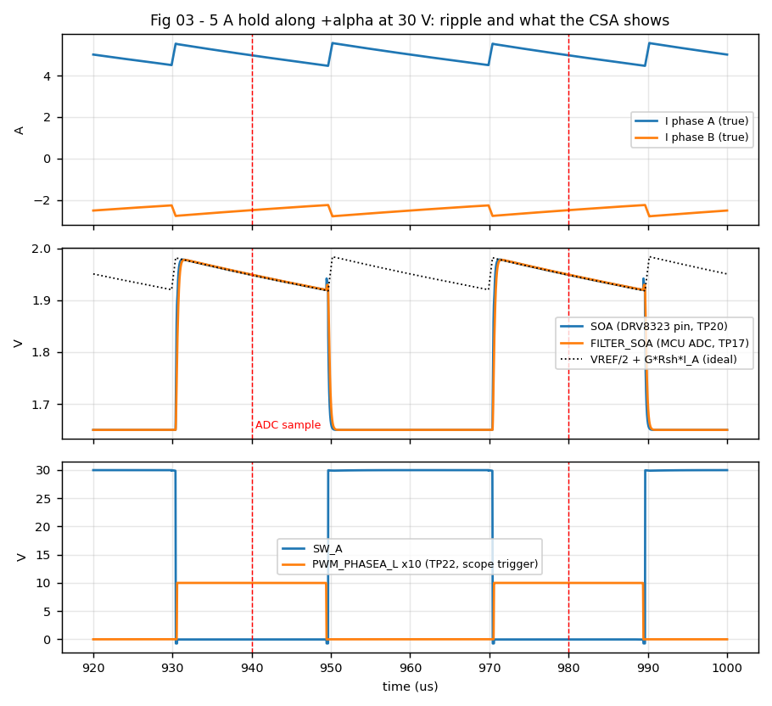
Sim 3 · 5 A standstill hold: result
Ripple 1.10 A p-p
At 5.00 A mean. Roughly V_applied·T/L, so nearly independent of Vbus at standstill.
SOA pulse
0.30 V (G·Rsh·I), present only in the LS window; the slope is the ripple.
Sample at carrier peak
FILTER_SOA gives 4.988 A vs 4.974 A true: +0.28 %. Sampled mid-window, so it reads the mean.
VREF/2 = 1.650 V
While the HS conducts there is no shunt current.

Slide 12
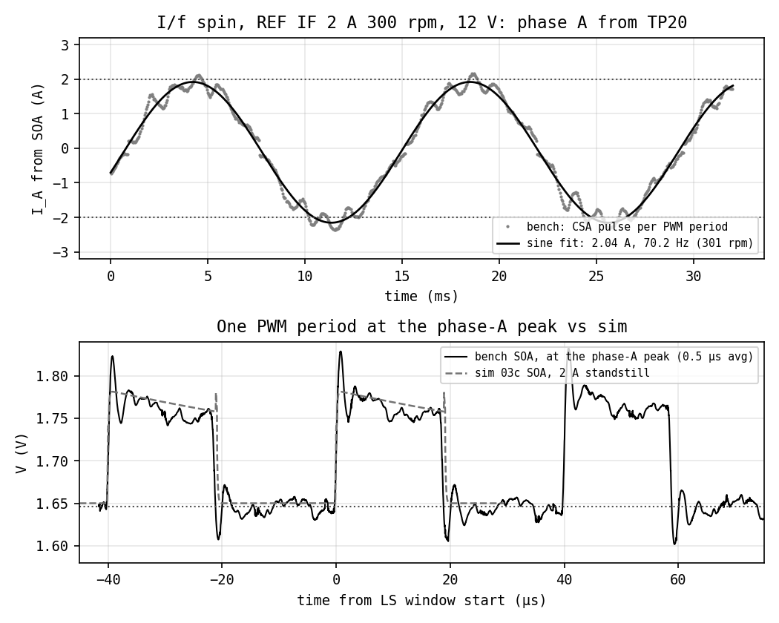
Sim 3 · Current sense: bench (I/f spin) vs sim
compared with: 03c_standstill_12V_2A.asc (deck 03 at 12 V, 2 A)
Envelope 2.04 A, 70.2 Hz
= 301 rpm at 14 pole pairs; REF IF 2 A 300 rpm. Offset -0.12 A.
~20 Hz wobble
Open-loop I/f rotor swing, as already noted in the firmware.
Spike at window start
~1.82 V for ~1 µs: edge pickup + CSA settling. Settled long before the mid-window sample.
Pulse 112 mV vs sim 120 mV
LS window ~19 µs, ripple slope as in the sim.
Baseline 1.646 V
= the CSA_CAL offset (offA 1646 mV); HS windows within 3.7 mV.
Run
RUN IF_SPIN + REF IF 2 300 over UART (FOCLink CLI, user-approved), 12 V, motor clamped. TP20, 20 MHz BWL, 20 ms at 3.2 ns.

Slide 13
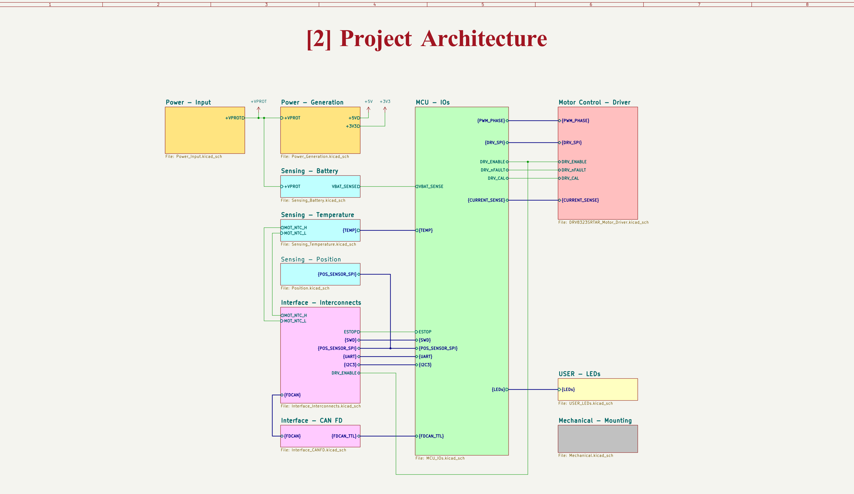
System architecture
Hierarchical KiCad 10 project, 12 functional sheets.
12S bus (44.4 V nom, 56 V max). TVS-only input; hot-swap and inrush moved to a shared battery box.
LMR36520 buck to 5 V, TLV757 LDO to 3V3.
STM32G431 + DRV8323S + 3-shunt low-side sensing + AS5047P + CAN-FD.

Slide 14
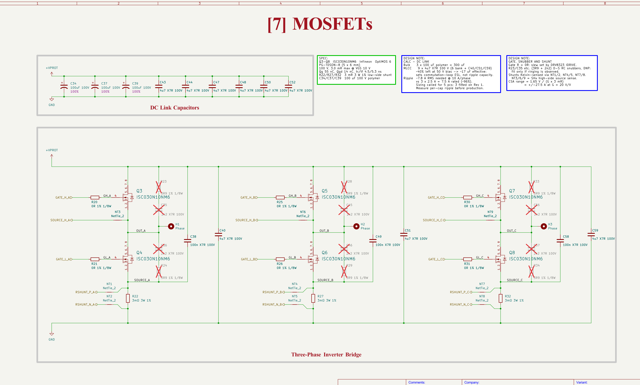
Three-phase bridge
ISC030N10NM6: 100 V, 3.0 mΩ max, Qg 55 nC, Qgd 14 nC max.
Voltage rating checked first, against the worst-case bus transient.
The 1.5 mΩ IPT015N10N5 lost on total loss (5.65 vs 4.27 W): at this current and f_sw, Qgd-driven switching loss dominates.
3x 3 mΩ low-side shunts, Kelvin net ties: ±27.5 A full scale at G = 20.
3.9 Ω + 2.2 nF snubbers; 100 nF per leg from +VPROT to the shunt top.

Slide 15
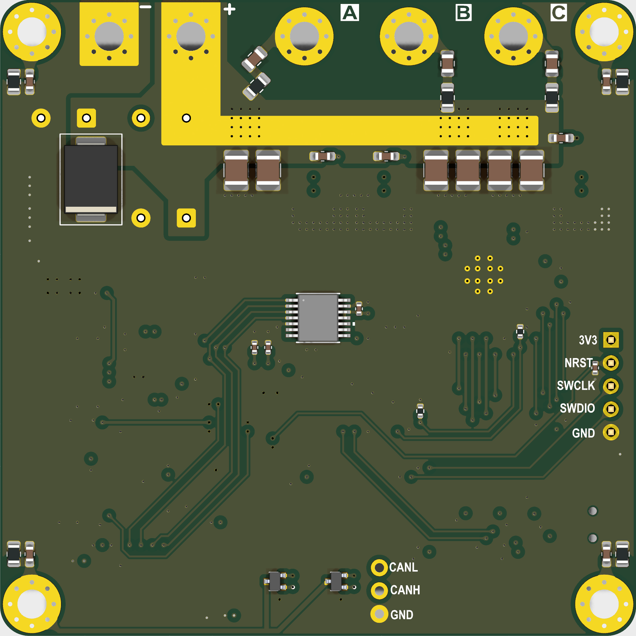
3D render
70 x 70 mm, 6 layers, L2/L5 solid GND.
Bus and phases on the top edge; JST GH along the bottom.
D1 SMCJ51CA
1500 W bidirectional TVS on +VPROT.
U1 AS5047P
14-bit, SPI, centred on the rotor axis under the shaft magnet.
F.Cu
B.Cu (mirrored)

Slide 16
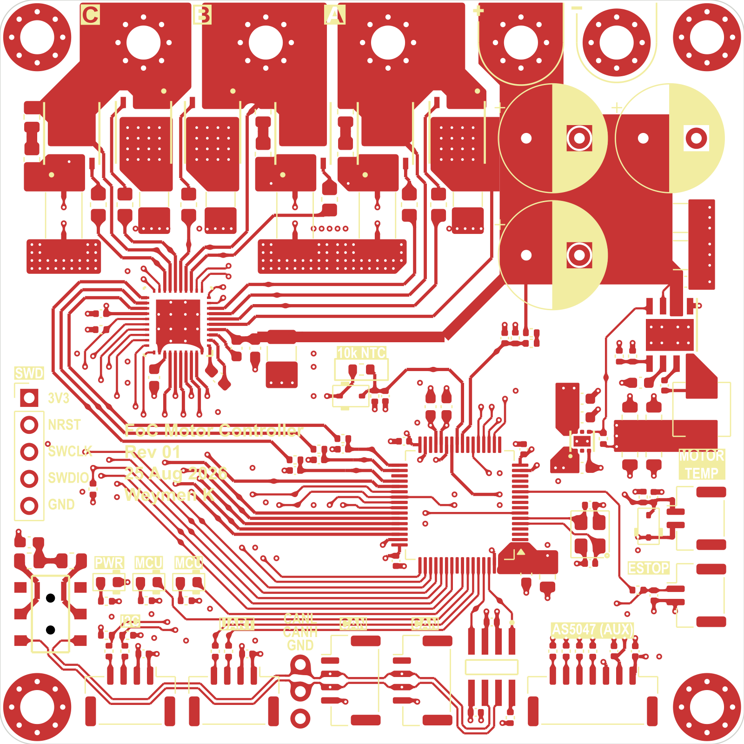
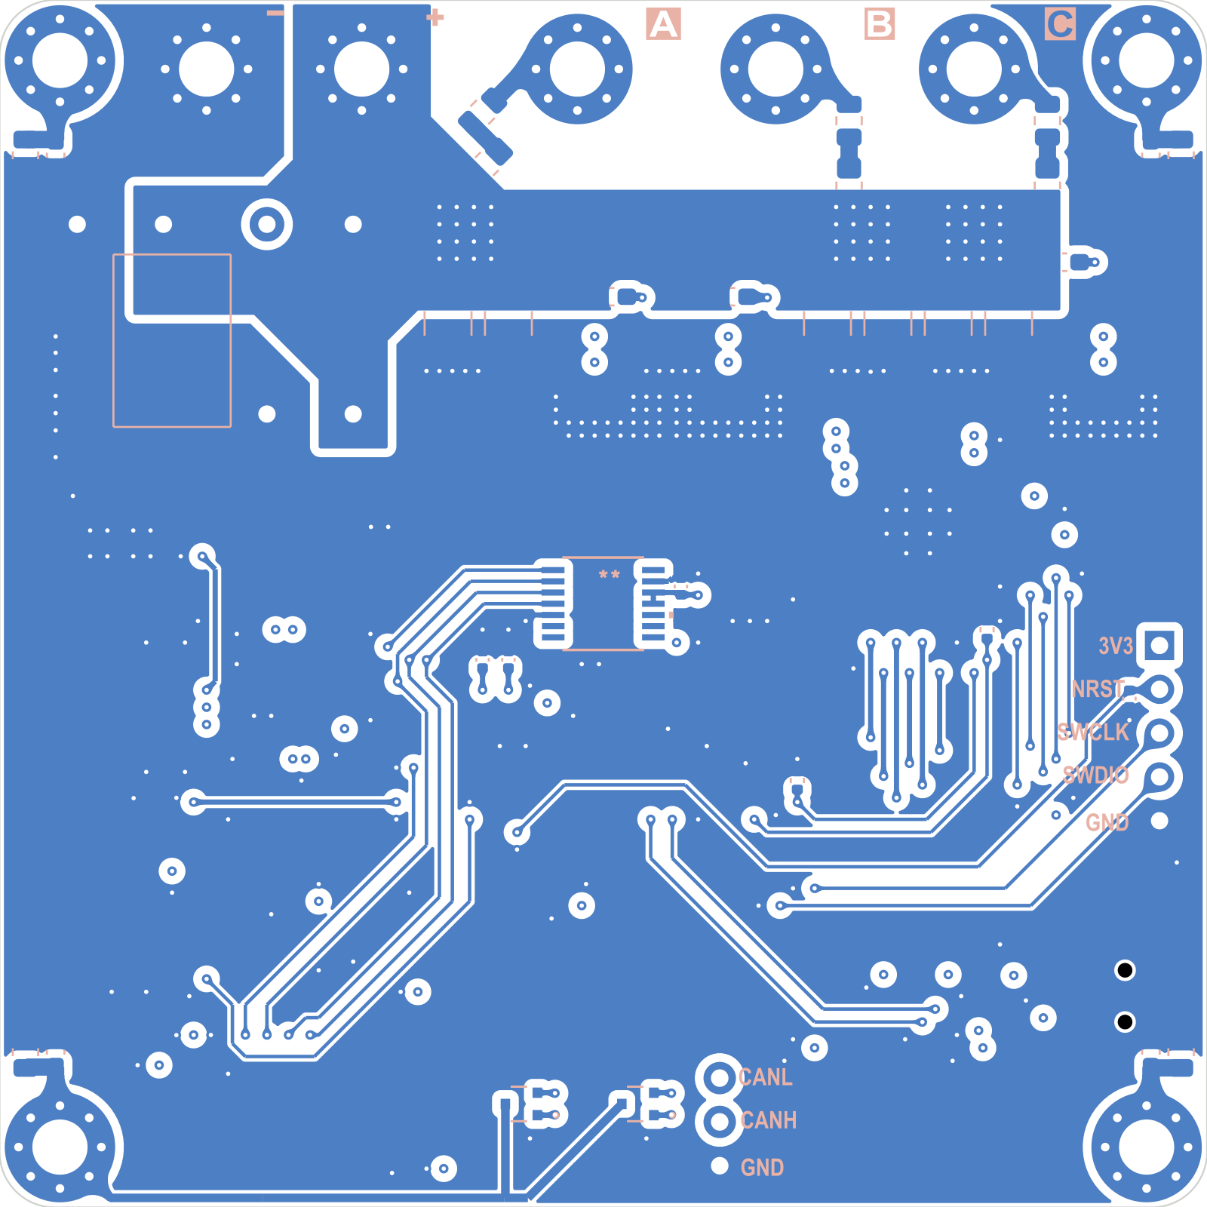
PCB layout
Phase and bus current in outer-layer pours.
DRV8323 next to the bridge: short GHx/SHx and GLx loops.
Per-leg 4.7 µF + 100 nF keep the commutation loop small. Sim 2 assumes 0.5 nH per lead: check it against the measured ring.
F.Cu + F.Silkscreen
B.Cu + B.Silkscreen (mirrored)

Slide 17
Assembled board
top
bottom

Slide 18
Bench
equipment
Rigol DHO804: 4 ch, 70 MHz, 1.25 GSa/s, 12-bit. USB SCPI to the host (pyvisa-py).
10x passive probes, spring ground tips.
Korad KA3005P: 0-30 V / 0-5 A linear. Cannot sink.
EEVblog BM235 DMM.
USB-UART bridge to the board (GUI).
ST-LINK (SWD) for flashing.
T-Motor MN601-S KV320, clamped.

Slide 19
Next: measure and compare
1 Hot-plug: done (runs 4-5). Peak 30.15 V, no overshoot; charge is supply-limited, τ ≈ 6.5 ms. Update the deck 01 source model to match.
2 Edges: done at 12 V (RUN ID_R, 0.8 A; firmware caps switching at 12 V). Rise matches the sim through 70 MHz; overshoot below the sim. Fit Lpar.
3 CSA: done at 12 V via an I/f spin (2 A, 300 rpm): 2.04 A, 301 rpm; pulse 112 vs 120 mV sim. Scale cross-check: ID_R 99-101 mΩ vs DC 98 mΩ.
Tests 2-3 ran at 12 V: the approved firmware scopes cap switching at 12 V. 30 V switching needs a reviewed scope change.
predicted (and measured) values
hot-plug peak 36.3 V sim, 30.15 V meas
edge, +5 A HS on 5.5 ns, 4.4 V/ns
edge, 12 V 0.8 A 7.0 ns sim, 8.8 ns meas
edge, -2.5 A LS on 4.3 ns, 5.6 V/ns
Vds peak 38.6 V
Miller VGS (LS) 2.36 V
ripple 1.10 A p-p
CSA error +0.28 %
CSA pulse, 2 A 120 mV sim, 112 mV meas
supply current 0.140 A

