Slide 1
Current-pump characterization
Deck 2 of 4 (24 October 2026): the client's JY063 STIM prototype, characterised in LTspice. It builds on deck 1 (architecture); deck 3 takes its load reach to the worst case and deck 4 builds the protection it lacks. Plots generated by a Python script from the LTspice results; every plot was first checked by hand in LTspice.

Slide 2
How to read this deck (key terms)
The circuit
Current pump (Howland): a circuit that pushes a set current through whatever is connected, adjusting its voltage as needed. Here 1 V of command gives 1 mA.
Dummy head / load: a resistor (or resistor–capacitor network) standing in for the head and electrodes in the simulation.
Command / DAC: the requested current, produced as a voltage by the FPGA team's digital-to-analog converter.
Op-amp: an amplifier chip. The board uses two: U2 (INA149) drives the output, U1 (TLE2141) measures the load voltage.
Rails / supply: the ±100 V that powers the stage, made by the power team's flyback converter.
Floating (bootstrapped) supply: a ≈19.5 V supply for the op-amps that rides up and down with the output, so low-voltage chips can drive high voltages.
Compliance: the largest voltage (and so the largest load) at which the full current can still be delivered.
The measurements
Feedback loop / loop gain: the circuit constantly compares what it delivers with what was asked for and corrects the difference. Loop gain is how strong that correction is at each frequency.
Stability, ringing, damping: a lightly damped loop overshoots and "rings" after a change, like a car with worn shock absorbers; an unstable one oscillates on its own. Damping ratio ζ: 1 = no ringing, near 0 = rings a long time.
Nyquist plot: a standard test that tells from the loop gain whether the circuit is stable, and how close it is to oscillating.
Output impedance: how well the current stays fixed when the load changes; higher is better.
Monte Carlo: simulating hundreds of boards, each with random part tolerances, to see the spread of results.
Worst-case corner: every tolerance pushed the same unlucky way at once.
Units: mA, µA = thousandths, millionths of an amp; µs = millionth of a second; kHz, MHz = thousand, million cycles per second; dB = a log ratio (+6 dB ≈ 2×).

Slide 3
Reproducing the plots in this deck
Before you start
This deck's folder: 2-pump-characterization/
1. Install LTspice (free: analog.com/ltspice), version 24 or later, on Windows or macOS. The screenshots are LTspice 26.0.2 on macOS; Windows looks the same.
2. Get the repository (GitHub WeymenKoo/CurrentSource_Ptototype_Simulation, or the team's shared Drive folder) and keep its folder structure: every schematic loads its models and symbols by relative path.
3. Keep the path short. LTspice fails on paths over 260 characters. On Windows, put the repository at e.g. C:\jy063\SPICE_SIM. Check with: python3 tools/check_path_lengths.py
4. Nothing needs editing. Each test schematic already holds its settings, and its .plt file opens the plots.
SPICE_SIM/
2-pump-characterization/
client-board-model.asc # the board (S01)
1-bootstrap/ # step 1
2-load-reach/ # step 2
3-dac-step-response/ # step 3
4-frequency-response/ # step 4
5-power-sequencing/ # step 5
6-converter-ripple/ # step 6 (two)
7-loop-stability/ # step 7
8-output-impedance/ # step 8
*.lib, *.asy # models, symbols
Each step folder: the .asc, its .plt,
make_figures.py (the deck figures) and
a README with the expected numbers.
How each reproduction is laid out
• Each reproduction sits right after the result it backs up, on two slides: the schematic as LTspice opens it, then the waveform window after Run.
• The grey strips under the screenshots are read from the files: the simulation commands on the schematic, and the traces its .plt opens.
• LTspice writes <test>.raw and <test>.log next to the schematic. They are not in Git; run the test to make them.

Slide 4
LTspice in a few actions
Run: starts the simulation
To | Do this
Open a schematic | File → Open, file type "Schematics (*.asc)", then browse to the folder named on the slide.
Run it | Press Run (the green ▶ on the toolbar). A stepped test runs once per .step combination.
Get the plots | LTspice reads <test>.plt when the results open, so the panes appear by themselves. To load it by hand: Plot Settings → Open Plot Settings File.
Read the numbers | View → SPICE Error Log: every .meas result, one row per run. Right-click in the log → Plot .step'ed .meas data plots them against the stepped value.
Tell the runs apart | Click a trace name to attach a cursor, move it from run to run with the ↑ / ↓ keys, then right-click the cursor: it shows that run's step values.
Add a trace | Plot Settings → Add Trace and type the expression, e.g. V(sense)-V(elec). Or click a wire (voltage) or a part (current) on the schematic while the plot is open.
Read a value off a curve | Click the trace name at the top of its pane: a cursor appears; drag it and read the readout.
Zoom | Drag a box on the plot. Undo steps back through the zooms.

Slide 5
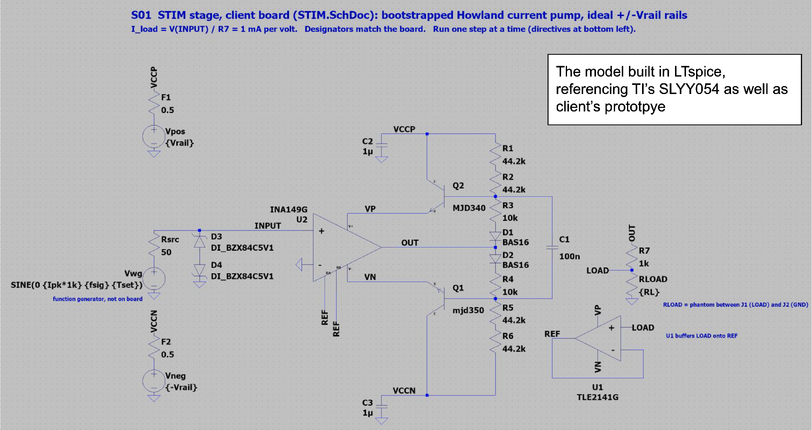
Step 1 - verify the bootstrap
Figure 1: LTspice model of the client's prototype board
Built from the board schematic, referencing TI's SLYY054.

Slide 6
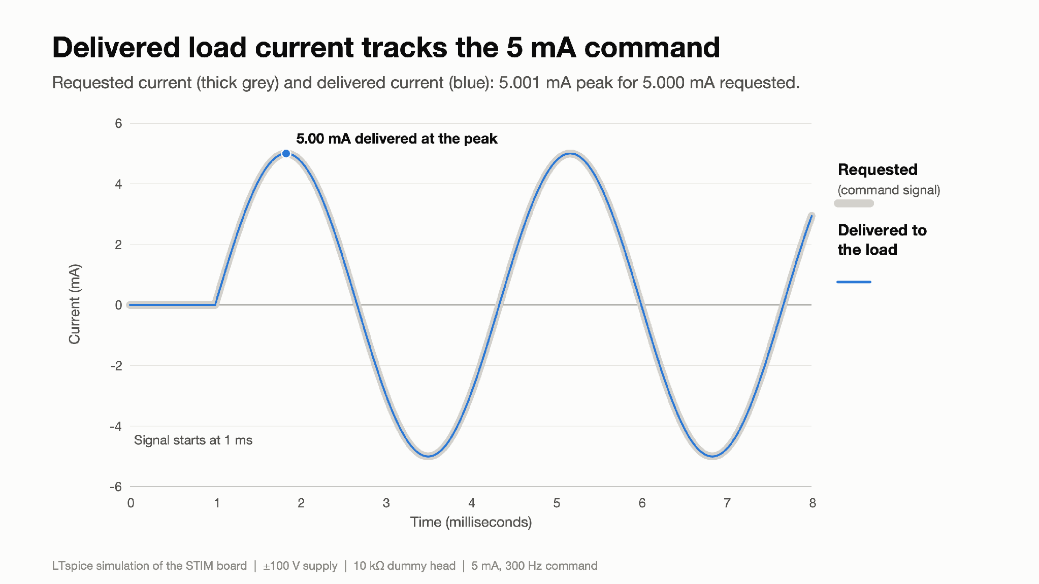
Step 1 - verify the bootstrap
Figure 2: Delivered load current tracks the 5 mA command
What you are looking at: Two lines over 8 ms. Grey is the current we asked for (the "command" from the DAC); blue is the current that actually flows through a 10 kΩ resistor standing in for the head. A current pump should make blue copy grey no matter what the load is.
Result: The command is a 5 mA, 300 Hz sine wave. The load receives 5.001 mA at the peaks, +0.02 % off. The two lines overlap to within their width.
Why it matters: This is the basic job of the board: deliver the requested current. With a 10 kΩ load that takes ±50 V across the head, which the board manages from ±100 V supplies.

Slide 7
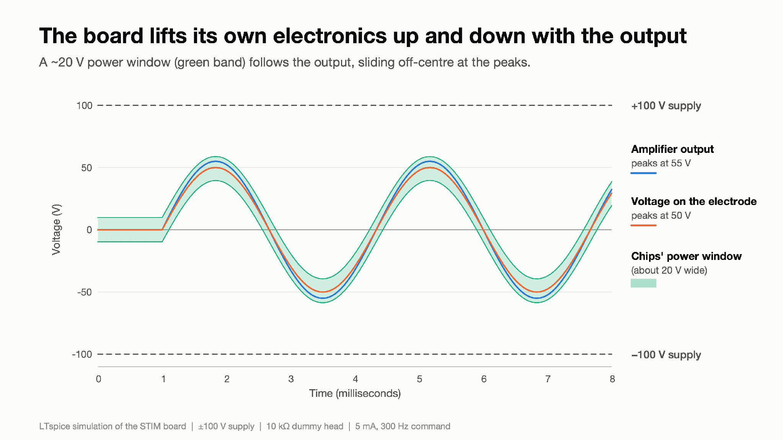
Step 1 - verify the bootstrap
Figure 3: The board lifts its own electronics up and down with the output
What you are looking at: Voltages at several points in the circuit over time. Blue is the amplifier output, orange the voltage across the head. The green band is the small power supply the op-amp chips run from; it is "floating": it rides up and down with the output. Dashed lines are the fixed ±100 V supplies.
Result: The output swings ±55 V and the head ±50 V, while the green band (about 19.5 V wide) follows the output. It is not centred: at the +55 V peak it extends about 4 V above the output and 16 V below it.
Why it matters: The chips can only survive about 36 V, yet the output must swing over 100 V. The floating supply is the trick that makes that possible. Its off-centre position is what eventually limits how large a load the board can drive (Step 2).

Slide 8
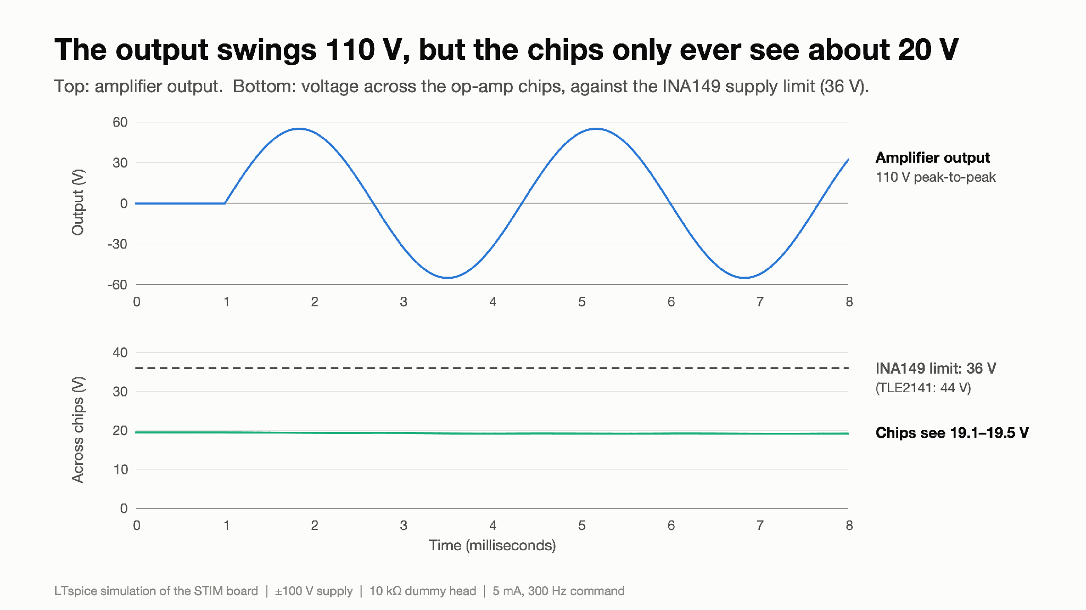
Step 1 - verify the bootstrap
Figure 4: The output swings 110 V, but the chips only ever see about 20 V
What you are looking at: Top: the amplifier output. Bottom: the voltage the op-amp chips actually see across their supply pins, with the chips' limits as dashed lines.
Result: The output swings 110 V peak-to-peak, but the chips see only 19.1–19.5 V. That is well under the INA149's 36 V limit (the TLE2141 allows 44 V).
Why it matters: This confirms the floating supply works: high-voltage swing with low-voltage chips.

Slide 9
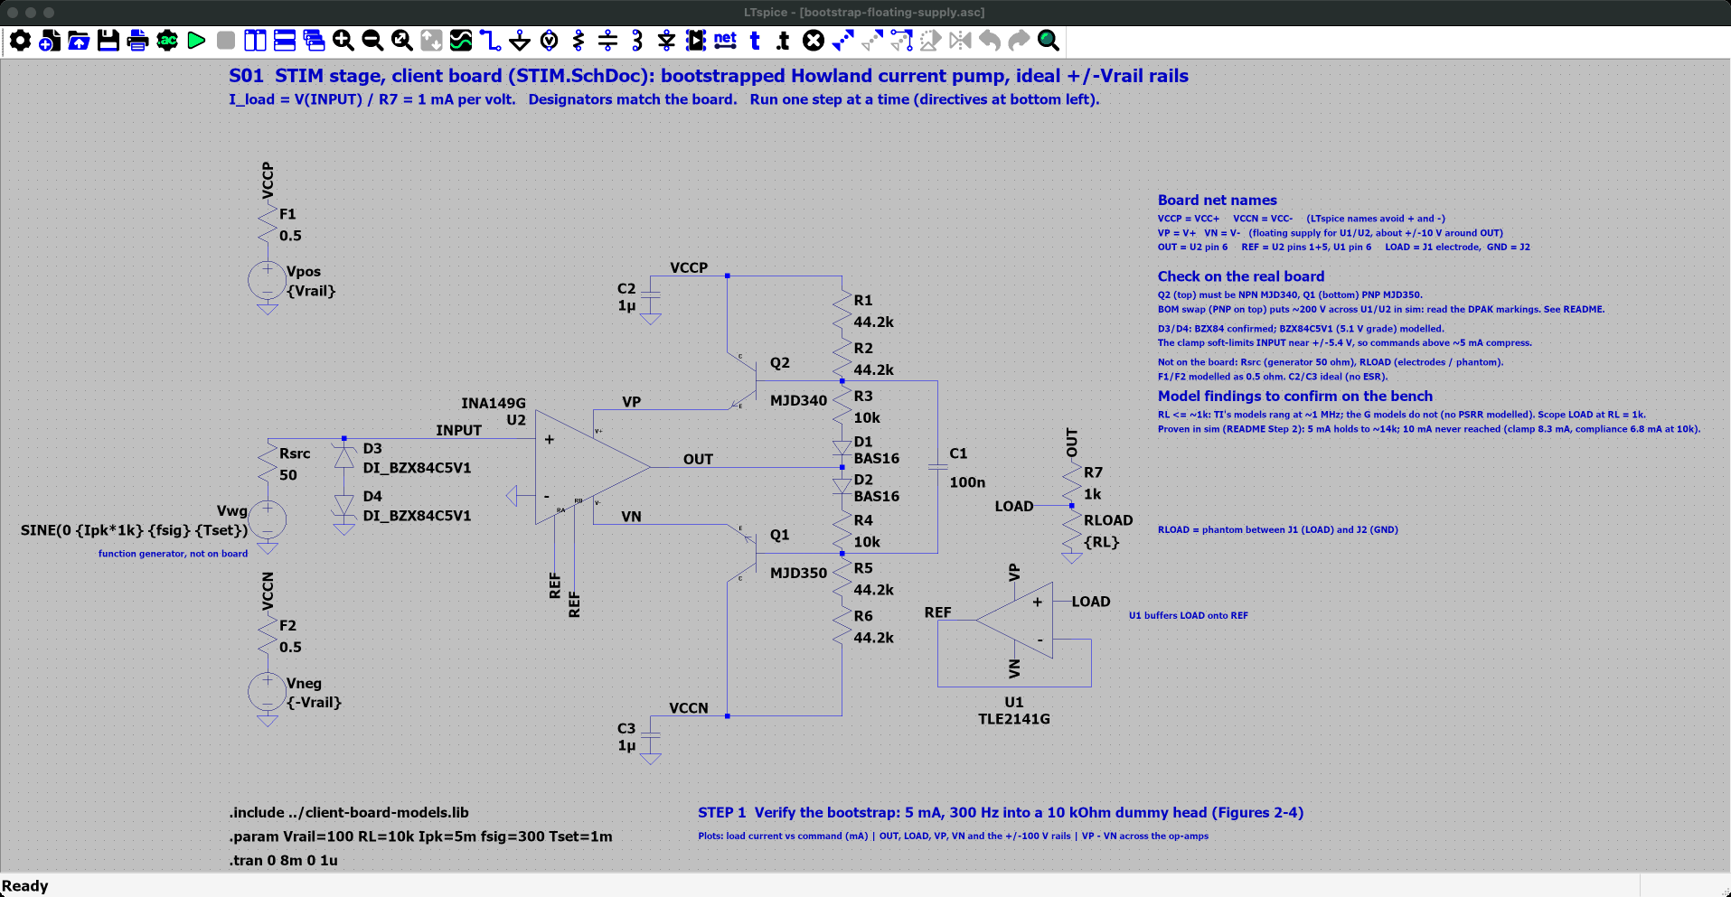
Step 1 - verify the bootstrap - LTspice schematic
Where
SPICE_SIM/
2-pump-characterization/
1-bootstrap/
bootstrap-floating-supply.asc
Open it
1. Start LTspice, then File → Open ("Schematics (*.asc)").
2. Go to SPICE_SIM → 2-pump-characterization → 1-bootstrap.
3. Open bootstrap-floating-supply.asc.
On the schematic
• The client board as built: INA149 U2, TLE2141 U1, MJD340/MJD350 bootstrap transistors Q2/Q1.
• Directives at the bottom left: 5 mA, 300 Hz into RL = 10 kΩ, ±100 V rails.
Simulation commands (1 run)
.tran 0 8m 0 1u

Slide 10
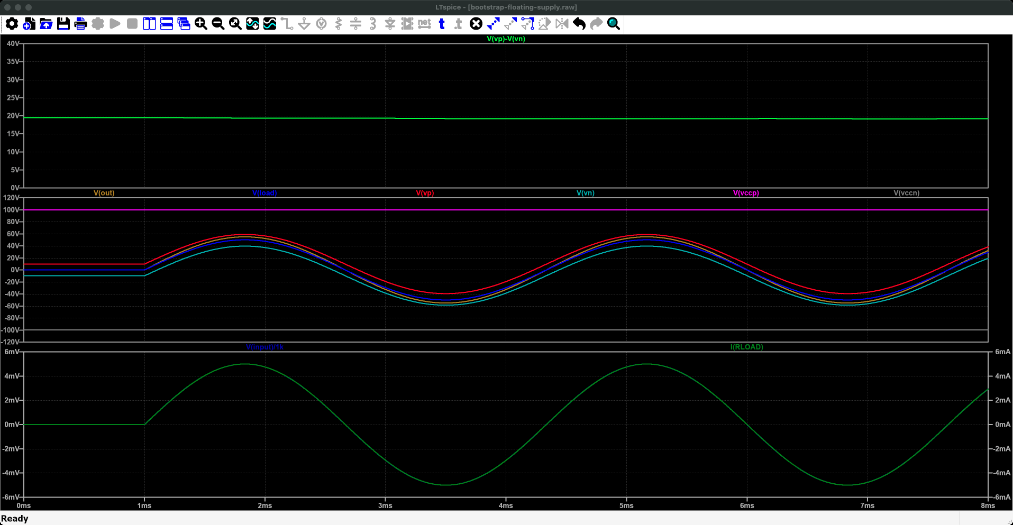
Step 1 - verify the bootstrap - LTspice plot
Run it
1. Press Run (green ▶). Takes a few seconds.
2. bootstrap-floating-supply.plt opens these panes. If not: Plot Settings → Open Plot Settings File.
What to read
• I(RLOAD) and the command V(input)/1k lie on top of each other: 5.001 mA for 5.000 mA.
• V(vp)-V(vn), the op-amps' supply, stays near 19.5 V while V(out) swings ±55 V.
What you are looking at: Time runs across, 0 to 8 ms. Bottom pane: the current we asked for and the current that flows in the 10 kΩ dummy head; they lie on top of each other. Middle pane: voltages in the circuit, all swinging up and down together by about ±55 V, between the fixed ±100 V supplies. Top pane: the supply the chips see, a steady line near 19.5 V.
Why it matters: The output swings 110 V while the chips only ever see about 20 V: that is how 36 V chips drive ±100 V.
Traces (bootstrap-floating-supply.plt, panes from the top) 1: V(vp)-V(vn) 2: V(out), V(load), V(vp), V(vn), V(vccp), V(vccn) 3: I(RLOAD), V(input)/1k

Slide 11
Step 1 - verify the bootstrap
Summary:
Into a 10 kΩ dummy head the model delivers 5.001 mA for a 5.000 mA, 300 Hz command (+0.02 %), while a bootstrapped floating supply holds the op-amps at ≈19.5 V as their output swings ±55 V.
Technical footnotes:
The +0.02 % is the net of two test-setup effects at the 5 mA peak: +0.11 % from the 50 Ω generator working against the INA149's 399 kΩ input-to-REF resistance, and −0.09 % from D3/D4 zener leakage through that same 50 Ω (the BZX84C5V1 has a soft knee; it clamps hard, ≥1 % error, only from a 5.39 V command). With a low-impedance DAC buffer both vanish (Figure 24). With the 50 Ω source and a low-tolerance zener (4.8 V) the error at 5 mA reaches −0.71 % (tests/T14).
U1 buffers V(LOAD) onto REF, so V(OUT) = V(INPUT) + V(LOAD) and I = V(INPUT) / R7 (1 kΩ). Q2/Q1 are emitter followers biased by R1–R6, D1/D2.
How to recreate the plots:
Ready-made: open 2-pump-characterization/1-bootstrap/bootstrap-floating-supply.asc and press Run.
Or by hand in client-board-model.asc:
1. Set the directives, and comment out .op with ";":
.include client-board-models.lib
.param Vrail=100 RL=10k Ipk=5m fsig=300 Tset=1m
.tran 0 8m 0 1u
2. Figure 2: plot I(RLOAD), then add the trace V(input)/1k (the command in amps).
3. Figure 3: in a new pane plot V(out), V(load), V(vp), V(vn), V(vccp), V(vccn).
4. Figure 4: one pane with V(out), another with V(vp)-V(vn).
Script versions of the figures: 2-pump-characterization/1-bootstrap/make_figures.py.

Slide 12
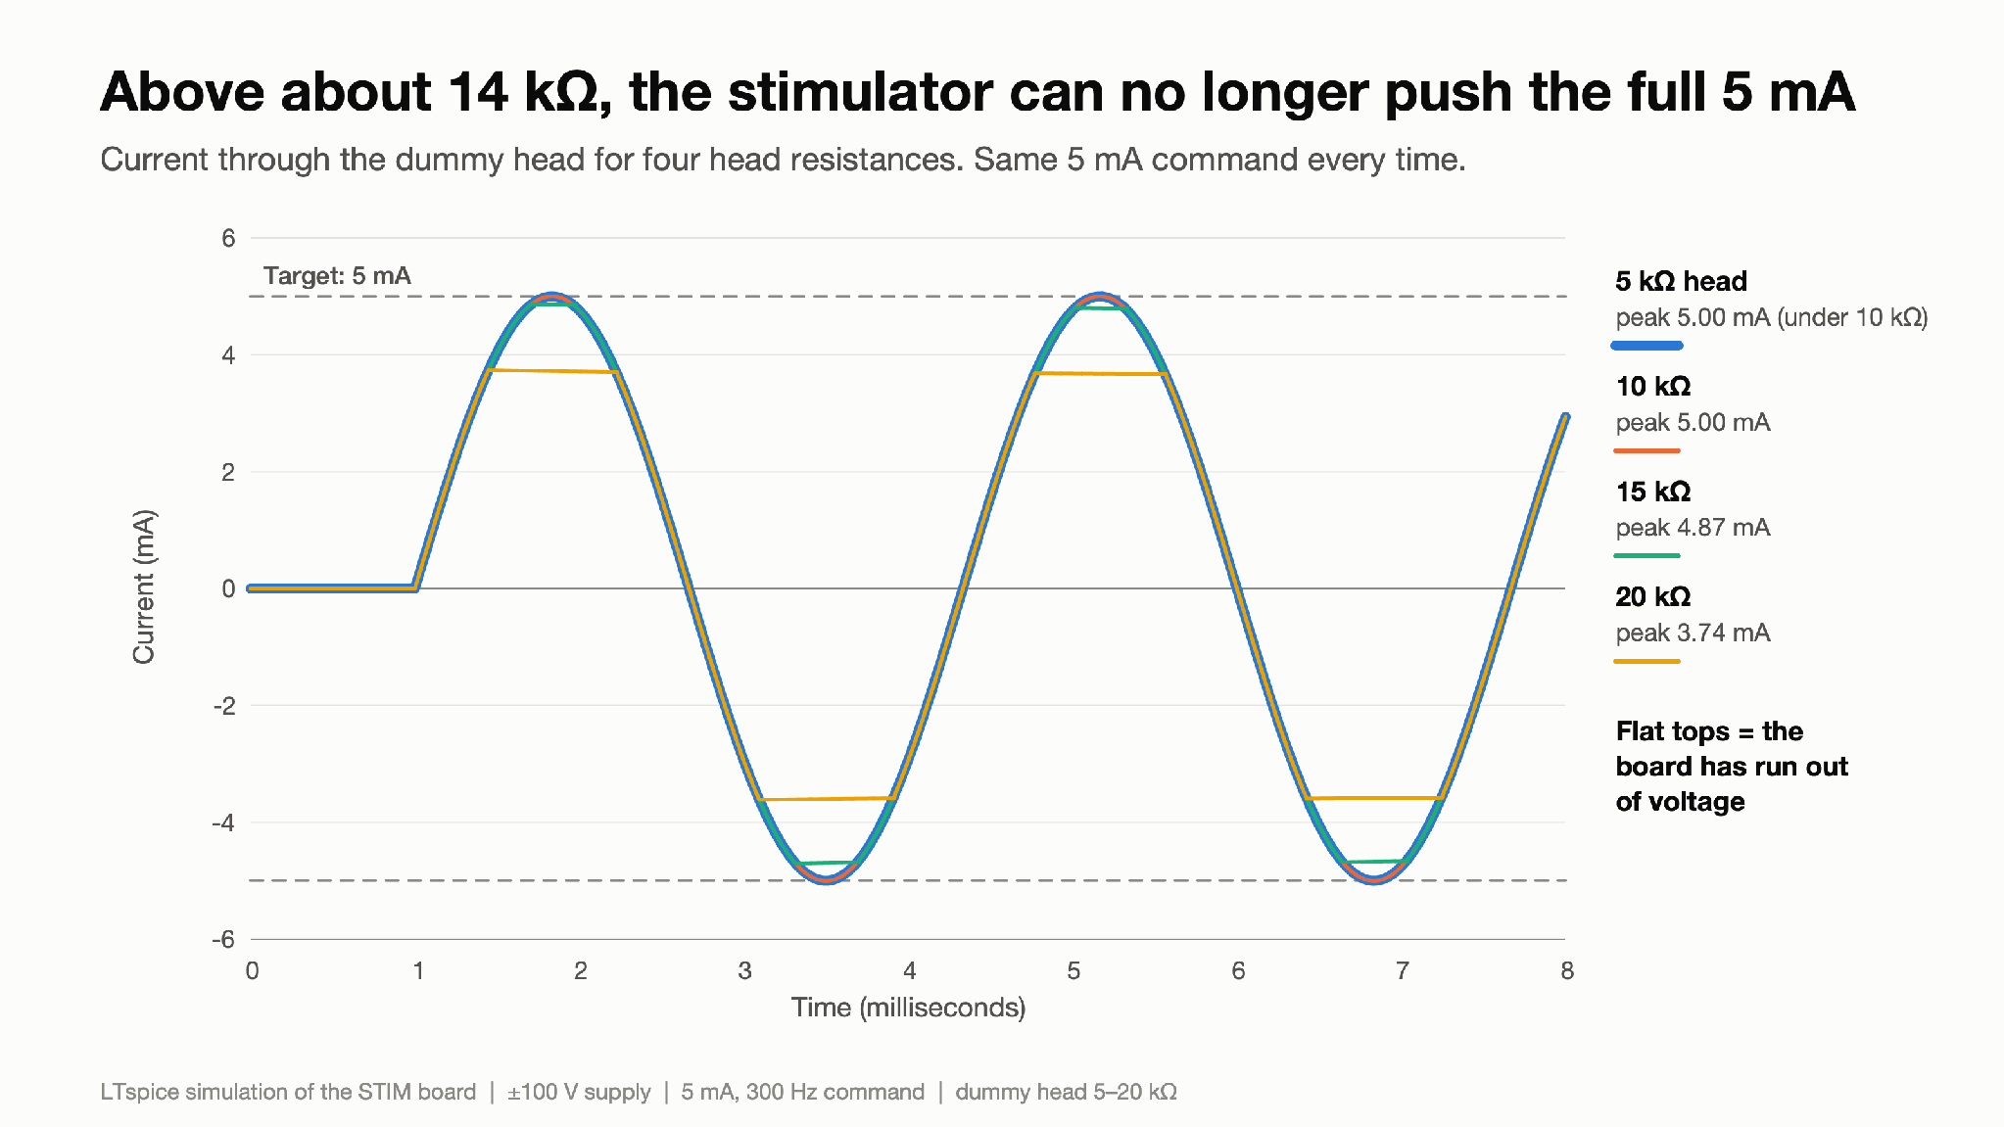
Step 2 - finding the compliance limit
Figure 5: Above about 14 kΩ, the stimulator can no longer push the full 5 mA
What you are looking at: The same 5 mA command applied to four different head resistances (5, 10, 15 and 20 kΩ). A larger resistance needs a larger voltage to push the same current (V = I × R).
Result: 5 kΩ and 10 kΩ receive the full 5.00 mA (their lines overlap). 15 kΩ flattens at +4.87 / −4.71 mA and 20 kΩ at +3.74 / −3.62 mA: they would need 75–100 V, but the board can only provide about 73–75 V.
Why it matters: This flattening ("clipping") marks the compliance limit: the largest load the board can drive at full current. Electrode-on-skin resistance must stay below it.

Slide 13
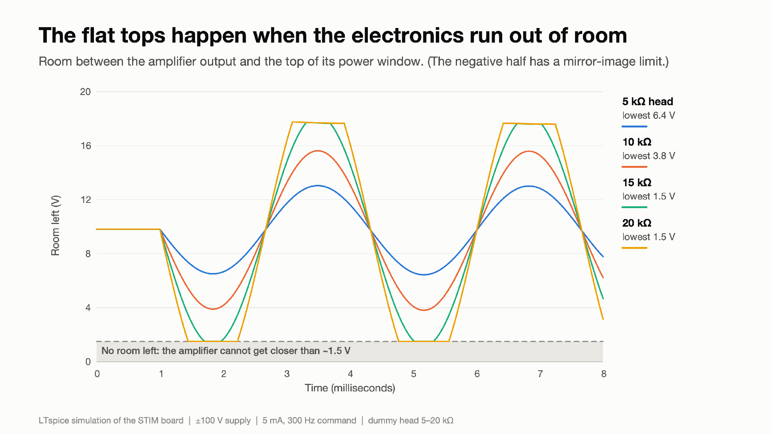
Step 2 - finding the compliance limit
Figure 6: The flat tops happen when the electronics run out of room
What you are looking at: "Headroom": how far the amplifier output is from the top of its floating supply. An amplifier output cannot reach its own supply; it stops about 1.5 V short.
Result: Headroom falls to 6.4 V (5 kΩ) and 3.8 V (10 kΩ) at the peaks. For 15 and 20 kΩ it hits the ≈1.5 V floor exactly when the current in Figure 5 flattens.
Why it matters: This shows why the board clips: the floating supply is not centred on the output, so the amplifier runs out of room on one side first. Re-centring it would buy extra compliance.

Slide 14
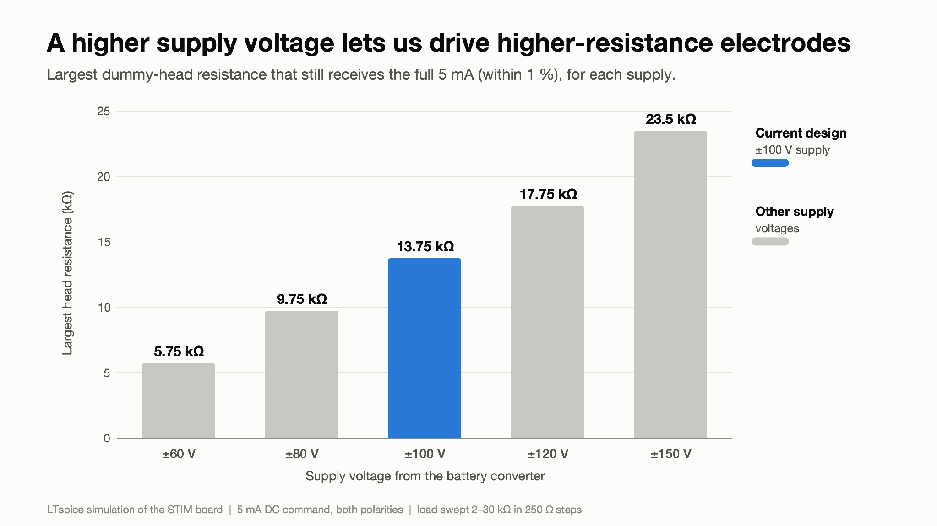
Step 2 - finding the compliance limit
Figure 7: A higher supply voltage lets us drive higher-resistance electrodes
What you are looking at: Each bar is a supply voltage (±60 V to ±150 V); its length is the largest head resistance that still gets 5 mA within 1 %.
Result: ±100 V reaches 13.75 kΩ, ±120 V 17.75 kΩ and ±150 V 23.5 kΩ. The reach grows almost in proportion to the supply. This agrees with Figure 5: at ±100 V, 10 kΩ passes and 15 kΩ clips.
Why it matters: This is the number the power team needs: once the real electrode resistance is measured, this chart gives the supply voltage required. (Method: slow DC sweep, valid because 300 Hz is slow for this circuit.)

Slide 15
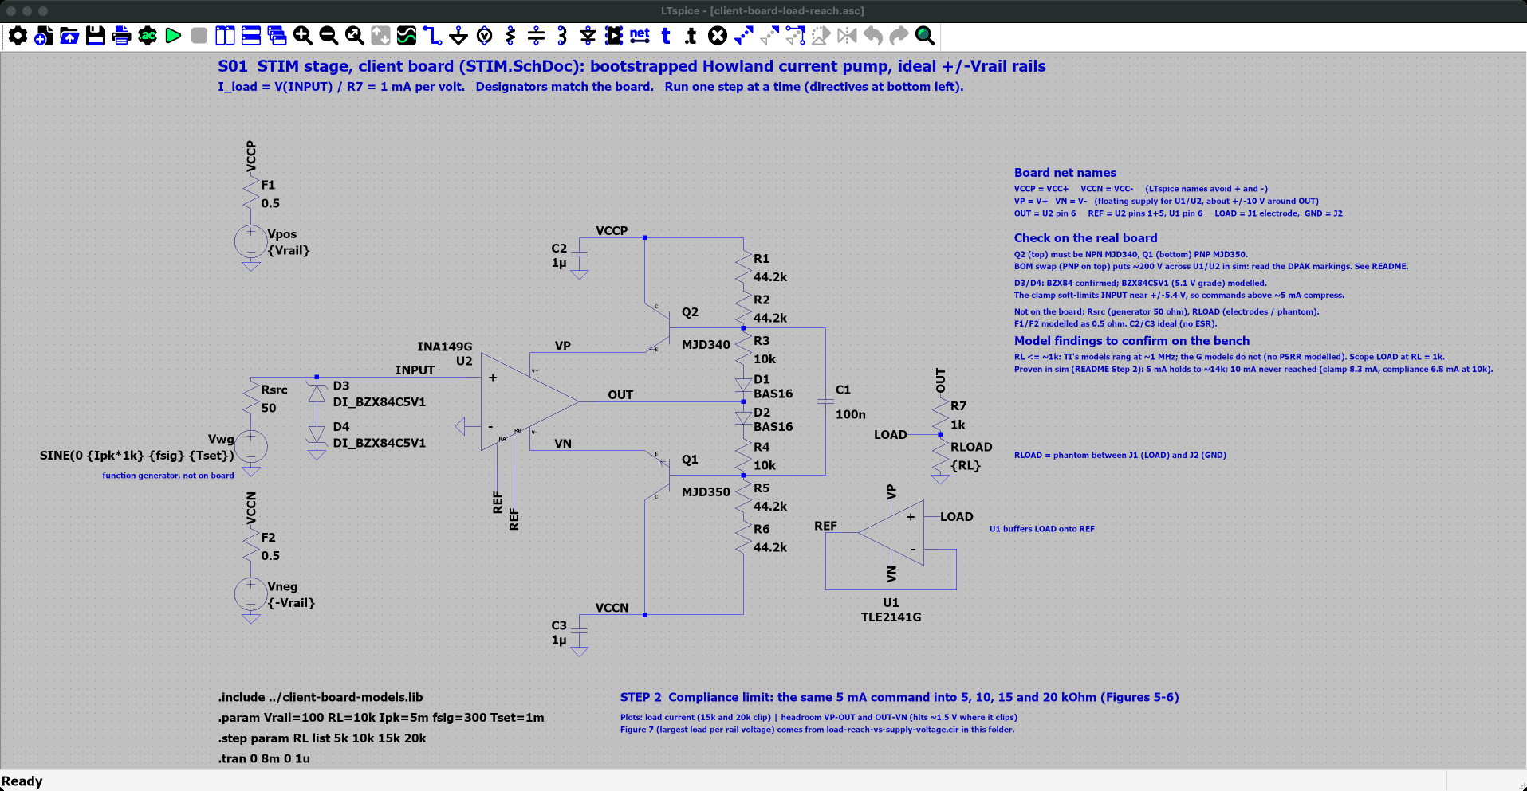
Step 2 - finding the compliance limit - LTspice schematic
Where
SPICE_SIM/
2-pump-characterization/
2-load-reach/
client-board-load-reach.asc
Open it
1. Start LTspice, then File → Open ("Schematics (*.asc)").
2. Go to SPICE_SIM → 2-pump-characterization → 2-load-reach.
3. Open client-board-load-reach.asc.
On the schematic
• Same 5 mA command into RL = 5, 10, 15 and 20 kΩ (.step).
Simulation commands (4 runs)
.step param RL list 5k 10k 15k 20k
.tran 0 8m 0 1u

Slide 16
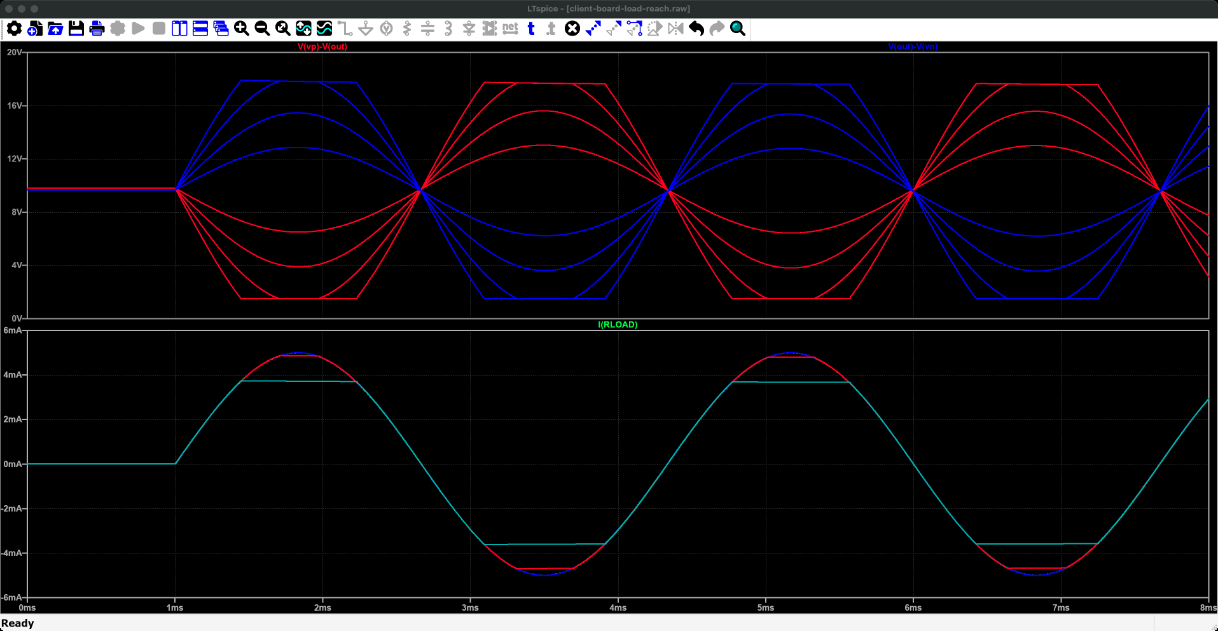
Step 2 - finding the compliance limit - LTspice plot
Run it
1. Press Run (green ▶). Takes a few seconds.
2. client-board-load-reach.plt opens these panes. If not: Plot Settings → Open Plot Settings File.
What to read
• I(RLOAD): 5 and 10 kΩ give full sines; 15 and 20 kΩ flatten near ±3.7-4.8 mA.
• Headroom V(vp)-V(out), V(out)-V(vn): the flat tops start where it falls to about 1.5 V.
• Reach at 100 V: 13.75 kΩ (Figure 7 comes from load-reach-vs-supply-voltage.cir, ngspice).
What you are looking at: Time runs across. Bottom pane: the same 5 mA command into four head resistances (5, 10, 15, 20 kΩ). Two are clean sine waves; the larger heads get their peaks cut flat. Top pane: the "headroom", how much room the amplifier has left. The flat tops start where that room runs out, near 1.5 V.
Why it matters: This is where the board stops delivering the full current: about 13.75 kΩ at ±100 V.
Traces (client-board-load-reach.plt, panes from the top) 1: V(vp)-V(out), V(out)-V(vn) 2: I(RLOAD)

Slide 17
Step 2 - finding the compliance limit
Summary:
Inside its compliance range the stage behaves as a current source; beyond it the current clips. At ±100 V it delivers 5 mA within 1 % into loads up to 13.75 kΩ (≈69 V across the load). The reach scales almost linearly with the rail voltage (23.5 kΩ at ±150 V), so the measured electrode-on-skin resistance sets the rail voltage the power team must provide.
Technical footnotes:
The limit is the INA149's output swing (≈1.5 V from its floating rail), not Q2 (still >20 V of V_CE). V(VP) − V(VN) stays ≈19.3 V but slides off-centre: as OUT rises, less current flows in the R1–R3 string, so V(VP) − V(OUT) shrinks to 1.51 V while V(OUT) − V(VN) grows to 17.7 V. LOAD stays ≥6.4 V from either floating rail, so the op-amp input range (not modelled) is not the limit (tests/T08).
How to recreate the plots:
Ready-made: open 2-pump-characterization/2-load-reach/client-board-load-reach.asc and press Run.
1. Directives:
.param Vrail=100 RL=10k Ipk=5m fsig=300 Tset=1m
.step param RL list 5k 10k 15k 20k
.tran 0 8m 0 1u
2. Figure 5: plot I(RLOAD).
3. Figure 6: add the trace V(vp)-V(out); add V(out)-V(vn) for the negative half.
4. Figure 7: run 2-pump-characterization/2-load-reach/load-reach-vs-supply-voltage.cir, then View → SPICE Error Log → right-click → Plot .step'ed .meas data.

Slide 18
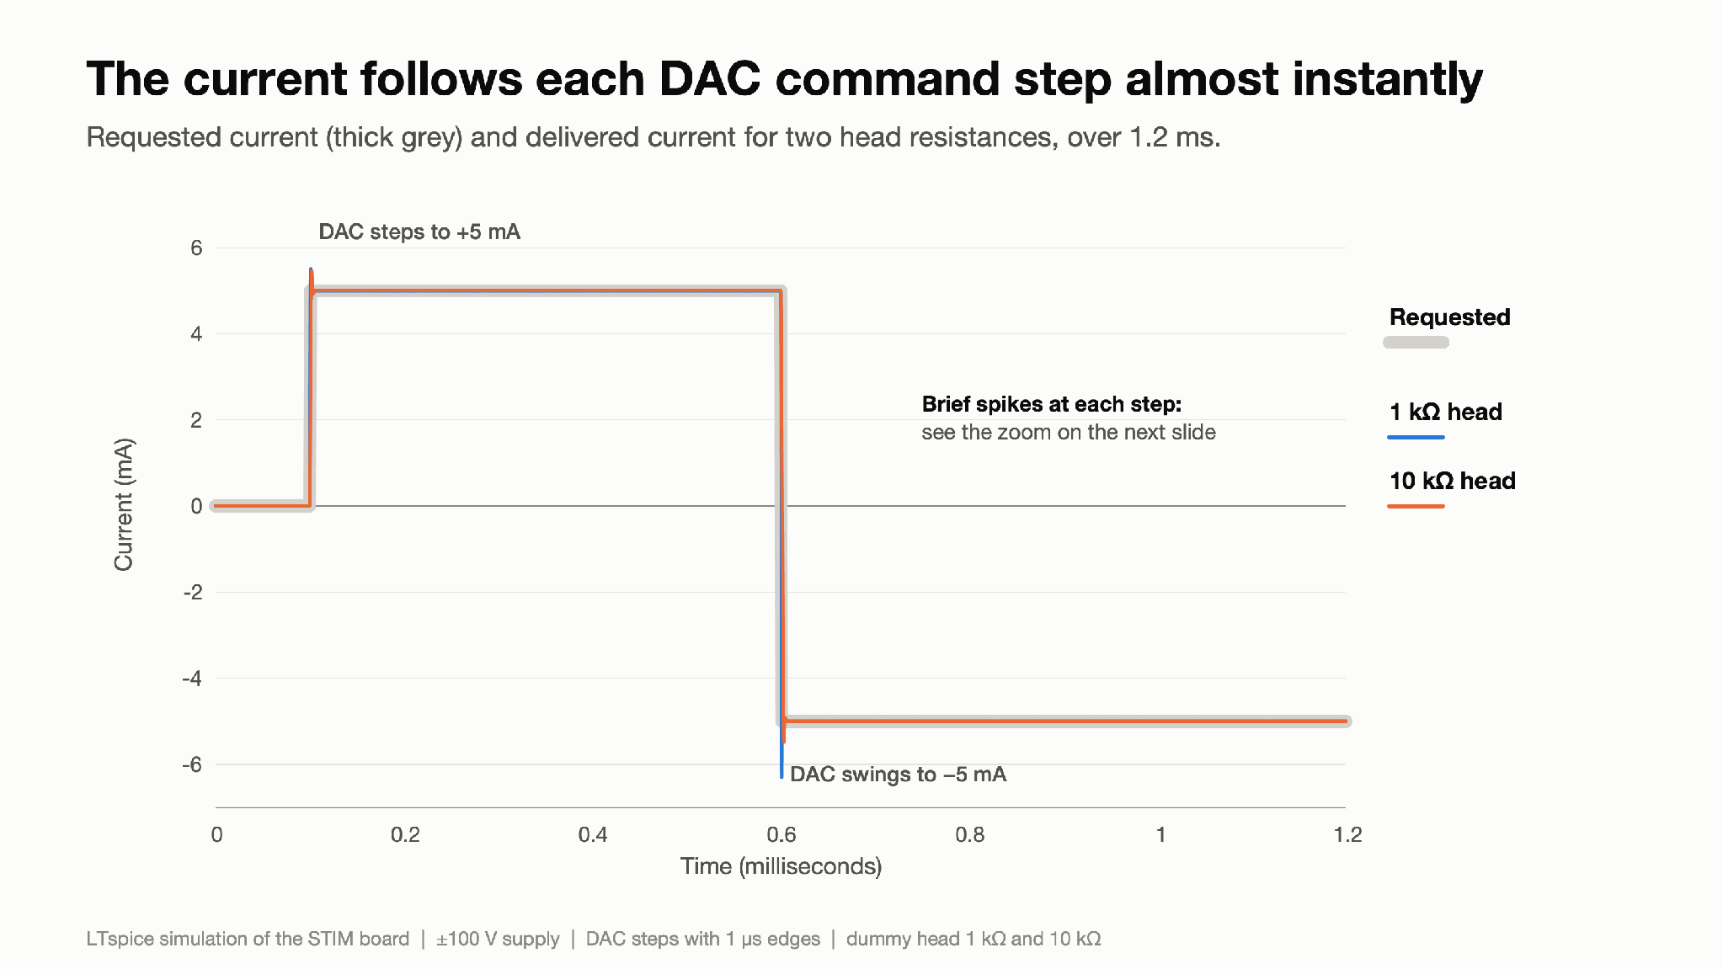
Step 3 - DAC step response
Figure 8: The current follows each DAC command step almost instantly
What you are looking at: The DAC changes its output in sudden steps (0 → +5 mA, then +5 → −5 mA). Grey is the request; coloured lines are the load current with 1 kΩ and 10 kΩ heads, over 1.2 ms.
Result: At this time scale the current follows every step almost perfectly. Small spikes at each step are examined in Figure 9.
Why it matters: The FPGA/DAC team can update the current every 1 ms and trust the analog stage to follow.

Slide 19
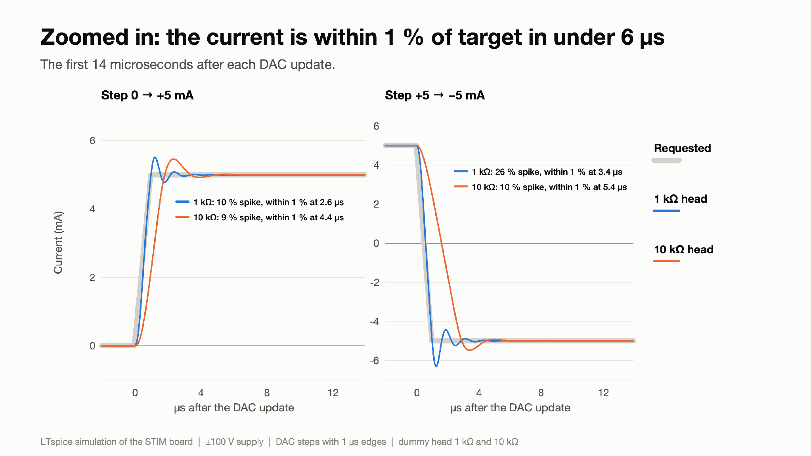
Step 3 - DAC step response
Figure 9: Zoomed in: the current is within 1 % of target in under 6 µs
What you are looking at: A zoom on the first 14 µs (millionths of a second) after each step. The current overshoots, rings a few times and then settles, like a car suspension after a bump.
Result: Overshoot is 10 % (0 → +5 mA, 1 kΩ) to 26 % (+5 → −5 mA, 1 kΩ), ringing at about 0.8 MHz for roughly 1 µs. The current is within 1 % of its target 2.6–5.4 µs after the step, and within 0.1 % after at most 7.2 µs.
Why it matters: The settling is fast, but the ringing shows a lightly damped feedback loop. Step 7 looks at whether that is a stability risk.

Slide 20
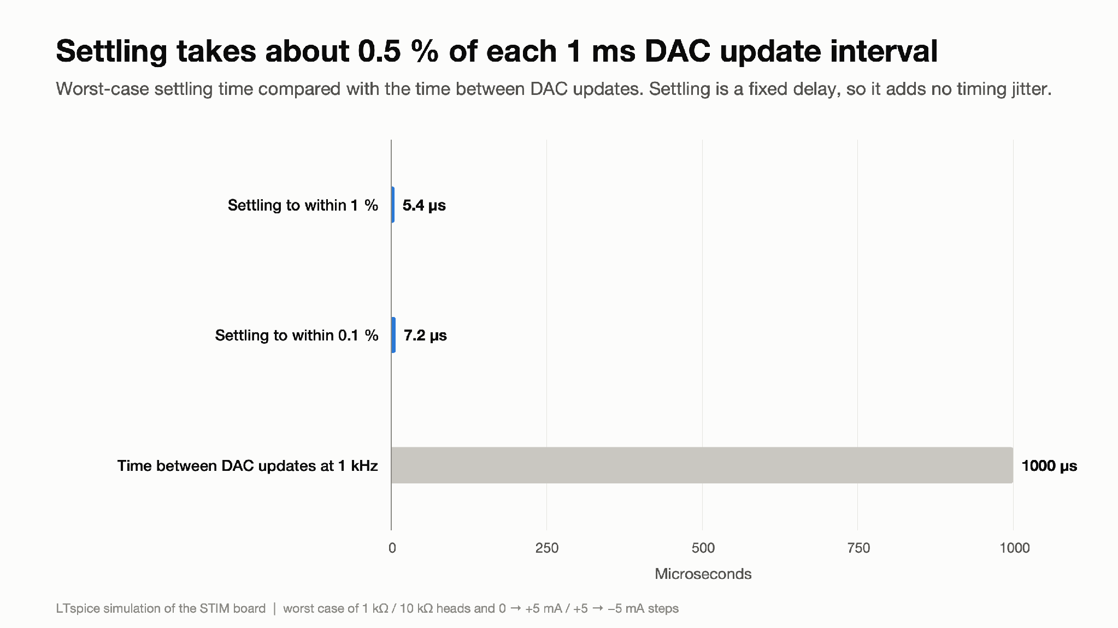
Step 3 - DAC step response
Figure 10: Settling takes about 0.5 % of each 1 ms DAC update interval
What you are looking at: Bar lengths are times in microseconds: how long the current takes to settle, compared with the time between two DAC updates at 1 kHz.
Result: Worst-case settling is 5.4 µs to 1 % and 7.2 µs to 0.1 %, about 0.5 % of the 1000 µs between updates.
Why it matters: The analog stage will not limit the update rate. Settling is a fixed delay that is the same every time, so it adds no timing jitter (variation) to the FPGA's schedule.

Slide 21
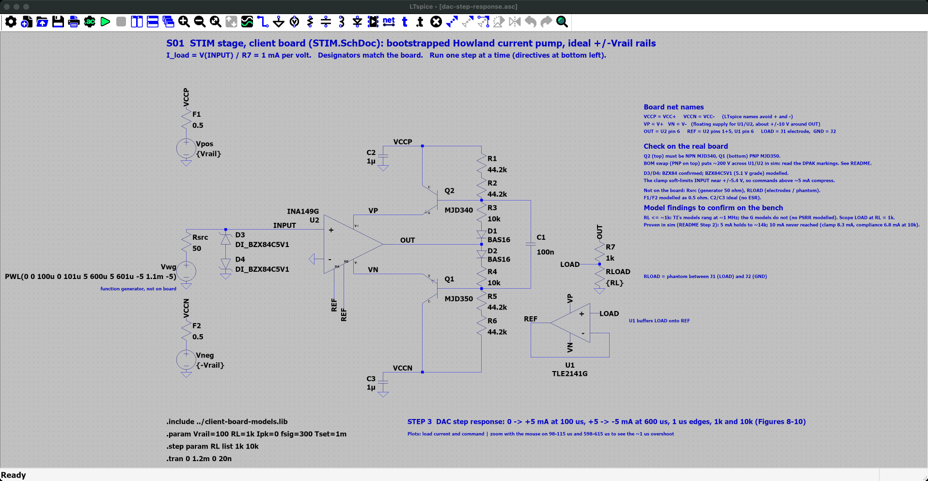
Step 3 - DAC step response - LTspice schematic
Where
SPICE_SIM/
2-pump-characterization/
3-dac-step-response/
dac-step-response.asc
Open it
1. Start LTspice, then File → Open ("Schematics (*.asc)").
2. Go to SPICE_SIM → 2-pump-characterization → 3-dac-step-response.
3. Open dac-step-response.asc.
On the schematic
• Vwg is a PWL source: 0 → +5 V → -5 V steps (1 mA per volt); RL = 1k and 10k.
Simulation commands (2 runs)
.step param RL list 1k 10k
.tran 0 1.2m 0 20n

Slide 22
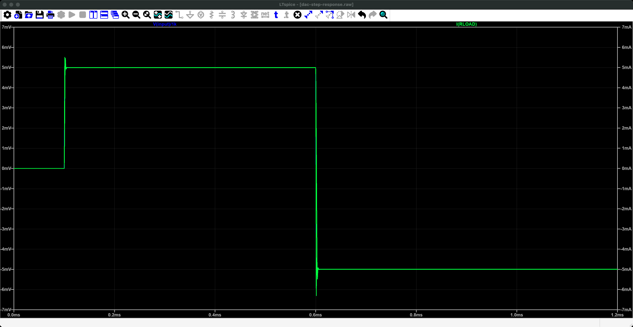
Step 3 - DAC step response - LTspice plot
Run it
1. Press Run (green ▶). Takes a few seconds.
2. dac-step-response.plt opens these panes. If not: Plot Settings → Open Plot Settings File.
What to read
• I(RLOAD) follows each step of V(input)/1k; zoom on an edge (drag a box) to see the ringing.
• Settles within 1 % in ≤ 5.4 µs, within 0.1 % in ≤ 7.2 µs.
What you are looking at: Time runs across, 0 to 1.2 ms. The command jumps from 0 to +5 mA and then to -5 mA; the head current follows so closely that the two lines overlap. The small spikes at each jump are a brief overshoot.
Why it matters: The current settles in a few microseconds, far inside the 1 ms between computer updates.
Traces (dac-step-response.plt, panes from the top) 1: I(RLOAD), V(input)/1k

Slide 23
Step 3 - DAC step response
Summary:
For full-scale DAC steps the current settles within 1 % in at most 5.4 µs and within 0.1 % in at most 7.2 µs (1 kΩ and 10 kΩ loads), about 0.5 % of a 1 ms update interval. The analog stage adds a small, fixed delay to the FPGA/DAC timing chain and no jitter. Each edge overshoots by 9–26 % for about 1 µs.
Technical footnotes:
The overshoot and ≈0.8 MHz ringing come from the lightly damped loop (Step 7). The op-amp models are generic; TI's full models (which only run in ngspice) showed ±0.5 mA ringing at ≈1 MHz into 1 kΩ, so the bench step response at 1 kΩ is the deciding test.
How to recreate the plots:
Ready-made: open 2-pump-characterization/3-dac-step-response/dac-step-response.asc and press Run.
1. Set Vwg to:
PWL(0 0 100u 0 101u 5 600u 5 601u -5 1.1m -5)
2. Directives (the 20 ns step resolves the spike):
.param Vrail=100 RL=1k
.step param RL list 1k 10k
.tran 0 1.2m 0 20n
3. Plot I(RLOAD) and V(input)/1k; zoom on 98–115 µs and 598–615 µs.
4. Error in %: add the trace 100*(I(RLOAD)/5m-1).
5. Restore Vwg to SINE(0 {Ipk*1k} {fsig} {Tset}).

Slide 24
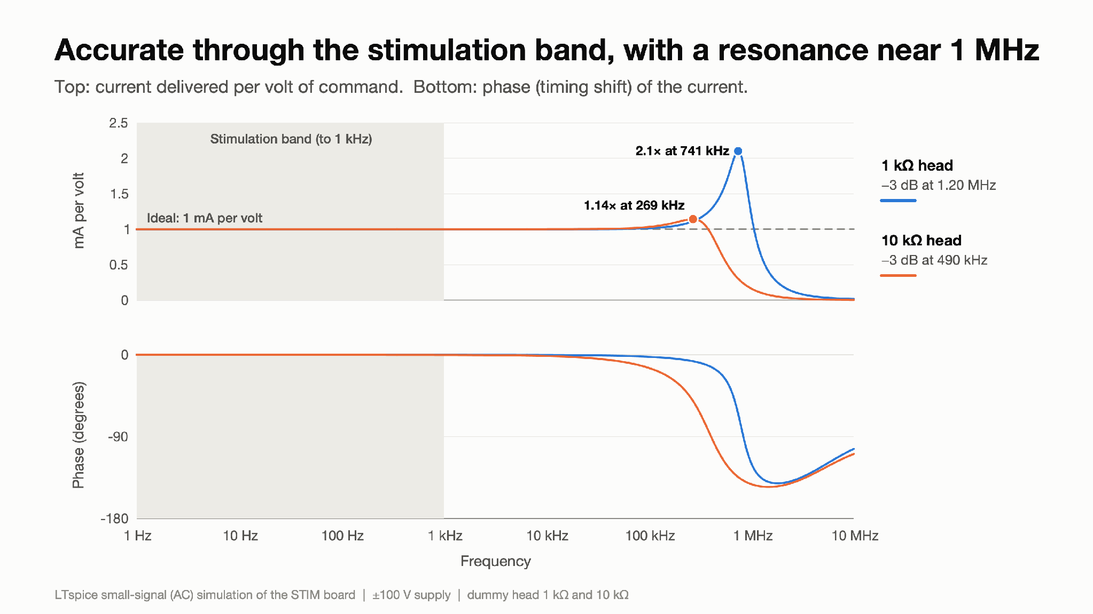
Step 4 - frequency response
Figure 11: Accurate through the stimulation band, with a resonance near 1 MHz
What you are looking at: A "Bode plot": how strongly the board responds to a small command at each frequency, from 1 Hz to 10 MHz. The ideal is a flat line at 1 mA per volt; the dashed line is the phase (timing shift).
Result: Flat at 1.000 mA/V (1 kΩ) and 1.001 mA/V (10 kΩ) up to 10 kHz, with under 1.4° of phase shift. Above that it rises to a +6.5 dB peak (about 2×) at 741 kHz with 1 kΩ, and +1.2 dB at 269 kHz with 10 kΩ.
Why it matters: Stimulation (up to 300 Hz, 1 kHz updates) sits in the flat region. The peak far above that band is the same light damping seen as ringing in Figure 9.

Slide 25
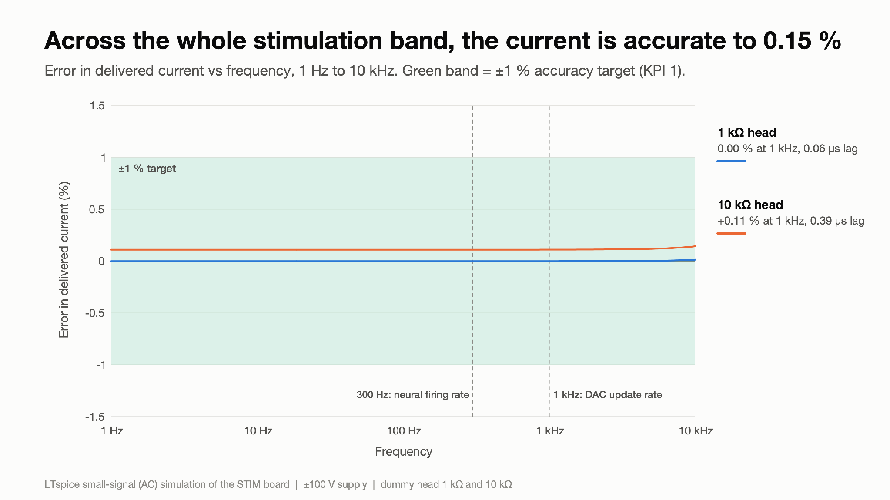
Step 4 - frequency response
Figure 12: Across the whole stimulation band, the current is accurate to 0.15 %
What you are looking at: A zoom on the stimulation band (1 Hz–10 kHz) showing the error in percent: 0 % means the current is exactly what was asked for.
Result: With 1 kΩ the error is ≈0 %. With 10 kΩ it is a constant +0.11 %, caused by the 50 Ω signal generator used in the simulation (a test-setup effect, not the board; Figure 23). It stays under 0.15 % up to 10 kHz.
Why it matters: Across the band the board is accurate to a fraction of the ±1 % target. A DAC with a low-impedance output buffer removes the 0.11 %.

Slide 26
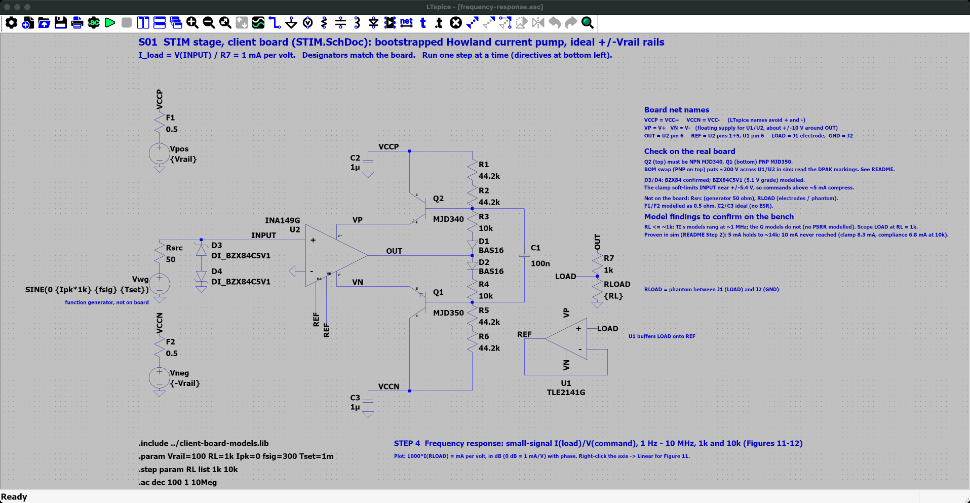
Step 4 - frequency response - LTspice schematic
Where
SPICE_SIM/
2-pump-characterization/
4-frequency-response/
frequency-response.asc
Open it
1. Start LTspice, then File → Open ("Schematics (*.asc)").
2. Go to SPICE_SIM → 2-pump-characterization → 4-frequency-response.
3. Open frequency-response.asc.
On the schematic
• Vwg carries "AC 1": a 1 V small-signal command, 1 Hz-10 MHz, RL = 1k and 10k.
Simulation commands (2 runs)
.step param RL list 1k 10k
.ac dec 100 1 10Meg

Slide 27
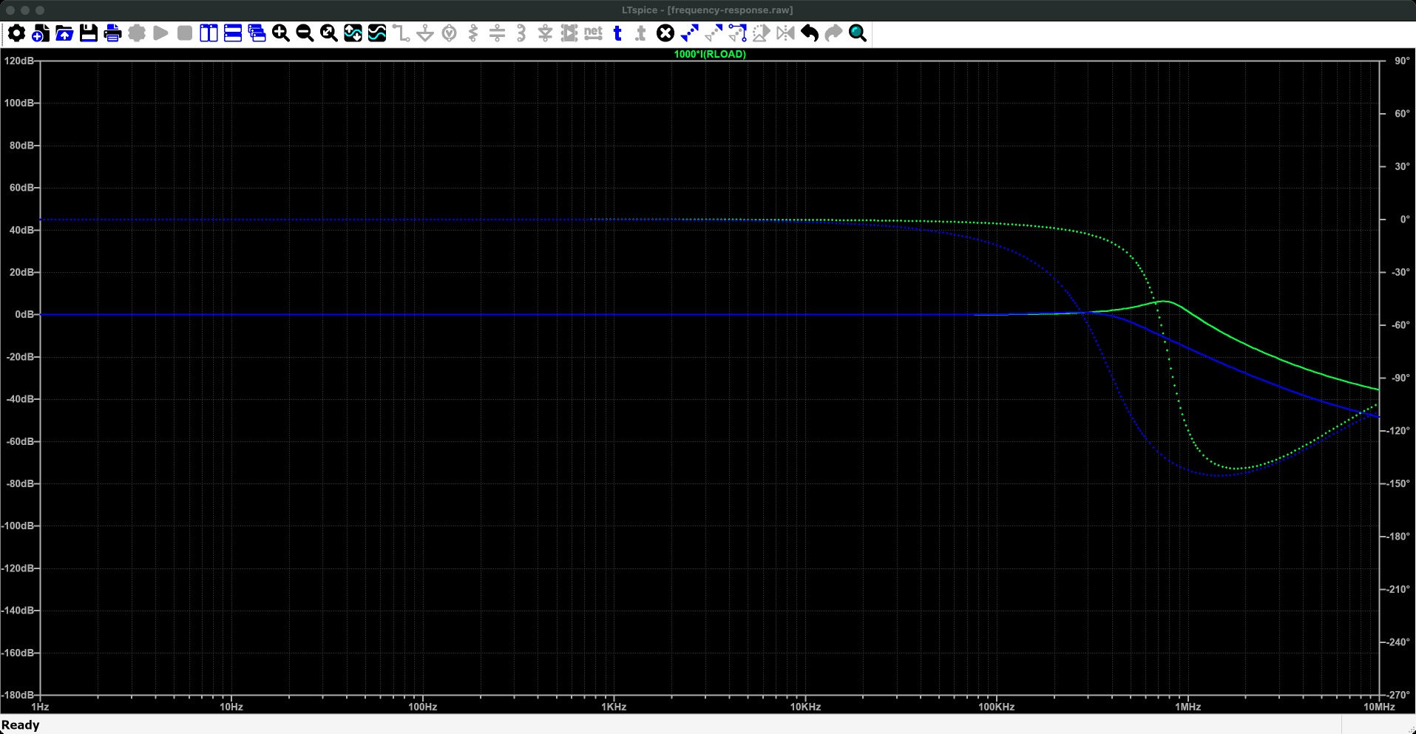
Step 4 - frequency response - LTspice plot
Run it
1. Press Run (green ▶). Takes a few seconds.
2. frequency-response.plt opens these panes. If not: Plot Settings → Open Plot Settings File.
What to read
• Solid line: magnitude (left axis); dotted: phase (right axis). 1000*I(RLOAD) reads 0 dB (1 mA/V) flat through the stimulation band, with a resonance near 1 MHz.
• Click the trace name for a cursor: within 0.15 % and 1.4° up to 10 kHz.
What you are looking at: Across is frequency, 1 Hz to 10 MHz, on a log scale. The solid lines are how much current comes out per volt of command: flat at 0 dB (exactly 1 mA per volt) up to about 100 kHz, then a bump near 1 MHz. The dotted lines are the delay (phase), near zero in the useful range. One colour per head resistance.
Why it matters: Across every frequency used for stimulation the board delivers exactly what is asked.
Traces (frequency-response.plt, panes from the top) 1: 1000*I(RLOAD)

Slide 28
Step 4 - frequency response
Summary:
Across the stimulation band (≤300 Hz neural rates, 1 kHz DAC updates) the board delivers 1 mA per volt within 0.15 % with under 1.4° of phase shift. The +0.11 % at 10 kΩ is the 50 Ω test generator, not the board (Step 8). The +6.5 dB peak at 741 kHz is the same light damping examined in Step 7.
Technical footnotes:
Linear .ac analysis about the bias point: no slew limiting, so it describes small signals only. The peak is formed by the INA149's own loop together with the Howland loop through R7, the load, U1 and REF; it is largest with the 1 kΩ load.
How to recreate the plots:
Ready-made: open 2-pump-characterization/4-frequency-response/frequency-response.asc and press Run.
1. Add " AC 1" to the end of Vwg's value.
2. Directives:
.param Vrail=100 RL=1k Ipk=0 fsig=300 Tset=1m
.step param RL list 1k 10k
.ac dec 100 1 10Meg
3. Plot 1000*I(RLOAD) (mA/V); right-click the axis → Linear for Figure 11.
4. Figure 12: add the trace 100*(mag(1000*I(RLOAD))-1) and zoom to 1 Hz–10 kHz.
5. Remove " AC 1" from Vwg when done.

Slide 29
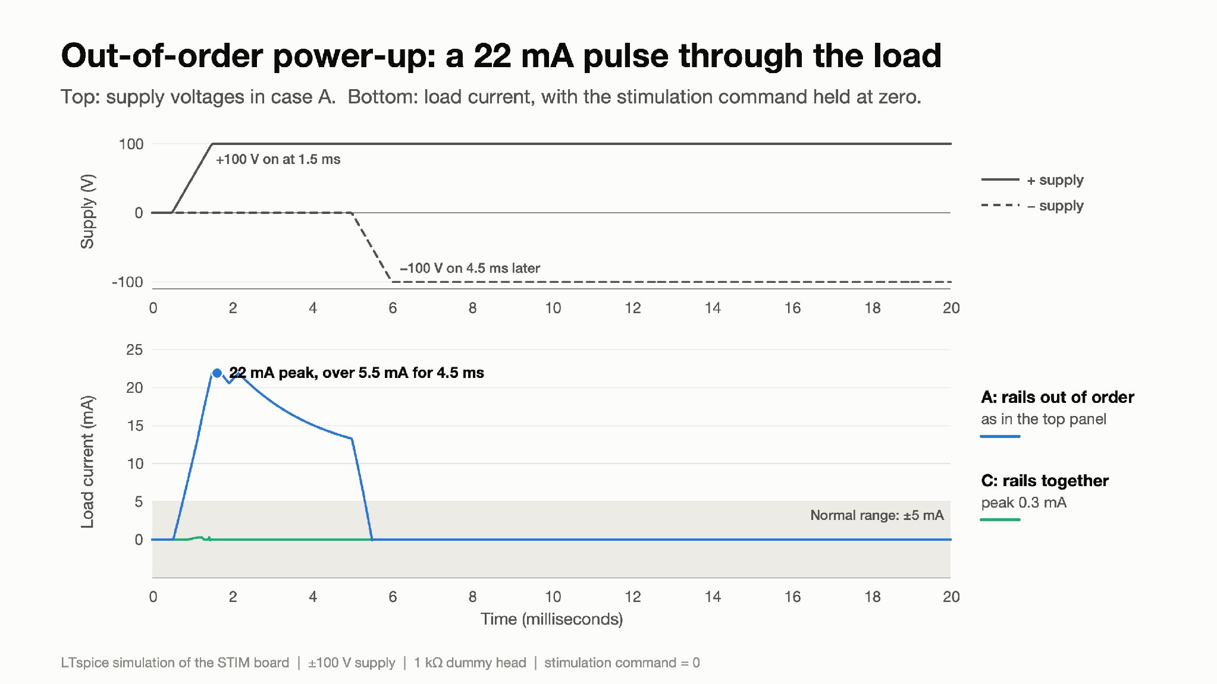
Step 5 - power sequencing and supply faults
Figure 13: Out-of-order power-up: a 22 mA pulse through the load
What you are looking at: Top: the two high-voltage supplies switching on. Bottom: current through a 1 kΩ head while the command is held at zero, so ideally the bottom lines stay at 0. Grey band: the normal ±5 mA range.
Result: Case A (blue): +100 V comes on 4.5 ms before −100 V. The load current jumps to 21.9 mA and stays above 5.5 mA for 4.5 ms, delivering 52 µC of charge above the 5 mA limit. Case C (green): both rails together; the current stays below 0.3 mA.
Why it matters: Power-up order matters for safety. The prototype has nothing that blocks this pulse.

Slide 30
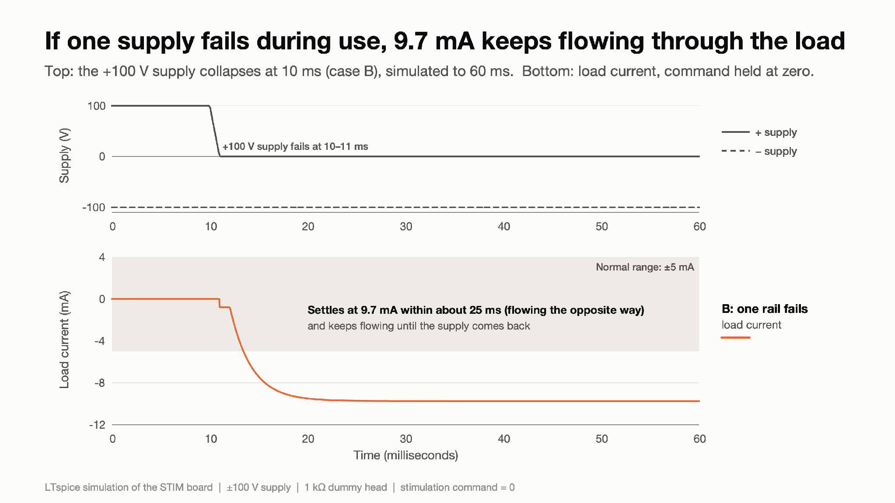
Step 5 - power sequencing and supply faults
Figure 14: If one supply fails during use, 9.7 mA keeps flowing through the load
What you are looking at: Same layout as Figure 13, but both supplies start on and the +100 V supply fails at 10 ms (case B). The simulation runs to 60 ms so the current can settle.
Result: The load current settles at −9.7 mA within about 25 ms and keeps flowing for as long as the rail is missing, nearly twice the 5 mA maximum. Nothing on the board detects or interrupts it.
Why it matters: A single supply fault turns the board into an uncontrolled current source through the head.

Slide 31
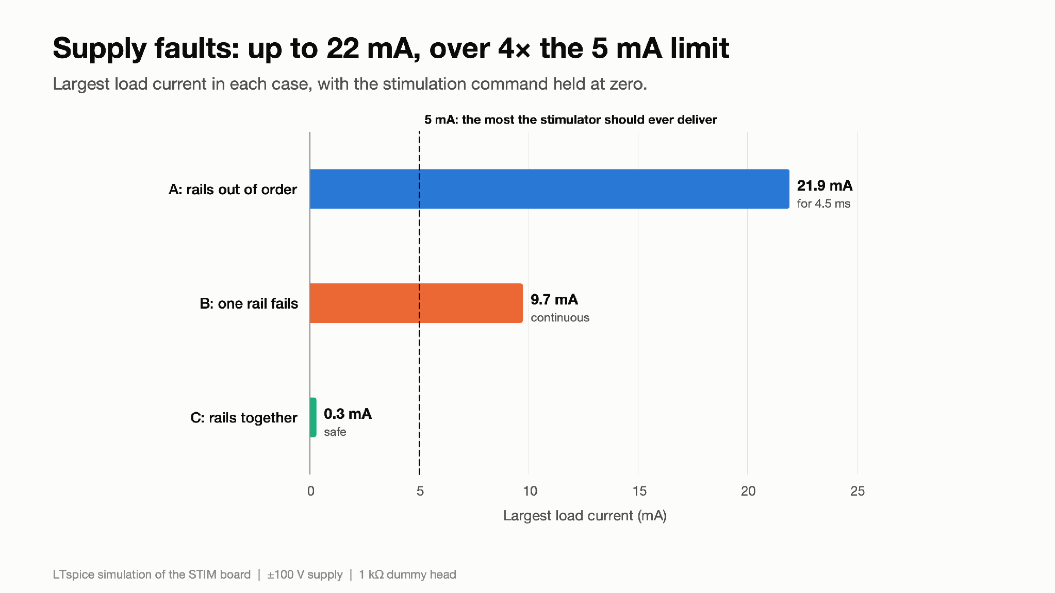
Step 5 - power sequencing and supply faults
Figure 15: Supply faults: up to 22 mA, over 4× the 5 mA limit
What you are looking at: Each bar is the largest current in one fault case, all with a zero command. The dashed line is 5 mA, the most the stimulator should ever deliver.
Result: 21.9 mA for 4.5 ms (A), 9.7 mA continuous (B), 0.3 mA (C). Neither the 500 mA fuses (F1/F2) nor the input zener limit these currents.
Why it matters: These are findings on the prototype as built. A protection circuit (supply monitor plus output disconnect, independent current limit, sequenced supplies) is needed and has not been designed yet.

Slide 32
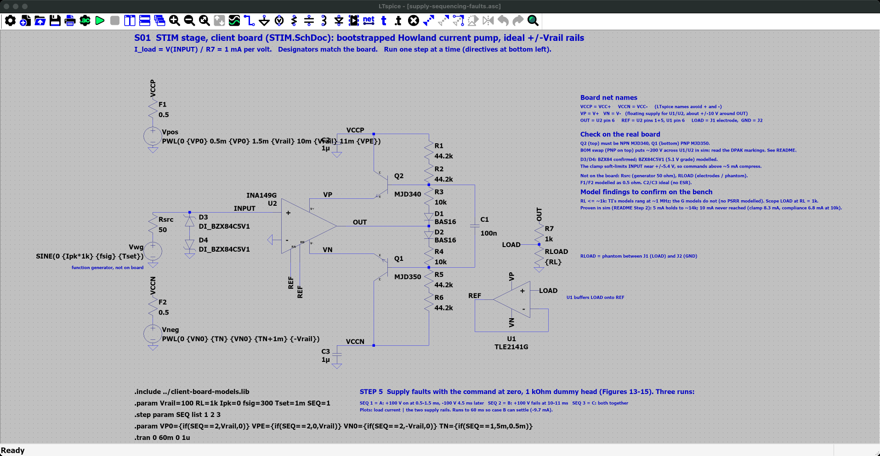
Step 5 - power sequencing and supply faults - LTspice schematic
Where
SPICE_SIM/
2-pump-characterization/
5-power-sequencing/
supply-sequencing-faults.asc
Open it
1. Start LTspice, then File → Open ("Schematics (*.asc)").
2. Go to SPICE_SIM → 2-pump-characterization → 5-power-sequencing.
3. Open supply-sequencing-faults.asc.
On the schematic
• Zero command, RL = 1 kΩ. SEQ steps three cases: rails 4.5 ms apart, +100 V lost while running, and rails 0.5 ms apart.
Simulation commands (3 runs)
.step param SEQ list 1 2 3
.tran 0 60m 0 1u

Slide 33
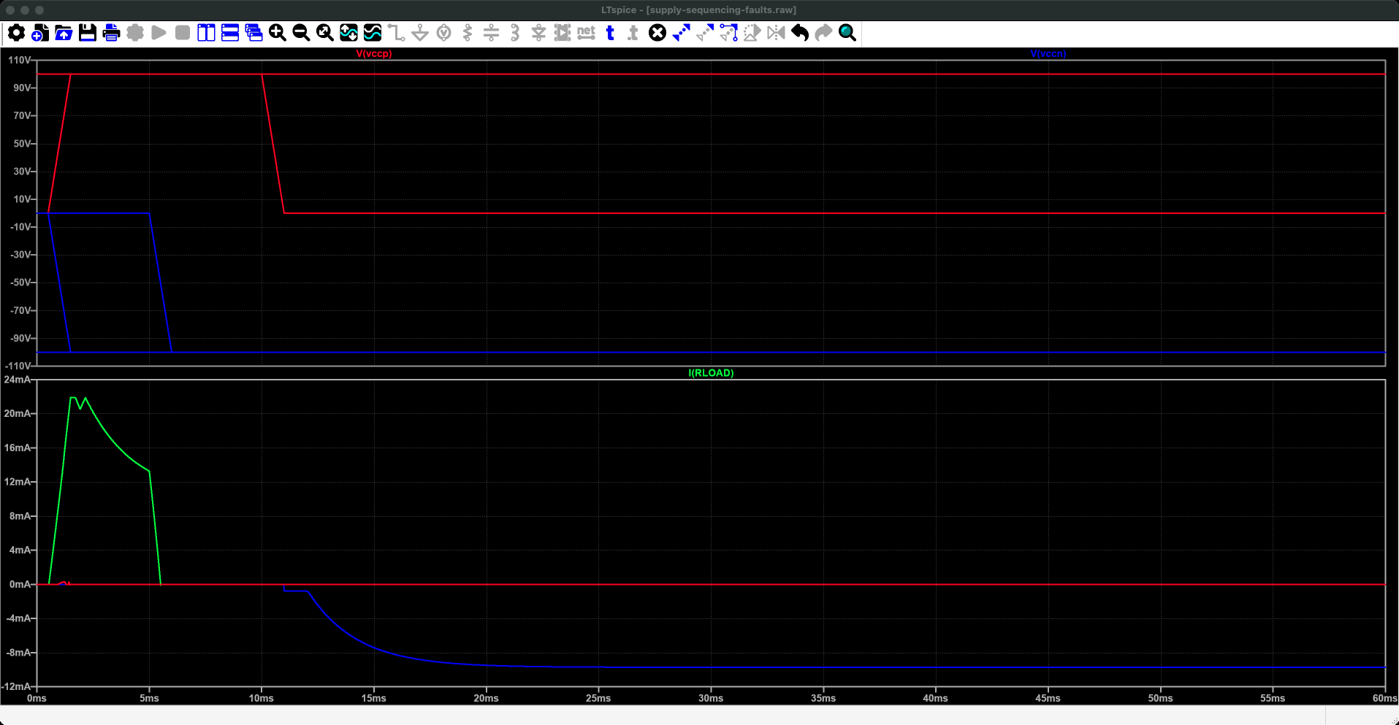
Step 5 - power sequencing and supply faults - LTspice plot
Run it
1. Press Run (green ▶). Takes about 10 s.
2. supply-sequencing-faults.plt opens these panes. If not: Plot Settings → Open Plot Settings File.
What to read
• V(vccp), V(vccn): the rail timing of each case.
• I(RLOAD): a 21.9 mA pulse when the rails come up apart; -9.7 mA continuous when +100 V is lost. Nothing on the client board limits it.
What you are looking at: Time runs across, 0 to 60 ms, with no stimulation requested. Top pane: the two ±100 V supplies switching on or failing. Bottom pane: the current through the head, which should stay at zero. One run shows a pulse of about 22 mA when the supplies come up 4.5 ms apart; another settles at about -10 mA after one supply fails.
Why it matters: The client's board does nothing to stop these currents: a safety finding that Rev 1 fixes.
Traces (supply-sequencing-faults.plt, panes from the top) 1: V(vccp), V(vccn) 2: I(RLOAD)

Slide 34
Step 5 - power sequencing and supply faults
Summary:
With zero command and a 1 kΩ dummy head, the prototype does not protect the load from supply faults. Rails powering up 4.5 ms apart produce a 21.9 mA pulse (52 µC above 5 mA); losing the +100 V rail leaves −9.7 mA flowing for as long as the fault lasts. Rails ramping together stay below 0.3 mA. These are findings on the prototype as built; protection has not been designed or simulated yet.
Technical footnotes:
Same behaviour in tests/T10. With the DAC already at +5 mA when power arrives, an out-of-order power-up reaches 29 mA, and even a simultaneous power-up peaks at 8.1 mA for 0.36 ms. In case B the INA149 loses its upper floating rail (VP ≈ −18 V, VN ≈ −26 V) and the output is pulled toward the remaining −100 V rail; the exact path through Q1/Q2 and the bias string still has to be traced, and Q1/Q2 safe-operating-area in the faults checked.
How to recreate the plots:
Ready-made: open 2-pump-characterization/5-power-sequencing/supply-sequencing-faults.asc and press Run (three runs, 60 ms).
Directives:
.param Vrail=100 Ipk=0 RL=1k fsig=300 Tset=1m
.tran 0 60m 0 1u
Case A: Vpos PWL(0 0 0.5m 0 1.5m {Vrail}), Vneg PWL(0 0 5m 0 6m {-Vrail})
Case B: Vpos PWL(0 {Vrail} 10m {Vrail} 11m 0), Vneg {-Vrail}
Case C: Vpos PWL(0 0 0.5m 0 1.5m {Vrail}), Vneg PWL(0 0 0.5m 0 1.5m {-Vrail})
Plot I(RLOAD) with V(vccp) and V(vccn). Restore Vpos to {Vrail} and Vneg to {-Vrail} afterwards.

Slide 35
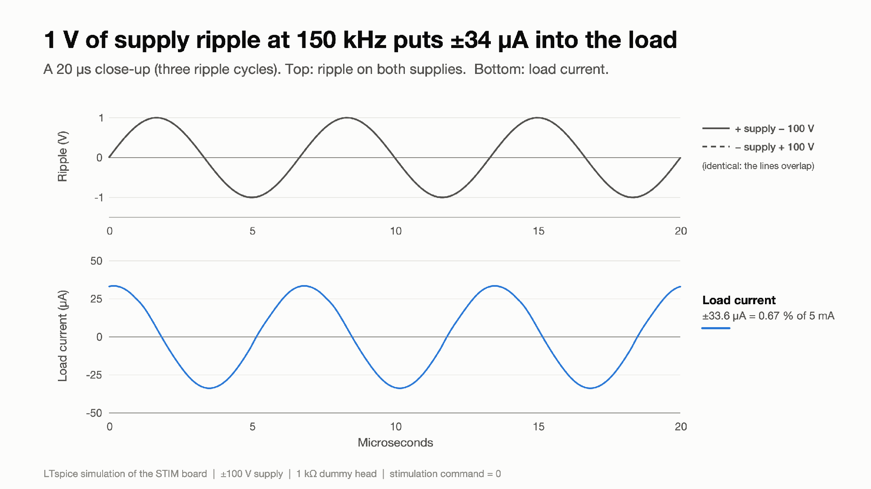
Step 6 - converter ripple into the load
Figure 16: 1 V of supply ripple at 150 kHz puts ±34 µA into the load
What you are looking at: The flyback converter will not give perfectly smooth ±100 V; it leaves a small "ripple" at its switching frequency. Here both rails carry 1 V of 150 kHz ripple and the command is zero. The trace is the current that leaks into the 1 kΩ head.
Result: ±33.6 µA of 150 kHz current flows in the head, 0.67 % of the 5 mA full scale, with nothing commanded.
Why it matters: Ripple on the supplies shows up in the head. The power team needs a ripple limit (Figure 18).

Slide 36
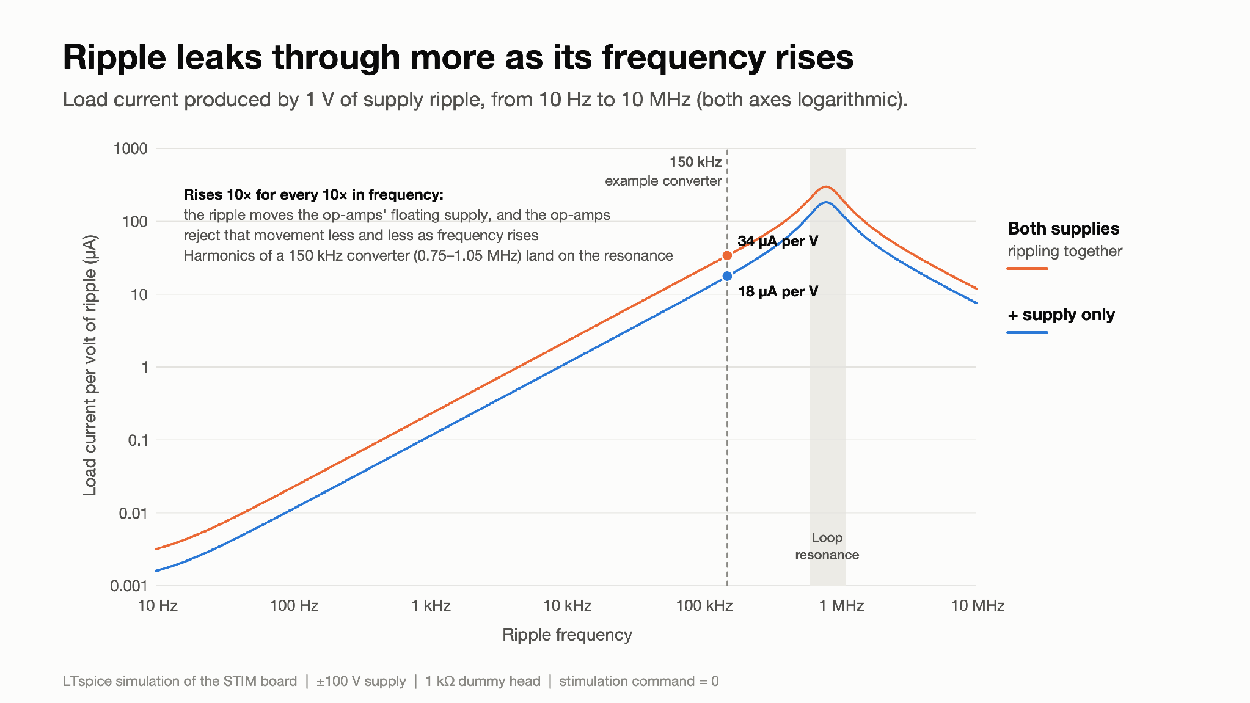
Step 6 - converter ripple into the load
Figure 17: Ripple leaks through more as its frequency rises
What you are looking at: Leaked current per volt of ripple, against ripple frequency, on log–log axes. A straight rising line means the leakage grows in proportion to frequency.
Result: 0.023 µA/V at 100 Hz, 34 µA/V at 150 kHz with both rails rippling together (half with one rail), peaking at about 300 µA/V near 0.8 MHz. The path: ripple moves the op-amps' floating supply up and down, and the op-amps reject that movement less and less as frequency rises. (Removing transistor capacitance changes it by only 1 dB.)
Why it matters: The 5th–7th harmonics of a 150 kHz converter (0.75–1.05 MHz) land on the 0.8 MHz peak and are amplified, not just scaled up. The generic op-amp models set this number, so it must be measured on the bench.

Slide 37
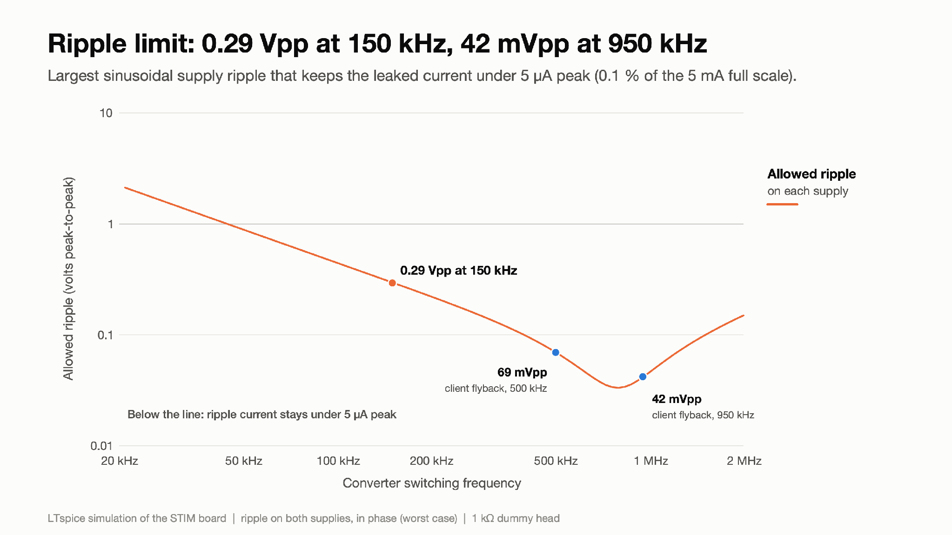
Step 6 - converter ripple into the load
Figure 18: Preliminary ripple limit (set by generic op-amp models): 0.29 Vpp at 150 kHz, 42 mVpp at 950 kHz
What you are looking at: For each converter switching frequency, the largest sinusoidal ripple (peak-to-peak volts) that keeps the leaked current under 5 µA peak (0.1 % of full scale, a budget we chose, not a standard).
Result: Preliminary, model-dependent: 0.29 Vpp at 150 kHz, 0.14 Vpp at 300 kHz. The client's flyback schematics switch at 500 kHz (Power_Circuit) and 950 kHz (PSU_150V): there the limit is only 69 mVpp and 42 mVpp, because they sit near the 0.8 MHz peak of Figure 17.
Why it matters: A starting specification for the power team. Real flyback ripple is not a clean sine: its harmonics near 0.8 MHz leak more (Figure 17), so the converter should be smoother than this line, and the limit checked on the bench. The value depends on the op-amps' real supply rejection; treat it as an order-of-magnitude target until measured.

Slide 38
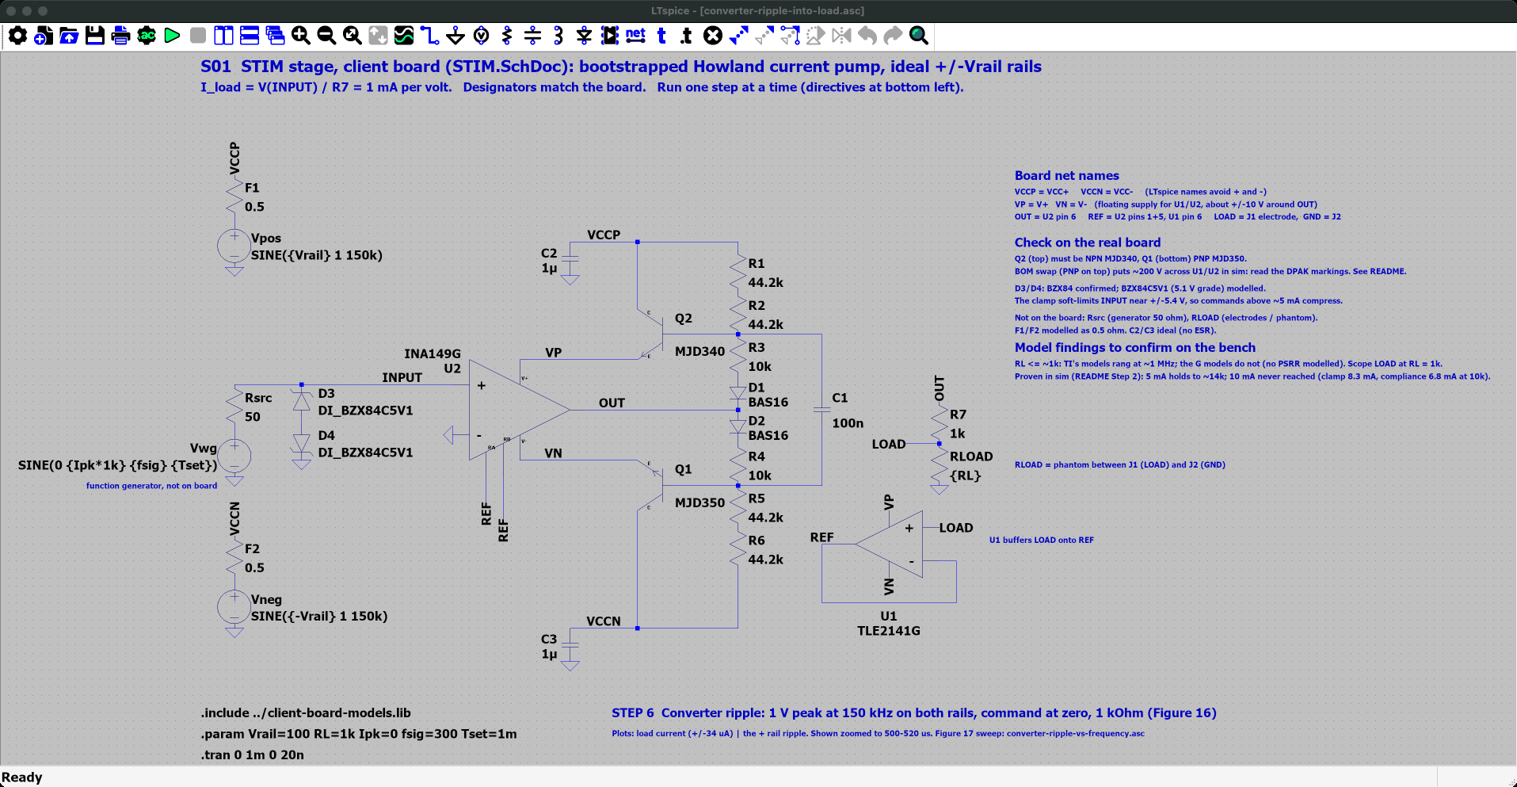
Step 6 - converter ripple into the load - LTspice schematic (1 of 2)
Where
SPICE_SIM/
2-pump-characterization/
6-converter-ripple/
converter-ripple-into-load.asc
Open it
1. Start LTspice, then File → Open ("Schematics (*.asc)").
2. Go to SPICE_SIM → 2-pump-characterization → 6-converter-ripple.
3. Open converter-ripple-into-load.asc.
On the schematic
• Zero command, RL = 1 kΩ; 1 V of 150 kHz ripple added on both rails.
Simulation commands (1 run)
.tran 0 1m 0 20n

Slide 39

Step 6 - converter ripple into the load - LTspice schematic (2 of 2)
Where
SPICE_SIM/
2-pump-characterization/
6-converter-ripple/
converter-ripple-vs-frequency.asc
Open it
1. Start LTspice, then File → Open ("Schematics (*.asc)").
2. Go to SPICE_SIM → 2-pump-characterization → 6-converter-ripple.
3. Open converter-ripple-vs-frequency.asc.
On the schematic
• AC source on the rails instead of the command: leaked load current per volt of ripple, 10 Hz-10 MHz.
Simulation commands (1 run)
.ac dec 50 10 10Meg

Slide 40
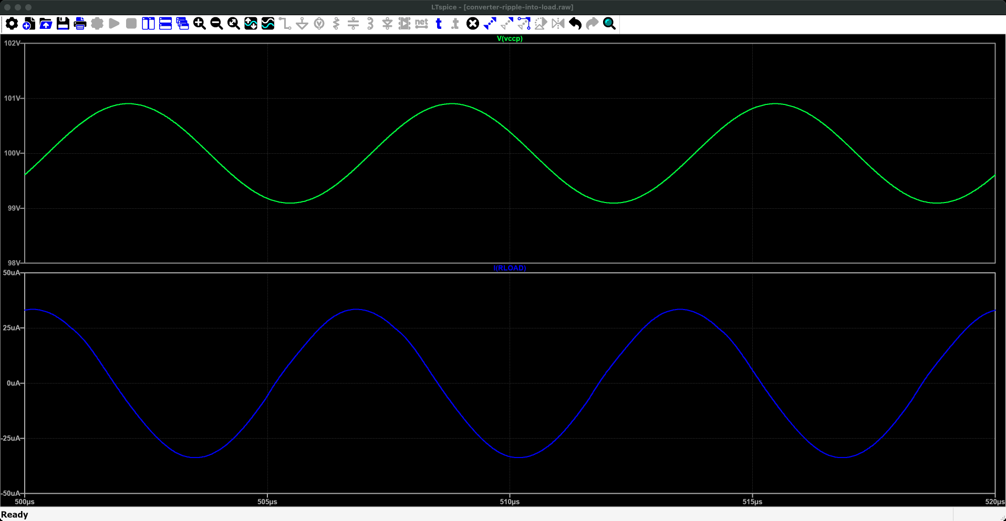
Step 6 - converter ripple into the load - LTspice plot (1 of 2)
Run it
1. Press Run (green ▶). Takes a few seconds.
2. converter-ripple-into-load.plt opens these panes. If not: Plot Settings → Open Plot Settings File.
What to read
• The plot opens zoomed on 500-520 µs: V(vccp) ripples by ±1 V; I(RLOAD) by ±33.6 µA.
What you are looking at: A 20 µs close-up. Top pane: one supply rail wobbling by ±1 V at 150 kHz, the switching of the power converter. Bottom pane: the head current, which should be zero but wobbles by about ±34 µA in step with it.
Why it matters: Supply noise leaks into the head; the converter must be quiet enough to keep this small.
Traces (converter-ripple-into-load.plt, panes from the top) 1: V(vccp) 2: I(RLOAD)

Slide 41
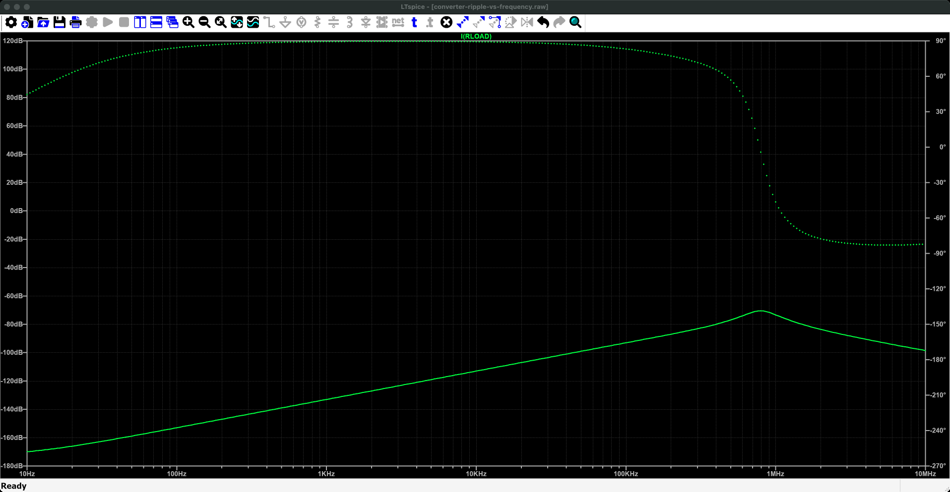
Step 6 - converter ripple into the load - LTspice plot (2 of 2)
Run it
1. Press Run (green ▶). Takes a few seconds.
2. converter-ripple-vs-frequency.plt opens these panes. If not: Plot Settings → Open Plot Settings File.
What to read
• Solid line: magnitude (left axis); dotted: phase (right axis). I(RLOAD) in dB re 1 A per volt of ripple: -89 dB = 35 µA/V.
• It rises in proportion to frequency (20 dB/decade) and peaks near 0.8 MHz.
What you are looking at: Across is the frequency of the supply wobble, 10 Hz to 10 MHz. The solid line is how much head current leaks through per volt of wobble: it climbs steadily with frequency and peaks near 0.8 MHz. The dotted line is the phase.
Why it matters: Fast supply noise leaks through more than slow noise: this sets how clean the power supply must be.
Traces (converter-ripple-vs-frequency.plt, panes from the top) 1: I(RLOAD)

Slide 42
Step 6 - converter ripple into the load
Summary:
Supply ripple reaches the load: 1 V of 150 kHz ripple on both rails gives ±33.6 µA (0.67 % of full scale) in 1 kΩ with zero command. The leakage rises in proportion to frequency and peaks near 0.8 MHz. To keep it under 5 µA peak the rails need ≤0.29 Vpp at 150 kHz, but only ≤69 mVpp at 500 kHz and ≤42 mVpp at 950 kHz, the switching frequencies in the client's flyback schematics. Post-regulation or LC filtering of the rails is likely needed.
Technical footnotes:
Path (checked by removing parts in the model): the ripple moves both floating rails together (−24 dB), and the op-amps pass that movement to their output. Q1/Q2 junction capacitance changes the result by 1 dB and C1 by nothing. An op-amp model that fully rejects supply movement cuts it by 76 dB, so the real number depends on the chips' high-frequency PSRR. The previous "≈36 pF, consistent with 45 pF C_cb" explanation was wrong and is withdrawn. 5 µA peak is a chosen budget, not a standard.
How to recreate the plots:
Ready-made: open 2-pump-characterization/6-converter-ripple/converter-ripple-into-load.asc and converter-ripple-vs-frequency.asc and press Run.
Directives:
.param Vrail=100 Ipk=0 RL=1k fsig=300 Tset=1m
.tran 0 1m 0 20n
Vpos SINE({Vrail} 1 150k), Vneg SINE({-Vrail} 1 150k). Plot I(RLOAD) and zoom to 20 µs.
Frequency sweep: Vpos "{Vrail} AC 1", Vneg "{-Vrail} AC 1", and .ac dec 50 10 10Meg.
Restore Vpos to {Vrail} and Vneg to {-Vrail} afterwards.

Slide 43
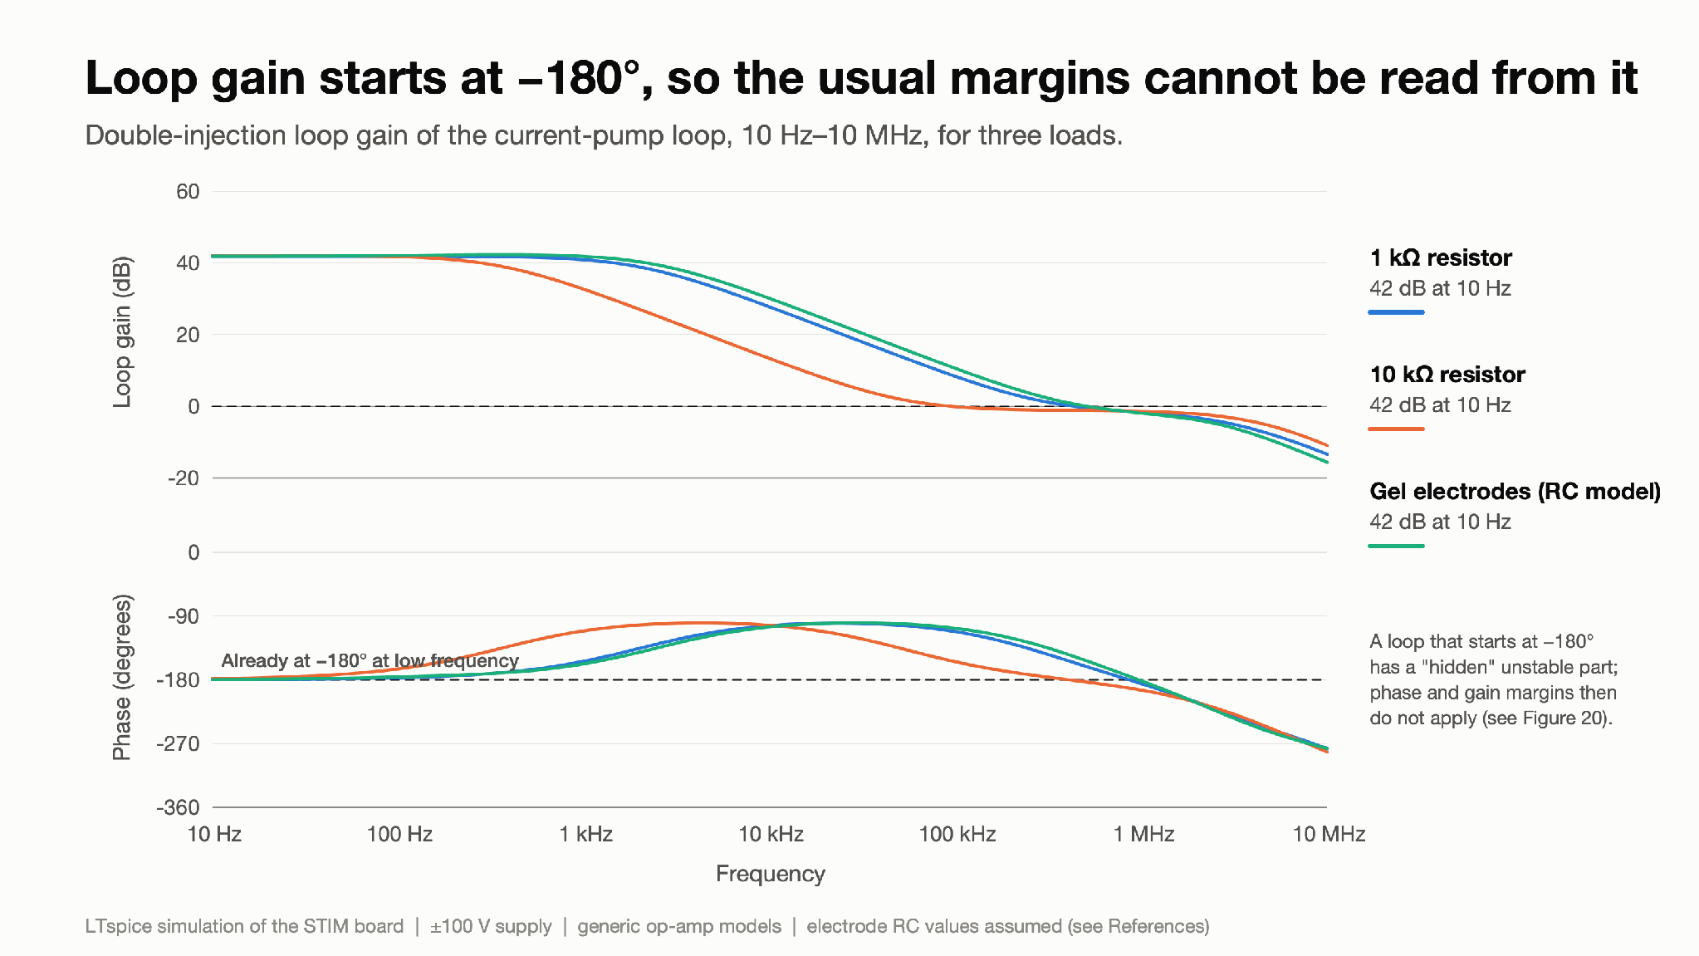
Step 7 - loop stability
Figure 19: Loop gain starts at −180°, so the usual margins cannot be read from it
What you are looking at: "Loop gain" measures how strongly the feedback loop corrects errors at each frequency. Engineers usually read stability margins where the gain crosses 0 dB. Three loads shown, 10 Hz–10 MHz.
Result: The loop gain is 42 dB with a phase of −180° already at 10 Hz. A loop that starts at −180° contains an unstable part when it is opened for measurement (a right-half-plane pole, inferred from the phase and the encirclement count; an independent open-loop pole check is pending). For such loops the usual phase and gain margins do not apply.
Why it matters: The 24–39° phase margin and 1–2 dB gain margin quoted in the previous version came from this plot and are withdrawn. Figures 20–21 replace them.

Slide 44
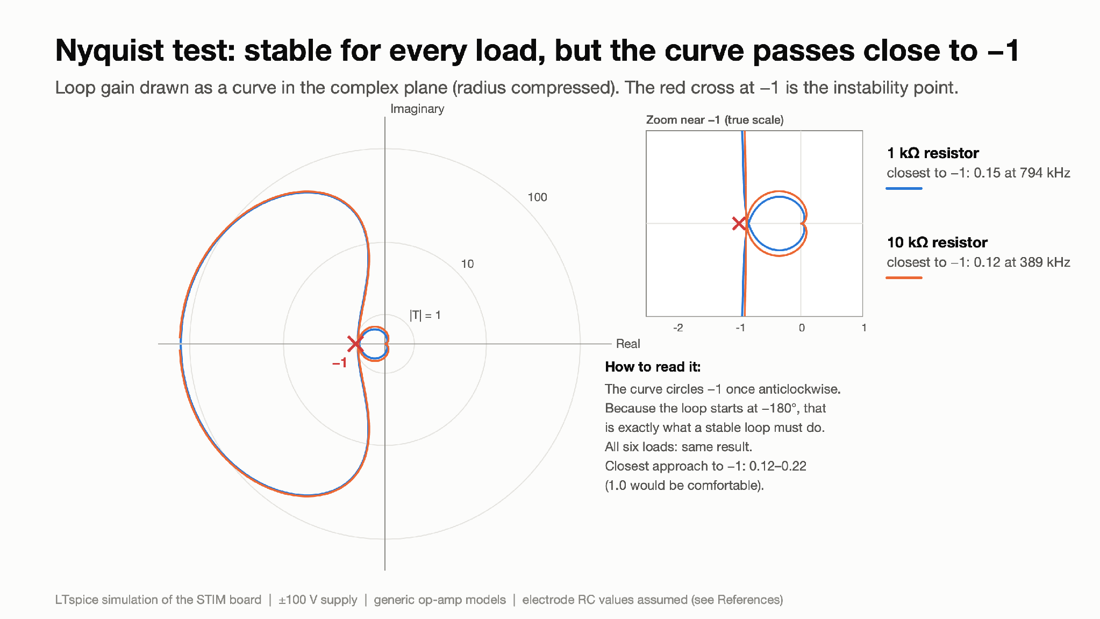
Step 7 - loop stability
Figure 20: Nyquist plot: consistent with a stable loop, but the curve passes close to −1
What you are looking at: A Nyquist plot draws the loop gain as a curve in the complex plane. The rule: the closed circuit is stable if the curve circles the red −1 point the right number of times; how close it passes to −1 shows how close it is to oscillating. The inset zooms in near −1.
Result: For all six loads the curve circles −1 once anticlockwise, which is what a stable loop of this kind should show, given one unstable open-loop pole. But it passes only 0.12–0.22 from −1 (≥0.5 is a common design target), at 0.4–1 MHz.
Why it matters: Stable, but close to the edge, matching the ringing in Figure 9 and the 6.5 dB peak in Figure 11. With an op-amp model that fully ignores supply movement the curve stays 1.0 away, so the real chips' supply rejection decides the true margin.
Load | Closest distance to −1 | At
1 kΩ resistor | 0.149 | 794 kHz
10 kΩ resistor | 0.121 | 389 kHz
1 kΩ + 1 nF cable | 0.219 | 1000 kHz
Gel electrodes (RC model) | 0.182 | 891 kHz
Poor contact (RC model) | 0.204 | 813 kHz
Dry electrodes (RC model) | 0.183 | 933 kHz

Slide 45
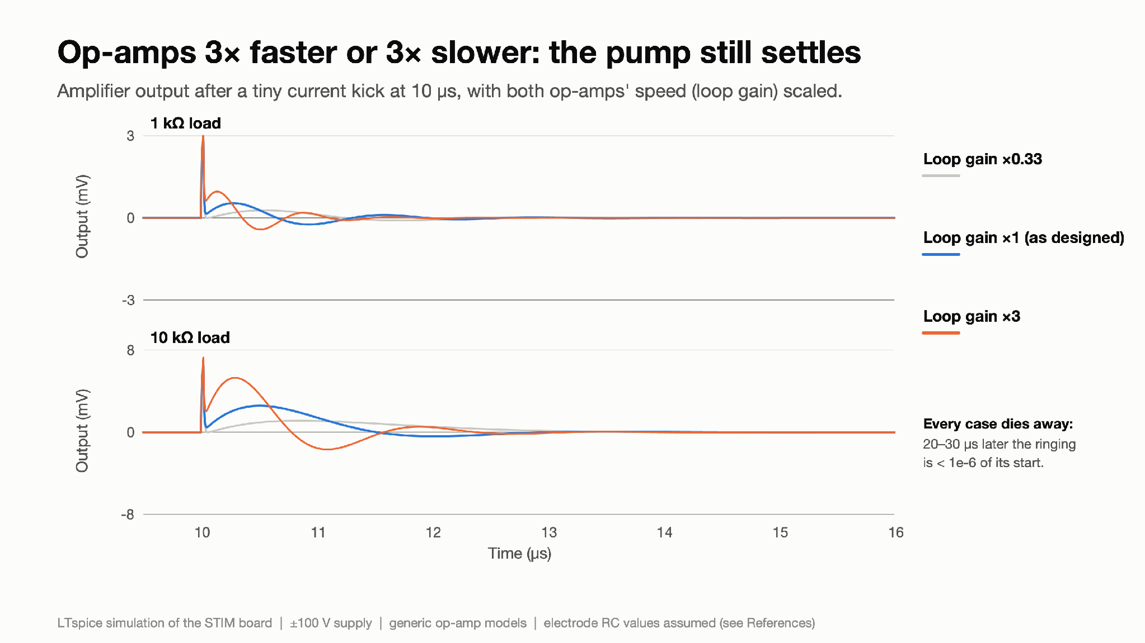
Step 7 - loop stability
Figure 21: Op-amps 3× faster or 3× slower: the pump still settles
What you are looking at: A tiny current "kick" is injected at 10 µs and we watch the amplifier output ring and die away. The experiment is repeated with both op-amps made 3× slower and 3× faster, which scales the loop gain by the same factor.
Result: Every case settles: 20–30 µs later the ringing is below a millionth of its start (full sweep 0.33× to 3×, U2 alone or both chips, 1 kΩ and 10 kΩ: tests/T18). The 1 kΩ case rings at 0.77 MHz with damping ratio ζ ≈ 0.25; 10 kΩ at 0.33 MHz with ζ ≈ 0.52.
Why it matters: The model does not tip into oscillation even with large gain changes. Damping is still low, and the op-amp models are generic, so oscillation on the real board cannot be ruled out. A MHz oscillation into a person would be a safety issue, so the bench test in Next steps is required.

Slide 46
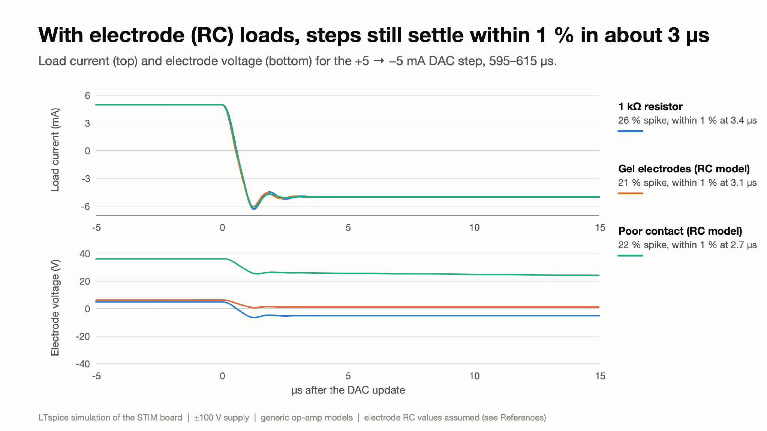
Step 7 - loop stability
Figure 22: With electrode (RC) loads, steps still settle within 1 % in about 3 µs
What you are looking at: Real electrodes on skin behave like a resistor plus capacitors (an "RC model"). Top: load current for a +5 → −5 mA step into a plain 1 kΩ resistor and two electrode models. Bottom: the voltage across the electrodes.
Result: Overshoot is 21–26 % and the current is within 1 % in 2.7–3.4 µs for all three loads. The electrode values are assumptions: tissue itself is resistive (References), but the electrode–skin values must be measured.
Why it matters: Capacitive electrodes do not make the response worse in this model; their Nyquist distances are 0.18 (gel), 0.20 (poor contact) and 0.18 (dry), against 0.15 for the 1 kΩ resistor (Figure 20).

Slide 47
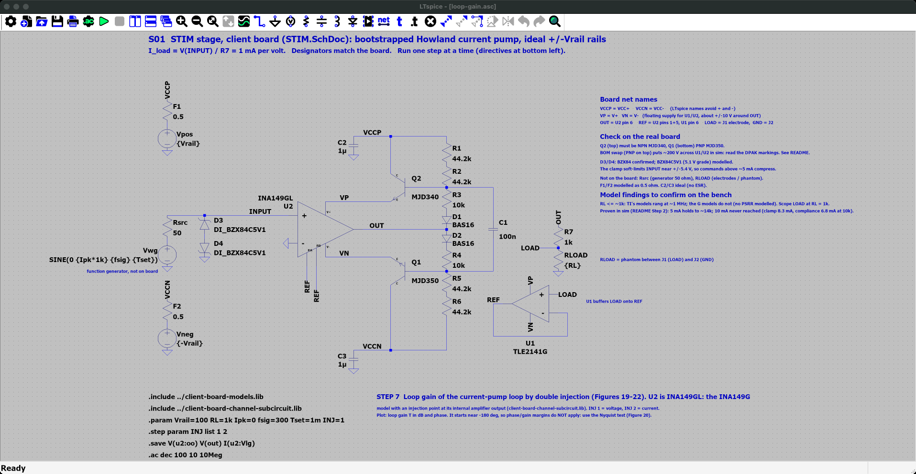
Step 7 - loop stability - LTspice schematic
Where
SPICE_SIM/
2-pump-characterization/
7-loop-stability/
loop-gain.asc
Open it
1. Start LTspice, then File → Open ("Schematics (*.asc)").
2. Go to SPICE_SIM → 2-pump-characterization → 7-loop-stability.
3. Open loop-gain.asc.
On the schematic
• Double injection inside U2 (INJ = 1, 2: voltage, then current); RL = 1 kΩ. The plotted expression combines both runs into the loop gain.
Simulation commands (2 runs)
.step param INJ list 1 2
.ac dec 100 10 10Meg

Slide 48
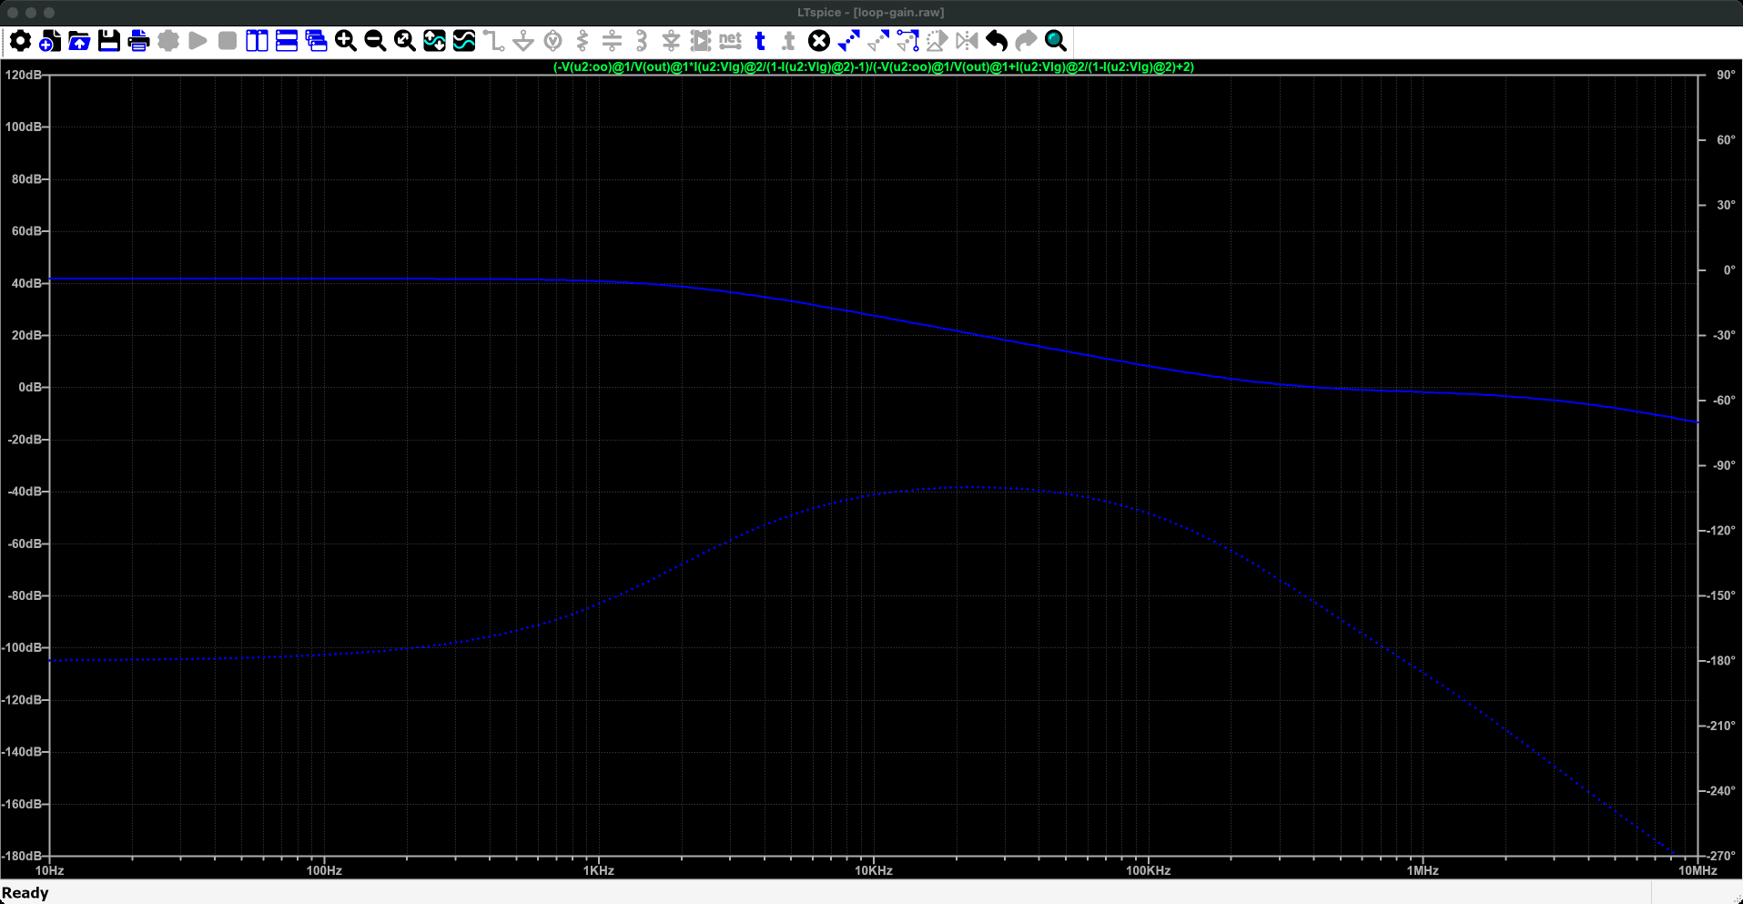
Step 7 - loop stability - LTspice plot
Run it
1. Press Run (green ▶). Takes a few seconds.
2. loop-gain.plt opens these panes. If not: Plot Settings → Open Plot Settings File.
What to read
• Solid line: magnitude (left axis); dotted: phase (right axis). Loop gain, 10 Hz-10 MHz: about 42 dB at low frequency. The phase starts at -180°, so the usual margins cannot be read off it: deck 2 uses the Nyquist plot and step tests instead (Figures 20-22).
What you are looking at: Across is frequency. The solid line is how strongly the circuit corrects its own errors: strong (about 42 dB) at low frequency, fading as frequency rises. The dotted line is the phase. It starts at -180°, which is why the usual way of judging stability from this plot does not apply here.
Why it matters: Stability is judged instead from step tests and the Nyquist plot in deck 2.
Traces (loop-gain.plt, panes from the top) 1: (-V(u2:oo)@1/V(out)@1*I(u2:Vlg)@2/(1-I(u2:Vlg)@2)-1)/(-V(u2:oo)@1/V(out)@1+I(u2:Vlg)@2/(1-I(u2:Vlg)@2)+2)

Slide 49
Step 7 - loop stability
Summary:
In simulation the pump settles after a small kick for every load, and still settles with op-amp speed scaled from 0.33× to 3× (Figure 21), but it is lightly damped (ζ ≈ 0.2–0.5, 10–26 % overshoot). The Nyquist plot is consistent with this and shows the curve passing within 0.12–0.22 of −1. Stability on the real board is not assured.
Oscillation on the real board is plausible, and a MHz oscillation into a person is a safety issue as well as a performance one. Bench verification and a compensation design are needed.
Technical footnotes:
Double-injection loop gain T = (Tv·Ti − 1)/(Tv + Ti + 2) at the INA149's internal amplifier output (tests/T15). T starts at −180° with +1 anticlockwise encirclement of −1, which indicates a right-half-plane pole in the opened loop (to be confirmed by an independent open-loop pole check) and Bode margins do not apply; the earlier PM/GM figures are withdrawn. This also explains the reviewer's 10 kΩ mismatch (PM 27° vs ζ 0.52). The ~13 dB of loop gain at 10 kHz does not set the 0.15 % accuracy: that comes from the INA149's trimmed resistor ratios. Perturbation sweep: tests/T18. U1's own loop: ≈90° margin (tests/T16).
How to recreate the plots:
Ready-made: open 2-pump-characterization/7-loop-stability/loop-gain.asc and press Run.
It plots the double-injection loop gain directly (10 Hz–10 MHz).
1. All six loads + Nyquist: run loop-gain-across-loads.cir, then make_figures.py.
2. Gain perturbation: loop-gain-perturbation.cir; plot V(xs:out) after 10 µs.
3. Kick test (damping): current-kick-damping.cir.
4. Electrode steps: dac-steps-into-electrode-loads.cir; plot I(Vm) and V(LOAD).
All .cir files use the test library tests/STIM_ch.lib.

Slide 50
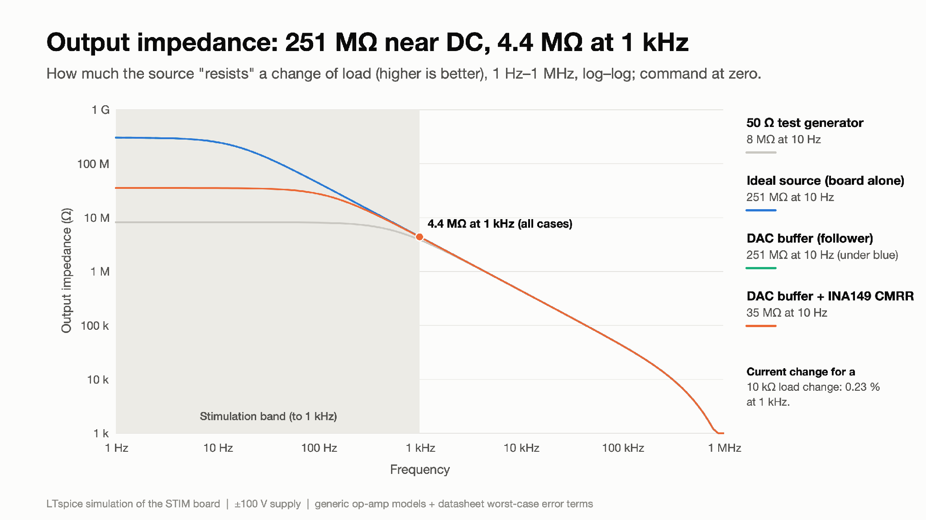
Step 8 - output impedance and accuracy
Figure 23: Output impedance: 251 MΩ near DC, 4.4 MΩ at 1 kHz
What you are looking at: "Output impedance" says how well the current stays fixed when the load changes: the higher, the better. Four ways of driving the board's input are compared, over 1 Hz–1 MHz.
Result: Near DC: 8 MΩ with the 50 Ω test generator, 251 MΩ with an ideal source or a DAC buffer (they overlap), and 35 MΩ with the INA149's worst-case CMRR added. Above about 100 Hz all cases fall together: 4.4 MΩ at 1 kHz, 0.44 MΩ at 10 kHz.
Why it matters: The 8 MΩ in the previous version was the test generator, not the board (the INA149 input has 399 kΩ to REF, and 1 kΩ × 399 kΩ / 50 Ω ≈ 8 MΩ). In-band, a 10 kΩ load change moves the current by 0.23 % at 1 kHz.

Slide 51
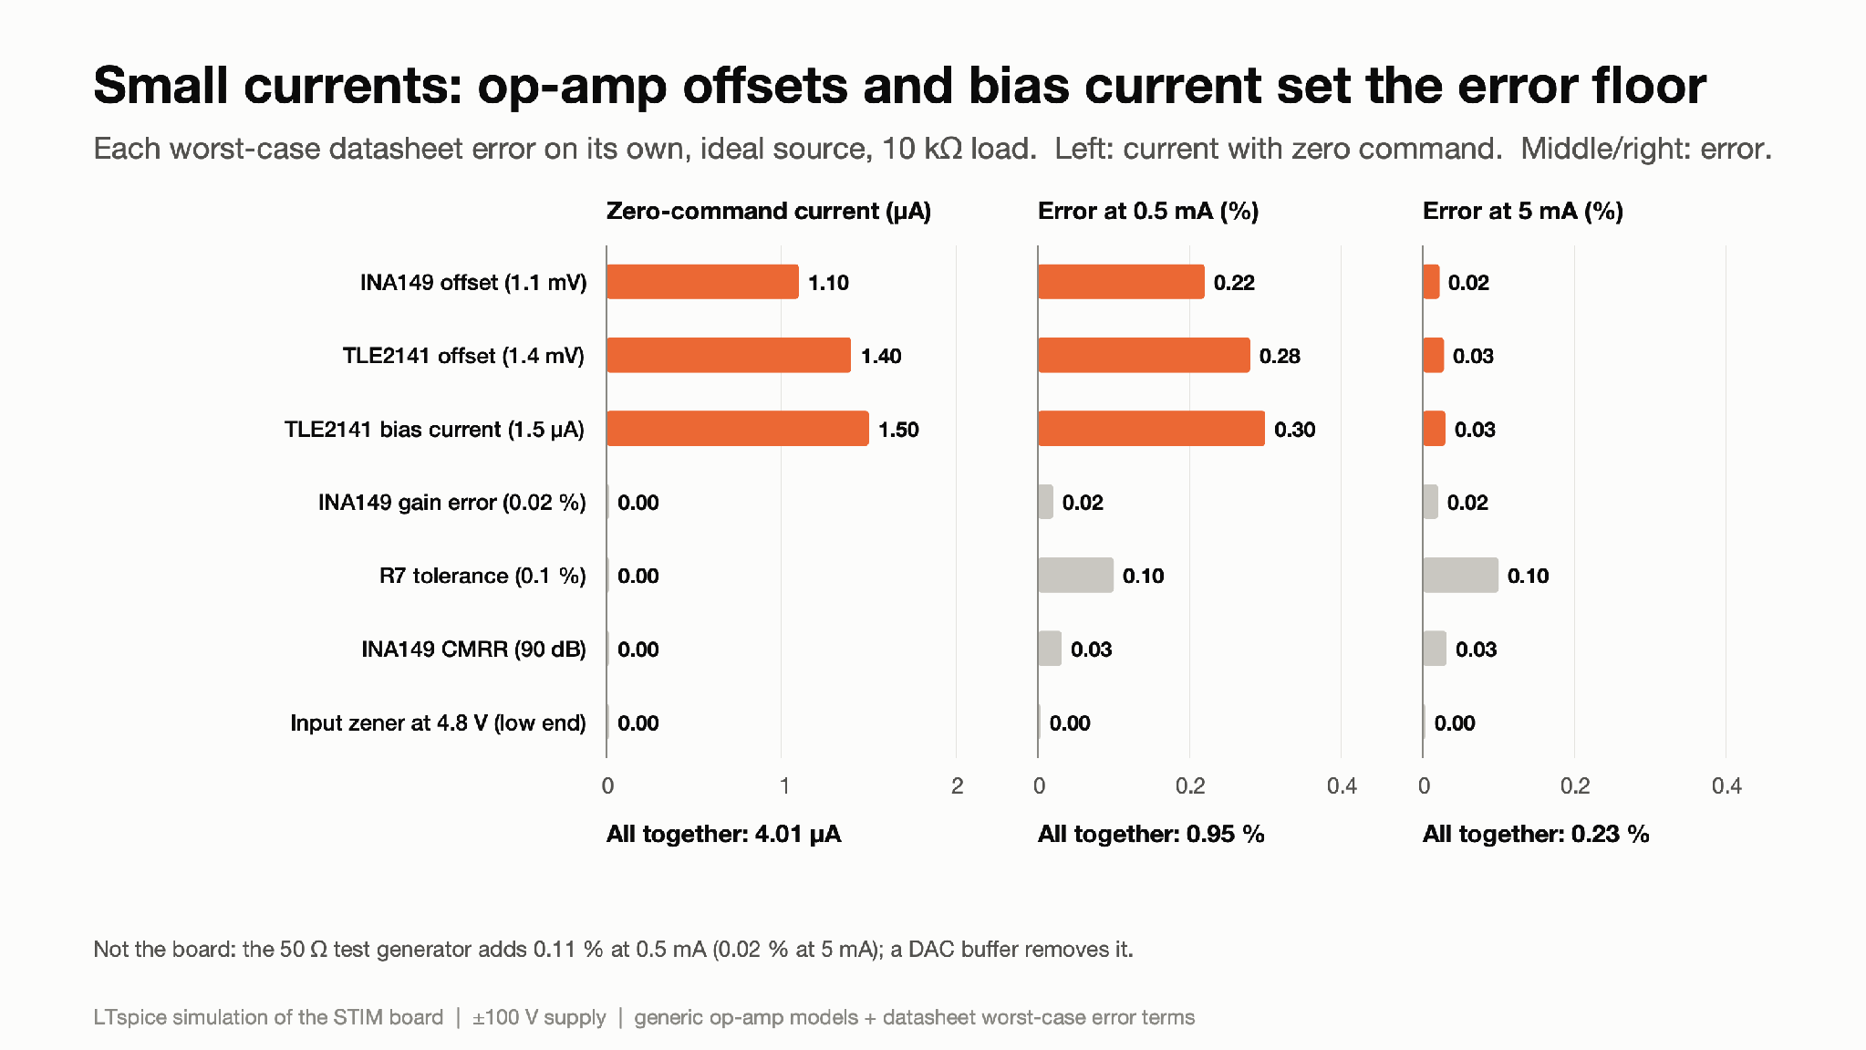
Step 8 - output impedance and accuracy
Figure 24: Small currents: op-amp offsets and bias current set the error floor
What you are looking at: Each bar is one worst-case datasheet error, turned on alone. Left: current flowing with zero command. Middle and right: error at 0.5 mA and 5 mA. Orange bars are the three that dominate.
Result: With zero command, 4.0 µA flows: TLE2141 bias current 1.5 µA, TLE2141 offset 1.4 µA, INA149 offset 1.1 µA. All errors together: 0.95 % at 0.5 mA, 0.23 % at 5 mA. The input zener at its low tolerance (4.8 V) has no effect with a low-impedance source.
Why it matters: A fixed ≈4 µA dominates small currents, so ±1 % holds from about 0.5 mA up. A stored zero-offset calibration would remove most of it.

Slide 52
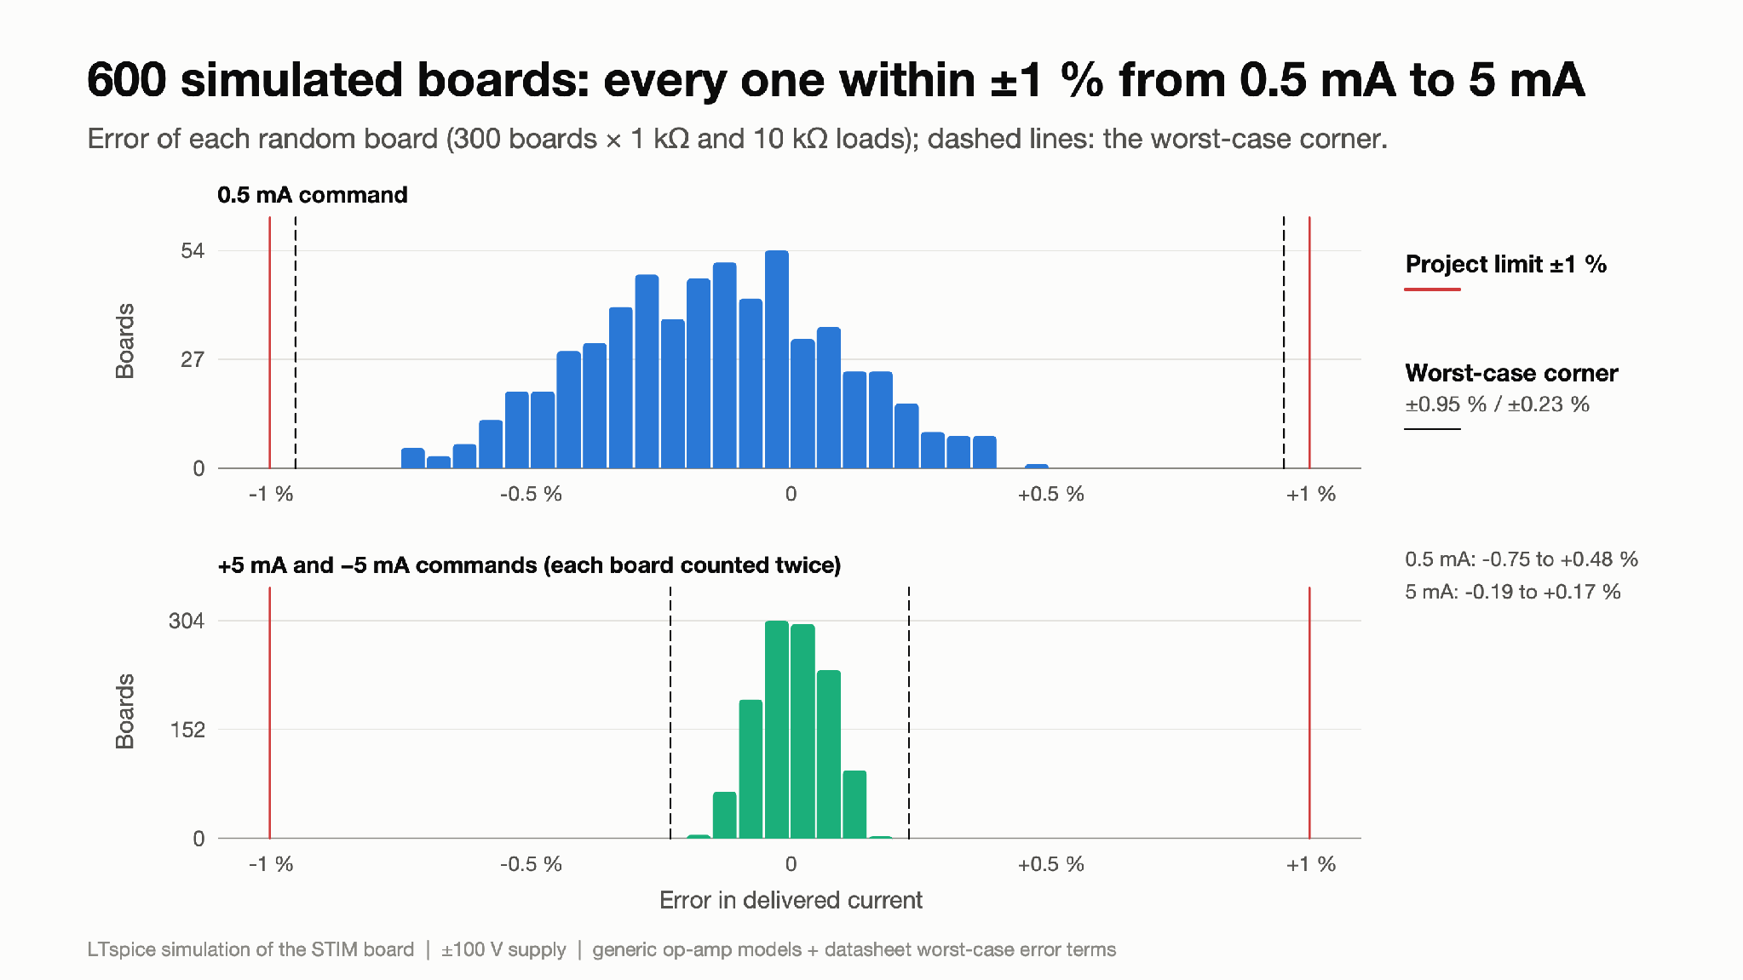
Step 8 - output impedance and accuracy
Figure 25: 300 boards × 2 loads: all within ±1 % from 0.5 mA to 5 mA
What you are looking at: A histogram: 300 simulated boards, each with randomly chosen part tolerances, tested with 1 kΩ and 10 kΩ heads (300 boards, each tested at both loads). Each bar counts how many boards had a given error. Red lines: the ±1 % target; dashed: the worst case from Figure 24.
Result: 0.5 mA: −0.75 % to +0.48 %. 5 mA: −0.19 % to +0.17 %. Every board lies inside the worst-case lines and inside ±1 %.
Why it matters: The random and worst-case analyses now agree, because they include the same error terms (including the zener tolerance) and the same ideal source.

Slide 53
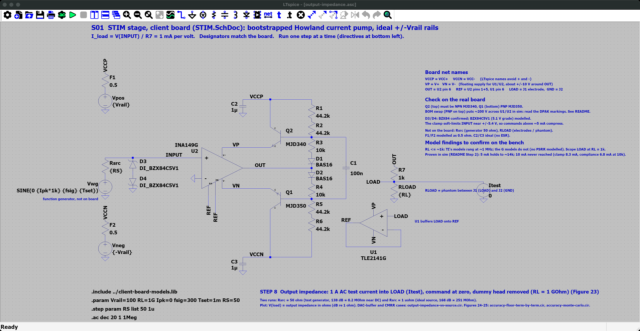
Step 8 - output impedance and accuracy - LTspice schematic
Where
SPICE_SIM/
2-pump-characterization/
8-output-impedance/
output-impedance.asc
Open it
1. Start LTspice, then File → Open ("Schematics (*.asc)").
2. Go to SPICE_SIM → 2-pump-characterization → 8-output-impedance.
3. Open output-impedance.asc.
On the schematic
• Itest pushes 1 A of AC test current into LOAD with the command at zero and the dummy head removed (RL = 1 GΩ). RS steps 50 Ω (test generator) and 1 µΩ (ideal source).
Simulation commands (2 runs)
.step param RS list 50 1u
.ac dec 20 1 1Meg

Slide 54
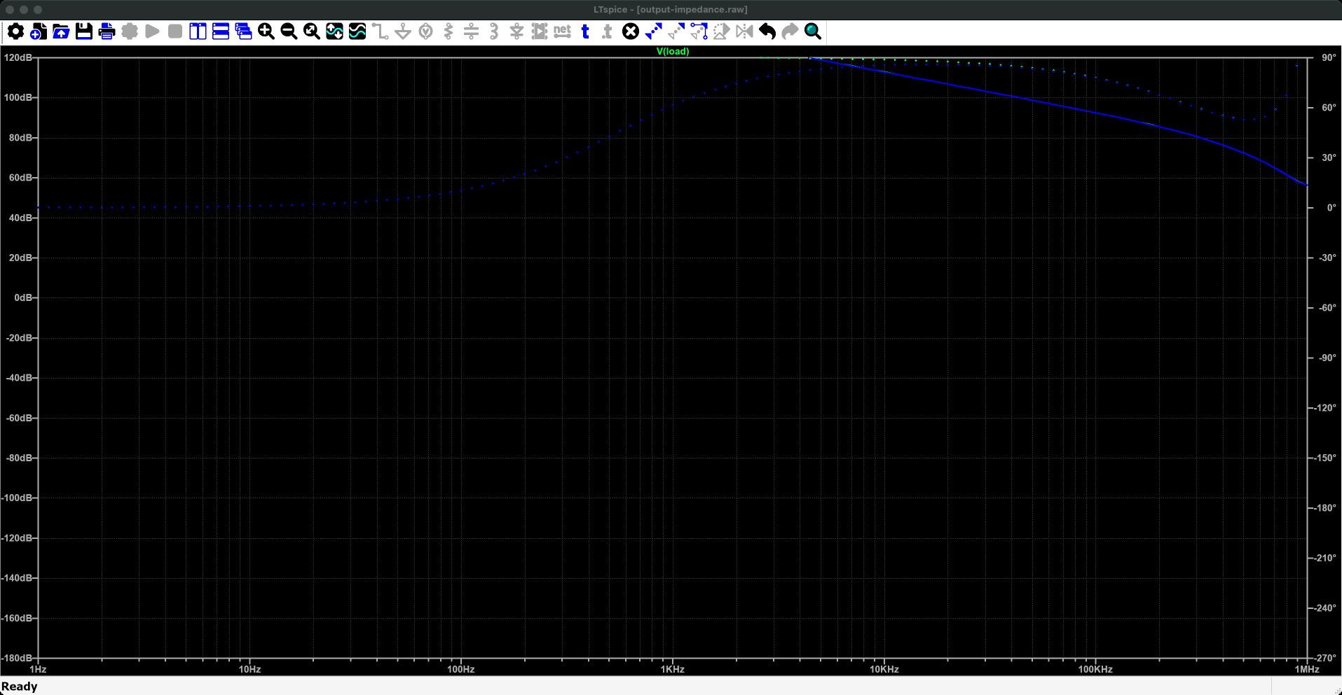
Step 8 - output impedance and accuracy - LTspice plot
Run it
1. Press Run (green ▶). Takes a few seconds.
2. output-impedance.plt opens these panes. If not: Plot Settings → Open Plot Settings File.
What to read
• Solid line: magnitude (left axis); dotted: phase (right axis). V(load) per amp of test current is the output impedance, in dB re 1 Ω.
• Near DC: 168 dB = 251 MΩ (ideal source), 138 dB = 8.2 MΩ (50 Ω generator), above the .plt's 120 dB top: click the left axis numbers and set the top to 180 dB to see them. 4.4 MΩ at 1 kHz.
What you are looking at: Across is frequency. The line shows how "stiff" the current is, as a resistance: the higher, the less the current changes when the head resistance changes (in dB: 120 dB = 1 MΩ). It is so high at low frequency (up to 251 MΩ, 168 dB) that it runs off the top of this 120 dB scale, then falls as frequency rises.
Why it matters: A stiff source means the delivered current hardly depends on the person's skin resistance.
Traces (output-impedance.plt, panes from the top) 1: V(load)

Slide 55
Step 8 - output impedance and accuracy
Summary:
The board's own output impedance is 251 MΩ near DC and 4.4 MΩ at 1 kHz, so a 10 kΩ load change moves the current by about 0.2 % in-band. Accuracy is within ±1 % from 0.5 mA to 5 mA in both the worst-case corner (0.95 % at 0.5 mA, 0.23 % at 5 mA) and a 600-board Monte Carlo (−0.75 to +0.48 % at 0.5 mA). Below about 0.5 mA a fixed ≈4 µA offset dominates; a zero-offset calibration would remove most of it.
Technical footnotes:
All accuracy runs use an ideal source; the 50 Ω generator (+0.11 % at 0.5 mA) is a test-setup effect, listed separately. Monte Carlo and corners now include the same terms: R7 ±0.1 % (assumed 0.1 % part), R1–R6 ±1 %, INA149 gain/offset/CMRR, TLE2141 offset (1.4 mV, most pessimistic published) and bias current, zener ±0.3 V. INA149 +IN to REF in the model: 380 kΩ + 19 kΩ = 399 kΩ.
How to recreate the plots:
Ready-made: open 2-pump-characterization/8-output-impedance/output-impedance.asc and press Run (two runs: 50 Ω generator, ideal source).
1. DAC-buffer and CMRR cases: output-impedance-vs-source.cir; plot V(LOAD) in ohms.
2. Error floor: accuracy-floor-term-by-term.cir; the zero-command current and errors per term are in the SPICE Error Log.
3. Monte Carlo: accuracy-monte-carlo.cir (600 runs, a few minutes); View → SPICE Error Log → right-click → Plot .step'ed .meas data.
Figures: 2-pump-characterization/8-output-impedance/make_figures.py.

Slide 56
Findings on the client's prototype (simulation)
What the simulation shows
• Current source: within ±1 % from 0.5 mA to 5 mA, worst case and in 600 random boards (Figures 24–25). A ≈4 µA offset sets the floor below that.
• Compliance: 5 mA into loads up to 13.75 kΩ at ±100 V (the weaker, sinking direction); more with higher rails (Figure 7). Deck 3: 7.1 kΩ at the worst corner.
• Speed: within 1 % of a DAC step in ≤5.4 µs (Figure 10); in-band error ≤0.15 % to 10 kHz (Figure 12).
• Output impedance: 251 MΩ near DC, 4.4 MΩ at 1 kHz (Figure 23).
• Stability: stable in the model for 0.33×–3× loop gain, but lightly damped and close to −1 (Figures 20–21). Not assured on the real board.
• Supply faults: 21.9 mA pulse on out-of-order power-up, 9.7 mA continuous on rail loss (Figure 15).
• Preliminary (model-dependent): Ripple: ≤42 mVpp at the client flyback's 950 kHz (≤69 mVpp at 500 kHz) for a 5 µA peak leak (Figure 18).
Issues found on the prototype
• The BOM swaps Q1/Q2: the top device must be the NPN MJD340.
• Nothing limits the load current during supply faults (Step 5): a safety finding.
• Low damping; a possible MHz oscillation into the load is also a safety finding (Step 7).
• The BZX84C5V1 input clamp has a soft knee near the 5 V command: with a 50 Ω source it costs up to 0.7 % at 5 mA; with a low-impedance DAC buffer it has no effect.
No finding requires a change of topology; each is addressable within this architecture (protection circuit, rail filtering, compensation network, BOM correction). Deck 3 later added Darlington drivers for the worst case; deck 4 designed the protection.
Model limits
• Generic op-amp models: supply rejection (PSRR) and input range not modelled accurately; TI's full models do not run in LTspice.
• Electrode RC values are assumed (tissue itself is resistive, see References); loads are dummy heads, not tissue.

Slide 57
Next steps
Simulation
1. Stability across tolerance corners and Monte Carlo, and a compensation proposal (for example an RC network at the output or at REF), re-simulated; confirm the open-loop right-half-plane pole independently. Rev 1: no instability in 27 cases (deck 4).
2. Trace the rail-loss current path through Q1/Q2 and the bias string; check Q1/Q2 safe operating area and dissipation in every fault case. Done: deck 3 (safe operating area, heat).
3. Protection circuit (supply monitor + output disconnect, independent current limit, sequenced rails) and a re-centred bias window, then re-simulate Steps 2 and 5. Done: architecture in deck 1, Rev 1 circuit in deck 4.
4. Model real flyback ripple (with harmonics) once the power team has a design; add PSRR if better op-amp models become available.
5. Check the rails against the client's flyback schematics (PSU_150V: 950 kHz, possibly ±150 V), which change Steps 2, 5 and 6; move the switching frequency away from the 0.8 MHz loop peak or filter the rails.
Standards
6. Map the safety findings (fault currents, oscillation, charge per fault) to IEC 60601-1 and IEC 60601-2-10 (nerve and muscle stimulators).
Bench (first PCB)
7. Step response and ringing into 1 kΩ and 10 kΩ (compare with Figure 9).
8. Loop-gain perturbation: change gain by ±10–20 % (e.g. a series resistor) and watch for oscillation.
9. Zero-command current (expect up to ≈4 µA) and accuracy at 0.5, 1 and 5 mA.
10. Compliance at 10–15 kΩ (expect clipping above ≈13.75 kΩ at ±100 V).
11. Ripple leakage from the real converter, including harmonics near 0.8 MHz.
12. Output impedance with the real DAC buffer.
13. Measure electrode–skin impedance on the dummy head setup to replace the assumed RC values.
Scope note for the probes: use the DHO804 with a differential or isolated probe across the load; never ground-reference the ±100 V output.

Slide 58
References
Papers
Vöröslakos M. et al. (2018). Direct effects of transcranial electric stimulation on brain circuits in rats and humans. Nature Communications 9:483. doi:10.1038/s41467-018-02928-3. (Tissue is resistive at stimulation frequencies.)
Kwan A., Forbes P. A., Mitchell D. E., Blouin J.-S., Cullen K. E. (2019). Neural substrates, dynamics and thresholds of galvanic vestibular stimulation in the behaving primate. Nature Communications 10:1904. doi:10.1038/s41467-019-09738-1.
Chen A., Kuo C., Blouin J.-S. (2022). A portable and low-cost solution for real-time manipulation of the vestibular sense. Journal of Neuroscience Methods 382:109709. doi:10.1016/j.jneumeth.2022.109709. (UBC EVS setup: 3×3 cm carbon-rubber electrodes with gel, 1 mA/V isolated stimulator, ±10 mA, <25 Hz.)
Forbes P. A. et al. (2023). The neural basis for biased behavioral responses evoked by galvanic vestibular stimulation in primates. Journal of Neuroscience 43(11):1905–1919. doi:10.1523/JNEUROSCI.0987-22.2023. (≈6 cm² carbon-rubber electrodes; 0–25 Hz stochastic stimulation up to 1 mA.)
Design notes and datasheets
Texas Instruments, SLYY054 (the bootstrapped Howland current pump the board follows).
Texas Instruments: INA149 datasheet (±2 to ±18 V supply, 36 V max) and SPICE model; TLE2141 datasheet (±2 to ±22 V, 44 V max).
MJD340 / MJD350, BZX84C5V1 and BAS16 datasheets.
Client schematics: Power_Circuit (LM3481 flyback, 500 kHz) and PSU_150V (LM3481, 950 kHz).
Analog Devices: biopotential electrode modelling note (series R with parallel RC electrode model; topology only, values assumed here).
IEC 60601-1 and IEC 60601-2-10 (medical electrical equipment; nerve and muscle stimulators).
This project
Simulation files: github.com/WeymenKoo/CurrentSource_Ptototype_Simulation (tests/ and STIM_Characterized/).

