Slide 1
JY063 Stimulator, Rev 1
Architecture, safety and current paths
Reference document | 24 October 2026
UBC ELEC 491 Capstone, Project 63: four-channel electrical vestibular stimulator
Client: UBC Sensorimotor Physiology Lab
Notes:
Reference deck. Written so that someone opening it months later, without the original conversations, can follow every design decision and its reasoning.

Slide 2
Document control
Field | Value
Document | JY063 STIM Rev 1: architecture, safety and current paths
Date / version | 24 October 2026, Rev B: brought in line with decks 2-4. The pump decision (A1) is revised with the worst-case result of deck 3; every block whose value changed in Rev 1 carries a "Rev 1 (deck 4)" note; the Simulation slides give results; decisions renamed A1-A5. Rev A: 21 October 2026, first issue.
Author | Weymen Koo
Audience | Capstone team, ELEC faculty reviewers, client lab. Written for readers who are not electrical engineers.
Status | Architecture agreed within the team and carried into Rev 1 (deck 4), which released one channel to schematic and PCB on 24 October. Return-electrode design to be presented to the client. Each "Simulation" slide gives the result and where it comes from.
Diagram source | Miro board, frames "STIM Rev 1 architecture" and "Grounding and return-off fault" (miro.com/app/board/uXjVNlcU4wQ=). The diagram images in this deck were rendered from that board's data on the date above.
Related documents | Deck 2: current-pump characterization (the client's board as built). Deck 3: output compliance and current limiter (worst case). Deck 4: Rev 1 design review. Behavioural safety-chain model: 1-safety-model/. Client board schematic and BOM; TI app note SLYY054.
How to use this document
Read the scope and disclaimer (slide 3) first, then the summary of decisions (slide 7). Each section then explains one part of the system in plain language: what the block does, why it exists and what happens if it fails. Terms in the glossary (slides 5 and 6) are used without further explanation. Slides titled "Simulation" summarise the SPICE results and say where they come from. "Rev 1 (deck 4)" marks every place where the built design differs from this architecture.

Slide 3
Scope and disclaimer
No human or animal subjects will be used in this project.
All testing by the JY063 capstone team is bench verification and validation on electrical dummy loads (resistors and resistor-capacitor networks that imitate skin and electrodes). No device built in this project will be connected to a person or an animal.
What this project covers
Why this document still discusses people
Design, simulation and assembly of the Rev 1 stimulator boards.
Bench tests: accuracy, compliance, stability, power, and fault injection, all on dummy loads.
Verification against the agreed requirements, and documentation for hand-over.
The client lab will take the design forward after the project ends, and its intended use is stimulating human participants.
Designing for that future use now is the responsible thing to do. Safety features that are missing from the hardware cannot be added by procedure later.
Wherever slides mention a person, a patient or the head, they describe that future use, or a dummy load standing in for it.
Any future use with people is the client's responsibility and requires its own ethics approval, safety review and testing against the applicable standards (for example IEC 60601-1). Nothing in this document is a claim that the device is safe for human use.

Slide 4
Contents
Section | Slides | Question it answers
Front matter | 1-9 | Scope and disclaimer, what was decided, and where the sources are
1. Background | 10-14 | What electrical vestibular stimulation is, where electrodes go, how current moves through the head
2. The current pump | 15-23 | Why Rev 1 keeps the client's circuit, and how that circuit works
3. System walkthrough | 24-47 | Every block between the computer and the electrode, and how each adds safety
4. Current paths and grounding | 48-64 | How four channels share one head, why a return electrode is needed, and what happens if it falls off
5. Next steps | 65-67 | Open work, open questions, assumptions and references

Slide 5
Glossary (1 of 2)
Term | Meaning in this document
EVS / GVS | Electrical (or galvanic) vestibular stimulation. Small currents passed through the head to activate the balance nerves of the inner ear.
Mastoid | The bony bump behind each ear. Standard electrode site for EVS.
Bipolar / monopolar | Bipolar: current flows between two stimulating electrodes. Monopolar: current flows from one electrode to a separate return.
Montage | The set of electrode positions and the current assigned to each.
Current source | A circuit that forces a set current through whatever is connected, adjusting its voltage as needed.
Howland current pump (STIM) | The client's current-source circuit. Here built from an INA149 amplifier, a TLE2141 op-amp and two high-voltage transistors.
Compliance | The largest load resistance a current source can still drive at full current. Limited by the supply voltage.
Bootstrap / floating supply | A small ±10 V supply for the op-amps that moves up and down with the output, so low-voltage chips can work at high voltage.
Rail | A power-supply line. Here the ±100 V lines from the power board (VCC+ and VCC−).

Slide 6
Glossary (2 of 2)
Term | Meaning in this document
DAC / ADC | Digital-to-analog converter (numbers to voltage: the command). Analog-to-digital converter (voltage to numbers: the measurements).
Isolation / isolator | A barrier that passes data or power without a wire connection, so no current can flow across it.
Zener clamp | Diodes that stop a voltage from rising past a set value.
Depletion-mode MOSFET (DN2540) | A transistor that conducts unless pushed off. Used here as a self-powered current limiter (at most 10 mA; Rev 1 sets 7.6 mA).
PhotoMOS | A switch driven by light from an internal LED. Opens the electrode line with no supply on the high-voltage side.
Shunt | A small resistor placed in a current path so the current can be measured from the voltage across it (10 Ω gives 10 mV per mA).
Trip / latch | A trip detects a fault and disconnects stimulation. The latch keeps it disconnected until a person resets it.
Earth vs patient GND | Earth: mains protective ground. Patient GND: the floating centre of the stimulator's own ±100 V supply. Kept apart on purpose.
KCL | Kirchhoff's current law: current into a point equals current out. Applied here to the head as a whole.

Slide 7
Summary of decisions
# | Decision | Reason | Status (as of date) | Revisit when
A1 | Keep the client's current pump as the core of Rev 1 | It meets the 13 kΩ target at nominal values (deck 2: 13.75 kΩ). | Revised (deck 3): at the worst corner it reaches only 7.1 kΩ. Rev 1 keeps the topology and adds Darlington drivers, an OPA171 buffer and 14.3 kΩ bias resistors (D-05): 13.15 kΩ (deck 4). | Bench gain measurement on the first board
A2 | Current spec: 5 mA nominal, 10 mA maximum (safety limit), loads up to 13 kΩ | Agreed with the client | Confirmed | Client changes the protocol
A3 | One dedicated return electrode shared by all four channels (option A) | Simplest; supports bipolar and monopolar montages; enables fault detection | Decided for one channel. With four channels the mismatch trip must change (D-19, open). | Rev 2: choose option B or C
A4 | Layered protection: clamp, Current limiter, trips, PhotoMOS, isolation | No single failure may push more than 10 mA through a person | Designed and simulated in Rev 1: every requirement passes (deck 4) | Bench fault tests (release condition C4)
A5 | The mismatch trip is mandatory | It is the only layer that catches a detached return electrode | Decided | -

Slide 8
Reproducing the plots in this deck
Reproduce in LTspice · how to use these slides
Before you start
This deck's folder: 1-safety-model/
1. Install LTspice (free: analog.com/ltspice), version 24 or later, on Windows or macOS. The screenshots are LTspice 26.0.2 on macOS; Windows looks the same.
2. Get the repository (GitHub WeymenKoo/CurrentSource_Ptototype_Simulation, or the team's shared Drive folder) and keep its folder structure: every schematic loads its models and symbols by relative path.
3. Keep the path short. LTspice fails on paths over 260 characters. On Windows, put the repository at e.g. C:\jy063\SPICE_SIM. Check with: python3 tools/check_path_lengths.py
4. Nothing needs editing. Each test schematic already holds its settings, and its .plt file opens the plots.
SPICE_SIM/
1-safety-model/
safety-chain-model.asc # the whole channel
9-input-clamp-and-buffer/ # T9.1, T9.2
10-current-limiter/ # T10.1-T10.4
11-normal-operation/ # T11.1-T11.5
12-fault-injection/ # T12.1-T12.7
shared-return/ # V3a, V3b
*.lib, *.asy # models, symbols
README.md # every test, expected values
Results quoted on the "Simulation" slides are the
Rev 1 ngspice numbers (deck 4). The LTspice tests
here are the behavioural model they started from;
its numbers are on each "run it" slide.
How each reproduction is laid out
• Each reproduction sits right after the result it backs up, on two slides: the schematic as LTspice opens it, then the waveform window after Run.
• The grey strips under the screenshots are read from the files: the simulation commands on the schematic, and the traces its .plt opens.
• LTspice writes <test>.raw and <test>.log next to the schematic. They are not in Git; run the test to make them.

Slide 9
LTspice in a few actions
Reproduce in LTspice · the controls these slides use
Run: starts the simulation
To | Do this
Open a schematic | File → Open, file type "Schematics (*.asc)", then browse to the folder named on the slide.
Run it | Press Run (the green ▶ on the toolbar). A stepped test runs once per .step combination.
Get the plots | LTspice reads <test>.plt when the results open, so the panes appear by themselves. To load it by hand: Plot Settings → Open Plot Settings File.
Read the numbers | View → SPICE Error Log: every .meas result, one row per run. Right-click in the log → Plot .step'ed .meas data plots them against the stepped value.
Tell the runs apart | Click a trace name to attach a cursor, move it from run to run with the ↑ / ↓ keys, then right-click the cursor: it shows that run's step values.
Add a trace | Plot Settings → Add Trace and type the expression, e.g. V(sense)-V(elec). Or click a wire (voltage) or a part (current) on the schematic while the plot is open.
Read a value off a curve | Click the trace name at the top of its pane: a cursor appears; drag it and read the readout.
Zoom | Drag a box on the plot. Undo steps back through the zooms.

Slide 10
1. Background
What the device does, where the electrodes go, and how current moves through the head

Slide 11
What electrical vestibular stimulation does
A small electrical current passed between electrodes behind the ears changes the firing of the balance nerves in the inner ear. The brain reads that change as head motion, so the person feels tilt, sway or rotation that is not happening.
inner ear (balance organs)
Currents are a few milliamps (mA). The client's lab uses up to ±10 mA; this project uses 5 mA nominal and 10 mA as the hard safety limit.
Waveforms are slow, mostly below 25 Hz, the frequency range of natural head movement.
Both main balance sensors respond: the canals (rotation) and the otoliths (tilt and linear motion).
The device's job is to deliver exactly the commanded current on four channels, and never more than 10 mA, whatever goes wrong.
+ electrode
left mastoid
− electrode
right mastoid
current
Front view, simplified. Not to scale.
Sources: Kwan et al. 2019 (Nat Commun 10:1904): recordings of vestibular nerve fibres during mastoid stimulation. Chen, Kuo & Blouin 2022 (J Neurosci Methods 382:109709).

Slide 12
Electrode placement in the client's papers
Every study supplied by the client uses the same setup: one electrode on each mastoid ("binaural bipolar"). Current enters behind one ear and leaves behind the other.
Paper | Subjects | Electrodes | Configuration | Stimulator
Chen, Kuo & Blouin 2022 | Humans, standing balance | 3 × 3 cm carbon rubber, conductive gel, taped over mastoids | Binaural bipolar | Isolated current unit (Biopac STMISOLA), 1 mA/V, ±10 mA, 200 V compliance
Forbes et al. 2023 | Monkeys | ~6 cm² carbon rubber, gel | Binaural bipolar | Same isolated unit
Kwan et al. 2019 | Monkeys | ~6 cm² carbon rubber, gel | Binaural bipolar | Same isolated unit
Vöröslakos et al. 2018 | Rats, human cadavers, humans | Scalp and skull electrodes | Various pairs (brain stimulation, not vestibular) | Isolated current sources
Numbers that set our design targets
Skin impedance with gel was typically 5-10 kΩ (Chen 2022). Our 13 kΩ target sits above this range, which leaves room for poorer contact.
The lab's stimulator handled up to 20 kΩ at 10 mA. Our Rev 1 target is lower (13 kΩ at 5 mA) because our supply is ±100 V, not 200 V.
Chen 2022 names monopolar, three-pole and four-pole setups as future work. Those need more than two electrodes, which is what our four channels and return electrode provide.

Slide 13
How current moves through the head
Measurements inside human cadaver heads show most of the current applied to the scalp never reaches the brain. It spreads through the skin and soft tissue between the electrodes.
What this means for the device
The stimulator controls how much current flows, not where it goes inside the head. Electrode placement sets the path.
Because most current runs through the skin near the electrodes, current density at the skin decides comfort. That is why the lab uses large gelled electrodes and no anaesthetic.
When several channels share one head, their currents mix in the same tissue (section 4).
Where the scalp current goes | Share
Shunted by skin and soft tissue | 58 ± 7 %
Lost across the skull | 16 ± 8 %
Reaches the brain | about 26 %
Two findings this design relies on
Tissue behaves like a plain resistor: voltage rises in a straight line with current (Vöröslakos 2018), and the head's response is flat across frequency (Kwan 2019).
So the circuit can treat the head as a simple load resistance between electrodes.
Sources: Vöröslakos et al. 2018 (Nat Commun 9:483), Fig. 5. Kwan et al. 2019, Fig. 6 (head impedance modelled with flat gain and phase).

Slide 14
Why the device controls current, not voltage
Skin impedance varies between people and drifts during a session as gel dries or the electrode shifts. With a fixed voltage, the dose would change with it. A current source holds the dose constant.
Skin impedance | Fixed 50 V source delivers | 5 mA current source delivers | Voltage the current source must produce
5 kΩ | 10 mA (double the intended dose) | 5 mA | 25 V
10 kΩ | 5 mA | 5 mA | 50 V
13 kΩ | 3.8 mA (dose too low) | 5 mA | 65 V
20 kΩ | 2.5 mA | 5 mA only if it can produce 100 V | 100 V (beyond our compliance)
Compliance: the catch
A current source can only raise its voltage as far as its supply allows. Ohm's law gives the required voltage: V = I × R. At 5 mA into 13 kΩ that is 65 V. Our supply is ±100 V, but the circuit loses about 31 V internally, so the usable limit at 5 mA is about (100 − 31) / 5 mA ≈ 13.75 kΩ at nominal values. That is the client board at nominal values (deck 2). Rev 1 holds 5 mA into 13.15 kΩ even at the worst corner (deck 4).

Slide 15
2. The current pump (STIM)
Why Rev 1 keeps the client's circuit, how it works, and what limits it

Slide 16
The client's current pump stays the core of Rev 1 (A1)
Metric (deck 2, client board) | Result | Need
Current accuracy, 0.5-5 mA | within ±1 % (worst case and Monte Carlo, 300 boards × 2 loads) | ±1 %
Compliance at 5 mA, ±100 V | 13.75 kΩ | 13 kΩ
Settling time to 1 % | ≤ 5.4 µs | ≪ 1 ms update
Frequency response | flat to 10 kHz | below 25 Hz
Output impedance near DC | 251 MΩ | as high as possible
What the worst case changed (deck 3)
At nominal values the client pump meets every target in the table.
At the worst corner (rails at 90 V, minimum transistor gain) it reaches only 7.1 kΩ, about half the target.
Darlington drivers remove the cause: 13.7 kΩ together with the OPA171 buffer and 14.3 kΩ bias resistors.
Rev 1 adopts all three (D-05): 13.15 kΩ at the worst corner with the full protection chain (deck 4).
The topology, R7 and the INA149 stay as the client designed them.
Generic op-amp models were used. Treat these as targets to confirm on the bench.
Follow-up analysis (done: deck 3)
Deck 3 did it, with the worst case included: the changes add little at nominal values (14.2 to 16.3 kΩ), but at the worst corner the client board falls to 7.1 kΩ, so Rev 1 needs the Darlington drivers. The hand-analysis rows below were the starting point.

Slide 17
How the pump sets the current
The pump is a feedback circuit. A precision difference amplifier (INA149) keeps the voltage across one resistor, R7, equal to the command voltage. A second op-amp (TLE2141) copies the electrode voltage back to the amplifier's reference so the load cannot disturb this.
DAC command
0 to ±5 V
INA149
difference amp
R7 = 1 kΩ
Electrode
(head = load)
Result
Voltage across R7 = command voltage
I = V / R7 = 1 mA per volt
5 V command → 5 mA, whatever the skin impedance (within compliance).
TLE2141
buffer
copies electrode voltage to the amplifier's reference pin
Intuition
If skin impedance rises, the electrode voltage rises. The buffer raises the amplifier's reference by the same amount, so the amplifier output rises too and the voltage across R7 stays the same. The current never changes.

Slide 18
How low-voltage chips survive ±70 V: the bootstrap
The electrode may need to reach ±70 V, but the op-amps tolerate only about 36-44 V across their supply pins. The bootstrap gives them a small supply that rides along with the output.
A resistor chain from each ±100 V rail sets a voltage a fixed fraction above (and below) the output.
Two high-voltage transistors (MJD340 top, MJD350 bottom) copy those voltages and supply the op-amps' current.
So the op-amps always see roughly ±10 V around the output, wherever the output is.
The transistors absorb the rest of the 100 V. Each can dissipate up to about 1 W, so they need copper area for cooling.
Output voltage | Op-amp + supply | Op-amp − supply | Window width
0 V | +10 V | −10 V | ≈20 V
+50 V | ≈ +55 V | ≈ +35 V | ≈20 V
−50 V | ≈ −35 V | ≈ −55 V | ≈20 V
Approximate, nominal ±100 V rails. The window slides off-centre as the output moves but keeps its width.
Why this matters later
As the output approaches a rail, the gap between the output and the top of its window shrinks. When it falls to about 1.5 V the amplifier can no longer drive the output higher. That point sets the compliance limit (next slide).

Slide 19
What limits compliance
Compliance ends when the floating supply no longer has room above the output. Four things eat into that room.
Factor | Effect | What controls it
Supply voltage | Room scales with rail minus output. 10 % lower rails cost about 2 kΩ of compliance. | Power board regulation
Transistor current gain (β) | The transistor's base current is drawn from the bias chain. Low β steals current and shrinks the room. This is the largest effect. | Part spread; Darlington drivers remove it
Op-amp supply current | Feeds through the transistor and adds to the base current. The TLE2141 draws 3.5 mA, about 40 % of that load. | Op-amp choice (OPA171 draws 0.5 mA)
Output swing of INA149 | Needs 1.5 V between its output and its supply. | Fixed by the part
Condition (hand analysis, 5 mA) | Max load
Nominal: ±100 V, typical β, typical op-amp current | 14.0 kΩ
Supply −10 % | 12.1 kΩ
+ datasheet minimum β (30) | 8.0 kΩ
+ β derated for low current, max op-amp current, 1 % resistors | 3.8 kΩ
Reading this table
Deck 2's 13.75 kΩ is the nominal row; deck 3 simulated the worst rows: 7.1 kΩ (β 30) and 4.7 kΩ (β 20). Real boards land between the rows. Measuring β on the client's transistors is the quickest way to know where.

Slide 20
Simulation: current accuracy across loads
Purpose
Show the pump delivers the commanded current within ±1 % over the operating range.
Result
Results: deck 2 (client board) and deck 4, "Output accuracy: passes with the per-board zero calibration"
Client board: ±1 % from 0.5 to 5 mA (deck 2).
Rev 1: passes with the zero calibration (D-12).
Uncalibrated: 12 of 72 points fail at 0.5-1 mA.
Bench: zero current and 0.5 / 1 / 5 mA.
Simulation used
ngspice, Rev 1 netlist (OPA171, Darlington, full protection chain); ±0.5-5 mA, 0.5-13 kΩ, 0/25/50 °C; offsets calibrated and at datasheet max.

Slide 21
Simulation: compliance and headroom
Purpose
Show where the pump stops regulating, and how much margin remains at 13 kΩ.
Result
Results: deck 2 (client board), deck 3 (worst case) and deck 4, "Load reach: 13.15 kΩ at the worst corner (target 13 kΩ)"
Client board, nominal: 13.75 kΩ (deck 2).
Client board, worst corner: 7.1 kΩ (deck 3).
Rev 1, worst corner: 13.15 kΩ (deck 4).
About 2 kΩ per 10 V of rail.
Simulation used
ngspice + LTspice, load ramped 2 V/ms; 90/100/110 V rails, transistor gain 20-150, worst parts, 0/25/50 °C, both directions.

Slide 22
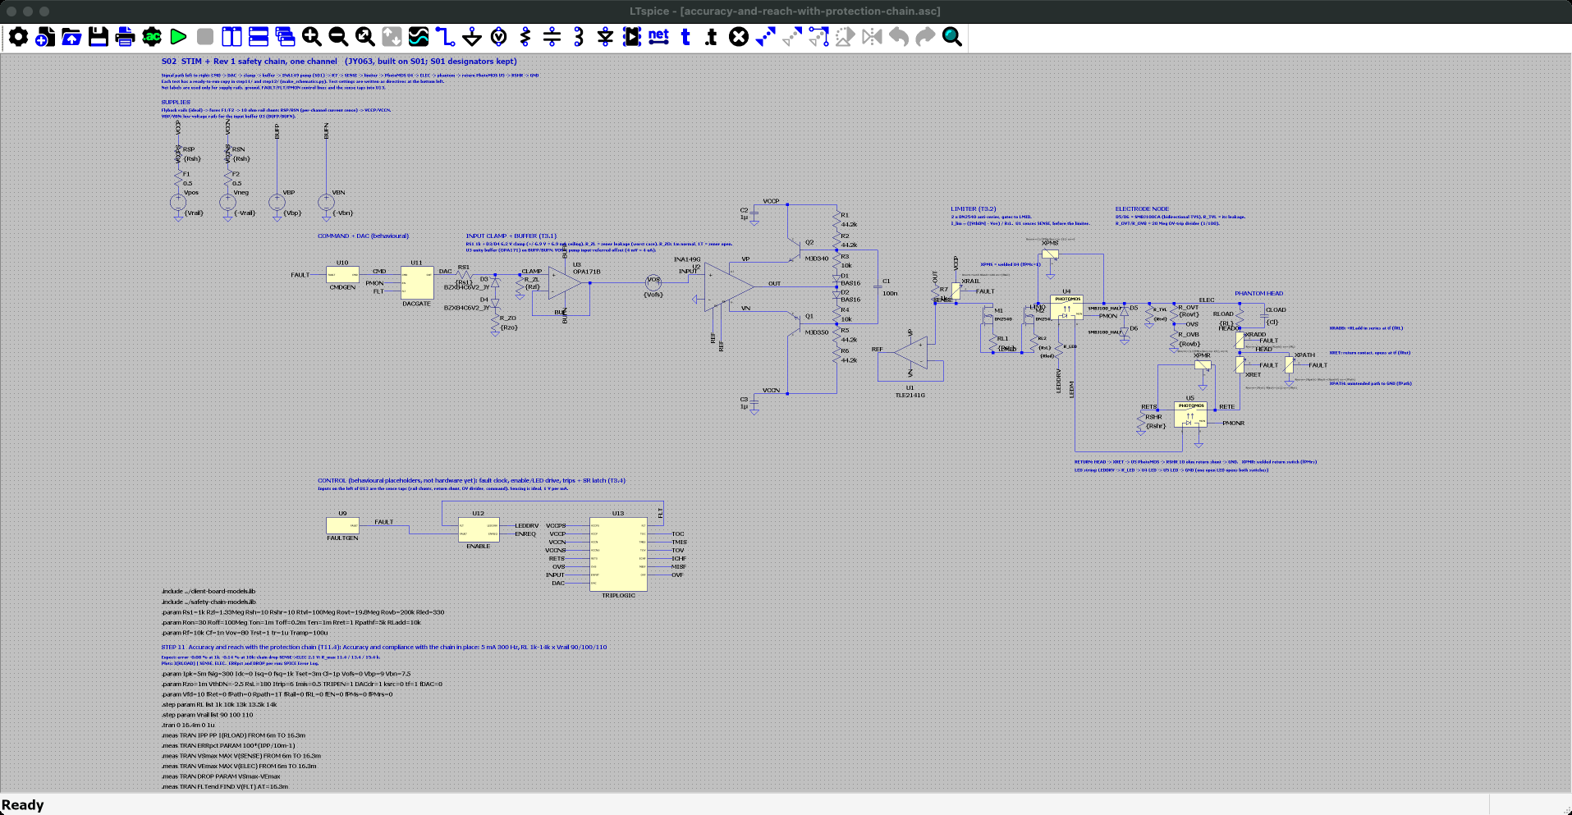
Accuracy and reach with the protection chain (T11.4): the schematic
Reproduce in LTspice · 1 of 2 · accuracy-and-reach-with-protection-chain.asc
Where
SPICE_SIM/
1-safety-model/
11-normal-operation/
accuracy-and-reach-with-protection-chain.asc
Open it
1. Start LTspice, then File → Open. Set the file type to "Schematics (*.asc)".
2. Go to SPICE_SIM → 1-safety-model → 11-normal-operation.
3. Open accuracy-and-reach-with-protection-chain.asc. It opens zoomed to fit, as in the screenshot.
On the schematic
• The full behavioural channel delivering 5 mA, 300 Hz.
• Steps: load RL = 1k, 10k, 13k, 13.5k, 14k and rails Vrail = 90 / 100 / 110 V (15 runs).
Simulation commands on this schematic (15 runs, one per .step combination)
.step param RL list 1k 10k 13k 13.5k 14k
.step param Vrail list 90 100 110
.tran 0 16.4m 0 1u
.meas: IPP, ERRpct, VSmax, VEmax, DROP, FLTend

Slide 23
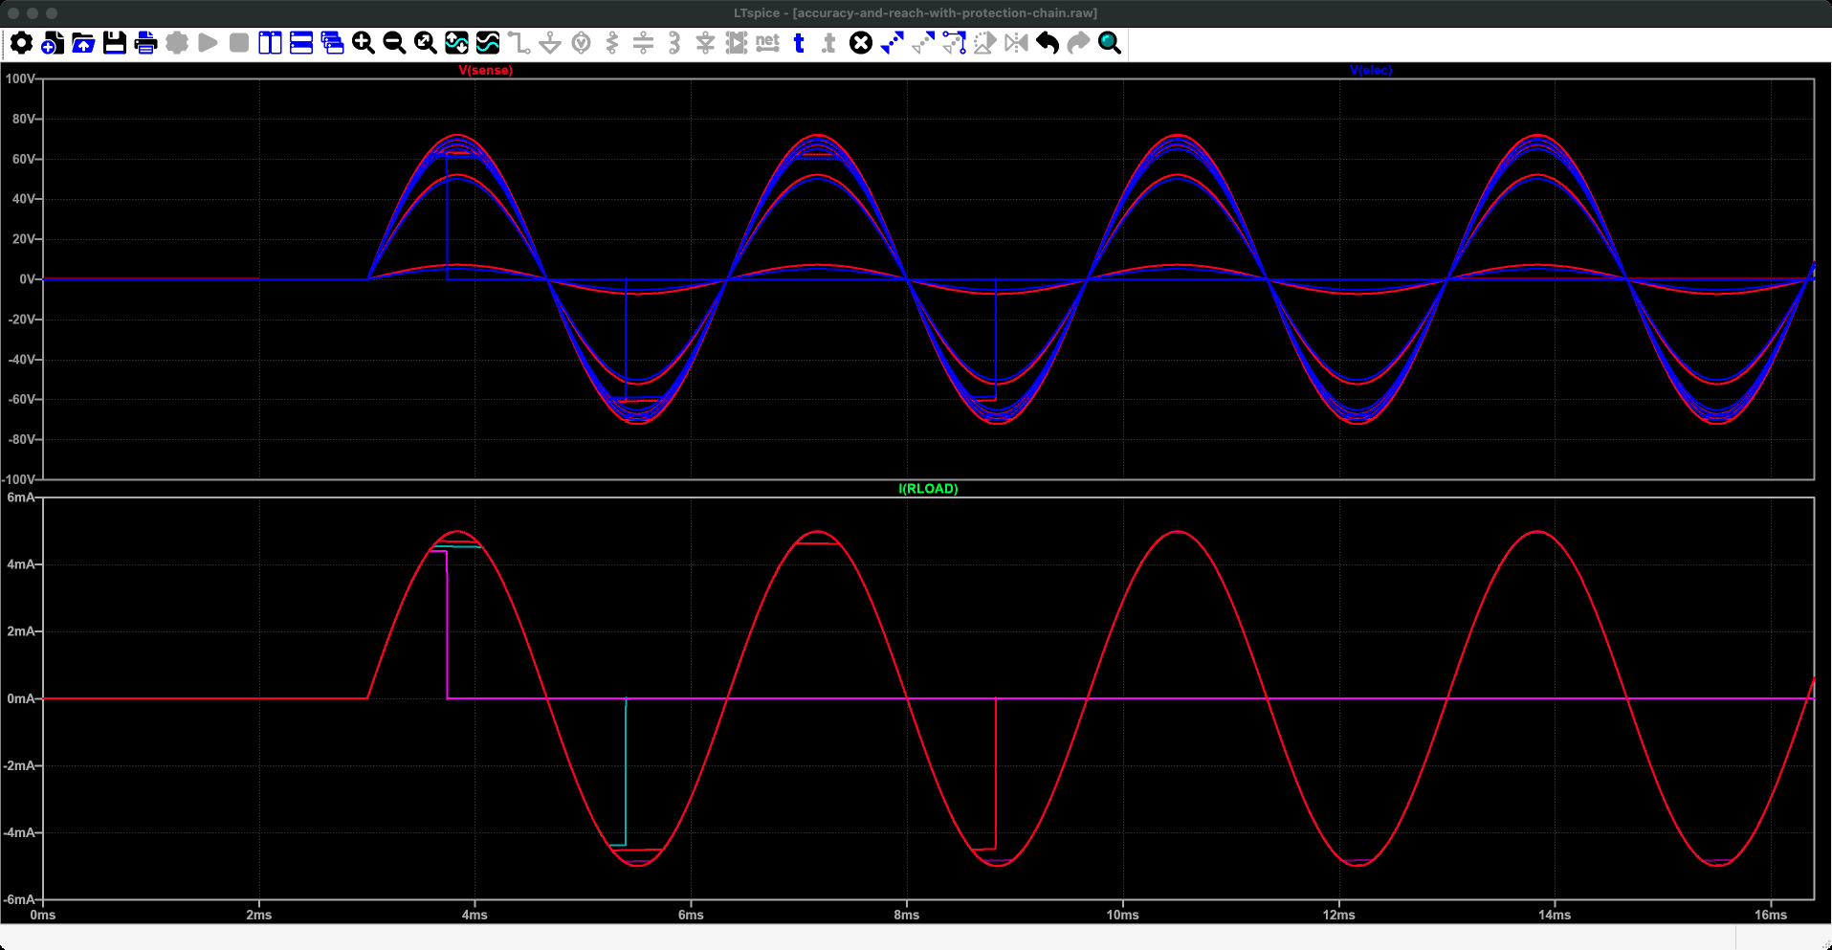
Accuracy and reach with the protection chain (T11.4): run it and read the plot
Reproduce in LTspice · 2 of 2 · accuracy-and-reach-with-protection-chain.plt
Run it
1. Press Run (the green ▶ on the toolbar, or Simulate → Run). It takes about 15 s.
2. The waveform window opens with these panes: LTspice reads accuracy-and-reach-with-protection-chain.plt because it sits next to the schematic. If not: Plot Settings → Open Plot Settings File.
3. Numbers: View → SPICE Error Log lists every .meas result, one row per run.
What to read
• I(RLOAD): sine waves of ±5 mA; the runs that run out of voltage clip or collapse (the trips latch).
• Error log ERRpct: -0.08 % at 1 kΩ, -0.14 % at 10 kΩ, -0.16 % at 13 kΩ (100 V).
• At 90 V the 13 kΩ run fails (-8.7 %) and 13.5 / 14 kΩ trip: the client pump cannot reach 13 kΩ at 90 V with the chain. Deck 3 finds the fix.
• drop: 2.09 V across the chain (SENSE → ELEC).
What you are looking at: Time runs across, 0 to 16 ms. Bottom pane: the current in the dummy head, a 5 mA sine wave, one line per head resistance and supply voltage; most lie exactly on top of each other. Top pane: the voltage the pump needs to push that current; bigger heads need more. Lines that suddenly drop to zero are runs where the pump ran out of voltage and the protection shut the output off.
Why it matters: The current is accurate whenever the voltage is available; with 90 V supplies a 13 kΩ head is already too much.
Traces (accuracy-and-reach-with-protection-chain.plt, panes from the top) 1: V(sense), V(elec) 2: I(RLOAD)

Slide 24
3. System walkthrough
Every block from the computer to the electrode, what it does, and how it adds safety

Slide 25
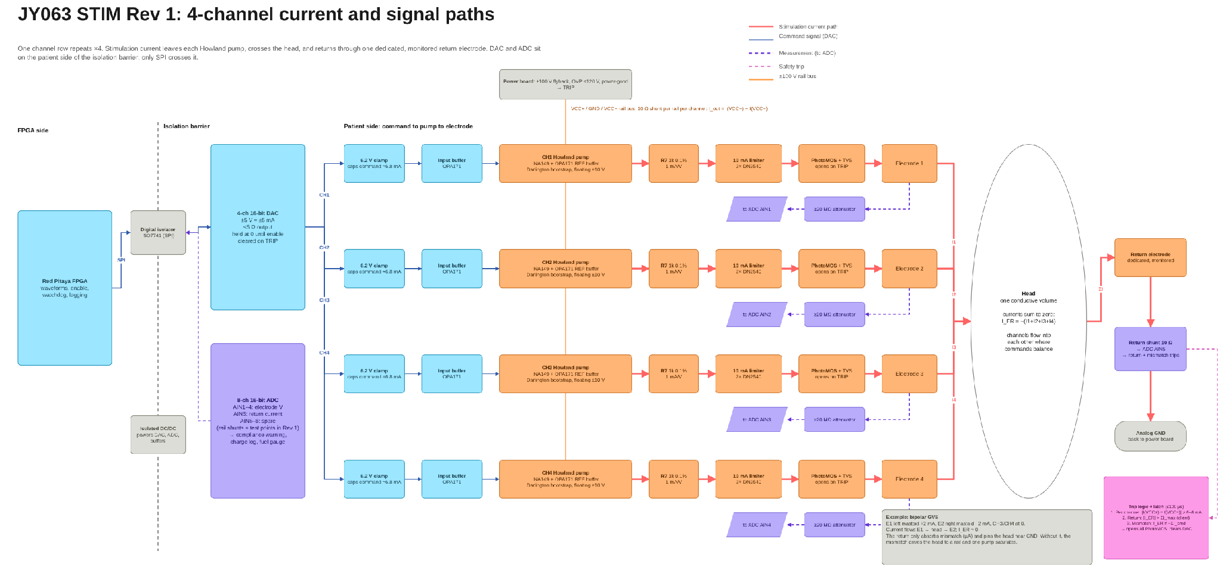
The full four-channel system (Miro)
Miro board frame "STIM Rev 1 architecture", rendered from the board data on 2026-10-24. Each row is one channel (CH1-CH4). Read left to right; see the next slide for the legend.

Slide 26
How to read the system diagram
Line on the diagram | Meaning
Solid blue | Command signal: the requested current, as a voltage
Thick red | Stimulation current: the actual current through the person
Dashed purple | Measurement going to the ADC
Dashed pink | Safety trip signal
Orange vertical line | ±100 V supply rails shared by all channels
Dashed black vertical | Isolation barrier: nothing conducts across it
Step | Block | Job | Slide
1 | FPGA, isolator, DAC | Make the command; keep the computer electrically separate | 27
2 | 6.2 V clamp, input buffer | Put a hard ceiling on the command without hurting accuracy | 28
- | Howland pump, R7 | Turn the command into current (1 mA per volt) | 17-19
3 | Current limiter | Physically cap the current, even if everything else fails | 31
4 | PhotoMOS + TVS | Disconnect the electrode on any fault | 36
5 | Attenuators, shunts, ADC | Measure what is actually delivered | 37-38
- | Head, return electrode | Where the four currents meet and return (section 4) | 49-60
- | Trip logic + latch | Decide when to disconnect | 39

Slide 27
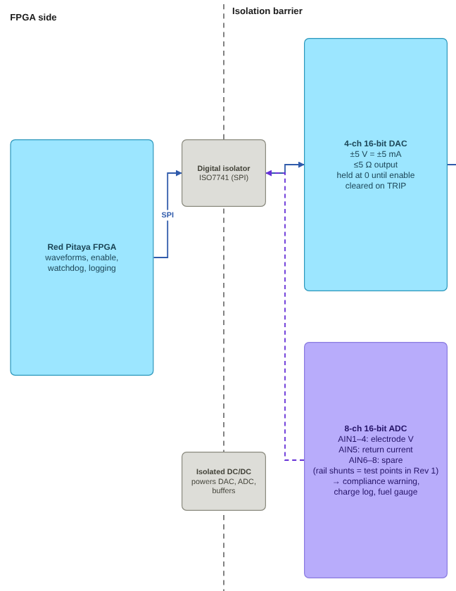
Step 1: the computer never touches the patient side
What happens here
The FPGA (Red Pitaya) generates the stimulation waveforms. It and any laptop connected to it are referenced to mains earth.
Everything that touches the person runs from its own isolated supply (isolated DC/DC). This is the patient side.
Only digital data crosses between the two sides, over SPI through a digital isolator (ISO7741, rated above 1.5 kV). No wire connects them.
The DAC sits on the patient side. It converts numbers into a ±5 V command: 1 V asks for 1 mA.
The ADC also sits on the patient side and sends its readings back across the isolator.
How it adds safety
A fault on the mains or the laptop cannot push current through the person, because there is no conducting path across the barrier.
The DAC is held at zero until stimulation is enabled, and is cleared at once by a trip.

Slide 28
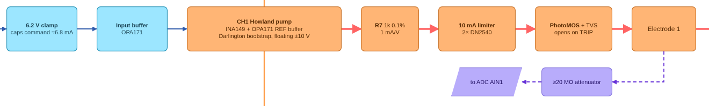
Step 2: a hard ceiling on the command
DAC
R + 6.2 V zener pair
Buffer (OPA171)
INA149 +IN
The clamp
The buffer
Two zener diodes back to back stop the command from going past about ±6.9 V in either direction. At 1 mA per volt that caps the current at about 6.9 mA: above the 5 mA we use, below the 10 mA limit. It protects against a software bug, a corrupted SPI message or a DAC powering up at full scale. A 6.2 V zener is used because lower-voltage zeners start leaking near 5 V, which would distort the 5 mA operating point.
The pump's amplifier is very sensitive to resistance in front of its input: 75 Ω in series drops its common-mode rejection from 100 dB to 74 dB, which lets the electrode voltage leak into the current. The clamp needs a series resistor, so a unity-gain buffer sits between them. Its input ignores the resistor; its output looks like 0 Ω to the amplifier. Order matters: clamp first, then buffer.
Image: channel row from the Miro diagram. Source for CMRR figures: INA149 datasheet (TI SBOS579B).

Slide 29
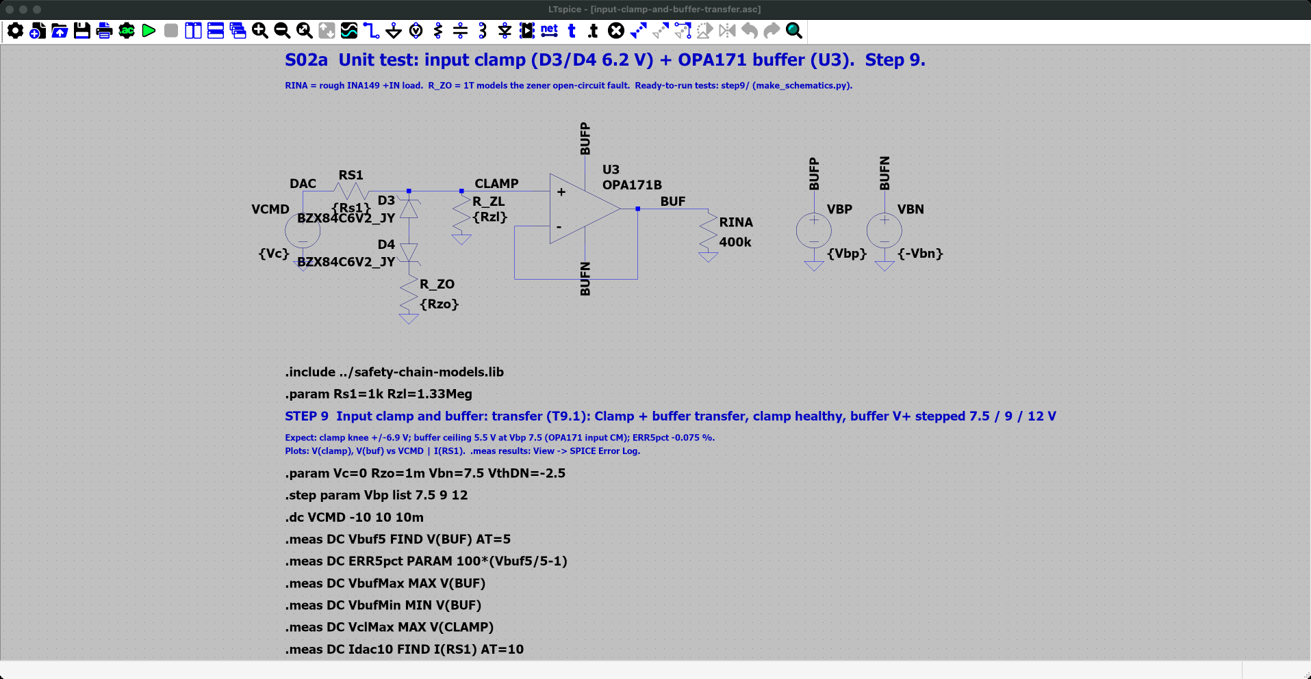
Input clamp and buffer: transfer (T9.1): the schematic
Reproduce in LTspice · 1 of 2 · input-clamp-and-buffer-transfer.asc
Where
SPICE_SIM/
1-safety-model/
9-input-clamp-and-buffer/
input-clamp-and-buffer-transfer.asc
Open it
1. Start LTspice, then File → Open. Set the file type to "Schematics (*.asc)".
2. Go to SPICE_SIM → 1-safety-model → 9-input-clamp-and-buffer.
3. Open input-clamp-and-buffer-transfer.asc. It opens zoomed to fit, as in the screenshot.
On the schematic
• The DAC command VCMD drives RS1 (1 kΩ) into the D3/D4 6.2 V zener pair; the OPA171 buffer U3 follows the clamp node.
• .dc sweeps the command from -10 to +10 V, three times: buffer supply Vbp = 7.5, 9 and 12 V.
Simulation commands on this schematic (3 runs, one per .step combination)
.step param Vbp list 7.5 9 12
.dc VCMD -10 10 10m
.meas: Vbuf5, ERR5pct, VbufMax, VbufMin, VclMax, Idac10

Slide 30
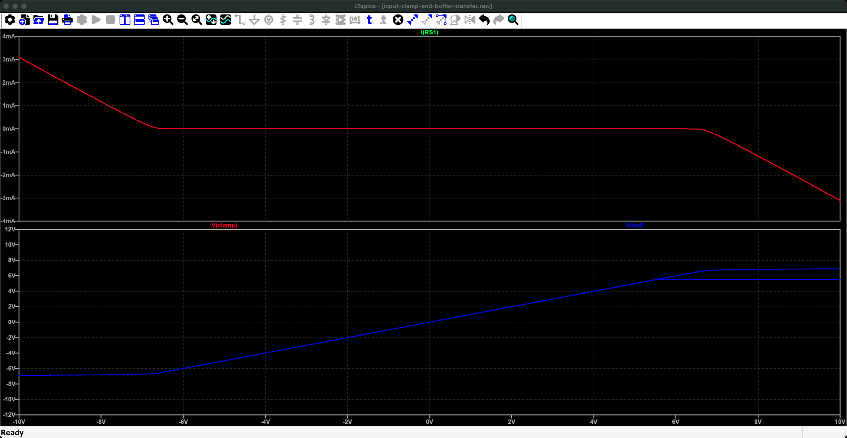
Input clamp and buffer: transfer (T9.1): run it and read the plot
Reproduce in LTspice · 2 of 2 · input-clamp-and-buffer-transfer.plt
Run it
1. Press Run (the green ▶ on the toolbar, or Simulate → Run). It takes a few seconds.
2. The waveform window opens with these panes: LTspice reads input-clamp-and-buffer-transfer.plt because it sits next to the schematic. If not: Plot Settings → Open Plot Settings File.
3. Numbers: View → SPICE Error Log lists every .meas result, one row per run.
What to read
• Bottom pane: V(clamp) and V(buf) follow the command, then flatten at ±6.9 V (the clamp).
• At Vbp = 7.5 V the buffer flattens earlier, at +5.5 V: its input range ends 2 V below its supply. Rev 1 uses ±9 V (D-01).
• Top pane: the DAC current I(RS1), 3.1 mA at ±10 V.
• Error log: Vbuf5 = 4.996 V, ERR5pct = -0.075 % (zener leakage through 1 kΩ).
What you are looking at: Across the bottom is the command the computer sends (-10 to +10 V); up is what comes out. The bottom pane is the command after the safety clamp and after the buffer: a straight line that goes flat at about ±6.9 V. Each line is one buffer supply; at the lowest one the top flattens early, at 5.5 V. The top pane is the current the clamp diverts once it starts working.
Why it matters: Whatever the computer sends, the command can never ask the pump for more than about 6.9 mA.
Traces (input-clamp-and-buffer-transfer.plt, panes from the top) 1: I(RS1) 2: V(clamp), V(buf)

Slide 31
Step 3: a current limiter that cannot be switched off
How it works
Why not a current-limit chip?
Two DN2540 depletion-mode transistors sit in series with each electrode, one for each current direction.
A depletion-mode transistor conducts until its gate is pulled negative. Its gate connects to the far end of a small resistor (about 180 Ω) that the current flows through.
As current rises, the resistor pulls the gate more negative and the transistor starts to turn off.
It settles at the current where it is just barely on. Any extra push is absorbed as voltage across the transistor (rated 400 V), not passed on as current.
Need | TPS25221 (example chip)
Works at ±100 V | 2.5-5.5 V only
Limits at 10 mA | 275 mA minimum setting
Limits both directions | One direction only
No supply or control needed | Needs its own 5 V supply and enable pin
Why passive matters
Trade-offs
The limiter has no supply, no logic and no enable pin. A software crash, a dead rail or a failed chip cannot turn it off. It is the last line of defence.
Uses about 1.5-2 V at 5 mA, part of the compliance margin.
Varies 6-14 mA from part to part with a fixed resistor. Rev 1: one resistor per matched pair, set for 7.6 mA (D-02).
Dissipates about 1 W in a sustained fault; needs a package with copper area.
Sources: Microchip DN2540 datasheet; TI TPS25221 product page.

Slide 32
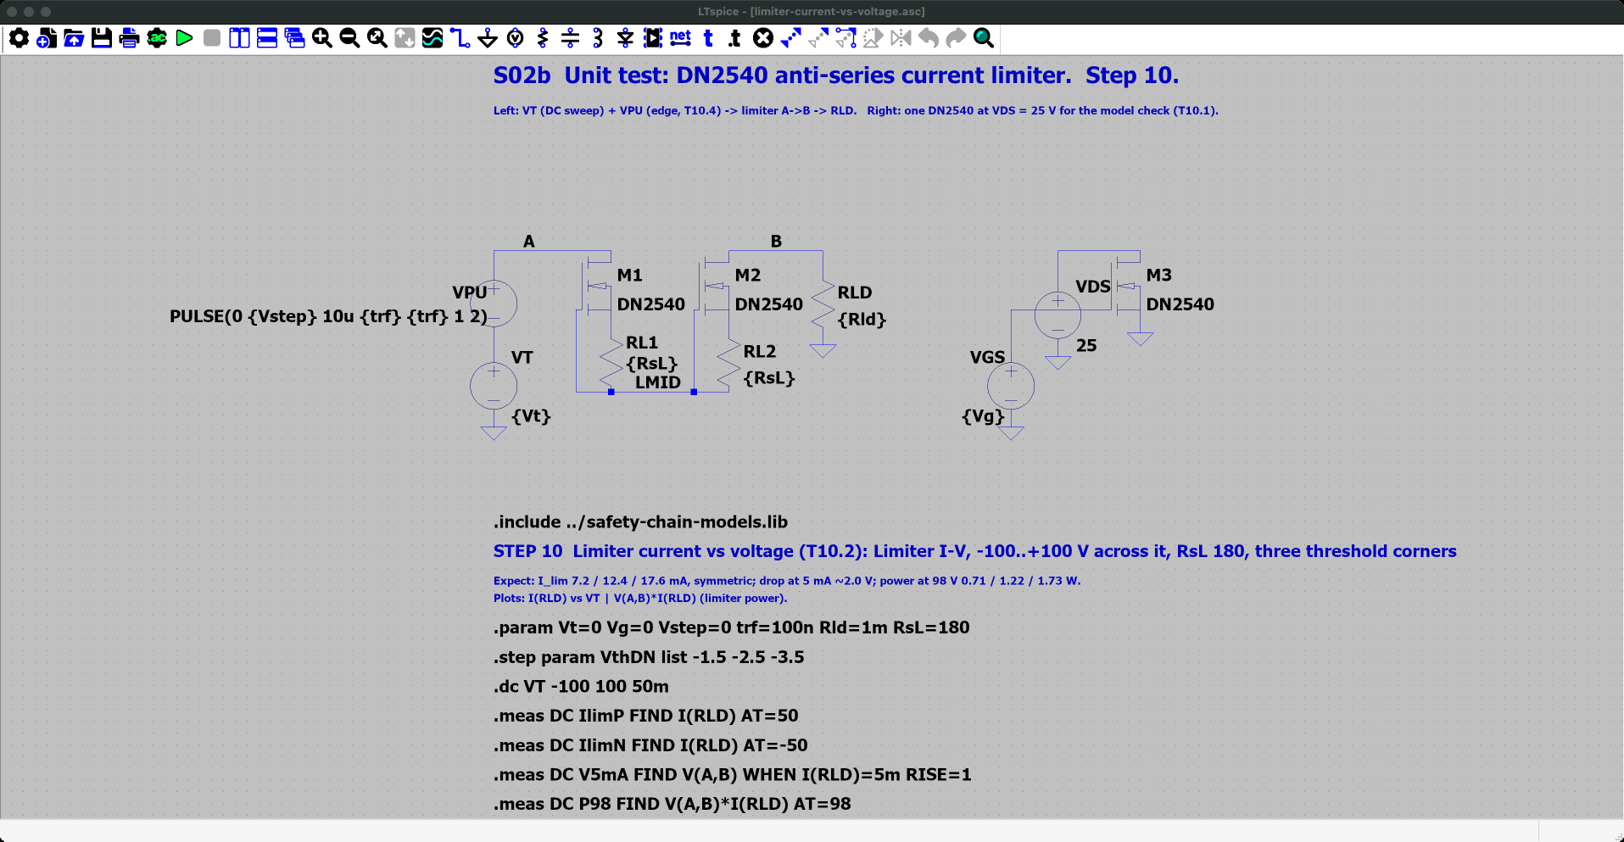
Limiter current vs voltage (T10.2): the schematic
Reproduce in LTspice · 1 of 2 · limiter-current-vs-voltage.asc
Where
SPICE_SIM/
1-safety-model/
10-current-limiter/
limiter-current-vs-voltage.asc
Open it
1. Start LTspice, then File → Open. Set the file type to "Schematics (*.asc)".
2. Go to SPICE_SIM → 1-safety-model → 10-current-limiter.
3. Open limiter-current-vs-voltage.asc. It opens zoomed to fit, as in the screenshot.
On the schematic
• Two DN2540 in series, sources joined through RsL = 180 Ω, one per current direction: the fixture of the limiter.
• VT sweeps the voltage across the limiter from -100 to +100 V; VthDN steps the turn-off voltage -1.5 / -2.5 / -3.5 V (the datasheet spread).
Simulation commands on this schematic (3 runs, one per .step combination)
.step param VthDN list -1.5 -2.5 -3.5
.dc VT -100 100 50m
.meas: IlimP, IlimN, V5mA, P98

Slide 33
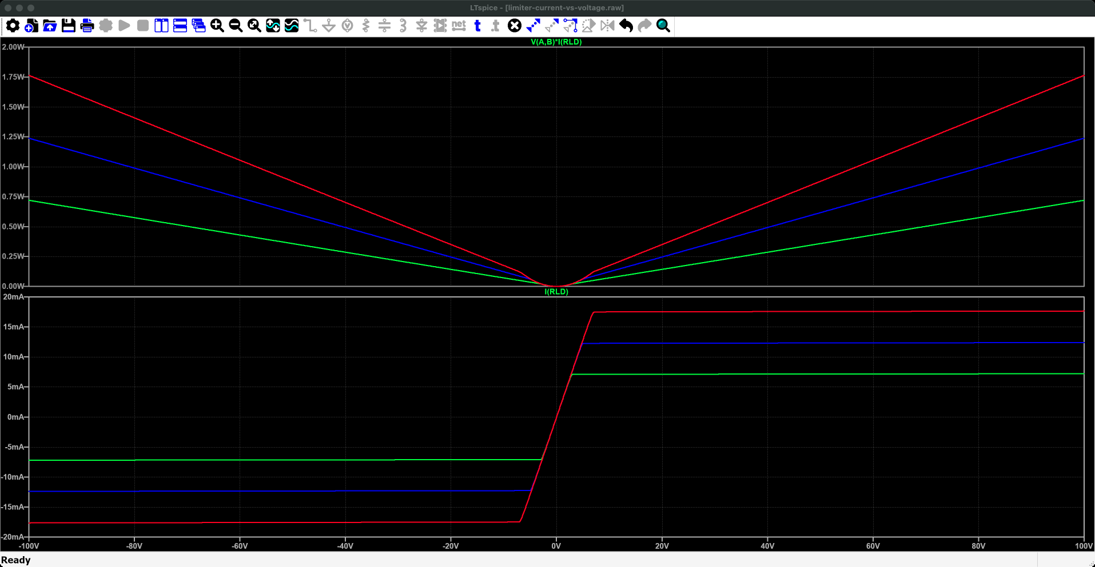
Limiter current vs voltage (T10.2): run it and read the plot
Reproduce in LTspice · 2 of 2 · limiter-current-vs-voltage.plt
Run it
1. Press Run (the green ▶ on the toolbar, or Simulate → Run). It takes a few seconds.
2. The waveform window opens with these panes: LTspice reads limiter-current-vs-voltage.plt because it sits next to the schematic. If not: Plot Settings → Open Plot Settings File.
3. Numbers: View → SPICE Error Log lists every .meas result, one row per run.
What to read
• I(RLD): the current rises, then flattens at the limit. Three curves, one per VthDN.
• Error log: IlimP = 7.15 / 12.3 / 17.6 mA, the same negative (symmetric).
• V5mA: about 1.94-1.96 V across the limiter at 5 mA: the compliance it costs.
• P98: 0.71 / 1.21 / 1.73 W at 98 V, the fault dissipation.
What you are looking at: Across is the voltage forced across the current limiter, from -100 to +100 V. Bottom pane: the current that flows. It rises, then goes flat: that flat level is the limit. The three lines are three limiter parts, from a weak one (lowest) to a strong one (highest). Top pane: the heat in the limiter, which grows with the voltage because the current is held fixed.
Why it matters: The limiter is the last line of defence: it caps the current in either direction, with no power and no logic.
Traces (limiter-current-vs-voltage.plt, panes from the top) 1: V(A,B)*I(RLD) 2: I(RLD)

Slide 34
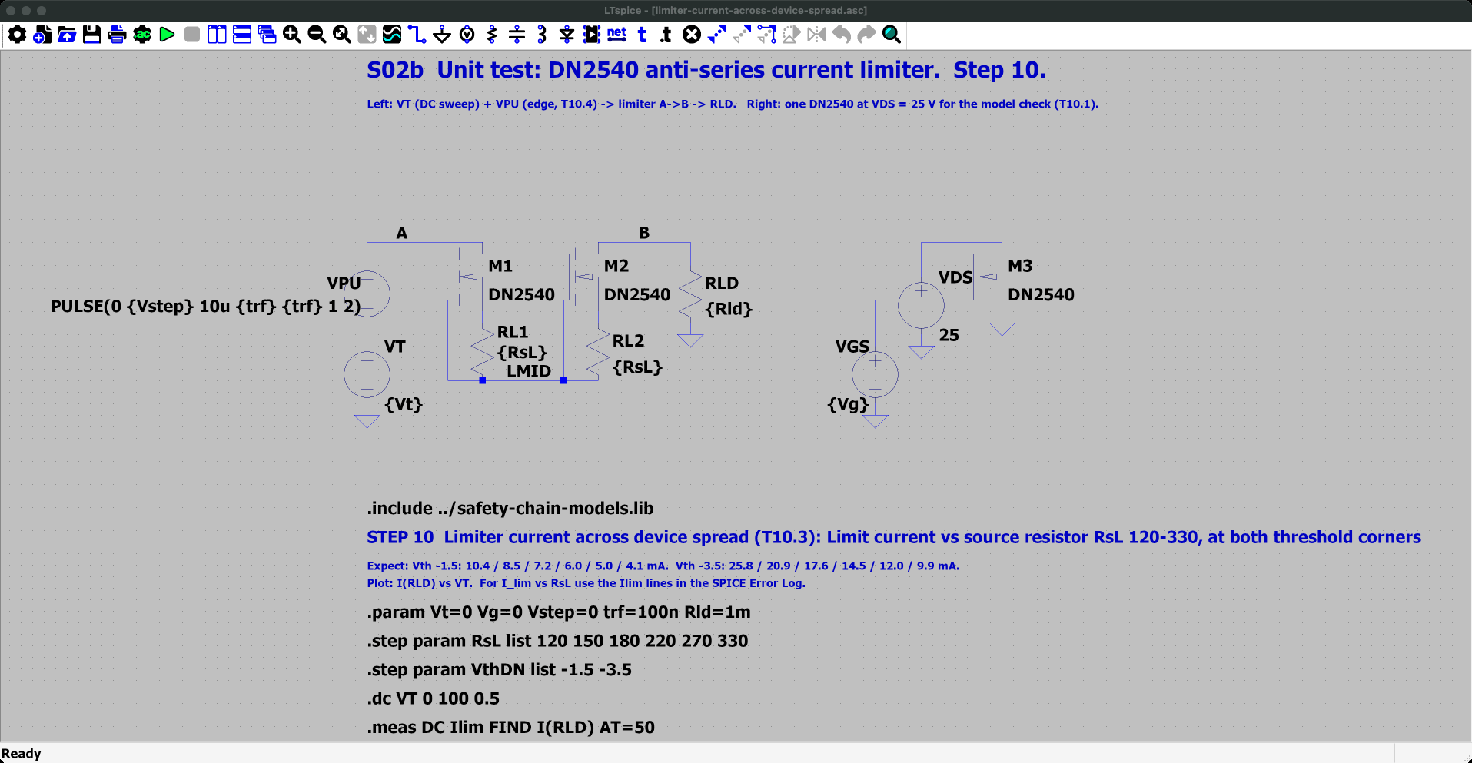
Limiter current across device spread (T10.3): the schematic
Reproduce in LTspice · 1 of 2 · limiter-current-across-device-spread.asc
Where
SPICE_SIM/
1-safety-model/
10-current-limiter/
limiter-current-across-device-spread.asc
Open it
1. Start LTspice, then File → Open. Set the file type to "Schematics (*.asc)".
2. Go to SPICE_SIM → 1-safety-model → 10-current-limiter.
3. Open limiter-current-across-device-spread.asc. It opens zoomed to fit, as in the screenshot.
On the schematic
• Same fixture as T10.2. RsL steps 120-330 Ω and VthDN steps -1.5 and -3.5 V: 12 runs.
Simulation commands on this schematic (12 runs, one per .step combination)
.step param RsL list 120 150 180 220 270 330
.step param VthDN list -1.5 -3.5
.dc VT 0 100 0.5
.meas: Ilim

Slide 35
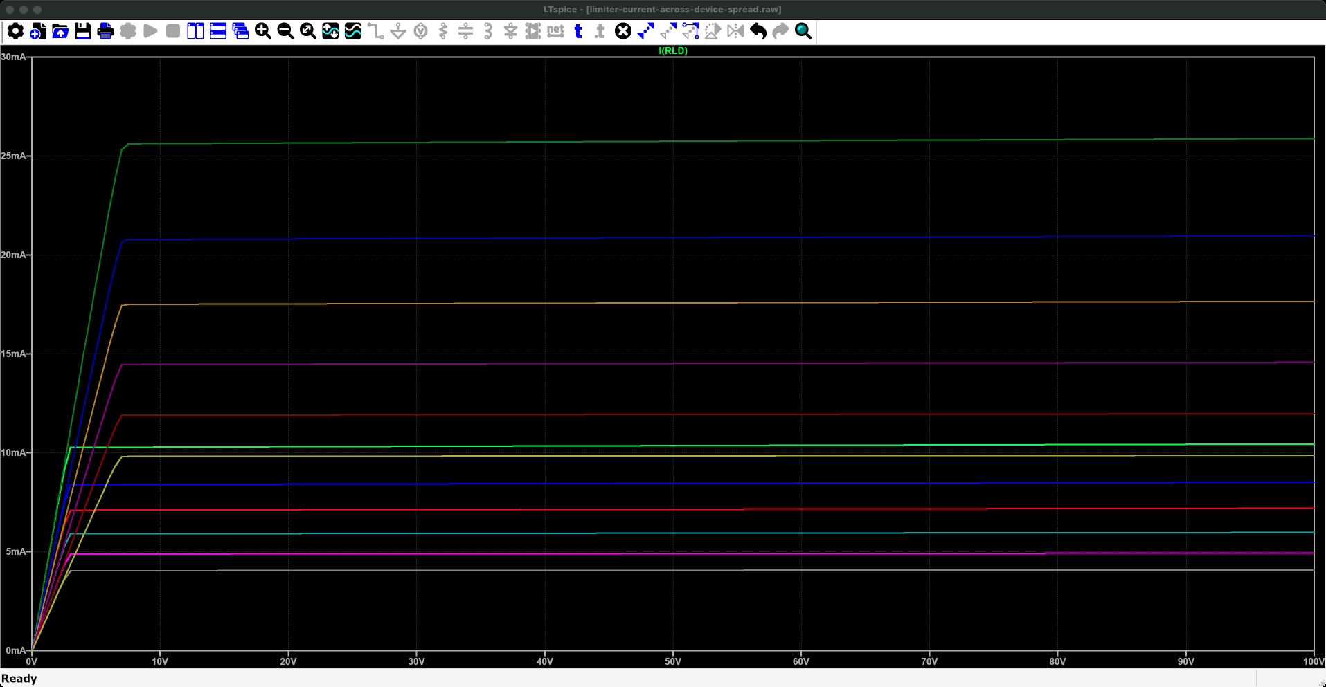
Limiter current across device spread (T10.3): run it and read the plot
Reproduce in LTspice · 2 of 2 · limiter-current-across-device-spread.plt
Run it
1. Press Run (the green ▶ on the toolbar, or Simulate → Run). It takes about a second.
2. The waveform window opens with these panes: LTspice reads limiter-current-across-device-spread.plt because it sits next to the schematic. If not: Plot Settings → Open Plot Settings File.
3. Numbers: View → SPICE Error Log lists every .meas result, one row per run.
What to read
• Each curve is one RsL at one end of the spread. No single RsL keeps every part between 5.5 and 10 mA.
• Error log, Ilim at 50 V: VthDN -1.5 V gives 10.4 → 4.1 mA (RsL 120 → 330 Ω); -3.5 V gives 25.7 → 9.8 mA.
• So the resistor must be chosen per part: Rev 1 trims one per matched pair for 7.6 mA (D-02).
What you are looking at: Across is the voltage across the limiter; up is the current it lets through. Each flat line is one combination of resistor value and part. The lines spread from about 4 mA to about 26 mA.
Why it matters: With one fixed resistor some parts block normal stimulation (below 5.5 mA) and others let too much through (over 10 mA). That is why Rev 1 trims each pair of parts by hand.
Traces (limiter-current-across-device-spread.plt, panes from the top) 1: I(RLD)

Slide 36
Step 4: a light-controlled switch disconnects the electrode
Trip latch
LED
photocells make
~8-10 V
two MOSFETs
back to back
Spec | Target
Load voltage | ≥ 400 V
On-resistance | ≤ 30 Ω (Rev 1 part AQY214S: 35 Ω max, D-17)
Off leakage | ≤ 1 µA
Turn-off time | 0.2 ms max (AQY214S)
light
isolation inside the part
How it works
A PhotoMOS is a relay with no moving parts. An LED on the control side shines on photocells on the switch side.
The photocells generate the voltage that turns the switch on, so the high-voltage side needs no power supply of its own.
Two transistors in series, facing opposite ways, block current in both directions.
No light means open. A trip, a dead controller, a broken wire or lost power all disconnect the electrode. This is called failing safe.
It sits after the limiter, outside the pump's feedback loop. When it opens, the pump sees an open circuit and saturates, which is why a trip also clears the DAC.
Rejected option | Why
Mechanical relay | 2-10 ms, unreliable at 5 mA, wears out, can weld shut
Load-switch chip | 5.5 V max, one direction, needs a floating supply
Reed relay | Acceptable, but can also weld shut

Slide 37
Step 5: the system measures what it delivers
Measurement | Sensor | Signal | Used for
Electrode voltage (×4) | ≥ 20 MΩ resistor divider to the ADC | Scaled-down electrode voltage | Compliance warning, over-voltage trip, fuel-gauge display
Return current | 10 Ω resistor in the return line | 50 mV at 5 mA | Mismatch trip, return overcurrent trip, charge log
Supply current per channel | 10 Ω resistor in each rail feed (47 Ω in Rev 1) | 10 mV per mA | Rev 1: per-channel over-current trip (slide 38)
Why the divider must be ≥ 20 MΩ
What the client gets from it
Any measurement attached to the electrode steals some of the current meant for the person. At 13 kΩ load, a 20 MΩ divider takes 13 / 20 000 = 0.065 % of the current, and that error is constant so calibration removes it. A ready-made high-voltage amplifier such as the INA149 has only about 200 kΩ input resistance and would steal about 3 % at 65 V.
A warning when the load is too high to deliver the commanded current (compliance warning, set near 12-13 kΩ).
A log of delivered charge per session.
The "fuel gauge" display the client asked for.
Evidence, after the fact, that the delivered current matched the command.

Slide 38
Detail: the rail shunts
Each channel takes its ±100 V supply through two resistors, one per rail (10 Ω in this architecture; 47 Ω in Rev 1, D-06). They replace the client board's 500 mA fuses, which would never blow at milliamp fault currents.
Function | How | Value
Rail-current readout | Voltage across the resistor | 10 mV per mA
Independent output-current check | Output = I(VCC+) − I(VCC−). Every other current flows rail to rail. | Cross-check against the return shunt
Ripple filter | Forms an RC filter with the 100 nF local rail capacitor | Corner ≈ 160 kHz; −10 dB at 500 kHz, −16 dB at 950 kHz
Channel disconnect for debugging | Remove the resistor to unpower one channel | -
Expected readings during bring-up
Rev 1 (deck 4)
Idle: about 2.5 mA per rail (op-amps plus bias chain).
Much more than that: suspect oscillation or latch-up.
Cost: about 0.09 V drop and under 1 mW. Negligible.
Rev 1 reads each rail shunt with an INA149 high-voltage amplifier (two per channel) and uses them for the per-channel over-current trip at 5.72 mA (D-04, D-06): 10 Ω would have left ±1.4 mA of sense error against a 1.1 mA window.

Slide 39
Safety in layers: no single failure delivers more than 10 mA
Layer | Type | Acts at | Speed | Catches | Still works if
Isolation barrier | Passive | Always | - | Mains or laptop faults | Software fails
DAC hold / clear | Active | Before enable, on trip | µs | Start-up glitches | -
6.2 V clamp | Passive | ≈ 6.9 mA command | Instant | Bad command from software or DAC | Software fails
Per-channel trip | Active | 5.72 mA (Rev 1, D-03) | ≤ 100 µs | One channel running away | Clamp fails
Mismatch trip | Active | Own return vs own command (Rev 1); shared return: D-19 | ≤ 100 µs | Detached return, current through an unintended path | Clamp, per-channel trip fail
Over-voltage trip | Active | |electrode| > ~80 V | ≤ 100 µs | Head charging toward a rail | Mismatch trip fails
PhotoMOS | Fail-safe | Any trip or power loss | ≤ 0.2 ms (AQY214S) | Disconnects every path | Controller dead
Current limiter | Passive | 10 mA | Instant | Everything upstream failed | Everything else failed
Normal operation is 5 mA. Each row is a separate circuit, so the failure of any one layer still leaves those below it in the table. Rev 1 (deck 4): the worst current 1 µs after any single fault is 7.68 mA.

Slide 40
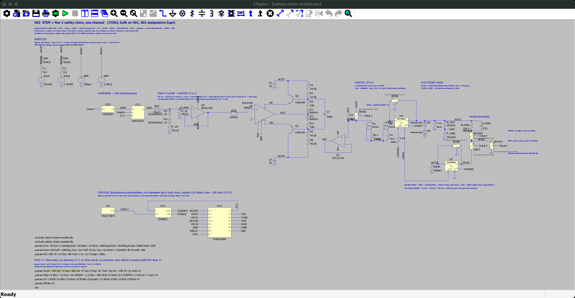
The behavioural safety model (S02): the schematic
Reproduce in LTspice · schematic · safety-chain-model.asc
Where
SPICE_SIM/
1-safety-model/
safety-chain-model.asc
Open it
1. Start LTspice, then File → Open. Set the file type to "Schematics (*.asc)".
2. Go to SPICE_SIM → 1-safety-model.
3. Open safety-chain-model.asc. It opens zoomed to fit, as in the screenshot.
On the schematic
• Left to right: DAC (behavioural) → input clamp and buffer → client pump (unchanged, S01) → R7 → DN2540 limiter → channel PhotoMOS U4 → electrode and dummy head → return PhotoMOS U5 → return shunt.
• Underneath: the trips, latch and enable logic as ideal blocks (U9-U13). These tests check the architecture, not the circuits; Rev 1 (deck 4) designs the real ones.
• This file runs a bias point only (.op). Each test on the next slides is a ready-made copy with its own settings; zoom with the mouse wheel to read the parts.
Simulation commands on this schematic (1 run)
.op

Slide 41
Simulation: fault response and trip timing
Purpose
Show each safety layer holding the current where the table on slide 39 says it should.
Result
Results: behavioural safety model (1-safety-model/, steps 9-12) and deck 4, "Output-stage short: limit the current, then disconnect" and "Independent output disconnects and safe power-up behavior"
DAC runaway: clamp holds 6.9-7.0 mA; trip in 10-20 µs.
Output-stage short: limiter holds until the switches open (0.24 ms).
Welded switch: the return switch stops it (0.21 µA).
Rev 1: ≤ 7.68 mA after 1 µs, latched.
Simulation used
ngspice, Rev 1 netlist: DAC runaway, clamp open, output stage shorted to a rail, welded switch, rail loss, power-up.

Slide 42
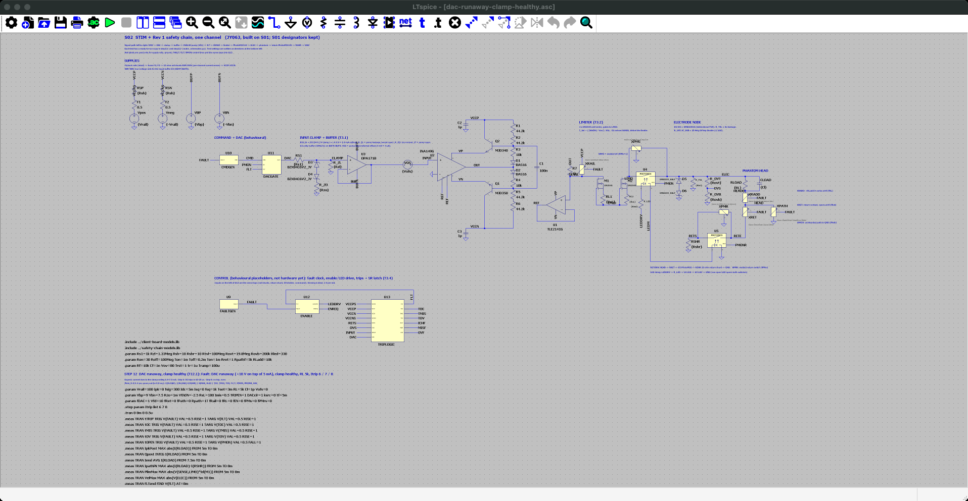
DAC runaway, clamp healthy (T12.1): the schematic
Reproduce in LTspice · 1 of 2 · dac-runaway-clamp-healthy.asc
Where
SPICE_SIM/
1-safety-model/
12-fault-injection/
dac-runaway-clamp-healthy.asc
Open it
1. Start LTspice, then File → Open. Set the file type to "Schematics (*.asc)".
2. Go to SPICE_SIM → 1-safety-model → 12-fault-injection.
3. Open dac-runaway-clamp-healthy.asc. It opens zoomed to fit, as in the screenshot.
On the schematic
• +5 mA DC into 5 kΩ; at tf = 5 ms the DAC runs away to full scale (fDAC = 1).
• The over-current trip level steps Itrip = 6 / 7 / 8 mA.
Simulation commands on this schematic (3 runs, one per .step combination)
.step param Itrip list 6 7 8
.tran 0 8m 0 0.5u
.meas: tTRIP, tOC, tMIS, tOV, tOPEN, IpkPost, Qpost, Iend …

Slide 43
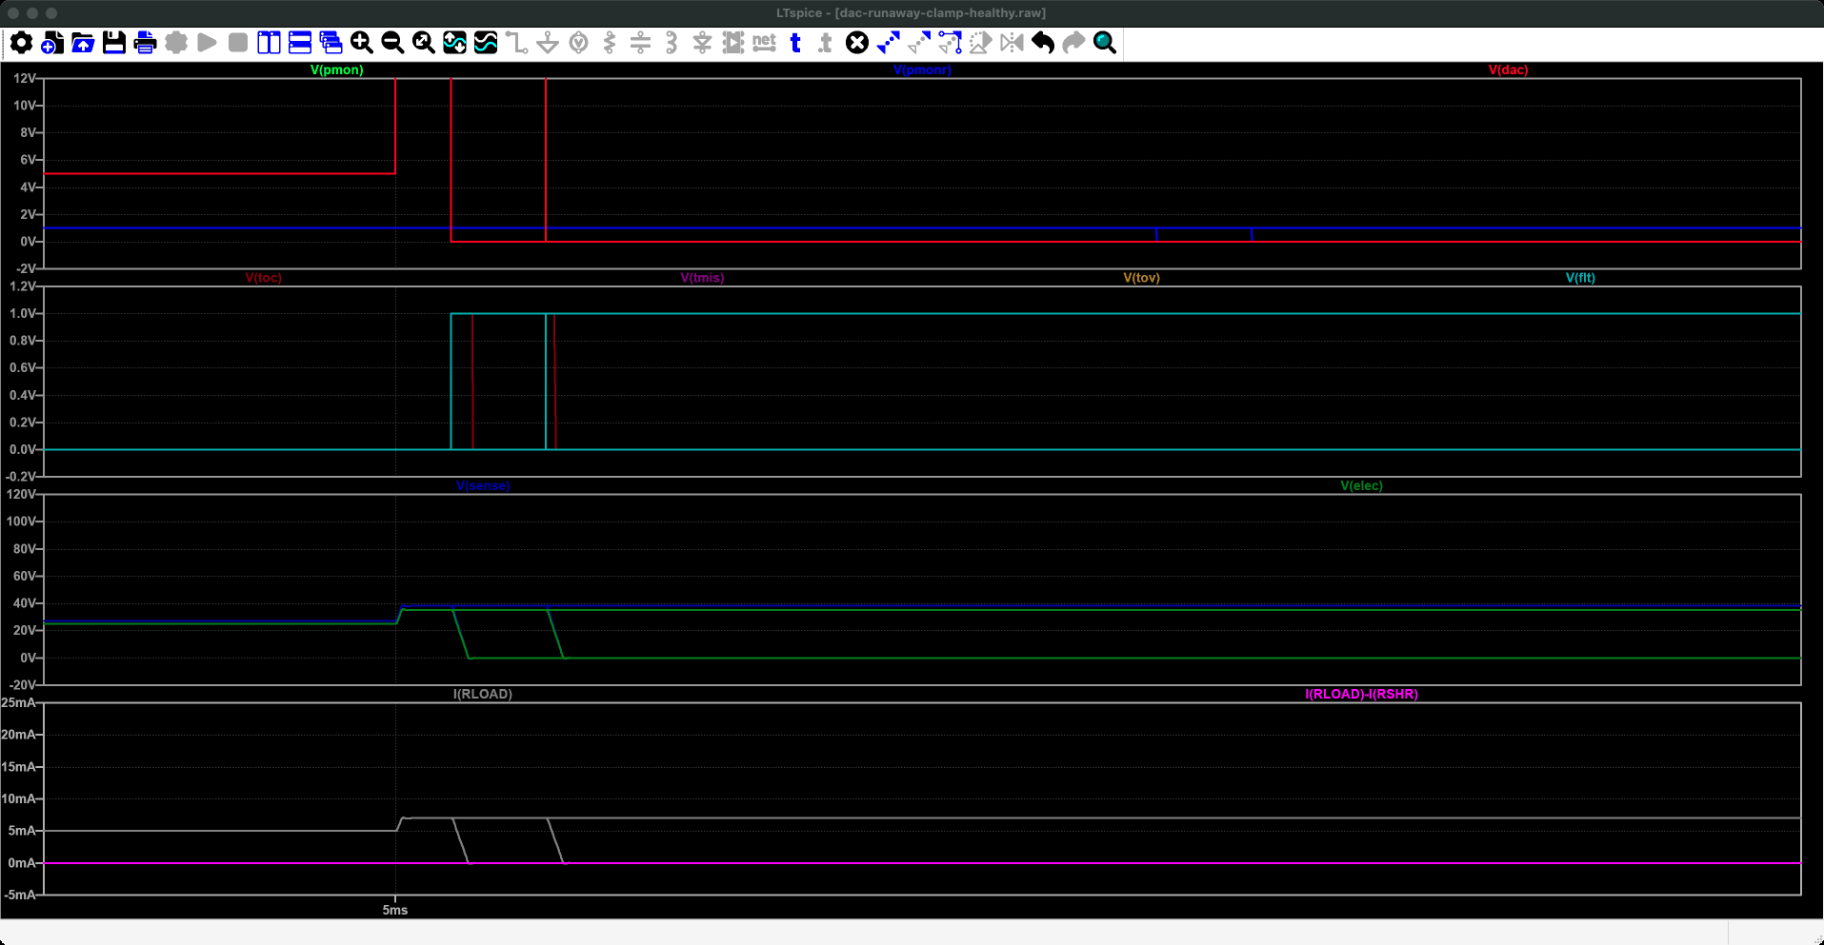
DAC runaway, clamp healthy (T12.1): run it and read the plot
Reproduce in LTspice · 2 of 2 · dac-runaway-clamp-healthy.plt
Run it
1. Press Run (the green ▶ on the toolbar, or Simulate → Run). It takes about 10 s.
2. The waveform window opens with these panes: LTspice reads dac-runaway-clamp-healthy.plt because it sits next to the schematic. If not: Plot Settings → Open Plot Settings File.
3. Numbers: View → SPICE Error Log lists every .meas result, one row per run.
What to read
• Plot window 4.9-5.4 ms: the current rises to the clamp ceiling, about 7.1 mA.
• Itrip 6 and 7 mA: V(FLT) latches and V(PMON) drops; tTRIP = 16 µs and 43 µs; the switches are open after about 0.22 ms.
• Itrip 8 mA: no trip at all (tTRIP "failed"), because the clamp holds the current below the trip. Rule: trip below the lowest clamp ceiling (S3).
What you are looking at: A close-up of half a millisecond around the fault at 5 ms. Bottom pane: the head current, 5 mA before, then up to about 7 mA when the computer's output runs away. In two runs it drops to zero: the trip fired and the switches opened. In the third (trip set at 8 mA) it stays at 7 mA. The second pane shows the trip signals; the top pane the computer output and the switch drive.
Why it matters: The trip must be set below what the clamp allows, or a runaway is never caught.
Traces (dac-runaway-clamp-healthy.plt, panes from the top) 1: V(pmon), V(pmonr), V(dac) 2: V(toc), V(tmis), V(tov), V(flt) 3: V(sense), V(elec) 4: I(RLOAD), I(RLOAD)-I(RSHR)

Slide 44
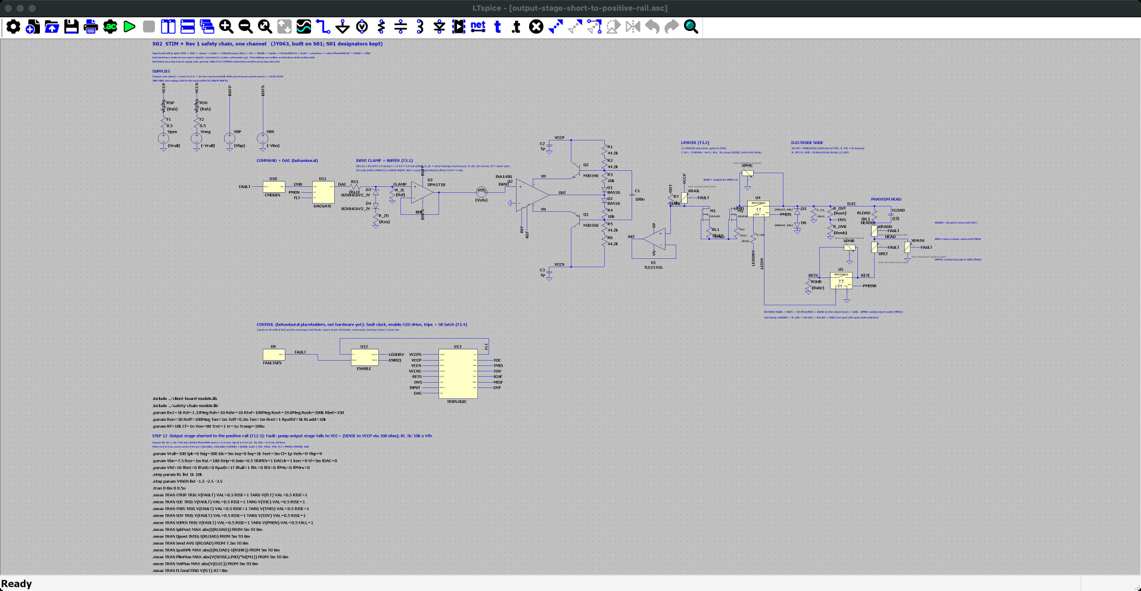
Output stage shorted to the positive rail (T12.3): the schematic
Reproduce in LTspice · 1 of 2 · output-stage-short-to-positive-rail.asc
Where
SPICE_SIM/
1-safety-model/
12-fault-injection/
output-stage-short-to-positive-rail.asc
Open it
1. Start LTspice, then File → Open. Set the file type to "Schematics (*.asc)".
2. Go to SPICE_SIM → 1-safety-model → 12-fault-injection.
3. Open output-stage-short-to-positive-rail.asc. It opens zoomed to fit, as in the screenshot.
On the schematic
• +5 mA DC; at tf = 5 ms the pump output is shorted to +100 V (fRail = 1).
• Steps: RL = 1k / 10k and VthDN = -1.5 / -2.5 / -3.5 V (6 runs).
Simulation commands on this schematic (6 runs, one per .step combination)
.step param RL list 1k 10k
.step param VthDN list -1.5 -2.5 -3.5
.tran 0 8m 0 0.5u
.meas: tTRIP, tOC, tMIS, tOV, tOPEN, IpkPost, Qpost, Iend …

Slide 45
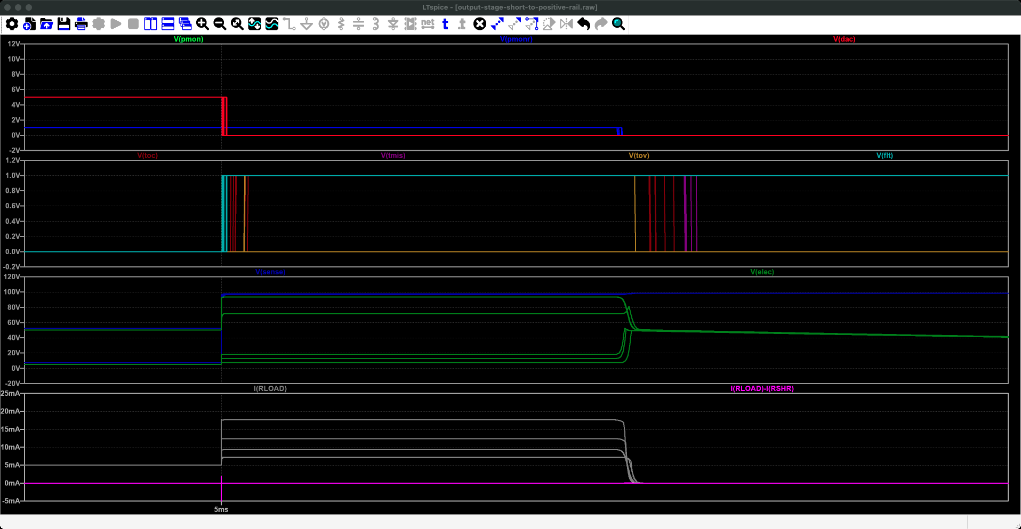
Output stage shorted to the positive rail (T12.3): run it and read the plot
Reproduce in LTspice · 2 of 2 · output-stage-short-to-positive-rail.plt
Run it
1. Press Run (the green ▶ on the toolbar, or Simulate → Run). It takes about 10 s.
2. The waveform window opens with these panes: LTspice reads output-stage-short-to-positive-rail.plt because it sits next to the schematic. If not: Plot Settings → Open Plot Settings File.
3. Numbers: View → SPICE Error Log lists every .meas result, one row per run.
What to read
• The .plt opens the plot on 4.9-5.4 ms, around the fault at 5 ms. The limiter holds the current until the PhotoMOS opens about 0.2 ms after the fault (tOPEN).
• Error log, RL 1 kΩ: IpkPost 11.5 / 13.3 / 17.8 mA (one per VthDN), Qpost 1.5-3.6 µC, limiter power up to 11 W for those 0.2 ms.
• RL 10 kΩ: about 9.3 mA; the electrode reaches 94 V and the over-voltage trip also fires.
What you are looking at: A close-up around the fault at 5 ms, when the pump output is shorted to +100 V. Bottom pane: the head current jumps to 7-18 mA, depending on the limiter part, and stays flat (the limiter holding) until about 0.2 ms later, when it drops to zero. The panes above show the voltages, the trip signals going high and the switch drive going low.
Why it matters: Even with the pump completely failed, the current is capped and then cut off within a fraction of a millisecond.
Traces (output-stage-short-to-positive-rail.plt, panes from the top) 1: V(pmon), V(pmonr), V(dac) 2: V(toc), V(tmis), V(tov), V(flt) 3: V(sense), V(elec) 4: I(RLOAD), I(RLOAD)-I(RSHR)

Slide 46

Channel switch welded (T12.7): the schematic
Reproduce in LTspice · 1 of 2 · channel-switch-welded.asc
Where
SPICE_SIM/
1-safety-model/
12-fault-injection/
channel-switch-welded.asc
Open it
1. Start LTspice, then File → Open. Set the file type to "Schematics (*.asc)".
2. Go to SPICE_SIM → 1-safety-model → 12-fault-injection.
3. Open channel-switch-welded.asc. It opens zoomed to fit, as in the screenshot.
On the schematic
• Worst stack: channel PhotoMOS U4 welded (fPMs = 1) + DAC runaway + clamp zener open (Rzo = 1T) + command not cleared (DACclr = 0), RL 1 kΩ.
• fPMrs steps 0 / 1: return PhotoMOS healthy, then also welded. VthDN -1.5 / -3.5 V.
Simulation commands on this schematic (4 runs, one per .step combination)
.step param fPMrs list 0 1
.step param VthDN list -1.5 -3.5
.tran 0 8m 0 0.5u
.meas: tTRIP, tOC, tMIS, tOV, tOPEN, IpkPost, Qpost, Iend …

Slide 47
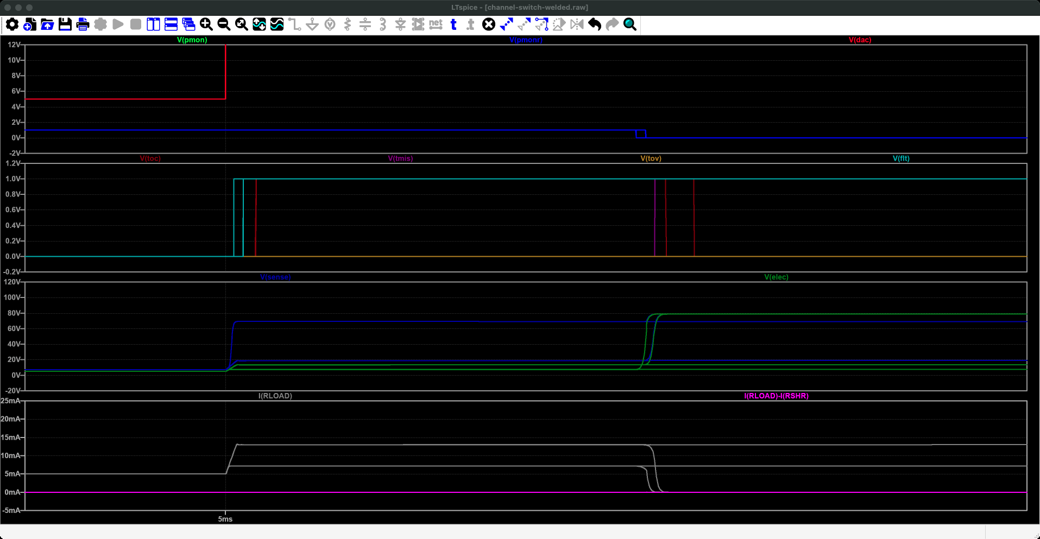
Channel switch welded (T12.7): run it and read the plot
Reproduce in LTspice · 2 of 2 · channel-switch-welded.plt
Run it
1. Press Run (the green ▶ on the toolbar, or Simulate → Run). It takes a few seconds.
2. The waveform window opens with these panes: LTspice reads channel-switch-welded.plt because it sits next to the schematic. If not: Plot Settings → Open Plot Settings File.
3. Numbers: View → SPICE Error Log lists every .meas result, one row per run.
What to read
• The .plt opens the plot on 4.9-5.4 ms, around the fault at 5 ms. fPMrs = 0: the return switch U5 opens and the current stops: Iend ≈ 0.8 µA. It is an independent second disconnect (S5).
• fPMrs = 1 (both welded): only the limiter is left: Iend = 7.2 mA (VthDN -1.5) and 13.7 mA (-3.5), over 10 mA without the Rev 1 trim.
What you are looking at: A close-up around the fault at 5 ms: the main output switch is stuck closed and the command runs away. Bottom pane: the head current rises to 7-14 mA. In two runs it falls to zero about 0.2 ms later: the second switch, in the return wire, opened. In the other two it stays up: both switches were stuck and only the limiter is left.
Why it matters: One stuck switch is not enough to hurt anyone: the second switch alone stops the current.
Traces (channel-switch-welded.plt, panes from the top) 1: V(pmon), V(pmonr), V(dac) 2: V(toc), V(tmis), V(tov), V(flt) 3: V(sense), V(elec) 4: I(RLOAD), I(RLOAD)-I(RSHR)

Slide 48
4. Current paths and grounding
Four channels, one head, one return electrode, and what happens when the return falls off

Slide 49
Four channels share one head: the currents must sum to zero
The head is one connected volume of conductive tissue. Charge cannot pile up inside it, so at every instant the current going in equals the current coming out (Kirchhoff's current law). The return electrode carries whatever the four channels do not balance:
I_return = −(I1 + I2 + I3 + I4)
Example | Channel currents | Return current | What happens
Bipolar (the client's usual setup) | Left mastoid +2 mA, right mastoid −2 mA, others 0 | 0 mA | Current flows ear to ear. Each pump supplies half the voltage across the head, so the pair can drive twice the load.
Monopolar | One electrode +5 mA, others 0 | 5 mA | All current goes from that electrode to the return.
All four the same sign | Four electrodes at +5 mA each | 20 mA | The return carries the sum. The maximum allowed must be agreed with the client.
Two consequences
Each channel forces its own current regardless of the others. A channel set to 0 mA behaves like an open circuit and does not steal current.
The return electrode's resistance is shared. 20 mA through a 1 kΩ return raises every electrode by 20 V and costs every channel 20 V of compliance. The return must be large and well gelled.

Slide 50
Without a return, the head slowly charges up
The return electrode is not only a path for current. It also holds the head at a fixed voltage. This slide shows what happens without it, even when the channels are meant to cancel out exactly.
An everyday picture: a bathtub with two taps
CH1 pushes in
+2.000 mA
Head
(stores charge,
like a capacitor)
CH2 pulls out
−1.996 mA
Think of the head as a bathtub. Channel 1 is a tap pouring water in at exactly 2.000 litres per minute. Channel 2 is a drain pulling water out at what should also be 2 litres per minute, but real parts are never perfect, so it pulls 1.996.
The difference is tiny, but there is no overflow. The water level rises slowly and never stops rising. In the circuit, "water level" is the voltage of the head, and the tiny leftover current is charge piling up on it.
0.004 mA (4 µA) left over, with nowhere to go
Time after start | Head voltage (approx.) | CH1 status
0 s | 0 V | Regulating normally
5 s | ≈ +20 V | Regulating; its output rises to follow
10 s | ≈ +40 V | Regulating; less headroom left
20 s | ≈ +80 V | Close to its limit
≈ 25 s | ≈ +98 V | Saturated: cannot push any higher
Where the numbers come from
Voltage rise per second = leftover current ÷ capacitance. 4 µA into about 1 µF (head plus electrodes, estimated) gives about 4 V per second. Real values depend on electrode size and gel.
The ≈ 1 µF capacitance is an order-of-magnitude estimate, to be measured on the bench (open questions, slide 66).

Slide 51
What "saturating" means, and why it matters
Saturation in plain words
Why it matters
A current pump keeps its current fixed by raising or lowering its output voltage as needed. It can only go as high as its power supply allows: about +98 V here. When the head has charged up to that level, the pump is "pushing as hard as it can". It has stopped controlling the current and simply delivers whatever it can. That state is called saturation. Back to the bathtub: the tap is fully open and the water still is not coming out at the set rate.
Effect | Consequence
Lost accuracy | One channel is no longer delivering what was commanded
Different sensation | The stimulus becomes one-sided. Forbes et al. 2023 predict about 30 % asymmetry for same-polarity stimulation of both ears, against 1-4 % for the usual setup.
Hidden hazard | A body at ~98 V is harmless while nothing else is connected, but becomes a shock path if it touches earth while patient GND is earthed (slides 54-55)
Even small offsets cause it | A few µA of DC offset is enough. It just takes longer.
What happens when CH1 saturates
CH1's current falls until it equals CH2's 1.996 mA. The circuit is balanced again, but only because CH1 gave up control.
Any waveform on CH1 is clipped: there is no room left for it to go higher.
The head and every electrode now sit near +98 V relative to patient GND.
What the return electrode fixes
With a return electrode connected to patient GND, the leftover 4 µA simply flows out through it. The head stays near 0 V, no pump saturates, and the measured return current tells us exactly how unbalanced the channels are. The client's existing two-electrode stimulator never meets this problem: with only one loop, the current in always equals the current out.
Source for the sensation effect: Forbes et al. 2023 (J Neurosci 43(11):1905-1919), Discussion.

Slide 52
Return-path options, and the Rev 1 choice (A3)
Option | How it works | Strength | Weakness | Hardware cost
A. One dedicated return [CHOSEN for Rev 1] | Four stimulating electrodes plus one return electrode tied to patient GND | Simplest. Supports bipolar and monopolar. Enables a mismatch trip. | Return carries the sum. Its resistance couples the channels. Detaching it needs a trip. | Lowest
B. Active (driven) return | An amplifier holds the head at 0 V and limits the return current | Channels stop affecting each other's compliance | The amplifier needs its own protection | +1 HV amplifier
C. Isolated pair per channel | Each channel drives its own two electrodes from its own isolated supply | Strongest: current cannot leave its own pair. Used by clinical stimulators. | 8 electrodes, 4 isolated ±100 V supplies, 4 barriers | Highest
D. Switchable return | Any electrode can be switched to patient GND | Flexible montages | A wrong switch state means a wrong montage | +4 switches and logic
Reasoning
A fits the Rev 1 schedule (board order 8-10 November) and covers the client's current bipolar mastoid setup.
C has the best safety argument but needs four isolated high-voltage supplies; not feasible for Rev 1.
Rev 2 chooses between B and C once the client confirms which montages they will run.

Slide 53
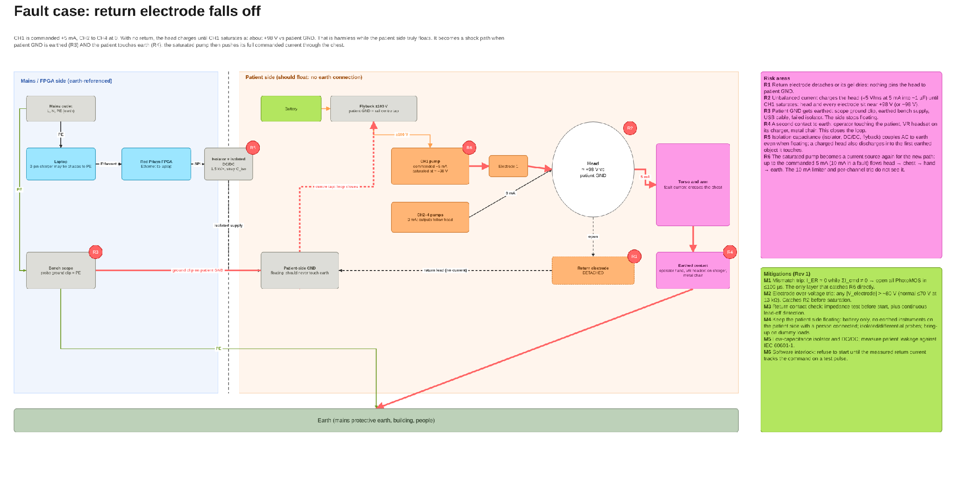
Grounding and the return-off fault (Miro)
Miro board frame "Grounding and return-off fault", rendered from the board data on 2026-10-24. Red markers R1-R6 are the risk points; the green panel lists mitigations M1-M6.

Slide 54
Two different "grounds" that must stay apart
Earth
Patient GND
The protective earth wire of the mains supply. The laptop charger, the oscilloscope, metal furniture, the building and anyone standing on the floor are all connected to it.
The centre point of the stimulator's own battery-powered ±100 V supply. Every voltage on the patient side is measured from here. It should connect to nothing else.
Laptop, scope
Mains outlet
Battery + ±100 V
Head + electrodes
isolation
barrier
Key point
"The head is at 100 V" always means 100 V relative to patient GND, not to earth. While the patient side floats, nothing flows: like a bird on a power line, there is no second path. In future human use it becomes dangerous only if patient GND gets connected to earth and the person also touches something earthed (next slide).

Slide 55
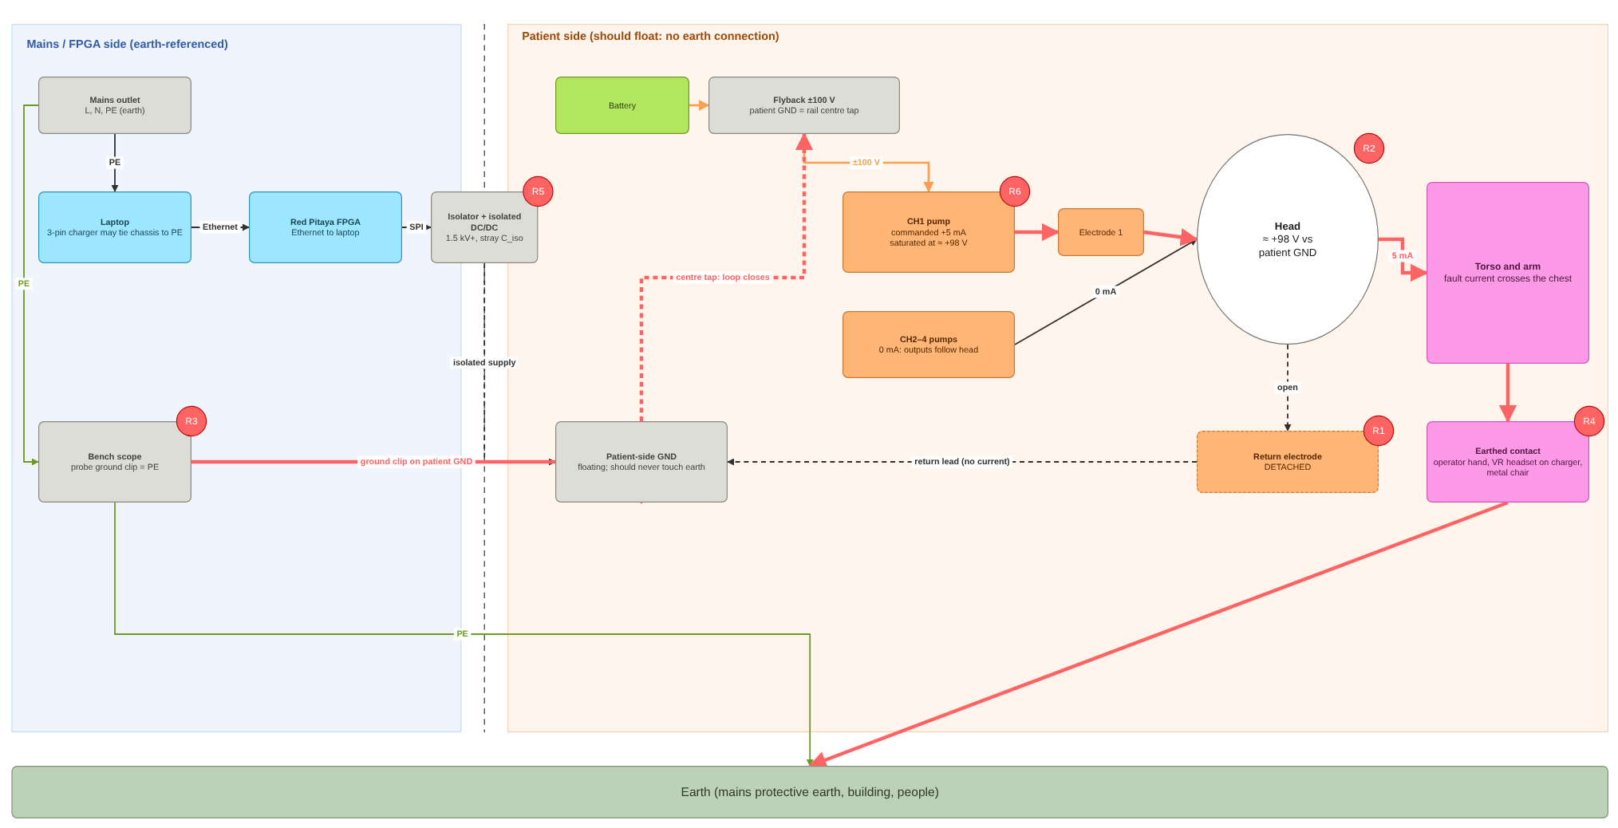
Fault case (future human use): the return falls off
Sequence (CH1 at +5 mA, others at 0)
The return detaches. Nothing holds the head near patient GND.
CH1's 5 mA charges the head, about 1000× faster than the 4 µA example (≈ 5 V per ms). CH1 saturates near +98 V within about 20 ms and its current falls to zero. So far, harmless.
An earthed instrument, such as a scope probe ground clip, is connected to patient GND. Patient GND is now earthed.
The person touches something earthed: an operator's hand, a VR headset on its charger, a metal chair.
A loop now exists: pump → electrode → head → chest → hand → earth → scope → patient GND → pump.
CH1 comes out of saturation and pushes its full 5 mA through the chest.
Why the usual protection misses it
5 mA is a legal current, so the limiter and per-channel trip do nothing, and the return overcurrent trip sees nothing. Only the mismatch trip catches it: the return reads zero while the commands add up to 5 mA.

Slide 56

Return electrode detached (T12.4): the schematic
Reproduce in LTspice · 1 of 2 · return-electrode-detached.asc
Where
SPICE_SIM/
1-safety-model/
12-fault-injection/
return-electrode-detached.asc
Open it
1. Start LTspice, then File → Open. Set the file type to "Schematics (*.asc)".
2. Go to SPICE_SIM → 1-safety-model → 12-fault-injection.
3. Open return-electrode-detached.asc. It opens zoomed to fit, as in the screenshot.
On the schematic
• +5 mA DC into 1 kΩ; at 5 ms the return contact opens (fRet = 1).
• fPath steps 0 / 1: without and with a 5 kΩ unintended path from the head to ground.
Simulation commands on this schematic (2 runs, one per .step combination)
.step param fPath list 1 0
.tran 0 8m 0 0.5u
.meas: tTRIP, tOC, tMIS, tOV, tOPEN, IpkPost, Qpost, Iend …

Slide 57
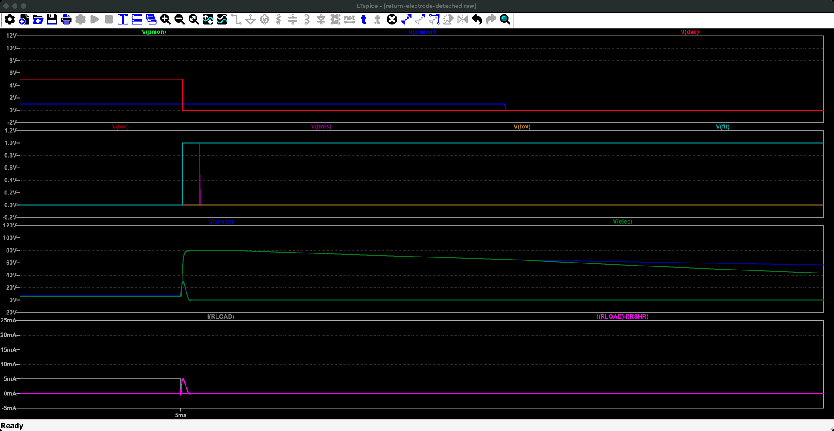
Return electrode detached (T12.4): run it and read the plot
Reproduce in LTspice · 2 of 2 · return-electrode-detached.plt
Run it
1. Press Run (the green ▶ on the toolbar, or Simulate → Run). It takes a few seconds.
2. The waveform window opens with these panes: LTspice reads return-electrode-detached.plt because it sits next to the schematic. If not: Plot Settings → Open Plot Settings File.
3. Numbers: View → SPICE Error Log lists every .meas result, one row per run.
What to read
• The .plt opens the plot on 4.9-5.4 ms, around the fault at 5 ms. The mismatch trip (V(TMIS)) fires in about 1 µs in both runs; the over-current trip does not.
• Error log: tTRIP = 1.06 µs; the switches open about 0.2 ms later; Iend ≈ 0.
What you are looking at: A close-up around 5 ms, when the return electrode comes off. Bottom pane: the head current falls to zero (the circuit is broken), and the pink "mismatch" line, the difference between current out and current back, spikes. The trip signals in the second pane go high about a microsecond later. The electrode voltage (third pane) jumps up and then decays once the switch opens.
Why it matters: A detached return is caught at once by comparing what goes out with what comes back.
Traces (return-electrode-detached.plt, panes from the top) 1: V(pmon), V(pmonr), V(dac) 2: V(toc), V(tmis), V(tov), V(flt) 3: V(sense), V(elec) 4: I(RLOAD), I(RLOAD)-I(RSHR)

Slide 58
Risk register for the return-off fault
ID | Risk | What happens | Caught by
R1 | Return electrode detaches or its gel dries | Nothing pins the head to patient GND | M1, M3, M6
R2 | Unbalanced current charges the head | Head and every electrode drift to ±98 V (≈ 5 V per ms at 5 mA into ~1 µF, estimate) | M2
R3 | Patient GND gets earthed | Scope ground clip, earthed bench supply, USB cable or failed isolator. The patient side stops floating. | M4, M5
R4 | Person touches earth | Operator contact, headset on charger, metal chair. Closes the loop. | M4
R5 | Isolation capacitance | AC couples to earth even when floating; a charged head discharges into the first earthed object it meets | M5
R6 | Saturated pump finds a new path | Full commanded current (5 mA, up to 10 mA in a fault) flows head → chest → hand → earth | M1 only
In future human use, serious harm needs R1, R3 and R4 at the same time. On the bench, R3 is normal (scope grounds are clipped to patient GND), so a detached return plus a touch would be a single fault. That is one reason this project tests on dummy loads only, and why the operating rule on the next slide must carry over to the client.

Slide 59
Mitigations for a detached return (Rev 1)
ID | Mitigation | How it works | Type
M1 | Mismatch trip | Return current must equal minus the sum of commanded currents. If not, all PhotoMOS switches open within 100 µs. | Hardware
M2 | Electrode over-voltage trip | Any electrode above about 80 V trips before a pump saturates. Normal maximum is about 70 V at 13 kΩ. | Hardware
M3 | Return contact check | Measure return electrode impedance before starting and keep checking during stimulation. | Hardware + software
M4 | Keep the patient side floating | For future human use: battery power only; no earthed instrument on the patient side while a person is connected; isolated or differential probes. | Procedure
M5 | Low leakage | Choose low-capacitance isolators and DC/DC; measure patient leakage against IEC 60601-1 (limits to be looked up). | Design + test
M6 | Software interlock | Refuse to start until a test pulse shows the return current tracking the command. | Software
Operating rules
This project (bench):
dummy loads only. Earthed scopes on the patient side are allowed because no person is ever connected.
Future human use (client):
no earthed instrument may touch the patient side while a person is connected. Battery power only; isolated or differential probes only.

Slide 60
Simulation: return electrode removed
Purpose
Show how fast the head drifts after the return opens, and that the mismatch trip ends it.
Result
Results: LTspice tests 1-safety-model/shared-return/ (two channels on one head) and the open decision on the mismatch trip with a shared return (D-19)
Simulated: without the return the head settles at 49-74 V (electrode leakage ~5 MΩ holds it; it does not ramp forever). Rev 1's per-channel mismatch trip false-trips with a shared return; a system-level check misses a detached return in bipolar (D-19).
Simulation used
Two Rev 1 channels, 1 kΩ per electrode, 1 nF head capacitance [ASSUME]; return connected / removed; R7 ±0.1 %, offsets 0 / 4.7 mV.

Slide 61
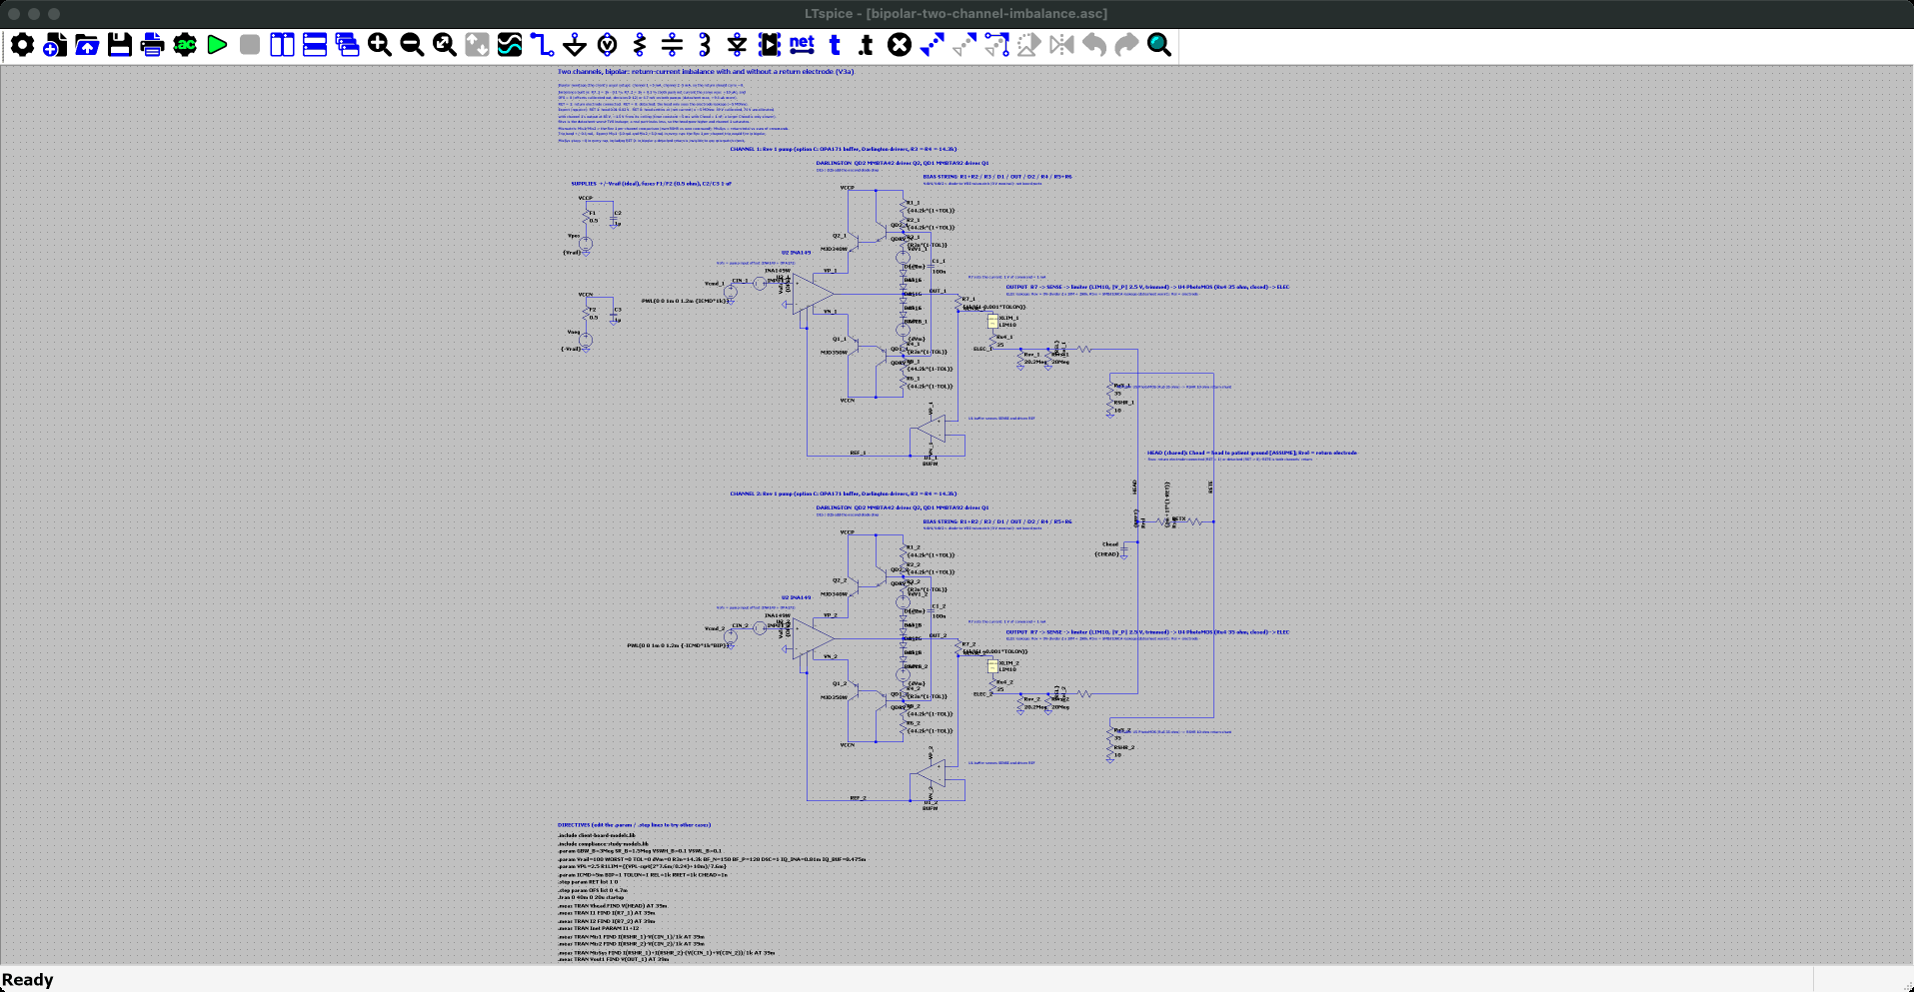
Two channels, bipolar: return-current imbalance (V3a): the schematic
Reproduce in LTspice · 1 of 2 · bipolar-two-channel-imbalance.asc
Where
SPICE_SIM/
1-safety-model/
shared-return/
bipolar-two-channel-imbalance.asc
Open it
1. Start LTspice, then File → Open. Set the file type to "Schematics (*.asc)".
2. Go to SPICE_SIM → 1-safety-model → shared-return.
3. Open bipolar-two-channel-imbalance.asc. It opens zoomed to fit, as in the screenshot.
On the schematic
• Two Rev 1 channels (_1, _2) on one head node: channel 1 at +5 mA, channel 2 at -5 mA.
• RET steps 1 / 0 (return electrode on / off); OFS steps 0 / 4.7 mV (offsets calibrated / datasheet maximum).
Simulation commands on this schematic (4 runs, one per .step combination)
.step param RET list 1 0
.step param OFS list 0 4.7m
.tran 0 40m 0 20u startup
.meas: Vhead, I1, I2, Inet, Mis1, Mis2, MisSys, Vout1

Slide 62
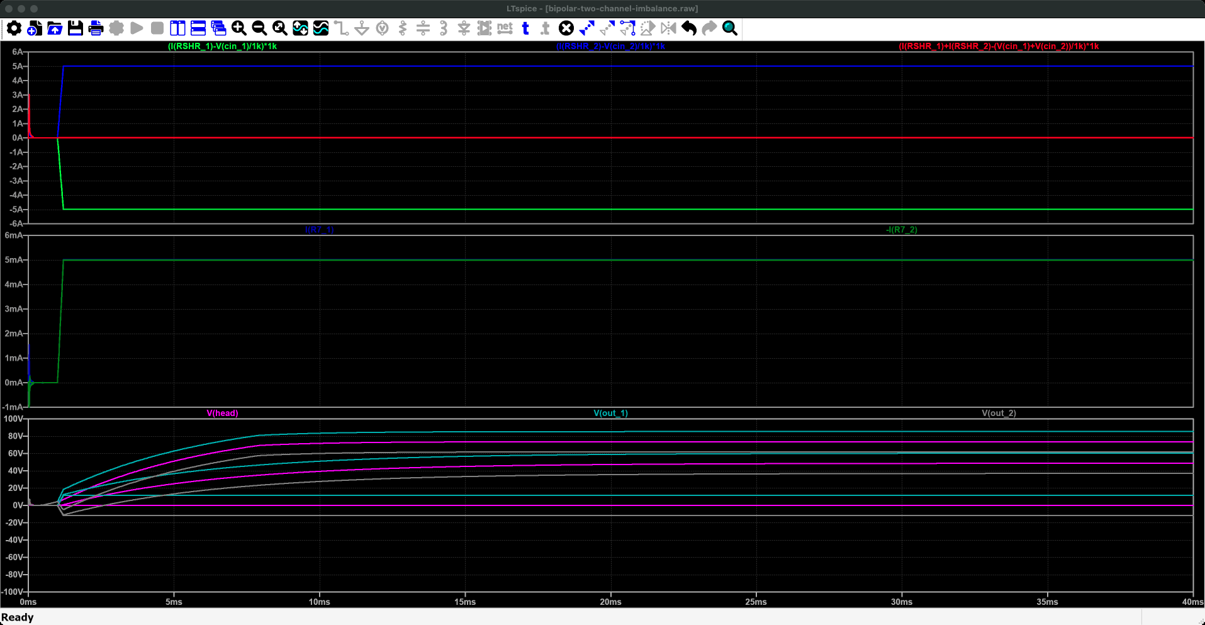
Two channels, bipolar: return-current imbalance (V3a): run it and read the plot
Reproduce in LTspice · 2 of 2 · bipolar-two-channel-imbalance.plt
Run it
1. Press Run (the green ▶ on the toolbar, or Simulate → Run). It takes a few seconds (up to 2 min on older PCs).
2. The waveform window opens with these panes: LTspice reads bipolar-two-channel-imbalance.plt because it sits next to the schematic. If not: Plot Settings → Open Plot Settings File.
3. Numbers: View → SPICE Error Log lists every .meas result, one row per run.
What to read
• Return on: the head stays at 0.01-0.02 V.
• Return off: the head drifts to 48.7 V (offsets calibrated) or 73.6 V (datasheet-max offsets); channel 1's output reaches 85 V, near its ceiling.
• Per-channel mismatch Mis1/Mis2 = ∓5 mA in every run: Rev 1's per-channel trip would fire at once with a shared return (open decision D-19).
What you are looking at: Two channels drive one head, one pushing 5 mA in, the other pulling 5 mA out; time runs 0-40 ms. Bottom pane: the voltage of the head and of each channel's output. With the return electrode on they stay near zero; with it off the head drifts up to 49-74 V. Middle pane: the two channel currents (both 5 mA). Top pane: what each channel's mismatch check would see (±5 mA) and what a whole-system check would see (about 0).
Why it matters: Real channels never cancel exactly, so without a return electrode the head drifts high; per-channel checks cannot work with a shared return.
Traces (bipolar-two-channel-imbalance.plt, panes from the top) 1: (I(RSHR_1)-V(cin_1)/1k)*1k, (I(RSHR_2)-V(cin_2)/1k)*1k, (I(RSHR_1)+I(RSHR_2)-(V(cin_1)+V(cin_2))/1k)*1k 2: I(R7_1), -I(R7_2) 3: V(head), V(out_1), V(out_2)

Slide 63
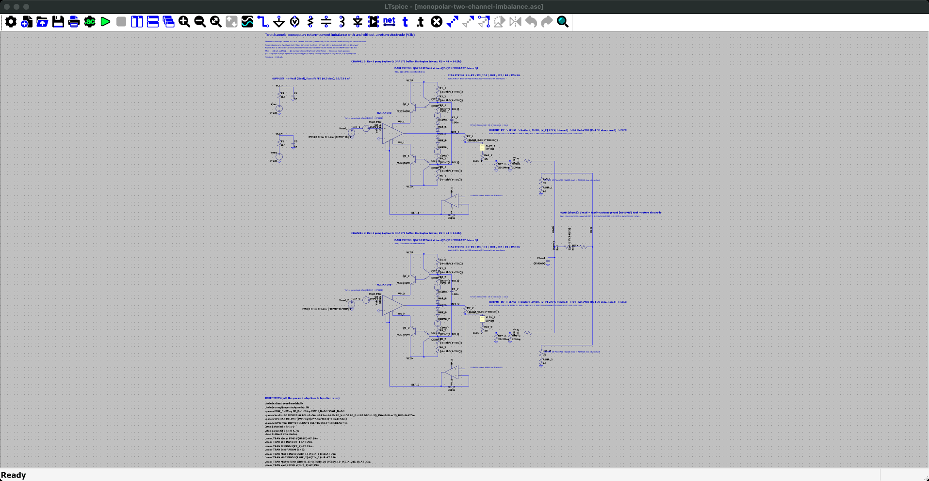
Two channels, monopolar: return-current imbalance (V3b): the schematic
Reproduce in LTspice · 1 of 2 · monopolar-two-channel-imbalance.asc
Where
SPICE_SIM/
1-safety-model/
shared-return/
monopolar-two-channel-imbalance.asc
Open it
1. Start LTspice, then File → Open. Set the file type to "Schematics (*.asc)".
2. Go to SPICE_SIM → 1-safety-model → shared-return.
3. Open monopolar-two-channel-imbalance.asc. It opens zoomed to fit, as in the screenshot.
On the schematic
• Same two channels; channel 1 at +5 mA, channel 2 at 0.
• RET steps 1 / 0, OFS 0 / 4.7 mV.
Simulation commands on this schematic (4 runs, one per .step combination)
.step param RET list 1 0
.step param OFS list 0 4.7m
.tran 0 40m 0 20u startup
.meas: Vhead, I1, I2, Inet, Mis1, Mis2, MisSys, Vout1

Slide 64
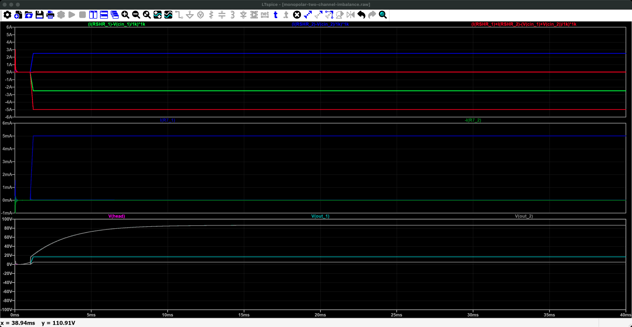
Two channels, monopolar: return-current imbalance (V3b): run it and read the plot
Reproduce in LTspice · 2 of 2 · monopolar-two-channel-imbalance.plt
Run it
1. Press Run (the green ▶ on the toolbar, or Simulate → Run). It takes a few seconds (up to 2 min on older PCs).
2. The waveform window opens with these panes: LTspice reads monopolar-two-channel-imbalance.plt because it sits next to the schematic. If not: Plot Settings → Open Plot Settings File.
3. Numbers: View → SPICE Error Log lists every .meas result, one row per run.
What to read
• Return on: the head sits at 5.1 V (5 mA × 1 kΩ return) and both channels regulate.
• Return off: channel 1 saturates near 87 V and its current collapses to about 17 µA.
• System-level mismatch MisSys = -5 mA when the return is off: it would catch this; per-channel mismatch reads ∓2.5 mA with the return on (a false trip).
What you are looking at: One channel pushes 5 mA into the head, the other is idle; time runs 0-40 ms. Bottom pane: the head voltage. With the return on it sits at about 5 V; with it off it climbs to about 87 V, as high as the channel can go. Middle pane: channel 1's current, which collapses when the head is that high. Top pane: the mismatch checks.
Why it matters: With nowhere for the current to go, the channel saturates; a whole-system mismatch check sees this, -5 mA.
Traces (monopolar-two-channel-imbalance.plt, panes from the top) 1: (I(RSHR_1)-V(cin_1)/1k)*1k, (I(RSHR_2)-V(cin_2)/1k)*1k, (I(RSHR_1)+I(RSHR_2)-(V(cin_1)+V(cin_2))/1k)*1k 2: I(R7_1), -I(R7_2) 3: V(head), V(out_1), V(out_2)

Slide 65
Next steps
# | Task | Why | Target date | Status
1 | Follow-up analysis: quantify the gain from further pump optimization, including −10 % supply and minimum β | Prove A1 holds at the worst case, not only nominal | Before sim review (~31 Oct) | Done: deck 3 (needs Darlington drivers)
2 | Measure transistor gain (β) on the client's board at 5 and 10 mA | Cheapest way to know where real boards land | Before 31 Oct | Open
3 | Fill in the four simulation slides | Evidence for each claim in this document | ~31 Oct | Done: this deck, from the behavioural model and deck 4
4 | Design trip logic, limiter trim and PhotoMOS stage | Layered protection (A4), mismatch trip (A5) | Before PCB order | Done in simulation: deck 4
5 | Present the return-electrode design and questions to the client | One shared return (A3); inputs for Rev 2 | Next client meeting | Open
6 | Order Rev 1 PCBs | Bring-up 18-28 Nov; DR1 29 Nov / 1 Dec | 8-10 Nov | Released to schematic and PCB (deck 4)

Slide 66
Open questions and assumptions
Item | Current assumption | How to confirm | Owner
Electrode montages the client will run | Bipolar mastoid pairs; four independent sites possible | Ask the client | Client
Maximum total current in the return | Not yet defined (20 mA with four channels at +5 mA) | Ask the client | Client
Return electrode site and size | Forehead or back of the neck; large and gelled | Ask the client | Client
Head + electrode capacitance | ≈ 1 µF (order of magnitude) | Bench measurement on dummy and human electrodes | Team
Supply regulation | ±10 % of 100 V | Power board design | Power
Transistor cooling | θJA ≈ 50 °C/W with a 300 mm² copper pour | Thermocouple at bring-up | Team
Patient leakage limits | IEC 60601-1 applies | Look up and verify the figures before quoting | Team

Slide 67
References
Chen A, Kuo C, Blouin J-S (2022). A portable and low-cost solution for real-time manipulation of the vestibular sense. J Neurosci Methods 382:109709. doi:10.1016/j.jneumeth.2022.109709
Forbes PA, Kwan A, Mitchell DE, Blouin J-S, Cullen KE (2023). The neural basis for biased behavioral responses evoked by galvanic vestibular stimulation in primates. J Neurosci 43(11):1905-1919. doi:10.1523/JNEUROSCI.0987-22.2023
Kwan A, Forbes PA, Mitchell DE, Blouin J-S, Cullen KE (2019). Neural substrates, dynamics and thresholds of galvanic vestibular stimulation in the behaving primate. Nat Commun 10:1904. doi:10.1038/s41467-019-09738-1
Vöröslakos M, et al. (2018). Direct effects of transcranial electric stimulation on brain circuits in rats and humans. Nat Commun 9:483. doi:10.1038/s41467-018-02928-3
Caldwell J. A high-voltage bidirectional current source. Texas Instruments app note SLYY054.
Datasheets: TI INA149 (SBOS579B), OPA171, TLE2141 (SLOS183E); TI TPS25221 product page; Microchip DN2540; onsemi MJD340/MJD350.
Project sources: Miro board (frames named on slide 2); "JY063 STIM Rev 1 Optimized Design"; simulation deck "Howland Current Pump Simulation" v4.

