Slide 2
Course Agenda
 | Introduction & Course Concept | Workshop 1 (03.07.2024)
1 | Development Environment & IDE | Workshop 1 (03.07.2024)
2 | Recap: C++ Syntax & Language Elements | Workshop 2 (04.07.2024)
3 | Software Design & Patterns | Workshops 3, 4 (28.08.2024, 04.09.2024)
4 | Modern C++ Concepts | Workshops 5, 6 (02.10.2024, 09.10.2024)
5 | Embedded Software | Workshop 7 (30.10.2024)
6 | Efficient Software Development & Best Practices | Workshop 8 (06.11.2024)
7 | Testing & Code Quality | Workshop 9 (13.11.2024)
 | Latest Trends & Wrap-up | Workshop 10 (??.??.2024)

Slide 3
Workshop 1
1 | Development Environment & IDE
Aachen, July 3, 2024
Lennart Reiher, M.Sc.

Slide 4
Learning Objectives
Get to know the development environments of the course
Gain background knowledge about containerization and remote development
Get started with C++ development in Visual Studio Code
Know details about the compilation process
Learn about C++’s history and relevance

Slide 5
C++ Background
What‘s needed?
Working with JupyterHub
Working with Visual Studio Code – Remote Containers
Step-by-Step Compilation
Working with Visual Studio Code – Extensions, Tasks, Debugging
Wrap-up

Slide 6
C++ Background
What‘s needed?
Working with JupyterHub
Working with Visual Studio Code – Remote Containers
Step-by-Step Compilation
Working with Visual Studio Code – Extensions, Tasks, Debugging
Wrap-up

Slide 7

Agenda Item Title
Slide Title
Standard slide bullets in Arial 20, black, 6pt margin after (if possible space-wise)
Sub-bullets in Arial 18
Bullets may use highlighting through bold font or highlighting of special terms through italic font, preferably without changing the black text color
Icons / pictograms in blue, if used
Inline code snippets in Consolas 20 like so: int x = 1; initializes an integer named x
All code is to be copy-pasted from VS Code in Light Modern color theme
Spaces before and after code snippets should also be set to Consolas
For non-C++ code snippets, simply use black color like so: git fetch

Slide 8

Template
Code Blocks
Code blocks follow the template on this slide: at least Consolas 12, may also be larger
All code is to be copy-pasted from VS Code in Light Modern color theme
All code must be formatted with our formatter and adhere to our basic coding style guidelines
File name in top right corner is optional, only to be used if needed for understanding
If code snippet is a little longer / more complex, there should be a self-contained demo in the Git repository, referenced by the orange bar at the slide’s bottom
StateMachine.cpp
class StateMachine {
public:
StateMachine() : state_(State::Unconfigured) { // [...] } // [...]
void configure() { // [...] } // [...]
private:
State state_;
}; class PointCloudObjectDetection : public StateMachine {
public:
PointCloudObjectDetection(const std::string& inference_server_address) : StateMachine(State::Unconfigured) { // [...] }
void connectToInferenceServer() { // [...] }
private:
std::string inference_server_address_;
};
stdout / stderr output window, if needed
May be positioned anywhere where there is space, preferably in the code box like this
demos/11_inheritance/11a_basic-inheritance

Slide 9






Template
Callouts
You may use callout lines for highlighting good practices, bad practices, etc.
They should in general not require more space than standard bullets
Good practice
Bad practice
Caution
Note
Task
Will be covered in later lecture
Multiple lines …
… may look like this

Slide 10
Template
Demos in general
If we are switching to a demo (lecturer leaving PPT), use the demo badge at the bottom
Demo | Hello World

Slide 11
Template
Demos with documentation/code in Git
If we are switching to a demo (lecturer leaving PPT) that is documented in the Git repository (potentially including code), use the demo badge with Git logo and demo name at the bottom
demos/01_hello-world

Slide 12
Template
Demos on Compiler Explorer
If we are switching to a demo (lecturer leaving PPT) on Compiler Explorer, use the demo badge with Git logo, demo name and link at the bottom
demos/01_hello-world https://compiler-explorer.ika.rwth-aachen.de/z/TPEh8v

Slide 13
Template
Exercises in general
Similar to demo badges
Use standard bullets (enumeration possible) on slide to explain exercise
Connect VS Code on your computer to your development container on our server
Open the repository in VS Code
Open a terminal and check the compiler version: clang --version
Exercise | Visual Studio Code Connection

Slide 14
Template
Exercises with documentation/code in Git
Similar to demo badges
exercises/03_golden-ratio

Slide 15
Template
Exercises on Compiler Explorer
Similar to demo badges
exercises/03_golden-ratio https://compiler-explorer.ika.rwth-aachen.de/z/TPEh8v

Slide 16
Template
Homework in general
Similar to demo badges
Use standard bullets (enumeration possible) on slide to explain homework
Do this
Do that
Homework | State Machine

Slide 17
Template
Homework with documentation/code in Git
Similar to demo badges
Homework | State Machine

Slide 18
Template
All demo / exercise / homework badges for reference
Demo | Hello World
demos/01_hello-world
demos/01_hello-world https://compiler-explorer.ika.rwth-aachen.de/z/TPEh8v
Exercise | Visual Studio Code Connection
exercises/03_golden-ratio
exercises/03_golden-ratio https://compiler-explorer.ika.rwth-aachen.de/z/TPEh8v
Homework | State Machine
Homework | State Machine
Homework | State Machine

Slide 19
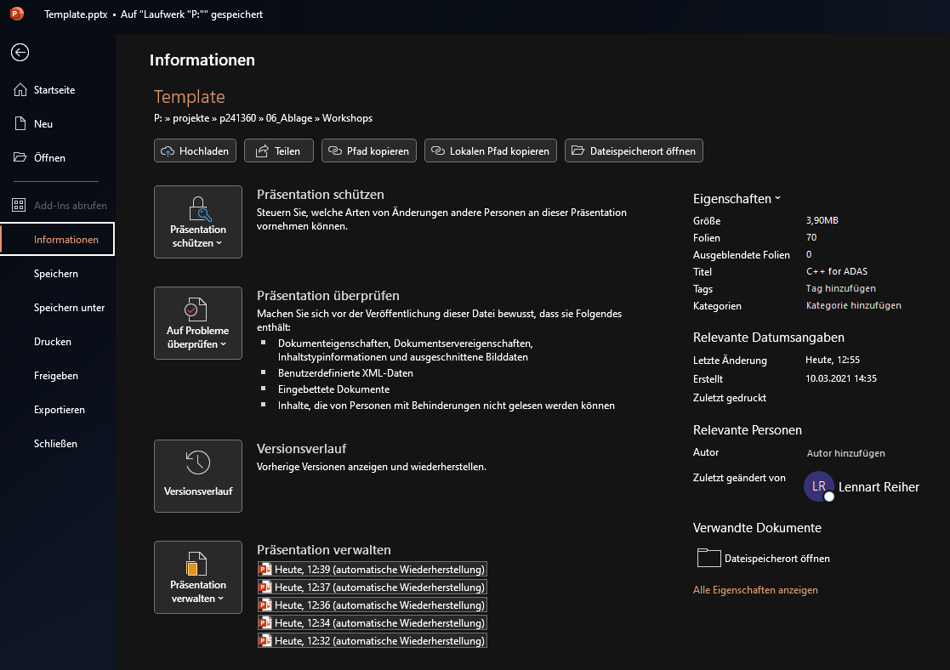
Template
Title of exported PDF
Make sure to manually set the title of the PPT file to its filename
This title will be shown in a PDF reader once exported

Slide 21
C++ Background
What‘s needed?
Working with JupyterHub
Working with Visual Studio Code – Remote Containers
Step-by-Step Compilation
Working with Visual Studio Code – Extensions, Tasks, Debugging
Wrap-up

Slide 22
Wrap-up
Learning Objectives
Get to know the development environments of the course
Gain background knowledge about containerization and remote development
Get started with C++ development in Visual Studio Code
Know details about the compilation process
Learn about C++’s history and relevance

Slide 23
Wrap-up
Homework
…
Homework | State Machine

Slide 24
Wrap-up
Course Agenda
 | Introduction & Course Concept | Workshop 1 (03.07.2024)
1 | Development Environment & IDE | Workshop 1 (03.07.2024)
2 | Recap: C++ Syntax & Language Elements | Workshop 2 (04.07.2024)
3 | Software Design & Patterns | Workshops 3, 4 (28.08.2024, 04.09.2024)
4 | Modern C++ Concepts | Workshops 5, 6 (02.10.2024, 09.10.2024)
5 | Embedded Software | Workshop 7 (30.10.2024)
6 | Efficient Software Development & Best Practices | Workshop 8 (06.11.2024)
7 | Testing & Code Quality | Workshop 9 (13.11.2024)
 | Latest Trends & Wrap-up | Workshop 10 (??.??.2024)

Slide 25


Introduction & Course Concept
Development Environment & IDE
Workshop 1
Q & A
Aachen, July 3, 2024
Lennart Reiher, M.Sc.
Feedback

