Slide 2
Course agenda
 | Introduction & Course Concept | Workshop 1
1 | Development Environment & IDE | Workshop 1
2 | Recap: C++ Syntax & Language Elements | Workshop 2
3 | Software Design & Patterns | Workshops 3, 4
4 | Modern C++ Concepts | Workshops 5, 6
5 | Embedded Software | Workshop 7 (today)
6 | Efficient Software Development & Best Practices | Workshops 8, 9
7 | Testing & Code Quality | Workshops 9, 10
 | Wrap-Up & Conclusion | Workshop 10

Slide 3
Workshop 7
Embedded Software
Aachen, October 30, 2024
Gergely Bilkei-Gorzo, M.Sc.

Slide 4
Learning Objectives
At the end of this lecture, you will…
Have a basic knowledge about embedded systems
Know how to use specific hardware modules to increase program efficiency
Learn about different memory regions and how to map variables into them
Know the basics about coding standards and AUTOSAR
Get an introduction about real-time operating systems

Slide 5
Embedded Systems
Architectures
Parallel Computing
Comparison of different Embedded CPUs
Memory Types and Linking
Stack, Heap and Exceptions
AUTOSAR Guidelines
RTOS

Slide 6
Embedded Systems
Architectures
Parallel Computing
Comparison of different Embedded CPUs
Memory Types and Linking
Stack, Heap and Exceptions
AUTOSAR Guidelines
RTOS

Slide 7

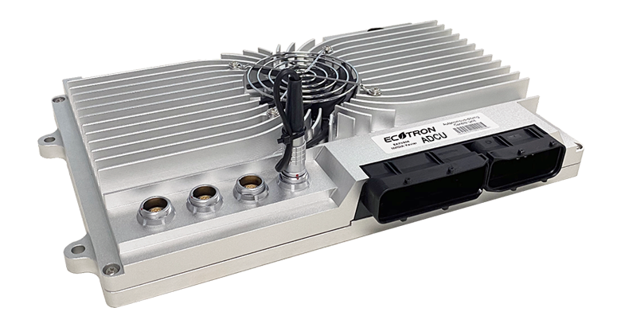
Embedded Systems
Introduction
Embedded Systems are computer systems with cpu, memory, io that are integrated into a technical system to fullfill specific functions
No specific standard that defines the exact definition of an embedded system
Key features:
Specialized in functionality
In most cases Real-time Operation capable
Limited resources
Common examples:
Smartphones
Wearables
Automotive ECU-s
Source: www.samsung.com
Source: ecotron.ai

Slide 8
Embedded Systems
Differences to programming for PC
Developing Software for Embedded differs from developing for PC-s in different aspects:
Memory management
Resource allocation
Available resources
Hardware interaction
Operating System
Compiler behavior
Hardware architecture dependent variables
Debugging
For safety critical application some C++ features should not be used

Slide 9
Embedded Systems
Architectures
Parallel Computing
Memory Types and Linking
Stack, Heap and Exceptions
AUTOSAR Guidelines
RTOS

Slide 10
Architectures
Computer Architectures
Von-Neumann-Architecture
Shared memory for data and programs
Still used by most computer systems today
Advantage: Optimal utilization of memory
Disadvantage: Performance reduction due to competing data and instruction accesses
Harvard-Architecture
Separation of program memory and data memory
Advantage: Simultanious access to data memory and program memory
Disadvantage: Poor memory utilization with uneven memory usage
Super-Harvard-Architecture
Mostly for special application with high data throughput
Additional IO controller and cache for program instructions

Slide 11
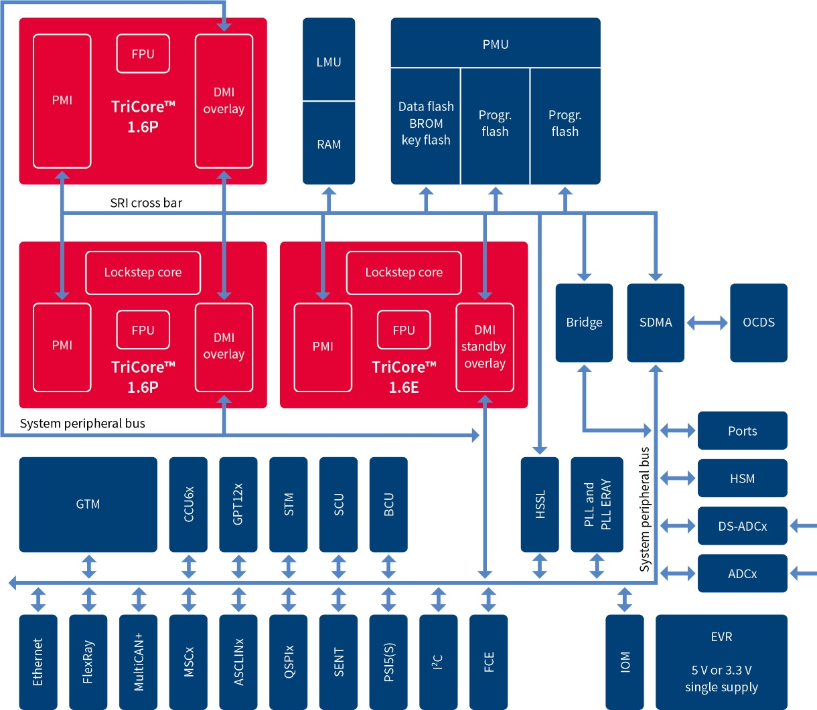
Architectures
Example: Infineon AURIX Example
Based on the Harvard-Architecture with separate Program Memory and Data Memory
Depending on the variant multiple CPU cores, each with ist own Data and Program Memory
Separate LMU RAM as shared memory for data exchange between CPU cores
Separate Program and Data Flash for persistent/inital data values and program code
Communication with Flash, Shared Memory, Memory of other CPU cores via crossbar
Peripherals accessible via System peripheral bus
Supports common periperals:
Bus Interffaces: CAN, FlexRay, Ethernet
GPIO: General Purpose In/Out (Digital)
ADC: Analog Inputs
PWM Module: Generates PWM for Motor Control Applications
GTM: Timer Module for precise time triggered events
Source: www.infineon.com
Notes:
LMU -> Local Memory Unit
SRI -> Shared Resource Interconnect

Slide 12
Architectures
Instruction Set Architectures
The instruction set architecture is an interface between the hardware and the software. It defines the following properties of a CPU:
Instruction Set: Defines the available machine code operations a CPU can execute
MOV, ADD, SUB, JMP
Instruction Format: defines the layout of an instruction in memory,
Data Types: defines the data types and their sizes the cpu supports
Int32, Int64, Float32, Float64
Registers: defines the the number and type of registers available in the cpu
Register size, Amount of registers, register types, special registers
Memory Addressing Modes: defines methods by which instructions can adress memory
Access via register, using offset from current instruction
Interrupt and Exception Handling: defines how the processor handles interrupts and exceptions
Interrupts triggered by external events, exceptions caused by unexpected conditions (out of range memory access, division by zero)

Slide 13
Architectures
Instruction Set Architectures
Most instruction set Architectures can be divided into two types:
CISC (Complex Instruction Set Computer)
RISC (Reduced Instruction Set Computer)
Feature | CISC | RISC
Instruction Complexity | Complex, multi-step instructions | Simple, single-step instruction
Instruction Execution Time | Variable, often multi-cycle | Typically single-cycle
Memory Access | Can operate directly on memory | Load/store architecture (separate memory ops)
Instruction Length | Variable | Fixed
Code Density | More compact, fewer instructions | Less compact, more instructions
Power Consumption | Higher | Lower
Hardware complexity | Higher, hardware decodes complex instructions | Lower, most instructions are hardwired control logic
Real-World Examples | x86 | ARM, RISC-V, MIPS

Slide 14
Architectures
Assembly
Assembler Language:
Assembler is a machine-oriented programming language:
no longer written by hand in most applications today (special cases with severely limited hardware resources or other special requirements)
Without precise specialist knowledge, assembler code written by hand is often worse than code generated by modern compilers from higher programming languages.
Assembler is closely related to machine code, each assembler instruction is a specific bit sequence in machine code
The example on the right shows an assembler code example for calculating a Fibonacci sequence for x86 Architecture

Slide 15
Architectures
CPU Modules
CPU Units:
A CPU consists of at least three different logical units:
Control Unit: manages the execution flow, fetches and decodes instructions, coordinates between other parts of the CPU like memory, execution unit or I/O
Execution Unit (ALU): Performs arithemtic, logical and data operations. Uses general-purpose registers to hold data during program execution on which operations can be performed
Storage: Persistent storage for program code and static/initial values of variables need to be available as well as memory for variable values during runtime.
Additional Units:
Many CPU-s use additional units to increase computing performance and efficiency for specific operations.
Floating Point Unit (FPU): Handles floating-point arithmehtic on hardware level
Vector Unit (SIMD/AVX): Handles vectorized instructions that can execute operations on multiple data points simultaniously
DSP Unit: Handles signal processing tasks on hardware level like applying filters
Graphics Processing Units (GPU): Handles graphics workload and general-purpose computations like AI or machine learning tasks that are optimized for parallel execution

Slide 16
Architectures
Example: Tricore AURIX CPU Registers
32 32-bit General-Purpose Registers
Holds adresses and values
2 32-bit Status Registers (PCXI, PSW)
Contain status flags, previous execution and protection information
Program Counter (PC)
Contains the memory adress of the next instruction
A15
D15
PCXI
A14
D14
PSW
A13
D13
PC
A12
D12
A11
D11
A10
D10
A9
D9
A8
D8
A7
D7
A6
D6
A5
D5
A4
D4
A3
D3
A2
D2
A1
D1
A0
D0
Adresses
Data
System

Slide 17
Embedded Systems
Architectures
Parallel Computing
Comparison of different Embedded CPUs
Memory Types and Linking
Stack, Heap and Exceptions
AUTOSAR Guidelines
RTOS

Slide 18
Parallel Computing
Parallel Computing Classification
Flynn´s taxonomy: classification of parallel computing systems into four major categories
SISD – Single instruction, single data system
Traditional single CPU computers
MISD – Multiple instruction, single data system
Pipelined computers
Instruction Pool
Instruction Pool
Data Pool
Processor
Data Pool
Processor
MIMD – Multiple instruction, multiple data system
Multi computers, Multiprocessors
SIMD – Single instruction, multiple data system
Vector processors, parallel computers
Instruction Pool
Instruction Pool
Processor
Processor
Processor
Data Pool
Data Pool
Processor
Processor
Processor
Processor

Slide 19
Parallel Computing
Vector Module
SIMD can execute the same operation on multiple data, reducing the amount of neccessary operations
Only the same type of operation can be executed on all data in one cycle
Data is stored as a vector of multiple scalar values.
SIMD registers support different data types of different sizes
Within a single operation and vector, all data types must be the same
The number of data that can be handled within a single operation depends on the register size and data type
Vector modules only support a limited set of variable types and limited types of operations depending on the variable type
One vector module contains multiple vector registers, for example AVX2 has 16 256 bit registers
Common examples for SIMD: MMX, SSE, AVX
Scalar Operation
SIMD Operation
A₀
+
B₀
=
C₀
A₀
B₀
C₀
A₁
+
B₁
=
C₁
A₁
B₁
C₁
+
=
A₂
+
B₂
=
C₂
A₂
B₂
C₂
A₃
B₃
C₃
A₃
+
B₃
=
C₃
128 bit register
2 x 64 bit
4 x 32 bit
8 x 16 bit
16 x 8 bit

Slide 20

Parallel Computing
Vector Module Exercise
In this excercise we will modify an image by using standard C/C++ instructions and by using AVX2 instructions to compare the execution speed and the differences in the code
Connect VS Code on your computer to your development container on the server
Open the path sections/05_Embedded-Software/excercises/parallel_computing
This example is a cmake project, it should be built by using the provided CMakeLists.txt
Create a build folder with mkdir build
Switch to this build folder
Create the makefiles using cmake and the CMakeLists.txt in the parent directory with cmake ..
Use make to compile the project
exercises/01_parallel_computing

Slide 21
Parallel Computing
Vector Module Exercise
There is a picture called „car.jpg“ included in the directory. We will load this picture as a vector data in our code and modify the brightness of the picture by adding/subtracting an offset for each pixel
Using the „parallel_computing.cpp“ file, implement the „adjustBrightness()“ function that adds or subtracts the given offset from each pixel value using conventional C/C++ operations.
Implement the „adjustBrightnessAVX2()“ function using AVX2 instructions
AVX supports a limited set of instructions and data type support. In this example we will use uint8 data
Use the following instructions:
_mm256_loadu_si256: Moves integer values from unaligned memory location to a destination vector
_mm256_storeu_si256: Moves values from a integer vector to an unaligned memory location.
_mm256_adds_epu8: Adds the unsigned 8/16-bit integer data elements with saturation of two vectors.
_mm256_subs_epu8: Subtracts the unsigned 8/16-bit integer data elements with saturation of two vectors.
_mm256_set1_epi8: Broadcasts 8-bit integer a to all elements of returned vector.
Once done, you can compare the differences in execution time via the included timer that measures execution time
exercises/01_parallel_computing

Slide 22
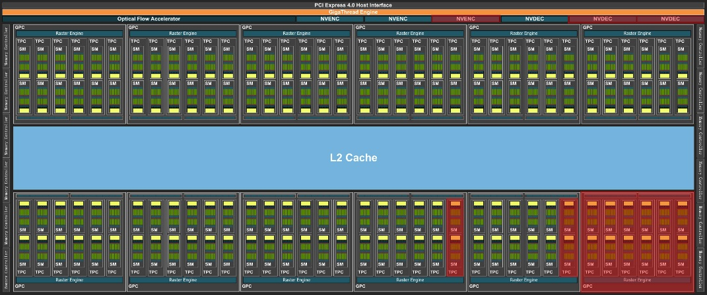
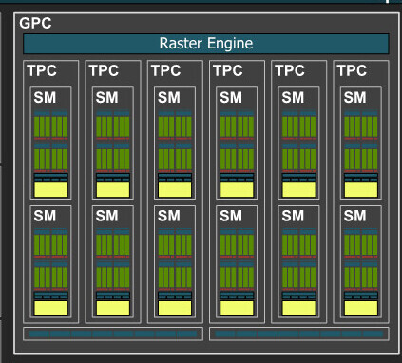
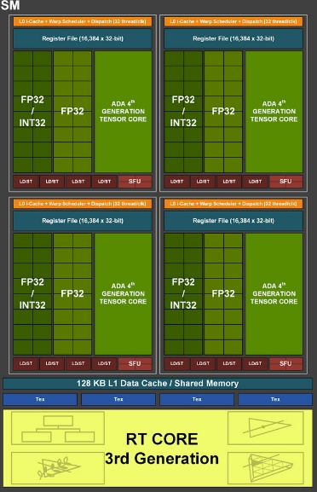
Parallel Computing
Parallel Computing in GPUs
GPUs can be considered as external additional execution units for the CPU. They are highly specialized for parallel execution
Example: Nvidia Ada Lovelace architecture
One GPU contains multiple Graphics Processing Clusters (GPC)
Each GPC contains multiple Streaming Multiprocessors (SM)
Each SM contains 3 types of execution units:
CUDA Cores: General Purpose computation module
Tensor Cores: matrix operation module, particularly for AI and deep learning
RT Cores: Ray tracing acceleration for graphics rendering
Source: www.nvidia.com

Slide 23
Parallel Computing
Parallel Computing in GPUs
CUDA Core:
One core contains one ALU capable of performing either Floating Point or Int operations with 32 bit precision
General-Purpose Module for parallelized computing tasks
Not a typical SIMD implementation, does not use vectors of scalar values to perform operations
CUDA cores are adressed as warps, each containing 32 cores. In a warp each core performs the same operation on different data in parallel. This creates a similar behaviour as in SIMD modules
Register size 32 Bit, no support for vectorized operations, therfore no performance gain for using 16 Bit scalars
Source: www.nvidia.com

Slide 24
Parallel Computing
Parallel Computing in GPUs
Similarly to using vector modules in a CPU, using CUDA cores has specific coding requirements:
Code for CUDA cores needs to be compiled with the nvcc compiler provided by Nvidia
Program code needs to have a specific function with a kernel function that is executed on the CUDA cores and specific function call that calls this function specifing an execution configuration.
__global__ void saxpy(int n, float a, float *x, float *y) // function to be executed on CUDA cores
{
int i = blockIdx.x*blockDim.x + threadIdx.x;
if (i < n) y[i] = a*x[i] + y[i];
}
int main(void)
{
...
cudaMemcpy(d_y, y, N*sizeof(float), cudaMemcpyHostToDevice);
// Perform SAXPY on 1M elements
saxpy<<<(N+255)/256, 256>>>(N, 2.0f, d_x, d_y);
cudaMemcpy(y, d_y, N*sizeof(float), cudaMemcpyDeviceToHost);
...
}
Notes:
Cuda_function<<<numBlocks, threadsPerBlock>>>(input, output);

Slide 25
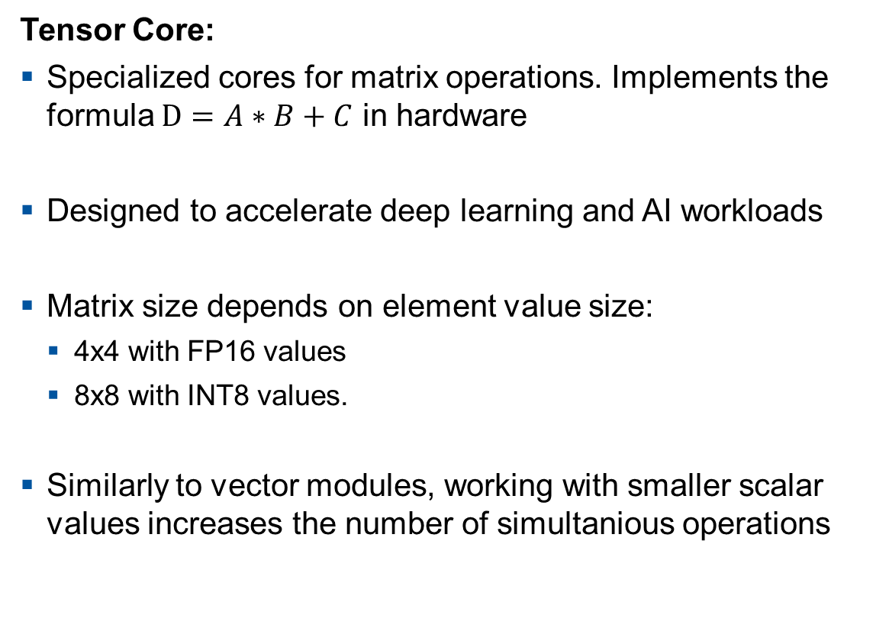
Parallel Computing
Parallel Computing in GPUs
Tensor Core:
Specialized cores for matrix operations. Implements the formula $D=A∗B+C$ in hardware
Designed to accelerate deep learning and AI workloads
Matrix size depends on element value size:
4x4 with FP16 values
8x8 with INT8 values.
Similarly to vector modules, working with smaller scalar values increases the number of simultanious operations
A_{0,0}
A_{0,1}
A_{0,2}
A_{0,3}
B_{0,0}
B_{0,1}
B_{0,2}
B_{0,3}
C_{0,0}
C_{0,1}
C_{0,2}
C_{0,3}
D =
A_{1,0}
A_{1,1}
A_{1,2}
A_{1,3}
B_{1,0}
B_{1,1}
B_{1,2}
B_{1,3}
+
C_{1,0}
C_{1,1}
C_{1,2}
C_{1,3}
*
A_{2,0}
A_{2,1}
A_{2,2}
A_{2,3}
B_{2,0}
B_{2,1}
B_{2,2}
B_{2,3}
C_{2,0}
C_{2,1}
C_{2,2}
C_{2,3}
A_{3,0}
A_{3,1}
A_{3,2}
A_{3,3}
B_{3,0}
B_{3,1}
B_{3,2}
B_{3,3}
C_{3,0}
C_{3,1}
C_{3,2}
C_{3,3}
FP16
FP16
FP16 or FP32

Slide 26
Embedded Systems
Architectures
Parallel Computing
Comparison of different Embedded CPUs
Memory Types and Linking
Stack, Heap and Exceptions
AUTOSAR Guidelines
RTOS

Slide 27
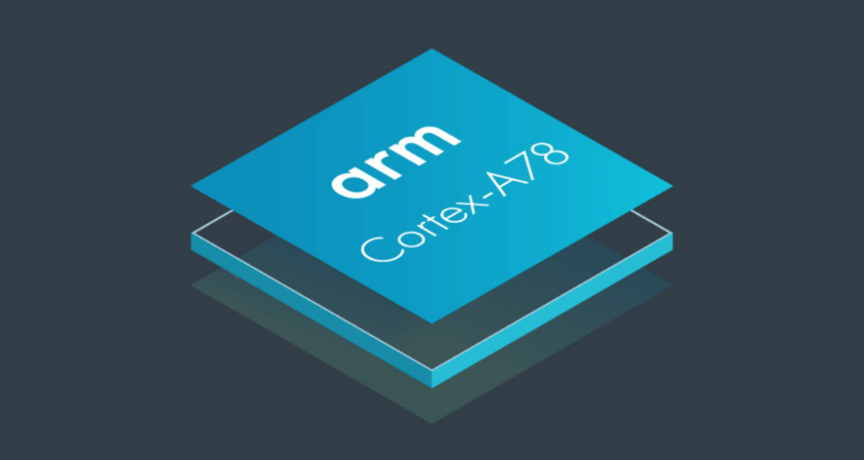
Comparison of different Embedded CPUs
ARM Cortex A78
ARM Cortex A78
High performance CPU for mobile devices such as smartphones
Focus on general-purpose computing, balancing performance, power efficiency and scalability
Instruction microarchitecture: ARMv8-A
SIMD functionality with ARM NEON module (128bit)
FPU for 32 and 64 bit floating-point operations
Supports Out-of-Order Execution and Branch Prediction mechanisms
Cache based Memory System
Source: www.arm.com

Slide 28
Comparison of different Embedded CPUs
Comparison of Trixore AURIX and ARM Cortex A78
Feature | Infineon Aurix TC3XX | ARM Cortex-A78
Architecture | Infineon Tricore (Modified RISC) | ARMv8-A
Max CPU clock | 300 MHZ | 3.3 GHZ
CPU count | 1-6 | 4-24
SIMD capability | None (DPS Module) | NEO SIMD Vector Unit
Real-time capability | Deterministic behaviour for real-time applications | Non-deterministic behaviour due to multilevel cache and branch prediction
Memory structure | Small on-chip ram, optimized for low latency | External DRAM, multilevel Cache
Memory size | 152 KB to ~7 MB | External and extendable, typically multiple GB
Safety certification | ASIL-D | None (Automotive variant with up to ASIL-D available)

Slide 29
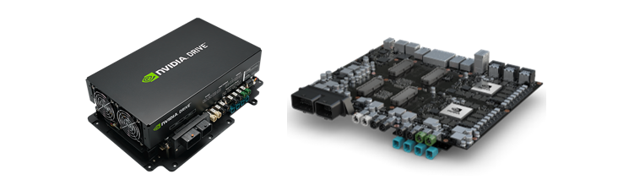
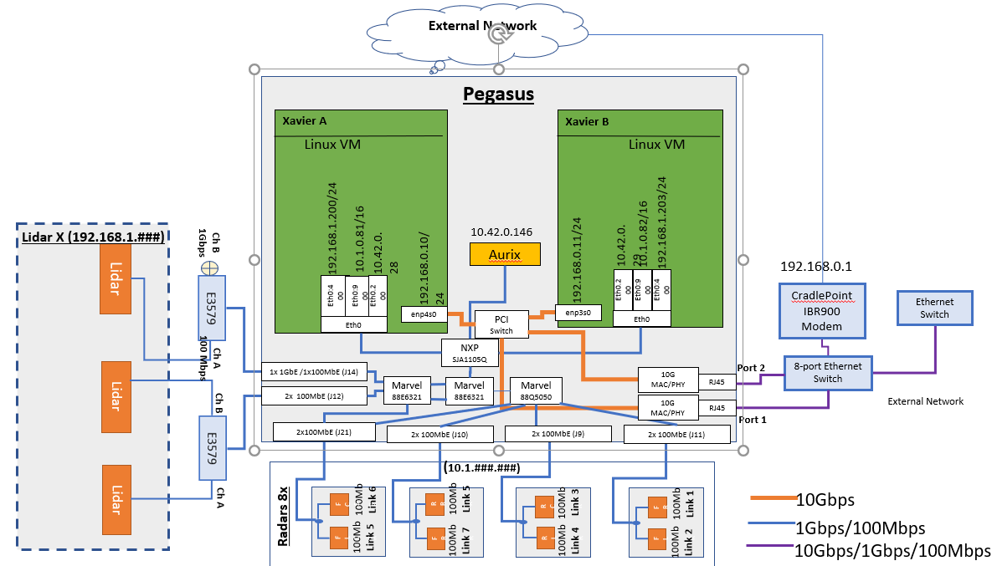
Comparison of different Embedded CPUs
Nvidia Dirve AGX Orin SoC
Nvidia Drive AGX Orin:
System-on-a-Chip integrating a GPU and CPU in one Chip
Combines an Ampere based GPU with 2048 Compute Unified Device Architecture (CUDA) cores and 64 Tensor cores and an Nvidia Caramel CPU containing 12 ARM Cortex A78 cores
One Drive AGX unit can contain multiple Orin SoC-s to deliver increased computing performance
Unit includes an Infineon Aurix Controller for safety critical tasks such as supervising autonomous driving, sensor fusion and handling faults.
Performance of one Orin SoC:
87 TOPS (INT8) Deep Learning Accelerators
167 TOPS (INT8) 5.2 TOPS (FP32)
Source: www.nvidia.com

Slide 30
Comparison of different Embedded CPUs
Computing Power Comparison between the 3 Chips
Performance Comparison of the presented Chips:
Processor | Single-Precision Performance (32-bit) | Double-Precision Performance (64-bit) | Requirements
Infineon AURIX TC3xx | ~300 MFLOPS per core | ~150 MFLOPS per core | -
ARM Cortex-A78 | ~10 GFLOPS per core | ~5 GFLOPS per core | Using the NEO SIMD Unit
NVIDIA Orin SoC | ~17.1 TFLOPS (combined CPU + GPU) | ~580 GFLOPS (combined CPU + GPU) | Using the NEO SIMD Unit + Using CUDA and tensor cores
Infineon AURIX is much slower than the other alternatives but is the only chip capable to fulfill both hard real time requirements and ASIL-D safety
Both ARM Cortex-A78 and Orin SoC can only achieve their maximum computing performance, if the task can utilize their computing modules efficiently

Slide 31
Embedded Systems
Architectures
Parallel Computing
Comparison of different Embedded CPUs
Memory Types and Linking
Stack, Heap and Exceptions
AUTOSAR Guidelines
RTOS

Slide 32
Memory Types and Linking
Storage Types Overview
Overview of the storage types found in embedded systems:

Slide 33
Memory Types and Linking
Common Storage Types
Commonly used Storage technologies in Embedded systems:
Flash Memory:
electrically erasable non-volatile memory
Used for program code and initial/static values
Not modified during operation, only during firmware update or as error state storage
Data Memory:
Volatile memory
Used to store the current value of a static or global variable
Stores heap/stack
Program Memory (optional):
Volatile memory
Used to store program code that needs to be accessed with shorter access times
Performance critilcal code needs to be copied from Flash to the RAM at startup

Slide 34
Memory Types and Linking
Example: Tricore AURIX Memory Adresses
Aurix TC3xx uses physical memory adressing
Memory adresses are 32bit values
Some regions are not used or not available on all variants
Caching is enabled/disabled by accessing the same physical memory via different adresses
Peripheral registers are also accessed by specific memory adresses
0000 0000_{H} – 0FFF FFFF_{H}
Reserved
1000 0000_{H} – 1001 7FFF_{H}
CPU5 Data Scratch-Pad
1001 8000_{H} – 1001 BFFF_{H}
CPU5 Data Cache
1001 C000_{H} – 100B FFFF_{H}
Reserved
100C 0000_{H} – 100C 17FF_{H}
CPU5 Data Cache TAG
100C 1800_{H} – 100F FFFF_{H}
Reserved
1010 0000_{H} – 1010 FFFF_{H}
CPU5 Program Scratch-Pad
1011 0000_{H} – 1011 7FFF_{H}
CPU5 Program Cache
1011 8000_{H} – 101B FFFF_{H}
Reserved
101C 0000_{H} – 101C 2FFF_{H}
CPU5 Program Cache TAG
101C 3000_{H} – 1FFF FFFF_{H}
Reserved
…
8000 0000_{H} – 802F FFFF_{H}
Program Flash 0
8030 0000_{H} – 805F FFFF_{H}
Program Flash 1
…
9000 0000_{H} – 9000 FFFF_{H}
dLMU CPU0
9001 0000_{H} – 9001 FFFF_{H}
dLMU CPU1
…
9004 0000_{H} – 9007 FFFF_{H}
LMU0
9008 0000_{H} – 900B FFFF_{H}
LMU1
…
F000 0000_{H} – FFC1 FFFF_{H}
Peripheral registers
Example memory addreses of an Aurix TC3xx controller

Slide 35

Memory Types and Linking
Reminder: Compiling and Linking
#include <iostream>
int main() {
std::cout << "Hello World!" << std::endl;
return 0;
}
“Hello World!”

Slide 36
Memory Types and Linking
Reminder: Compiling and Linking
# | Name | Command | Description
1 | Preprocessing | clang++ –E hello.cpp –o hello.i | Expands macros and included header files
2 | Compilation | clang++ –S hello.i –o hello.s | Translates high-level C++ code to low-level, platform-dependent, but still human-readable assembly instructions
3 | Assembly | clang++ –c hello.s –o hello.o | Produces binary machine code; not yet executable
4 | Linking | clang++ hello.o –o hello | Combines object file with necessary libraries and resolves symbol references; produces final executable
5 | Execution | ./hello | Runs the program
1-4 | „Compilation“ | clang++ hello.cpp –o hello | Combines all compilation steps into one single command

Slide 37
Memory Types and Linking
Reminder: Compiling and Linking
# | Name | Command | Description
1 | Preprocessing | clang++ –E hello.cpp –o hello.i | Expands macros and included header files
# 1 "hello.cpp"
# 1 "<built-in>" 1
# 1 "<built-in>" 3
# 404 "<built-in>" 3
# 1 "<command line>" 1
# 1 "<built-in>" 2
# 1 "hello.cpp" 2
# 1 "/usr/bin/../lib/gcc/x86_64-linux-gnu/11/../../../../include/c++/11/iostream" 1 3
# 37 "/usr/bin/../lib/gcc/x86_64-linux-gnu/11/../../../../include/c++/11/iostream" 3
# 1 "/usr/bin/../lib/gcc/x86_64-linux-gnu/11/../../../../include/x86_64-linux-gnu/c++/11/bits/c++config.h" 1 3
# 278 "/usr/bin/../lib/gcc/x86_64-linux-gnu/11/../../../../include/x86_64-linux-gnu/c++/11/bits/c++config.h" 3
namespace std
{
typedef long unsigned int size_t;
typedef long int ptrdiff_t;
// plus 30.000+ more lines
#include <iostream>
int main() {
std::cout << "Hello World!" << std::endl;
return 0;
}

Slide 38
Memory Types and Linking
Reminder: Compiling and Linking
# | Name | Command | Description
2 | Compilation | clang++ –S hello.i –o hello.s | Translates high-level C++ code to low-level, platform-dependent, but still human-readable assembly instructions
# 1 "hello.cpp"
# 1 "<built-in>" 1
# 1 "<built-in>" 3
# 404 "<built-in>" 3
# 1 "<command line>" 1
# 1 "<built-in>" 2
# 1 "hello.cpp" 2
# 1 "/usr/bin/../lib/gcc/x86_64-linux-gnu/11/../../../../include/c++/11/iostream" 1 3
# 37 "/usr/bin/../lib/gcc/x86_64-linux-gnu/11/../../../../include/c++/11/iostream" 3
# 1 "/usr/bin/../lib/gcc/x86_64-linux-gnu/11/../../../../include/x86_64-linux-gnu/c++/11/bits/c++config.h" 1 3
# 278 "/usr/bin/../lib/gcc/x86_64-linux-gnu/11/../../../../include/x86_64-linux-gnu/c++/11/bits/c++config.h" 3
namespace std
{
typedef long unsigned int size_t;
typedef long int ptrdiff_t;
// plus 30.000+ more lines
.text
.file "hello.cpp"
.section .text.startup,"ax",@progbits
.p2align 4, 0x90 # -- Begin function __cxx_global_var_init
.type __cxx_global_var_init,@function
__cxx_global_var_init: # @__cxx_global_var_init
.cfi_startproc
# %bb.0:
pushq %rbp
.cfi_def_cfa_offset 16
.cfi_offset %rbp, -16
movq %rsp, %rbp
.cfi_def_cfa_register %rbp
leaq _ZStL8__ioinit(%rip), %rdi
callq _ZNSt8ios_base4InitC1Ev@PLT
movq _ZNSt8ios_base4InitD1Ev@GOTPCREL(%rip), %rdi
leaq _ZStL8__ioinit(%rip), %rsi
leaq __dso_handle(%rip), %rdx
// 100 lines in total

Slide 39

Memory Types and Linking
Reminder: Compiling and Linking
# | Name | Command | Description
3 | Assembly | clang++ –c hello.s –o hello.o | Produces binary machine code; not yet executable
.text
.file "hello.cpp"
.section .text.startup,"ax",@progbits
.p2align 4, 0x90 # -- Begin function __cxx_global_var_init
.type __cxx_global_var_init,@function
__cxx_global_var_init: # @__cxx_global_var_init
.cfi_startproc
# %bb.0:
pushq %rbp
.cfi_def_cfa_offset 16
.cfi_offset %rbp, -16
movq %rsp, %rbp
.cfi_def_cfa_register %rbp
leaq _ZStL8__ioinit(%rip), %rdi
callq _ZNSt8ios_base4InitC1Ev@PLT
movq _ZNSt8ios_base4InitD1Ev@GOTPCREL(%rip), %rdi
leaq _ZStL8__ioinit(%rip), %rsi
leaq __dso_handle(%rip), %rdx
// 100 lines in total

Slide 40
Memory Types and Linking
Reminder: Compiling and Linking
# | Name | Command | Description
4 | Linking | clang++ hello.o –o hello | Combines object file with necessary libraries and resolves symbol references; produces final executable

Slide 41
Memory Types and Linking
Reminder: Compiling and Linking
# | Name | Command | Description
5 | Execution | ./hello | Runs the program
“Hello World!”

Slide 42
Memory Types and Linking
Data Sections
*.c/
*.cpp
Compiler
*.c/
*.cpp
Assembler
*.c/
*.cpp
Linker
*.c/
*.cpp
*.c/
*.cpp
*.c/
*.cpp
ELF
executable
*.c/
*.cpp
*.s
*.o
Compiler creates Assembly files, that contain Assembler instruction and section directives depending on the type
Assembler translates Assembly to machine code and creates sections according to the section directives. The output of this step is the object file
Linker links the different object files and optionally included external libraries into one single file. It also maps the different section into different memory regions according to the linker script directives
Linker
script
System
Libraries
Init Data
Initial value is known during compile time, but changes during runtime. Value is stored in ROM but copied and accessed in RAM
void f1() { }
Code
Value stored in ROM and executed from ROM. Can optionally copied to RAM for faster execution
void main()
{
…
}
.text
.data
int var1 = 0xAF34;
char msg[10] = „hello“;
int xxx() { }
struct stat st = {0};
.bss
Non init Data
Data has no defined initial value. These sections are not stored in ROM, they are accessed from RAM during runtime. Values are filled with 0 at initialization.
int vec[10] = {0};
Constant Data
Value is known at compile time and does not change during runtime. Stored and accessed in ROM
struct {int x, y, z;}= { 0, 0, 0, }
.rodata
const int BFZE = 1024;
const char *str = „…“;
COMMON
char buffer[1024];
int value;

Slide 43
Memory Types and Linking
Virtual vs Physical Memory Management
Physical memory Mapping vs Virtual Memory:
Most embedded systems map code directly to the physical memory adresses of the system. Memory map is static and predefined in the firmware
PC-s and high performance embedded systems use a Memory Management Unit with an Operating System supporting virtual memory management.
Program execution with virutal memory management:
Loader loads the executable from disk to memory, sets up the programs virtual adress space
Memory Management Unit with the Operating System maanges the mapping between virtual address space and the physical memory. Memory is divided into small fixed block sizes called pages. Operating System maintains page tables to map virtual adresses to physical adresses
At application start, only the essential amount of data is loaded into the physical memory. The rest is only loaded once it is needed. This is called demand paging.
Dynamic Memory Management like growing stack and heap can request more memory at runtime
More virtual memory can be reserved than available physical memory. If the physical memory is full, currenty unaccessed pages are written to disk into a page file. If this memory is needed again, it generates a page fault and the OS loads the needed pages back to the physical memory
Once the program has been terminated, the virtual space adress is invalidated, and the physical memory is freed that was reserved for this application

Slide 44
Memory Types and Linking
Virtual vs Physical Memory Management
Memory Protection:
Physical Memory Access:
On Embedded System with direct access to physical memory there is no memory protection, unless specifically implemented and configured
The programmer is responsible to not access and modify memory regions outside of the accessed variable and cause potential memory corruption. Alternatively, if supported by the controller, memory protection rules can be manually configured.
Virtual Memory Access:
Physical memory access is handled by the Operating System and MMU.
Each executable has its own memory space, an executable can not access another executables memory
Memory corruption is still possible but only within the executable

Slide 45
Memory Types and Linking
Linker Script Example
Linker Script contents:
Memory Definitions: defines the adress and size of the available memory regions on the system
Linkerscript.ld
memory dspr0 // Data Scratch Pad Ram
{
mau = 8;
size = 112k;
type = ram;
map (dest=bus:tc0:fpi_bus, dest_offset=0xd0000000, size=112k, priority=1, exec_priority=0); // for access over FPI Bus
map (dest=bus:sri, dest_offset=0x70000000, size=112k); // For access over SRI bus (external cores)
}
memory pflash0 // Program Flash 0
{
mau = 8;
size = 2M;
type = rom;
map cached (dest=bus:sri, dest_offset=0x80000000, size=2M, reserved); // cached access to PFLASH
map not_cached (dest=bus:sri, dest_offset=0xa0000000, size=2M); // non-cached access to PFLASH
}
Notes:
FPI -> Fast Peripheral Interconnect
SRI -> Shared Resource interconnect

Slide 46
Memory Types and Linking
Linker Script Example
Sections: defines how the different parts of the program are organized in memory. Each section in the linker script corresponds to a section in the object files (.text, .data, .bss,…). Also defines the location of the Interrupt and Trap vectors.
Linkerscript.ld
#ifndef INTTAB
#define INTTAB 0xa00f0000 /* start address of interrupt table */
#endif
#ifndef TRAPTAB
#define TRAPTAB (INTTAB + 0x6000) /* start address of trap table */
#endif
section_layout :vtc:linear
{
group not_cached (run_addr=mem:mpe:lmuram/not_cached)
{
select "(.bss.main|.bss.main.*)";
select "(.data.main|.data.main.*)";
select "(.bss.objectpool|.bss.objectpool.*)";
select "(.data.objectpool|.data.objectpool.*)";
select "(.rodata.objectpool|.rodata.objectpool.*)";
}
}

Slide 47
Memory Types and Linking
Linker Script Example
Entry Point: the entry point defines where the program starts executing
Linkerscript.ld
#ifndef RESET
#define RESET 0xa0010000 /* internal flash start address tc0 */
#endif
#ifndef __LINKONLY__
start_address
(
run_addr = (RESET),
symbol = "_START"
);
#endif

Slide 48
Memory Types and Linking
Linker Script Example
Stack and Heap Setup: defines the memory regions for heap and stack
Linkerscript.ld
section_layout :vtc:linear (direction = low_to_high) // heap memory area for freeRTOS
{
group freertos_heap0 (ordered, run_addr = mem:mpe:dspr0[0x6440]) //0x70006440UL
{
reserved "protected0" (alloc_allowed=absolute, size = 0x0000);
}
}
section_layout :tc0:csa // context save area/stack for core0
{
group (ordered, align = 64, attributes=rw, run_addr=(CSA_START_TC0))
reserved "csa_tc0" (size = 64 * (CSA_TC0));
"_lc_ub_csa_01" := "_lc_ub_csa_tc0"; /* common cstart interface for first or single core */
"_lc_ue_csa_01" := "_lc_ue_csa_tc0"; /* common cstart interface for first or single core */
}

Slide 49
Memory Types and Linking
Linker Script Example
On multicore embedded systems like the Infineon AURIX, it is the programmers responsibility to optimize memory access to global/static variables
These variables should be in the data memory of the core that executes the program code containing these variables
Linkerscript.ld
section_setup :vtc:linear
{
modify input (space = mpe:tc0:linear)
{
select "(.bss.tasks|.bss.tasks.*)";
select "(.bss.mem.ram_heap|.bss.mem.ram_heap.*)";
select "(.bss.os_common|.bss.os_common.*)";
select "(.bss.timers|.bss.timers.*)";
select "(.bss.list|.bss.list.*)";
select "(.bss.ptpd|.bss.ptpd.*)";
select "(.data.tasks|.data.tasks.*)";
select "(.data.os_common|.data.os_common.*)";
select "(.data.timers|.data.timers.*)";
select "(.bss.port|.bss.port.*)";
select "(.data.port|.data.port.*)";
select "(.data.ptpd|.data.ptpd.*)";
}
}

Slide 50
Memory Types and Linking
Linker Script Example
This excercise demonstrates the use of a linker script in a software project
Connect VS Code on your computer to your development container on the server
Open the path sections/05_Embedded-Software/excercises/linker_script
To use the provided default linkerscript „linkerscript.ld“ we need to compile with a directive to the linker to use this script:
clang++ main.cpp -o main -Wl,-T,linkerscript.ld -Wl,-Map=output.map
This directive tells the linker to use “linkerscript.ld” and also to generate a map file where we can observe where the sections in the code have been linked
After testing the default settings, try to modify the linkerscript in a way that both our variables are mapped to a memory address offset by 0x1000 from the original adress
exercises/02_linker_script

Slide 51
Embedded Systems
Architectures
Parallel Computing
Comparison of different Embedded CPUs
Memory Types and Linking
Stack, Heap and Exceptions
AUTOSAR Guidelines
RTOS

Slide 52
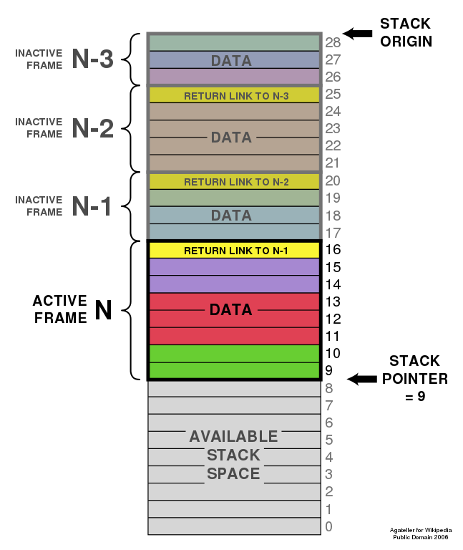
Stack, Heap and Exceptions
Reminder: Stack
What happens, when we declare a variable like int x;?
Memory is allocated for the variable on the RAM
More specifically, static memory is allocated on the stack
The stack works like a stack of paper
New data is put on top of the stack
Data no longer needed can only be removed from the top
The stack pointer stores where the current „top“ is
Each scope allocates a new frame in the stack, that is deleted when the scope is closed
Notes:
https://de.wikipedia.org/wiki/Datei:ProgramCallStack2_en.svg

Slide 53
Stack, Heap and Exceptions
Stack Contents
Contents of the Stack:
When a function is called, the state and the return point of the current function needs to be saved.
Stack is saved in a designated area in RAM
Every time a new function is called, a new stack frame is created. The stack frame contains the following items:
Local variables
Function parameters
Return address
Saved registers
Stack uses a Last In – First Out structure, when a function returns, the contents of the caller functions are restored
Memory for Stack has to be preallocated. In embedded systems, a worst case stack size estimation needs to be made. Insufficient available stack size causes stack overflow error.
Previous Stack Frame
Local Variables of current function
Function parameters
Saved Register Values
Return Address
Stack Pointer
Example of a stack data structure

Slide 54
Stack, Heap and Exceptions
Stack Overflow Demo
On x86 Systems with virtual memory, a stack overflow is detected by the operating system
Program that causes the stack overflow is terminated, the rest of the system remains unaffected
On many embedded systems such memory protection is not available, stack overflow can corrput other running tasks and the operating system
The following demo demonstrates a stack overflow in the development environment running a linux system with virtual memory
Default stack size for an application is 8MiB on Linux, 1MiB on Windows
demos/01_stack_overflow

Slide 55
Stack, Heap and Exceptions
Example: Stack Structure of Infineon AURIX
Stack on the Infineon AURIX controller:
On AURIX Controllers the stack structure consists of two components:
Context Save Area: Stores core specific registers:
General-purpose registers
Program counter
Processor status
Stack pointer
Stack: Stores all other information:
Local variables
Function call parameters
Return adresses
This structure allows for faster store/restore CPU state operation during context switch due to not having to manage this information on the regular stack. It also increases reliability by separating CPU context from function data.

Slide 56
Stack, Heap and Exceptions
Linked List Stack
Linked list stack example:
start
start
data
next
data
next
data
next
NULL
1862
24
2248
87
1024
15
NULL
7720
7720
1862
2248
1024
Push 15
Pop (Remove 24)
start
data
next
start
data
next
data
next
1024
15
NULL
2248
87
1024
15
NULL
7720
1024
7720
2248
1024
Push 87
Pop (Remove 87)
start
data
next
data
next
start
data
next
2248
87
1024
15
NULL
1024
15
NULL
7720
2248
1024
7720
1024
Push 24
Pop (Remove 15)
start
data
next
data
next
data
next
start
1862
24
2248
87
1024
15
NULL
NULL
7720
1862
2248
1024
7720

Slide 57

Stack, Heap and Exceptions
Reminder: Heap
Going back to the stack: What can we do, if we don’t know the size of an object at compile time?
Use the heap
The heap is another (usually large) memory block, inside which programs can dynamically allocate and deallocate memory
It has no idea of scopes, so we have to take care of deallocation as well
Using the heap explicitly is error-prone and thus discouraged.
Luckily, modern C++ offers many ways to avoid having to do so.
Notes:
Example: Array of unknown size
Possibility 1: Use an array that large, that it will be enough for any usage ➔ inefficient!
Possibility 2: Use the heap

Slide 58
Stack, Heap and Exceptions
Reminder: Heap
As space for objects on the heap is only generated at runtime, these never exist as plain objects (which would be created on the stack at compile-time), but only as pointers!
More advanced would be the usage of multi-dimensional arrays, which we will not cover, as we shouldn’t use them anyway.
int *p = new int; // Allocates space for a single int on the heap
*p = 17; // Now use p as a normal int pointer.
int *q = new int(17); // Short version
delete p,q; // Important: Don’t forget to delete heap objects
int *pa = new int[4]; // Allocate space for an array on the heap
// Now, size doesn’t need to be known at compile time
delete [] pa; // Delete this with the array delete operator
Notes:
https://de.wikipedia.org/wiki/Datei:ProgramCallStack2_en.svg

Slide 59

Stack, Heap and Exceptions
Heap on Embedded
On embedded with no virtual memory, a part of the physical memory is reserved for heap
Size of this memory area needs to be specified before building the program
Dynamic memory allocation in c is part of the stdlib library:
malloc() and calloc() for reserving space
realloc() for reallocating a reserved block of memory to another location
free() for releasing allocated memory
C++ provides an abstraction layer for managing dynamic memory
Maximum heap size required for the program needs to be determined before program is released, so that no heap overflow occurs during normal operation

Slide 60
Stack, Heap and Exceptions
Interrupts
Interrupt is a signal to the CPU from a hardware or software component that needs immediate attention
Interrupts halt the the current execution and switch to a specual routine called Interrupt Service Routine (ISR). This handles the task that needs to be done when the specific interrupt is triggered
Interrupts can be generated by hardware modules or software
Hardware Interrupts: Caused by an electronic signal from an external hardware module
Examples: Timer event, I/O event, new message from a bus network
Software Interrupts: Interrupt signal triggered by software
Examples: Managing inter-process-communication in an operating system, software implemented timer, thread synchronization
Interrupts have assignable priorities on most hardware architectures, where higher priority interrupts are handled first
Pointer addresses to the corresponding ISR-s are stored in the Interrupt Vector Table.

Slide 61
Stack, Heap and Exceptions
Interrupts
Interrupt execution steps:
Hardware or software module triggers an interrupt signal
Similarly to function calls, a context switch is performed. Current context including Program Counter and CPU register content is saved on the stack
The Program Counter jumps to the corresponding adress of the triggered interrupt by fetching the adress from the interrupt vector table
The Interrupt Service Routine is executed
CPU returns from interrupt by popping the stack and restoring the previous context that was executed before the interrupt

Slide 62
Stack, Heap and Exceptions
Traps
Traps are a special type of interrupts. They are exclusively software generated.
Traps are synchronous, they occur as a direct result of a executing an instruction in a program
In most cases, traps have a higher priority than interrupts
Traps are typically used for exception handling, they are triggered when a condition occurs during execution that the CPU can not resolve normally.
Similarly to Interrupts, a trap vector table contains pointers to the trap handlers that are executed when the given trap occurs.

Slide 63
Stack, Heap and Exceptions
Traps
Examples of traps:
Division by Zero error: program attempts to divide by zero
Page fault: access to an invalid memory address
Protection traps: access to protected memory or peripheral adresses
User triggered trap: system call
Similarly to interrupts, when a trap occurs, the trap handler is called by fetching its adress from the trap vector table for the corresponding trap
Trap handling depends on the type:
System call is a user triggered trap to give the operating system control over the executing context. Usually used for scheduling.
Faults: The trap handler is able to potentially recover the issue
Aborts: the error is not recoverable, trap handler aborts program execution. It can additionally log the trap for debugging purposes

Slide 64
Stack, Heap and Exceptions
Startup Sequence
Embedded Systems require startup configuration before they can execute user code:
Depending on Controller: Setting the oscillator frequency and multiplier for the correct core clock speed
Setting the interrupt vector table adress
Setting the trap vector table adress
Setting the stack adress
Setting the heap adress
Setting the start vector where the user code starts
Initializing RAM sections (initializing init data, setting uninit data to 0)
Initializing the C/C++ library
This code is called the startup code
Many chip vendors provide development environments with an IDE where startup code and debugging capabilities are already preconfigured and set up.

Slide 65
Embedded Systems
Architectures
Parallel Computing
Comparison of different Embedded CPUs
Memory Types and Linking
Stack, Heap and Exceptions
AUTOSAR Guidelines
RTOS

Slide 66

AUTOSAR Guidelines
Coding Standards
Coding Standards:
Coding standards AUTOSAR (AUTomotive Open System ARchitecture) and MISRA (Motor Industry Software Reliability Association) were developed to increase the quality of embedded software systems for safety critical applications
Coding guidelines help avoid coming programming mistakes that can lead to dangerous bugs such as:
Undefined behaviours
Memory corruption
Concurrency issues
These guidelines also aim to increase maintainability und readability of the code
AUTOSAR:
No appropiate coding standard exist for C++11 and 14 for safety critical software at the time of ist release
Latest MISRA guideline at that time was for C++ 2008
In 2019 it was announced that later releases of MISRA will incorporate AUTOSAR coding guidlines, a separate AUTOSAR guidline will not be released anymore
Newest MISRA guideline for C++ 23 incorporates AUTOSAR guidelines as well
Source: www.misra.org.uk
Source: www.autosar.org

Slide 67
AUTOSAR Guidelines
Memory Management
Dynamic Memory management:
Dynamic memory is a flexible tool to extend the lifecycle of objects outside of the functions where it is created. It also introduces additional challenges and risks, therefore static allocation should be prefered if possible.
AUTOSAR defines various guidelines for dynamic memory management usage:
Memory leaks: Avoid memory leaks by using the RAII design pattern for memory allocation and release. Explicitly calling new and delete operators is prohibited to force programmers the use of manager objects.
Memory fragmentation: Memory allocator used in the project needs to avoid memory fragmentation
Invalid memory access: C-style functions malloc/calloc/realloc are prohibited as they are not type safe and to not use constructors and destructors. Memory allocator needs to guarantee that objects do not overlap in the memory
Erroneous memory allocations: Application program needs to define the maximum amount of dynamic memory it needs. It must not run out of memory during faultless execution. Dynamic memory should be pre-allocated before the run-time phase of the program.
Not deterministic execution time of memory allocation and deallocation: Memory allocator needs to guarantee that memory allocation and deallocation are executed in a defined time constraint. Time constraint needs to meet the maximum reaction time of the real-time system.

Slide 68
AUTOSAR Guidelines
Deterministic Behaviour
Safety critical applications are mostly systems with hard real-time requirements, operations with non-deterministic runtime need to be avoided to guarantee response-time constraints are met in every condition
Dynamic_cast: relies on runtime type information, which causes a performance overhead. Additional operations can introduce non-deterministic timing
Worst-case execution time: execution time of the program and possible exceptions within the program should be analyzed to make sure mit meets the time constraint requirements.
Dynamic memory management: Dynamic memory allocation and deallocation should guarantee a maximum execution time.
Recursive function calls: Avoid recursive function calls, as it can become difficult for the programmer to keep track of the call depth and the resulting stack size. A potential stack overflow can cause memory corruption and exceptions.
Program termination: Program should not be abruptly terminated, in particular no invocation of std::abort(), std::quick_exit(), std::_Exit(), std::terminate(). This sudden stop of execution is non-deterministic.

Slide 69


AUTOSAR Guidelines
Strong Typing
Variable Types:
Do not use basic numerical types char, int, short, long, as they are architecture/compiler specific.
Use specific-length types from the <cstdint> header. (std::int8_t, std::int16_t,…)
Variable Conversion
Avoid data loss during data type conversion and possible overflow conditions
Constant values should not be explicitly converted from floating to integer
Constant value conversion
Conversion in non constant variable
void Fn() noexcept
{
float f = -4.5;
std::int8_t const x1 = (std::int8_t)(f);
// Non-compliant – conversion in a cvalue
}
void Fn() noexcept
{
float f = -4.5;
std::int8_t x1 = static_cast<std::int8_t>(f);
// Compliant, x1 = -4
}

Slide 70
AUTOSAR Guidelines
Strong Typing
Integer conversion should not lead to data loss. Avoid implicit conversion, casts, overflows, underflows, wrap-arounds.
Overflow:
Range check to avoid overflow
Overflow might occur
std::uint8_t Fn2(std::uint8_t x, std::uint8_t y) noexcept
{
if (x > 100 || y > 100) // Range check
{
throw std::logic_error("Preconditions check error");
}
return (x + y); // Compliant - ranges of x and y
// checked before the arithmetic operation
}
std::uint8_t Function(std::uint8_t x, std::uint8_t y) noexcept
{
return (x + y); // Non-compliant - may lead to overflow
}
Wrap around:
Wrap around may occur
Selected return type avoids wrap around
std::uint8_t Fn4(std::uint8_t x, std::uint8_t y) noexcept
{
return (x * y); // Non-compliant - may lead to wrap-around
}
std::uint16_t Fn4(std::uint8_t x, std::uint8_t y) noexcept
{
return (static_cast<std::uint16_t>(x) * y);
// compliant – uint16_t type is enogh to avoid overflow
}

Slide 71
AUTOSAR Guidelines
Strong Typing
Implicit type conversion:
Implicit type conversion
Type conversion explicitly stated
std::uint16_t speed = 50
std::uint32_t new_speed = speed
// Non-compliant – implicit type conversion
std::uint16_t speed = 50
std::uint32_t new_speed = <static_cast><std::uint32_t>speed // compliant
Unions: Do not use unions, they can have undefined behavior and are platform dependent. The way the data is laid out in memory can vary across different harware architectures
Unions have undefined behavior when they combine different data types
union Intensity{
float floatvalue;
int intvalue;
};
Intensity i;
i.floatvalue = 3.5f; // Make the floatvalue active
std::cout << i.intvalue; // Non-compliant – invalid value

Slide 72
AUTOSAR Guidelines
Global Variable Usage
Global Variable Rules:
Limit the use of global variables to avoid unexpected dependencies
Do not use global and static non-POD type variables
It should be possible to include any header file in multiple translation units without violating the One Definition rule. Header file is not supposed to contain or produce definitions of global object that occupy storage.
Objects of function with external linkage should be declared in the header file
Use functions with local or passed variables whenever possible to increase code clarity and modularity
Define interfaces for functions

Slide 73
Embedded Systems
Architectures
Parallel Computing
Comparison of different Embedded CPUs
Memory Types and Linking
Stack, Heap and Exceptions
AUTOSAR Guidelines
RTOS

Slide 74
RTOS
OS Overview
Operating systems manage hardware and software resources on a system.
On general-purpose computing systems like PC-s always have an operating system to provide general-purpose capabilities.
Most Embedded Systems also use an operating system, bare-metal programming (without any OS) on simple systems also possible
For safety and timing critical automotive applications an operating system is used that garantees that tasks meet the specified time constraints, called Real-Time Operating System (RTOS)
User
Applications
Operating System
Hardware

Slide 75
RTOS
OS vs RTOS Differences
Differences between a general-purpose OS (GPOS) and an RTOS:
Scheduling:
GPOS employs scheduling algorithms like Round Robin, Priority Scheduling, Fair Share. It aims for optimal resource utilization across all tasks but does not garantee specific time constraints or deadlines
RTOS implements a deterministic scheduling like Rate Monotonic Scheduling, Earliest Deadline First. Priority is to ensure that tasks meet their specified deadlines
Interrupt Handling:
GPOS handles interrupts on OS level. Interrupt handling can be delayed by other tasks and does not guarantee a specific reaction time
RTOS can handle interrupts with higher priority, ensuring that high priority interrupts are handled immediately.
Memory Management:
GPOS typically emply dynamic memory management, including virtual memory and paging. It optimizes memory usage, but introduces unpredictability in execution times
RTOS memory management is typically static or minimal to avoid delays and unpredictable behavior. Many RTOS do not use virtual memory management.

Slide 76
RTOS
RTOS Examples
FreeRTOS: open source, MIT license. Currently developed and maintained by Amazon. Used for cost-sensitive automotive application
SafeRTOS: Based on FreeRTOS, but with additional memory safety and higher task separation. ASIL-D certified.
AUTOSAR OS: Specification for a standardised automotive RTOS. Compliant OS are offered by multiple vendors
QNX Neutrino RTOS: ASIL-D Safety certified RTOS, developed by BlackBerry QNX.
Nvidia Drive OS: Hybrid OS, can run both RTOS and general purpose OS environments at the same time. Developed by Nvidia for Nvidia SoC platforms.

Slide 77



Embedded Systems
Workshop 1
Q & A
Aachen, October 30, 2024
Gergely Bilkei-Gorzo, M.Sc.
Feedback

