Slide 2
Course agenda
 | Introduction & Course Concept | Workshop 1
1 | Development Environment & IDE | Workshop 1
2 | Recap: C++ Syntax & Language Elements | Workshop 2
3 | Software Design & Patterns | Workshops 3, 4
4 | Modern C++ Concepts | Workshops 5 (today), 6
5 | Embedded Software | Workshop 7
6 | Efficient Software Development & Best Practices | Workshops 8, 9
7 | Testing & Code Quality | Workshops 9, 10
 | Wrap-Up & Conclusion | Workshop 10

Slide 3
Agenda for Workshop 5 & 6
1 | What is Modern C++?
2 | Templates
3 | STL & Lambda expressions
4 | Smart pointers
5 | Threading
6 | Understanding 3rd-party Code
7 | Challenges compared to MBD
8 | CPP Core Guidelines
9 | Rvalues and Move semantics
 | Wrap-Up
 | Breaks & Lunch Break | on demand

Slide 4
Workshop 5
Modern C++ Concepts
Aachen, September 18, 2024
Fabian Thomsen, M.Sc.

Slide 5
Learning Objectives
At the end of this lecture, you will…
Be able to apply modern C++ concepts to many problems
Know how to write efficient code (not to be confused with “how to write code efficiently”)
Be aware of common pitfalls when using C++
Have become quite a nerd concerning recent C++ functionalities

Slide 7
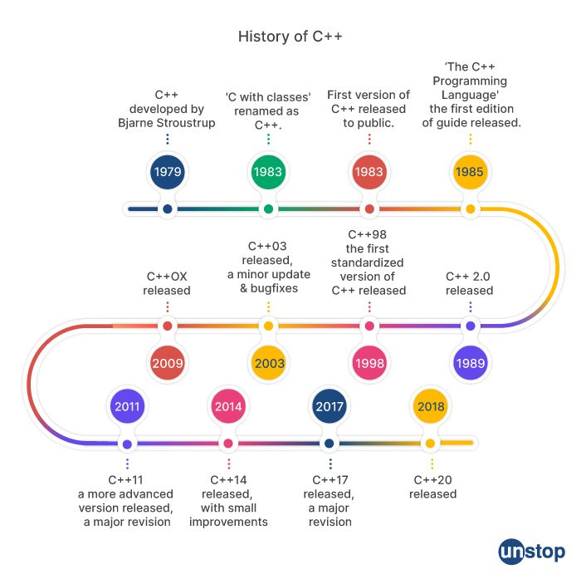
What is modern C++?
History
C was made for efficiency, but hard to program
Early C++ brought improvements in usability by introducing OOP, trying to nearly match C-efficiency
It was still lacking far behind other languages (Java, Python, …) in functionality / User-friendliness
With C++11, many new features were introduced making our work easier. Since then, new versions arrive in a ~3-year-cycle
Since that brought massive efficiency losses, the compiler has gained more and more optimization power at the same time. But we need to know how to program such that the compiler can best optimize our code

Slide 8
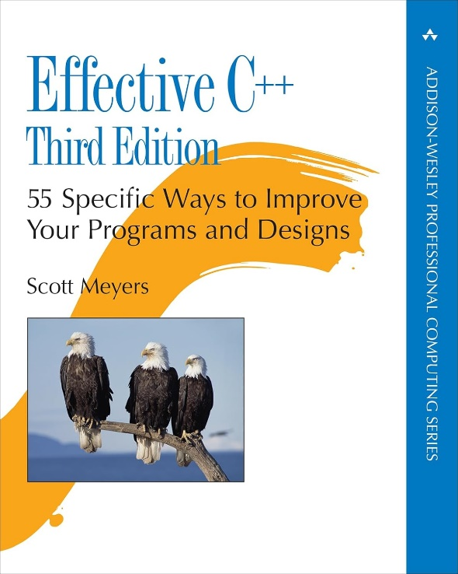

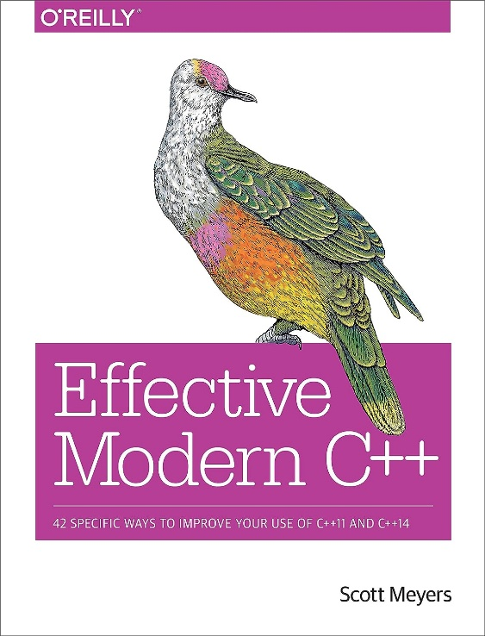

What is modern C++?
Literature
11
14
S. Meyers
Effective C++
ISBN-13: 978-0321334879
S. Meyers
More Effective C++
ISBN-13: 978-0201633719
S. Meyers
Effective Modern C++
ISBN-13: 978-1491903995
Notes:
Smartet Typ – teilt sein Wissen auf 3 Bücher auf, damit man alle kaufen muss

Slide 9
What is modern C++?
Overview of modern features per version
C++11 | Auto & decltype keywords | Simplifies variable declarations by automatically deducing the type from the initializer.
 | Range-based for loops | Allows for cleaner and more readable code when iterating over containers.
 | nullptr | Represents a null pointer, which is safer and more self-explanatory than the older NULL macro.
 | Lambda expressions | Enables you to define simple, anonymous functions directly within your code.
 | Smart pointers | Improved memory management with unique_ptr, shared_ptr, and weak_ptr.
 | Initialization improvements | Uniform initialization syntax using braces {} to initialize variables and objects.
 | static_assert | Compile-time assertions to check for certain conditions and provide helpful error messages.
 | Move semantics | Performance improvements through inhibiting copies of temporary objects
C++14 | Binary literals | More readable binary number representation with the 0b prefix.
 | Digit separators | Single quote (') can be used as a digit separator to improve the readability of large numerics.
 | Generic lambdas | Allows lambda expressions to take auto-typed parameters for more flexible use.
 | Return type deduction | Simplifies function declaration by automatically deducing the return type from the function body.
C++17 | Structured bindings | Simplify the process of unpacking values from tuples, pairs, or other aggregate types.
 | if and switch with init | Cleaner syntax for initializing a variable and using it within an if or switch statement.
 | constexpr if | Enables compile-time branching based on constant expressions, simplifying template metaprogramming.
 | std::optional | Represents an optional value, useful for functions that may or may not return a value.
 | std::filesystem | Provides a portable and user-friendly API for file and directory operations, replacing platform-specific APIs.
 | std::variant | Represents a type-safe union, which can hold different types of values.
C++20 | Concepts | Enables you to define and constrain template parameters, making your code more readable.
 | Ranges | Introduces a new library for working with ranges and simplifying common operations on containers.
 | Coroutines | A new way to write asynchronous and non-blocking code using co_await, co_yield, and co_return.
 | Lambdas with template params | Allows lambda expressions to have template parameters, providing more flexibility.
 | Modules | Improves build times and encapsulation by providing a new way to organize and share code between translation units.
Notes:
Overview slide. DON’T GO INTO DETAIL!

Slide 10



Templates
Recap
Remember our overloaded versions of the max function
We also need overloads for double, all integral types, unsigned versions…
All of these will have the exact same code ➔ inefficient!
We can define a function template from which the compiler will generate concrete functions if needed
max.cpp
int max(int a, int b){
if (a > b) return a;
return b;
}
float max(float a, float b){
if (a > b) return a;
return b;
}
template <typename T>
T max(T a, T b){
if (a > b) return a;
return b;
}
Now!
Templates are a vital part to modern C++. In a future lecture, we will cover them in detail.
Notes:
Old slide from lecture 2 ➔ We now go into detail about templates

Slide 11

Templates
Introduction
Templates let us define a family of
Functions
Classes
Types
Variables
based on a list of parameters.
Whenever arguments are provided for the parameters, a specialization of the template is automatically generated. Class and variable templates allow partial specialization.
When the specialization is used in a way that resembles a normal function/class/…, the concrete instance of the template is generated.
The definitions of templates must be visible at the point of instantiation, often simply in header files
11
14

Slide 12
Templates
Function templates
Definition
template <typename T> // or template <class T>
const T& mymin(const T& a, const T& b) { // This name avoids a disambiguity with std::min
return a < b ? a : b;
}
template <typename T>
std::ostream& operator<<(std::ostream& os, const std::vector<T>& v) {
os << "[";
for (int i{0}; i < v.size() - 1; ++i) {
os << v[i] << ", ";
}
os << v.back() << "]";
return os;
}

Slide 13
Templates
Function templates
Usage
std::cout << mymin(3, 4) << std::endl;
std::cout << mymin(3.14, 2.71) << std::endl;
std::cout << mymin(std::string{"hello, "}, std::string{"world"}) << std::endl;
std::vector<int> v{1, 2, 3, 4, 5};
std::cout << v << std::endl;
std::vector<std::vector<double>> M{{1.1, 2.2, 3.3}, {4.4, 5.5, 6.6}};
std::cout << M << std::endl;
We could also explicitly call a specific template specialization with mymin<double>(3, 4). If we don’t do that, the types are deduced. The rules for that are very complicated, see Cppreference, but usually generate the desired behavior, so we don’t have to think too much about it.

Slide 14


Templates
Function templates
(Full) Specialization
template<>
const std::string& mymin<std::string>(const std::string& a, const std::string& b) {
return a.length() < b.length() ? a : b;
}
The specialization must be defined after the general version
The <std::string> can be omitted due to automatic type deduction
Writing a template specialization instead of declaring a new function has the advantage that other algorithms using the template will automatically also know all specializations. This is especially useful if we write a specialization for a template defined in 3rd party code. Also, the template gives us more type safety as automatic type conversions are not applied to the parameters.

Slide 15
Templates
Function templates
Explicit instantiation
template const long& mymin<long>(const long&, const long&);
The explicit instantiation lets the compiler generate code for a variant of the template without it being used in the code. It is often confused with the specialization, but is an entirely different thing – see the missing “diamond” <> after the template.
Explicit instantiations allow us to place the definition of a template in the source file instead of the header file if we know beforehand for which types the template will be used. This reduces compile times and sizes. But usually, we don’t want to restrict us to a fixed number of types.

Slide 16
Templates
Class templates
An entire class may be defined with template parameters
All of its members can make use of the template parameters, or can be templates themselves with new template parameters
We have already used class templates with the std::vector class that actually is a template depending on the type of elements stored in the vector
The rules rules for instantiation are the same as for template functions, with one notable addition:
Using only a pointer to a template class will not instantiate this variant!

Slide 17

Templates
Class templates
Example
vector.hpp
vector.hpp
template <typename T>
class vec {
private:
T *data_{nullptr};
std::size_t size_{0};
std::size_t capacity_{0};
public:
vec() = default;
void push_back(const T &value) {
if (size_ == capacity_) {
reserve(capacity_ * 2);
}
data_[size_++] = value;
}
T pop_back() {
if (size_ == 0) {
throw std::out_of_range("empty");
}
return data_[--size_];
}

Slide 18
Templates
Class templates
Example
vector.hpp
vector.hpp
void reserve(size_t new_capacity) {
T *new_data = new T[new_capacity];
for (size_t i = 0; i < size_; ++i) {
new_data[i] = data_[i];
}
delete[] data_;
data_ = new_data;
capacity_ = new_capacity;
}
T &operator[](size_t index) {
return data_[index];
}
const T &operator[](size_t index) const {
return data_[index];
}
std::size_t size() const { return size_; }
std::size_t capacity() const {
return capacity_;
}
~vec() { delete[] data_; }
The std::vector works roughly like this, but is implemented much better

Slide 19
Templates
Non-type template parameters
array.hpp
Template parameters don’t need to be types
template <typename T, std::size_t max_size>
class array {
private:
T data_[max_size];
std::size_t size_{0};
...
};
Non-type parameters are not special to class templates, but are most often used with them
Their main use-case is to provide classes (or rarely functions) with values that need to be known at compile-time
Non-type template parameters may only be integral types, enum types, references or pointers to an object or function, or std::nullptr_t.
11

Slide 20
Templates
Parameter defaults
For all template parameters, we can give default values. Also, the name of the parameter is not required to be specified, if we don’t use it in the implementation.
template<typename = int>
void f(); // Doesn't really make sense, but it's valid

Slide 21
Templates
Type templates
Type templates are an alias that can be applied to a template type
// alias template
template <typename T>
using Pair = array<T, 2>;
// no alias template
using IntPair = array<int, 2>;

Slide 22
Templates
Variable templates
Variable templates let us define a value in different types
#include <iostream>
#include <iomanip>
template<class T>
constexpr T pi = T(3.1415926535897932385L);
int main(){
float f = pi<float>;
double d = pi<double>;
int i = pi<int>;
std::cout << std::setprecision (15);
std::cout << f << std::endl; // 3.14159274101257
std::cout << d << std::endl; // 3.14159265358979
std::cout << i << std::endl; // 3 ➔ maybe we want to inhibit this?
}

Slide 23
Templates
Variadic templates
Variadic templates are capable of accepting an arbitrary number and type of arguments
template <typename T>
T sum(T a) {
return a;
}
template <typename T, typename... Args>
T sum(T a, Args... args) {
return a + sum(args...);
}
int main() {
std::cout << sum(1.5, 2, 3, 4.5) << std::endl;
}
Recursive variadic templates always need a base case!
Be careful with variadic templates and types! Implicit conversions may lead to an unexpected return type, or – like here even worse – make those rounding errors on the way.
Explain the printed number!
?
Notes:
10.5. Why?
First, double sum<double, int, int, double> is called. This calls
Int sum<int, int, double>, which calls
Int sum <int, double>, which calls
Double sum<double>.
Rolling back, we get
… + 4.5
… + (3+4.5) = … + 7 (!)
… + (2+7) = … + 9
1.5 + 9 = 10.5

Slide 24
Templates
Variadic templates
Instead of recursion, we can also forward the entire parameter pack to another function
template <typename T, typename... Args>
std::vector<T> make_vector(T a, Args... args) {
return std::vector<T>{a, args...};
}
int main() {
std::cout << make_vector(1.0, 2.0, 3.0, 4.5) << std::endl;
}
Just handing over the parameter pack to another function is much simpler. In this example, the vector constructor accepts an initializer list, which is constructed from the pack. It only accepts uniform types!

Slide 25
Templates
Variadic templates
17
Finally, there are fold expressions that apply the same operation to all parameters
template <typename T, typename... Args>
T sum1(T start, Args... args) {
return (start + ... + args);
}
template <typename... Args>
double sum2(Args... args) {
return (args + ...);
}
int main() {
std::cout << sum1(1.5, 2, 3, 4.5) << std::endl;
std::cout << sum2(1.5, 2, 3, 4.5) << std::endl;
}
Fold expressions are more type-safe than recursive variadic templates as they don’t call themselves over and over again with a new first type T. If that first type is “wrong” though, we still are not warned.

Slide 26
Templates
Versus Macros
Templates enable a technique called Metaprogramming, i.e. the code itself writes the code
This has the advantage, that many operations are performed at compile time, making the program faster at runtime
In C++, this can also be achieved by macros, which we don’t cover much in this course, as that could easily fill another 20 hours.
Whenever possible, use templates instead of macros. They are more type-safe, better debuggable, …
Some tasks are just possible with Macros, as they don’t work on C++ types, but on the text that makes up the code.

Slide 27

Templates
Pairs and Tuples
Often, we need a pair of two values of specific types together in a single variable. We could of course define a struct/class for that, but there is an easier way in :
std::pair is a class template with two public members, first and second, of the respective types
They can easily be constructed as a copy of two objects, given to the uniform initializer
You can also use std::make_pair which deduces both types, enabling auto
11
std::pair<int, bool> utm_zone{32, true};
std::cout << "Cologne is in UTM zone " << utm_zone.first << (utm_zone.second ? 'N' : 'S');
Don’t overuse pairs. There is no possibility to tell the user directly, what the meaning of first and second are. Also, any pair of compatible types can be assigned to any other, even though their meaning might be a complete different one.
Pairs are, however, a perfectly fine solution for returning multiple values from a function. We will see more good examples for pairs later.

Slide 28
Templates
Pairs and Tuples
If we need more than two values, there exists the variadic template std::tuple.
std::tuple<std::string, int, bool> here() {
std::tuple<std::string, int, bool> city{"Cologne", 32, true};
std::cout << std::get<0>(city) << " is in UTM zone " << std::get<1>(city)
<< (std::get<2>(city) ? 'N' : 'S');
return city;
}
int main() {
std::string city;
int zone;
bool is_northp;
std::tie(city, zone, is_northp) = here();
}
Notes:
We can access values with std::get<index>
Or unpack the tuple using std::tie ➔ Just like python

Slide 29
Templates
SFINAE
When writing a template, we have (until now) no possibility to tell the compiler, for which types it shall be available. If used with a “wrong” type, this leads to quite unobvious compilation or even linking errors at the place, where the type fails inside the template’s code.
Use SFINAE to restrict templates to types satisfying specific criteria, or provide variants for different families of types
SFINAE = “Substitution Failure Is Not An Error”
If the compiler tries to substitute a template’s arguments, but fails to do so in the template’s signature, the compiler will not throw an error, but just discard this template for the type.
Only if all possible templates are discarded, a compiler error will be thrown
This enables us to establish a technique of writing templates, which is consequently just called SFINAE (even though the name makes not really sense for what the technique does, only for why it works)

Slide 30
Templates
Type traits
Imagine we want to receive the raw data buffer from either an std::vector or our own vec implementation. The std version offers the convenient data() function, but our own class does not have this method, so we need to use a workaround.
For this, we can define a type trait that detects, if any class has a data method or not.
Let’s first understand what happens under the hood. Most type traits are children of std::integral_constant:
template <class T, T v>
struct integral_constant {
static constexpr T value = v;
using value_type = T;
using type = integral_constant<T, v>;
constexpr operator value_type() const noexcept { return value; }
constexpr value_type operator()() const noexcept { return value; }
};
using true_type = integral_constant<bool, true>;
using false_type = integral_constant<bool, false>;

Slide 31
Templates
Type traits
Now we can define our own type trait using true_type and false_type:
template <typename, typename = std::void_t<>>
struct has_data
: std::false_type {};
template <typename T>
struct has_data<T, std::void_t<decltype(std::declval<T>().data())>>
: std::true_type {};
std::declval gives us an instance of T without calling a constructor. The instance is only available at compile time to infer its type, e.g. with decltype.
std::void_t is always void. We will now see why that is needed.
Notes:
See https://stackoverflow.com/a/27688405 for an explanation why void_t is required

Slide 32
Templates
Type traits
template <typename, typename = std::void_t<>>
struct has_data
: std::false_type {};
template <typename T>
struct has_data<T, std::void_t<decltype(std::declval<T>().data())>>
: std::true_type {};
template <>
struct has_data<vec, void>
: std::false_type {};
template <typename T>
struct has_data<T, std::void_t<decltype(std::declval<T>().data())>>
: std::true_type {};
template <>
struct has_data<vec, void>
: std::false_type {};
template <> struct has_data<vec, std::void_t<decltype(std::declval<vec>().data())>>
: std::true_type {};
template <>
struct has_data<vec, void>
: std::false_type {};
What happens, if we now write has_data<vec>?
1
Check if the general version fits
First typename: vec ✅
2
Check the specialized version
First typename: vec ✅
Second typename: void ✅
Second typename: No deduction possible ✅
3
Evaluate the void_t
SFINAE-Failure, because vec has no function data!
4
Use the general version
No error, but the specialized version is dicarded
Notes:
VERSION WITH SMART ART

Slide 33
Templates
Type traits
template <typename, typename = std::void_t<>>
struct has_data
: std::false_type {};
template <typename T>
struct has_data<T, std::void_t<decltype(std::declval<T>().data())>>
: std::true_type {};
template <>
struct has_data<vec<int>, void>
: std::false_type {};
template <typename T>
struct has_data<T, std::void_t<decltype(std::declval<T>().data())>>
: std::true_type {};
template <>
struct has_data<vec<int>, void>
: std::false_type {};
template <> struct has_data<vec<int>, std::void_t<decltype(std::declval<vec<int>>().data())>>
: std::true_type {};
template <>
struct has_data<vec<int>, void>
: std::false_type {};
What happens, if we now write has_data<vec<int>>?
1
Check if the general version fits
First typename: vec ✅
Second typename: void ✅
3
Evaluate the void_t
SFINAE-Failure, because vec has no function data!
2
Check the specialized version
First typename: vec ✅
Second typename: No deduction possible ✅
4
No error, but the specialized version is discarded
Use the general version
Notes:
Source: https://stackoverflow.com/a/27688405

Slide 34
Templates
Type traits
template <typename, typename = std::void_t<>>
struct has_data
: std::false_type {};
template <typename T>
struct has_data<T, std::void_t<decltype(std::declval<T>().data())>>
: std::true_type {};
template <>
struct has_data<std::vector<int>, void>
: std::false_type {};
template <typename T>
struct has_data<T, std::void_t<decltype(std::declval<T>().data())>>
: std::true_type {};
template <>
struct has_data<std::vector<int>, void>
: std::false_type {};
template <> struct has_data<std::vector<int>, std::void_t<decltype(std::declval<std::vector<int>>().data())>>
: std::true_type {};
template <>
struct has_data<std::vector<int>, void>
: std::false_type {};
template <> struct has_data<std::vector<int>, std::void_t<int*>>>
: std::true_type {};
template <>
struct has_data<std::vector<int>, void>
: std::true_type {};
This is why we need the void_t! Otherwise, we would have needed to either name the second type explicitly, or give a default of int* instead of void, which would restrict the function to all classes whose data() function resturns in int*.
What happens, if we now write has_data<std::vector<int>>?
1
Check if the general version fits
First typename: std::vector ✅
Second typename: void ✅
3
Evaluate the void_t
The inner type will be int*
2
Check the specialized version
First typename: std::vector ✅
Second typename: No deduction possible ✅
4
This results in void, so we get a second overload to the same typenames
Use the specialized version

Slide 35
Templates
Type traits
Using our type trait inside a template looks like this:
template <typename T>
int* get_raw_data(T& container) {
if constexpr (has_data<T>::value) {
std::cout << "Using data() function" << std::endl;
return container.data();
} else {
std::cout << "Using operator[]" << std::endl;
return &container[0];
}
}
if constexpr checks at compile time which of the branches is chosen for a concrete type T
17
Writing and using type traits is difficult. During development, always check if they really do what you want! Besides, chatGPT is very helpful (and much better than Copilot) when writing such traits.

Slide 36
Templates
Type traits
Remember the type slide from the first lecture?
If possible, use the pre-defined type traits, whose number massively increases in each version of C++
Datatypes
Fundamental
void
nullptr
Compound
Arithmetic
Integral
Floating point
union
Array
class
enum
Pointer
Member pointer
Reference
Function

Slide 37
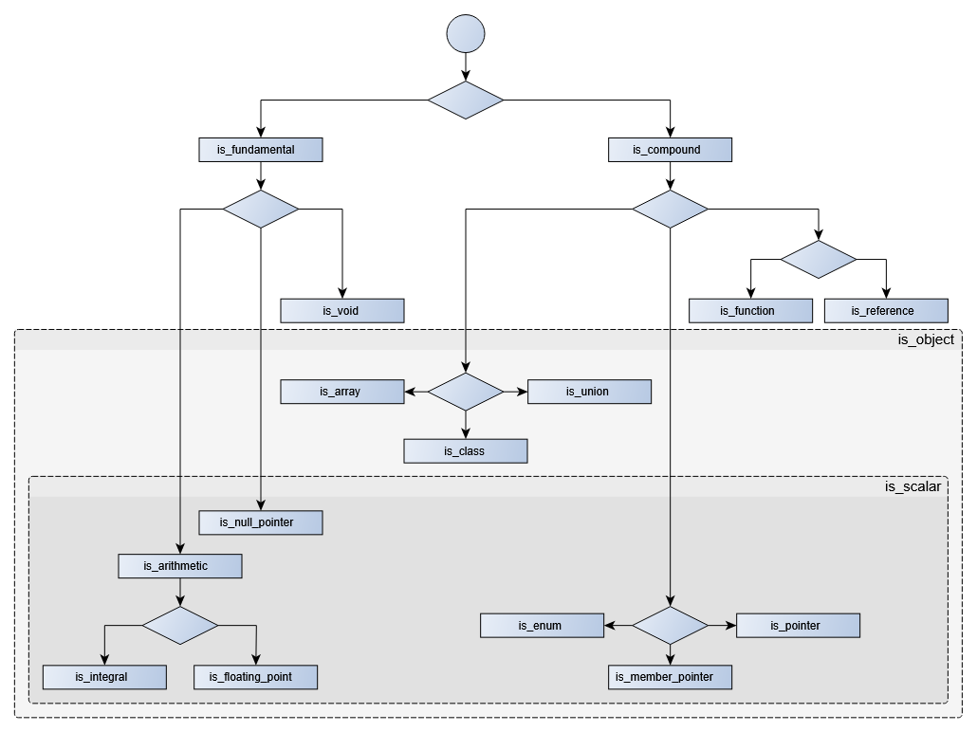
Templates
Type traits
This was actually derived from the overview of the basic type traits available since
(https://en.cppreference.com/w/cpp/language/type)
11

Slide 38
Templates
Type traits
Notable other unary type traits
template<class T> struct is_const;
template<class T> struct is_literal_type;
template<class T> struct is_polymorphic;
template<class T> struct is_abstract;
template<class T> struct is_final;
template<class T> struct is_signed;
template<class T> struct is_unsigned;
template<class T> struct is_default_constructible;
template<class T> struct is_copy_constructible;
template<class T> struct is_move_constructible;
template<class T> struct is_copy_assignable;
template<class T> struct is_move_assignable;
template<class T> struct is_destructible;
template<class T> struct has_virtual_destructor;
Look up these type traits, understand what they do and why they may be useful.
?
Notes:
Definitions are omitted here, but they are all quite simple

Slide 39
Templates
Type traits
Notable other type traits
template<class T, class... Args> struct is_constructible;
template<class T, class U> struct is_assignable;
template<class T, class U> struct is_same;
template<class T, class U> struct is_base_of;
template<class T, class U> struct is_convertible;
The order of arguments is important here! All these check if the first type is assignable/convertible/… to the second
template<class T> struct remove_reference;
template<class T> struct remove_pointer;
template<class T> struct remove_const;
Which type is revealed by std::remove_const<const int*>::type?
?
Notes:
Still const int* ! Remove_const would remove a const from int* const, but const int* is a non-const pointer!

Slide 40
Templates
Type traits
Shortcuts
Many type traits are structs holding a value in a variable of this name, or define a type named type
For not always having to write ::value or ::type, shortcuts for most type traits exist since
14
template<class T>
using remove_pointer_t = typename remove_pointer<T>::type;
template<class T>
inline constexpr bool is_const_v = is_const<T>::value;
Use these shortcuts! They increase readability of SFINAE-stuff by at least 90%.

Slide 41
Templates
Type traits
std::enable_if
This type trait really kicked of SFINAE. It is defined like this:
Using std::enable_if_t<some_condition_v<T>, T> in a template’s signature instead of just T will make this template version only available to those types, for which the condition type trait is true. Otherwise, no typedef named type will be available and SFINAE will trigger.
template<bool B, class T = void>
struct enable_if {};
template<class T>
struct enable_if<true, T> { typedef T type; };

Slide 42
Templates
Type traits
template <typename T>
std::enable_if_t<std::is_arithmetic_v<T>, T> sum(T a, T b) {
return a + b;
}
template <typename T>
std::enable_if_t<std::is_convertible_v<T, std::string>, std::string> sum(T a, T b) {
return std::string(a) + " and " + b;
}
int main() {
int a{4}, b{5};
int c = sum(a, b);
const char *d{"abc"};
const char *e{"def"};
std::string f = sum(d, e);
std::cout << c << std::endl; // 9
std::cout << f << std::endl; // "abc and def"
}
This will be the return type of the function…
… if this is true

Slide 43
Templates
Type traits
std::enable_if
We could also use enable_if as additional unused template parameter
template <typename T, std::enable_if_t<std::is_integral_v<T>, bool> = true>
void print(T t) {
std::cout << "Integer: " << t << std::endl;
};
template <typename T, std::enable_if_t<std::is_floating_point_v<T>, bool> = true>
void print(T t) {
std::cout << "Float: " << t << std::endl;
};
int main() {
print(4);
print(4.5);
}
You need to make sure that the versions don’t just differ in their default arguments. Writing typename = std::enable_if_t… usually doesn‘t work.
The enables type (bool) and its default value (true) have no meaning. There just has to be something so that the compiler can deduce the second parameter’s type and value when using print.

Slide 44
Templates
SFINAE
In the sample application, pcod, search for the keyword template and choose one for which it makes sense to restrict it to certain types. Do so using enable_if.
?
In the PBODTritonInterface, the pointCloudToModelInput is split into two versions of a template, depending on whether the mask needs to be provided as boolean or as float. Why can’t we solve this using a simple if statement?
?
In , the new framework of Concepts and Constraints was introduced, making SFINAE much more user-friendly. That’s not part of this course – sorry!
20

Slide 45
STL & Lambda expressions
The Standard Template Library
In the 1980s, HP developed a library all around data structures, iterators, and algorithms
The library was designed to be as flexible as possible, using only templates
This library was so useful that large parts of it are today part of the C++ standard
The term STL is not well-defined and never occurs in the C++ standard definition. So there exist different opinions on what exactly the STL is and which concepts are part of it.
We have already used the std::vector class that definitely is a core part of the STL and the std::string that, in some definitions, also belongs to it.

Slide 46
STL & Lambda expressions
Basic Idea of STL
For different purposes, we want to store multiple elements of data in different storage containers
Algorithms working on this data should work for all types of containers (and all types of elements inside the containers)
So we need a common interface, which are iterators that visit all elements of the container once
The most basic example of a container would be a C-Array, for which the iterator is just a pointer to an element
For all containers of the STL library, the begin() method returns an iterator to the first element, while end() gives us an iterator to the position after the last element
Iterators behave like pointers: Dereferencing them with * gives us access to the element, while ++ and -- move the iterator around the container.
Dereferencing end() results in an error
Let’s look at the different container types to understand this in detail

Slide 47
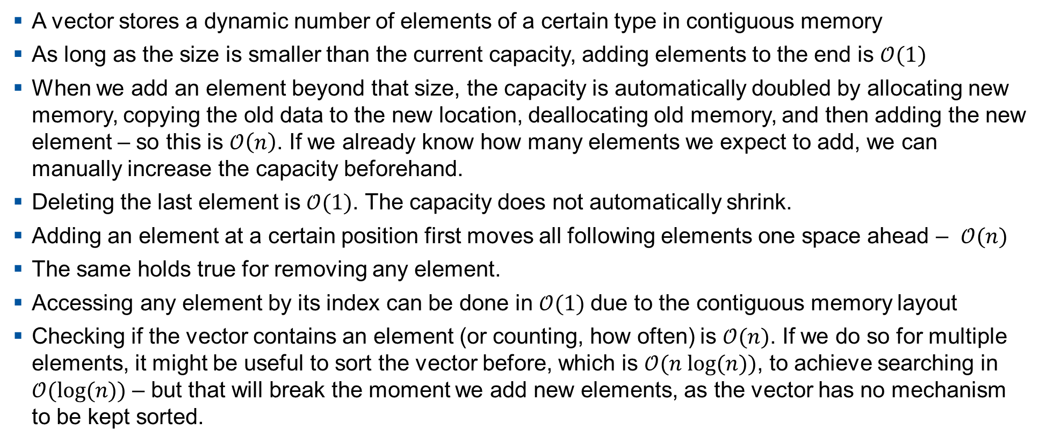
STL & Lambda expressions
std::vector
A vector stores a dynamic number of elements of a certain type in contiguous memory
As long as the size is smaller than the current capacity, adding elements to the end is $𝒪(1)$
When we add an element beyond that size, the capacity is automatically doubled by allocating new memory, copying the old data to the new location, deallocating old memory, and then adding the new element – so this is $𝒪\left(n\right)$. If we already know how many elements we expect to add, we can manually increase the capacity beforehand.
Deleting the last element is $𝒪(1)$. The capacity does not automatically shrink.
Adding an element at a certain position first moves all following elements one space ahead – $𝒪(n)$
The same holds true for removing any element.
Accessing any element by its index can be done in $𝒪(1)$due to the contiguous memory layout
Checking if the vector contains an element (or counting, how often) is $𝒪(n)$. If we do so for multiple elements, it might be useful to sort the vector before, which is $𝒪(n log⁡(n))$, to achieve searching in $𝒪(log⁡(n))$ – but that will break the moment we add new elements, as the vector has no mechanism to be kept sorted.

Slide 48
STL & Lambda expressions
std::vector
std::vector<int> v{1, 2, 3, 4, 5, 6}; // Initializer list
v.reserve(10); // Reserve space for 10 elements
v[4] = -5; // Access to element 4 (0-based)
v.at(4) = -5; // Same, but with range check
v.push_back(7); // Add value to the end
v.insert(v.begin() + 2, 2, -1); // Insert 2 elements of value -1 at position 2 (&3)
v.erase(v.begin() + 2); // Delete the element at position 2
int last = v.pop_back(); // Will be 7
// vector is now [1, 2, -1, 3, 4, -5, 6]
std::vector has many more member functions to modify elements. You can look them up under https://en.cppreference.com/w/cpp/container/vector. We will for now focus on the usage of iterators
How can we, naively, search for an element in the vector?
?

Slide 49
STL & Lambda expressions
std::vector
int val = 3; // Value to search
for (auto it = v.begin(); it != v.end(); ++it) {
if (*it == val) {
std::cout << "Found " << val << std::endl;
break;
}
}
This for loop from begin till before end is so common that we can use the shorter range-based for loop
for (const auto& el : v) {
if (el == val) {
std::cout << "Found " << val << std::endl;
break;
}
}
This naïve way is still not very reusable.

Slide 50
STL & Lambda expressions
std::vector
template <typename It, typename T>
It search(It begin, const It end, const T& val) {
while (begin != end && *begin != val) {
++begin;
}
return begin;
}
We can also write an algorithm for finding an element that will be applicable to all other containers
auto it = search(v.begin(), v.end(), val);
if (it == v.end()) {
std::cout << "Value " << val << " not found" << std::endl;
} else {
std::cout << "Found value " << val << " at position " << it - v.begin() << std::endl;
}
This task is so common, that we can just use std::find which does basically the same. Returning the end() iterator if some algorithm failed, is very common. To distinguish between this case and the last element being the one we looked for is the reason why end points behind the last element.
Notes:
Now we know, how Iterators work with Algorithms and vice versa. Let’s now look at the other types of containers

Slide 51
STL & Lambda expressions
std::array
An array has exactly the same interface as a vector, except it has a constant size. This is achieved by a non-type template parameter defining the size at compile time
This means, all operations changing the size are not allowed
All operations that are allowed have the same time complexity compared to vector, but the array is more memory efficient
Use std::array whenever you are 100% certain that the number of elements will never change. Otherwise, just use std::vector – its overhead is not huge!

Slide 52

STL & Lambda expressions
std::deque
Deque stands for double ended queue
The deque stores its data not contiguously, but rather in multiple dynamically allocated blocks
This means, that insertion and deletion from the beginning and the end are $𝒪(1)$, while both in the middle are $𝒪(n)$.
For operations on the beginning, there are the additional methods push_front and pop_front
Access to all elements is still $𝒪(1)$, as the deque remembers centrally, which memory block is where in the queue.
Use std::deque whenever you only need to add or remove elements at the ends. The standard example for this is obviously a queue, but also a stack works well as deque.

Slide 53

STL & Lambda expressions
std::list
In a list, each element stores its value together with a pointer to the elements before and after it
The list itself only stores the first and last element and the size
As a result, we can insert and delete elements anywhere in the list in $𝒪(1)$, but we need to have an iterator to the position we want to modify
Access to a certain position in the list discouraged, and therefore operator[] and at() don’t exist. Also, iterator arithmetic is disabled except ++ and --. With these, we can theoretically achieve element access in $𝒪(n)$.
Use std::list whenever you need fast insertion and deletion while iterating over the list, but rarely need access to specific elements
introduced std::forward_list, where also the backwards-facing pointers are removed, so we can only iterate the list in one direction, but save a bit more memory.
11

Slide 54

STL & Lambda expressions
std::set
A set automatically stores all elements in order by comparing them with <.
While insertion becomes $𝒪(log⁡(n))$, finding an element and deleting by value also is only $𝒪(log⁡(n))$.
The standard does not enforce a specific implementation of the set, but most ones nowadays use red-black-trees.
Inserting elements may be slow if the tree needs to be entirely rebalanced. This is often the case if we add the elements in already sorted order. If that is the case, prefer using vectors or lists.
Use std::set whenever you need fast search for elements without them being ordered anyway. Also use it, when you need the sorted order of the elements as opposed to the order they were inserted.
introduced std::unordered_set, where values are inserted by calculating their hash. Finding them becomes 𝒪(1) under certain conditions, at the cost of storage size and a constant larger than log(n) for small n.
11

Slide 55
STL & Lambda expressions
std::multisetset
Sets can only contain each value once. std::multiset does not have this restriction.
All operations keep the same time complexity
Counting the number of times an element occurs becomes a bit slower, though. For a set, this returns 1 after the element was found, while for a multiset, the number of occurences must be counted as well.
Use std::multisetset whenever you need a set with duplicates. This is actually rarely the case.

Slide 56
STL & Lambda expressions
std::map
A map is a set where the user can specify under which key a value is stored
Therefore, the template has two type parameters for keys and values, commonly called K and V.
We could also say, that the keys are stored in a set together with a pointer to their value
Iterating over a map gives an iterator to a std::pair<K, V>
Initialization can be achieved using a nested initializer like std::map<int,int> m{{1, 2}, {3,1}}
Maps reintroduce the operator[] and at() functions to get the value belonging to a key.
Just like multiset and unordererd_set, we can use multimap and unordererd_map
While at() throws a std::out_of_range if the given key does not exist, operator[] tries to construct a new entry in that case and thus does not exist in a const version.
Use std::map as a lookup-table for associations. Actually, this container has a different purpose than all the others, but is handled here as its storage and usage are related.

Slide 57
STL & Lambda expressions
Overview and Comparison
Container | Access (by index/key) | Search (by value) | Insertion (beginning) | Insertion (middle) | Insertion (end) | Deletion (beginning) | Deletion (middle) | Deletion (end) | Main Use Cases / Pitfalls
array | O(1) | O(n) | N/A | N/A | N/A | N/A | N/A | N/A | Fixed-size collection. Fast access by index. Pitfall: Size must be known at compile time
vector | O(1) | O(n) | O(n) | O(n) | O(1) (*) | O(n) | O(n) | O(1) | Dynamic array. Use when the size may change or you need contiguous memory layout. Pitfall: (*): Expensive reallocation when growing
deque | O(1) (*) | O(n) | O(1) | O(n) | O(1) | O(1) | O(n) | O(1) | Double-ended queue. Fast insertions and deletions at both ends. Pitfall: (*): Indexing and iterating is a bit slower
list | O(n) | O(n) | O(1) | O(1) | O(1) | O(1) | O(1) | O(1) | Doubly linked list. Fast insertions and deletions at any position. Pitfall: No direct access by index, no iterator arithmetic
set | N/A | O(log n) | N/A | O(log n) | N/A | N/A | O(log n) | N/A | Sorted unique elements. Use when uniqueness and order are required. Pitfall: Higher overhead due to tree structure
map | O(log n) | O(n) | N/A | O(log n) | N/A | N/A | O(log n) | N/A | Key-value pairs with unique keys. Use for fast lookups by key. Pitfall: Same as set. Searching for values instead of keys is complicated

Slide 58
STL & Lambda expressions
Lambda template arguments
Many STL containers have more template arguments than the type they store
All of them have for example an allocator object that is used to allocate memory – the default allocator that we don‘t need to explicitly specify works for 99% of the use-cases.
More interesting are the objects used for comparison or hash creation in the containers where that is relevant. If the default behavior is not desired, they are often created quickly with a lambda:
auto comp = [](const int a, const int b) { return a > b; };
std::set<int, decltype(comp)> s({1, 2, 3}, comp);
s.insert(3);
s.insert(5);
for (const auto& v : s) {
std::cout << v << ", ";
} // 5, 3, 2, 1,
For comparators this simple, there exist standard types like std::greater. Mainly when the container’s element type is no standard type, we really need those lambdas.

Slide 59
STL & Lambda expressions
Lambdas for algorithms
Lambdas are even more important for algorithms.
For the “search” application, we have already seen ho algorithms are implemented in principle, and learned that std::find already exists for the purpose of finding a specific value in a container.
There is a second version std::find_if that doesn’t find an exact value, but an entry that satisfies a certain condition
struct Point {
double x, y, z, intensity;
};
std::vector<Point> points;
// Fill vector with points ...
// Find a point with an intensity large enough
double thresh;
Point& p1 =
*std::find_if(points.begin(), points.end(),
[thresh](const Point& p) { return p.intensity > thresh; });

Slide 60
STL & Lambda expressions
Lambda Captures
Remember the lambda from the last slide:
[thresh](const Point& p) { return p.intensity > thresh; }
The part in the first brackets [] is called capture clause. Here, it lets us use the local variable thresh inside the lambda function
By default, variables are captured by value, so the lambda cannot change the variable outside it and will not “react” to changes of it later in the code
By prepending the captured variable with a &, we can capture it by reference
Just writing [&] captures all local variables by reference, [=] captures all of them by value
For both, we can define exceptions, like [=,&thresh]
We can also define new constants inside the lambda by assigning a fixed value like [thresh=0.5]
Finally, if we write the lambda inside a class, we can capture all members by reference with [this] or by read-only reference with [*this]

Slide 61
STL & Lambda expressions
Algorithms
Algorithm | Functionality | Functor parameters
find, find_if | Find a certain element, or an element that satisfies a condition | Unary Predicate
count, count_if | Count a certain element, or all elements that satisfies a condition | Unary Predicate
copy, copy_if | Copy a range or all the values inside the range that satisfy a condition | Unary Predicate
replace, replace_if | Replace a certain value or all elements that satisfy a condition with another value | Unary Predicate
remove, remove_if | Removes all elements with a certain value or satisfying a condition from a range | Unary Predicate
Many algorithms exist in a version for a special value and another one for an “unary predicate” – a function given any element of the vector and returning a bool. Find more examples here.

Slide 62
STL & Lambda expressions
Algorithms
Algorithm | Functionality | Functor parameters
min_element, max_element | Get Iterator of min/max element in range | Comparator
sort | Sort in non-descending order | Comparator
lower_bound | In a sorted range, find the smallest element that is not smaller than a threshold | Comparator
accumulate | Perform an action to all elements to get a single value, e.g. add | Function combining initial/intermediate value with a single element from the range
unique | Remove all neighboring duplicates from a range | Equality check
transform | Applies a function to all elements and stores the result in a new container | Transformation function
random_shuffle | Shuffles the range | Function producing random values
reverse, rotate | Reverse order, or move first few elements to the end | /

Slide 63
STL & Lambda expressions
Algorithms: Common pitfalls
What will the following code do?
(assuming we have included the relevant headers and specified operator<< for vectors)
?
std::vector<int> v{1, 2, 3, 4, 5, 5, 4, 3, 2, 1, 0, -1};
std::remove_if(v.begin(), v.end(), [](int i) { return i % 2 == 0; });
std::cout << v;
// [1, 3, 5, 5, 3, 1, -1, 3, 2, 1, 0, -1, ]
Caution! Remove only removes values from the range, but does not erase anything from the underlying data structure. Instead, it returns a new “end” iterator such that the values from begin to the new end contain what we need. All values between the new and the original end may contain anything.
Use the erase-remove-idiom to erase all the unwanted elements!
( also offers us std::vector::erase_if to do so in one step)
20
v.erase(std::remove_if(v.begin(), v.end(), [](int i) { return i % 2 == 0; }), v.end());

Slide 64
STL & Lambda expressions
Algorithms: Common pitfalls
We could also write our own code to loop over the vector and erase elements on-the-fly. Why is the following code considered bad?
?
auto it = v.begin();
while(it != v.end()){
if(*it % 2 == 0){
it = v.erase(it);
} else {
++it;
}
}
First, each erase call leads to a move of all subsequent elements. std::remove_if handles this in a nicer way.
Second, this mechanism is quite error-prone. It is easy e.g. to forget assigning the result of erase, or forget the else around ++it.

Slide 65

STL & Lambda expressions
Algorithms: Common pitfalls
But it could have been even worse! What happens with this code?
?
std::set<int> s{1, 2, 3, 4, 5, 6, 7, 8, 9};
for (auto& el : s) {
if (el % 2 == 0) {
s.erase(el);
}
}
std::cout << s << std::endl;
We use set here for demonstration because it has an overload of erase by value
Everything fine?
Remove the 9 and try again!
?
Remember that using the range-based for loop is internally rewritten to using iterators. Bun when we erase an element from the set, the current iterator is obviously invalidated. So the next ++ may do anything – in some cases, nothing bad happens. Sometimes, some even values will not be erased, but worst of all, the program might crash. Read about more iterator invalidation rules here.
Use pre-defined algorithms whenever possible!

Slide 66
STL & Lambda expressions
Algorithms: Common pitfalls
What will the following code do?
(assuming we have included the relevant headers and specified operator<< for vectors)
?
std::vector<int> v{1, 2, 3, 4, 5, 5, 4, 3, 2, 1, 0, -1};
v.erase(std::unique(v.begin(), v.end()), v.end());
std::cout << v;
// [1, 2, 3, 4, 5, 4, 3, 2, 1, 0, -1, ]
Caution! Unique only removes neighboring duplicates. Also, we still need the erase-remove-idiom.
First sort the range, then apply unique.
std::sort(v.begin(), v.end());

Slide 67
STL & Lambda expressions
Algorithms: Common pitfalls
What will the following code do?
(assuming we have included the relevant headers and specified operator<< for vectors)
?
std::vector<int> v{1, 2, 3, 4, 5, 5, 4, 3, 2, 1, 0, -1};
std::sort(v.begin(), v.end(), [](int a, int b){return std::abs(a) < std::abs(b);});
std::cout << v;
// [0, 1, 1, -1, 2, 2, 3, 3, 4, 4, 5, 5, ]
Here, everything is fine. But std::sort does not guarantee that the order of equal (with respect to the comparator) elements is preserved.
If you need that, use std::stable_sort.
std::stable_sort(v.begin(), v.end(), [](int a, int b){return std::abs(a) < std::abs(b);});

Slide 68
Next topic ?
MyClass.hpp
Main.cpp
#include <iostream>
#include <stdexcept>
#include <vector>
struct MyClass {
MyClass() {
std::cout << "MyClass created\n"; }
~MyClass() {
std::cout << "MyClass destroyed\n"; }
std::vector<int> data;
void process() {
std::cout << "Processing object „
<< data.at(0); }
};
int main() {
try {
MyClass* obj = new MyClass();
obj->process();
delete obj;
} catch (const std::exception& e) {
std::cerr << "Error: " << e.what();
}
}
What goes wrong here?
?
Notes:
Even though we catch the error, that data.at(0) does not exist, we now don’t delete obj! ➔ MEMORY LEAK

Slide 69
Smart Pointers
Introduction
Raw pointers are error-prone. It is very easy to forget some edge case in which the delete operator won’t be called at all, leading to memory leaks, or to try and access already deleted data
The solution to this is smart pointers, which were first introduces by boost, a large collection of useful libraries
In , the standard introduces its own version of smart pointers, which differs from the boost implementation, but has the same use-cases
The idea is based on the principle called Resource Acquisition is Initialization (RAII), stating that objects should automatically delete all their resources when they are deleted themselves
Heap objects created with new do not follow RAII!
11

Slide 70
Smart Pointers
Unique Pointer
unique_ptr is a class with a single important member: An object on the heap
In its destructor, delete is called on that object
The copy constructor and assignment operator are not declared for unique_ptr, thus a single (unique) unique_ptr manages that object
The unique_ptr is thus movable!
Notes:
MOVE VORHER!!!!!!!!!!!!!!!!!!!!!

Slide 71
Smart Pointers
Unique Pointer
Usage
#include <memory>
std::unique_ptr<Point> p{new Point{1, 2}}; // create with new, immediately manage with unique_ptr
std::cout << p.get() << '\n'; // get the underlying raw pointer
take_over_point(std::move(p)); // Move the pointer into another function
std::cout << p.get() << '\n'; // Prints 0, as the unique_ptr now points to nullptr
p.reset(new Point{3, 4}); // Bind another object to the existing unique_ptr
p = std::make_unique<Point>(5, 6); // make_unique is a better way to create unique_ptr w/o new since C++14
void do_something(Point& p){...};
do_something(*p1); // Get a reference to the Point by dereferencing with *
Point* other_library_function_1() { // Some libraries will give us new objects as raw pointer
return new Point{7, 8};}
p.reset(other_library_function_1()); // Just reset the unique_ptr with that
void other_library_function_2(Point** p) { // Some library functions are really stupid and need a Point**
*p = new Point{9, 10}; }
Point* p_tmp = nullptr;
other_library_function_2(&p_tmp);
p.reset(p_tmp); // that we should immediately manage with a unique_ptr
Notes:
MOVE VORHER!!!!!!!!!!!!!!!!!!!!!

Slide 72
Smart Pointers
Unique Pointer
Use a unique pointer whenever an object on the heap always belongs to one certain owner. This owner holds the unique_ptr and can hand it over to a new owner with std::move.
A typical example could be the point cloud in an automated vehicle: The lidar driver generates the point cloud, moves it to a transformation node, which moves the result into the PCOD, which ultimately destroys the point cloud after having detected the objects
When writing a function operating on data, but not owning it, just hand the data to the function as reference. This does not restrict the caller to having the data as unique pointer. If the caller of the function has the data available as unique pointer, he can dereference it.
If a function needs to return a unique pointer to a newly created object, just return the unique pointer per value. The compiler will optimize away any overhead.
If other functions give us raw pointers, immediately manage them with a unique pointer and assign nullptr to any temporary raw pointer.
Notes:
MOVE VORHER!!!!!!!!!!!!!!!!!!!!!

Slide 73
Smart Pointers
Unique Pointer
Never let two unique pointers manage the same object. Deleting the first one will delete the object!
Don’t exchange data with a function by moving the unique pointer in and out again. This is just inefficient.
Don’t give a reference or raw pointer to the underlying object to another function that needs ownership of the data – if the unique pointer is deleted in the meantime, this other function will fail!
Don’t access data in a unique pointer that may or may not point to a real object. You can easily check with if(ptr) as the unique pointer has a cast to void*.
Notes:
MOVE VORHER!!!!!!!!!!!!!!!!!!!!!

Slide 74
Smart Pointers
Shared Pointer
shared_ptr is a class with two important members: an object on the heap and a reference counter
Copying and copy-assigning the shared pointer increases the reference counter
Its destructor just decreases the reference counter until
Notes:
MOVE VORHER!!!!!!!!!!!!!!!!!!!!!

Slide 75
Wrap-Up
Learning Objectives
At the end of this lecture, you will…
Be up to date with the important concepts from the udemy C++ course
Understand the fundamentals of data types and control structures in C++
Have a basic understanding of Object Orientation
Hopefully have some fun playing around with code

Slide 76
Wrap-Up
Course agenda
 | Introduction & Course Concept | Workshop 1
1 | Development Environment & IDE | Workshop 1
2 | Recap: C++ Syntax & Language Elements | Workshop 2 (today)
3 | Software Design & Patterns | Workshops 3, 4
4 | Modern C++ Concepts | Workshops 5, 6
5 | Embedded Software | Workshop 7
6 | Efficient Software Development & Best Practices | Workshops 8, 9
7 | Testing & Code Quality | Workshops 9, 10
 | Wrap-Up & Conclusion | Workshop 10

Slide 77
Wrap-Up
Homework
Repeat all the exercises that we didn’t have time to.
Implement useful classes Point and PointCloud to store real 3D measurements from lidar sensors.
Fill them with as much life as you have fun and time. Feel free to overload operators, provide functions for geometrical transformations, filtering points based on certain conditions …
You may try to implement functions to read and write PointClouds from the provided pcd files – for simplicity, assume that they always come in this format.
If you are super ambitious, you could read about the format at https://pointclouds.org/documentation/tutorials/pcd_file_format.html and try to make the class read in files with different fields or another viewpoint. Be warned though, that with our current state of the lecture, this will be really hard.

Slide 78



Modern C++ Concepts
Workshop 1
Q & A
Aachen, September 18, 2024
Fabian Thomsen, M.Sc.
Feedback

Slide 79

Templates
11
Caution!
Code block
With at least 2 lines
14
Will later be part of the lecture
Point.hpp
Code block with filename
17
Note: …
Code block not adjusting size
Good practice
Point.hpp
Code block with filename not size adj.
Bad practice
Task
?
Notes:
Icons by flaticon

