Slide 1
Project: [Soul Forge] 73rd Cycle 项目：[灵魂锻造] 第73周期
By 1820251088 颜键杨 & 1820251084 宋理

Slide 2
Introduction/Overview 引言/概述
Pygame files have now been compiled as an executable program application for the 2D stealth platformer with customized player movement systems having undergone overhaul, followed y platform collision and save management as well as User interface buttons, lore delivery, enemy artificial intelligence and a branching epilogue sequence. Pygame
文件现已编译为可执行程序，适用于这款2D潜行平台游戏，定制的玩家移动系统经过全面改造，包含平台碰撞与存档管理、用户界面按钮、背景故事传递、敌人人工智能以及分支尾声序列。
Premise being you are Marquette Verne the 73rd Soul Forge, not a location but a title as a concept, the world you enter is a minimal subspace where the essence of souls have wandered to and those who can understand souls as code can create the world that exists as is and your mission is to stop the warden that misuses such talent to create oppressing forces by platforming through his domain. Avoid enemies, collect the tablets the secrets left behind by your forebearers and defeat the Warden Gerard Gatewald.
前提是你是第73个灵魂锻造者马凯特·凡尔纳，不是地点，而是一个头衔概念，你进入的世界是一个最小的亚空间，灵魂的本质游荡其中，能理解灵魂作为代码的人创造出现存的世界，你的任务是阻止那个滥用这种天赋通过跳跃创造压迫力量的守卫者。避开敌人，收集祖先留下的秘密石板，击败守护者杰拉德·盖特沃尔德。

Slide 3
Game Development Elements 游戏开发元素
Demonstrating fundamental building blocks of game development WITH in lore complimentary explanations & acknowledgement that the character and player in and out of lore both understand and experience the elements in order to learn to code and create afterwards.
展示游戏开发的基本构建要素，同时在背景故事中辅导补充解释，并承认角色和玩家在背景故事内外都理解并体验元素，以便之后学习编程和创作.
Game loops with clock tick while running & the state machine is implemented with Menu, level select, playing, paused, journal, reading followed by warden dialogue and ending sectioning the long progress and experience before the conclusion of the elements and narrative point.
游戏循环，运行时钟滴答，状态机通过菜单、关卡选择、游戏、暂停、日志、阅读、守卫对话和结束分段，展示漫长的进展和体验，直到元素和叙事点结束。
Event handles with pygame.event.get() for the keyboard and mouse for consistent swift player input while the code like screen.blit() handles the rendering for physics elements of velocity collision resolution & gravity with minimal resource consumption saved with JSON save systems with checkpoints implemented to ensure the player can enjoy all the creative levels up to the point that the typewriter dialogue branch endings and journal chapters culminate towards to, the epilogues.
Event 通过 pygame.event.get（） 处理键盘和鼠标，确保玩家输入稳定且迅速，而 screen.blit（） 等代码则处理速度、碰撞分辨率和重力等物理元素的渲染，资源消耗最小，通过 JSON 存档系统和检查点的实现，确保玩家能享受所有创意层次，直到打字机对话分支结尾和日记章节最终汇聚至尾声。

Slide 4
Player Character Movement 玩家角色移动
General Basis 基础
Updating Sequence 更新序列
The Class known as player uses attributes of rect for pixel structure and vel_x or _y for horizontal and vertical velocity with Boolean jump validation known as “on_ground” with constants of a customized gravity jump_strength and movement_speed value run by If else loop keys for the logic.
称为 player 的类使用 rect 属性表示像素结构，vel_x 或 _y 属性表示水平和垂直速度，并采用布尔跳验证“on_ground”，常数为自定义的重力jump_strength和 movement_speed 值，并由 If else 循环键执行。
Updating sequence applies gravity to vertical velocity and movements any direction resolve collisions clamp within screen boundaries but given ample angles of wall jumping/climbing to maneuver in their own territory.
更新序列会将重力作用于垂直速度和移动，任何方向的解析碰撞都会被限制在屏幕边界内，但允许有足够的角度进行墙壁跳跃/攀爬，以便在自己的领地内机动。

Slide 5
Platforms & Platforming 平台与平台
Construction 建设
Collisions 碰撞
Platforms, lore_keys and enemies are returned from lists of lorekey enemy and pygame.rect with the basis of build_level(level) and the custom designed maps implemented by our chief coder set with screen height and width to manage cluttering.
平台、lore_keys和敌人均来自 lorekey 敌人列表和 pygame.rect，基于 build_level（关卡）和由首席程序员实现的自定义地图，这些地图带有屏幕高度和宽度以管理杂乱。
Rect.right = p.left or rect.left = p.right just as rect.bottom = p.top or rect.top = p.bottom resolve velocity of orizontal and vertical set to be 0 and level transitions when the player.rect.x > screen_width – 60, next_level() is called.
Rect.right = p.left 或 rect.left = p.right，就像 rect.bottom = p.top 或 rect.top = p.bottom 一样，分辨率分辨率的初和垂直速度设为 0，当调用 player.rect.x > screen_width – 60，next_level（） 时水平转换。

Slide 6
Save Management Classes & Buttons
Save manager 存档管理器
Buttons 按钮
Persists progress across sessions using JSON using load and save to read and write JSON validates structures adding missing keys and can update, wipe or retrieve slots data.
通过使用 JSON 使用 load 和 save 来读写 JSON 来持久保存会话间的进度，验证添加缺失密钥的结构，并能更新、清除或检索槽位数据.
Reuses user interface elements for menus with attributes of rect color hover_color, current_color. Font. Text, text_surface and text_rect. 在具有rect色hover_color、current_color等属性的菜单中重用用户界面元素。字体。文本、text_surface和text_rect。
Implementation methods include updating mouse position to switch hover colors or draw surface to render rectangle with border radius and centered text while is clicked event returns true to left click within bounds. 实现方法包括更新鼠标位置切换悬停颜色，或绘制表面以渲染带有边界半径和居中文本的矩形，点击事件在范围内返回true为左点击。

Slide 7
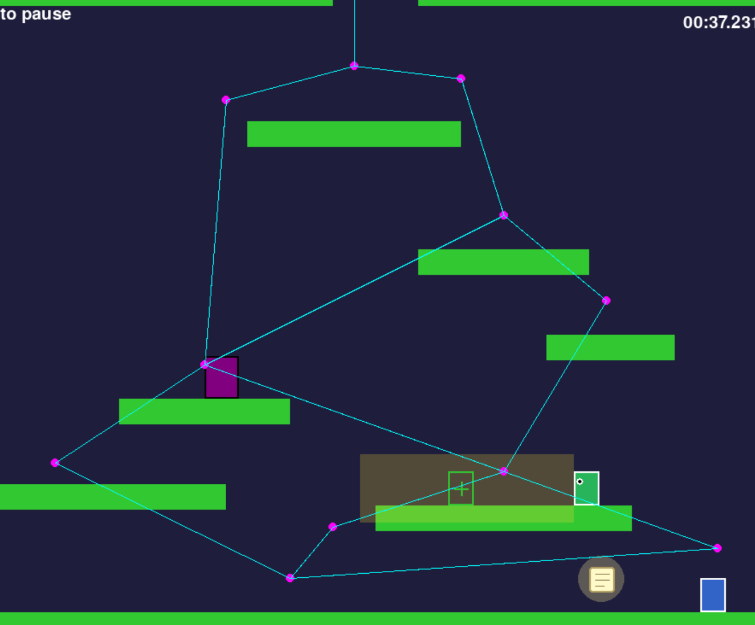
Lore Keys (Tablets) 知识钥匙（石板）
Collectible fragments to unlock journal chapters with chapter id attributes to string into the journal chapters alongside the Boolean registered values of the collected states and bob_phase += 0.05 each frame with vertical bob and pulsing glow as float for animation of the objects.
收集碎片用于解锁带有章节ID属性的日志章节，并与收集状态的布尔注册值并每帧以 bob_phase += 0.05 进行，垂直浮动和脉动发光作为物体动画浮动。

Slide 8
Enemy Class 敌舰级
General Basis 基础
Patrol & Sight 巡逻与视野
Attributes shares rect of pixels as the player character with different velocity however its patrol_range limits how far it can range from its starting position with Boolean value of player_spotted with constants such as enemy_vision_range and enemy_vision_height.
属性与玩家角色共享像素的矩形像素，但速度不同，但其patrol_range限制了其从起始位置（布尔值为player_spotted，常数如enemy_vision_range和enemy_vision_height）之间的范围。
Reverses direction at start_x the starting position paired with reverses direction when hitting the platform edge which gives the passive patrol appearance.
start_x起始位置反向，撞击平台边缘时反向，形成被动巡逻的外观。
Vision system runs on the vision.collidirect(player.rect) overla[ is sight with visual feedback of a translucent bar/ray that turns translucent red when spotted and yellow when not spotted as the body also turns brighter orange when spotted, also the SPOTTED! Text appears on screen
视觉系统运行在vision.collidirect（player.rect）覆盖上，是带有视觉反馈的半透明条/射线，当被发现时会变成半透明的红色，未被发现时变成黄色，身体在被发现时也会变成更亮的橙色，同样是“斑点！”屏幕上会出现文字

Slide 9
The Warden (Antagonist) 典狱长（反派）
Rect foundation as is others however slightly different with talking dialogue unlike the husks they created as guard minions and a specific defeat state measured with Boolean data with scaling phases and dialogue system from their index otherwise for combat they pursue the player and must be dealt damage from dropping with present health.
Rect Foundation和其他人一样，但略有不同，对话是对话，不同于他们作为守卫小兵创造的空壳，且有特定的失败状态，使用布尔数据测量，带有缩放阶段和基于索引的对话系统，否则战斗时他们会追击玩家，必须在当前生命值下通过掉落造成伤害。

Slide 10
Epilogue Part 1 尾声 第一部分
General 概述
Coniditons 分生子
State of defeat_dialogue with 26 lines of dialogue from the defeated warden with the typewriter effect “typewriter_progress += 1.5” per frame with progress indicator of “dialogue_index +1 / 26” to manage the lines.
defeat_dialogue状态，击败的典狱长对话26行，每帧有打字机效果“typewriter_progress += 1.5”，进度指示器为“dialogue_index +1 / 26”以管理台词.
Key lines about the breaking of expectations the true secret of the world the meta awareness and the confrontation of choice
关于打破期望、世界真正秘密、元觉察以及选择对抗的关键句子
When the warden is defeated → phase sets as 2 → dialogue reaching the → choice buttons, while all journal chapters collected → apply choice break automatically with standalone module for testing the ending sequence(s).
当守望者被击败时，阶段设置为两段对话，进入选择按钮，而收集的所有日志章节会自动应用选择休息，并有独立模块测试结局序列。
State of choice screen presents the options he proposes to complete the game with the following slide’s content descriptions/details
选择状态界面展示了他提出的完成游戏选项，下面是幻灯片的内容描述/细节

Slide 11
Endings Part 1 尾声 第二部分
Epilogue Ending 1 The New Warden
尾声 结局1 新典狱长
Epilogue Ending 2 Break the Cycle
尾声结局2 打破循环
You take up his mantle as well as his responsibility to be the next warden giving up yourself to become the next puppeteer for the stage of wandering souls to attract more essence required for the beings of this realm to exist it is too risky to try and break a status quo that makes sense with evidence and holds the lives of everyone
你承担起他的责任，成为下一任守护者，放弃自己成为流浪灵魂舞台的傀儡师，以吸引更多本质，以维持这个领域的存在。试图打破一个有证据且关乎所有人生命的现状太冒险了
Refusing the proposal risking the world unraveling either because the world as is isn’t worth saving or their faith in the people as wel as themselves exceeds the doubt and pursues making the world better because maybe it will not need a warden to not chase the future is to be trapped in the past
拒绝提议，冒着世界崩溃的风险，要么是因为他们对像自己一样善良人民的信任超越了怀疑，追求让世界变得更好，因为也许不需要守护者来追逐未来，那就是被困在过去

Slide 12
Technical Conclusion 技术结论
Code organized with clear separation constants classes level builders & state handlers. Additionally reusable buttons save managers, journal managers, and state handlers with modular level construction.
代码组织清晰，包含分离常量、类、层级构建器和状态处理程序。此外，可复用按钮可通过模块化层构建保存管理器、日志管理器和状态处理程序。
Persistence of JSON file saving checkpoint progress & journal states followed by the UI/UX hover states and dialogue effects with color coded visual feedback for entities interactions and state changes.
JSON文件的持久化、保存检查点进度和日志状态，随后是UI/UX悬停状态和对话效果，并配有颜色编码的视觉反馈，涵盖实体交互和状态变化。
Narrative Content contains 16 Journal Chapters, 12 warden lines, 26 defeat lines, 2 entire epilogues and 2 branching endings thus far in the first complete demo.
叙事内容包含16个日志章节、12条守卫线、26条失败线、2个完整的尾声和2个分支结局，迄今为止，首个完整演示版中已呈现。

