Slide 1

Part 1: The model and the HR track
Attribute-Driven Migration to Entra ID — technical deep dive, in two parts
Module 1 The model · Module 2 The HR track: sourcing and proving
Module 3 HR-track mechanisms: groups, units, Conditional Access
Part 2: the Intune, Arc and non-person tracks, and running the migration
Facts dated October 29, 2026 · design guidance labeled as such
Presented by Michael F. Stratton
Not an official U.S. government publication. Independent technical analysis; not reviewed or endorsed by any federal agency.
Notes:
[0:00–2:16] This is Part 1 of the technical deep dive for the Federal Modernization Workbook's companion guide, Attribute-Driven Migration from Active Directory to Microsoft Entra ID. It's for identity engineers, Entra and AD administrators, Intune and Azure platform owners, PKI and credential teams, and ISSOs: the people who will write the attributes, the rules that read them and the evidence that shows they were true.
The guide's claim fits in one line. In Active Directory an object's place in the tree decided what applied to it; in Entra ID what the object says about itself decides. So the migration is the work of making those statements true and keeping them true.
The forest's identities move on four tracks, each with its own source of truth: the HR track for people, the Intune track for end-user devices, the Azure Arc track for servers, and the non-person track for service accounts, service principals, managed and workload identities and AI agents. The deep dive is split by track. Part 1 is the model and the HR track; Part 2 is devices, servers, non-person identities and running the migration.
Part 1 has three modules. Module 1 is the model: what the OU tree encoded, the four tracks, what the migration accomplishes and the federal rules behind it, the attributes primer, the nine-stage map and Stage 0. Module 2 is the HR track's sourcing: HR as the authority, Federal HR 2.0 and API-driven inbound provisioning, contractors, the canonical schema and its single writer, then proof and sync. Module 3 is the HR track's mechanisms: dynamic user groups, administrative units and Conditional Access personas, the dangers of dynamic user groups and their limits, and the HR-track decisions.
Three labels to listen for. The guide is a map; the books hold the depth, and each slide names the chapter. Microsoft facts were checked against Microsoft Learn on October 29, 2026. And the program's own recommendations are marked design guidance.
Workbook: Attribute-Driven Migration guide, "How to read this guide," "Four tracks," "The path on one page"; Book 01, Chapter 04; Books 02, 03, 04 and 06 as linked.

Slide 2
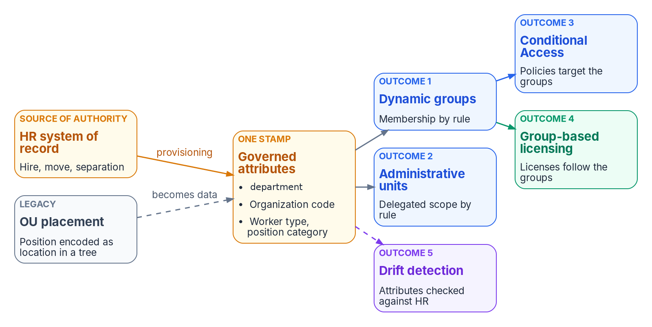

Why this matters: the attributes now decide
WHY
THE OU TREE DID FOUR JOBS AT ONCE
Delegation: who may manage the object
Policy scope: which GPOs inherit down to it
Accountability: which office owns it
Security scope: what it can reach
Entra ID has no OUs: its directory is flat
One stamp, five outcomes: a wrong HR-sourced attribute is wrong group membership, unit scope, policy, licensing and drift, all at once.
Sources: Microsoft Learn, Manage rules for dynamic membership groups (Oct. 29, 2026). Guide, Stage 0 and Stage 1; Book 01, Ch 04; Book 03, Ch 12.
Notes:
[2:16–3:43] Why this matters. The Active Directory OU tree was never just folders. It did four jobs at once: delegation, policy inheritance, operational accountability and security scope, all in one hierarchy. Entra ID has no OUs. Its directory is flat, and it has none of that structure by default.
The attribute-driven model rebuilds those properties with governed mechanisms, and the figure from Book 01 shows the contract. One governed set of HR-sourced attributes, department, an organization code, worker type and position category, drives five outcomes: dynamic group membership, administrative-unit scope, Conditional Access targeting through those groups, group-based licensing, and drift detection against HR. The grey card is the legacy: OU placement, position encoded as location in a tree, which becomes data.
That's the reason the attributes have to be true first. Book 03 puts it bluntly: every later control reads these attributes, so a drifted HR feed produces drifted access faster than any ticket queue. And Book 01 adds the token view: a token has to assert an authorization that's true, not just well-formed.
So the migration isn't moving objects. It's moving the meaning the tree carried into attributes, and proving those attributes before anything depends on them. Module 1 starts with what the tree actually encoded.
Workbook: Attribute-Driven Migration guide, Stage 0 "What it is," Stage 1 "What it is," Stage 2 "What it is"; Book 01, Chapter 04 — "The identity claim," "What the attributes drive"; Book 03, Chapter 12 — "Sequencing principle."

Slide 3
Module 1: The model, from placement to attributes
Book 01, Chapter 04 · Book 02, Chapters 07–09 · the four tracks
IN THIS MODULE · ABOUT 23 MINUTES
What the OU tree encoded; the four tracks and their sources of truth
What the migration accomplishes, the federal rules behind it, and the attributes
The nine stages and their gates; Stage 0, reading the tree
Presented by Michael F. Stratton
Not an official U.S. government publication. Independent technical analysis; not reviewed or endorsed by any federal agency.
Notes:
[3:43–4:43] Module 1: the model. Before anything moves, the team needs a shared picture of what the OU tree was doing and where each of those jobs lands in Entra ID, because the target has to reproduce intent, not structure.
So: the four jobs and the mechanism that replaces each; the four tracks the forest's identities move on, HR for people, Intune for end-user devices, Azure Arc for servers and the non-person track for workloads, each with its own source of truth; what the migration accomplishes on each track, how you know you're there, and the federal requirements each track satisfies; a primer on Entra ID's attributes against Active Directory's; the nine stages of the guide's path, each with one decider and a gate that says it's done; and Stage 0, the read-only inventory of the tree, its GPO links and its hand-made delegations.
Workbook: Attribute-Driven Migration guide, "What this migration accomplishes," "Four tracks," "Attributes," "The path on one page," Stage 0; Book 01, Chapter 04; Book 02, Chapters 07–09.

Slide 4
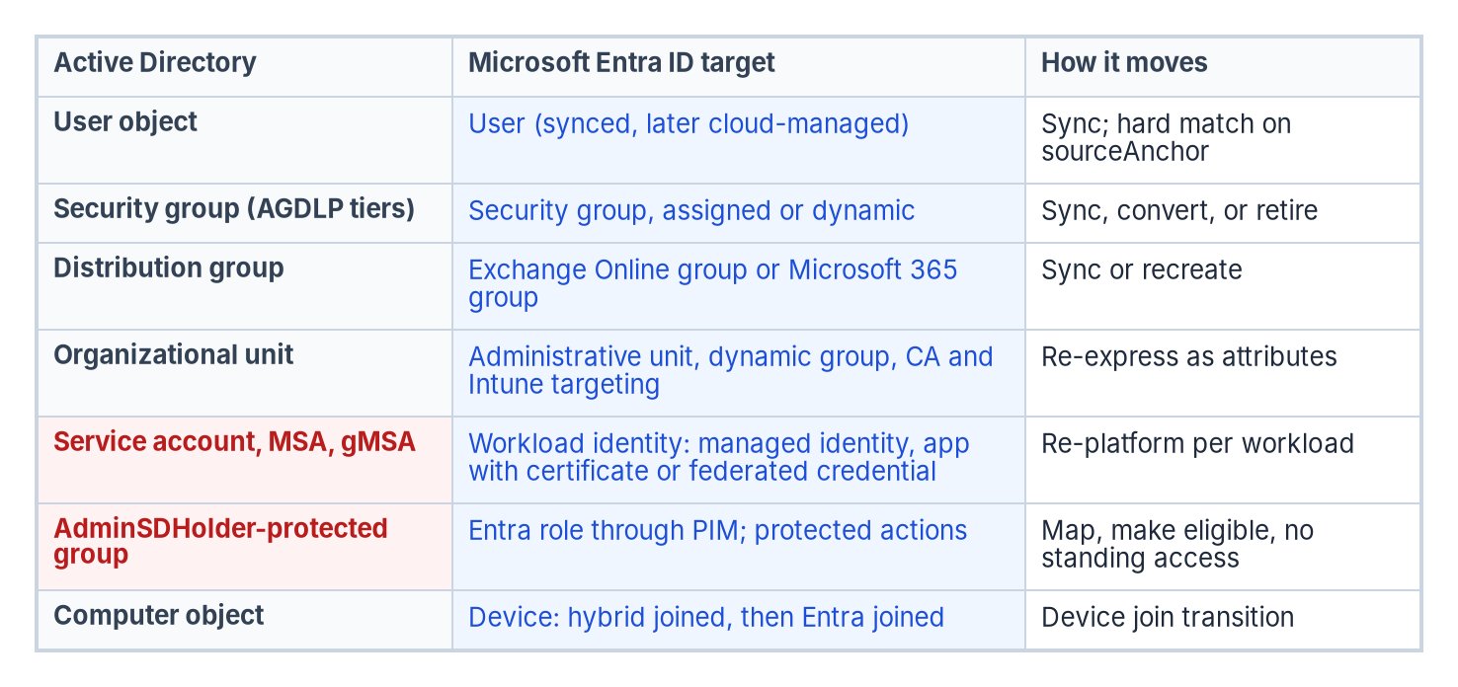
What the OU tree encoded, and where each job goes
WHAT
OU job | Entra ID mechanism | Driven by
OU placement | Organizational attributes | HR, through provisioning
OU-derived security groups | Dynamic groups | Rules over coded attributes
OU-level delegation | Administrative units | Unit rules mirroring group rules
GPO inheritance | Conditional Access and Intune targeting | Governed groups
WHERE THE ATTRIBUTES LIVE
Native Entra attributes first
Extension attributes only where a rule can't read a native one
Rules can't read employeeType, employeeOrgData or manager
Codes, never display strings, in anything a rule reads
Sources: Microsoft Learn, Manage rules for dynamic membership groups (Oct. 29, 2026). Guide, Stage 0, Limits; Book 01, Ch 04; Book 02, Ch 09; Book 03, Ch 06.
Notes:
[4:43–6:27] Book 01 names four governed mechanisms, and the table pairs each with the OU job it replaces. OU placement becomes organizational attributes on every governed user. OU-derived security groups become dynamic groups. OU-level delegation becomes administrative units. And GPO inheritance becomes Conditional Access and Intune targeting. Microsoft documents each mechanism; the program's contribution is the contract that binds them, so setting a user's attributes produces consistent effects everywhere.
The figure below is Book 02's object map. Users sync and later become cloud-managed. Security groups become assigned or dynamic groups, by sync, conversion or retirement. The organizational unit row is the one that matters here: it becomes administrative units, dynamic groups and policy targeting, re-expressed as attributes. Service accounts become workload identities, protected groups become PIM-eligible roles, and computers become devices.
On the right, where the attributes live. Native Entra attributes first, and an extension attribute only where a dynamic rule needs a value it can't read natively. Rules can't read employeeType, employeeOrgData or manager, which is why the schema carries coded mirrors; Microsoft's page still said so on October 29. And codes, never display strings, in anything a rule reads, because a display string breaks the next time someone retypes it.
Stage 0's decision follows: for every OU function, where it goes. GPO scoping to Conditional Access and Intune, delegation to units, logical organization to attributes and dynamic groups. But the tree held more than people, and the next slide sorts its objects into four tracks.
Workbook: Attribute-Driven Migration guide, Stage 0 "Decision," "Limits: rule limits"; Book 01, Chapter 04 — "The four mechanisms," "Where the attributes live"; Book 02, Chapter 09 — "Organizational units"; Book 03, Chapter 06 — "Design rules."

Slide 5
Four tracks, four sources of truth
WHAT
Track | Source of truth | Where it's written | What reads it in the target
HR track: people | HR (Core HCM; Federal HR 2.0 for employees) and the contractor source, through provisioning | The user object: in AD while synced, in Entra ID once cloud-mastered | Dynamic user groups, units, CA personas, Lifecycle Workflows, licenses, access packages
Intune track: end-user devices | Autopilot registration and group tag, Intune enrollment, Graph writes by device provisioning | The Entra device object: extension attributes 1–15, enrollment profile, physical IDs | Dynamic device groups, assignment filters, CA device filters, compliance
Azure Arc track: servers | Arc onboarding (azcmagent connect --tags, resource group), then Azure Policy | Azure resource tags; the resource group or subscription | Azure Policy and machine configuration, Update Manager, Defender for Servers, RBAC
Non-person track: workloads | The owner and sponsor record: system inventory or CMDB, app registration, AI inventory. Not HR | SP and app properties, custom security attributes, owners and sponsors, credentials | CA for workload identities, app roles, Azure RBAC, owner reviews, expiry and orphan checks
GROUP POLICY SPLITS THE SAME WAY
WHAT EACH ATTRIBUTE CAN REACH
User-configuration settings move with people: user-targeted Intune policy and Conditional Access
Computer-configuration settings move with devices (Intune) and with servers (Azure Policy)
HR never describes a device, a server or a service
A device rule can never read its owner's attributes
A non-person identity has no HR record: its owner and sponsor are its accountability
Sources: Guide, "Beyond users"; Book 03 (HR); Book 05, Ch 03, 04, 08 (Intune), Ch 09 (Arc); Book 02, Ch 09; Book 06; Book 17 (non-person). The track model is design guidance.
Notes:
[6:27–9:28] An Active Directory forest holds four different populations of identity, and they move to Entra ID and Azure by different paths. So the series treats them as four tracks, each with its own source of truth. The track model is the program's framing, design guidance; the facts in each row come from the chapters named in the sources line.
The HR track is people: user accounts for employees and contractors. HR, meaning Core HCM and Federal HR 2.0 for employees, and the contractor source of authority are the source, through provisioning. The values land on the user object, in AD while users are synced and in Entra ID once they're cloud-mastered, and dynamic user groups, administrative units, Conditional Access personas, Lifecycle Workflows, and license and access-package assignment read them. Book 03 carries it.
The Intune track is end-user devices. Device provisioning is the source: Autopilot registration and its group tag, Intune enrollment, and Graph writes by the device provisioning service. The values land on the Entra device object, extension attributes one to fifteen, the enrollment profile and physical IDs, and dynamic device groups, Intune assignment filters, Conditional Access device filters and compliance read them. Book 05, Chapters 03, 04 and 08.
The Azure Arc track is servers, brought under Azure Resource Manager. Arc onboarding, the connect command's tags and the resource group, then Azure Policy, are the source; tags and the resource group or subscription hold the values; Azure Policy and machine configuration, Update Manager scoping, Defender for Servers and Azure RBAC read them. Book 05, Chapter 09.
The non-person track is workloads and services: AD service accounts, MSAs and gMSAs, app registrations and service principals, managed identities, workload identities and AI agents. Their source is the owner and sponsor record, the system inventory or CMDB entry, the app registration and the AI inventory, not HR. Service principal and application properties, custom security attributes, owners, sponsors and credentials hold the values, and Conditional Access for workload identities, app roles, Azure RBAC, owner access reviews and credential-expiry and orphan checks read them. Book 02, Chapter 09 for service accounts, Book 06 for SQL principals, Book 17 for AI agents.
Group Policy splits the same way: user-configuration settings move with people, to user-targeted Intune policy and Conditional Access; computer-configuration settings move with devices, to Intune device policy and filters, and with servers, to Azure Policy and machine configuration. And each attribute's reach is bounded: HR never describes a device, server or service, a device rule can't read its owner's attributes, and a non-person identity's accountability is its owner and sponsor.
Workbook: Attribute-Driven Migration guide, "Beyond users"; series framing (four tracks, design guidance); Book 03; Book 05, Chapters 03, 04, 08 and 09; Book 02, Chapter 09 — "Service accounts," "Modernizing service accounts"; Book 06; Book 17.

Slide 6
What this migration accomplishes, and how you know
WHY
THE GOAL
True, owned, read by policy
Track | You're there when (design guidance, on the books' gates) | Federal requirement
HR | Every enabled account correlates to HR or the contractor source, or carries an owned exception; every OU-derived access group is a validated rule over codes | AC-2, PS-4, PS-5, IA-4
Intune | Every managed device carries provisioning-written attributes that target its policy; computer-side GPO links disabled per population, rollback tested | CM-2, CM-6, CM-8, IA-3
Arc | Every in-scope server is Arc-enabled with its tag taxonomy, and its baseline assigned and evaluated by Azure Policy | CM-2, CM-6, CM-8
Non-person | Every service account and service principal has an owner, a sponsor, a reason and a target; no password that never expires; none orphaned | AC-2, AC-6(5), IA-5, IA-9
All tracks | The scheduled drift comparison is clean; findings fixed at the source, not in the copy | AU-6, SI-4, CA-7
Joining, moving and leaving change access automatically, with no ticket or hand-edited group; a new device or workload gets access from its owning record
Delegation and policy follow facts about the object, not its folder
Every non-person identity: a named owner, least privilege, an expiring or managed credential
Every access decision and change leaves evidence
AD can be reduced, then retired, without losing any of the tree's four jobs
Sources: Guide, "What this migration accomplishes," federal requirements; Book 03, Ch 12; Book 05, Ch 08–10; Book 02, Ch 10; Book 17, Ch 05; NIST SP 800-53 Rev. 5 (5.2.0) as named.
Notes:
[9:28–12:49] What is the migration trying to accomplish? The program's goal, stated as design guidance: every person, device, server and workload is governed by attributes that are true, owned by exactly one source, and read by policy.
That means five things. Joining, moving and leaving change access automatically and correctly, with no ticket and no hand-edited group, and a new workload or device gets its access the same way, from its owning record. Delegation and policy follow facts about the object, not its position in a folder tree. Every non-person identity has a named owner, the least privilege it needs, and a credential that expires or is managed, so none is left orphaned. Every access decision and change leaves evidence. And Active Directory can be reduced and eventually retired without losing any of the four jobs the OU tree did: delegation, policy scope, accountability and security scope.
How you know you're there, per track. These criteria are design guidance; where a book states its own gate, that gate governs.
The HR track: every enabled account correlates to an authoritative record, HR or the contractor source, or carries an owned exception; and every OU-derived access group is a validated rule over coded attributes, so no hand-maintained membership remains for it. The gates are Book 03's Phase 1 and Phase 5, its sole-source proof in Appendix C, and Book 01's verification list.
The Intune track: every managed device carries attributes written by provisioning, its policy is targeted by them, and computer-side GPO links are disabled population by population, with rollback tested. Book 05, Chapter 08's testing at each gate and its rollback govern.
The Arc track: every in-scope server is Arc-enabled with its tag taxonomy applied, and its baseline is assigned and evaluated by Azure Policy: Book 05, Chapter 09's day-one baseline.
The non-person track: every service account and service principal has an owner and sponsor, a reason and a target. Each one is retired, re-platformed to a managed identity or gMSA, or made a certificate or federated-credential workload identity. None holds a password that never expires, and none is orphaned. Book 02's Phase 4 is the gate for service accounts, and Book 17's lifecycle for agents.
Across all tracks: the scheduled drift comparison is clean, and findings are fixed at the source, not in the copy, the Stage 8 gate.
The right-hand column names the federal requirement each track's end state supports, from the guide's federal-requirements mapping, which the next slide sets out: account management, personnel termination and transfer, and identifier management for HR; baseline configuration, configuration settings, component inventory and device identification for Intune; the configuration controls for Arc; account management, privileged accounts, authenticator management and service identification for the non-person track; and audit review, system monitoring and continuous monitoring across all four. NIST SP 800-53 Rev. 5, release 5.2.0; the mapping is the program's reading.
Workbook: Attribute-Driven Migration guide, "What this migration accomplishes" (design guidance), Stage 8; Book 01, Chapter 04 — "Verification"; Book 03, Chapter 12 — Phases 1 and 5; Appendix C — "Proving HR is the sole source"; Book 05, Chapter 08 — "Testing at each gate," "Rollback"; Chapter 09 — "The day-one baseline"; Book 02, Chapter 10 — "Phase 4: service account modernization"; Book 17, Chapter 05 — "The lifecycle, event by event."

Slide 7
Federal requirements each track satisfies
WHY
Track | Requirement | What satisfies it
HR | SP 800-53 AC-2, AC-2(1), AC-2(3); PS-4, PS-5; IA-4, IA-4(4) | Accounts trace to worker records; joiner, mover and leaver by workflow, not ticket; one person key
HR: the source | OMB M-19-17; FICAM ILM playbook (not policy); Federal HR 2.0 memo, Dec. 10, 2025 | HR authoritative for who works here; the pipeline keyed so the source can change; a contractor source
HR: sign-in and PIV | OMB M-22-09; IA-2(1), (2), (8), (12); FIPS 201-3; SP 800-63-4; AC-3; BOD 25-01 SCuBA | PIV-bound certificate sign-in at a phishing-resistant strength; Conditional Access on every sign-in
HR and Intune: Stages 4–5 | AC-3(13), tailored in; AC-6; AC-6(7) | Access computed from coded attributes; scoped roles; access reviews
Intune | CM-2, CM-3, CM-6, CM-7, CM-8; IA-3; M-22-09 device signal | Policy library as code; weekly reconciliation; compliance feeds Conditional Access
Arc | CM-2, CM-6, CM-8; IA-9, tailored in | Machine-configuration baselines; a reconciled inventory; the tiers
Non-person | AC-2, AC-6(5); IA-4, IA-5, IA-9; SCuBA MS.AAD.5.1–5.3; M-25-21 for AI | Sponsors and owners; no standing privilege; no stored secrets; the AI inventory
All tracks: Stage 8 | AU-2, AU-6, AU-12, SI-4, CA-7; OMB M-26-14, which rescinded M-21-31 | Logs out of Entra ID from day one; the drift comparison; metrics on the ConMon cadence
The program's mapping, reusing the books' crosswalks: the architecture contributes evidence; the authorizing official decides. Not mapped, for lack of support in the books: PS-7, IA-8 for contractors.
Sources: NIST SP 800-53 Rev. 5 (5.2.0); OMB M-19-17, M-22-09, M-25-21, M-26-14; OMB/OPM HR 2.0 memo; FIPS 201-3; SP 800-63-4; BOD 25-01. Guide; full citations in backup.
Notes:
[12:49–16:42] The tracks and their end state aren't only good practice: each one supports controls and mandates the agency already has to meet. This table is the guide's mapping, which reuses only mappings the books already make. The control identifiers and titles are SP 800-53 Rev. 5, release 5.2.0, and the mapping is the program's reading, as it is in every book: the architecture contributes mechanisms and evidence to a control, and the agency's authorizing official and assessors decide whether it's satisfied.
The HR track. Account management, AC-2, with automated account management, AC-2(1), and disable accounts, AC-2(3): every account traces to a worker record, and hire, transfer and separation create, change and disable accounts by workflow, not ticket; the evidence is provenance records, provisioning logs and Lifecycle Workflows run history. Personnel termination and transfer, PS-4 and PS-5, measured as separation-to-block, separation-to-revocation and transfer-to-review intervals. Identifier management, IA-4, and identify user status, IA-4(4): one enterprise person key kept across rehire and conversion, with worker type as the status.
HR as the source: OMB M-19-17, the enterprise ICAM policy framework, and the FICAM Identity Lifecycle Management Playbook, which recommends HR as the authoritative source and says it isn't official policy. The coming source: the OMB and OPM Federal HR 2.0 memorandum of December 10, 2025, consolidating Core HCM; contractors and vendors are outside it, so the agency designates a contractor source.
Sign-in and PIV: OMB M-22-09's phishing-resistant MFA for staff, contractors and partners; IA-2 with enhancements 1, 2, 8 and 12, acceptance of PIV credentials; FIPS 201-3; and SP 800-63-4. Plus access enforcement, AC-3, and CISA BOD 25-01's required SCuBA policies, such as blocking legacy authentication and phishing-resistant MFA for all users, evidenced by ScubaGear reports.
Stages 4 and 5, for the HR and Intune tracks: attribute-based access control, AC-3(13), which is outside the Moderate baseline and so tailored in; least privilege, AC-6; and review of user privileges, AC-6(7). The rule set in Git is itself the audit evidence.
Intune: baseline configuration CM-2, change control CM-3, configuration settings CM-6, least functionality CM-7 and component inventory CM-8, with exported policy JSON, status reports and the weekly reconciliation; and device identification, IA-3, with M-22-09's device-level signal. Arc: CM-2, CM-6 and CM-8 through machine-configuration baselines, a reconciled inventory and the tiers for what neither tool reaches, and service identification, IA-9, tailored in, for the Arc managed identity.
The non-person track: AC-2 and privileged accounts, AC-6(5), with every workload and agent identity a defined account type with a sponsor and no standing privileged roles; IA-4, authenticator management IA-5, and IA-9, with managed identities and federation first and credentials rotated; the SCuBA policies MS.AAD.5.1 to 5.3 on application creation and consent; and OMB M-25-21's AI use-case inventory and the ability to discontinue an AI system.
All tracks, at Stage 8: AU-2, AU-6, AU-12, SI-4 and continuous monitoring, CA-7, and OMB M-26-14 on agency logging, which rescinded M-21-31. And the GCC boundary: Microsoft 365 GCC is offered at FedRAMP Moderate, and the NIST baseline and the FedRAMP class are separate facts, Book 14 Chapter 03.
The guide leaves out what the books don't support: PS-7, external personnel security; AC-2(13), which the books map to incident response; IA-8 for contractors, which the books map to guests and agents acting for the public; and M-21-31, rescinded. The full citations are in the backup section.
Workbook: Attribute-Driven Migration guide, "The federal requirements each track satisfies"; Book 02, Appendix A — "NIST SP 800-53 Rev. 5 control mapping," "The crosswalk: identity controls"; Book 03, Chapters 02, 03, 08, 09, 11; Book 05, Chapters 04, 10; Book 06, Appendix A; Book 01, 11, 12, 14 and 17, Appendix A or as named.

Slide 8

AD vs Entra ID: the model
WHAT
Topic | Active Directory | Entra ID
Structure | Hierarchy: distinguished names and OUs | Flat
Schema | Extensible LDAP schema; additions are forest-wide and can't be removed, only made defunct | Fixed properties, plus extension mechanisms
Access | LDAP or AD PowerShell | Microsoft Graph; some filters, such as on extension attributes, need advanced queries
Write control | Per-attribute ACLs and OU delegation | Roles scoped by administrative units; custom security attributes have their own roles
Groups from attributes | None native: scripts | Dynamic rules, over some attributes only
Identity anchor | objectGUID, objectSid | The Entra object ID, plus onPremisesImmutableId: Connect uses ms-DS-ConsistencyGuid; Cloud Sync falls back to objectGUID
Mastering | AD | For synced users, AD still masters most attributes; read-only in Entra ID until the source of authority moves
The key line: in AD, where an object sits does half the work; in Entra ID, what the object says about itself has to do all of it.
Sources: Microsoft Learn: user resource type; dynamic membership rules; Connect attributes synchronized (as cited in the guide). Book 01, Ch 04; Book 02, Ch 03, 09.
Notes:
[16:42–18:31] Before the stages, a primer the rest of the deck leans on: how Entra ID's attributes differ from Active Directory's, and the stores they live in. The key line: in AD, where an object sits does half the work; in Entra ID, what the object says about itself has to do all of it.
The model, row by row. AD is a hierarchy of distinguished names and OUs; Entra ID is flat. AD's LDAP schema is extensible, and additions are forest-wide and can't be removed, only made defunct; Entra ID has fixed properties plus extension mechanisms, which the store slide sorts out. AD is read over LDAP or AD PowerShell; Entra ID over Microsoft Graph, and some filters, such as those on extension attributes, need advanced queries. Write control in AD is per-attribute ACLs and OU delegation; in Entra ID it's roles scoped by administrative units, and custom security attributes have their own roles. AD has no native groups from attributes, only scripts; Entra ID has dynamic rules, over some attributes only. The anchor in AD is objectGUID and objectSid; in Entra ID it's the Entra object ID, plus onPremisesImmutableId, the source anchor: Entra Connect uses ms-DS-ConsistencyGuid, from version 1.1.524.0, and Cloud Sync uses ms-DS-ConsistencyGuid with a fallback to objectGUID, which can't be changed.
And mastering. For synced users AD still masters most attributes, and they're read-only in Entra ID until the source of authority moves. That one fact shapes the whole migration: while users are synced, edit attributes in AD or HR, not in Entra ID.
Workbook: Attribute-Driven Migration guide, attributes primer (Entra ID compared with AD); Book 01, Chapter 04 — "Where the attributes live"; Book 02, Chapter 03 — AD and Entra side by side; Chapter 09 — "Soft match and hard match"; Book 03, Chapter 06 — "Design rules."

Slide 9
The attributes you know, side by side
WHAT
AD attribute | Entra ID property | What to know
sAMAccountName | onPremisesSamAccountName | Read-only in Entra ID
distinguishedName | onPremisesDistinguishedName | Read-only; never use it for policy
objectGUID / ms-DS-ConsistencyGuid | onPremisesImmutableId | The source anchor
department / title / company | department / jobTitle / companyName | Rules read codes, not these strings
manager (a DN) | manager (a reference) | Rules can't read it, except in the direct-reports rule
employeeID / employeeType | employeeId / employeeType | employeeId carries the person key; rules can't read employeeType, so slot 11 mirrors it
extensionAttribute1–15 | onPremisesExtensionAttributes | AD-mastered for synced users; rules can read them
Custom schema attributes | Directory extensions | extension_<appId>_<name>
userAccountControl (disabled bit) | accountEnabled | Every access rule requires it to be true
altSecurityIdentities | certificateUserIds | Only through sync rules the administrator adds: the PIV binding
servicePrincipalName (Kerberos) | No equivalent | SPNs stay in AD until workloads move: the non-person track
adminCount | None | Privilege comes from roles and PIM
Sources: Microsoft Learn: user resource type; extension attributes; dynamic membership rules; certificateUserIds (as cited in the guide). Book 03, Ch 06 (slot 11: design guidance).
Notes:
[18:31–20:21] The attributes the team already knows, and what each becomes. This is the key rows of the guide's mapping table.
userPrincipalName carries over as itself. sAMAccountName becomes onPremisesSamAccountName, read-only. distinguishedName becomes onPremisesDistinguishedName, read-only, and never used for policy, because it is the placement we're leaving. objectGUID, or ms-DS-ConsistencyGuid, becomes onPremisesImmutableId, the source anchor; objectSid becomes onPremisesSecurityIdentifier.
department, title and company become department, jobTitle and companyName; rules read codes, not these strings. Office, city, state and country map across, and Entra ID adds usageLocation for licensing. manager, a DN in AD, becomes a reference that rules can't read, except in the direct-reports rule. employeeID becomes employeeId, which carries the enterprise person key; employeeType carries over, but rules can't read it, so the program mirrors it in slot 11, design guidance from Book 03's attribute map.
extensionAttribute1 to 15 become onPremisesExtensionAttributes, AD-mastered for synced users, and rules can read them. Custom schema attributes become directory extensions. The userAccountControl disabled bit becomes accountEnabled, which every access rule should require to be true. memberOf and member carry over, but rules don't nest, and the memberOf rule preview ends November 3, 2026. altSecurityIdentities reaches certificateUserIds, the PIV binding, only through sync rules the administrator adds, because it isn't in the default attribute set. And two have no attribute at all: Kerberos service principal names stay in AD until the workloads move, which is the non-person track, and adminCount has no equivalent, because privilege comes from roles and PIM. A computer object becomes a device object with its own properties and slots, which can't read its owner.
Workbook: Attribute-Driven Migration guide, attributes primer, "Attribute mapping"; Book 03, Chapter 06 — "Program attribute map" (slot assignments are design guidance); Book 02, Chapter 09; Book 03, Chapter 09 (certificateUserIds).

Slide 10
Attribute stores and who can read them
WHAT
Store | Objects | Dynamic rules | Conditional Access | Other readers
Native properties | Users, devices | Yes, except employeeType, employeeOrgData, manager | Through groups | Lifecycle Workflows; licensing (usageLocation)
extensionAttribute1–15 | Users (read-only for synced users); devices (Graph) | Yes, users and devices | Device filters, if managed, compliant or hybrid joined | Lifecycle Workflows scope
Directory extensions | Users, groups, devices; synced or Graph | Yes, single-value only | Not documented | Token claims
Custom security attributes | Users; service principals | No | App filters (SPs, string type) | Azure ABAC; LCW scope; HR provisioning
Schema and open extensions | Many Graph resources | No | No | Application data only
Intune inventory | Managed devices | No | No | Assignment filters
Azure resource tags | Arc servers, Azure resources | No | No | Policy; Resource Graph; Update Manager
certificateUserIds | Users | No | Authentication strength, through CBA | CBA username binding
Sources: Microsoft Learn: dynamic rules; custom security attributes; directory extensions; CA filters; certificateUserIds (Oct. 29, 2026). Guide, attribute stores; Book 03, Ch 06.
Notes:
[20:21–23:18] Every later slide that names a store points back here, so this is the store table: the places an attribute can live, in the order to reach for them, and what can read each. The table is the guide's; the writers are in these notes.
One: native properties, written by HR provisioning, sync from AD or an administrator. Use a native property first. Dynamic rules read many of them, but not employeeType, employeeOrgData or manager. Two: extensionAttribute1 to 15, which came from the Exchange schema. On synced users they're mastered in AD and read-only in Entra ID; on cloud-only users they're writable in Entra ID; on devices they're written through Graph. Dynamic user and device rules read them, Conditional Access device filters read the device's own slots, but only when the device is Intune-managed, compliant or hybrid joined, and Lifecycle Workflows can scope on them. On a cloud-only user who was once synced, they're read-only in Graph and managed through Exchange; test that case before a population's source of authority moves, which is design guidance. The catch: anyone who can read the object can read them, so they aren't for sensitive values. Three: directory extensions, for more than fifteen slots or custom AD schema attributes; rules read single-valued ones, and Microsoft doesn't document Conditional Access reading them.
Four: custom security attributes, typed, in attribute sets, on users and service principals. The Attribute Definition Administrator defines them and the Attribute Assignment Administrator assigns them; Global Administrator can't read them by default; HR provisioning can set them. Conditional Access app filters, Azure ABAC and Lifecycle Workflows read them; dynamic rules can't. At most 500 active definitions and 50 values per object. Use them for sensitive values no rule reads, and for tagging service principals.
Five: device properties, on the Entra device object, read by device rules, and Intune's own inventory, read by assignment filters. Six: Azure resource tags on the Arc track, read by Azure Policy, Resource Graph and Update Manager. Tags aren't a role-assignment scope, since Azure RBAC attaches to the management group, subscription, resource group or resource, and they're plain text, so no security boundary. Seven: certificateUserIds, the credential binding, up to ten values each unique in the tenant, written only by Entra Connect for synced users, through sync rules the administrator adds, and by a Privileged Authentication Administrator or Graph for cloud-only users. And schema and open extensions hold application data; they can't be used in rules and don't sync from AD, so no targeting relies on them.
Workbook: Attribute-Driven Migration guide, attributes primer (attribute stores), "Which attribute store each mechanism can read"; Book 01, Chapter 04 — "Where the attributes live"; Book 03, Chapter 06 — "Design rules"; Book 03, Chapter 09 (certificateUserIds); Book 05, Chapters 08 and 09.

Slide 11
Nine stages, each with a decider and a gate
HOW
# | Stage | Decision, and who decides | Gate: done when
0 | Read what the tree encodes | What each OU function becomes: identity engineering | Inventory in Git; a decision for every group; OU-to-unit map drafted
1 | Source the attributes | Authority map, person key, contractor source: ICAM governance body | Identifier decision, authority map and schema signed
2 | Prove they're true | Correlation threshold: the agency's risk governance | Threshold met on the pilot; every enabled account correlated or excepted
3 | Map them through sync | Sync engine and sign-in method: identity engineering | Counts match; no sync errors; shadow-mode differences explained
4 | Subtrees as dynamic groups | An application's access rule: its owner | Each rule validated, shadowed against its old group, piloted
5 | Delegate with units | Delegation model: identity engineering; restriction default no | Unit rules mirror group rules; role assignments match the matrix
6 | Retarget policy | Control requirements: the CISO | Report-only reviewed; enforced in waves; GPO links disabled
7 | Cut over in phases | Wave go/no-go: identity engineering | Seven days of sole-source proof; ticket path closed; rollback tested
8 | Detect and correct drift | Drift findings: the CISO | Zero-action plan; high-severity findings closed or dated
Sources: Guide, "The path on one page" and "How the books' phase numbers line up"; Book 02, Ch 06 and Book 03, Ch 07 responsibility matrices (design guidance).
Notes:
[23:18–24:57] This is the guide's path on one page: nine stages, numbered zero to eight. Each book numbers its own phases; the guide names stages instead, and its phase-alignment table, in the backup sources, lines them up. That alignment is approximate, and each book's gates still govern its own work.
Read the columns as a contract. Every stage has one decision and one decider, taken from two responsibility matrices, Book 02 Chapter 06 for the directory and Book 03 Chapter 07 for the data. Both are the program's recommended model, design guidance, with one decider per row.
A few to notice. Stage 1's authority map, person key and contractor source belong to the ICAM governance body; HR owns the code lists and the data architect owns the schema. Stage 2's correlation threshold is the agency's, through risk governance, not a number the program imposes. Stage 4 puts each application's access rule with its owner, while HR owns the values the rule reads. Stage 6's control requirements and Stage 8's drift findings sit with the CISO.
And every stage has a gate that says it's done. The gates are the point: Stage 4 doesn't grant production access until the rule has been validated, shadowed against the group it replaces and piloted; Stage 7 doesn't close a population until seven days of changes all trace to HR. The rest of the deck walks the stages in order.
Workbook: Attribute-Driven Migration guide, "The path on one page," "How the books' phase numbers line up"; Book 02, Chapter 06 — "The responsibility matrix"; Book 03, Chapter 07 — "The responsibility matrix."

Slide 12
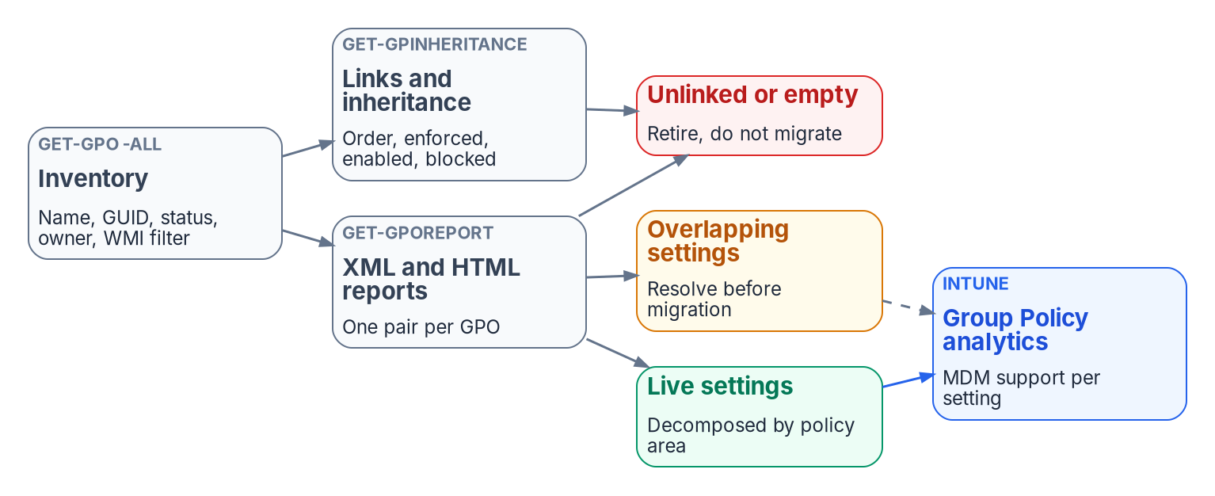
Stage 0: read what the tree encodes before moving it
HOW
READ-ONLY INVENTORY
Placement and size of every OU
GPO links and inheritance, site links included
Non-inherited access-control entries someone delegated by hand
What read-only discovery couldn't see, recorded
DECISION AND GATE
FAILURE MODES
Every security group: keep synced, convert to cloud-only, convert to dynamic, or retire
GPO settings: user-side to the HR track; computer-side to Intune and Arc
Gate: inventory in Git, a UPN remediation plan, a decision per group, OUs mapped to proposed units
A site-linked GPO looks unlinked to an OU-only search
adminCount stays set after an account leaves a protected group, so it overstates privilege
Sources: Guide, Stage 0; Book 02, Ch 07, Ch 08 (OU hierarchy; what to collect), Ch 09 (per-group decision; AdminSDHolder), Ch 10 (Phase 0); Book 05, Ch 08, 09 (GPO split).
Notes:
[24:57–27:02] Stage 0 is read-only. The assessment captures what each OU actually encodes so the target reproduces intent, not structure. The figure is Book 02's GPO analysis: the inventory of every GPO with its status, owner and WMI filter, then the reports and inheritance views per GPO and per OU.
Collect four things. Placement and size of each OU. GPO links and inheritance. The non-inherited access-control entries that someone delegated by hand, because that's where the real delegation lives. And a record of what read-only discovery couldn't see, so nobody mistakes a gap for an absence.
Two decisions come out of it. For every OU function, where it goes, which the OU-jobs slide covered. And for every security group, one of four outcomes: keep it synced, convert it to cloud-only, convert it to dynamic, or retire it.
The GPO analysis also sorts by track. User-configuration settings move with people, so they belong to the HR track and go to user-targeted Intune policy and Conditional Access. Computer-configuration settings move with machines: end-user devices on the Intune track, to Intune device policy and filters, and member servers on the Arc track, to Azure Policy and machine configuration. That split is the series framing, design guidance; Book 05, Chapters 08 and 09 carry each half.
The gate is Book 02's Phase 0: a complete inventory in Git, a UPN remediation plan, a recorded decision for every group, and the OU structure mapped to proposed administrative units.
Two failure modes. A GPO linked at a site looks unlinked to a search that only walks OUs, so include site links. And adminCount overstates current privilege, because it stays set after an account leaves a protected group; check actual membership.
That's the model. Module 2 sources the attributes that replace the tree.
Workbook: Attribute-Driven Migration guide, Stage 0; Book 02, Chapter 07 — "Recording what read-only discovery couldn't see"; Chapter 08 — "OU hierarchy and delegation," "What to collect"; Chapter 09 — "The per-group decision," "AdminSDHolder and protected groups"; Chapter 10 — "Phase 0: assessment."

Slide 13
Module 2: Sourcing and proving the attributes
The HR track: people · Stages 1 to 3 · Book 03, Chapters 03–07 and 12
IN THIS MODULE · ABOUT 13 MINUTES
HR as the authority; Federal HR 2.0 and API-driven provisioning
Contractors, the canonical schema and its single writer
Proving the attributes true, then mapping them through sync
Presented by Michael F. Stratton
Not an official U.S. government publication. Independent technical analysis; not reviewed or endorsed by any federal agency.
Notes:
[27:02–27:53] Module 2: sourcing and proving the attributes. This module is the HR track: the people, employees and contractors, whose attributes come from HR and the contractor source. Devices, servers and workloads are Part 2. Every mechanism in Module 3 reads these values, so this is where the migration is won or lost, and it's the work estates skip because users never see it.
So: which system owns each fact, and the enterprise person key; Federal HR 2.0 as the coming source and how Core HCM reaches Entra ID through API-driven inbound provisioning; the facts HR doesn't supply, including contractors; the canonical schema and its one writer; and then Stages 2 and 3, proving the values true and carrying them through sync.
Workbook: Attribute-Driven Migration guide, Stages 1–3; Book 03, Chapters 03–07 and 12; Book 02, Chapter 09.

Slide 14
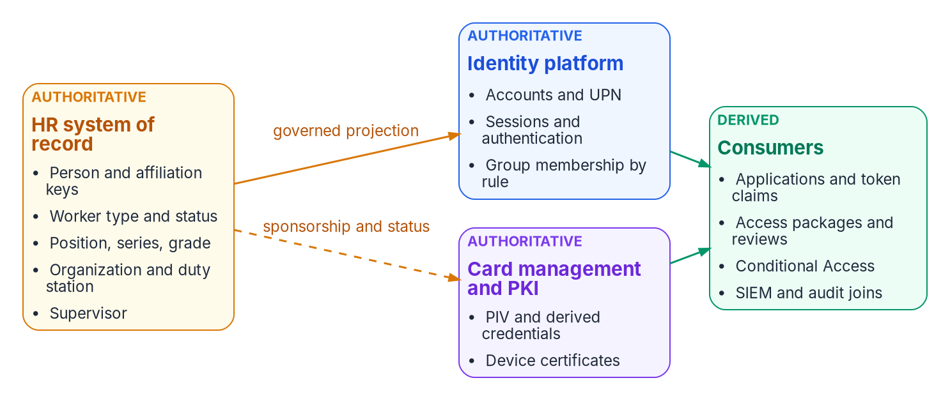

Stage 1: HR is the authority, one fact to one system
WHAT
THE ENTERPRISE PERSON KEY
A key the agency controls, carried in employeeId (at most 16 characters)
The source person number maps to it
A change of HR source changes only the source key
Decided by the ICAM governance body
Authoritative once, derived everywhere: each attribute is authoritative in one system, and corrections flow upstream to it, never into the copy.
Sources: Guide, Stage 1 "Decisions and owners" and "Failure modes"; Book 01, Ch 04; Book 03, Ch 04 (authority; identifiers), Ch 07 (where ownership fails).
Notes:
[27:53–29:29] Stage 1 decides where each attribute comes from, what it's called, what it holds and who may write it.
Start with which system owns each fact; the figure is Book 03's authority map. HR is authoritative for who a worker is and where they sit: person and affiliation keys, worker type and status, position, organization, duty station and supervisor. The identity platform is authoritative for how identity is proven and whether a request is permitted now: accounts, sessions and group membership by rule. Card management and PKI own the PIV and derived credentials. Consumers only derive. Every attribute is authoritative in one system and derived everywhere else, and corrections flow upstream.
Then the enterprise person key. It's a key the agency controls, carried in employeeId, which holds at most 16 characters, with the source system's person number mapped to it. That layering is what lets the HR source change without breaking identity: a new source changes only the source key. The governance body decides it.
Book 03 Chapter 07 names three ways ownership fails. A key owned by the source breaks at the Core HCM cutover. An owner without the means leaves duty station stale. And the help desk becomes a shadow source. The design answers each: an agency-owned key, owners with the means, and one writer.
And that cutover is coming, which is the next slide.
Workbook: Attribute-Driven Migration guide, Stage 1 "What it is," "Decisions and owners," "Failure modes"; Book 01, Chapter 04 — "What the attributes drive"; Book 03, Chapter 04 — "System of record versus identity provider," "Authoritative versus derived attributes," "One person, layered identifiers"; Chapter 07 — "Where ownership fails."

Slide 15

Federal HR 2.0: the coming source and what OPM leaves open
WHY
THE PROGRAM FACTS (BOOK 03, OCT. 20, 2026)
WHAT OPM DOESN'T SPECIFY
OMB/OPM memo, Dec. 10, 2025: one government-wide Core HCM platform
Award to Oracle Fusion Cloud HCM, June 10, 2026
Wave 2 in FY 2027; adoption goal FY 2028; eOPF and EHRI expected to go
Sample onboarding ~8 months, interconnections ~month 5: a planning assumption
No OPM document mandates how the platform reaches the agency's directory
Only a sample "Identity Management Solution" interconnection; no protocol or product
Design guidance: take the HR-to-identity feed to the Steering Committee in Phase 0
The window closes at interconnection go-live
Sources: Guide, Stage 1 "Building the attributes from Federal HR 2.0"; Book 03, Ch 03 (program facts; what OPM requires), Ch 12. Schedule: confirm with the HR 2.0 program office.
Notes:
[29:29–31:14] Federal HR 2.0 will supply most of these attributes for federal employees, so it belongs in Stage 1, not after it. These are Book 03 Chapter 03's facts, dated October 20, 2026; the guide didn't re-check the schedule after that, and says to confirm it with the HR 2.0 program office.
The joint OMB and OPM memorandum of December 10, 2025 consolidates the government's Core HCM systems onto one government-wide platform, and OPM awarded the contract to Oracle, Oracle Fusion Cloud HCM, on June 10, 2026. Wave 1 is the volunteer agencies; Wave 2 is everyone else, in fiscal 2027; the adoption goal is fiscal 2028; and the memo expects the platform to make eOPF and EHRI redundant. The sample onboarding runs about eight months with interconnections live around month five, which Book 03 treats as a planning assumption.
What OPM doesn't require matters more. No OPM document mandates or specifies how the platform integrates with the agency's directory. The solicitation's identity requirements point into the platform: its users sign in through OPM's identity provider and are provisioned by SCIM. The reverse direction appears only as a sample interconnection, an Identity Management Solution fed by Core HCM, with no protocol, product or directory named, and the Steering Committee approves agency integrations.
So the Entra design is the agency's own. The book's design guidance: take the HR-to-identity feed to the Steering Committee in Phase 0 and name it in the memo's integration inventory, because the window closes at go-live.
Workbook: Attribute-Driven Migration guide, Stage 1 "Building the attributes from Federal HR 2.0"; Book 03, Chapter 03 — "The program facts," "What OPM requires and what it leaves to the agency," "Why this is the opportunity, not the project"; Chapter 12 — "Phase 0: program alignment."

Slide 16

API-driven inbound provisioning and the two landing zones
HOW
LICENSING AND GCC, OCT. 29, 2026
Included with Entra ID P1, P2 and ID Governance
GA in the US Government cloud since June 2025
/bulkUpload: 2,000 calls a day (P1/P2), 6,000 (ID Governance), 50 operations a call
Population | Where HR writes | How it reaches Entra ID
AD-mastered (synced), most of the estate today | AD, through the provisioning agent; the OU is computed from HR attributes | Connect Sync or Cloud Sync; Entra extension attributes read-only
Cloud-mastered | Entra ID directly; structure lands as attributes, not an OU | Already there; any AD account an app needs is provisioned from Entra ID
Sources: Microsoft Learn, API-driven inbound provisioning concepts; Entra releases archive (June 2025); Entra feature availability (Oct. 29, 2026). Guide, Stage 1; Book 03, Ch 05.
Notes:
[31:14–32:57] How the record gets from HR to Entra ID. Oracle Fusion Cloud HCM has no native Entra connector, so the Microsoft realization is API-driven inbound provisioning. The figure is Book 03's pipeline: HCM Extracts for the full load and Atom feeds for changes, read by middleware in the agency's boundary. The middleware has five duties per event: validate, failing closed; sequence; normalize to SCIM; write provenance; and reconcile the result. Then it posts to the Microsoft Graph bulk upload endpoint. One rule from Book 03: read the hire, termination and cancellation feeds by published date, or pre-hire workflows never run.
Each provisioning app has its own endpoint and lands users in one of two places, the table at the bottom. For AD-mastered users, most of the estate today, the provisioning agent writes AD, the OU is computed from HR attributes and manager becomes a DN reference; sync carries them up, and the Entra extension-attribute values are read-only. For cloud-mastered users HR writes Entra ID directly. The two converge population by population: HR stays the authority for the person, and AD becomes a shrinking downstream target.
Licensing, from Microsoft Learn on October 29, 2026. API-driven provisioning is included with Entra ID P1, P2 and ID Governance. It became generally available in the US Government cloud in June 2025, and the feature-availability table lists it. The daily cap is 2,000 calls with P1 or P2 and 6,000 with ID Governance, at up to 50 operations a call.
Workbook: Attribute-Driven Migration guide, Stage 1 "The path from HR to Entra ID," "Licensing and GCC"; Book 03, Chapter 05 — "Why API-driven inbound provisioning," "What the feeds do," "Two landing zones," "Over the Entra ID migration."

Slide 17
What HR doesn't supply: contractors and other writers
WHO
Not from HR | Writer instead
Contractors and vendors (not in HRIT) | One authority per fact: suitability register, contract record, PIV system, a federal sponsor mastered in HR
Account type: Standard, Service, Privileged (slot 7) | Identity team; during transition a sync rule derives it from OU placement
Clearance level (slot 9) | Personnel security system
DoNotSync (slot 15) | Identity operations, in AD
Device region, department, tier, role, environment | Device provisioning at registration, through Graph
Where someone signs in from | Sign-in signals: duty location scopes; network-location policy enforces
Credentials, sessions, group membership | The identity platform
BEFORE THE WAVE LANDS
A source swap, not a redesign
Key on an agency-owned person key
Map to OPM standard elements and codes
One door into the directory: middleware
Don't build on EHRI or eOPF feed shapes
NO HR FEED YET (DESIGN GUIDANCE)
Treat the hand steward as a temporary source: named owner, same writer and provenance; retire it read-only first
Sources: Guide, Stage 1 "What HR supplies" and "Before the agency's wave lands"; Book 03, Ch 03, 04, 05, 06 (one fact, one authority; sequence), Ch 13; Book 05, Ch 08.
Notes:
[32:57–34:46] HR supplies most of the person, but not all of it, and the guide names a writer for every fact HR doesn't own.
Contractors and vendors aren't in HRIT. Book 03's rule is one authority per fact: the suitability register, the contract record, the PIV system, and a federal sponsor who is mastered in HR. Account type, slot 7, is the identity team's; during the transition a sync rule derives it from OU placement, and that rule is dropped once the value is on the source object. Clearance comes from the personnel security system. The do-not-sync flag is identity operations', in AD. Device attributes come from device provisioning at registration, through Graph, not from the user's HR record. Where someone signs in from is a sign-in signal: duty location is for scoping, and network-location policy enforces on the sign-in. Credentials, sessions and membership belong to the identity platform.
On the right, the pipeline doesn't wait for Core HCM. Book 03's reference deployment builds the middleware against the current HR system and Core HCM sandbox extracts at once, and switches source at go-live. Four choices make that a source swap: key on an agency-owned person key; map to OPM's standard elements, not vendor field names; keep one door into the directory, so validation, provenance and reconciliation outlast the source; and don't build on EHRI or eOPF shapes.
Where no HR feed exists yet, the guide's design guidance treats whoever stewards the attributes by hand as a temporary source contract, then retires it the way the contractor sequence does.
Workbook: Attribute-Driven Migration guide, Stage 1 "What HR supplies, and what it doesn't," "Before the agency's wave lands"; Book 03, Chapter 04 — "Authoritative versus derived attributes"; Chapter 06 — "One fact, one authority," "Sequence: start with what already exists"; Chapter 13 — "Phase by phase"; Book 05, Chapter 08 — "The device attribute schema."

Slide 18
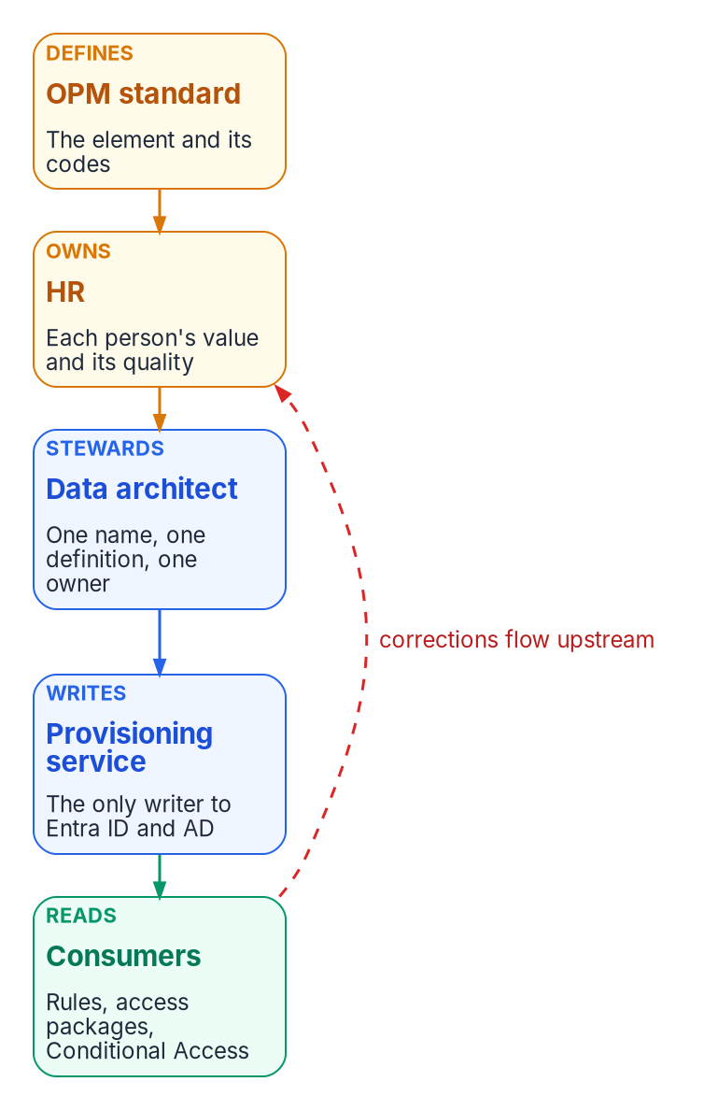
The canonical schema, and one writer per attribute
WHAT
Fact (codes are placeholders) | Carrier | Rules read it?
Enterprise person key | employeeId | Yes; rarely used
Organization code, e.g. FIN-LED | extensionAttribute10 | Yes: node groups
Worker type code | extensionAttribute11 (mirrors employeeType) | Yes: personas
Position category | extensionAttribute12 | Yes: functional groups
Division; cost center | extensionAttribute6; 5 (mirror employeeOrgData) | Yes: division units
Region code (duty station) | extensionAttribute4 | Yes: region groups
Hire and leave dates | employeeHireDate; employeeLeaveDateTime | Hire date preview only; leave no
THE PROVISIONING SERVICE IS THE ONLY WRITER
Help-desk, self-service and Exchange-admin write paths to the access slots are removed
Security decides write permissions on HR-mastered attributes; any other write is drift
Sources: Guide, Stage 1, crosswalk; Book 03, Ch 06 (design rules; writers; program attribute map), Ch 07; Book 06, Ch 17. Slots per the program attribute map (design guidance).
Notes:
[34:46–36:34] The canonical schema is the data architect's, with HR owning the code lists. The chain on the left is Book 03's ownership model: OPM's standard defines the element and its codes, HR owns each person's value, the data architect stewards one name and one definition, the provisioning service is the only writer, and consumers read the value. A red arrow runs back: corrections flow upstream.
Book 03's design rules. Native Entra attributes first. Three coded extension attributes for access: organization code in slot 10, worker type code in slot 11, position category in slot 12. Codes, never display strings, in anything a rule reads. The table shows the program's carriers; FIN-LED and the other codes are placeholders for the agency's own lists. Division and cost center mirror employeeOrgData in slots 6 and 5, because rules can't read employeeOrgData; the worker type code mirrors employeeType for the same reason. Hire date is readable by rules only in preview, so keep it out of production rules; leave date isn't readable at all. For AD-landed users, the dates travel in slots 2 and 3 and a sync rule maps them. Use the same carrier in both landing zones, so a rule on slot 10 works for hybrid and cloud users alike.
And the writer rule, which is the one that holds the rest together. The provisioning service is the only writer of every schema field. Help-desk, self-service and Exchange-admin write paths to the access slots are removed, and security decides write permissions on HR-mastered attributes. Any other write is drift.
Workbook: Attribute-Driven Migration guide, Stage 1 "The canonical schema," "Writers"; "Attribute-to-mechanism crosswalk"; Book 03, Chapter 06 — "Design rules," "Writers," "Program attribute map," "The schema"; Chapter 07 — "The data architect"; Book 06, Chapter 17 — "FedRAMP Moderate in the commercial cloud."

Slide 19
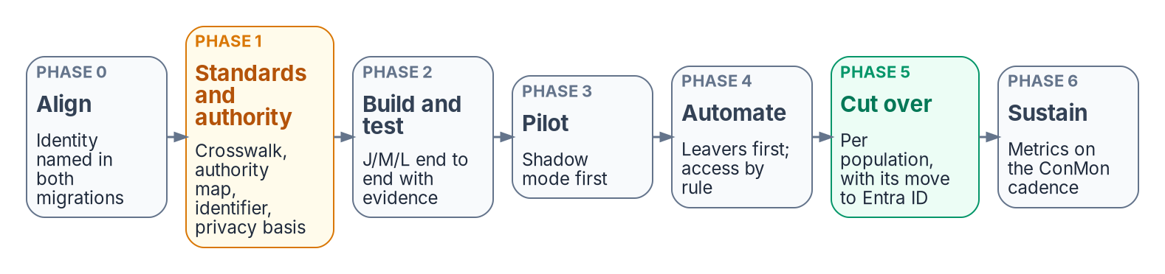
Stage 2: prove the attributes true before use
HOW
THE WORK (BOOK 03, PHASE 1)
DECISION AND GATE
Baseline HR against reality: worker type, organization, supervisor, status
Fix errors at the source; populate employeeId before the first full sync
Flag every unmatched enabled account as an orphan candidate with an owner
Remove AD write paths on target OUs and Exchange custom-attribute cmdlets
Threshold set by the agency's risk governance; 99% on the pilot is a proposed start, not a requirement
Every enabled account correlated or on a dated exception list
Privacy basis, PIA and the minimized attribute set are gate items too
Expect a burst of high-severity findings in month one: the measurement working
Sources: Guide, Stage 2; Book 01, Ch 04 (from sessions to tokens); Book 03, Ch 06 (writers), Ch 07 (privacy office), Ch 11, Ch 12 (sequencing principle; Phase 1).
Notes:
[36:34–38:16] Stage 2 is the one most programs want to skip, and the one Book 03 says not to. Every later control reads these attributes, so prove them before anything depends on them. The strip across the top is Book 03's phase model; Phase 1 is standards and authority, and its gate is Stage 2's.
The work. Baseline HR against reality for worker type, organization, supervisor and status, and fix every error at the source; HR owns the fix. Populate employeeId on existing accounts before the first full sync, because matching is what prevents duplicate identities at go-live. Flag every unmatched enabled account as an orphan candidate and give it an owner. Confirm the extension-attribute carriers are free. And remove the other writers: in AD, the write paths on the target OUs and Exchange's custom-attribute cmdlets.
The decision is the correlation threshold, set by the agency's risk governance. Ninety-nine percent on the pilot cohort is Book 03's proposed starting point, not a requirement, and a risk-tiered threshold is usually better. The gate: the threshold met on the pilot, and every enabled account correlated or on a dated exception list. Book 03 Chapter 07 adds that the privacy basis, the PIA and the minimized attribute set are Phase 1 gate items too.
The failure mode is automating against unverified data in month one. And expect a burst of high-severity findings when a new pipeline starts. That's the measurement working, not the program failing.
Workbook: Attribute-Driven Migration guide, Stage 2; Book 01, Chapter 04 — "From sessions to tokens"; Book 03, Chapter 06 — "Writers"; Chapter 07 — "The privacy office"; Chapter 11 — "Drift between HR and the directory"; Chapter 12 — "Sequencing principle," "Phase 1: attribute authority and schema," "The program at a glance."

Slide 20
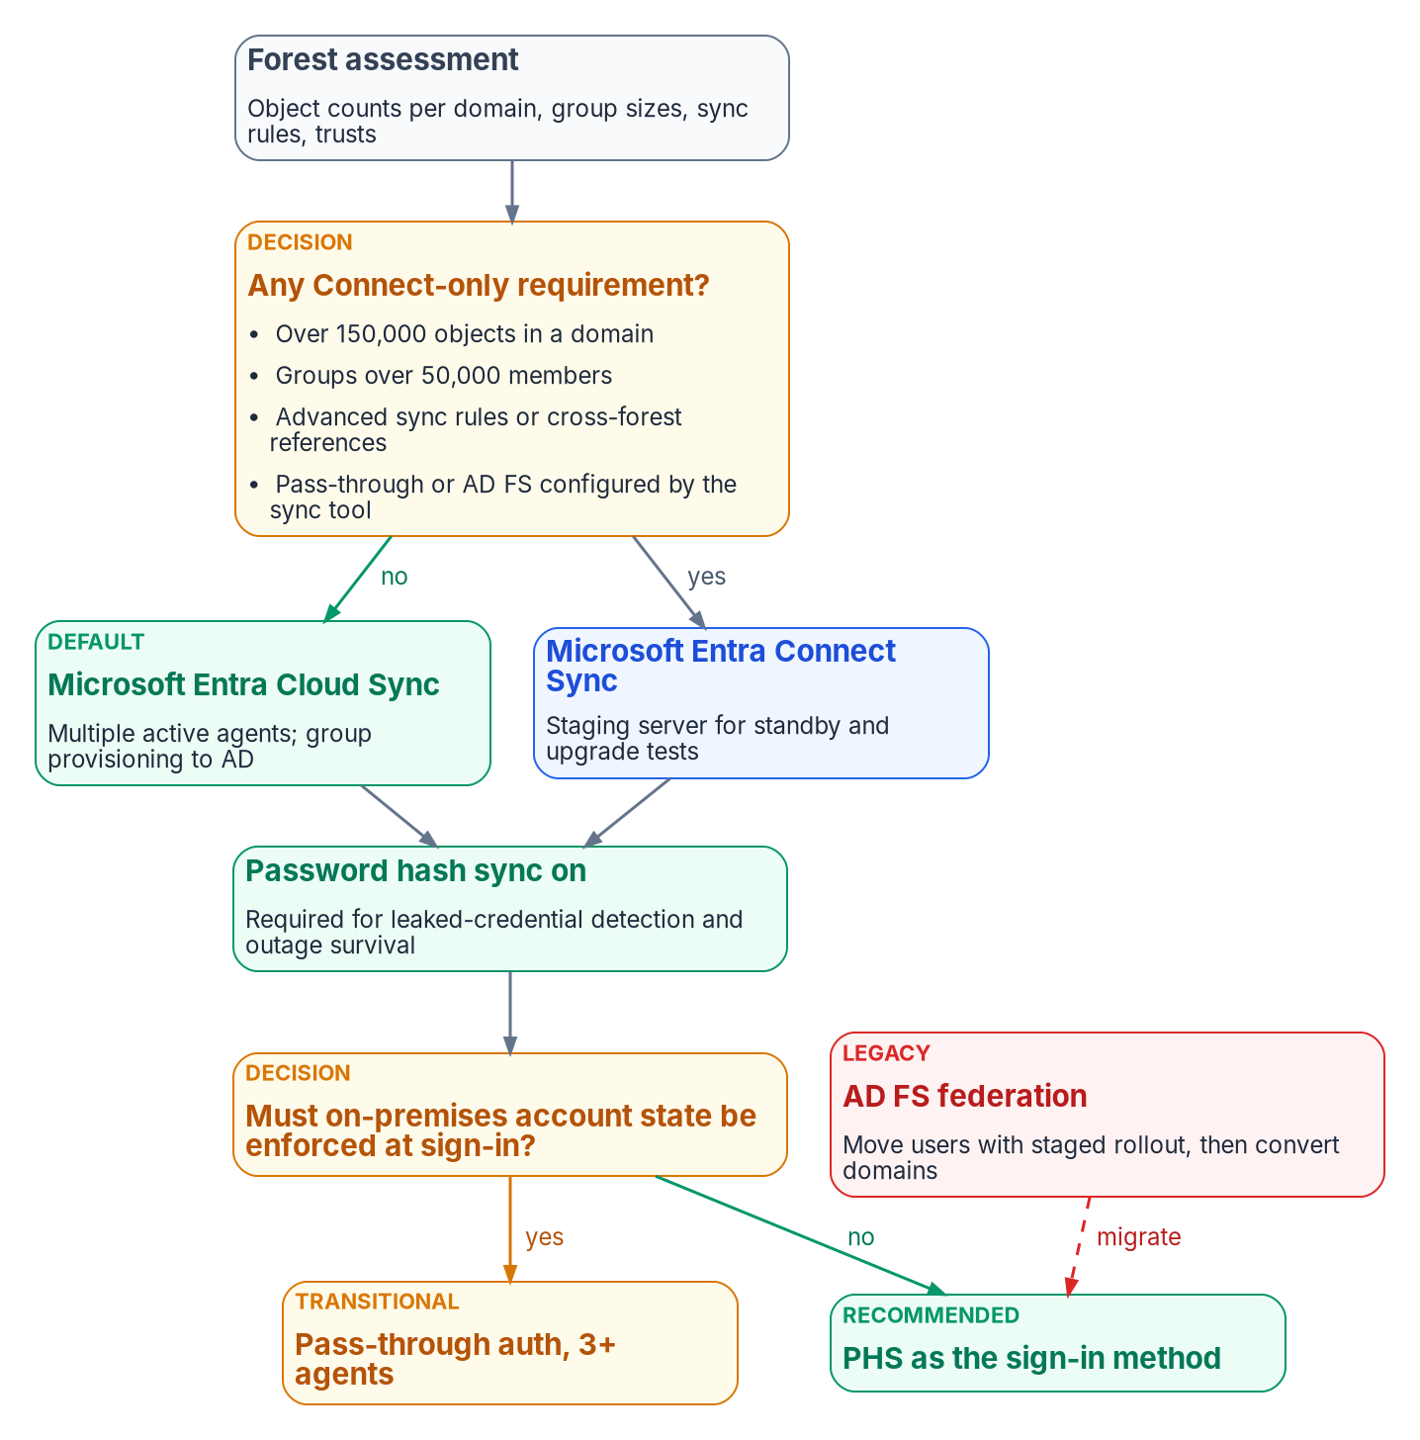
Stage 3: map the attributes through sync
HOW
DECISIONS: IDENTITY ENGINEERING
Cloud Sync unless a Connect-only requirement applies; password hash sync everywhere
Filtering: the DoNotSync scoping filter on extensionAttribute15
Attribute flow: date mappings for AD-landed users; a transitional account-type rule from OU placement
Gate: counts within ±1%, no sync errors; full sync reconciled, then shadow mode explained
FAILURE MODES
A soft or hard match overwrites cloud values: clean AD first, block both outside a window
Connect Sync below 2.6.84.0 with app-based auth stops syncing on April 7, 2027
An omitted attribute in a /bulkUpload record can clear the target: send the whole record
Sources: Guide, Stage 3; Book 02, Ch 09 (sync engine; filtering; attribute flow; soft and hard match), Ch 10 (Phase 1); Book 03, Ch 05, Ch 06, Ch 12 (Phase 3).
Notes:
[38:16–40:01] Stage 3 is the plumbing between HR, AD and Entra ID during coexistence. The figure is Book 02's sync and sign-in decision.
Two decisions, both identity engineering's. The sync engine: Cloud Sync, the default, unless a Connect-only requirement applies, such as very large domains or groups, advanced sync rules, or cross-forest references. And the sign-in method: password hash sync everywhere, which leaked-credential detection and outage survival both need.
Then filtering and attribute flow. The do-not-sync scoping filter reads slot 15. The date mappings carry hire and leave dates for AD-landed users. And the transitional account-type rule derives slot 7 from OU placement until the value is on the source object, then it's dropped.
The gate comes from two books. Book 02's Phase 1: object counts within plus or minus one percent, no sync errors, and an attribute spot check. Book 03's Phase 3: the initial full sync reconciled before deltas, then shadow mode with every difference between pipeline and directory explained, and zero unmatched-record creations.
Three failure modes. A soft or hard match overwrites cloud attributes with on-premises values, so clean AD first and keep both match types blocked outside a planned window. A Connect Sync server that isn't on version 2.6.84.0 with application-based authentication stops synchronizing on April 7, 2027. And an omitted attribute in a bulk-upload record can clear the target value if clearing is enabled, so send the complete record every time.
With the attributes true and in place, Module 3 puts them to work.
Workbook: Attribute-Driven Migration guide, Stage 3; Book 02, Chapter 09 — "Choosing and configuring the sync engine," "Filtering," "Attribute flow and transformations," "Soft match and hard match," "Cloud Sync or Connect Sync"; Chapter 10 — "Phase 1"; Book 03, Chapter 05 — "The middleware"; Chapter 06 — "The schema"; Chapter 12 — "Phase 3."

Slide 21
Module 3: HR-track mechanisms
Stages 4 to 6 · dynamic user groups, administrative units, Conditional Access
IN THIS MODULE · ABOUT 15 MINUTES
Stage 4: OU subtrees as dynamic user groups; Stage 5: administrative units
Stage 6: Conditional Access personas
The dangers of dynamic user groups, their limits, and the HR-track decisions
Presented by Michael F. Stratton
Not an official U.S. government publication. Independent technical analysis; not reviewed or endorsed by any federal agency.
Notes:
[40:01–40:45] Module 3: the HR track's mechanisms. The attributes are true and in the directory. Now each mechanism that replaces an OU job for people reads them, and each has its own rules for what it can read.
So: Stage 4, OU subtrees rebuilt as dynamic user-group rules; Stage 5, delegation through administrative units; Stage 6, Conditional Access personas built from the attributes. Then the dangers of dynamic user groups and how to avoid them, the limits of dynamic membership and its latency, and the decisions the HR track needs, with their owners. Dynamic device groups, Intune targeting, Arc and the non-person identities are Part 2.
Workbook: Attribute-Driven Migration guide, Stages 4–6, "Dynamic group dangers and how to avoid them," "Limits"; Book 01, Chapter 04; Book 02, Chapter 05; Book 03, Chapter 10; Book 04, Chapter 03; Book 06, Chapters 16–17.

Slide 22
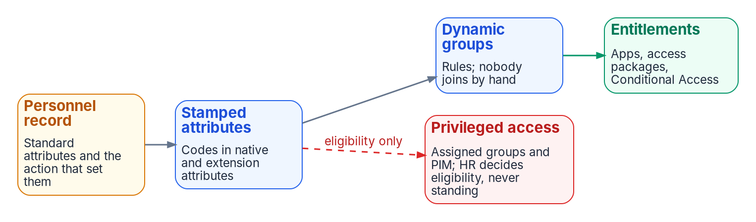
Stage 4: OU subtrees become dynamic-group rules
HOW
Pattern | What it answers
Node query | One place in the organization, by organization code; -in for a roll-up of codes
Functional query | An organizational attribute combined with another, e.g. IT and the security position category
Every access rule | Excludes disabled accounts, guests and agents' user accounts explicitly
DECIDE, GATE, FAIL
Convert only groups whose membership really follows department, location or role; flatten nesting
No production access until the rule is validated, shadowed against its old group and piloted
A rule change removes members who no longer match
Sources: Guide, Stage 4; Book 01, Ch 04 (two query patterns); Book 02, Ch 09 (converting groups; nesting); Book 03, Ch 07, Ch 10 (rule patterns); Book 06, Ch 16, Ch 17.
Notes:
[40:45–42:27] Stage 4. AD answered "who is in the Finance branch?" by walking the tree. Entra ID answers it by evaluating a rule. The strip at the top is Book 03's derivation chain: the personnel record, the stamped codes, dynamic groups where nobody joins by hand, and then access.
Every governed group uses one of two patterns from Book 01. A node query captures one place in the organization by organization code, and a roll-up over several codes uses the in operator rather than a chain of ors. A functional query combines an organizational attribute with another, for a question that isn't about position at all, like every IT user in the security position category, in every region. And every access rule explicitly excludes disabled accounts, guests and agents' user accounts.
The decision: convert a group only where its membership really follows department, location or role; otherwise keep it assigned. The application owner decides the access rule, and HR owns the values. Flatten nested chains rather than rebuilding them.
The gate is Book 06's: no dynamic group grants production access until its attributes are verified for a pilot cohort and its rule has been validated, shadowed against the group it replaces and reconciled.
Two failure modes. A rule on a display string breaks the next time someone retypes it. And a rule change removes existing members who no longer match, so a rule edit is a change with blast radius. Next, delegation.
Workbook: Attribute-Driven Migration guide, Stage 4; Book 01, Chapter 04 — "The two query patterns"; Book 02, Chapter 09 — "Converting static groups to dynamic groups," "Nested groups"; Book 03, Chapter 07 — "Who uses it"; Chapter 10 — "Rule patterns"; Book 06, Chapter 16 — "Flat by design"; Chapter 17 — "Writing, naming and testing rules," "Choosing the attributes."

Slide 23

Stage 5: delegation moves to administrative units
WHO
DECISIONS (DESIGN GUIDANCE)
Each unit's dynamic rule mirrors its group's rule; division units read extensionAttribute6
Restricted management: per unit, default no, decided before creation
Role principals: assigned, role-assignable, PIM-eligible groups
Create the unit and its scoped role before the groups it holds
A unit scopes writes, not reads: it isn't a confidentiality boundary, and restricting a broad HR population takes it out of PIM, access reviews and workflows.
Sources: Guide, Stage 5; Book 01, Ch 04 (three-tier model; restricted management); Book 02, Ch 05 (units; restriction; role matrix; drift), Ch 06; Book 06, R07.
Notes:
[42:27–44:08] Stage 5. OU-level delegation becomes administrative units: containers of users, groups or devices against which a role is assigned, so it applies only to the unit's members. The figure is the three-tier model. Tenant-scoped readers sit on top, because reader roles have no unit scope. Department units sit below with user and group administrators. Division units, created on demand, hold help-desk and password roles. Units don't nest; the dashed lines are naming only.
Each unit's dynamic rule mirrors the matching group's rule, and division units read the division code in slot 6.
The decisions. The delegation model is identity engineering's. Restricted management is a per-unit decision with a default of no, and it's made before the unit exists, because it can't be changed afterward. Role principals are assigned, role-assignable groups whose members are PIM-eligible. And create the unit and its scoped assignment before the groups it will hold, so there's no window where only a tenant-wide administrator can manage them.
The gate: every unit's rule matches the registry with processing on, every role assignment is in the matrix, and the scoped role is denied outside its unit.
Three failure modes from Book 01. Treating a unit as a confidentiality boundary when it only scopes writes. Restricting a broad HR-driven population, which removes it from PIM, entitlement management, Lifecycle Workflows and access reviews. And expecting a Global Administrator to be locked out, when restriction only makes the bypass deliberate and audited.
Workbook: Attribute-Driven Migration guide, Stage 5; Book 01, Chapter 04 — "The three-tier model," "Restricted management"; Book 02, Chapter 05 — "What administrative units are," "Division AUs," "Restricted management: a per-AU decision," "Role assignment matrix," "Drift detection"; Chapter 06 — "The responsibility matrix"; Book 06, Runbook R07 — "Sequencing."

Slide 24
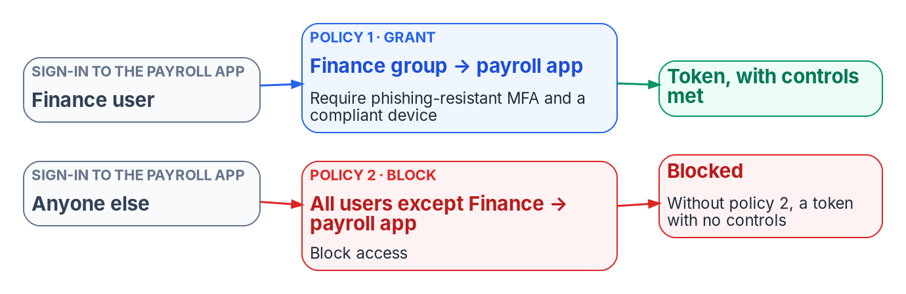
Stage 6: Conditional Access targets personas, not the tree
HOW
PERSONAS FROM ATTRIBUTES
Internals: worker type code in extensionAttribute11
Admins: account type Privileged, or the PIM-eligible population
Emergency-access group excluded
GATE
FAILURE MODES
Every policy in report-only for two to four weeks, then enforced in waves behind a monitoring gate
Every policy targets only governed groups
Account lockout isn't a CA control: Entra smart lockout or Intune
A grant policy restricts nothing on its own: pair it with a block
A policy on a dynamic group misses every user whose attribute is empty
Role targeting misses unit-scoped roles: target the admins' group
No inheritance through units: the branch group must hold everyone the GPO reached
Sources: Guide, Stage 6; Book 01, Ch 04 (CA, the inheritance replacement; verification); Book 02, Ch 06, Ch 09 (testing and rollout); Book 04, Ch 03 (personas; pairs; exclusions).
Notes:
[44:08–45:51] Stage 6. GPOs inherited down the tree; Conditional Access policies and Intune assignments target groups. So the targeting unit becomes a persona built from authoritative attributes. Internals come from the worker type code in slot 11. Admins come from account type Privileged, or the PIM-eligible population. And the emergency-access group is excluded from enforced policies.
The figure is Book 04's most important pattern. A grant policy restricts nothing on its own: requiring phishing-resistant MFA for Finance on the payroll app doesn't stop anyone else. It needs a paired block for everyone who isn't in the group.
The gate. Every policy runs in report-only for two to four weeks, then is enforced in waves behind a monitoring gate, with the emergency-access group excluded, and every policy targets only governed groups. The CISO owns the control requirements. Some GPO settings aren't Conditional Access controls at all; account lockout goes to Entra smart lockout or Intune.
Three more failure modes, all attribute-shaped. A policy that includes a dynamic group silently misses every user whose attribute is empty, so the block side has to catch them. Role targeting doesn't reach roles scoped to an administrative unit, so target the administrators' group instead. And Conditional Access doesn't inherit through units, so the branch group has to include everyone the ancestor GPO targeted.
Devices are the other half of Stage 6, and Part 2 takes them up on the Intune track; first, the dangers of dynamic user groups.
Workbook: Attribute-Driven Migration guide, Stage 6; Book 01, Chapter 04 — "Conditional Access: the policy-inheritance replacement," "Verification"; Book 02, Chapter 09 — "Testing and rollout"; Book 04, Chapter 03 — "Personas," "Policies come in pairs," "Exclusions," "Users, groups, roles and workload identities."

Slide 25
Dynamic user groups: the dangers, and how to avoid them
HOW
Danger (HR track) | How to avoid it
Write access to an attribute is access | The provisioning service is the only writer; remove help-desk, self-service and Exchange custom-attribute write paths, in AD and Entra ID
One rule edit has a large blast radius | Validate (up to 20 users at a time), shadow against the group it replaces, pilot; rule changes under change control, rules held in Git
Rules that forget the guards | Every access rule requires accountEnabled true and userType Member, and excludes agents' user accounts
Display names instead of codes | Rules read codes in slots 10 to 12 from HR-owned code lists; a value not on the list is drift
Empty or missing values | No rule grants production access until its attributes are verified for a pilot cohort; report empty carriers as drift
Processing delay and pauses; removal doesn't revoke tokens | Never the only control for urgent revocation: pair it with disable and session revocation; check for paused rules
Automatic removal has side effects | Licenses and app access go with the group: base license groups on stable attributes; fix a mis-coded record inside 30 days
What dynamic groups can't do; slow operators | Privilege stays assigned, cloud-only and time-bound; prefer -eq, -startsWith and -in to -match and -contains
Unwatched membership; emergency access caught | Alert on membership deltas; review rule history in Git; emergency-access accounts excluded from CA and from all of this
Sources: Microsoft Learn: dynamic rules; validate rules; processing; group licensing; Exchange licensing (Oct. 29, 2026). Guide, dangers; Book 03, Ch 06, 10; Book 06, Ch 16, 17.
Notes:
[45:51–50:46] Dynamic groups remove the ticket queue, and with it the human check that came with it, so the guide names their dangers. This is the HR track's mechanism. The facts come from the chapters and were checked on Microsoft Learn on October 29, 2026; the responses are design guidance unless a chapter states them as its rule.
Write access to an attribute is access. Anyone who can write an attribute a rule reads can put an account into the group. Microsoft warns that the group is only as secure as the write permissions on the attributes its rule references, in Entra ID and in any source directory, and that some synced AD attributes may let users write their own values. So the provisioning service is the only writer, help-desk, self-service and Exchange custom-attribute write paths are removed in AD and Entra ID, Book 03 Chapter 06, and the write permissions on every attribute a security-relevant rule reads are audited.
One rule edit has a large blast radius. A typo or wrong operator adds or drops every matching member at the next evaluation, and a rule change removes existing members who no longer match, Book 06 Chapter 17. Validate the rule, the Validate rules tab tests up to 20 users or devices at a time and needs at least Groups Administrator, shadow it against the group it replaces, pilot it, and put rule changes under change control with the rules held in Git, Book 03 Chapter 10.
Rules that forget the guards. Without accountEnabled and userType clauses, a rule includes disabled accounts and guests, and an agent's user account is a kind of user that user rules include unless they exclude it. Every access rule requires accountEnabled true and userType Member and excludes agents' user accounts.
Display names instead of codes: renames, retyping, case and whitespace move people silently, so rules read the codes in extensionAttribute10 to 12 from HR-owned code lists, and a value not on the list is drift. Empty or missing values: an account with an empty carrier falls out of every group that tests for a value, and a Conditional Access policy that includes a dynamic group silently misses it, Book 04 Chapter 03. No rule grants production access until its attributes are populated and verified for a pilot cohort; test for the value you expect, and report empty carriers as drift.
Processing delay. Membership is usually processed within hours but can take more than 24, bulk changes can call for pausing groups, and a paused rule stops updating. Removal doesn't revoke tokens or sessions already issued, Book 06 Chapter 16. So a dynamic group is never the only control for urgent revocation: pair it with disabling the account and revoking sessions, and check for paused rules in the drift scan.
Automatic removal has side effects. A mover or a mis-coded record leaves a group and loses what it gave: application access, and with group-based licensing the license itself. A user who leaves one licensed group before the new license applies is unlicensed until processing finishes, and when an Exchange Online license goes, mailbox access goes with it; the data is held for 30 days, and adding the license back restores it. So base license groups on attributes that don't change on an ordinary move, such as legal employer or worker type, monitor group-based licensing errors, and fix a mis-coded record at the source inside the 30 days. Microsoft documents an optional delicensing-resiliency setting; confirm it's available in the tenant's cloud before relying on it.
What dynamic groups can't do: they can't be role-assignable or used by PIM for Groups, they don't nest, and the Limits slide has the numbers. Prefer equals, starts-with and in to match and contains, which slow processing.
And monitoring, design guidance: alert on membership deltas above a threshold per group per evaluation, from the audit logs routed to Log Analytics; review the rule change history, since the rules live in Git and the nightly comparison flags any rule that differs; keep emergency-access accounts excluded from every Conditional Access policy and dependent on none of this; and know how to pause processing before a bulk change, then check no rule stayed paused.
Workbook: Attribute-Driven Migration guide, "Dynamic group dangers and how to avoid them": "Dynamic user groups (HR track)," "Monitoring both"; Book 02, Chapters 05 and 10; Book 03, Chapters 06, 08 and 10; Book 04, Chapter 03; Book 06, Chapters 16 and 17; Microsoft Learn as footnoted in the guide (Oct. 29, 2026).

Slide 26

Limits: dynamic membership and latency
WHAT
WHERE DYNAMIC MEMBERSHIP STOPS
LATENCY
Role-assignable groups: assigned, no nesting, at most 500 per tenant
PIM for Groups takes no dynamic or AD-synced groups: privilege stays assigned and time-bound
A rule is at most 3,072 characters; 15,000 dynamic groups per tenant, dynamic units included
Rules can't read employeeType, employeeOrgData or manager; no multi-value extension properties
Membership usually within hours, sometimes over 24
Bulk change (500+ groups or 20,000+ changes): pause nonessential groups 24 hours or more
Tokens last 60 to 90 minutes: urgent removal disables and revokes sessions
Lifecycle Workflows run every 3 hours by default (1 to 24); synced users also wait for sync
memberOf preview ends November 3, 2026: groups, units and auto-assignment policies that use it freeze in their last state. Microsoft's page still said so on Oct. 29.
Sources: Microsoft Learn: dynamic membership rules; memberOf operator (preview); dynamic group processing; Intune assignment (Oct. 29, 2026). Guide, Limits; Book 03, Ch 08, 10.
Notes:
[50:46–52:40] The limits, as the chapters state them, with the Microsoft Learn pages re-checked on October 29, 2026.
Where dynamic membership stops. Groups that hold Entra roles must have assigned membership, can't nest, and are capped at 500 per tenant. PIM for Groups doesn't take dynamic groups or groups synced from AD, so privileged access is assigned, cloud-only and time-bound, and HR attributes decide only eligibility. Break-glass accounts depend on none of this machinery.
Rule limits. A rule body is at most 3,072 characters, a tenant can have at most 15,000 dynamic groups, and dynamic units count against the same total. Rules can't read employeeType, employeeOrgData or manager, and multi-value extension properties aren't supported; both still held on October 29. Prefer equals, starts-with and in over match and contains. And dynamic groups hold users or devices, never groups.
The date to note. The memberOf preview ends on November 3, 2026, after which groups, units and auto-assignment policies that use it freeze in their last state. Microsoft's page still said so on October 29, five days before that date. The checklist says plainly: no memberOf.
Latency. Membership is usually processed within a few hours but can take more than 24; for bulk changes Microsoft recommends pausing nonessential groups for at least a day. Tokens live 60 to 90 minutes by default, so urgent removal disables the account and revokes sessions. Lifecycle Workflows run on a tenant schedule, every three hours by default, with a three-day catch-up. Synced users also wait for the sync cycle, and dynamic Intune device groups add the same delay, which is why Microsoft points time-sensitive assignment at filters.
Workbook: Attribute-Driven Migration guide, "Limits": "Where dynamic membership stops," "Rule limits," "Latency"; Book 02, Chapter 09 — "Dynamic group rule syntax"; Book 03, Chapter 06 — "Design rules"; Chapter 08 — "Triggers and schedule"; Chapter 10 — "Where dynamic membership stops," "Limits and efficiency"; Book 04, Chapter 03; Book 06, Chapter 16.

Slide 27
Part 1 decisions: the HR track, owners, where to start
HOW
Decision (design guidance) | Who decides | Stage
Where each OU function goes; each group's fate | Identity engineering | 0
Authority map, person key, contractor source | ICAM governance body | 1
Code lists; the schema | HR; the data architect | 1
Correlation threshold | Agency risk governance | 2
Write permissions on HR-mastered attributes | Security | 1–2
Sync engine, sign-in method, provisioning rules | Identity engineering | 3
An application's access rule | The application owner | 4
Delegation model; restriction per unit | Identity engineering | 5
Control requirements | The CISO | 6
FROM THE CHECKLIST
Start with these
Export the tree, read-only
Name the HR feed to the Steering Committee
Populate employeeId
Remove other writers
Route logs out now
Sources: Guide, "The path on one page," "Checklist"; Book 02, Ch 06 and Book 03, Ch 07 responsibility matrices. Decisions and sequence are design guidance.
Notes:
[52:40–54:11] The HR track's decisions, each with one decider from the two responsibility matrices, Book 02 Chapter 06 for the directory and Book 03 Chapter 07 for the data. All of it is the program's recommended model, design guidance.
Identity engineering decides where each OU function goes and each group's fate, the sync engine, sign-in method and provisioning rules, and the delegation model, with restriction per unit defaulting to no. The ICAM governance body decides the authority map, the enterprise person key and the contractor source. HR owns the code lists and the data architect owns the schema. The agency's risk governance sets the correlation threshold. Security decides who may write HR-mastered attributes. Each application's owner decides its access rule. And the CISO owns the control requirements.
Five places to start, all from the checklist and none needing a new platform. Export the OU tree, its GPO links and its hand-made delegations, read-only. Name the HR-to-identity feed and take it to the HR 2.0 Steering Committee before the interconnection goes live. Populate employeeId before the first full sync. Remove every other writer to the access attributes. And route logs out of Entra ID from day one, because history starts the day export does.
The wave go/no-go, drift findings, service-account conversion and AI sponsors are Part 2's decisions.
Workbook: Attribute-Driven Migration guide, "The path on one page," "Checklist," Stages 0–6; Book 02, Chapter 06 — "The responsibility matrix"; Book 03, Chapter 07 — "The responsibility matrix."

Slide 28

What's in Part 2
WHAT
MODULE 1
Intune and Arc tracks
MODULE 2
Non-person track and PIV
MODULE 3
Running it
What Intune covers; targeting and device attributes
Dangers of dynamic device groups
What Azure Arc covers; servers through Resource Manager
Devices neither tool covers: four tiers
Service accounts, MSAs and gMSAs
Service principals, managed and workload identities, AI agents
The object-type crosswalk
PIV and CAC binding; certificateUserIds
One analyst through a mover event
Phased cutover; drift at the source
Units, Lifecycle Workflows, what still needs AD
The checklist and decisions for every track
Part 2 opens with a recap: the four tracks and the store table from this part's attributes primer.
Sources: Guide, "Beyond users: the Intune, Arc and non-person identity tracks," Stages 7–8, "Limits," "Checklist"; Books 02, 03, 05, 17 as Part 2 cites them.
Notes:
[54:11–55:27] That's Part 1: the model and the HR track. Part 2 covers devices, servers and non-person identities, and then runs the migration.
Module 1 of Part 2 is the Intune and Arc tracks: what Intune covers, which isn't only Windows, how it targets devices and how device attributes are written, the dangers of dynamic device groups, what Azure Arc covers and how a server becomes attribute-driven through Azure Resource Manager, and the four-tier strategy for devices neither tool reaches.
Module 2 is the non-person track: service accounts, MSAs and gMSAs and their targets; service principals, managed identities, workload identities and AI agents, each with an owner and sponsor, a credential and a lifecycle; the object-type crosswalk; and PIV and CAC certificate binding.
Module 3 runs it: one analyst through a mover event, the phased cutover, drift correction at the source, the limits of administrative units and Lifecycle Workflows and what still needs AD during hybrid, and the checklist and decisions for every track. Part 2 opens with a short recap of the four tracks and the store table.
Workbook: Attribute-Driven Migration guide, "Beyond users," Stages 7–8, "Limits," "Checklist."

