Slide 1

Part 2: Devices, servers and non-person identities
Attribute-Driven Migration to Entra ID — technical deep dive, and running the migration
Module 1 The Intune and Arc tracks · Module 2 The non-person track and PIV
Module 3 Running it: cutover, drift, limits, checklist, decisions
Part 1: the model and the HR track
Facts dated October 29, 2026 · design guidance labeled as such
Presented by Michael F. Stratton
Not an official U.S. government publication. Independent technical analysis; not reviewed or endorsed by any federal agency.
Notes:
[0:00–1:23] This is Part 2 of the technical deep dive for the Federal Modernization Workbook's companion guide, Attribute-Driven Migration from Active Directory to Microsoft Entra ID. Part 1 covered the model and the HR track: the four tracks, what the migration accomplishes and the federal rules behind it, the attributes primer, sourcing and proving people's attributes, and the mechanisms that read them.
Part 2 covers the other three tracks and then runs the migration. Module 1 is the Intune track for end-user devices and the Azure Arc track for servers, with what each tool covers and the four-tier strategy for what neither reaches. Module 2 is the non-person track, service accounts, service principals, managed and workload identities and AI agents, with the object-type crosswalk and PIV and CAC binding. Module 3 runs it: the worked mover example, the phased cutover, drift, the limits of administrative units and Lifecycle Workflows, what still needs AD, and the checklist and decisions for every track.
The same three labels apply. The guide is a map and the books hold the depth; Microsoft facts were checked on Microsoft Learn on October 29, 2026; and the program's own recommendations are marked design guidance.
Workbook: Attribute-Driven Migration guide, "Beyond users: the Intune, Arc and non-person identity tracks," Stages 7–8, "Limits," "Checklist."

Slide 2
Recap: four tracks, and where the attributes live
WHAT
Track | Source of truth | What reads it
HR (Part 1) | HR and the contractor source | User groups, units, CA personas, Lifecycle Workflows
Intune | Device provisioning: Autopilot, enrollment, Graph writes | Device groups, filters, CA device filters
Arc | Arc onboarding tags, then Azure Policy | Azure Policy, Update Manager, RBAC
Non-person | The owner and sponsor record, not HR | Workload CA, app roles, reviews, expiry checks
Store (from Part 1) | Dynamic rules | Conditional Access
Native properties | Most | Through groups
extensionAttribute1–15 | Users, devices | Device filters
Directory extensions | Single-value | Not documented
Custom security attributes | No | App filters (SPs)
Intune inventory | No | No (filters read it)
Azure resource tags | No | No (Policy reads them)
certificateUserIds | No | Through CBA
Part 1 covered the HR track. Every device and server, and every workload, needs the same thing people got: one source of truth, written by one writer, read by policy.
Sources: Guide, "Four tracks," "Attributes" (the attribute stores; which store each consumer reads); Microsoft Learn as cited there (Oct. 29, 2026). Track model: design guidance.
Notes:
[1:23–3:13] A quick recap, because Part 2 builds on two things from Part 1.
First, the four tracks, each with its own source of truth. The HR track, which Part 1 covered, takes people's attributes from HR and the contractor source, and dynamic user groups, administrative units, Conditional Access personas and Lifecycle Workflows read them. The Intune track takes device attributes from device provisioning: the Autopilot registration and group tag, Intune enrollment and Graph writes by the provisioning service; dynamic device groups, assignment filters and Conditional Access device filters read them. The Arc track takes server attributes from Arc onboarding tags and the resource group, then Azure Policy; Azure Policy, Update Manager and Azure RBAC at management group, subscription or resource group read them. And the non-person track takes its accountability from the owner and sponsor record, the system inventory, the app registration and the AI inventory, never HR.
Second, the store table, reduced from Part 1's attributes primer. Native properties are read by most rules and by Conditional Access through groups. extensionAttribute1 to 15 are read by user and device rules, and by Conditional Access device filters on the device's own slots when it's managed, compliant or hybrid joined. Directory extensions are read by rules when single-valued. Custom security attributes can't be read by dynamic rules, but Conditional Access application filters read them on service principals. Intune's inventory is read only by assignment filters, Azure tags only by Azure Policy, Resource Graph and Update Manager, and certificateUserIds by certificate-based authentication. Later slides that mention a store point back to this table.
Workbook: Attribute-Driven Migration guide, "Four tracks, each with its own source of truth," "Attributes: what you know from AD, and what Entra ID gives you"; Part 1, Module 1.

Slide 3
Module 1: The Intune and Arc tracks
End-user devices through Intune · servers through Azure Arc · Book 05
IN THIS MODULE · ABOUT 18 MINUTES
What Intune covers; targeting; device attributes; dynamic device group dangers
What Azure Arc covers; servers through Azure Resource Manager
Devices neither tool covers: a four-tier strategy
Presented by Michael F. Stratton
Not an official U.S. government publication. Independent technical analysis; not reviewed or endorsed by any federal agency.
Notes:
[3:13–4:03] Module 1: the Intune and Arc tracks. People were Part 1. Now the computers the OU tree held: end-user devices, which Intune manages, and member servers, which Azure Arc brings under Azure Resource Manager. Neither takes its attributes from HR, and a device rule can never read its owner's attributes, so each has its own source of truth.
So: what Intune covers, which isn't only Windows; Intune targeting, device groups and filters; how device attributes are written; the dangers of dynamic device groups and how to avoid them; what Arc covers, which isn't only Windows Server either; how tags and Azure Policy make a server attribute-driven; and the four-tier strategy for the devices and servers neither tool reaches.
Workbook: Attribute-Driven Migration guide, "Intune track," "Which end-user devices Intune covers," "Azure Arc track," "Which servers Arc covers," "What neither tool reaches," "Dynamic device groups (Intune track)"; Book 05, Chapters 03, 04, 08, 09 and 10.

Slide 4
What Intune covers
WHAT
Intune isn't only for Microsoft platforms: it manages Apple, Android and Linux devices as well as Windows, within these limits.
Platform | Coverage (Microsoft Learn, Oct. 29, 2026)
Windows 11; Windows 10 LTSC 2019, 2021; Windows 11 LTSC 2024 | Managed: Autopilot, Entra join, provisioning package, co-management, or GPO-triggered for hybrid-joined devices
Windows 10, not LTSC | Limited: out of support since October 14, 2025, so only allowed; it enrolls, but nothing is guaranteed
Windows 365 Cloud PC; Azure Virtual Desktop | Managed. AVD with limits: settings catalog and a few templates, no Autopilot, pooled host pools for multi-session
macOS; iOS and iPadOS | Managed: macOS 15 and later, iOS 18 and later supported; Automated Device Enrollment through Apple Business Manager
Android Enterprise; AOSP | Managed: work profile, corporate work profile, fully managed, dedicated; AOSP for listed devices without Google services
Linux desktop | Limited: Ubuntu 24.04 and 26.04 LTS, RHEL 9 and 10; compliance, and Conditional Access for Microsoft 365 in Edge
ChromeOS | Limited: a connector syncs inventory and a few actions; enrollment and policy stay in the Google Admin console
HoloLens 2, Surface Hub, Teams Rooms, AR/VR; kiosks and shared devices | Managed; some specialty devices need extra licensing
Not covered | Windows 7 and 8.1, write-filter devices; Android device administrator; Windows Server (Arc); printers, network gear, IoT and OT
Sources: Microsoft Learn: Intune supported platforms; enrollment; Windows 365; AVD; Apple; Android; AOSP; Linux; ChromeOS (Oct. 29, 2026). Guide, Intune coverage; Book 05, Ch 03.
Notes:
[4:03–7:20] Now the Intune track: end-user devices, whose attributes come from device provisioning, not HR. First, what Intune covers, because it isn't only for Microsoft platforms. It manages Apple, Android and Linux devices as well as Windows, within the limits the guide verified on Microsoft Learn on October 29, 2026.
Windows. Windows 11 in its editions, Windows 10 LTSC 2019 and 2021 and Windows 11 LTSC 2024 are managed, enrolling through Autopilot or Autopilot device preparation, Entra join with automatic enrollment, a provisioning package, co-management, Group Policy-triggered enrollment for hybrid-joined devices, or a work account for personal devices. Windows 10 outside LTSC went out of support on October 14, 2025, so Intune treats it as allowed: it enrolls, but functionality isn't guaranteed. Windows 7, 8.1 and devices with Unified Write Filter on aren't supported.
Windows 365 Cloud PCs are provisioned, joined and enrolled automatically. Azure Virtual Desktop is managed with limits: the settings catalog plus certificate and device-tunnel VPN templates only, no Autopilot or Enrollment Status Page, some update rings and remote actions unsupported, pooled host pools only for multi-session; it's supported in GCC, GCC High and DoD.
Apple. macOS 15 and later is supported, and 13 and later allowed for devices with no user affinity; iOS and iPadOS 18 and later supported, 16 and later allowed. Automated Device Enrollment through Apple Business Manager or Apple School Manager, Apple Configurator, and the Company Portal or account-driven user enrollment for personal devices.
Android. Android Enterprise personally owned work profile, corporate-owned work profile, fully managed and dedicated, on Android 10 and later, dedicated 8 and later, enrolling by QR code, zero-touch, Knox Mobile Enrollment, NFC or token. AOSP covers a listed set of devices without Google Mobile Services, mostly AR and VR headsets and rugged devices. Android device administrator isn't supported on devices with Google Mobile Services since December 2024, except Teams Android devices.
Linux desktops are limited: Ubuntu Desktop 24.04 and 26.04 LTS and Red Hat Enterprise Linux 9 and 10, managed for compliance, including custom Bash scripts, and Conditional Access for Microsoft 365 in Edge. ChromeOS is limited too: the Chrome Enterprise connector syncs inventory and allows deprovision, lost mode, restart and wipe, but enrollment and policy stay in the Google Admin console, compliance shows Not evaluated, and app protection isn't supported.
Specialty devices, HoloLens 2, Surface Hub, Teams Rooms on Windows and AR and VR headsets, are managed, some with extra licensing; kiosks and shared devices through kiosk profiles and shared PC on Windows, and Entra shared device mode on iOS, iPadOS and Android.
Not covered: Windows Server, which goes to Arc, and printers, network gear, IoT and OT devices, cameras and thin clients that don't run a supported Windows edition. Defender for Endpoint device discovery finds those, which is the tiered strategy two slides on.
Workbook: Attribute-Driven Migration guide, "Which end-user devices Intune covers" (Microsoft Learn, Oct. 29, 2026: supported operating systems, enrollment methods, Windows 365, Azure Virtual Desktop, Apple and Android enrollment, AOSP, Linux, ChromeOS connector, specialty and frontline devices, Defender device discovery); Book 05, Chapter 03 — "Which end-user devices Intune covers"; Chapter 04.

Slide 5
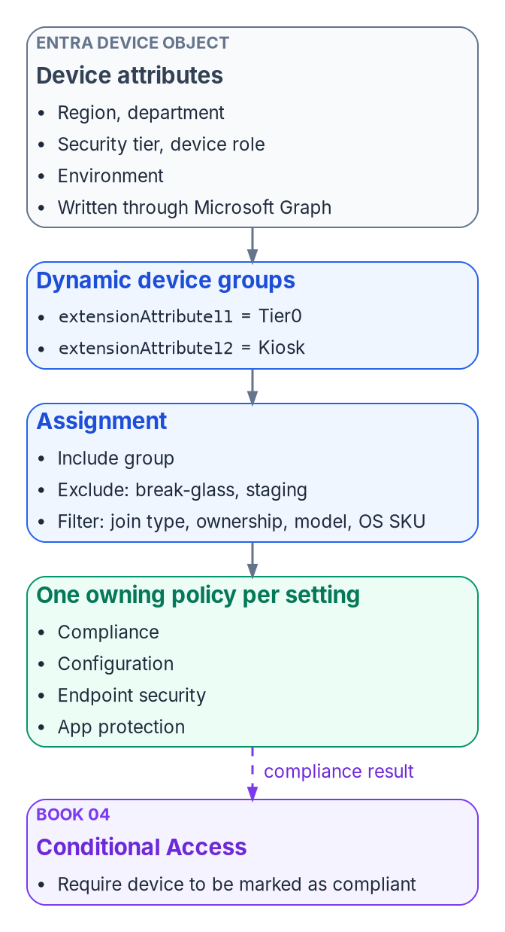
Intune targeting: device groups, and prefer filters
HOW
Target | Use it for (Microsoft Learn, Oct. 29, 2026)
User groups | Settings that belong to the user, such as email and user certificates
Device groups | Settings that must stay on a device; dynamic rules read device attributes only
Assignment filters | Where a filter meets the need; for time-sensitive assignment, a filter on a user group or All devices
Device extension attributes | Group rules only: filters can't read them, so tier and role stay in dynamic device groups
PREFER FILTERS WHERE THEY MEET THE NEED
Dynamic device groups add processing delay; for time-sensitive assignment, filter a user group or All devices
Device rules can't read the owner's attributes: a user's code never reaches a device group
Sources: Microsoft Learn, Assign policies in Microsoft Intune; Manage rules for dynamic membership groups (Oct. 29, 2026). Guide, Stage 6, Limits; Book 05, Ch 08.
Notes:
[7:20–8:59] Intune targeting is where Microsoft's current guidance changes the emphasis, and Book 05 now carries it.
By default Book 05 assigns each Intune policy to dynamic device groups built from device extension attributes, with assignment filters as a second layer for hardware, ownership, join type and OS. The figure is that layering: device attributes on the Entra device object, dynamic device groups, then the assignment with exclusions and a filter, then one owning policy per setting, feeding compliance to Conditional Access.
Microsoft Learn, checked October 29, 2026, moves the emphasis. Intune can assign to user groups too: settings that belong to the user, such as email and user certificates, go to user groups, and settings that must stay on a device go to device groups. Dynamic device groups add processing delay, and for time-sensitive assignment Microsoft recommends an assignment filter on a user group or on All devices. So prefer filters where they meet the need.
It's not a contradiction for extension-attribute targeting, because filters evaluate Intune device properties at check-in and can't read extension attributes. Security tier, device role and environment still belong in dynamic device group rules. The guide and Book 05 state both.
And one rule underneath everything: device rules can read only device attributes, never the device owner's. A user's organization code never reaches a device group by itself; device attributes come from device provisioning. Next slide, how those are written.
Workbook: Attribute-Driven Migration guide, Stage 6 "What it is," "Limits: latency"; verification log D2; Book 05, Chapter 08 — "Assignment strategy," "The device attribute schema," "Policy types."

Slide 6
Beyond users: Intune and Entra devices
WHAT
DYNAMIC DEVICE GROUPS
WRITING DEVICE EXTENSION ATTRIBUTES
Rules read device properties only: OS type, ownership, trust type, enrollment profile, physical IDs, extension attributes 1–15
Autopilot: a [ZTDid] rule selects every Autopilot device; the group tag maps to OrderID
Microsoft Graph: PATCH /devices/{id} with an extensionAttributes body
Application permission: Device.ReadWrite.All
Delegated: Directory.AccessAsUser.All, with Intune Administrator as the least role
App-only calls, or non-Windows devices: only extensionAttributes can be updated
ASSIGNMENT FILTERS AND SCOPE TAGS
Filters read Intune properties at check-in: name, ownership, trust type, model, OS SKU, OS version and more
No extension attributes in filters
Scope tags: at most 100 per object or role; Intune RBAC doesn't apply to Entra roles
PICK THE PERMISSION FOR THE CALL
Signed in: Directory.AccessAsUser.All as at least Intune Administrator, as Book 05's sample now does; an unattended service: Device.ReadWrite.All
Sources: Microsoft Learn, dynamic membership rules; Windows Autopilot device groups; Graph Update device; Intune filters; scope tags (Oct. 29, 2026). Guide; Book 05, Ch 08.
Notes:
[8:59–10:33] Beyond users. The stages move users, but the tree held other objects, and the guide asks the same question of each: does Microsoft document targeting it by attribute? For Intune and Entra devices, yes. These are Microsoft Learn facts as of October 29, 2026.
Dynamic device groups read device properties, such as OS type, ownership, trust type, enrollment profile name, physical IDs and extension attributes one through fifteen, and only device properties. Windows Autopilot devices carry their own markers: a rule on the zero-touch ID marker selects every Autopilot device, and the Autopilot group tag maps to the device's order ID, so a rule can select one tag.
Writing device extension attributes is a Graph call, a patch on the device with an extension-attributes body. The permission depends on the call. Microsoft's least-privileged application permission is Device read-write all. For delegated calls it's Directory access-as-user all, with Intune Administrator as the least-privileged role. And in app-only calls, or for non-Windows devices, only the extension attributes can be updated. Book 05's sample signs in with the delegated permission, as at least Intune Administrator.
Assignment filters evaluate Intune properties at check-in, operating-system version among them; no extension attributes, which matches Book 05. And scope tags delegate inside Intune: at most 100 per object or role, and Intune's role-based access control doesn't apply to Entra roles.
Workbook: Attribute-Driven Migration guide, "Beyond users: Intune and Entra devices"; verification log D5; Book 05, Chapter 08 — "Writing a device attribute," "Scope tags."

Slide 7
Dynamic device groups: the dangers, and how to avoid them
HOW
Danger (Intune track) | How to avoid it
Who can write device extension attributes | The device provisioning service is the only writer, with the app-only permission; Intune Administrator PIM-eligible, not standing; reconcile weekly
Wrong or reused Autopilot group tags and enrollment profiles | Take the tag from procurement intake as a controlled vocabulary, and reconcile it against the CMDB
Device rules can't read the owner's attributes | Write the device's own organization value at provisioning, or send user-owned settings to user groups
Stale and duplicate device objects still match | Require device.accountEnabled; follow Microsoft's stale-device guidance; prevent the registered-plus-joined dual state
Evaluation delay | For time-sensitive assignment, a filter on a user group or All devices; never a dynamic device group as an exclusion
A rule edit's fleet-wide blast radius | Validate and shadow the rule, move it through the pilot rings, keep rule changes under change control
Overlapping groups and conflicting policies | One owning policy per setting, and tier groups that are mutually exclusive by design
Ownership values and enrollment edge cases | Rules say Company, Intune says Corporate: use each tool's vocabulary; Unknown ownership is a finding
Unwatched membership deltas | Alert on deltas; add membership counts to the weekly reconciliation report
Sources: Microsoft Learn: dynamic rules; Update device; Autopilot groups; stale devices; Intune cleanup; assignment (Oct. 29, 2026). Guide, dangers; Book 05, Ch 03, 04, 08, 10.
Notes:
[10:33–14:29] The same goes for dynamic device groups on the Intune track, and here one mistake reaches the whole fleet. Facts as the guide checked them on October 29, 2026; responses are design guidance unless a chapter states them.
Who can write device extension attributes. Device slots are written through Graph, with Device read-write all app-only or, delegated, Directory access-as-user all as at least Intune Administrator, and whoever can write them can retarget compliance, configuration and app policy. So the device provisioning service is the only writer, holding the app-only permission; Intune Administrator is PIM-eligible rather than standing; and the inventory is reconciled weekly, Book 05 Chapter 10.
Group tags and enrollment profiles. The Autopilot group tag becomes the device's OrderID physical ID, and the enrollment profile name comes from enrollment, so a wrong or reused tag or profile name moves a device into the wrong policy set. Take the tag from the procurement intake, Book 05 Chapter 04, as a controlled vocabulary, and reconcile it against the CMDB.
Device rules can't read the owner's attributes. A device group keyed to the user's department finds nothing, and the primary user's department isn't a source anyway, Book 05 Chapter 03. Write the device's own department or organization value at provisioning from the procurement record, or send user-owned settings to user groups.
Stale and duplicate device objects. Reimaging leaves duplicates; a domain-joined device that is also Entra registered has two states that can evaluate nondeterministically; and stale objects still match rules. Intune cleanup rules only hide records, after 30 to 270 days without check-in, and don't remove the Entra device object. Include device.accountEnabled true in device rules, and follow Microsoft's stale-device guidance: a timeframe of at least 21 days, disable for a grace period before deleting, retire in Intune first, delete hybrid-joined devices in AD and let sync carry it, back up BitLocker keys, and don't delete system-managed Autopilot devices. Prevent the dual state on Windows 10 1803 and later, or block Entra registration on domain-joined devices.
Evaluation delay. Membership-driven policy is slower than assignment filters, which are evaluated at check-in, and a dynamic exclusion computed late lets the policy reach the device first. For time-sensitive assignment use a filter on a user group or on All devices, and don't use dynamic device groups as exclusions, Book 05 Chapter 08.
Blast radius. One rule edit can push or pull compliance, configuration, endpoint security and app assignments for a whole fleet, and a device that falls out of its tier group lands in none, so the tenant setting marks it noncompliant and Conditional Access blocks it. Validate and shadow the rule, move it through the pilot rings, and keep rule changes under change control.
Conflicts and overlap. A device in two groups gets two policies that set the same setting, and between configuration policies there's no precedence, so one owning policy per setting, and tier groups mutually exclusive by design.
Ownership values. Entra rules use Company, Personal or Unknown while Intune shows Corporate, so a rule written with Corporate matches nothing, and trust type values differ the same way. Devices enrolled outside Autopilot carry no group tag. Use each tool's vocabulary, and treat Unknown ownership and an enrollment without a registration as findings.
And monitoring: alert on membership deltas, and add membership counts to the weekly reconciliation report, Book 05 Chapter 10.
Workbook: Attribute-Driven Migration guide, "Dynamic group dangers and how to avoid them": "Dynamic device groups (Intune track)," "Monitoring both"; Book 05, Chapter 03 — "Which system owns which fact"; Chapter 04 — "Registration and group tags"; Chapter 08 — "Assignment strategy," "The device attribute schema," "Policy types," "Testing at each gate"; Chapter 10 — reconciliation, stale records, alerts; Microsoft Learn as footnoted in the guide (Oct. 29, 2026).

Slide 8
What Azure Arc covers
WHAT
Arc isn't limited to Microsoft platforms either: it manages Linux servers, VMware virtual machines and AWS and Google Cloud instances.
Server or platform | Coverage (Microsoft Learn, Oct. 29, 2026)
Windows Server 2016–2025 | Supported, Desktop Experience and Server Core; 2016 gets new agent versions until February 2030
Windows Server 2012 and 2012 R2 | Listed; no new agent versions after November 2026; their ESUs ended October 13, 2026, and Arc doesn't extend them
Linux: RHEL, Rocky, Alma, Oracle, SUSE, Ubuntu, Debian, Amazon, Azure Linux | Supported, by listed version; several older versions get no new agent versions after November 2026
Physical servers; VMs on any hypervisor | Supported, with the Connected Machine agent
VMware vSphere VMs, including Azure VMware Solution | Supported through a resource bridge to vCenter 8, then the agent; ESXi hosts appear as inventory only
System Center VMM VMs | Retiring: new onboardings stop by October 2026, the service ends September 2029
AWS EC2 and Google Cloud VMs | Supported: the agent, or the multicloud connector (AWS; Google Cloud in preview; not in Azure Government)
Azure Local; Kubernetes; SQL Server | Azure Local through its built-in Arc plane; Arc-enabled Kubernetes; SQL Server enabled by Arc (Book 06)
Azure VMs; Windows 10 and 11 | Azure VMs are native, so no Arc; clients only in server-like roles, since end-user machines belong in Intune
Not covered | 2008 R2 and earlier, 32-bit; AIX, Solaris, HP-UX, mainframe, network devices; sealed appliances (program's reading)
Sources: Microsoft Learn: Arc agent prerequisites; choose Arc; Arc VMware vSphere; SCVMM; multicloud connector; Arc Kubernetes (Oct. 29, 2026). Guide, Arc coverage; Book 05, Ch 09.
Notes:
[14:29–17:11] Now the Arc track: servers. Arc isn't limited to Microsoft platforms either; it manages Linux servers, VMware virtual machines and AWS and Google Cloud instances. These are Microsoft Learn facts the guide verified on October 29, 2026, and the guide marks the two entries that are the program's reading.
Windows Server 2016, 2019, 2022 and 2025, Desktop Experience and Server Core, are supported, and 2016 gets new agent versions until February 2030. Windows Server 2012 and 2012 R2 are listed with no new agent versions after November 2026; their Extended Security Updates ended October 13, 2026, and Arc support doesn't extend them. 2008 R2 and earlier, and any 32-bit OS, aren't supported, and machine configuration doesn't run on Arm64.
Linux: Red Hat Enterprise Linux 7 to 10, Rocky and AlmaLinux 8 and 9, Oracle Linux 7 to 10, SUSE 12 SP5 and 15, Ubuntu 18.04 to 26.04, Debian 11 to 13, Amazon Linux 2 and 2023, and Azure Linux 3.0. Several of the older ones get no new agent versions after November 2026, and the agent isn't tested on CIS-hardened systems.
Physical servers and VMs on any other hypervisor are supported with the agent. VMware vSphere VMs, including Azure VMware Solution, connect through an Arc resource bridge to vCenter Server 8, up to 9,500 VMs per bridge, then guest management installs the agent; ESXi hosts are discovered as inventory, and that the host itself takes no agent is the program's reading. VMs under System Center Virtual Machine Manager are retiring: new onboardings stop by October 2026 and the service ends in September 2029.
AWS EC2 and Google Cloud VMs take the agent, or the multicloud connector, which covers AWS, with Google Cloud in preview, and isn't available in Azure Government. Azure Local is supported through its built-in Arc control plane. Arc-enabled Kubernetes attaches any CNCF-certified cluster, and SQL Server enabled by Arc is Book 06's subject.
Azure VMs aren't Arc: Microsoft says not to install Arc on them, because they're already native Azure resources. Windows 10 and 11 clients are only for server-like roles such as signage; end-user machines belong in Intune. And AIX, Solaris, HP-UX, mainframe operating systems and network devices aren't on Microsoft's list; vendor-sealed appliances aren't covered where the vendor doesn't allow an agent, which is the program's reading.
Workbook: Attribute-Driven Migration guide, "Which servers Arc covers" (Microsoft Learn, Oct. 29, 2026: Connected Machine agent prerequisites, choosing Arc, Arc-enabled VMware vSphere, Arc-enabled SCVMM retirement, multicloud connector, Arc-enabled Kubernetes); Book 05, Chapter 09 — "Which servers Arc reaches"; Book 06, Chapter 09.

Slide 9
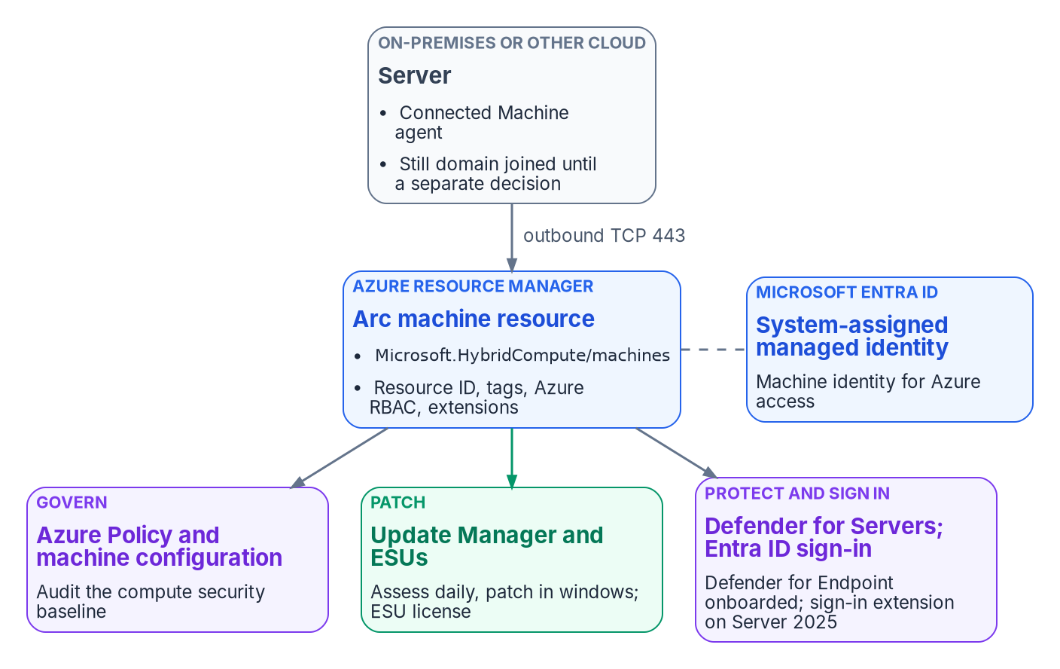

Beyond users: Azure Arc servers, through Resource Manager
WHAT
TAGS ARE THE SERVER'S ATTRIBUTES
The Connected Machine agent gives the server an Azure resource ID, governed and tagged like a VM
Tags set at onboarding with azcmagent connect --tags, or later through portal, CLI, PowerShell, ARM or Policy
Azure Policy can test tags; the built-in inherit-a-tag policy uses modify, with remediation
Azure Resource Graph queries tags at scale
Not documented for Arc: Azure ABAC conditions work only on role assignments with blob or queue storage data actions, not on managing servers.
Sources: Microsoft Learn: Cloud-native server management; Organize and inventory servers; azcmagent connect; Tag policies; Azure ABAC overview (Oct. 29, 2026). Guide; Book 05, Ch 09.
Notes:
[17:11–18:56] Azure Arc-enabled servers: yes, attribute-driven, but through Azure Resource Manager rather than Entra ID. The figure is Book 05's management plane: the on-premises server runs the Connected Machine agent, still domain joined until a separate decision, and connects outbound to an Arc machine resource with its resource ID, tags, Azure role assignments and extensions, plus a system-assigned managed identity in Entra ID.
From Microsoft Learn, October 29, 2026. Once connected, the server is an Azure resource, organized by management group, subscription and resource group like an Azure VM, and policies, role assignments and tags apply the same way. Tags are its attributes: key-value pairs set at onboarding, where the connect command takes a comma-delimited tag list, or afterward through the portal, CLI, PowerShell, ARM templates or Azure Policy. Book 05 sets the program's tag taxonomy and warns that tags are plain text.
Azure Policy assignments are scoped by management group, subscription or resource group, and rules can test tag values. The built-in policy that inherits a tag from the resource group if it's missing uses the modify effect, and a remediation task fixes existing resources. Resource Graph queries server metadata and tags at scale.
And one boundary, stated as the guide states it. Azure attribute-based access control conditions can currently be added only to role assignments with blob or queue storage data actions. Microsoft doesn't document them for managing Arc servers. So role assignments at those scopes govern who manages the server. Next, what neither Intune nor Arc reaches.
Workbook: Attribute-Driven Migration guide, "Azure Arc-enabled servers: yes, through Azure Resource Manager"; Book 05, Chapter 09 — "Resource groups and tags," "Azure Policy and machine configuration."

Slide 10

Devices neither covers: the strategy
HOW
Tier (design guidance) | What's in it | How it's governed
1. Managed by Intune or Arc | The default for every platform on the last two slides | Attributes written at enrollment or onboarding from the procurement record; policy reads them
2. The platform's own tool, with an evidence feed | ChromeOS in the Google Admin console; network devices under their controllers; the mainframe's security system; ESXi under vCenter | Attributes mastered in the CMDB; each tool sends inventory and configuration state there on a schedule
3. Discovered and monitored only | Printers, cameras, badge readers, OT, anything that can't take an agent | Defender for Endpoint discovery, Defender for IoT for OT, NAC records, CDM asset feeds; the CMDB record still exists
4. Segmented and isolated, or retired | Out-of-support systems; anything that can't be inventoried with confidence | Behind segmentation, with a recorded risk acceptance and a retirement date
CM-8, System Component Inventory: every component is in exactly one tier and counted once. A device in no tier is a finding.
Sources: Guide, "What neither tool reaches" (design guidance); Book 05, Ch 03, 09, 10; Books 09, 12; Microsoft Learn, Defender device discovery. NIST SP 800-53 Rev. 5, CM-8.
Notes:
[18:56–21:13] Both tools manage non-Microsoft platforms, Intune for Apple, Android, Linux and ChromeOS within its limits, and Arc for Linux, VMware, AWS and Google Cloud, but neither reaches everything. This is design guidance from the guide: a four-tier strategy for the rest. The four-track rule still holds: every device and server has exactly one source of truth for its attributes, and for anything Intune and Arc don't manage, that source is the CMDB or asset inventory, the same record that owns the business facts for managed devices, Book 05 Chapter 03.
Tier 1 is managed by Intune or Arc, the default for every platform on the last two slides: attributes written at enrollment or onboarding from the procurement record, and policy reads them.
Tier 2 is managed by the platform's own tool, with an evidence feed: ChromeOS in the Google Admin console, network devices under their controllers, Book 09 Chapter 09, the mainframe under its own security system, Book 01 Chapter 04, and ESXi hosts under vCenter. Attributes are mastered in the CMDB, and each tool sends its inventory and configuration state there on a schedule.
Tier 3 is discovered and monitored only: printers, cameras, badge readers, OT equipment and anything else that can't take an agent. Defender for Endpoint device discovery finds them, with Defender for IoT for OT; network access control connection records, Book 09 Chapter 07; and CISA CDM asset feeds under BOD 23-01, Book 12 Chapter 01. The CMDB record exists even though no tool manages the device.
Tier 4 is segmented and isolated, or retired: out-of-support systems and anything that can't be inventoried with confidence, behind segmentation, with a recorded risk acceptance and a retirement date, Book 05 Chapter 09.
The tiers are how the inventory meets NIST SP 800-53 Rev. 5 control CM-8, System Component Inventory, in the program's mapping: it includes every component and counts none twice, Book 05 Chapter 10. A device in no tier is a finding.
Workbook: Attribute-Driven Migration guide, "What neither tool reaches: a tiered strategy" (design guidance); Book 05, Chapter 03 — "Which system owns which fact"; Chapter 09 — "Extended Security Updates"; Chapter 10 — "Reporting and the evidence an assessor reads"; Book 09, Chapters 07 and 09; Book 12, Chapter 01; Book 01, Chapter 04; NIST SP 800-53 Rev. 5, CM-8.

Slide 11
Module 2: The non-person track and PIV
Service accounts, workload identities, AI agents · Books 02, 06 and 17
IN THIS MODULE · ABOUT 14 MINUTES
Service accounts, MSAs and gMSAs; workload identities and AI agents
Service principals, custom security attributes, the object-type crosswalk
PIV and CAC certificate binding as an attribute
Presented by Michael F. Stratton
Not an official U.S. government publication. Independent technical analysis; not reviewed or endorsed by any federal agency.
Notes:
[21:13–22:01] Module 2: the non-person track. Service accounts, service principals, managed and workload identities and AI agents have no HR record. Their accountability is a named owner and sponsor, and their lifecycle runs on the owning system's record and on credential expiry, not on a hire or leave date.
So: the AD service accounts, MSAs and gMSAs and the target for each; service principals, managed identities, workload identity federation and AI agent identities, each with its owner and sponsor, credentials and lifecycle; what Microsoft documents for targeting service principals by attribute, with custom security attributes; the object-type crosswalk across all four tracks; and PIV and CAC certificate binding, the people's credential, which is attribute-driven too.
Workbook: Attribute-Driven Migration guide, "Non-person identity track," "Which attribute store each mechanism can read," "Object types, stores, writers and consumers," "PIV and CAC certificates as attributes"; Book 02, Chapters 06, 09 and 10; Book 17, Chapters 04–06.

Slide 12
Non-person track: service accounts, MSAs and gMSAs
WHAT
AD account | Where the workload runs | Entra ID or AD target | Credential
Traditional (svc- user) | Calls Entra-protected APIs | App registration and service principal | Certificate, or a federated credential
Traditional | An Azure resource | Managed identity (user-assigned preferred) | Managed by Azure
Traditional | On premises, Kerberos only | gMSA, or a dMSA on a Windows Server 2025 domain | Managed by AD
MSA | On premises | gMSA (upgrade first: an MSA or gMSA can't become a dMSA) | Managed by AD
gMSA | Moving to the cloud | Workload identity federation or managed identity | No stored secret
gMSA | Hybrid | Keep the gMSA, plus an app registration for cloud calls | Split
OWNER, SPONSOR AND RECORD
CREDENTIALS AND LIFECYCLE
The application owner is identified before the account is touched, and decides its conversion
Two human owners per replacement app; an account nobody will own is a retirement candidate
High-risk accounts (password never expires) convert first
Old and new credentials run in parallel for 30 days, then the legacy account is disabled
Sources: Book 02, Ch 09, "Service accounts," "The migration path matrix" (Microsoft Learn on dMSA, as footnoted); Ch 06 matrix; Ch 10, Phase 4. Guide, non-person track.
Notes:
[22:01–24:32] Now the non-person track, and it starts with the accounts Active Directory already holds. Service accounts are, in Book 02's words, a critical identity class that's often under-governed, and they have no HR record to drive them.
The table is Book 02 Chapter 09's migration path matrix, shortened. The general rule is to eliminate stored secrets. A traditional service account, a user object often with an svc prefix, a password that never expires and interactive logon, is the highest risk. If it calls Microsoft 365 or another Entra-protected API it becomes an app registration and service principal with a certificate, or a federated credential where the host has an OIDC issuer. If it runs on an Azure resource, a managed identity, user-assigned preferred. If it's on premises and Kerberos only, a gMSA, or a delegated managed service account on a Windows Server 2025 domain. An MSA upgrades to a gMSA first, because an MSA or gMSA can't be migrated to a dMSA. A gMSA moving to the cloud becomes workload identity federation or a managed identity; a hybrid one keeps the gMSA and adds an app registration for cloud calls. IIS application pools and scheduled tasks go to gMSAs now and managed identities once they move.
Owner and sponsor. Book 02's responsibility matrix gives service account conversion, per application, to the application owner, with identity engineering and the AD administrators doing the work. Book 02's Phase 4 identifies the owner before the account is touched and gives every replacement application two human owners; an account nobody will own is a retirement candidate. The owning system's inventory or CMDB entry, not HR, is its record.
Credentials and lifecycle. High-risk accounts, password never expires and over-privileged, convert first. The targets remove the stored secret: AD manages gMSA and dMSA passwords, Azure manages managed identities, and federation replaces the secret with a token. The lifecycle follows the owning application: discovered and classified read-only in Phase 0 with the Appendix C function, converted with old and new credentials in parallel for 30 days, then the legacy account disabled, and retired when the application is. Book 02's Phase 4 is the gate.
Workbook: Attribute-Driven Migration guide, "Non-person identity track"; Book 02, Chapter 09 — "Service accounts," "Modernizing service accounts," "The migration path matrix," "Discovering service accounts"; Chapter 10 — "Phase 4: service account modernization"; Chapter 06 — "The responsibility matrix" (service account conversion, per application); Appendix C; series framing (non-person track).

Slide 13

Non-person track: workload identities and AI agents
WHO
Identity | Owner and sponsor | Credentials | Lifecycle
Service principal (app registration) | At least two human owners, never service accounts; serviceManagementReference points at the inventory record | Federated credential or certificate; no client secrets in production; app management policies can block new secrets | Owners review permissions; credential expiry is a review point; orphan policy when owners lapse
Managed identity | The owner of the Azure resource it serves | Managed by Azure; nobody sees it | System-assigned: deleted with its resource. User-assigned: deleted explicitly
Workload identity federation | As its app registration or user-assigned managed identity | Trusts an external issuer; issuer, subject and audience must match; at most 20 per app | Test each one: a wrong subject fails only at token exchange
AI agent identity (Agent ID) | Sponsor required at creation. Program: an HR-mastered federal employee plus a small steward group; the owner is never the sponsor | None of its own: the blueprint holds them, so it is the credential boundary | Sponsor mover and leaver tasks in Lifecycle Workflows; access packages with end dates; disable, then delete
Check the agency's cloud: Agent ID has no Azure Government feature-list entry; GCC has a documented subset. Workload CA doesn't cover managed identities.
Sources: Book 02, Ch 09 (WIF; workload CA; governing SPs); Book 17, Ch 04, 05 (Microsoft Learn as footnoted, Oct. 2026); Guide, non-person track. Program rules are design guidance.
Notes:
[24:32–27:33] The rest of the non-person track lives in Entra ID: service principals, managed identities, workload identities and, now, AI agents. For each one, the question is who answers for it, what credential it holds and what ends its life.
Service principals, from Book 02 Chapter 09. Every app registration and service principal gets at least two human owners, never service accounts. Managed identities first, then federated credentials, then certificates on a rotation schedule, the program standard annually; no client secrets for production workloads. Microsoft's application management policies, free per the Workload ID FAQ, can block new password secrets and cap credential lifetimes tenant-wide. Owners review delegated and application permissions, and credential expiry is a scheduled review point. Book 17 adds that the app's serviceManagementReference points at its inventory record, and Book 04 Chapter 06's orphan policy applies when owners lapse.
Managed identities, from Book 17 Chapter 04. Azure manages the credential and nobody can see it. A system-assigned identity is created with one resource and deleted with it; a user-assigned one is a standalone resource that has to be deleted explicitly. Conditional Access for workload identities doesn't cover managed identities, so Book 02 puts them in access reviews instead.
Workload identity federation lets an app registration or user-assigned managed identity trust tokens from an external issuer, GitHub Actions, Kubernetes, another cloud. Issuer and subject must match exactly, the audience is the token-exchange value, there are at most 20 per app, and a wrong subject is accepted at creation and fails only at exchange, so test each one.
AI agents, from Book 17. Microsoft Entra Agent ID gives each agent an agent identity, a special service principal with no credentials of its own; the blueprint holds them, so Microsoft calls the blueprint the credential boundary. A sponsor is required at creation. The program's rule, design guidance: the sponsor is a federal employee mastered in HR, a second sponsor is a small dynamic group of the office's stewards, and the technical owner is never the sponsor. Lifecycle Workflows' sponsor tasks, generally available in May 2026, carry the sponsor's mover and leaver event; access packages carry end dates so expiry is the review; and retirement is disable, then delete, with a 30-day soft-delete window.
The callout: check the agency's cloud. Agent ID has no entry on Entra's Azure Government feature list; GCC has a documented subset, and GCC High and DoD should treat agent identities as unavailable until Microsoft confirms in writing. Where they aren't available, the same governance applies to the service principals and managed identities the agents run as.
Workbook: Book 02, Chapter 09 — "Workload identity federation," "Conditional Access for workload identities," "Governing service principals"; Book 17, Chapter 04 — "Workload identities," "Agent identities," "Release stage, licensing and government clouds"; Chapter 05 — "The program's rule," "The lifecycle, event by event," "Retirement"; Book 04, Chapters 05 and 06.

Slide 14
Beyond users: service principals and custom attributes
WHAT
Attribute store | Dynamic rules | Conditional Access | Other consumers
extensionAttribute1–15 (users, devices) | Yes, users and devices | Device filters | Lifecycle Workflows scope
Directory extension properties | Yes, single-value only | Not documented | —
Custom security attributes (users, SPs) | No | App filters (SPs, string type) | Azure ABAC principal; LCW scope; HR provisioning
Azure resource tags (Arc and others) | No | No | Azure Policy; Resource Graph; Update Manager
SERVICE PRINCIPALS: PARTLY
CUSTOM SECURITY ATTRIBUTES
CA for workload identities: single-tenant SPs, direct assignment, Block only, Workload ID Premium
App role assignment: group-based needs P1 or P2; no cascade to nested groups
No dynamic-group rule type for service principals is documented
Defined and assigned by two attribute roles; Global Administrator can't read them by default
Up to 500 definitions per tenant, 50 values per object
For sensitive values no rule reads; access codes stay in slots 10 to 12
Sources: Microsoft Learn: custom security attributes; CA filter for applications; CA for workload identities; app assignment; dynamic rules (Oct. 29, 2026). Guide; Book 04, Ch 03.
Notes:
[27:33–29:16] Service principals and applications: partly. The table at the top is the guide's view of which attribute store each mechanism can read, from Microsoft Learn as of October 29, 2026.
Extension attributes one to fifteen work in dynamic rules for users and devices, device filters read the device's slots, and Lifecycle Workflows can scope on them. Directory extension properties work in rules, single-value only, and Conditional Access use isn't documented. Custom security attributes can't be used in dynamic membership rules, but Conditional Access can filter applications by them on service principals, string type only, evaluated at token issuance; Azure ABAC conditions can read them on the principal; Lifecycle Workflows can scope on them; and they can be provisioned from HR, including through API-driven provisioning. Azure resource tags feed Policy, Resource Graph and Update Manager dynamic scoping.
For service principals specifically. Conditional Access for workload identities covers single-tenant service principals assigned directly; a group that contains one isn't enforced, Block is the only grant, managed identities aren't covered, and Workload ID Premium is required. App role assignment to users and groups reaches the token's roles claim; group-based assignment needs P1 or P2 and doesn't cascade to nested groups. And Microsoft documents no dynamic-group rule type for service principals; agent identities aren't supported as members.
Custom security attributes suit sensitive values no rule reads, because reading them is restricted to the attribute roles. Access codes stay in slots ten to twelve, as Book 03 decides.
Workbook: Attribute-Driven Migration guide, "Service principals and applications: partly," "Which attribute store each mechanism can read"; Book 03, Chapter 06 — "Design rules"; Book 04, Chapter 03 — "Target resources"; Book 05, Chapter 09 — "Resource groups and tags."

Slide 15
The object-type crosswalk: stores, writers, consumers
WHAT
Object | Attribute store | Who writes it | What consumes it
User | Native attributes; extensionAttribute1–15 | HR via API-driven provisioning, into Entra ID, or into AD then sync | Dynamic groups and units; CA through groups; Lifecycle Workflows
User | Custom security attributes | Attribute Assignment Administrator; HR provisioning | Azure ABAC; Lifecycle Workflows scope
User | certificateUserIds | Entra Connect from AD (synced); Graph or admin center (cloud-only) | CBA username binding
Device | extensionAttribute1–15 | Graph at registration (delegated or app-only permission) | Dynamic device groups; CA device filters
Device | Enrollment profile; physical IDs | Intune at enrollment; Autopilot registration and group tag | Dynamic device groups; Intune filters
Device | Intune inventory (model, ownership, OS SKU) | Intune | Assignment filters
Arc server | Azure tags; resource group | azcmagent --tags; CLI, PowerShell, ARM; Policy modify | Azure Policy; Resource Graph; RBAC scope
Service principal | Custom security attributes | Attribute Assignment Administrator | CA application filters; Azure ABAC
Service principal | None: direct assignment | Conditional Access Administrator | CA for workload identities
Sources: Microsoft Learn pages as footnoted in the guide's "Attribute-driven targeting by object type" table (Oct. 29, 2026); guide crosswalk; Book 02, App C; Book 03, Ch 06.
Notes:
[29:16–30:59] This is the guide's object-type crosswalk on one slide: for each object, the attribute store, who writes it, what consumes it. Every row carries a Microsoft Learn source in the guide, checked October 29, 2026.
Users have three stores. Native attributes and extension attributes, written by HR through API-driven provisioning, either into Entra ID or into AD and then sync, and consumed by dynamic groups and units, Conditional Access through groups, and Lifecycle Workflows. Custom security attributes, assigned by the Attribute Assignment Administrator or provisioned from HR, consumed by Azure ABAC and Lifecycle Workflows scope. And certificateUserIds, which the PIV slides come to next.
Devices have three too. Extension attributes, written through Graph at registration, with the delegated or app-only permission from the devices slide, and read by dynamic device groups and Conditional Access device filters. Enrollment profile and physical IDs, set by Intune at enrollment and by Autopilot registration and group tag. And Intune's own inventory, model, ownership and OS SKU, which only assignment filters read.
Arc servers carry Azure tags and their resource group, written at connect time or by CLI, PowerShell, ARM or a Policy modify effect, and consumed by Policy, Resource Graph and role-assignment scope. Service principals carry custom security attributes for application filters and ABAC, or nothing at all: workload-identity Conditional Access is direct assignment by the Conditional Access Administrator.
The pattern to take away: every row names one writer. That's the same single-writer rule as the user schema.
Workbook: Attribute-Driven Migration guide, "Object types, stores, writers and consumers," "Attribute-to-mechanism crosswalk"; Book 02, Appendix C — "Extension attribute assignments"; Book 03, Chapter 06 — "Program attribute map."

Slide 16
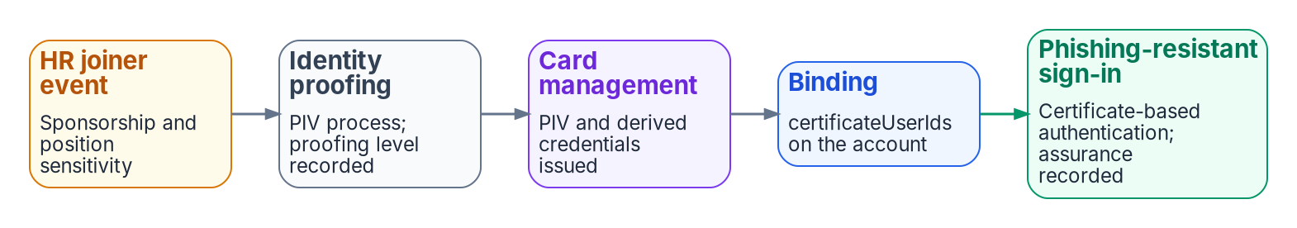
PIV and CAC: the certificate binding is an attribute
WHAT
Certificate field | User attributes it can bind to | Affinity
PrincipalName (SAN), RFC822Name | userPrincipalName, onPremisesUserPrincipalName, certificateUserIds | Low
Subject, IssuerAndSubject | certificateUserIds | Low
SKI, SHA1PublicKey, IssuerAndSerialNumber | certificateUserIds | High
AFFINITY AND STRENGTH
Default binding: SAN Principal Name to userPrincipalName; required affinity defaults to low
CBA is only as secure as its lowest-affinity binding
Setting high tenant-wide too early locks users out
Phishing-resistant strength takes multifactor CBA only
Sources: Microsoft Learn: CBA technical concepts; Set up CBA; Authentication strengths; M-22-09 MFA (Oct. 29, 2026). Guide, PIV section; Book 03, Ch 09; Book 07, Ch 06.
Notes:
[30:59–32:43] Certificate-based authentication is attribute-driven too: Entra ID finds the user by matching a field of the presented certificate to a user attribute. Book 03 Chapter 09 and Book 07 Chapter 06 carry the design; the guide ties it to attribute sourcing. The strip is Book 03's credential chain: the HR joiner event starts sponsorship, proofing follows, card management issues the PIV credential, it's bound to the account, and phishing-resistant sign-in records the assurance.
Microsoft Learn, October 29, 2026. By default the SAN Principal Name maps to userPrincipalName. The table is the binding policy: name and email fields, low affinity; subject and issuer-and-subject, also low, to certificateUserIds only; and subject key identifier, public-key hash and issuer-and-serial, high affinity. A note from the verification log: Microsoft's prose says three low-affinity mappings while its own table marks four; the guide and the chapters follow the table.
High-affinity bindings use identifiers that can't be reused. The tenant's required affinity defaults to low, can be set to high or overridden by rules on issuer or policy OID, and when high applies the low bindings are dropped. With several bindings, CBA is only as secure as the lowest one. Setting the tenant to high before every user's value is right can lock users out. The program's position is high affinity in production.
And strength. The built-in phishing-resistant strength accepts multifactor CBA; the binding policy treats every certificate as single-factor by default, and issuer or OID rules raise PIV or CAC certificates to multifactor.
Workbook: Attribute-Driven Migration guide, "PIV and CAC certificates as attributes": "Username binding," "Affinity," "Authentication strength"; verification log D6; Book 03, Chapter 09 — "Binding the PIV certificate to the Entra user"; Book 07, Chapter 06 — "Entra certificate-based authentication," "Username bindings and affinity."

Slide 17
certificateUserIds: who writes it, and the open pilot
WHO
User | Who can write certificateUserIds | How
Cloud-only | At least a Privileged Authentication Administrator | Admin center (four values of 120 characters) or Graph, authorizationInfo
Synced | At least a Hybrid Identity Administrator; only Entra Connect | Synced from AD, e.g. altSecurityIdentities, or an expression over the UPN
Either | Up to 10 values of 1,024 characters, unique in the tenant | Only current, valid certificates; remove on expiry or revocation
WHERE THE BINDING COMES FROM
UNVERIFIED: ISSUE #130, OPEN
HR supplies the person: record, key, the joiner event that starts sponsorship
The card management system supplies the binding; a reissue changes it
Hybrid: written to altSecurityIdentities in AD, then synced
The leaver removes the value as well as revoking the card
After AD, the card management system writes certificateUserIds through Graph at issuance: design guidance, unverified
Open: which permission a workload needs, and how the write behaves after source of authority moves
Cloud Sync for this attribute: not documented
Sources: Microsoft Learn, Mapping to the certificateUserIds attribute (Oct. 29, 2026). Guide, PIV section; workbook issue #130; Book 03, Ch 09; Book 07, Ch 06, Ch 07.
Notes:
[32:43–34:42] The certificate user IDs attribute is the one that carries a PIV or CAC binding, so who writes it matters as much as any HR attribute. From Microsoft Learn, October 29, 2026.
It holds up to ten values of up to 1,024 characters, each unique in the tenant, with case-sensitive prefixes. For cloud-only users, at least a Privileged Authentication Administrator writes it, in the admin center, up to four values of 120 characters there, or through Graph on the user's authorization info. For synced users, at least the Hybrid Identity Administrator role is needed and only Microsoft Entra Connect can update it, by syncing a value from AD such as altSecurityIdentities, or an expression over the UPN. Microsoft notes that AD administrators can change the value for any synced account, and asks that only current valid certificates be populated and that values be removed on expiry or revocation. The page names Entra Connect only; it doesn't document Cloud Sync for this attribute, and the guide says so.
Where the binding comes from. HR supplies the person: the record, the key and the joiner event. The card management system supplies the binding, because a high-affinity value identifies one certificate and a reissue changes it. During hybrid it's written to altSecurityIdentities in AD, which strong certificate mapping also uses on domain controllers, and synced.
After AD, the design is that the card management system writes the value through Graph at issuance. That's design guidance and unverified: an open pilot, workbook issue 130, asking which permission a workload needs and how the write behaves once source of authority has moved. Microsoft documents neither. Module 3 of this part puts all of this to work.
Workbook: Attribute-Driven Migration guide, "PIV and CAC certificates as attributes": "certificateUserIds," "Where the binding comes from"; verification log claims 70 and 74, "Could not verify"; Book 03, Chapter 09 — "Binding the PIV certificate," "The canonical leaver sequence"; Book 07, Chapter 06 — "Strong certificate mapping"; Chapter 07 — "AD CS chain into Entra ID."

Slide 18
Module 3: Running the migration
Stages 7 and 8 · worked example · limits, checklist and decisions
IN THIS MODULE · ABOUT 24 MINUTES
One analyst through a mover event, end to end
Phased cutover by attribute-defined waves; drift correction
Units, Lifecycle Workflows, what still needs AD; checklist and decisions
Presented by Michael F. Stratton
Not an official U.S. government publication. Independent technical analysis; not reviewed or endorsed by any federal agency.
Notes:
[34:42–35:30] Module 3: running it. The model is in place, every track's attributes are true, and every mechanism reads them. Now the guide follows one person through a mover event to show the chain working, then runs the cutover and the drift loop that keeps it true.
So: the worked example, one budget analyst and one reassignment with no ticket; Stage 7, the phased cutover and how a population proves HR is its sole source; Stage 8, drift detection and correction at the source; the limits of administrative units, Lifecycle Workflows and what could break at this estate's size, and what still needs AD during hybrid; and the checklist and decisions, with rows for every track.
Workbook: Attribute-Driven Migration guide, "Worked example," Stages 7–8, "Limits," "Checklist."

Slide 19

Worked example: one analyst, every mechanism
HOW
Her record (codes are placeholders) | Carrier | What it does for her
Enterprise person key | employeeId | Matches her worker record; joins audit and drift
Organization code FIN-LED | extensionAttribute10 | The node group for FIN-LED; a SQL Server reader group with her position code
Division code | extensionAttribute6 | The division unit, so its scoped help desk can reset her password
Worker type EMP | extensionAttribute11 | The Internals persona: the baseline Conditional Access policies
Position category ANALYST | extensionAttribute12 | The functional group for analysts across organizations
Supervisor | manager | Approver for access packages, reviewer for access reviews
Her laptop (not her record) | Device tier and role | Device groups on the laptop's own attributes
She's AD-mastered: the provisioning agent writes her AD account, Cloud Sync carries it up, and her Entra extension attributes are read-only.
Sources: Guide, "Worked example" Stages 1, 3 and 4 to 6; Book 02, Ch 05; Book 03, Ch 05, Ch 06, Ch 10; Book 04, Ch 03; Book 05, Ch 08; Book 06, Ch 17.
Notes:
[35:30–37:08] The guide's worked example follows one user. A budget analyst in a finance division, a federal employee, AD-mastered because her division hasn't cut over yet. The codes are placeholders.
Stage 1, the record. Core HCM holds her worker record and assignment, and the crosswalk projects it: her enterprise person key in employeeId, department Finance, organization code FIN-LED in slot 10, a division code in slot 6, worker type EMP in slot 11, position category ANALYST in slot 12, a region code, and her supervisor as manager.
Stage 3, the landing. Because she's AD-mastered, the provisioning agent writes these values to her AD account and Cloud Sync projects them to Entra ID, where her extension attributes are read-only.
Stages 4 to 6, the effects, the right-hand column. She's in the node group for FIN-LED and the functional group for analysts across organizations. She's in the department and division units, so the division's scoped help desk can reset her password. She's in the Internals persona, so the baseline Conditional Access policies apply. She's in a SQL Server reader group whose rule reads her organization and position codes. Her supervisor approves her access packages and reviews her access.
And the last row is deliberately not her record. Her laptop's policies come from device groups on the laptop's own tier and role attributes. Nobody assigned her to any of this by hand. Now HR moves her.
Workbook: Attribute-Driven Migration guide, "Worked example: one user and one mover event," Stages 1, 3 and 4–6; Book 02, Chapter 05 — "Role assignment matrix"; Book 03, Chapter 05 — "Landing in Active Directory"; Chapter 06 — "Program attribute map"; Chapter 10 — "Rule patterns"; Book 04, Chapter 03 — "Personas"; Book 05, Chapter 08 — "Tier groups"; Book 06, Chapter 17 — "Choosing the attributes."

Slide 20
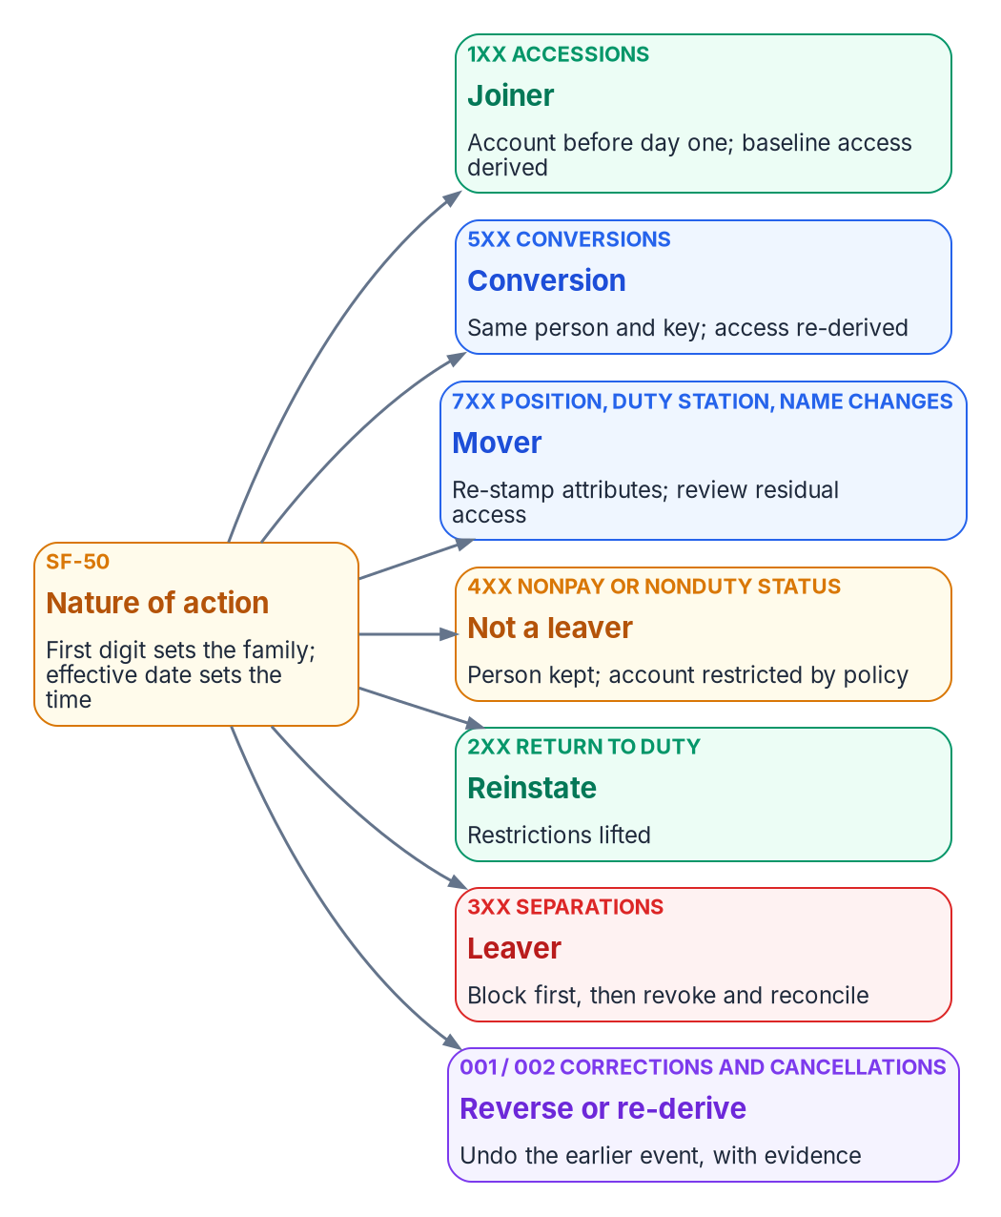
The mover event: one personnel action, no ticket
HOW
# | Nature-of-action code 721 moves her to accounts payable
1 | Core HCM publishes it; middleware validates, writes provenance, sends her complete record with FIN-AP
2 | The agent updates AD; the next sync carries it up. Attribute-change triggers fire only after sync
3 | Groups and units recompute, usually within hours but possibly over 24; analyst group and persona don't change
4 | The mover workflow swaps access packages, notifies managers and reviews what's left
5 | Her laptop's device groups don't move: device rules can't read her attributes
6 | The drift scan compares HR with the directory field by field; the evidence is what PS-5 asks for
Sources: Microsoft Learn, dynamic membership rules (Oct. 29, 2026). Guide, "The mover event"; Book 01, Ch 04; Book 02, Ch 10; Book 03, Ch 05, 08, 11; Book 05, Ch 08; Book 06, Ch 16.
Notes:
[37:08–39:07] HR processes her reassignment to the accounts-payable division as a personnel action, nature-of-action code 721, which the figure classifies as a seven-hundred-series mover. Nobody opens a ticket. The chain:
One. Core HCM publishes the change on its assignment feed; the middleware validates it, writes a provenance record and sends her complete record to bulk upload, with organization code FIN-AP and the new division code.
Two. The provisioning agent updates her AD account, and the next sync cycle carries the values to Entra ID. Attribute-change triggers fire only after the sync delivers the change.
Three. Dynamic groups and units recompute. She leaves the FIN-LED groups and the old division unit and joins the FIN-AP ones, usually within a few hours but possibly more than 24. The analyst group and the Internals persona don't change, because position category and worker type didn't. Access the SQL Server group gave her ends at the engine only after rule processing, token expiry and session turnover.
Four. The mover workflow, triggered by the division-code change, removes the old department's access package, requests the new one, notifies the managers and starts a review of what's left, because access from a package or a direct assignment doesn't leave on its own. Approvals now route to her new supervisor.
Five. Her laptop's device groups don't move, because device rules can't read her attributes; that's device reconciliation, not HR.
Six. The drift scan compares her HR record with the directory field by field. The evidence is the provenance record, the provisioning log, the workflow history and the transfer-to-review interval PS-5 asks for. When her division cuts over, the same record lands in Entra ID directly, and nothing she has changes.
Workbook: Attribute-Driven Migration guide, "Worked example: The mover event"; Book 01, Chapter 04 — "Mover"; Book 02, Chapter 10 — "Lifecycle Workflows," "Mover workflow"; Book 03, Chapter 05 — "The middleware"; Chapter 08 — "Personnel actions are the triggers," "Mover"; Chapter 11 — "The measured lifecycle"; Book 05, Chapter 08; Book 06, Chapter 16 — "When a change takes effect."

Slide 21
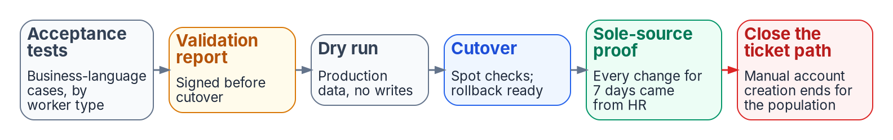
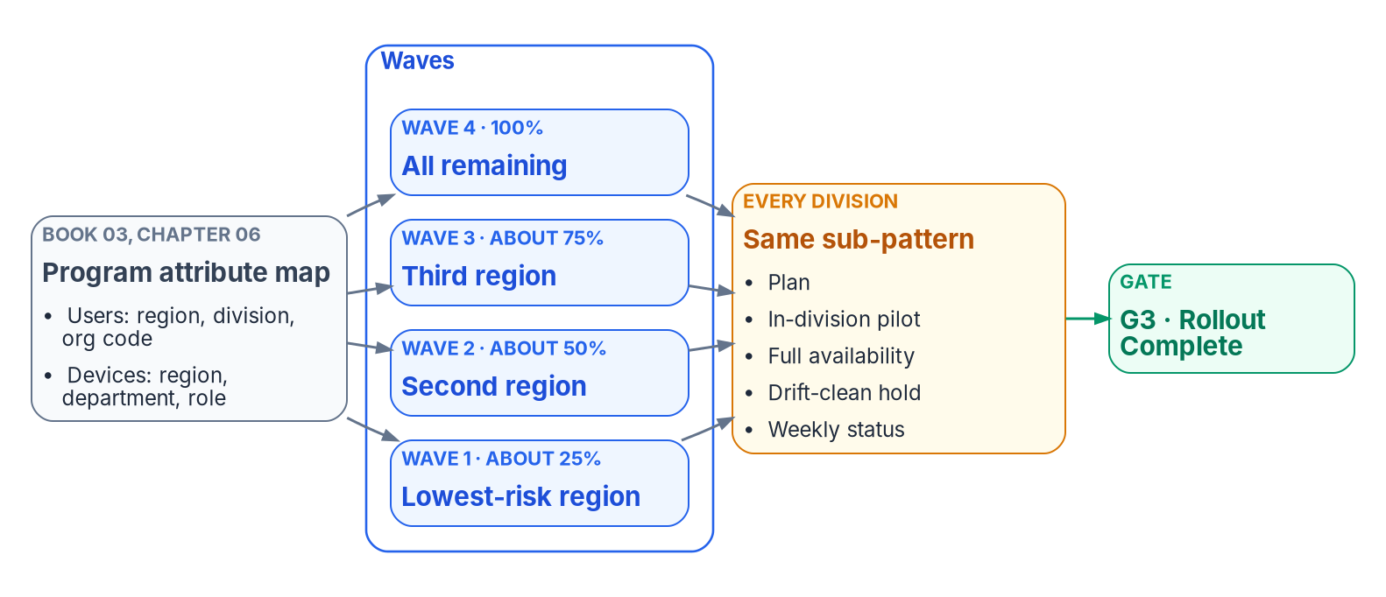

Stage 7: cut over in phases, wave by wave
HOW
THE RUNBOOK, NOT A FLAG DAY
Pilot division, then two or three at a time, each drift-clean
Waves are attribute values: each scope is a query
Leaver automation first; HR, directory and Core HCM aligned
Retarget provisioning to the Entra app; AD leg dormant
Disable, don't delete: deleting GPOs removes the rollback; deleting a synced user only in Entra ID gets restored by sync.
Sources: Microsoft Learn, Guidance for user Source of Authority (Oct. 29, 2026). Guide, Stage 7; Book 00, Ch 09; Book 01, Ch 04; Book 03, Ch 08, Ch 12, App C; Book 05, Ch 08.
Notes:
[39:07–41:04] Stage 7 is a phased runbook, not a flag day. The bottom-left figure is Book 00's waves by attribute: because waves are defined by attribute values, each wave's scope is a query and its dynamic groups already exist. A pilot division first, then division by division, two or three at a time, each drift-clean before the next. Book 05's workload waves run inside those division waves.
Decisions. Wave go and no-go is identity engineering's. Leaver automation goes first, because revocation is where the risk and the evidence are. Align each population's HR cutover with its move to Entra ID and with the agency's Core HCM interconnection. And as a population becomes cloud-mastered, retarget its provisioning from the AD app to the Entra app, with the AD leg dormant but intact. Microsoft's source-of-authority guidance, checked October 29, 2026, says the same: once the users' sync cycle completes, remove them from the HR-to-AD scope and add them to the HR-to-Entra configuration.
The gate is the strip across the top, Book 03's Appendix C. Acceptance tests by worker type, a signed validation report, a dry run on production data with writes disabled, cutover with rollback ready, then seven days in which every change for the population traces to an HR event, and only then the ticket path for account creation closes. Cloud-mastered populations run the full lifecycle with no AD writes, and rollback has been tested once. Legacy retirement is the only destructive phase, approved item by item.
Failure modes: a division reaching full availability before its own pilot is drift-clean; deleting GPOs instead of disabling links; and deleting a synced user only in Entra ID, which the next sync restores.
Workbook: Attribute-Driven Migration guide, Stage 7; Book 00, Chapter 09 — "Waves defined by attribute values"; Book 01, Chapter 04 — "Migration phases," "Phase 4: legacy retirement"; Book 03, Chapter 08 — "Deletion"; Chapter 12 — "Phase 4," "Phase 5"; Appendix C — "Proving HR is the sole source"; Book 05, Chapter 08 — "Phase 5," "Rollback."

Slide 22
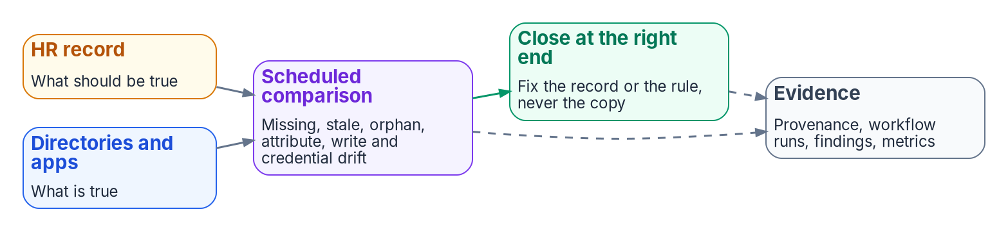

Stage 8: detect drift and fix it at the source
HOW
TWO SCHEDULED COMPARISONS
GATE: BOOK 01'S VERIFICATION LIST
HR against the directory: missing identity, stale access, orphan, attribute drift, unauthorized write, credential and schema drift
Registry against the tenant: unit rule drift, paused processing, unmatched role assignments, restriction mismatches
Findings belong to the CISO; close each at the source, the record or the rule, never the copy
Valid attributes for every HR-listed worker; every group on one of two patterns
Every unit rule mirrors its group, processing on; policies target governed groups only
Zero drift findings and a zero-action nightly plan; lifecycle metrics on the ConMon cadence
Route logs out from day one: Entra log retention is far shorter than federal records schedules, and isn't retroactive.
Sources: Guide, Stage 8; Book 01, Ch 04 (verification); Book 02, Ch 05 (drift detection), Ch 06, Ch 10; Book 03, Ch 11, Ch 12 (Phase 6); Book 06, Ch 17 (access reviews).
Notes:
[41:04–42:51] Stage 8 keeps the statements true. The loop at the top is Book 03's: the HR record says what should be true, the directories and applications hold what is true, a scheduled comparison finds the differences, and each is corrected and evidenced.
Two comparisons run on a schedule. HR against the directory, with Book 03's drift classes: missing identity, stale access, orphan account, attribute drift, unauthorized write, credential drift and schema drift. And the unit and role registry against the tenant, with Book 02's checks: unit rule drift, paused rule processing, unmatched role assignments and restriction mismatches.
The CISO owns continuous-monitoring evidence and drift findings. Each finding is closed at the source, by fixing the record or the rule, never the copy. If you patch the directory value, the next sync or provisioning cycle puts the wrong one back, and you've hidden the real error.
The gate is Book 01's verification list: valid attributes for every HR-listed worker, every group on one of the two patterns, every unit rule mirroring its group with processing on, every policy targeting only governed groups, zero drift findings, and a zero-action nightly plan. Book 03 adds a recurring gate: the six lifecycle metrics within thresholds on the ConMon cadence.
Two failure modes. Entra ID's log retention is far shorter than federal records schedules and isn't retroactive, so route logs out from the pilot's first day. And access-review decisions don't change dynamic-group membership; the next evaluation puts the member back, so review the rule and its inputs instead.
Workbook: Attribute-Driven Migration guide, Stage 8; Book 01, Chapter 04 — "Verification"; Book 02, Chapter 05 — "Drift detection"; Chapter 06; Chapter 10 — "The assessment pipeline"; Book 03, Chapter 11 — "Drift between HR and the directory," "The evidence each event leaves"; Chapter 12 — "Phase 6"; Book 06, Chapter 17 — "Access reviews."

Slide 23

Limits: administrative units
WHAT
Limit | What it means | Response (design guidance)
No nesting | The OU tree becomes a flat set of units | Flat units; where a role covers several, one assignment per unit, generated from one list
A write boundary, not a confidentiality boundary | Units limit who can change members, not who can read them | Custom security attributes and app-level controls for confidentiality
Only some roles can be unit-scoped | Part of the delegation matrix may not fit a unit | Check every role against Microsoft's list; the rest stay central or behind PIM approval
Dynamic units: global Azure cloud only | GCC can use them; GCC High and DoD can't | In GCC High or DoD, maintain units with an automation job under change control and drift checks
At most 100 restricted units; members outside ID Governance | Restriction stops joiner, mover and leaver automation for its members | Restrict only by explicit decision, default no; never restrict a large HR population
Units scope writes, not reads: delegation follows the unit; confidentiality needs its own controls.
Sources: Microsoft Learn: administrative units; dynamic administrative units; restricted management units (Oct. 29, 2026). Guide, Limits; Book 01, Ch 04; Book 02, Ch 05.
Notes:
[42:51–44:22] The limits of administrative units, each with what it means and the program's response. The limits are Microsoft's as the chapters state them; the responses are design guidance.
No nesting. The OU tree becomes a flat set of units. Where one role has to cover several units, give it one assignment per unit, generated from a single list so the assignments can't drift apart.
A write boundary, not a confidentiality boundary. A unit limits who can change its members, not who can read them. Confidentiality comes from custom security attributes and from controls in the applications.
Only some roles can be unit-scoped. Check every role in the delegation matrix against Microsoft's list; roles that can't be scoped stay central or go behind PIM approval.
Dynamic units are available only in the global Azure cloud. A GCC tenant, the program's target, can use them; GCC High and DoD can't, so there units are maintained by an automation job under change control and covered by the drift checks. Microsoft's prerequisite still read that way on October 29.
At most 100 restricted management units, and their members fall outside Entra ID Governance. So restriction is an explicit decision, default no, and never applied to a large HR population, or the joiner, mover and leaver automation stops for those people.
Workbook: Attribute-Driven Migration guide, "Limits: administrative units"; LIMITS shared content (design guidance responses); Book 01, Chapter 04 — "Administrative units: the delegation replacement," "The three-tier model"; Book 02, Chapter 05 — "Restricted management administrative units."

Slide 24

Lifecycle Workflows: the pieces and the limits
WHAT
THE PIECES
Limit | Value
Workflows per tenant | 100
Tasks per workflow | 25
Custom task extensions per tenant | 100
Trigger offset | -180 to +180 days
Administrative scopes per workflow | 5
Custom task extension timeout | Microsoft's pages disagree
Workflow: one scenario, with execution conditions (a trigger and a scope rule) and ordered tasks
Task: built-in steps, such as a Temporary Access Pass, groups, access packages, licenses, disable or delete
Custom task extension: calls a Logic App to reach other systems, fire-and-forget or with a callback
Scheduled run: one tenant interval, every 3 hours by default (1 to 24), switched on per workflow
On-demand run: at most 10 users, and it ignores the execution conditions
Execution limits quarantine scheduled runs only: an on-demand run bypasses quarantine and the workflow's own conditions. Edits create new versions.
Sources: Microsoft Learn: ID Governance service limits; Lifecycle Workflow deployment; execution limits and quarantine; extensibility; understanding lifecycle workflows (Oct. 29, 2026).
Notes:
[44:22–47:36] Lifecycle Workflows carry the joiner, mover and leaver events, so their pieces and limits matter. They need Entra ID Governance or Microsoft Entra Suite, and the books record ID Governance as available in GCC, GCC High and DoD; re-check feature-level availability on Microsoft's government pages.
The pieces. A workflow is one automated process for one scenario, joiner, mover, leaver, pre-hire and so on. Its execution conditions are a trigger, a time-based attribute such as employeeHireDate or employeeLeaveDateTime with an offset, or an attribute change, and a scope, a rule over user properties. Then an ordered list of tasks. Built-in tasks include a welcome email, a Temporary Access Pass, adding or removing groups and Teams, requesting or removing access packages, removing licenses, and disabling or deleting the account. A custom task extension calls an Azure Logic App, so the workflow can reach systems Microsoft doesn't, such as a card management system, Intune device retire, a ticketing system or an HR write-back, fire-and-forget or waiting for a callback.
Runs. The tenant evaluates every scheduled workflow on one interval, every three hours by default, configurable from one to 24, and scheduling is switched on per workflow. Real-time leaver and mover workflows can't be scheduled, by design. An on-demand run is for testing or a situation that requires it: at most ten users, and it ignores the workflow's execution conditions, so the tasks apply to whoever is selected, whether or not they qualify.
Limits: 100 workflows per tenant, 25 tasks per workflow, 100 custom task extensions per tenant, an offset of minus to plus 180 days, five administrative scopes per workflow. The custom task extension timeout is stated differently on two Microsoft pages: the service-limits page says 30 minutes to three hours, the deployment page three minutes to five hours. The guide flags it rather than picking one, and its response, design guidance, is to design callbacks to finish well inside 30 minutes until Microsoft reconciles the pages. Microsoft notes that these default limits can be raised through Microsoft Support.
Guardrails. Execution limits are a tenant-wide or per-workflow threshold, a percentage of users, a number, or both with OR logic. If a scheduled run would exceed it, the workflow is quarantined, administrators are notified, and it doesn't run until one approves; quarantine can't be cleared automatically. On-demand runs aren't subject to execution limits. The three-day catch-up processes a user whose trigger or scope attributes were set late, if the setup completes within three days of the intended time; it doesn't apply to the time-based attribute V2 preview. And execution conditions and tasks can't be edited in place: a change creates a new workflow version, which needs change control. Book 02 Chapter 10 says 50 workflows; Microsoft says 100, and the guide states 100.
Workbook: Attribute-Driven Migration guide, "Limits: Lifecycle Workflows"; Microsoft Learn: "Microsoft Entra ID Governance service limits" (Lifecycle Workflows), "Plan a Lifecycle Workflow deployment," "Understanding lifecycle workflows," "Configure execution limits and quarantine," "Lifecycle Workflow extensibility," Lifecycle Workflows API overview (all Oct. 29, 2026); Book 02, Chapter 10 (corrected); Book 03, Chapter 08.

Slide 25
Lifecycle Workflows at our scale: what could break
HOW
Risk (design guidance) | Mitigation
Running out of 100 workflows | A few general workflows (pre-hire, joiner, mover, leaver, rehire, conversion) branching on coded attributes; never one per organization; a workflow budget
Running out of 100 custom task extensions | One parameterized Logic App per integration, taking the component or code as input; count per environment
25 tasks per workflow | Group steps inside one Logic App, or chain a leaver with a post-leaver offset workflow
The 10-user on-demand cap | Fix the data at the source and let the scheduled run process it; a documented bulk-remediation procedure
On-demand ignores conditions and bypasses quarantine | Lifecycle Workflows Administrator behind PIM with approval; on-demand runs as changes, second-person check, logged
A reorganization fires the mover for thousands | Execution limits sized to normal weekly volume; reorganizations as change events with a pre-agreed release; rehearse
Urgent terminations wait for the schedule | Real-time leaver, plus disable and revoke sessions out of band
Late HR data beyond the 3-day catch-up | Monitor HR timeliness; report triggers in the past and never processed
No built-in PIV revoke or device retire | Custom extensions for card management and Intune; until then, a leaver checklist with owners
Sources: Microsoft Learn: ID Governance service limits; execution limits and quarantine; understanding LCW (Oct. 29, 2026). Book 03, Ch 08. Risks and mitigations: design guidance.
Notes:
[47:36–51:07] This is design guidance: what could break at an agency of this size. The estate is the one the guide and Book 03 describe: one forest of twelve trees synchronized to a live GCC Moderate tenant, with every user synced, so the attributes are AD-mastered.
Running out of workflows. A workflow per tree, per component, per worker type or per scenario multiplies fast: twelve trees times joiner, mover and leaver times three worker types is 108, before pre-hire, rehire, conversion and reminders. So build a small set of general workflows that branch on coded attributes through scope rules, up to five administrative scopes each, never one per organization, keep a workflow budget in change control, and ask Microsoft Support before planning beyond the default.
Running out of custom task extensions. Each integration becomes one: card management, Intune retire and wipe, server access removal, ticketing, mailbox delegation, HR write-back, and variants multiply them. Build parameterized Logic Apps, one per integration, that take the component or code as input, and count extensions in both the test and production tenants.
Twenty-five tasks per workflow can be tight for a four-track leaver, so group steps inside one Logic App or chain a leaver with a post-leaver offset workflow.
The ten-user on-demand cap. A reorganization, a failed HR batch or a correction can affect hundreds or thousands of people at once, and there's no manual bulk run, so fix the data at the source, let the scheduled run process it, and keep a documented bulk-remediation procedure for incidents.
On-demand ignores the execution conditions and bypasses quarantine. An administrator who runs the leaver on the wrong ten people disables them, whether or not they're leavers. So the Lifecycle Workflows Administrator role sits behind PIM with approval, and an on-demand run is a change with a second-person check, logged.
Mass events. A reorganization that recodes thousands of organization codes fires the mover workflow for all of them. A good execution limit quarantines it; without one, it runs. Size tenant-wide and per-workflow limits to normal weekly volume, plan reorganizations as change events with a pre-agreed approval to release the quarantine, and rehearse in test.
Urgent terminations. The schedule, plus sync, plus dynamic-group processing, means a scheduled leaver isn't immediate. For hostile or urgent cases, use the real-time leaver and also disable the account and revoke sessions out of band, the help desk's emergency path.
Late HR data. A hire or separation entered more than three days late can miss the time-based workflow, so monitor HR timeliness and report triggers in the past that were never processed, a validation-kit check.
No built-in PIV revoke or device retire. One HR leaver event has to reach all four tracks, and natively only the account side is done. Custom extensions handle card management, revoking the certificate and removing certificateUserIds, and Intune retire; until they exist, a leaver checklist with owners. And because workflow changes are new versions, change control, a test tenant, a scoped pilot and version history as evidence.
Workbook: Attribute-Driven Migration guide, "Limits: Lifecycle Workflows"; LIMITS shared content ("What could break," design guidance); Microsoft Learn as on the previous slide; Book 03, Chapter 08 — "Triggers and schedule," "Built-in tasks by stage"; the agency estate as Book 03 and Book 05 describe it.

Slide 26
What still needs AD during hybrid
WHAT
Still in AD | Response (design guidance)
Synced users' attributes, and their disposition | The provisioning service writes to AD; moving the source of authority is a gated step per population
Kerberos applications | Inventory them; write the group back as a universal group, or move the app to SAML or OIDC; each write-back is a dependency to retire
DNS, DHCP, Kerberos-bound legacy apps; SQL Windows logins bypass CA | They block AD retirement: track them in Books 08 and 06; report Windows-authenticated SQL logins as an IA-2 gap
Domain GPOs hybrid-joined devices still need | Move the policy to Intune first; disable links population by population with rollback tested
Moving the source of authority | Entry checks per population: HR direct to Entra ID, no on-premises Exchange, no AD FS, no password-based apps
Source-of-authority transfer in GCC: open | Confirm with Microsoft; until then the AD-mastered path is the default, with an owner and a decide-by date
Hybrid lasts: retiring AD means clearing a list of named dependencies, not reaching a date.
Sources: Microsoft Learn: user SOA guidance; Transfer user SOA (Oct. 29, 2026). Guide, Limits; Books 02, 03, 05, 06 as noted; NIST SP 800-53 Rev. 5, IA-2.
Notes:
[51:07–53:35] What still needs Active Directory during hybrid, and the response to each, design guidance.
Synced users' attributes. AD is where they're written, and the Entra copies are read-only, so the provisioning service writes to AD, Book 03 Chapter 05's landing zones, and disposition of synced users happens in AD or through the provisioning agent. Moving the source of authority is a gated step per population.
Kerberos applications need a cloud group provisioned back to AD as a universal group. Inventory them; write the group back, or move the app to SAML or OpenID Connect, and count each written-back group as a dependency to retire.
DNS, DHCP and Kerberos-bound legacy applications keep the forest alive after it stops being the governance model, and any surviving Windows login to SQL Server bypasses Conditional Access. They block AD retirement, so track them in Books 08 and 06, and report each Windows-authenticated SQL login as a gap against IA-2, identification and authentication, which is the program's mapping in Book 06, Appendix A. Deleting a synced user only in Entra ID doesn't stick, so synced users are disposed of at the source.
Domain-level GPOs that hybrid-joined devices still need, which is why migrated OUs don't block inheritance. Move the policy to Intune first, disable links population by population with rollback tested, and keep the domain baselines until the last hybrid device is gone.
Moving a user's source of authority has prerequisites Microsoft lists: HR integrated so changes go directly to Entra ID, no on-premises Exchange workloads, no AD FS federation for those users, and no applications that need password-based authentication such as LDAP bind. Make those the entry checks per population, evaluated by the validation kit; the populations that pass move first.
And whether user source-of-authority transfer is available in GCC is still open in Book 03's verification register. Confirm it with Microsoft; until then, plan the AD-mastered path as the default, which Book 03 supports in both editions, with an owner and a decide-by date. The overall lesson: hybrid lasts, and retiring AD means clearing a list of named dependencies, not reaching a date.
Workbook: Attribute-Driven Migration guide, "Limits: What still needs AD during hybrid"; LIMITS shared content (responses, design guidance); verification log "Could not verify"; Book 01, Chapter 04 — "Phase 5: steady state"; Book 02, Chapter 09 — "The per-group decision"; Book 03, Chapters 05, 06, 08 and 12; Book 05, Chapter 08; Book 06, Chapter 16; NIST SP 800-53 Rev. 5, IA-2.

Slide 27
The checklist, stage by stage
HOW
Stage | Check (design guidance)
0 | OU links, inheritance and hand-made delegations exported, site links included · A decision for every group · OU-to-unit mapping drafted
1 | Authority map, identifier and schema signed · Code lists owned by HR · HR-to-identity feed taken to the Steering Committee · Contractor source decided
2 | employeeId populated before the first full sync · Correlation threshold met · Orphans owned · Other write paths to access slots removed
3 | Sync engine and PHS decided · Carriers free and in the apps' target lists · Date mappings tested · Feeds read by published date · Shadow mode explained
4 | Every access rule on codes, excluding disabled accounts, guests and agents · Validated, shadowed, piloted · No memberOf · Nesting flattened
5 | Unit rules mirror group rules, processing on · Restriction decided before creation · Role principals PIM-eligible · Units before their groups
6 | Personas from authoritative attributes · Grant and block in pairs · Report-only first · Emergency access excluded · One owning policy per setting
7 | Validation report signed · Dry run, writes off · Seven days of sole-source proof · Ticket path closed · Provisioning retargeted · Rollback tested
PIV | Card management system named as the binding writer · High affinity piloted first · Phishing-resistant strength · Leaver removes the binding
8 | Drift scans scheduled for HR, units and roles · Logs routed out from day one · Findings closed at the source · Metrics on the ConMon cadence
Intune | Device attributes written by provisioning at registration · Policy targeted by them · Computer-side GPO links disabled per population, rollback tested
Arc | Every in-scope server Arc-enabled · Tag taxonomy applied at connect · Baseline assigned and evaluated by Azure Policy
Non-person | Every service account and SP: owner, sponsor, reason, target · No never-expiring password · Two human owners per app · Agents: HR-mastered sponsor
Sources: Guide, "Checklist"; track rows from Book 02, Ch 09; Book 05, Ch 08, 09; Book 17, Ch 05 (design guidance). Detail is in the stage and chapters each row names.
Notes:
[53:35–56:20] The guide's checklist, one row per stage, plus a row for PIV and a row each for the Intune, Arc and non-person tracks. The stage rows are mostly the HR track. It's design guidance, and it's meant to be printed and ticked.
A few checks that are easy to miss. Stage 0: export site links, not just OU links, because a site-linked GPO hides from an OU-only search. Stage 1: take the HR-to-identity feed to the Steering Committee and name it in the HR 2.0 integration inventory, and start the privacy basis and PIA, which the full checklist carries too. Stage 2: populate employeeId before the first full sync, and remove every other write path to the access slots, in AD and in Entra ID. Stage 3: confirm the carriers are free and in the provisioning apps' target lists, and read the feeds by published date.
Stage 4: every access rule on codes, excluding disabled accounts, guests and agents, and no memberOf, given the preview's end date. Stage 5: decide restriction before the unit exists, and create units before the groups they hold. Stage 6: grant and block policies in pairs, report-only first, the emergency-access group excluded, device attributes written at registration, and one owning policy per setting.
Stage 7: the signed validation report, the dry run with writes off, seven days of sole-source proof, then the ticket path closed and provisioning retargeted per population. PIV: name the card management system as the binding writer, pilot high affinity before the tenant setting changes, require phishing-resistant strength for CBA users, and make the leaver remove the binding. Stage 8: drift scans scheduled, logs routed outside Entra ID from day one, findings closed at the source.
The track rows come from the per-track success criteria, design guidance. Intune: device attributes written by provisioning at registration, policy targeted by them, and computer-side GPO links disabled population by population with rollback tested, Book 05 Chapter 08. Arc: every in-scope server Arc-enabled, the tag taxonomy applied at connection time, and its baseline assigned and evaluated by Azure Policy, Book 05 Chapter 09. Non-person: every service account and service principal with an owner, sponsor, reason and target, no password that never expires, at least two human owners per app registration, Book 02 Chapter 09, and every agent identity sponsored by an HR-mastered federal employee, Book 17 Chapter 05.
Workbook: Attribute-Driven Migration guide, "Checklist"; Stages 0–8 and "PIV and CAC certificates as attributes"; Book 02, Chapter 09; Book 05, Chapters 08–09; Book 17, Chapter 05; series framing (per-track success criteria, design guidance).

Slide 28
Decisions, owners, and where to start
HOW
Decision (design guidance) | Who decides | Stage
Where each OU function goes; each group's fate | Identity engineering | 0
Authority map, person key, contractor source | ICAM governance body | 1
Code lists; the schema | HR; the data architect | 1
Correlation threshold | Agency risk governance | 2
Write permissions on HR-mastered attributes | Security | 1–2
Sync engine, sign-in method, provisioning rules | Identity engineering | 3
An application's access rule | The application owner | 4
Delegation model; restriction per unit | Identity engineering | 5
Control requirements; drift findings | The CISO | 6, 8
Wave go/no-go | Identity engineering | 7
Each service account's conversion | The application owner | Non-person
An AI agent's sponsor | An HR-mastered federal employee | Non-person
FROM THE CHECKLIST
Start with these
Export the tree, read-only
Name the HR feed to the Steering Committee
Populate employeeId
Remove other writers
Route logs out now
Sources: Guide, "The path on one page," "Checklist"; Book 02, Ch 06 and Book 03, Ch 07 matrices; Book 17, Ch 05. Decisions and sequence are design guidance.
Notes:
[56:20–58:19] So, the decisions, each with one decider from the two responsibility matrices, Book 02 Chapter 06 for the directory and Book 03 Chapter 07 for the data. All of it is the program's recommended model, design guidance.
Identity engineering decides where each OU function goes and each group's fate, the sync engine and sign-in method, the delegation model with restriction per unit defaulting to no, and each wave's go or no-go. The ICAM governance body decides the authority map, the enterprise person key and the contractor source. HR owns the code lists and the data architect owns the schema. The agency's risk governance sets the correlation threshold. Security decides who may write HR-mastered attributes. Each application's owner decides its access rule, and, per Book 02's matrix, each of its service accounts' conversion. Book 17 makes an AI agent's sponsor a federal employee mastered in HR, never an administrator. And the CISO owns the control requirements and the drift findings.
Five places to start, all from the checklist and none needing a new platform. Export the OU tree, its GPO links and its hand-made delegations, read-only. Name the HR-to-identity feed and take it to the HR 2.0 Steering Committee before the interconnection goes live. Populate employeeId before the first full sync. Remove every other writer to the access attributes. And route logs out of Entra ID from day one, because history starts the day export does.
In Active Directory, where an object sat decided what applied to it. In Entra ID, what the object says about itself decides. Make those statements true, keep them true, and the migration follows. The guide maps every step to the chapter that carries it. Thank you.
Workbook: Attribute-Driven Migration guide, "The path on one page," "Checklist," Stages 0–8; Book 02, Chapter 06 — "The responsibility matrix"; Book 03, Chapter 07 — "The responsibility matrix."

