Slide 1

The First Four Weeks: What Phase 0 Produces
Executive briefing · Start series, Episode 2
WHAT THE PRE-FLIGHT PRODUCES · ABOUT 6 MINUTES
Entry conditions · The platform host · Reading the estate · Provenance
Least privilege · Owners and findings · Gate G0, Ready to Plan · Week four
Sources: Book 01, Ch 03, 10 and 12; Book 00, Ch 01, 03 and 08. Facts as of October 2026.
Presented by Michael F. Stratton
Not an official U.S. government publication. Independent technical analysis; not reviewed or endorsed by any federal agency.
Notes:
[0:00–0:31] Welcome back to the Federal Modernization Workbook. This is Episode 2 of the Start series. Episode 1 asked leadership to approve a four-week pre-flight, called Phase zero. This episode opens that box: what has to be true on day one, what the team builds and reads in those four weeks, and what the first gate, G zero, checks before anyone plans a change. By the end, you'll know what you're holding at week four. Let's start with the shape of the phase.
Detail: Episode 2 of the Start series. Episode 1 asked leadership to approve Phase 0, a four-week pre-flight that needs no vendor decision and produces an inventory, an owner and a date (Book 01 Chapter 12, "Where to start"). This episode opens that phase: the entry conditions, the platform host (Book 01 Chapter 03), the read-only assessment and its provenance (Book 01 Chapter 10), seeding the repository, least-privilege service principals, owners and classified findings, Gate G0 "Ready to Plan" and its checklist (Book 00 Chapter 08), and what leadership holds at week four. The workbook is independent analysis, not an official publication of any agency.
Sources: Book 01, Chapters 03, 10 and 12; Book 00, Chapters 01, 03 and 08.

Slide 2


Four weeks, one goal, one exit
WHAT
Entry
Sponsor and steward named; platform host provisioned; read-only assessment account created
Work
Build the platform host; run the assessment; seed the repository; create least-privilege service principals
Gate G0, Ready to Plan
Host operational; assessment committed; no open priority-one findings
Plan from the milestones, not the week count: four weeks is the roadmap's illustrative calendar; the program's master plan spends about nine on the same work, and large estates run longer.
Assessment before action: no migration work starts until the whole forest is inventoried and committed. A plan without an assessment is a guess.
Sources: Book 01, Ch 12 (Phase 0 — Pre-flight); Book 00, Ch 08 (Where pre-flight sits in the program).
Notes:
[0:31–1:03] Phase zero has one goal and one exit. The goal is to produce the planning artifacts and stand up the platform that will hold them. The exit is gate G zero, Ready to Plan: the platform works, the assessment is committed, and no priority-one finding is open. Two cautions. Four weeks is illustrative, so plan from the milestones, not the week count. And nothing moves before the assessment is done; a plan without one is a guess. So what has to be true on day one?
Detail: Book 01 Chapter 12, Phase 0 — Pre-flight (weeks 1–4). Goal: produce the planning artifacts and stand up the platform host. Entry: executive sponsor and steward named; platform host provisioned; read-only assessment account created. Work: build the platform host (Chapter 03); run the assessment (Chapter 10); seed the repository; create least-privilege service principals for Microsoft Entra ID, Intune and Azure Arc; profile the transactions of any application proposed to move away from its data. Gate G0, Ready to Plan: platform host operational; assessment committed; no open priority-one findings. Book 00 Chapter 08: Book 01's illustrative calendar gives pre-flight four weeks; the master plan spends about nine weeks on the same work (three to build the host, six to assess, generate plans, review them and prepare for the pilot). "Neither figure is a commitment, and large estates run longer. Plan from the milestone list, not the week count." The rule adopted unchanged: "assessment before action... A plan without an assessment is a guess."
Sources: Book 01, Chapter 12 (Phase 0); Book 00, Chapter 08 (Where pre-flight sits in the program).

Slide 3
Day one: three entry conditions
WHO
Entry condition | Why it has to exist first
An executive sponsor and a steward, named | The sponsor, with the CIO, owns scope, funding and sequence; the steward, the program office's accountable lead, decides Gate G0
The platform host, provisioned | Every artifact, from the first assessment run to each gate decision, is written there as a reviewed commit
A read-only assessment account, created | A dedicated standard account with no added rights: forest-wide read, never Domain Admin or Enterprise Admin
BUILD FROM ROLES YOU ALREADY HAVE
The names may already exist
OMB M-22-09 required a zero trust strategy implementation lead; OMB M-19-17 requires an agency-wide ICAM governance structure
The steward and steering committee should be built from those, not alongside them
Sources: Book 01, Ch 12 (Phase 0 entry); Book 00, Ch 03 (charter roles; governance and ownership); Book 01, Ch 10 (two tiers).
Notes:
[1:03–1:33] Three things have to exist before week one. First, two names: an executive sponsor, who owns scope, funding and sequence, and a steward, who runs the program and decides the first gate. Second, a server to hold the work. Third, a read-only account for the assessment, with no administrator rights at all. The names may already exist. Federal policy already required a zero trust lead and an identity governance group, so build from those people, not beside them. Next, that server.
Detail: Book 01 Chapter 12, Phase 0 entry: executive sponsor and steward named; platform host provisioned; read-only assessment account created. Book 00 Chapter 03, charter roles: the project sponsor (executive sponsor, with the CIO) decides scope, funding and sequence; the project lead (the steward, the program office's accountable lead) decides target architecture and the authoritative repository and gates G0, G1 and G4. The charter leaves names blank; the agency fills them in. Book 00 Chapter 03 also: OMB M-22-09 required each agency to designate a zero trust strategy implementation lead within 30 days; OMB M-19-17 requires an integrated, agency-wide ICAM office, team or other governance structure; "The program's steward and steering committee should be built from those, not alongside them." Book 01 Chapter 10: the assessment needs forest-wide read, never Domain Admin or Enterprise Admin; Tier A is a dedicated standard account with no added rights. Book 00 Chapter 08: every artifact is a file in the repository, changed only through a reviewed commit.
Sources: Book 01, Chapters 10 and 12; Book 00, Chapters 03 and 08.

Slide 4
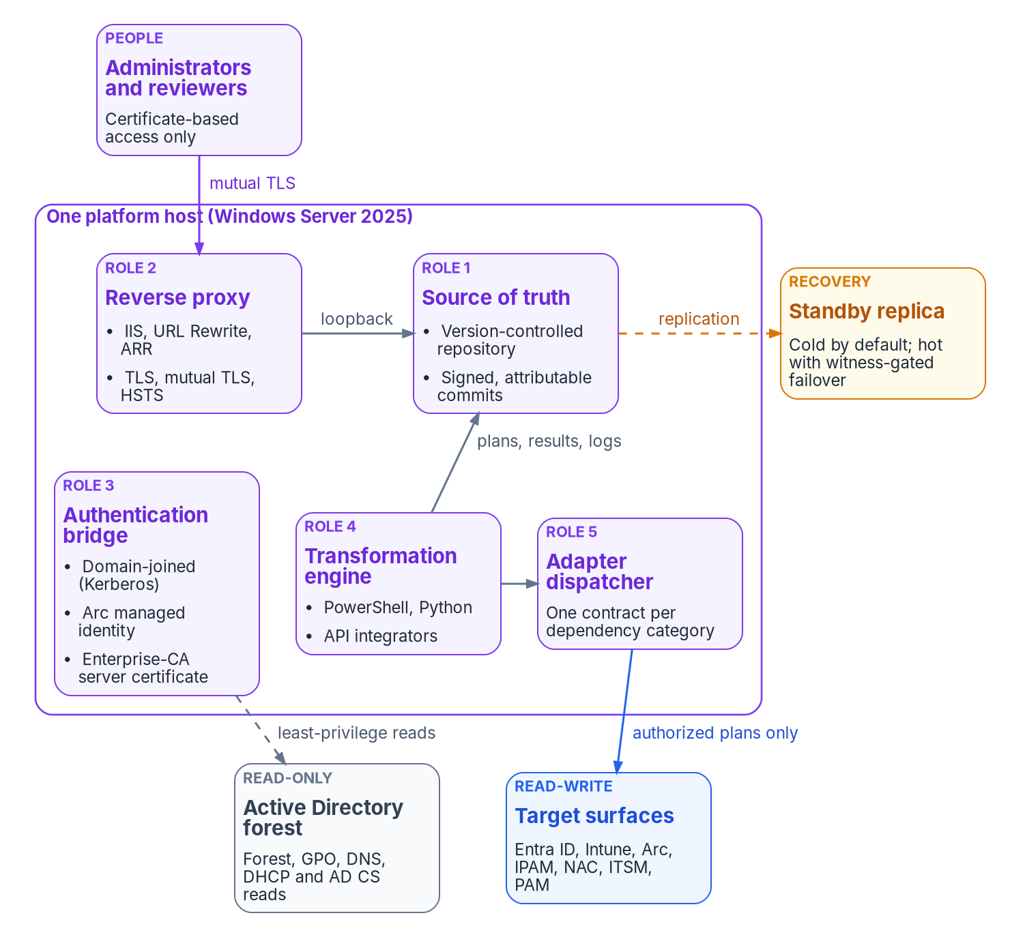
The platform host: where every decision is written down
WHAT
THE REFERENCE DESIGN
One host, one authoritative writer
One Windows Server 2025 server with a standby for recovery; one writer is the property that matters
Holds the repository: every artifact a signed, attributable commit
Reads Active Directory read-only; writes to the cloud only through authorized plans
Protected as a Tier 0 asset, with its logs in central logging (OMB M-26-14)
Built from standard components; a reference design, not a product
Sources: Book 01, Ch 03 (the architectural claim; why one host; operational properties); Book 00, Ch 08 (the reference design).
Notes:
[1:33–2:04] The platform host is one governed server, with a standby for recovery, and it's where the program writes everything down. What matters is one authoritative writer, so there's never a question of which copy is right. The host reads the old directory without changing it, and it writes to the cloud only through plans someone has approved. It's protected like the most sensitive identity systems. And it's a reference design built from standard parts, not a product to buy. Now, the reading.
Detail: Book 01 Chapter 03: every analysis, plan, delivery and evidence artifact can run on one Windows Server 2025 host, with a standby for recovery; "The property that matters is a single authoritative writer, and one host is the simplest way to get it. This is a reference architecture to build from standard components, not an existing product." Five roles: canonical source of truth (version control, for example Gitea, with signed, attributable commits), HTTPS reverse proxy (IIS with URL Rewrite and ARR), legacy-to-modern authentication bridge (domain-joined, Arc-connected, enterprise-CA certificate), transformation engine host (PowerShell, Python, API integrators) and adapter dispatcher. The AD side is read-only by policy; the cloud side is read-write because plans land there. Operational properties: treat it as Tier 0; forward its logs to central logging (OMB M-26-14 requires logs that identify the identity behind each operation). Book 00 Chapter 08: Gitea on Windows Server 2025 behind IIS is the reference design, "one well-understood way to meet the requirement, not the only one."
Sources: Book 01, Chapter 03; Book 00, Chapter 08 (The platform host: the program's reference design).

Slide 5
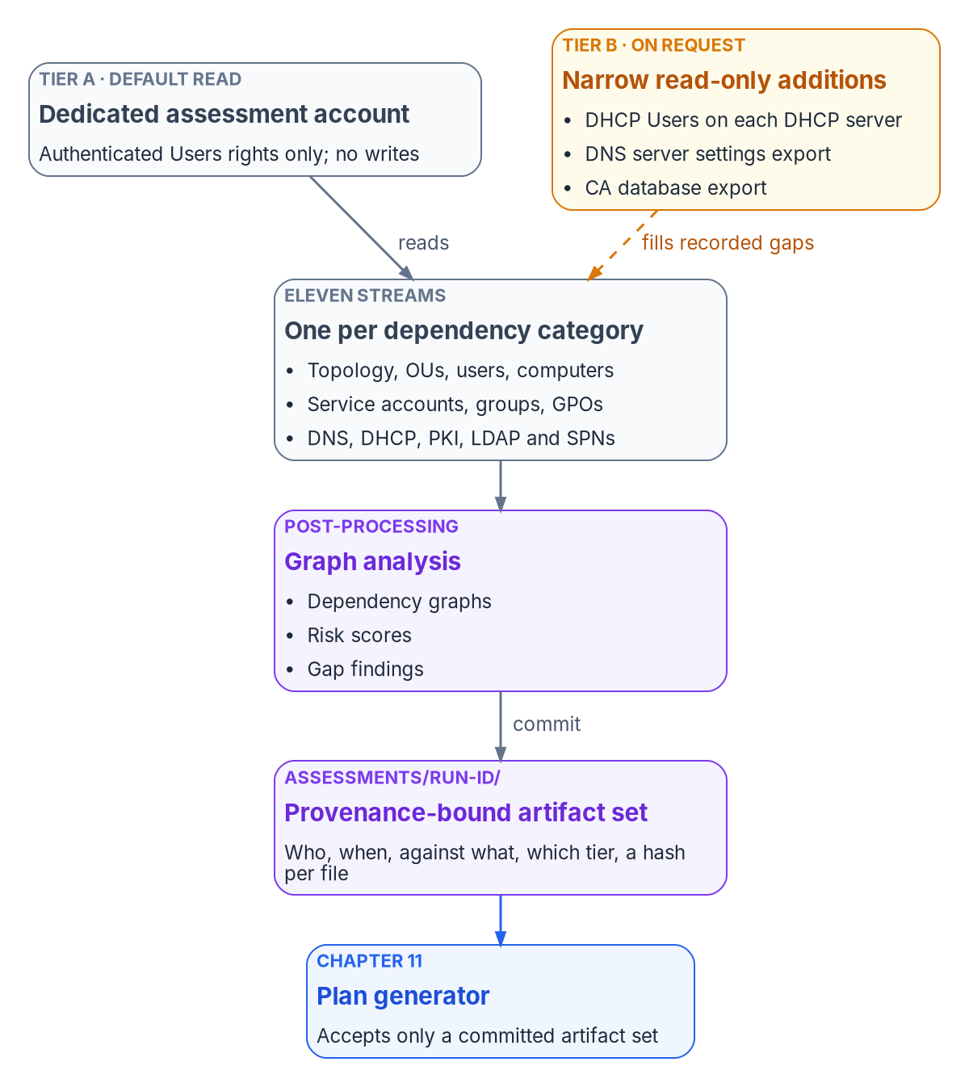
Reading the estate without changing it
HOW
READ-ONLY BY POLICY
Three locks, two tiers
Read-only at three levels: the account holds no write rights, the code imports no write commands, and every call is logged
Tier A: a standard account reads what default permissions expose, which is more than most teams expect
Tier B: narrow read-only additions for the gaps Tier A recorded, such as DNS server settings and the CA database; never rights that expose secrets
Security operations is told the window, the account and the query pattern first: broad enumeration looks like reconnaissance
Sources: Book 01, Ch 10 (three design principles: read-only by policy; least privilege in two tiers); Book 00, Ch 08 (five steps).
Notes:
[2:04–2:36] The assessment reads the whole estate and changes nothing. That's enforced three ways: the account can't write, the code has no write commands, and every call is logged. It runs in two tiers. A plain account reads what default permissions expose, which is usually more than people expect. Then a few narrow, read-only additions fill the gaps it recorded, and nothing that exposes secrets is ever requested. And tell security operations first: a full directory read looks a lot like reconnaissance. So what does it inventory?
Detail: Book 01 Chapter 10, "Read-only by policy": every assessment operation is limited to read rights, enforced at three levels: the account (no write rights), the code (no write cmdlets imported) and the audit trail (every call logged with its operation class). "Read-only isn't an honor system." Broad directory enumeration looks like reconnaissance to monitoring tools, so the security operations team is told the window, the account and the expected query pattern before the first run. "Least-privilege delegation in two tiers": Tier A, a dedicated standard account with no added rights, reads what default grants to Authenticated Users and Pre-Windows 2000 Compatible Access expose (topology, OU tree, most Group Policy settings, users, groups, computers, certificate templates, often AD-integrated DNS zones); Tier B adds read-only rights or administrator-run exports for recorded gaps (DHCP Users membership, DNS server settings, the CA's issued-certificate database, replication health and DC event logs). Rights that expose secrets are never requested. Book 00 Chapter 08 runs it as steps: read-only assessment (M-008), delegated assessment (M-009), security assessment (M-010) before G0.
Sources: Book 01, Chapter 10 (The assessment discipline; Three design principles); Book 00, Chapter 08.

Slide 6

What the assessment inventories
WHAT
Area | What is read | It feeds
Structure | Forest and domain topology, trusts, the OU tree and its delegation, schema extensions | Identity and attribute design
Accounts | Users, computers, groups, service accounts and their service principal names | Identity and compute plans
Policy | Every Group Policy Object: links, filtering and full settings | The Group Policy sunset
Network services | DNS zones and records, DHCP scopes, and the RADIUS and NPS servers that depend on the directory | Network services
Certificates | Certification authorities, templates and their permissions, including known escalation patterns | PKI and security findings
Applications | LDAP bindings, the Kerberos map, and transaction profiles for any app that would move away from its data | Compute and access
Risk findings come out too: unconstrained delegation, RC4-only accounts, and every server on Windows Server 2012 or 2016 needs a disposition in the plan.
Sources: Book 01, Ch 10 (the eleven ingestion streams; profiling transactions); Book 00, Ch 08 (twelve domains and the added streams).
Notes:
[2:36–3:09] Here's what it reads: the directory's structure, every kind of account, every Group Policy Object, the network services that lean on the directory, the certificate authorities and their templates, and the applications that bind to the directory. For any application that might move away from its data, it measures how chatty it is. Out of this come risk findings, like unsafe delegation or servers on Windows Server 2016, and every one gets a disposition. But a list only helps if you can prove where it came from.
Detail: Book 01 Chapter 10's eleven ingestion streams: 1 forest and domain topology (with trusts and schema version); 2 OU hierarchy (with delegation ACLs); 3 users; 4 computers; 5 service accounts and SPNs; 6 security and distribution groups; 7 Group Policy Objects; 8 DNS zones and records; 9 DHCP scopes and reservations (Tier B); 10 certificate services (templates, permissions including escalation patterns such as ESC1, which Microsoft Defender for Identity reports); 11 LDAP bindings and the Kerberos SPN map. RADIUS/NPS is inventoried separately (Book 09, Chapter 07). Transaction profiles record, per business transaction, the measured synchronous round trips for any application proposed to move away from its data. Risk scoring from Stream 4: unconstrained delegation; weak encryption types (Windows Server 2025 domain controllers no longer issue RC4 ticket-granting tickets); unsupported operating systems (Windows Server 2012/2012 R2 ESUs ended October 13, 2026; Windows Server 2016 reaches end of support January 12, 2027), each needing a disposition in the plan. Book 00 Chapter 08: the master plan's twelve assessment domains plus DHCP, LDAP bindings and the SPN map, transaction profiles and the RADIUS and NPS inventory; the program needs the union of both.
Sources: Book 01, Chapter 10 (The eleven ingestion streams; Profiling transactions before separation); Book 00, Chapter 08 (Twelve domains).

Slide 7

Provenance, and seeding the repository
WHY
EVERY RUN CARRIES
Proof of how the estate was read
SEEDING THE REPOSITORY
Every artifact is a reviewed commit
Who ran it, and when (UTC)
Against what: forest, domains, and the domain controller that served each read
With what rights profile: Tier A or Tier B
A SHA-256 hash of every output file, and the commit it landed in
The engine rejects a run without provenance
Main holds only approved artifacts; changes arrive through a pull request the steward approves
Every governed document carries a status: draft, in review, approved, current or deprecated
Server-side checks reject controlled-information markings
The assessment set is sensitive: stored encrypted, and the assessment workstation is sanitized afterward (NIST SP 800-88 Rev. 2)
Good enough to attest to: not a best-effort inventory or a sample, but the full record, reproducible from the repository.
Sources: Book 01, Ch 10 (provenance-bound output; one artifact set per run); Book 00, Ch 08 (repository conventions; the deliverables).
Notes:
[3:09–3:42] Every assessment run carries its own receipt: who ran it, when, against which forest and which domain controller, with which rights, and a fingerprint of every file it produced. A run without that receipt is rejected. The receipt lands in the repository, which this phase seeds. From here on, every artifact is a reviewed change with a status, and nothing becomes official until the steward approves it. The inventory itself is sensitive, so it's stored encrypted, and the assessment workstation is wiped afterward. Next, the program's own access.
Detail: Book 01 Chapter 10, "Provenance-bound output": every run records who ran it (account or service principal), when (UTC timestamp), against what (forest DNS name, domain FQDNs, the domain controller that served each read), with what profile (Tier A, Tier B or a recorded custom profile), producing what (a SHA-256 hash of each output file), and committed where (repository branch and commit). "The engine rejects a run without provenance." One artifact set per run under assessments/<run-id>/; every commit signed and attributable; the set maps privileged groups, service accounts and certificate-template permissions, so it is stored encrypted and handled under the agency's data classification policy. Book 00 Chapter 08, repository conventions: main is canonical and protected, changes arrive through a pull request the steward approves; five document states (DRAFT, IN_REVIEW, APPROVED, CURRENT, DEPRECATED); server-side hooks reject controlled-information markings (the agency's CUI markings and the legacy ones). The assessment workstation is sanitized under NIST SP 800-88 Rev. 2 once the initial assessment is committed.
Sources: Book 01, Chapter 10; Book 00, Chapter 08 (Repository conventions; The twenty-three deliverables).

Slide 8

Least privilege for the program's own access
WHO
The program's access | How Phase 0 sets it up
Directory reads | A dedicated forest-reader account; never Domain Admin or Enterprise Admin (NIST SP 800-53 AC-6, applied to the assessment team)
Entra ID, Intune and Azure Arc | Least-privilege service principals for each; Microsoft Graph calls get only the permissions they need
Arc onboarding | A certificate-based service principal scoped to the Azure Connected Machine Onboarding role; not needed once the server connects
Registering the repository app | The narrowest Entra role that does the job, such as Cloud Application Administrator, not Global Administrator
Signing in to the repository | Directory and Entra ID sign-in, with MFA enforced after at least a week in report-only
Decide and act stay separate: the layer that validates a plan and the layer that runs it use different service accounts, credentials and logs.
Sources: Book 01, Ch 12 (Phase 0 work), Ch 03 (authentication bridge; separation of governance and execution) and Ch 10; Book 00, Ch 08 (M-003, M-004).
Notes:
[3:42–4:13] The program practices what it asks of everyone else, starting with its own access. The directory reader is an ordinary account, never a domain administrator. The connections to cloud identity, device management and server management each get their own service identity, with only the permissions that job needs. And the part of the platform that approves a change runs under different credentials from the part that carries it out, so no single account can both decide and act. Then come the people.
Detail: Book 01 Chapter 12, Phase 0 work: create least-privilege service principals for Microsoft Entra ID, Intune and Azure Arc. Book 01 Chapter 10: least privilege for the assessment account is NIST SP 800-53 AC-6 applied to the assessment team; never Domain Admin or Enterprise Admin. Book 01 Chapter 03: the host's AD side is read-only using a least-privilege forest-reader account; Microsoft Graph calls use a workload identity granted only the permissions it needs; Arc onboarding is a separate, one-time credential, and Microsoft recommends the certificate form of service principal scoped to the Azure Connected Machine Onboarding role; the credential isn't needed after the server connects. Separation of governance and execution: separate service accounts, credential stores and log streams; "A component that both decides and acts can cover its tracks." Book 00 Chapter 08: Microsoft's least-privileged role for creating an enterprise application is Cloud Application Administrator (Application Developer where registration is restricted), rather than Global Administrator; Microsoft recommends each Conditional Access policy run in report-only for at least a week before enforcement, and MFA is enforced for the repository application before G0.
Sources: Book 01, Chapters 03, 10 and 12; Book 00, Chapter 08 (Seven build milestones).

Slide 9

Owners named, findings classified
WHO
Class | Must be closed by
Critical | Gate G0: remediated, or formally accepted by the authorizing official
High | Gate G1, before the pilot opens
Medium | Gate G3, during rollout
Low | Accepted or tracked; reviewed at each gate
WHO OWNS WHAT AT G0
One decider per decision
The steward decides G0, with the executive sponsor as backup
Workstream leads (identity, policy, services, compute, access) review the assessment and findings for their domain
The steering committee reviews; its review is an input, not a second signature
Every High finding has an owner and a date before G1
A Critical finding can't carry into planning: it is fixed before G0, or the authorizing official accepts the risk in writing.
Sources: Book 00, Ch 08 (finding classes; Gate G0 checklist); Book 01, Ch 12 (gate authority) and Ch 09 (decision rights).
Notes:
[4:13–4:46] By week four, every finding has a class and an owner. Critical findings block the gate: each one is fixed, or formally accepted by the authorizing official, the only person who can accept that risk. High findings get an owner and a date before the next gate. The people are named too. The steward decides the gate, with the sponsor as backup, and the workstream leads review what was found in their areas. The steering committee advises; it doesn't add a second signature. So what does the gate check?
Detail: Book 00 Chapter 08, step 3 (security assessment, M-010): certificate-template analysis, privileged access audit and imported posture findings merged into one set and classified. Critical (blocks migration) must be closed by G0, Book 01's "no open priority-one findings"; High by G1, before Phase 2 opens; Medium by G3; Low accepted or tracked and reviewed at each gate. A Critical finding is either remediated before G0 or formally accepted by the authorizing official, who holds risk acceptance (Book 01 Chapter 09: the authorizing official is the only organizational official who can accept security and privacy risk on the organization's behalf). G0 is decided by the steward with the executive sponsor as backup (Book 01 Chapter 12 gate authority table); the steering committee's review is an input, not a second signature. The G0 checklist requires every High finding to have an owner and a remediation date before G1, and the workstream leads and steering committee to have reviewed the assessment and the classified findings.
Sources: Book 00, Chapter 08 (Step 3; Gate G0); Book 01, Chapters 09 and 12.

Slide 10

Gate G0, Ready to Plan: the checklist
HOW
Gate G0 checks | Answered from the repository
Platform host operational | Platform checklist met with evidence; least-privilege service principals for Entra ID, Intune and Azure Arc; host protected as Tier 0, logging centrally
Assessment committed | Read-only and delegated runs cover every area, with provenance on every file; RADIUS and NPS inventory and transaction profiles committed
Findings | Every finding classified; no Critical open unless the authorizing official accepted it; every High owned and dated
Gate record | Go, no-go or conditional go, merged by pull request with who decided; the approved state frozen on a release branch
Hold the gate on evidence, not the calendar: a gate passed on a date without its evidence only moves the failure later.
Sources: Book 00, Ch 08 (Gate G0: the go/no-go checklist) and Ch 01 (what leadership should take from this); Book 01, Ch 12.
Notes:
[4:46–5:18] Gate G zero is a checklist, answered from the repository, not from a status meeting. Is the platform working, with its service identities scoped and its logs in central logging? Is the assessment committed, covering every area, with its receipts? Is every finding classified, with nothing critical left open? And is the decision itself recorded, with the name of whoever made it? The answer can be go, no-go, or go with conditions. A gate passed on a date without the evidence just moves the failure later.
Detail: Book 00 Chapter 08, "Gate G0: the go/no-go checklist", each item answered from the repository. Platform host operational: every platform checklist item met with evidence (Gitea reachable over HTTPS; directory and Entra ID sign-in with MFA enforced; upstream mirrored and the promotion path tested; hooks and branch protection verified; Arc connected or scheduled for Phase 1; M-001 to M-007 signed off; completion report committed); least-privilege service principals for Entra ID, Intune and Azure Arc; host protected as Tier 0 with logs in central logging. Assessment committed: read-only run reviewed and delegation request recorded (M-008); delegated run covers all twelve domains plus DHCP, LDAP bindings and the SPN map, with provenance on every file (M-009); RADIUS and NPS inventory committed; transaction profiles committed; the fifteen assessment deliverables under one run identifier. Findings: every finding classified, no Critical open unless accepted by the authorizing official; every High owned and dated before G1. Gate record: the decision (go, no-go or conditional go) merged by pull request, recording who decided; the approved state frozen on a release/ branch. Book 00 Chapter 01: "Hold gates on evidence, not on the calendar... a gate passed on a date without its evidence only moves the failure later."
Sources: Book 00, Chapters 01 and 08; Book 01, Chapter 12.

Slide 11
What leadership sees at week four
HOW
AT WEEK FOUR, LEADERSHIP HOLDS
Facts, not estimates
RIGHT AFTER G0
Phase 1 opens
An inventory of the whole estate, with proof of how it was read
A classified findings list, every item owned and dated
A platform that records every decision and who made it
A Gate G0 decision, merged and on the record
Eight modernization plans generated from the assessment, not designed by hand
Each workstream lead reviews their plan; the steward approves
Then the foundation build toward Gate G1
To go deeper | For
Book 00, Chapter 08 | Pre-flight: the build milestones, the twenty-three deliverables and the full G0 checklist
Book 01, Chapter 03 | The platform host: its five roles and how it is protected
Book 01, Chapter 10 | Analyzing the estate: the eleven streams, the two tiers and provenance
Next in the Start series: Episode 3, Foundation to Gate G1, covers weeks five to eight.
Sources: Book 00, Ch 08 (steps 4 and 5; key takeaways); Book 01, Ch 12 (Where to start).
Notes:
[5:18–5:53] At week four, leadership holds facts instead of estimates. An inventory of the whole estate, with proof of how it was read. A findings list where every item has an owner and a date. A platform that records every decision and who made it. And a gate decision, on the record. Right after the gate, the assessment becomes eight modernization plans, generated from data rather than drawn up by hand, and approved by the steward. That's where the foundation work begins, and it's the subject of Episode 3: Foundation to Gate G1.
Detail: Book 00 Chapter 08 key takeaways: pre-flight has one exit (the platform host works, the assessment is committed, and no priority-one finding is open); every artifact is a reviewed commit with a status. Steps 4 and 5 are the first work after G0: plan generation (M-011) produces eight machine-readable plans (computer, identity, GPO, DNS, PKI, attribute design, trust decommission and security remediation) generated from the committed assessment and only from it, "produced by generators from data, not drawn up by hand"; review and approval (M-012), where each workstream lead reviews their own plan, the security lead validates severities, and the steward approves each plan. Book 01 Chapter 12: Phase 1 — Foundation (weeks 5–8) ends at Gate G1, Foundation Complete. Next: Episode 3 of the Start series, Foundation to Gate G1.
Sources: Book 00, Chapter 08 (Five steps from default read to approved plans; Key takeaways); Book 01, Chapter 12.

