Slide 1

Certificates, Tokens and Keys Across the Hybrid Estate
Explainer · Research — under review
WHAT HAPPENS TO AD'S CREDENTIAL WORK · ABOUT 11 MINUTES
SQL Server with Entra ID · The clouds' key vaults · PIV from AD to Entra
RADIUS, 802.1X and NAC · Who issues and who renews
Sources: Microsoft Learn and Support; CyberArk Certificate Manager 26.1 docs; AWS; Google Cloud; IDManagement.gov; Cisco; FedRAMP Marketplace. All opened Oct. 23, 2026.
Presented by Michael F. Stratton
Not an official U.S. government publication. Independent technical analysis; not reviewed or endorsed by any federal agency.
Notes:
[0:00–0:40] Welcome. This is a research explainer from the Federal Modernization Workbook, and it answers a question that comes up in every Active Directory retirement: when AD goes, what happens to all the certificates, tokens and keys it quietly looked after? We'll follow four paths: SQL Server signing in with Entra ID, the clouds' own key vaults, the PIV card, and the network's RADIUS and 802.1X. For each one we'll look at today, the years of coexistence, and life after AD, and then put it all on one page: who issues each credential, and who renews it. The slides and notes carry the detail and the sources.
Detail: A research explainer for architects learning the area. Active Directory does more credential work than its name suggests; as the estate moves to Entra ID, Intune and Azure Arc, each job needs a new owner. Four paths, each at three stages (today, coexistence, after AD), and a summary of issuer and renewer per credential. It builds on Book 07, which makes CyberArk Certificate Manager the system of record for every certificate Intune and the PIV system don't manage. Every fact comes from a primary source opened on October 23, 2026. Recommendations are labeled design guidance, inferences as inferences.
Sources: Research brief, Certificates, Tokens and Keys Across the Hybrid Estate (verified Oct. 23, 2026); Book 07, Chapters 04 to 08 and Appendix C.

Slide 2

What AD does for credentials today
WHY
AD's job today | Why it matters | Who takes it after AD
Trusts the PIV issuer (NTAuth) and maps each card to an account | Smart card logon fails without both since the Feb. 2025 enforcement | Entra certificate-based authentication and certificateUserIds
Hands out Kerberos tickets to SQL Server | Apps and users sign in without a token or certificate of their own | Entra tokens through Azure Arc; managed identities
Autoenrolls DC and server certificates | Renewal happens without anyone tracking it | DC certificates end; server TLS moves to the CLM
Authorizes network access through NPS | NPS reads dial-in properties from AD | A NAC platform checking Intune; no Entra RADIUS
Feeds Entra through Connect Sync | Carries the card binding into the cloud | Graph writes from the card issuance event (design guidance)
One renewer per credential: every certificate gets exactly one system that renews it, written down in the CLM.
Sources: KB5014754; Microsoft Learn: smart card logon with third-party CAs, Plan NPS as a RADIUS server, certificateUserIds; Book 07, Ch 04 and Ch 07.
Notes:
[0:40–1:14] Start with what AD actually does, because most of it is invisible. It trusts the PIV card's issuer and maps each card to an account. It hands out Kerberos tickets, so SQL Server never has to think about tokens. It autoenrolls certificates for domain controllers and servers. And through NPS, it answers the network when a laptop plugs in. Each of those jobs needs a new owner, and the right-hand column shows who takes each one. Some answers are obvious. Others, like RADIUS, surprise people. Let's go through them in order.
Detail: AD's credential jobs: NTAuth trusts the third-party issuing CA ("Active Directory must have the third-party issuing CA in the NTAuth store"); the KDC maps the certificate to an account, and since the February 2025 update denies a certificate that can't be strongly mapped. Kerberos gives SQL Server Windows authentication. AD CS autoenrollment issues domain controller and server certificates. NPS reads users' dial-in properties from AD during authorization. Entra Connect Sync carries altSecurityIdentities into certificateUserIds. After AD: Entra CBA, Entra tokens via Arc and managed identities, the CLM for server TLS (Book 07 Ch 04), a NAC platform with Intune compliance retrieval, and Graph writes from the card management system's issuance event (design guidance). The rule "one renewer per credential" is program design guidance.
Sources: Microsoft Support, KB5014754; Microsoft Learn: Guidelines for enabling smart card logon with third-party CAs (Feb. 12, 2026), Plan NPS as a RADIUS server (Mar. 11, 2025), Mapping to the certificateUserIds attribute (Apr. 21, 2025); Book 07, Chapters 04 and 07.

Slide 3
Three stages, five paths
WHAT
Today
AD at the center: Kerberos, NTAuth, autoenrollment, NPS
Coexistence
AD and Entra side by side; both must work; the longest stage
After AD
The last domain controller is gone; cloud owners only
Path | The question it answers
1 SQL Server with Entra ID | If SQL Server takes Entra tokens, which certificates and identities does it still need, and who renews them?
2 The clouds' key vaults | Are Azure Key Vault, AWS Certificate Manager and Google's services coordinated with the CLM?
3 PIV from AD to Entra | What happens to smart card sign-in when the card's relying party moves from AD to Entra?
4 RADIUS, 802.1X and NAC | If AD is no longer behind RADIUS, what answers the switch?
5 Who issues and who renews | One table of every credential above, at every stage
Sources: Book 07, Ch 07 (coexistence rules and waves); research brief §1 and §6.
Notes:
[1:14–1:49] Here's how the explainer is laid out. Every path is shown at three stages. Today, with AD at the center. Coexistence, which is the long middle, when AD and the cloud run side by side and both have to work. And after AD, when the last domain controller is gone. The four paths are SQL Server, the cloud key vaults, PIV, and network access. The fifth part is the summary table. One rule runs through all of it: every credential has exactly one renewer, and we write down who that is. First, SQL Server.
Detail: The three stages follow Book 07 Chapter 07's coexistence model: today (AD-centric), coexistence (hybrid, during the waves), and after AD (the last domain controller retired). Paths 1 to 4 each end with a three-stage table; Path 5 is the ownership summary. The questions are the ones the program asked: SQL with Entra tokens and CyberArk; whether each CSP's key vault is coordinated with CyberArk; PIV, currently mapped to AD and synced to Entra, as AD deprecates; and how NAC, 802.1X and RADIUS are managed when AD no longer backs RADIUS.
Sources: Book 07, Chapter 07; research brief sections 1 and 6.

Slide 4
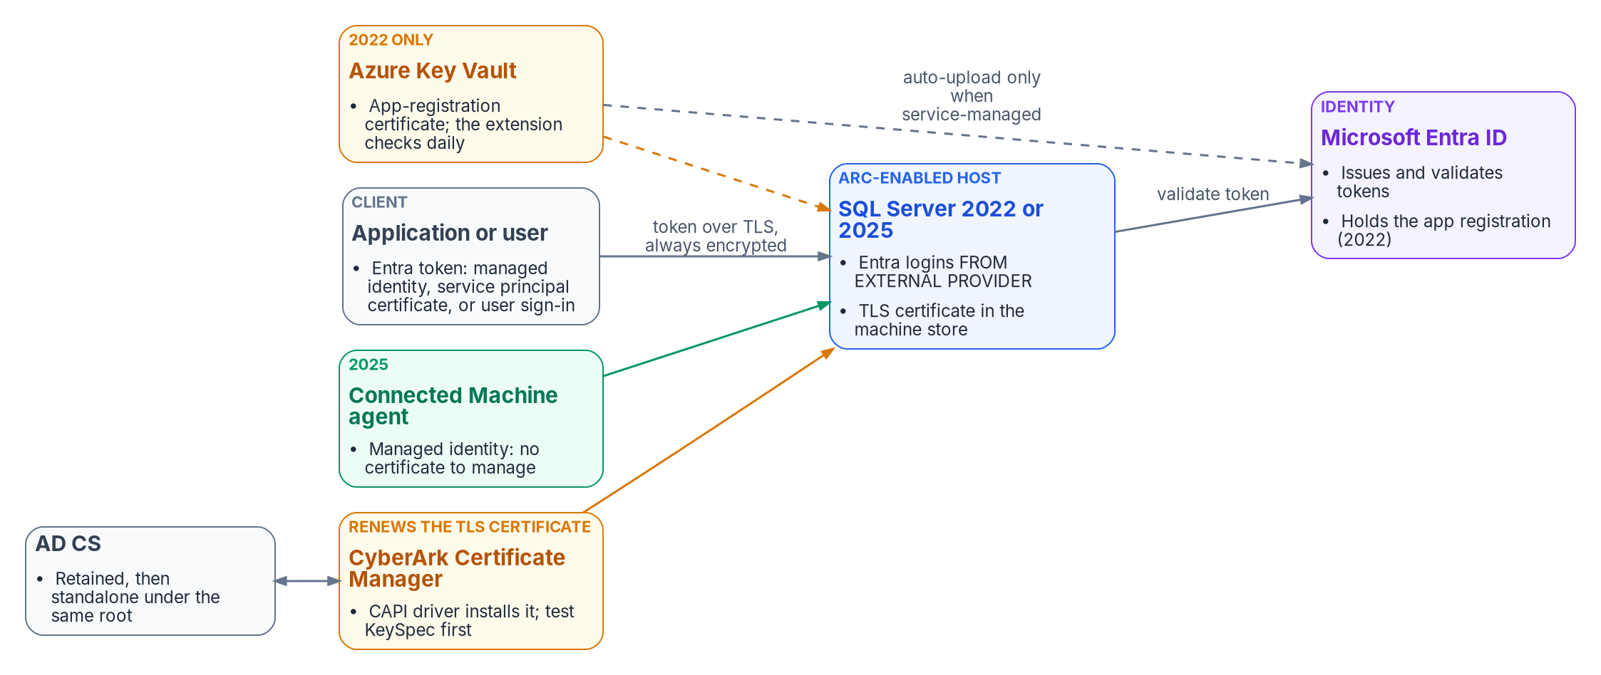
SQL Server: one server, three credentials
WHAT
Sources: Microsoft Learn: Entra authentication for SQL Server; Arc setup tutorial; Managed identity for Arc-enabled SQL Server; Rotate certificates.
Notes:
[1:49–2:24] SQL Server can now accept Entra ID tokens on premises, through Azure Arc, instead of Kerberos. That sounds like it removes certificates. It doesn't. Around one SQL Server there are three different credentials, with three different owners. The TLS certificate, which CyberArk Certificate Manager renews. On SQL Server 2022, an app-registration certificate that lives in Key Vault. And on SQL Server 2025, a managed identity that the Arc agent looks after, with no certificate to manage at all. The next slide explains why the TLS certificate suddenly matters more than it used to.
Detail: "SQL Server 2022 (16.x) introduces support for authentication with Microsoft Entra ID, on both Windows and Linux on-premises"; the host needs the Connected Machine agent and the Azure extension for SQL Server. Supported methods include password, integrated, universal with MFA, service principal, managed identity and access token; the token audience is https://database.windows.net/. Three credentials: (1) the TLS certificate in the machine store, installed by the CLM's CAPI driver over WinRM; (2) on 2022, the instance's app registration uses a certificate "stored in Azure Key Vault (AKV). The Azure Arc agent downloads the certificate to the SQL Server instance host"; it needs a unique CN, at most 12 months' validity, and must be a CSP certificate because Entra doesn't support CNG certificates; (3) on 2025, the Arc server's system-assigned managed identity authenticates inbound and outbound, only on Windows Server, with public-cloud access. A manual non-Arc path exists on Windows.
Sources: Microsoft Learn: Microsoft Entra authentication for SQL Server (Nov. 6, 2025); Tutorial: Set up Microsoft Entra authentication for SQL Server enabled by Azure Arc (Nov. 18, 2025); Managed identity for SQL Server enabled by Azure Arc (Nov. 18, 2025); CyberArk 26.1 CAPI driver.

Slide 5
SQL Server: the TLS certificate becomes mandatory
HOW
THE TLS CERTIFICATE
Always encrypted with Entra
SQL SERVER 2022 APP CERTIFICATE
It can rotate itself
"Connections authenticated by Microsoft Entra ID are always encrypted"
Self-signed fallback forces TrustServerCertificate, which doesn't check who the server is
Needs: Server Authentication EKU; every client name in the SAN; key read access for the service account
KeySpec must be AT_KEYEXCHANGE: KSP keys "aren't compatible with SQL Server"
The CLM's CAPI driver documents key location, not CSP vs KSP: prove KeySpec = 1 before rollout (design guidance)
Service-managed certificate and app registration, plus Key Vault Sign for the Arc identity: the extension rotates it
Key Vault renews at 80% of the lifetime by default
Customer-managed: the owner uploads the new .cer; the extension checks daily, up to 24 hours
No CLM driver uploads to an app registration: the CLM watches, it doesn't renew
Correction: Book 06 Ch 10 said "not rotated automatically"
Sources: Microsoft Learn: Arc tutorial; Configure encryption; Certificate requirements; Rotate certificates; CyberArk 26.1 CAPI object settings.
Notes:
[2:24–3:05] Here's the catch. Every connection authenticated by Entra ID is encrypted. If the server only has its own self-signed certificate, clients have to be told to trust it blindly, which gives up checking who the server is. So the day Entra logins start, every instance needs a real, CA-issued certificate. The CLM installs and renews it. There's one technical trap to test first: SQL Server only accepts a certificate whose key was made the older way, and CyberArk's driver documentation doesn't say which way it makes keys. Prove it in the lab. And on 2022, the app certificate can rotate itself, if you set it up as service-managed.
Detail: TLS: "Connections authenticated by Microsoft Entra ID are always encrypted. If SQL Server is using a self-signed certificate, you must add trust server cert = true in the connection string." Without a provisioned certificate SQL Server generates a self-signed one at startup, which "doesn't protect against identity spoofing by the server." Requirements: local computer or service-account store; Server Authentication EKU 1.3.6.1.5.5.7.3.1; KeySpec AT_KEYEXCHANGE (a legacy CSP such as Microsoft RSA SChannel Cryptographic Provider; "Certificates created with a Key Storage Provider (KSP) ... use KeySpec = 0 and aren't compatible with SQL Server"); SAN with all client names; availability groups share one certificate with every replica and listener name, or one per replica; restart after a change. The CAPI driver documents key generation on the device or Luna or nShield HSMs but not CSP versus KSP, hence the test gate (design guidance). App certificate: the automation tutorial says "The certificates created for Microsoft Entra aren't rotated automatically"; the newer rotation page says the extension "can automatically rotate certificates for Microsoft Entra ID for service managed certificates and service managed app registration", with the Key Vault key permission Sign granted to the Arc identity through an access policy. Customer-managed: create the new version and upload the .cer to the app registration; the extension "checks for a new certificate daily".
Sources: Microsoft Learn: Tutorial, Entra authentication for SQL Server enabled by Azure Arc; Configure SQL Server Database Engine for encrypting connections (Dec. 2, 2025); Certificate requirements for SQL Server (Mar. 3, 2026); Tutorial: Using automation to set up the Entra admin (June 19, 2026); Rotate certificates (June 23, 2026); CyberArk 26.1 CAPI application object settings.

Slide 6

SQL Server across the three stages
WHO
Stage | How users and apps sign in | TLS certificate | Instance identity
Today | Windows authentication (Kerberos or NTLM); TLS optional | AD CS autoenrollment, manual, or the CLM; or the self-signed fallback | Service account (gMSA or domain account)
Coexistence | Windows and Entra logins side by side on Arc-enabled 2022 and 2025 | Mandatory; retained AD CS through the CLM | 2022: app certificate in Key Vault; 2025: managed identity (Arc agent)
After AD | Entra logins only; apps by managed identity or service principal certificate | Standalone AD CS under the same root, through the CLM | 2025 managed identity
Design guidance: move to SQL Server 2025 with the managed identity so the app certificate disappears; where 2022 remains, use the service-managed pattern and let the CLM monitor it.
Sources: Microsoft Learn: Managed identity for SQL Server enabled by Azure Arc; Rotate certificates; Book 07, Ch 04; Book 05, Ch 09; Book 06, Ch 09, Ch 10 and Ch 22.
Notes:
[3:05–3:36] Put the stages side by side and the direction is clear. Today, Windows authentication, and TLS is optional. During coexistence, Windows and Entra logins run together, TLS becomes mandatory, and SQL Server 2022 carries an app certificate in Key Vault. After AD, it's Entra logins only, applications use managed identities, and the TLS certificate comes from the standalone CA under the same root. The program's advice is simple: move to SQL Server 2025, so one whole certificate disappears. Next, the clouds' key vaults.
Detail: Today: Windows authentication, TLS optional but recommended; the TLS certificate from AD CS (Book 06 Ch 22) or SQL's self-signed fallback; servers aren't Intune-managed (Book 05 Ch 09). Coexistence: Entra logins FROM EXTERNAL PROVIDER on Arc-enabled 2022 and 2025; TLS mandatory; retained AD CS through the CLM (Book 07 Ch 04); 2022 app certificate in Key Vault, renewed by Key Vault and the Arc extension when service-managed or by the owner when customer-managed; 2025 managed identity, managed by the Arc agent. After AD: Entra only; standalone AD CS under the same root through the CLM. Applications on Arc-enabled servers can use the server's managed identity from localhost:40342 if in local Administrators or Hybrid Agent Extension Applications (himds on Linux). In 2025, OPENROWSET BULK can read the agent's tokens folder, so bulk permissions "should be treated as equivalent to sysadmin". Azure SQL uses Microsoft's own server certificate; the customer owns client trust stores (DigiCert Global Root G2, Microsoft RSA Root CA 2017, Microsoft ECC Root CA 2017).
Sources: Microsoft Learn: Managed identity for SQL Server enabled by Azure Arc; Rotate certificates; Access Azure resources by using managed identity on Azure Arc-enabled servers (Feb. 5, 2026); Root CA change for Azure SQL; Books 05, 06 and 07.

Slide 7
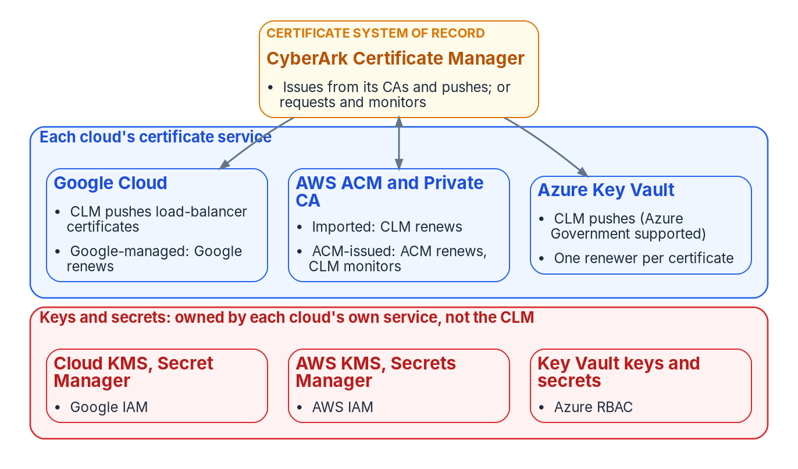
The clouds' key vaults: one renewer per certificate
WHAT
Sources: Microsoft Learn: About Key Vault certificates (July 10, 2026); AWS ACM managed renewal; Google Certificate Manager (Oct. 20, 2026); CyberArk 26.1 cloud drivers.
Notes:
[3:36–4:14] Every cloud has its own certificate service, and each one can issue and renew certificates by itself. Azure has Key Vault, AWS has Certificate Manager, and Google has its own. Nobody coordinates them unless the program does. So the rule is: for each certificate, decide one renewer, and record it in the CLM. Either the CLM issues it and pushes it into the cloud, or the cloud issues it and the CLM just watches. And notice the red band. Keys and secrets are a different job. They stay with each cloud's own key and secret services. The CLM manages certificates, not secrets.
Detail: The CLM pushes certificates into Azure Key Vault through its Azure Key Vault application driver; requests from or imports into AWS Certificate Manager (ACM CA template driver; AWS application driver); and writes classic SSL certificate resources to Google Cloud load balancers. Each cloud also issues and renews its own certificates. Keys and secrets: no CLM driver page treats Key Vault keys or secrets, AWS KMS keys, Secrets Manager secrets, Google Secret Manager secrets or Cloud KMS keys as managed objects (inference from the driver list); they stay with each cloud's own service. CyberArk's separate secrets products are Secrets Manager (Self-Hosted, formerly Conjur Enterprise, and SaaS) and Secrets Hub, which syncs secrets into the clouds' native stores; choosing one is outside this explainer. Coordination model: one renewer per certificate, recorded in the CLM policy folder (design guidance).
Sources: Microsoft Learn: About Azure Key Vault certificates (July 10, 2026); AWS ACM user guide, managed renewal; Google Cloud, Certificate Manager overview (Oct. 20, 2026); CyberArk 26.1: Azure Key Vault, AWS and Google Cloud Load Balancer drivers; CyberArk docs: Secrets Manager, Secrets Hub.

Slide 8
Azure, AWS and Google: who renews what
WHO
Cloud | The cloud renews by itself | The CLM's part | Government
Azure Key Vault | Partner CAs (DigiCert, GlobalSign) and self-signed only; any other CA: "Key Vault doesn't enroll or renew" | Pushes certificates, keys and chains; Key Vault's own renewal off for these | Driver Environment can be AzureUSGovernment; endpoint vault.usgovcloudapi.net
AWS ACM and Private CA | ACM-issued certificates; never imported ones | Imports CLM-issued certificates and renews them; or requests from ACM and monitors | ACM, Private CA, KMS, Secrets Manager in GovCloud; CLM driver pages silent on GovCloud
Google Cloud | Google-managed certificates in Certificate Manager | Pushes classic SSL certificates to load balancers; can request from CA Service | Assured Workloads lists the services; CLM pages silent
Don't forget the CLM's own credential: the Key Vault driver signs in with an app-registration certificate. Inventory it in the CLM with its own owner.
Sources: Microsoft Learn: Key Vault certificates, CSR merge, Azure Government comparison; AWS ACM and GovCloud guides; CyberArk 26.1 Web SDK schema and drivers.
Notes:
[4:14–4:48] The details differ a little by cloud. Key Vault only renews by itself for its two partner CAs and for self-signed certificates, so a certificate from the program's own CA comes from the CLM, and the good news is that the CLM's Key Vault driver supports Azure Government. In AWS, Certificate Manager renews what it issues, but never what you import, so imported certificates belong to the CLM. Google is similar. One thing to confirm with CyberArk in writing: its AWS driver pages don't mention GovCloud. Now, the PIV card.
Detail: Azure: "When a Key Vault certificate is created, an addressable key and secret are also created with the same name." Auto-renewal works with partner providers DigiCert and GlobalSign, "Supported in all Key Vault service locations in public cloud and Azure Government", and Key Vault handles autorenewal of self-signed certificates; lifetime actions default to 80 percent of the lifetime. For a non-partnered CA, IssuerName is Unknown and "Key Vault doesn't enroll or renew the certificate"; the workflow is CSR, sign, merge. The CLM's Web SDK schema has an Environment attribute that "can replace the default AzureGlobalCloud with an environment: AzureUSGovernment", closing a gap the earlier CLM guide listed. AWS: ACM renews Amazon-issued certificates; "ACM does not provide managed renewal for imported certificates"; private certificates issued directly through the Private CA IssueCertificate API aren't eligible either. CyberArk's ACM driver can request from ACM and Private CA and advises leaving ACM renewal on and widening the CLM renewal window about a week. GovCloud: ACM, Private CA, KMS and Secrets Manager run in US-West and US-East; the CLM AWS driver pages show no aws-us-gov partition (couldn't verify). Google: Certificate Manager issues and renews Google-managed certificates, including through CA Service; the CLM's load balancer driver uses compute.sslCertificates, not Certificate Manager maps (inference).
Sources: Microsoft Learn: About Azure Key Vault certificates; Configure certificate auto-rotation (July 8, 2026); Create and merge a CSR (July 8, 2026); Compare Azure Government and global Azure; AWS: ACM managed renewal, import, GovCloud ACM and Private CA; Google: Certificate Manager, CA Service, Assured Workloads; CyberArk 26.1: Azure Key Vault schema, ACM CA template, AWS, Google Cloud Load Balancer, CA Service drivers.

Slide 9
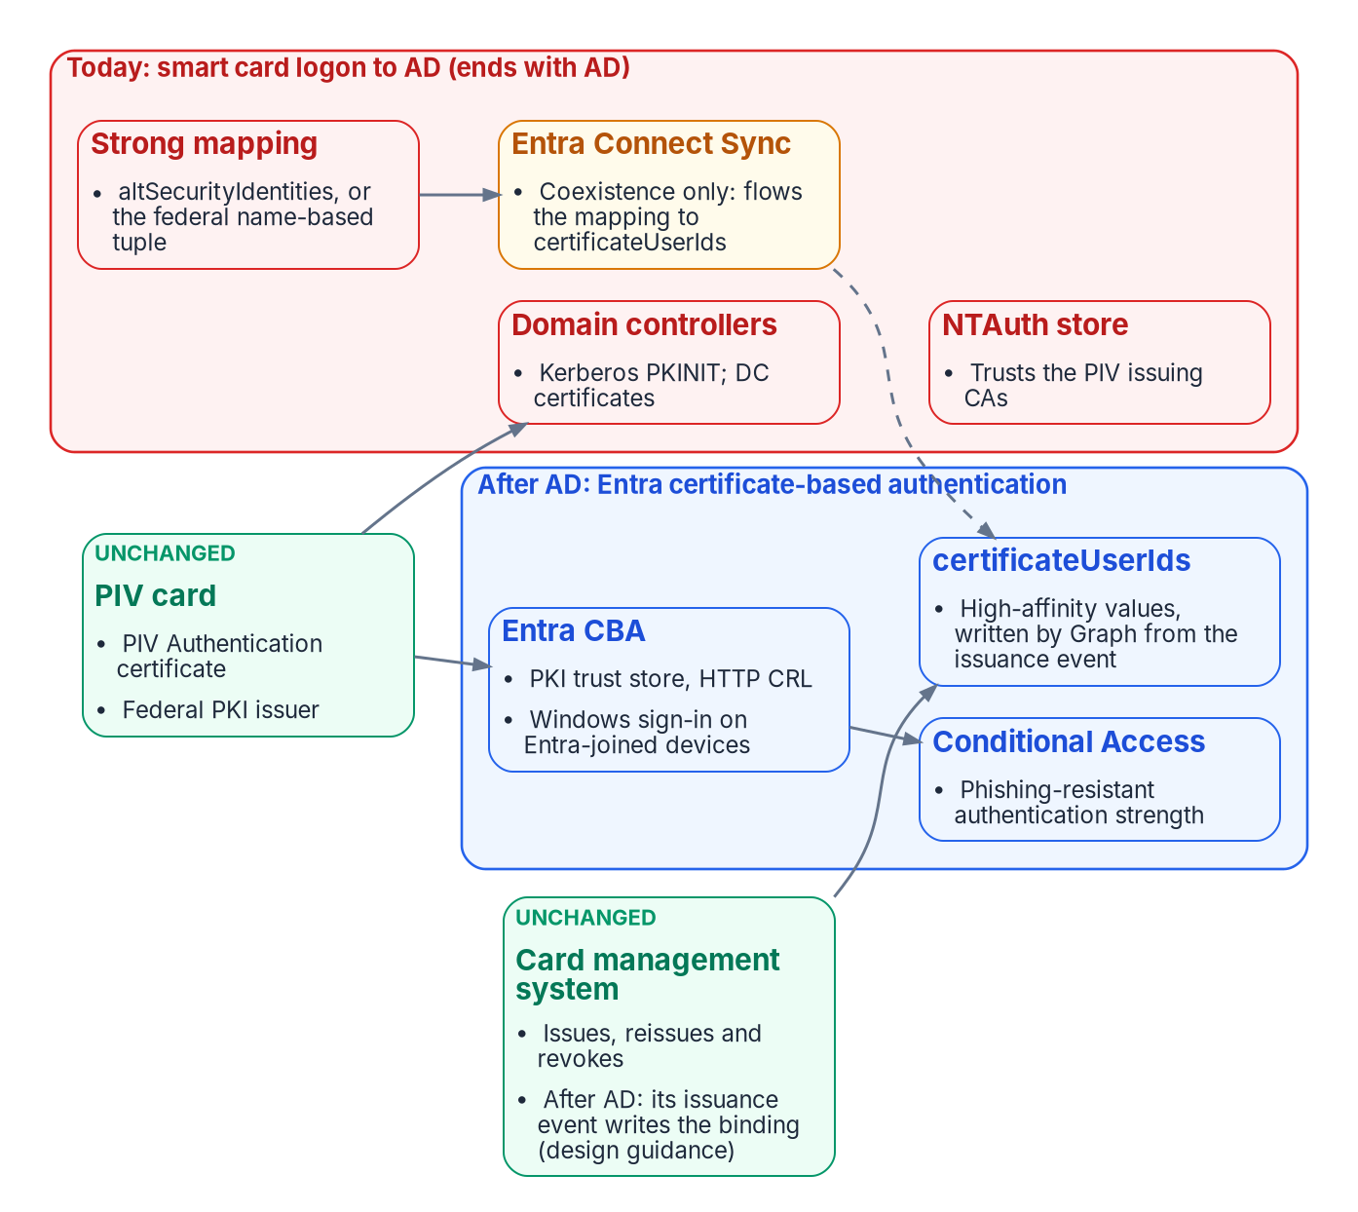
PIV: the card stays, AD's side goes
WHAT
Sources: Microsoft Learn: smart card logon with third-party CAs (Feb. 12, 2026); Entra CBA configuration (Aug. 15, 2025); certificateUserIds (Apr. 21, 2025); KB5014754.
Notes:
[4:48–5:25] The PIV card is the credential that changes least. The card, the Federal PKI issuer behind it, and the card management system all stay exactly as they are. What changes is the system that checks the card. Today that's AD: the domain controllers, the NTAuth store that trusts the issuer, and the mapping from card to account. All of that, shown in red, ends with AD. On the right is what replaces it: Entra certificate-based authentication, an attribute called certificate user IDs that binds the card to the person, and Conditional Access. Let's take the stages one at a time.
Detail: The card, the Federal PKI shared service provider or agency CA under Common Policy, and the card management system are unchanged by AD retirement. What disappears (inference from the cited pages): the NTAuth store, domain controller certificates and their autoenrollment, Kerberos PKINIT smart card logon, KDC strong-mapping enforcement with altSecurityIdentities and the name-based tuple policy, and the Connect Sync rule flowing altSecurityIdentities to certificateUserIds. What stays: the PIV issuer, the Entra trust store and CRLs, and certificateUserIds, written as a cloud attribute. Coexistence caveat: Entra-joined devices reaching on-premises resources still use DC certificates, which need HTTP CDPs and the root on the device (Book 07 Ch 07); keep the DC certificate path healthy until the last DC retires.
Sources: Microsoft Learn: Guidelines for enabling smart card logon with third-party CAs; How to configure Entra CBA; Mapping to certificateUserIds; Microsoft Support KB5014754; Book 07, Chapter 07; Book 03, Chapter 09.

Slide 10
PIV today: strong mapping for non-Microsoft CAs
WHY
Feb. 2025
Full Enforcement: certificates that can't be strongly mapped are denied
Sept. 9, 2025
The fallback to Compatibility mode ends
PIV's problem
The SID extension covers AD CS only; PIV comes from the Federal PKI
ROUTE 1
Explicit mapping on each account
ROUTE 2 · NEW IN THE BOOKS
Federal name-based strong mapping
altSecurityIdentities with a strong form: issuer and serial number, SKI, or SHA1 public key
IDManagement.gov calls it "recommended" over UPN mapping
Subject and RFC822 mappings are rejected in Full Enforcement
KDC policy "Allow name-based strong mappings for certificates" (Sept. 2024 update)
Accepts a name or UPN mapping for certificates from a named issuing CA that carry a named policy OID
Microsoft's example uses a Federal PKI policy OID; KB5014754 points to it
Sources: Microsoft Support KB5014754; Microsoft Public Sector Blog, name-based mapping in government scenarios; IDManagement.gov, Network Smart Card Logon for Windows.
Notes:
[5:25–5:59] Today, there's a deadline that already passed. Since September 2025, domain controllers refuse a certificate that isn't strongly mapped to its account. Microsoft's easy fix, a security identifier stamped inside the certificate, only works for certificates from Microsoft's own CA. PIV certificates come from the Federal PKI, so they need a different route. One is an explicit mapping on each account, which IDManagement dot gov recommends. The other is a government-specific policy Microsoft added, which trusts name-based mappings from named federal issuers. The books now cover both. Next, the coexistence years.
Detail: KB5014754: the February 2025 security update moves domain controllers to Full Enforcement, "Authentication will be denied if a certificate cannot be strongly mapped"; "The option to move back to Compatibility mode will remain until the September 9, 2025 Windows security update", after which StrongCertificateBindingEnforcement is no longer supported. "Environments that have non-Microsoft CA deployments will not be protected using the new SID extension." The SID extension is OID 1.3.6.1.4.1.311.25.2. Strong altSecurityIdentities forms: X509IssuerSerialNumber, X509SKI, X509SHA1PublicKey. IDManagement.gov's Windows smart card logon guide calls altSecurityIdentities recommended over UPN mapping, notes a domain can't use both, records that Subject and RFC822 mappings "as of September 2025 will be rejected in Full Enforcement", and requires DCs on Windows Server 2019 or later with the September 2025 updates. The government name-based policy, since the September 10, 2024 update, treats an Issuer/Subject or UPN mapping as strong for certificates from an issuing CA named by thumbprint and carrying a policy OID; Microsoft's example uses 2.16.840.1.101.3.2.1.3.45. Book 07 Chapter 06 now has a sidebar on it.
Sources: Microsoft Support, KB5014754; Microsoft Public Sector Blog, Enable strong name-based mapping in government scenarios; IDManagement.gov, Network Smart Card Logon for Windows; IDManagement.gov, Enterprise Trust of the FCPCA.

Slide 11
PIV in coexistence: Entra CBA and certificateUserIds
HOW
ENTRA CBA
Entra checks the card
THE BINDING
certificateUserIds
A TENSION TO SETTLE
Low or high affinity?
PKI trust store: up to 250 CAs, loaded by a Privileged Authentication Administrator
One HTTP CRL per CA; with no CRL URL, a revoked card still works
Windows sign-in with the card on hybrid and Entra-joined devices, for managed (not federated) users
Only multifactor CBA counts as phishing-resistant
Holds up to 10 values, unique across the tenant
Synced users: "Only Microsoft Entra Connect" can write it, usually from altSecurityIdentities
Cloud Sync: not documented; plan for it if you move
AD administrators can change synced values: a risk while AD feeds it
IDManagement.gov's CBA guide: "Select the Low affinity binding"
Microsoft: "should exclusively use high-affinity bindings"
Book 07: high affinity, tied to one certificate (issuer and serial, or SKI)
Sources: Microsoft Learn: Entra CBA configuration; Windows smart card sign-in (Mar. 4, 2025); certificateUserIds; authentication strengths; IDManagement.gov CBA guide v2.0.
Notes:
[5:59–6:37] During coexistence, Entra ID learns to check the card itself. You load the PIV issuers into its trust store, give it a revocation list it can reach over HTTP, and users can sign in to Windows with their card on Entra-joined devices. The binding between card and person lives in certificate user IDs, and for synced users only Entra Connect can write it. There's one tension worth naming: the federal guide suggests a looser binding, while Microsoft says use only the strict kind. The program uses the strict kind, tied to one specific certificate. So what happens when sync goes away?
Detail: Entra CBA: "A PKI-based trust store supports up to 250 CAs and 8 KB for each CA object", needing Privileged Authentication Administrator; "If the URL isn't set, an attempt to authenticate by using a revoked certificate doesn't fail"; one CDP per CA, HTTP only (no OCSP or LDAP). Allow *.certauth.login.microsoftonline.com and turn off TLS inspection on it. Windows smart card sign-in: "Microsoft Entra CBA is supported on Windows devices that are hybrid or Microsoft Entra joined"; users need managed authentication or Staged Rollout; the PRT can carry the multifactor claim. certificateUserIds: up to 10 values of 1,024 characters; formats X509:<PN>, <RFC822>, <I><S>, <S> (low affinity), <SKI>, <SHA1-PUKEY>, <I><SR> (high affinity). "Only Microsoft Entra Connect can be used to update certificateUserIds by synchronizing the value from on-premises"; Cloud Sync isn't documented (couldn't verify). Phishing-resistant MFA strength includes "Microsoft Entra certificate-based authentication (multifactor)". IDManagement.gov's guide v2.0 (Mar. 17, 2026): "Select the Low affinity binding here" and "select PrincipalName as the preferred binding"; Microsoft: administrators "should exclusively use high-affinity bindings". The program follows Microsoft and Book 07 Chapter 06 (design guidance).
Sources: Microsoft Learn: How to configure Entra CBA (Aug. 15, 2025); CBA technical concepts (Aug. 29, 2025); Windows smart card sign-in using Entra CBA (Mar. 4, 2025); Mapping to certificateUserIds (Apr. 21, 2025); Authentication strengths (Oct. 24, 2025); IDManagement.gov, CBA on Microsoft Entra ID Guide v2.0 (Mar. 17, 2026).

Slide 12
PIV after AD: who writes the binding
WHO
Card issued
The card management system knows the new certificate's serial number
Graph write
It writes the high-affinity value to certificateUserIds
First sign-in
Entra CBA finds the user by that value
DESIGN GUIDANCE · NOT DOCUMENTED BY MICROSOFT · PROVE IN A PILOT
ENDS WITH AD
STAYS
NTAuth store, DC certificates, Kerberos smart card logon
AD's mapping and the Connect Sync rule
HR can't replace it: HR knows the person, not the certificate
The card, its Federal PKI issuer, the card management system
The Entra trust store, CRLs and certificateUserIds
Windows Hello for Business as the PIV-bootstrapped alternative where PIV is impractical
Sources: Microsoft Learn: certificateUserIds; Source of Authority; IDManagement.gov, Windows Hello for Business guide v1.3; Book 03, Ch 09.
Notes:
[6:37–7:15] After AD, there's no sync to carry the binding, so it has to be written in the cloud. The program's design is that the card management system writes it, at the moment a card is issued, through Microsoft Graph. That's the only moment anyone knows the new certificate's serial number before it's first used. HR can't do this job: HR knows the person, not the certificate. Microsoft doesn't document this pattern, so it's design guidance, and it needs proving in a pilot. Windows Hello stays the backup for when a card isn't practical. Now, the one that surprises people: RADIUS.
Detail: No Microsoft page describes HR-driven or API-driven inbound provisioning writing certificateUserIds (couldn't verify). For cloud-only or Source-of-Authority-converted users, a Graph PATCH of authorizationInfo.certificateUserIds by a workload holding the right permission can carry X509:<I>…<SR>… or X509:<SKI>… values from the card management system's issuance event, the only place the serial number or SKI exists before first use (inference). Book 03 Chapter 09's design is consistent and is labeled design guidance. For cloud-only users Microsoft documents admin-center or Graph writes by a Privileged Authentication Administrator; whether that applies to SOA-converted users isn't stated. IDManagement.gov's WHfB guide (v1.3, Aug. 31, 2026) calls WHfB "an alternative authenticator for use cases where using PIV is impractical" and allows enrollment that requires PIV first. Microsoft recommends WHfB or FIDO2 over virtual smart cards for new installations. PIV stays the primary credential (design guidance).
Sources: Microsoft Learn: Mapping to certificateUserIds; Configure user Source of Authority; Windows security book, smart cards; IDManagement.gov, Windows Hello for Business (v1.3, Aug. 31, 2026); Book 03, Chapter 09.

Slide 13
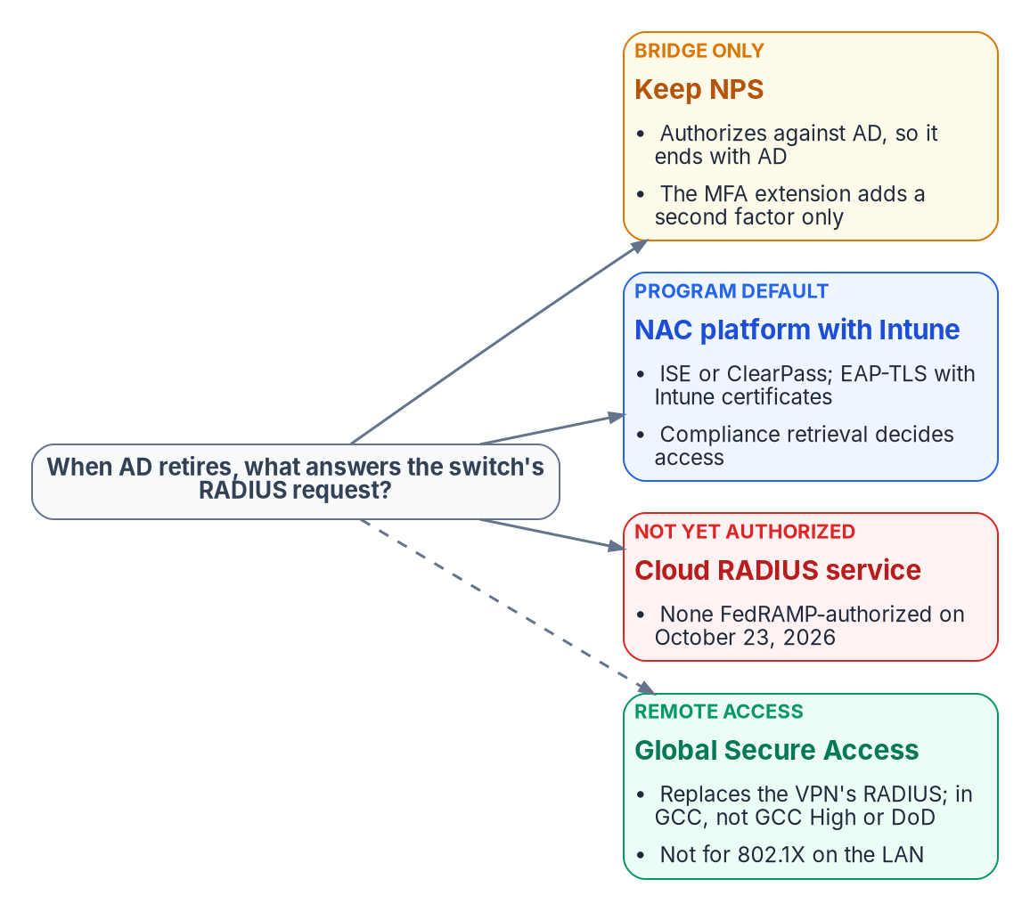
RADIUS: there is no Entra RADIUS
WHY
WHY NPS ENDS WITH AD
NPS reads users' dial-in properties from AD to authorize
Only an NPS proxy, which doesn't authorize, runs without a domain
Entra-joined devices can't use an AD computer object for Wi-Fi
The MFA extension adds a factor after AD; it doesn't replace AD
Microsoft's only statement: a Q&A answer, "Entra ID does not have a native RADIUS feature"
Sources: Microsoft Learn: Plan NPS server and proxy; Entra join planning (June 17, 2026); NPS MFA extension; RADIUS with Entra ID; Microsoft Q&A; FedRAMP Marketplace, Oct. 23, 2026.
Notes:
[7:15–7:51] When a laptop plugs into a switch, the switch asks a RADIUS server whether to let it on. Today that's usually NPS, and NPS checks with AD, so it ends with AD. People expect Microsoft to offer a RADIUS service in Entra ID. It doesn't. So there are four choices. Keep NPS as a bridge. Move to a network access control platform that checks Intune, which is the program's default. A cloud RADIUS service, except none is FedRAMP-authorized yet. Or, for remote users, Global Secure Access, which replaces the VPN, but not the switch on the campus network.
Detail: NPS: "To allow the NPS to read the dial-in properties of user accounts during the authorization process, you must add the computer account of the NPS to the RAS and NPSs group for each domain." "The NPS proxy can be a domain member or it can be a stand-alone server with no domain membership", because it "does not perform authorization"; no page documents an authorizing NPS without AD (couldn't verify). Entra-joined devices "don't support RADIUS authentication using an on-premises computer object and certificate for connecting to Wi-Fi"; use "certificates pushed via Intune or user credentials". The NPS extension "connects to Active Directory Domain Services (AD DS) to perform the primary authentication"; PAP supports all methods; CHAPv2 and EAP support phone call and app notification; no number matching. Microsoft's RADIUS architecture page reaches RADIUS only through NPS and recommends SAML federation for VPNs. "Entra ID does not have a native RADIUS feature" is a Microsoft Q&A accepted answer, community-tier. FedRAMP Marketplace (last change Oct. 23, 2026, 781 products): the only RADIUS-first listing, IronWiFi Cloud RADIUS, is at Initial Implementation; Forescout for Government is FedRAMP High (authorized Mar. 20, 2026) but describes visibility and enforcement, not RADIUS. Global Secure Access: available in GCC, "isn't yet supported" in GCC High or DoD; Internet Access doesn't support UDP yet.
Sources: Microsoft Learn: Plan NPS as a RADIUS server (Mar. 11, 2025); Plan NPS as a RADIUS proxy; Plan your Entra join deployment (June 17, 2026); NPS extension for Entra MFA; RADIUS authentication with Entra ID; Global Secure Access known limitations; Microsoft Q&A, RADIUS feature in Entra ID; FedRAMP Marketplace products.json.

Slide 14
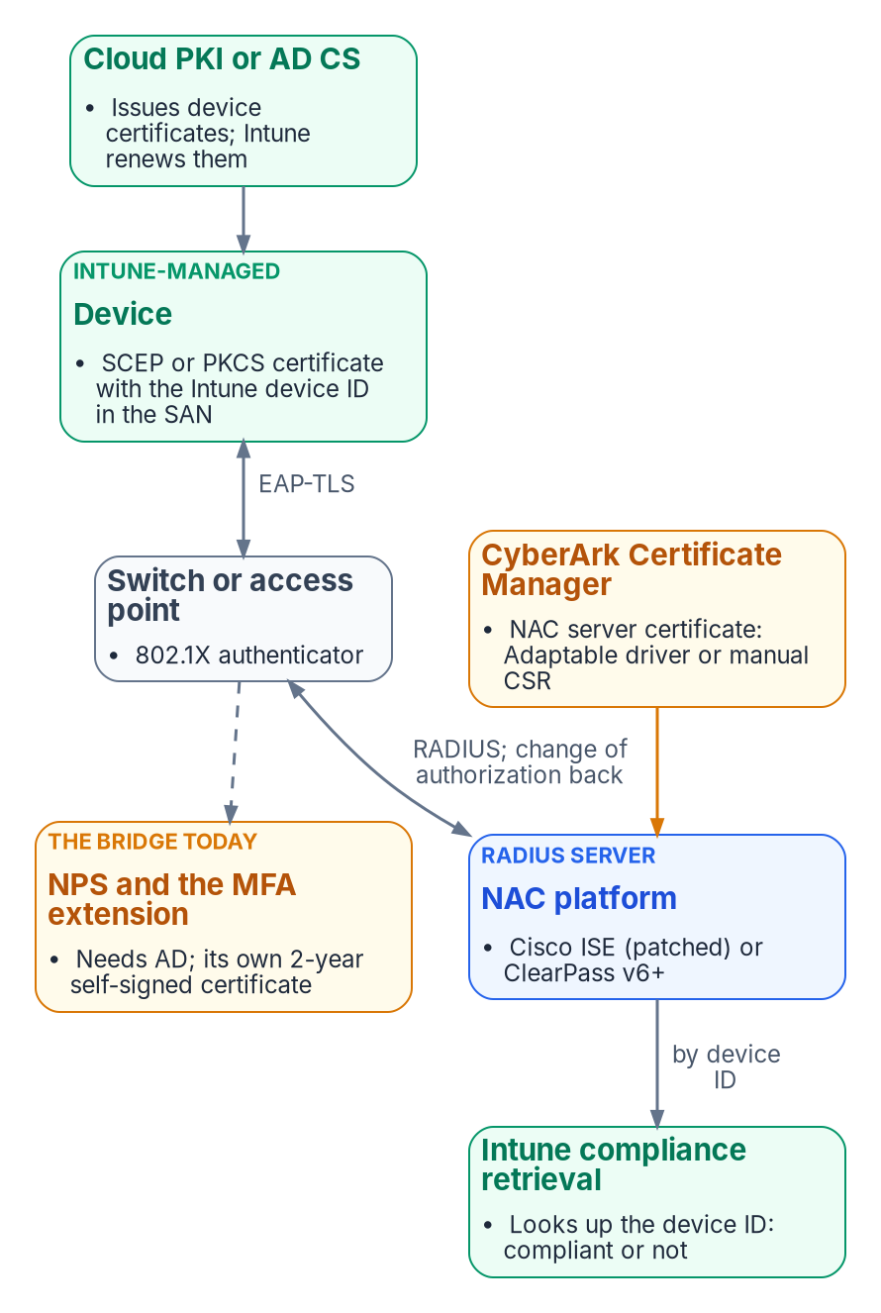
802.1X with Intune: EAP-TLS and compliance
HOW
WATCH 1
Patch Cisco ISE
WATCH 2
Certificates nobody tracked
Compliance retrieval needs the Intune device ID in the SAN as a URI
With the SID extension added, Intune certificates carry a second URI
ISE before 3.1 P10, 3.2 P7, 3.3 P4, 3.4 P1: certificate logins fail
NAC server certificate: no CLM driver for ISE or ClearPass; Adaptable driver or manual CSR
NPS MFA extension: its own self-signed certificate, 2 years, renewed by rerunning the script
Both now in the Book 09 inventory
Sources: Microsoft Learn, NAC integration with Intune (Apr. 15, 2026); Cisco FN74227; Cisco ISE 3.1 and 3.4 admin guides; CyberArk 26.1 system requirements; NPS MFA extension.
Notes:
[7:51–8:28] Here's how the default works. The device gets a certificate from Intune with its Intune device ID inside. It presents that certificate to the switch. The switch passes it to the access control platform, Cisco ISE or Aruba ClearPass, which asks Intune: is this device compliant? Then it tells the switch to let it on, restrict it, or block it. Two things to watch. ISE needs a recent patch, or these certificates fail. And the platform's own server certificate isn't Intune's, so the CLM renews it. Today's NPS also hides a certificate of its own that nobody tracked.
Detail: Compliance retrieval "was released in July 2021 and replaced the previous Intune NAC service", with legacy support "through March 31, 2024". Partners include Cisco ISE 3.1 and later, Aruba ClearPass with Intune Extension v6 and later, Forescout, FortiNAC, Portnox and others. "The compliance retrieval service requires certificate-based authentication and the use of the Intune device ID as the subject alternative name", as a URI defined by the NAC provider (example IntuneDeviceId://{{DeviceID}}); the broad noncompliant query runs at most every four hours. Cisco ISE 3.1+ uses MDM API v3 with the GUID in the SAN URI; FN74227 (Jan. 8, 2025): certificate-based logins fail when Intune's KB5014754 changes add a second URI; fixed in 3.1 P10, 3.2 P7, 3.3 P4, 3.4 P1. ISE ships a self-signed EAP certificate normally replaced by CSR and bind or import; "You must always use a new private key for each certificate that you import into Cisco ISE." No SCEP, EST or ACME enrollment of ISE's own certificates was found; a community post on native ACME is unverified. The CLM's 26.1 driver list has no ISE or ClearPass driver; the Adaptable driver route is inference. HPE Aruba's ClearPass pages returned HTTP 403 and weren't read. NPS MFA extension: the script "Creates a self-signed certificate"; these "are valid for 2 years"; Microsoft also allows your own certificates with Client Authentication EKU and NETWORK SERVICE read access.
Sources: Microsoft Learn: Network access control integration with Intune (Apr. 15, 2026); NPS extension for Entra MFA; Cisco Field Notice FN74227 (Jan. 8, 2025); Cisco ISE Administrator Guides 3.1 (Secure Wired Access) and 3.4 (Basic Setup); CyberArk 26.1 System Requirements.

Slide 15
RADIUS and NAC across the three stages
WHO
Stage | What admits a device | Device certificate | RADIUS server certificate
Today | NPS against AD (EAP-TLS or PEAP); VPN through NPS and the MFA extension | AD CS autoenrollment, mapped to the AD computer account | AD CS, renewed by the CLM; plus the extension's self-signed certificate
Coexistence | Intune devices by EAP-TLS to a NAC platform with compliance retrieval; hybrid devices still through NPS | Intune SCEP or PKCS with the device ID URI; Intune renews | NAC server: retained AD CS, renewed by the CLM (Adaptable driver or manual)
After AD | The NAC platform for the LAN; Global Secure Access or a federated VPN for remote access | Cloud PKI through Intune | Standalone AD CS under the same root, renewed by the CLM
Sources: research brief §5.8; Book 07, Ch 04, Ch 06 and Ch 08; Book 09, Ch 07; Microsoft Learn, NAC integration with Intune; Global Secure Access overview.
Notes:
[8:28–8:58] Across the stages, the network story is a handover. Today, NPS against AD, plus a VPN that relies on it. During coexistence, Intune devices move to the access control platform while older hybrid devices still go through NPS. After AD, the platform handles the campus network, and Global Secure Access or a federated VPN handles remote users. Device certificates come from Intune throughout, and the server certificates come from the CLM. Now let's put all four paths on one page.
Detail: Today: devices and users to the network via NPS against AD; VPN users through NPS and the MFA extension; device certificates from AD CS autoenrollment; NPS server certificate from AD CS renewed by the CLM's CAPI driver (Book 07 Ch 08); the extension's self-signed certificate rerun every two years. Coexistence: Intune devices by EAP-TLS with the device-ID URI to ISE or ClearPass using compliance retrieval; hybrid devices still via NPS; device certificates from Cloud PKI or AD CS through the connector, renewed by Intune; NAC server certificates from retained AD CS, renewed by the CLM through an Adaptable driver or manually (inference). After AD: Intune devices only; the NAC platform for the LAN, or an authorized cloud RADIUS when one exists; Global Secure Access Private Access, which provides "a quick and easy way to replace your VPN", or a federated ZTNA for remote access; device certificates from Cloud PKI; NAC and RadSec server certificates from standalone AD CS under the same root (Book 07 Ch 04).
Sources: Research brief section 5.8; Book 07, Chapters 04, 06 and 08; Book 09, Chapter 07; Microsoft Learn: NAC integration with Intune; Learn about Microsoft Entra Private Access.

Slide 16
Who issues and who renews: the whole estate
WHO
Credential (issuer / renewer) | Today | Coexistence | After AD
SQL Server TLS | AD CS / autoenrollment or CLM | Retained AD CS / CLM | Standalone AD CS / CLM
SQL 2022 app certificate | None | Key Vault / Arc extension, or app owner | Gone with SQL 2025
SQL 2025 managed identity | None | Azure / Arc agent | Azure / Arc agent
App service principal certificates | AD CS or self-signed / owner | Trusted CA / owner | Same; Entra caps lifetimes
Cloud certificates | Cloud or CLM / one renewer each | Same | Same
PIV Authentication certificate | Federal PKI / card system | Same | Same
PIV binding | AD mapping / AD admins | certificateUserIds / Connect Sync | certificateUserIds / issuance event (DG)
Domain controller certificates | AD CS / autoenrollment | Same | Gone
Intune device certificates | AD CS / Intune | Cloud PKI or AD CS / Intune | Cloud PKI / Intune
NPS server and MFA extension | AD CS / CLM; self-signed / NPS admin | Same while NPS remains | Gone with NPS
NAC server certificates | AD CS / manual | Retained AD CS / CLM | Standalone AD CS / CLM
Sources: research brief §6, built from the sources on Paths 1–4. DG = design guidance. Full table on the research page.
Notes:
[8:58–9:29] This is the page to keep. Each row is a credential, each column a stage, and each cell says who issues it and who renews it. Read it for three patterns. The PIV row barely changes. The domain controller and NPS rows simply end. And the CLM's rows stay steady while the CA behind them moves from the retained AD CS to the standalone one. Wherever two systems could renew the same certificate, the program picks one, and writes it down.
Detail: Each cell is issuer / renewer. SQL Server TLS: AD CS or self-signed fallback, then retained AD CS through the CLM (KeySpec test gate), then standalone AD CS through the CLM. SQL 2022 app-registration certificate: Key Vault Self or a chosen CA, renewed by Key Vault and the Arc extension when service-managed or by the app owner when customer-managed; removed with SQL 2025's managed identity. App service-principal certificates: the owner renews; the CLM can place them in Key Vault but the upload to Entra is the owner's step; Entra app-management policy caps lifetime at 180 days (Book 04 Ch 05). Cloud certificates: Key Vault for partner or self-signed, the CLM for pushed; ACM for ACM-issued, the CLM for imported; Google for Google-managed, the CLM for load-balancer pushes. Vault PKI intermediates (HashiCorp): the CLM. PIV certificate: the card management system, unchanged. PIV binding: AD, then Connect Sync, then the issuance-event workload (inference, design guidance). DC certificates: autoenrollment, watched by the CLM; gone after AD. Intune device certificates: Intune throughout. NPS server certificate: the CLM; extension certificate: the NPS admin every two years, or a CLM-issued replacement; both retire with NPS. NAC server certificates: the CLM via an Adaptable driver or manual CSR (inference). The CLM's own Key Vault driver credential: the CLM.
Sources: Research brief section 6, built from sections 2 to 5 and the sources cited there; Book 04, Chapter 05; Book 07, Chapters 04 to 08.

Slide 17
What changed in the books, and next steps
HOW
WHAT THIS CHANGED IN THE BOOKS
NEXT STEPS (DESIGN GUIDANCE)
Book 06 Ch 10: the SQL 2022 Key Vault certificate rotates automatically when service-managed
Book 06 Ch 22 and Book 04 Ch 05: Entra ID doesn't renew certificate credentials; Key Vault and the Arc extension, or the owner, do; the KeySpec test; managed identities on Arc servers
Book 07 Ch 06: federal name-based strong mapping; why high affinity
Book 09 Ch 07: the NPS extension's own certificate; NAC server certificates by Adaptable driver or manual CSR
Lab: prove a CLM-renewed SQL certificate shows KeySpec = 1
Pilot: card management system writes certificateUserIds through Graph
Ask CyberArk in writing: AWS GovCloud and Google government regions for its drivers
Patch Cisco ISE before Intune certificates carry the SID URI
Plan SQL Server 2025 upgrades to retire the app certificate
Sources: research brief §1.1 and §8; Books 04, 06, 07 and 09 as updated Oct. 23, 2026.
Notes:
[9:29–10:02] Finally, this research changed the books in five places: the SQL Server and application chapters on how certificates rotate and who renews them, Book 07 on federal smart card mapping, and Book 09 on the forgotten NPS certificate and the access control server's certificate. The next steps are tests, not more reading: prove the SQL key type, prove the card system can write the binding, and get CyberArk's answer on GovCloud. This is the program's research, under review, and not an endorsement by any federal agency. Thanks for watching.
Detail: Book corrections from this research: Book 06 Chapter 10's table said the Key Vault certificate is "not rotated automatically", true only for the customer-managed pattern. Book 06 Chapter 22 and Book 04 Chapter 05 named Entra ID as a renewer; it isn't. Book 04 Chapter 05 now notes managed identities are available on Azure Arc-enabled servers too. Book 06 Chapter 22 gains the KeySpec test gate. Book 07 Chapter 06 gains the federal name-based strong-mapping option and notes the federal CBA guide's low-affinity recommendation versus the program's high affinity. Book 09 Chapter 07 gains the NPS extension's self-signed two-year certificate and narrows the NAC server certificate path. Couldn't verify: CLM drivers in AWS GovCloud and Google government regions; CSP versus KSP in the CAPI driver; always-encrypted on the 2025 managed-identity path (stated only for 2022); Cloud Sync writing certificateUserIds; Graph writes for SOA-converted users; an official Microsoft statement that Entra has no RADIUS; NPS authorizing without AD; Aruba ClearPass documentation (HTTP 403); ISE or ClearPass SCEP or EST enrollment for their own certificates; the NAC partner's Entra app credential type. This is the program's research, under review, not an endorsement by any federal agency.
Sources: Research brief sections 1.1 and 8; Books 04, 06, 07 and 09.

