Slide 1

Start Here: Where Modernization Begins
Executive briefing · Start here
WHY IDENTITY COMES FIRST, AND THE FIRST STEP · ABOUT 6 MINUTES
Four reasons to start now · The first ask: a four-week pre-flight
The finish line: Gate G1 · Who decides · Where to go next
Sources: Book 00, Ch 01 and 03; Book 01, Ch 02 and 12; Book 03, Ch 02 and 03. Facts as of October 2026.
Presented by Michael F. Stratton
Not an official U.S. government publication. Independent technical analysis; not reviewed or endorsed by any federal agency.
Notes:
[0:00–0:30] Welcome to the Federal Modernization Workbook. If you lead an agency's technology, security or workforce, this is the place to start. In under ten minutes, I'll make one case: that modernization should begin with identity, and that the first step is small, bounded and can start now. There are four reasons, and then one specific ask, with a finish line you can check. Everything I say is sourced in the workbook's books, and I'll point you to them at the end.
Detail: An executive starting point for the whole workbook. One case: modernization begins with identity, and the first step is bounded. Four reasons (the external clocks, the dependency chain, Federal HR 2.0, the access risk already carried), then one ask (Phase 0, a four-week pre-flight with no vendor decision) and the finish line (Gate G1, Foundation Complete). The workbook is independent analysis, not an official publication of any agency.
Sources: Book 00, Chapters 01 and 03; Book 01, Chapters 02 and 12; Book 03, Chapters 02 and 03.

Slide 2

Four reasons to start now
WHY
1 The clocks
Federal directives and end-of-support dates are set outside the agency
2 Identity first
Access, devices, data and certificates all decide on who or what is asking
3 HR 2.0 is moving
HR is rebuilt government-wide anyway; the identity side is left to the agency
4 The risk is here
Account decisions live in tickets and spreadsheets; reviews can't see transitions
None of this needs a large commitment to begin: the first step is a four-week pre-flight that produces an inventory, an owner and a date.
Sources: Book 00, Ch 01 (clocks, sequencing); Book 03, Ch 02 and 03; Book 01, Ch 12 (Where to start).
Notes:
[0:30–0:59] Here are the four reasons on one page. There are deadlines nobody can move. Every other decision depends on identity, so it has to come first. The HR side of government is being rebuilt anyway, which makes this the cheapest moment to connect identity to it. And the access risk is already on the books today. None of this requires a large commitment to begin. Let's take them one at a time, starting with the clocks.
Detail: Book 00 Chapter 01: "The sequencing has a logic of its own, and it starts with identity. Policy, access, devices and data all decide on the basis of who or what is asking, so identity has to be authoritative before the decisions that depend on it can be trusted." Book 03 Chapter 03: Federal HR 2.0 "is not the project. It is the opening." Book 03 Chapter 02: spreadsheets and email carry authoritative-grade decisions (who gets an account, when access ends) with none of the properties of a system of record. Book 01 Chapter 12: "None of this requires a vendor decision on day one."
Sources: Book 00, Chapter 01; Book 03, Chapters 02 and 03; Book 01, Chapter 12.

Slide 3
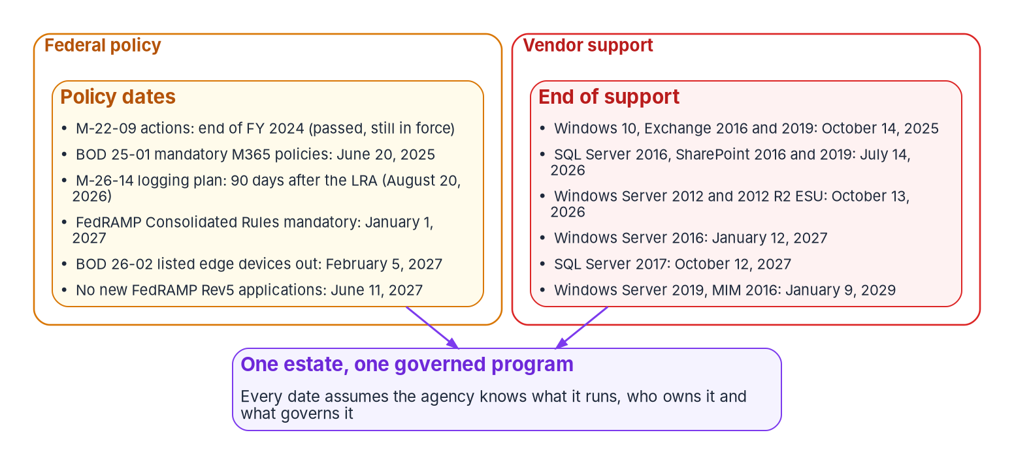
The clocks nobody can move
WHY
THE NEAREST DATE
Windows Server 2016
End of support January 12, 2027
Often where domain controllers, certificate authorities and NPS run
Bring your own count of 2016 servers (design guidance)
Sources: Book 00, Ch 01 (external clocks; Microsoft lifecycle pages; CISA BOD 25-01 and 26-02; OMB M-26-14; FedRAMP).
Notes:
[0:59–1:32] Modernization is usually treated as a choice of timing. It isn't, because the dates are set outside the agency. Federal directives already require secure cloud configurations and better logging. FedRAMP's new rules become mandatory in January 2027. And the closest date is Windows Server 2016, which reaches end of support on January twelfth, 2027. In many estates that's where domain controllers and certificate authorities run. Count your own 2016 servers before the meeting; that number will do more than any slide. So with time short, where do you begin?
Detail: Book 00 Chapter 01's tables: OMB M-22-09 (Jan. 26, 2022); CISA BOD 25-01 (Dec. 17, 2024), mandatory SCuBA configurations for production cloud tenants; CISA BOD 26-02 (Feb. 5, 2026), end-of-support edge devices; OMB M-26-14 (May 22, 2026), which rescinds M-21-31 and sets risk-based logging; FedRAMP Consolidated Rules for 2026, launched June 25, 2026, mandatory January 1, 2027. End of support: Windows 10 and Exchange 2016/2019 passed October 14, 2025; SQL Server 2016 passed July 14, 2026; Windows Server 2012 ESU Year 3 passed October 13, 2026; Windows Server 2016 January 12, 2027; SQL Server 2017 October 12, 2027; Windows Server 2019 and MIM 2016 January 9, 2029. Book 00 Chapter 03: NPS uses the AD domain as its user account database when it's a domain member. The local count is design guidance.
Sources: Book 00, Chapter 01 (external clocks and end-of-support tables) and Chapter 03.

Slide 4
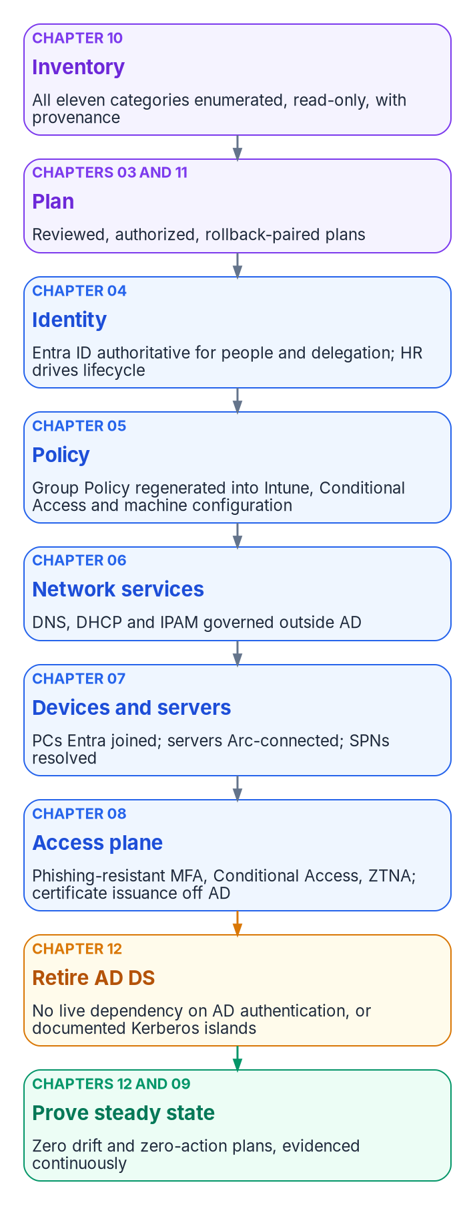
Everything decides on identity
WHAT
THE WORKBOOK'S ORDER
Identity first; the estate next; assurance last
Identity has to be authoritative before the decisions that depend on it can be trusted
Network services, addressing and certificates follow: they carry the names and trust everything relies on
Telemetry and governance come last in the build and first in importance once running
Books | Where they sit
00–01 | The program: charter, principles, roadmap, gates
02–04 | Identity, HR-driven identity, access and privilege
05–09 | Devices, data, certificates, DNS, network
10–17 | Boundary, Zero Trust, operations, governance, compliance, people, AI
Sources: Book 00, Ch 01 (sequencing) and Ch 02 (the numbering follows the dependency chain); Book 01, Ch 02.
Notes:
[1:32–2:03] You begin with identity, because everything else decides on it. Access policy, devices, data, certificates: each one asks who or what is making the request. If the answer to that question isn't trustworthy, nothing built on top of it can be either. That's why the workbook numbers its books in this order, with identity first and infrastructure next, then the cloud boundary, assurance and operations. Skipping ahead only moves the problem. And right now there's an unusual opportunity on the identity side.
Detail: Book 00 Chapter 01: identity first because every later decision depends on it; network services, addressing and certificates follow because they carry the names and trust everything else relies on; telemetry and automated governance come last in the build and first in importance once running. Book 00 Chapter 02: "The numbering follows the dependency chain... Identity comes first because every later decision depends on it; the estate's infrastructure follows; boundary, assurance and operations come after." Book 01 Chapter 02's dependency chain: inventory, plan, identity (Entra ID authoritative for people and delegation; HR drives lifecycle), policy, network services, devices and servers, access plane, retire AD DS, prove steady state.
Sources: Book 00, Chapters 01 and 02; Book 01, Chapter 02.

Slide 5

HR is being rebuilt anyway
WHY
Fact | Value (as of October 2026)
Directing instrument | Joint OMB/OPM memo, "Creating Federal HR 2.0", December 10, 2025: one government-wide Core HCM platform
Platform | Oracle Fusion Cloud HCM (SaaS), awarded June 10, 2026
Waves | Wave 1 volunteers (~900K FTE) and Wave 2, all remaining agencies (~1.1M FTE), through FY 2027; adoption goal FY 2028
Agency onboarding | About 8 months; new interconnections live around month 5
Agency obligation now | Pause own Core HCM procurement and modernization; prepare integration points and data flows
The opening, not the project: OPM rebuilds the HR side; the identity connection is the agency's. Ride along and connect once.
Sources: Book 03, Ch 03 (OMB/OPM memo Dec. 10, 2025 and Appendices A–C; OPM award; Oracle announcement). Verify each agency's wave and dates.
Notes:
[2:03–2:38] Federal HR 2.0 is moving agencies onto one government-wide human resources platform. The OMB and OPM memo came in December 2025, Oracle won the contract in June 2026, and agencies move in waves through fiscal 2027. Each agency's move includes new connections, designed during onboarding. OPM rebuilds the HR side, but the identity side is left to the agency. If identity rides along, the agency connects once. If it waits, it builds twice. That's why the workbook calls HR 2.0 the opening, not the project. Which brings us to the risk agencies already carry.
Detail: Book 03 Chapter 03's program facts as of October 20, 2026: the joint OMB/OPM memorandum of December 10, 2025 directs one government-wide Core HCM platform; agencies pause their own Core HCM procurement, development and related modernization. OPM awarded the Federal HRIT Modernization Core HCM contract to Oracle on June 10, 2026 (Oracle Fusion Cloud HCM, SaaS). Wave 1 (~900K FTE) and Wave 2 (~1.1M FTE) transition through FY 2027; the adoption goal is FY 2028. Appendix B's sample onboarding is about 8 months with interconnections live around month 5. Appendix C asks agencies to define integration points, identify interfacing systems and document data flows. The chapter: "Federal HR 2.0 is not the project. It is the opening: the HR side is rebuilt anyway, and the identity side is left to the agency." Wave membership and dates change; verify with the HR 2.0 program office.
Sources: Book 03, Chapter 03 (The program facts; Why this is the opportunity, not the project).

Slide 6
The access risk agencies already carry
WHY
TODAY
Decisions without a record
HR-DRIVEN IDENTITY
Fix the cause
Who gets an account, and when access ends, lives in tickets, spreadsheets and email
A contractor roster is a copy the moment it's saved
Quarterly reviews sample state; they can't see a transition
A review 90 days after a separation certifies an orphan for a quarter
The HR record becomes the source of who works here, in what role, for whom
Access follows attributes, so every entitlement has a because
Reviews stay, sharper, as the check on that truth (AC-2 j)
Contractors need a governed source too: an open decision in Book 03
Sources: Book 03, Ch 02 (fragmented truth; reviews and AC-2 j, NIST SP 800-53 Rev. 5) and Ch 10 (from attributes to access).
Notes:
[2:38–3:12] Today, who gets an account, and when access ends, often lives in tickets, spreadsheets and email. A contractor roster is out of date the moment it's saved. Quarterly access reviews can't see a transition when it happens, so a review ninety days after someone leaves ends up approving an account nobody should have. Assessors know this pattern well; it's where account-management findings come from. HR-driven identity fixes the cause: the HR record becomes the source of who works here, and access follows it. So what exactly is the ask?
Detail: Book 03 Chapter 02: spreadsheets and email ("the onboarding tracker, the contractor roster, the separation checklist") carry authoritative-grade decisions with none of the properties of a system of record; "The spreadsheet knows a contractor started but is a copy the moment it is saved." On reviews: "Quarterly access reviews sample state; they cannot observe transitions. A review that runs ninety days after a separation certifies an orphan for a quarter"; reviews are the verification layer of AC-2 j (NIST SP 800-53 Rev. 5, AC-2 items j and l, PS-5), and the architecture keeps them. Book 03 Chapter 10: every entitlement has a "because": access exists because an attribute satisfied a rule. Contractors' source of authority is an open program decision.
Sources: Book 03, Chapters 02 and 10.

Slide 7
The first ask: four weeks, no vendor decision
HOW
An inventory
A read-only assessment of the estate, committed with provenance (Book 01 Ch 10)
An owner
A named executive sponsor and steward, and a lead for each workstream
A date
Gate G0 on the calendar, beside the external clocks
Phase 0 — Pre-flight | Weeks 1–4
Entry | Executive sponsor and steward named; platform host provisioned; read-only assessment account created
Work | Build the platform host; run the assessment; seed the repository; least-privilege service principals for Entra ID, Intune and Azure Arc
Gate G0, Ready to Plan | Platform host operational; assessment committed; no open priority-one findings
Sources: Book 01, Ch 12 (Phase 0; Where to start) and Ch 10 (analyzing the estate).
Notes:
[3:12–3:44] The ask is small. Phase zero is a four-week pre-flight, and it doesn't require choosing a vendor. It needs three things: an inventory, from a read-only assessment of the current estate; an owner, meaning a named executive sponsor and a steward who runs the program; and a date, with the first gate on the calendar next to those external deadlines. At the end of four weeks, leadership sees the estate as it really is, and decides the next step from facts. Then comes the first real milestone.
Detail: Book 01 Chapter 12, "Where to start": "None of this requires a vendor decision on day one. It requires three things, and Phase 0 produces them: an inventory (the read-only assessment of Chapter 10, committed with provenance); an owner (a named executive sponsor and steward, and a lead for each workstream); a date (Gate G0 on the calendar, with the external clocks beside it)." Phase 0, weeks 1–4: entry, executive sponsor and steward named, platform host provisioned, read-only assessment account created; work, build the platform host, run the assessment, seed the repository, create least-privilege service principals for Entra ID, Intune and Azure Arc, profile transactions of any application proposed to move away from its data; Gate G0, Ready to Plan: platform host operational, assessment committed, no open priority-one findings.
Sources: Book 01, Chapter 12 (Phase 0 — Pre-flight; Where to start).

Slide 8

The finish line: Gate G1, Foundation Complete
HOW
Phase 1 — Foundation (weeks 5–8) | Gate G1 passes when, measured from data
Identity | Enterprise groups and administrative units in place and drift-clean
Policy | Baseline Conditional Access enforced: no user outside the MFA requirement except the documented emergency access accounts
Emergency access | Emergency access accounts vaulted and tested
Services | IP address management covering the platform host and Tier 0 infrastructure
HR feed | HR-to-cloud provisioning operational for the foundation scope
Overall | Zero drift across the foundation
Evaluated from data, not executive signature: when G1 passes, every later book has something solid to build on.
Sources: Book 01, Ch 12 (Phase 1 — Foundation; Gate G1; key takeaways); Book 03, Ch 12 (foundation-scope HR feed).
Notes:
[3:44–4:19] Phase one, the foundation, runs about four more weeks and ends at a gate leadership can check, not just sign. Groups and administrative units are in place, with no drift. Everyone is under multifactor authentication, except a few emergency accounts that are vaulted and tested. The core infrastructure is covered by address management. And the HR feed is live for a first group of people. Each of those is measured from data. When the gate passes, everything else has something solid to stand on. So who needs to be in the room?
Detail: Book 01 Chapter 12, Phase 1 — Foundation (weeks 5–8), goal: put the identity primitives in place before anything else moves. Identity: enterprise-level dynamic groups; administrative units for Tier 1 and selected Tier 2 scopes; the HR-to-cloud provisioning feed for the foundation scope (Book 03, Chapter 12). Policy: the enterprise Conditional Access baseline (MFA for all users, legacy authentication blocked, emergency access accounts excluded from every policy that blocks or restricts sign-in). Services: IPAM covering the platform host and Tier 0 infrastructure. Compute: platform host and pilot servers connected through Azure Arc. Gate G1: enterprise groups and administrative units drift-clean; baseline Conditional Access enforced with no user outside MFA other than documented emergency accounts; Tier 0 covered by IPAM; emergency accounts vaulted and tested; HR-to-cloud provisioning operational for the foundation scope; zero drift across the foundation. Key takeaway: "Gate criteria are evaluated from data, not executive signature."
Sources: Book 01, Chapter 12 (Phase 1 — Foundation; key takeaways); Book 03, Chapter 12.

Slide 9
Who decides, and what to bring
WHO
Role | Decides
Executive sponsor, with the CIO | Scope, funding and sequence; gates G3 and G5; when AD components retire
Steward | Target architecture and the authoritative repository; gates G0, G1 and G4
Workstream leads | Playbook content and readiness in their domain
BRING FOUR LOCAL NUMBERS · DESIGN GUIDANCE
And one decision
How many Windows Server 2016 servers you run
How many contractors sit outside the HR system
How long a departing person keeps access
Your Federal HR 2.0 wave and dates
Ask: approve the four-week pre-flight, with a named owner and a start date
Sources: Book 00, Ch 03 (charter roles and gate authorities); Book 01, Ch 09. The four numbers and the ask are design guidance.
Notes:
[4:19–4:53] The decision belongs to a few people. The executive sponsor, with the CIO, owns scope, funding and sequence. The steward owns the target design and the early gates. And workstream leads say when their area is ready. To make the conversation concrete, bring four local numbers: how many 2016 servers you run, how many contractors sit outside the HR system, how long it takes a departing person to lose access, and your HR 2.0 wave. Then ask for one decision: approve the four-week pre-flight, with a named owner and a start date.
Detail: Book 00 Chapter 03's charter roles: project sponsor (executive sponsor, with the CIO) decides scope, funding and sequence, gates G3 and G5, and when Active Directory components retire; project lead (the steward, the program office's accountable lead) decides target architecture and the authoritative repository, gates G0, G1 and G4, and co-signs G2 with the sponsor; domain leads (identity, policy, services and addressing, compute, access) own playbook content and execution readiness. The charter leaves names blank; the agency fills them in. The four local numbers and the shape of the ask are the program's design guidance for making the decision concrete.
Sources: Book 00, Chapter 03 (charter roles); Book 01, Chapter 09.

Slide 10

Where to go next
HOW
Read or watch | For
Book 00 executive briefing | The decisions leadership must make, with owners and timing
Book 01, Chapter 12 | The roadmap: seven phases and six gates
Book 02 — Identity & Directory | The identity foundation: Entra ID, groups, administrative units, delegation
Book 03 — HR-Driven Identity | The full case for HR as the source of authority, and Federal HR 2.0
Presentations page | A 15-minute deck for every book, with narrated editions
Independent analysis: every claim is footnoted to a primary source in the books. Not an official publication of any agency.
Sources: whalermike.github.io/modernization-workbook: Books 00–03 and the Presentations page.
Notes:
[4:53–5:23] To go deeper, start with the Book 00 executive briefing, which lays out the decisions with owners and timing. Book 01, Chapter 12 is the roadmap, with every phase and gate. Book 02 covers identity and the directory, and Book 03 makes the full case for HR-driven identity. Every claim in this briefing is footnoted to a primary source in those books. The workbook is independent analysis, not an official publication of any agency. Thank you for starting here.
Detail: Where to go next: the Book 00 executive briefing (decisions with owners and timing); Book 01 Chapter 12 (seven phases, six gates); Book 02 (identity and directory); Book 03 (HR-driven identity and Federal HR 2.0); the Presentations page for every book's deck. The site is independent analysis, not an official government publication; no agency reviewed or endorsed it.
Sources: Books 00 to 03; the Presentations page.

