Slide 1
The Field-Office WAN Case: SD-WAN for Executives
Executive briefing · Book 09 — Network & Transport
FIX THE CIRCUIT, NOT THE CONTENT · ABOUT 7 MINUTES
The problem · What SD-WAN can and can't fix · The target · The cost
Security and TIC 3.0 · Roadmap and gates · Risks · The decision
Sources: Book 09, Ch 11 (worked case), with Ch 01, 03, 05, 10 and 13. Every cost is the chapter's planning estimate. Facts as of October 2026.
Presented by Michael F. Stratton
Not an official U.S. government publication. Independent technical analysis; not reviewed or endorsed by any federal agency.
Notes:
[0:00–0:32] Welcome. This briefing from the Federal Modernization Workbook takes on one investment question: what to do about the network behind an agency's field offices. A familiar proposal asks for about fifty million dollars to refresh a content server in every office. I'll make the case that the problem is the circuit, not the content, and that fixing the circuit costs less and does more. You'll see the honest limits, the costs and their assumptions, the security conditions, and the one decision to ask for.
Detail: An executive business case for field-office SD-WAN. Book 09 Chapter 11 is a worked case, a framing pattern rather than a real engagement: about 1,500 field offices, about 70,000 managed Windows endpoints, branch traffic over MPLS to a central gateway, and a Configuration Manager distribution point in nearly every office. A proposal asks for about $50 million to refresh those distribution points. The chapter's alternative is SD-WAN over dedicated internet access with a 5G continuity path and a consolidated content tier at 12 hub sites. Chapter 11: "Every cost figure in this chapter is a planning estimate from the program's own analysis, not a quote." The wider TIC 3.0 and network decisions are in the Book 09 executive briefing. The workbook is independent analysis, not an official publication of any agency.
Sources: Book 09, Chapter 11 (introduction; Read this first).

Slide 2

The problem: 1,500 servers doing a circuit's job
WHY
The $50M request, reconciled | Per office | × 1,500
Small form factor PC | $3,500 | $5.3M
1U server, ECC, out-of-band | $12,000 | $18.0M
1U server plus deployment | $16,000 | $24.0M
Proposed estimate | $33,333 | $50.0M
CAPACITY, NOT OFFICE COUNT
24 needed, not 1,500
4,000 clients per distribution point: Microsoft's published ceiling
70,000 endpoints need 18 at the ceiling; 24 with headroom
The other 1,476 compensate for branch circuits
Content moved to the cloud; peer caching matured; circuits got cheaper
Planning unit costs are Chapter 11's assumptions. The request is about twice the fully loaded server case: ask whether it is acquisition cost or five-year cost of ownership.
Timing: Configuration Manager moved to an annual release cadence, and Microsoft says new device-management work happens in Intune. Hardware bought in FY26 depreciates through FY31.
Sources: Book 09, Ch 11 (The proposal under review; The timing problem; Published capacity limits; What changed). Microsoft Learn size-and-scale limits.
Notes:
[0:32–1:05] Here's why this matters. The worked case is an estate many agencies will recognize: about fifteen hundred field offices, about seventy thousand Windows endpoints, and a content server in nearly every office, because the circuit was once too slow for anything else. Microsoft's published limits say that estate needs about twenty-four of those servers, not fifteen hundred. The other fourteen hundred and seventy-six compensate for slow branch circuits. And the money would land on a tier the device strategy is already shrinking. So what would fixing the circuit actually buy?
Detail: Chapter 11's reconciliation, at the program's planning prices: small form factor PC $3,500 ($5.3M across 1,500); 1U rack server with ECC, out-of-band management and redundant power $12,000 ($18.0M); 1U server plus $4,000 per-site deployment $16,000 ($24.0M); proposed $33,333 per office ($50.0M), about twice the fully loaded server case. Decomposition request: the sponsor should state whether $50M is acquisition cost or five-year total cost of ownership, and itemize scope beyond the distribution point. Capacity (Microsoft's size-and-scale page): 4,000 clients per distribution point; 70,000 endpoints need 18 at the ceiling, 24 with headroom; "The other 1,476 serve no Configuration Manager requirement; they compensate for branch transport." What changed: content moved to Microsoft's content delivery network; peer cache, BranchCache and Delivery Optimization matured; dedicated internet access at 200 Mbps to 1 Gbps is assumed to cost less than the MPLS it replaces (Assumption 1). Timing: annual release cadence from version 2609 (shipped September 28, 2026, supported to March 28, 2028); hardware bought in FY26 depreciates through FY31. "The distribution point role isn't obsolete. The distribution-point-per-office topology is."
Sources: Book 09, Chapter 11 (The proposal under review; Why per-office distribution points are no longer the model).

Slide 3
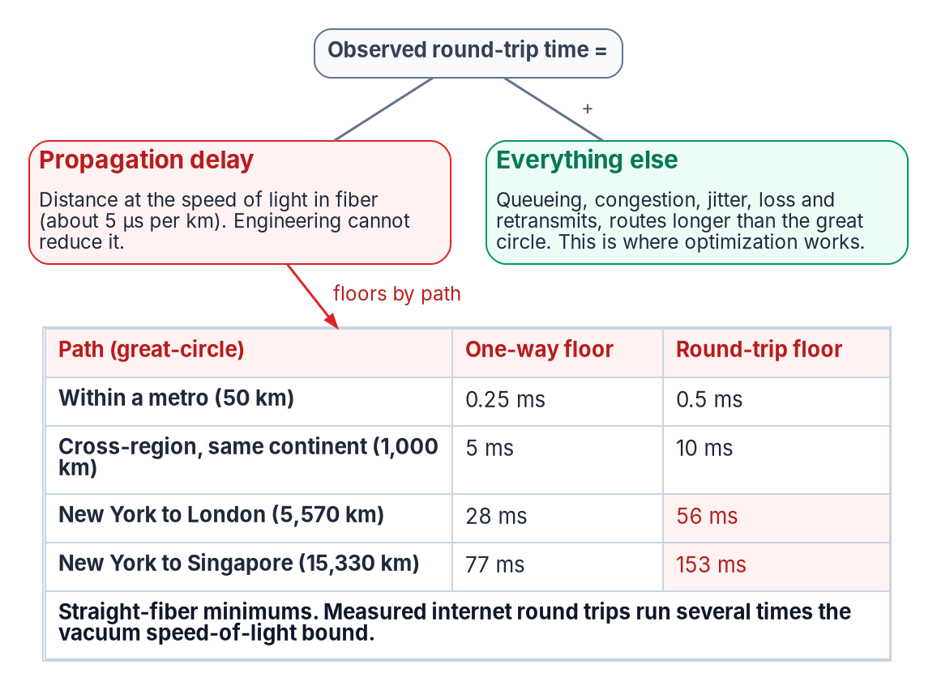
What SD-WAN fixes, and the floor it can't move
WHAT
WHAT SD-WAN FIXES
The gap above the floor
Route inflation pulled toward the floor
A tighter tail: fast failover, forward error correction, packet duplication
Bulk transfers kept off latency-critical traffic
WHAT IT CAN'T
The floor, and a 5G backup's limits
Light in fiber: about 5 microseconds per kilometer
New York to London: at least 56 ms per round trip
A 5G path keeps an office working; it won't carry an update wave
Sources: Book 09, Ch 01 (the speed-of-light floor); Ch 05 (SD-WAN as differentiated transport; the hard ceiling); Ch 11 (Branch network).
Notes:
[1:05–1:40] Let's be honest about the limits first. Part of every delay is the time light takes through fiber, about five microseconds per kilometer, and no product changes that. What SD-WAN does is close the gap above that floor: better paths, a tighter tail through fast failover, and bulk downloads kept away from traffic that has to be quick. Each office gets two paths, an internet circuit sized to its seats and a 5G link for continuity, not capacity. It's a better road, not a shorter one. Here's what the target looks like.
Detail: Book 09 Chapter 01: light in optical fiber covers roughly 200 km per millisecond, so every 1,000 km of path costs about 5 ms one way; optimization works on the gap above the floor, never the floor. Chapter 05: SD-WAN recovers route inflation and shrinks the tail with forward error correction, packet duplication and fast failover, and keeps bulk transfers off the commit path; "SD-WAN gets a path to the floor with a tight tail. It never gets it below the floor." Microsoft's worked figure for New York to London is 28 ms one way and 56 ms round trip. Chapter 11's branch network: every office gets a dedicated internet access circuit sized to seat count and a 5G fixed-wireless secondary for continuity. "5G is a continuity path, not a capacity path... It won't carry a feature-update wave." Symmetric, SLA-backed circuits beat raw bandwidth; verify physical path diversity per site.
Sources: Book 09, Chapters 01, 05 and 11.

Slide 4
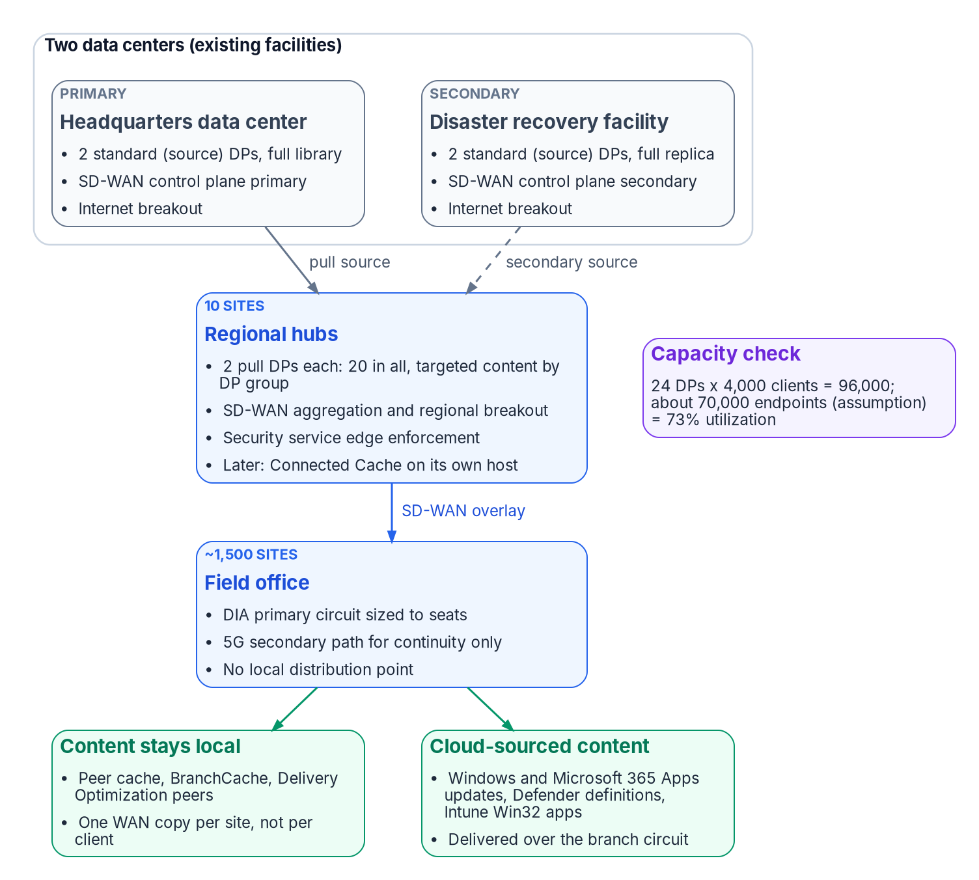
The target: 12 hubs and 24 distribution points
WHAT
Element | Target
Hubs | 12: two data centers and ten regional hubs, in existing facilities
Content tier | 24 distribution points, two per hub
Capacity | 96,000 clients; 73% used at 70,000 endpoints (assumption)
Field office | Internet circuit sized to seats, 5G continuity path, SD-WAN overlay, no local server
Local content | Peer caching: one WAN copy per site, not per client
SETTLED FOR GCC
Microsoft 365 informed routing isn't available
Direct breakout, app-aware routing and QoS are, from Phase 1
Cloud-dependent features stay enhancements, not dependencies
Sources: Book 09, Ch 11 (Hub topology; Content tier; Branch network; Microsoft 365 path optimization in GCC). Microsoft Learn.
Notes:
[1:40–2:14] The target fits in one picture. Two data centers hold the full content library and feed ten regional hubs, all in existing facilities. Each hub carries two servers, twenty-four in all, enough for ninety-six thousand clients, so about seventy-three percent utilization. Offices reach the hubs over the SD-WAN overlay with no server in the closet, and peer caching keeps most content local. One limit is settled: Microsoft's informed routing feature isn't available in GCC, so the design uses direct breakout and application-aware routing from day one. Now, what does it cost?
Detail: Chapter 11's hub topology: one primary data center (headquarters campus), one secondary (existing disaster recovery facility) and ten regional hubs at existing regional offices, so no new real estate, power or accreditation boundary. Content tier: 70,000 endpoints (Assumption 2) at 4,000 clients per distribution point is a theoretical minimum of 18; 24 deployed (two per hub) gives 96,000-client capacity, 73% design utilization, 37% above the current estimate. Regional DPs are pull distribution points sourcing from the two data centers, turning fan-out into 2-to-20 instead of 1-to-1,500. Sizing trigger: add two DPs per 8,000 net new endpoints, or at sustained load above 3,200 clients per DP. Peer cache, BranchCache and Delivery Optimization are optimizations, not dependencies. Microsoft 365 informed network routing supports worldwide commercial tenants "but not the GCC Moderate, GCC High, DoD, Germany, or China clouds"; direct breakout, application-aware routing on measured path metrics, and QoS marking are the baseline from Phase 1.
Sources: Book 09, Chapter 11 (Target architecture).

Slide 5

What it costs: about $10 million in Year 1
WHAT
Year 1 capital | Amount
Branch equipment | $5,085,000
Hub equipment | $1,048,224
Control plane and services | $3,850,000
Total Year 1 capital | $9,983,224
Steady state, per year | Amount
Internet circuits, tiered by office size | $8,460,000
Security service edge, 70,000 users | $4,550,000
5G secondary paths | $1,350,000
Total recurring, all items | $15,714,000
Less: MPLS retired (1,500 at $1,200 a month) | −$21,600,000
Net annual position | −$5,886,000
Branch: 1,500 edges in three tiers and 5G gear. Hubs: edge pairs, 24 servers, licenses, racks. Services: control plane, zero-touch staging, field installs, engineering.
Planning estimates, not quotes: hardware at a 40% discount to the program's planning list prices. Replace every figure with the estate's own data before a budget submission.
Sources: Book 09, Ch 11 (Sizing and bill of materials; Year 1 capital; Annual recurring cost at steady state). All figures are the chapter's assumptions.
Notes:
[2:14–2:49] On the book's planning assumptions, the first year needs just under ten million dollars of capital: about five million for branch equipment, about one million at the hubs, and nearly four million for the control plane, installation and engineering. At steady state, the new circuits, subscriptions and security licensing run about fifteen point seven million a year, while retiring MPLS removes about twenty-one point six million. That's roughly five point nine million a year back. Every figure is an estimate to replace with your own data, and one matters more than the rest.
Detail: Chapter 11, Year 1 capital: branch equipment $5,085,000 (750 Tier S, 525 Tier M and 225 Tier L edges, and 1,500 5G modules or gateways); hub equipment $1,048,224 (24 hub edges in high-availability pairs, 24 distribution point servers, 24 Windows Server 2025 Standard 16-core licenses at Microsoft's $1,176 suggested price, hub switching and racks at 12 sites); control plane and services $3,850,000 (on-premises SD-WAN control plane at two sites $400,000; zero-touch staging for 1,500 sites $1,200,000; field installation at 300 sites $750,000; professional services $1,500,000). Total $9,983,224. Annual recurring at steady state: dedicated internet access $8,460,000 (750 at $350, 525 at $500, 225 at $800 per month); 5G $1,350,000; SD-WAN subscriptions $750,000 branch and $72,000 hub; analytics and control plane support $100,000; hub internet transit $432,000; security service edge licensing $4,550,000 (70,000 users at $65); total $15,714,000. Less MPLS retired, 1,500 at $1,200 a month (Assumption 1): −$21,600,000. Net annual position −$5,886,000: "the program returns about $5.9M a year against today's transport spend." Hardware applies a 40% discount to planning list prices; the bill of materials names one vendor's line as a costable example, not a recommendation.
Sources: Book 09, Chapter 11 (Sizing and bill of materials; Cost model and sensitivity).

Slide 6

Five years out, and the one number that decides it
WHAT
Year | Migration | Capital | Net savings | Cumulative
1 | Design, hubs, pilot | $10.0M | $0 | −$10.0M
2 | 30% of offices | $0 | $1.77M | −$8.23M
3 | 70% of offices | $0 | $4.12M | −$4.11M
4 | 100% | $0 | $5.89M | +$1.78M
5 | Steady state | $0 | $5.89M | +$7.67M
MPLS per office, per month | Net per year | Character
$1,500 | −$11.29M | Strongly cash-positive
$1,200 (base) | −$5.89M | Cash-positive
$873 | $0 | Breakeven
$800 | +$1.31M | Modest net cost
$600 | +$4.91M | Justify on capability
$400 | +$8.51M | Financial argument inverts
Against the refresh: about $57.7M better over five years. The architecture holds on Microsoft's published limits; the cost case holds only once current MPLS cost is confirmed.
Sources: Book 09, Ch 11 (Five-year phased position; Sensitivity to current MPLS cost; Confidence statement). All figures are the chapter's assumptions.
Notes:
[2:49–3:24] Savings arrive as offices move at their MPLS renewal dates, not on day one. In the base case the program turns cumulatively positive in year four and is about seven point seven million ahead after five years. The refresh spends fifty million up front, so the five-year difference is about fifty-seven point seven million. But all of that turns on what MPLS costs per office today. Breakeven is eight hundred seventy-three dollars a month. Above it, the program pays for itself. Below it, it's still the better architecture, argued on capability. Then there's security.
Detail: Chapter 11's five-year phased position: savings ramp as offices move at MPLS contract renewal. Year 1 design, hubs and pilot, $10.0M capital, cumulative −$10.0M; year 2, 30% of offices, $1.77M net savings, −$8.23M; year 3, 70%, $4.12M, −$4.11M; year 4, 100%, $5.89M, +$1.78M; year 5, steady state, $5.89M, +$7.67M. "The refresh reaches −$50M in year one and recurs at the next refresh cycle. The five-year difference is about $57.7M." The comparison is deliberately not scope for scope: the $10M also carries Microsoft 365, Teams, TIC 3.0 breakout and the Intune migration. Sensitivity: $1,500 per office per month, −$11.29M a year; $1,200 base, −$5.89M, capital repaid in about 20 months of steady-state savings; $873 breakeven ($15,714,000 ÷ (1,500 × 12)); $800, +$1.31M; $600, +$4.91M; $400, +$8.51M. Below breakeven the program is "still the better architecture and still cheaper than the refresh," justified on capability and mission. Confidence statement: the architectural conclusion holds across Assumptions 2 to 10; the financial conclusion depends on Assumption 1.
Sources: Book 09, Chapter 11 (Cost model and sensitivity; Assumptions to validate).

Slide 7
Security: the branch edge becomes a control
WHAT
Parity on every path
TIC 3.0 branch use case: every path lands on enforcement of equal strength
Accreditation first
The critical path; 12 hubs, not 1,500 offices, shrink the surface
Telemetry gates MPLS
No office's MPLS retires before its replacement telemetry is confirmed
Controller first
Estate-wide attack surface: secured before it carries traffic
Exposure | What to require before production traffic
Administrative takeover | Phishing-resistant MFA; management reachable only from an administrative network; privileged actions logged
Rogue edges joining | Certificate-based onboarding from the agency PKI; alert on unexpected peers
Unpatched edges | Fleet inventory; remediation inside BOD 26-04 windows, the shortest three days
Lost forensic trail | Management-plane and edge logs exported off-box, to the agency pipeline and CISA
Sources: Book 09, Ch 03; Ch 05 (branch edge and TIC 3.0; securing the controller; ED 26-03; BOD 26-02 and 26-04); Ch 11 (Security and TIC 3.0).
Notes:
[3:24–4:00] Breaking out at the branch means operating under the TIC 3.0 branch office use case, and that changes what the edge is. Every path has to land on equally strong enforcement, so the steering policy itself becomes a security control. Accreditation, not procurement, is the critical path, which is why starting at twelve hubs instead of fifteen hundred offices matters so much. No office's MPLS circuit retires until its replacement telemetry is confirmed. And the controller is estate-wide attack surface, so it's patched, logged and locked down before it carries traffic. That sets the roadmap's order.
Detail: Chapter 11: regional breakout means operating under the CISA TIC 3.0 Branch Office Use Case (Version 3.0, September 2026), with a security service edge doing the inspection the central gateway used to do, and it removes branch traffic from the MTIPS sensors that feed CISA telemetry. Three consequences: accreditation is the critical path (circuits in about ninety days; an authorized breakout architecture takes far longer; 12 hubs instead of 1,500 offices shrinks the surface by two orders of magnitude); telemetry continuity gates MPLS retirement; and the compliance case and cost case point at the same build. Chapter 05: the use case's policy enforcement parity means every path class must land on enforcement of equal strength, so the steering policy is a security control. Securing the controller: ED 26-03 (February 25, 2026) covered an actively exploited authentication bypass in a widely used SD-WAN manager and controller; BOD 26-02 governs end-of-support edge devices; BOD 26-04 (June 10, 2026) sets risk-based remediation windows, the shortest three days. Step zero of Chapter 13's sequence: bring the governor under vulnerability management, privileged-access control and logging before it carries production traffic. Several security service edge offerings are FedRAMP Certified at Moderate or High; the design doesn't depend on which.
Sources: Book 09, Chapters 03, 05, 11 and 13.

Slide 8

The roadmap: hubs first, offices at renewal
HOW
Phase 0 · months 0–6
About $1.8M: design, TIC 3.0 branch package, control plane, ten-site pilot, CISA telemetry started
Phase 1 · months 6–18
Twelve hubs: aggregation, regional breakout, security service edge, 24 consolidated servers
Phase 2 · months 18–48
Office waves at MPLS renewal; each circuit retires only after its telemetry is confirmed
Phase 3 · months 36+
Microsoft 365 direct-path optimization; caching at hubs; servers retire as gates close
The first gate | Phase 0 exits when
Exit criteria | Authorization to operate for regional breakout; pilot sites stable for 30 days; validated per-site costs
The refresh is the fork: BOD 26-02 removes end-of-support edge devices by about August 5, 2027. Specify replacements to the target's attributes, not like-for-like.
Sources: Book 09, Ch 11 (Implementation roadmap; Why this order); Ch 10 (BOD 26-02 pulls the refresh forward).
Notes:
[4:00–4:38] There are four phases. Phase zero, about six months and about one point eight million dollars, does the design, the accreditation package, the control plane and a ten-site pilot. Phase one builds the twelve hubs and the consolidated content tier. Phase two moves offices in waves at their MPLS renewals, so each wave helps fund the next. Phase three adds Microsoft 365 path optimization and caching at the hubs. Meanwhile, a federal directive requires end-of-support edge devices to be replaced by about August 2027, so write the target's requirements into those replacements now. And the finish line isn't a date.
Detail: Chapter 11's roadmap. Phase 0, months 0–6: architecture and detailed design; the TIC 3.0 branch use-case package and accreditation; on-premises SD-WAN control plane; a ten-site pilot across all transport types and tiers; telemetry coordination with CISA started; serviceability survey. Exit: authorization to operate for regional breakout; pilot sites stable for 30 days; validated per-site costs. Phase 0 is funded first, at about $1.8M over six months, out of the Year 1 total. Phase 1, months 6–18: twelve hubs, 24 consolidated distribution points, content migration, replacement telemetry and encrypted DNS. Phase 2, months 18–48: office waves keyed to MPLS renewal dates; each office's MPLS retired only after its replacement telemetry is confirmed. Phase 3, months 36+: Microsoft 365 direct-path optimization (not informed network routing); Connected Cache at the hubs; DPs retired as the gates close. Why this order: accreditation is the critical path; hubs close three problems at once; waves follow contract expiry, avoiding early-termination liability. Chapter 10: BOD 26-02 requires identified end-of-support edge devices off agency networks within 18 months, about August 5, 2027; tell whoever scopes the replacements, in writing, what the target requires of a branch device (application-aware steering, path measurement, deterministic egress, exportable telemetry, PQC-capable key exchange, a BOD 23-02 management plane, a FIPS 140-3 expectation).
Sources: Book 09, Chapter 11 (Implementation roadmap) and Chapter 10 (BOD 26-02 pulls the refresh forward).

Slide 9
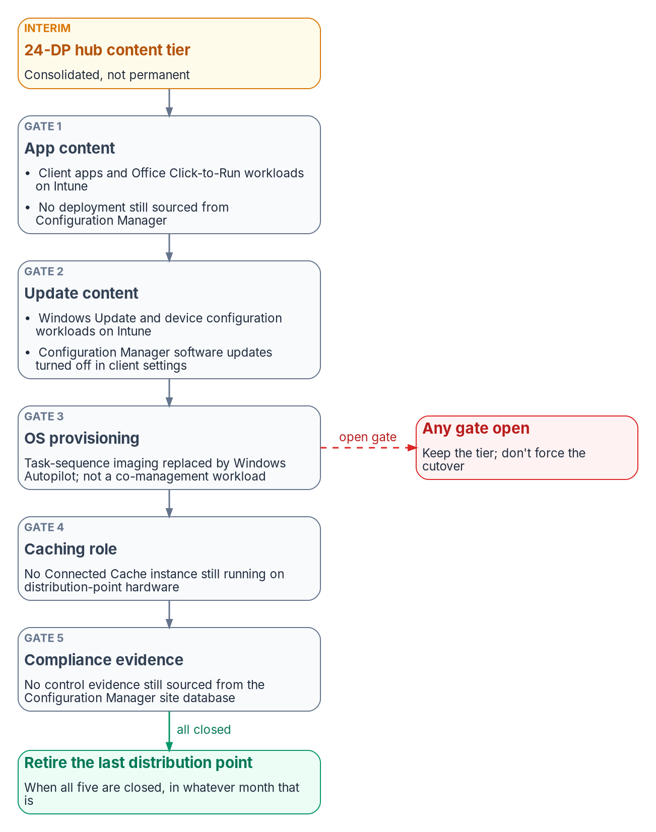
A gate, not a date: retiring the last server
HOW
Gate | Closed when
1 App content | Client apps and Office apps on Intune, and nothing still deployed from Configuration Manager
2 Update content | Windows Update and device configuration on Intune; the old update setting turned off
3 OS provisioning | Imaging moved from task sequences to Windows Autopilot
4 Caching role | No Connected Cache instance running on distribution-point hardware
5 Compliance evidence | No control evidence still sourced from the Configuration Manager site database
Month 30 or month 60: close all five in month 30, retire in month 30. Gates still open at month 60? Keep the tier; don't force the cutover.
Sources: Book 09, Ch 11 (When to retire the last distribution point; A gate, not a date). Microsoft Learn, co-management workloads.
Notes:
[4:38–5:10] The twenty-four-server tier is an interim state, not a new floor. The last one retires when five gates close: application and update content have moved to Intune, imaging has moved to Autopilot, no cache still runs on that hardware, and no compliance evidence still comes from the old site database. An estate that closes them in month thirty retires the tier in month thirty. One that hasn't by month sixty keeps it, rather than forcing a cutover against an open gate. Next, what could go wrong.
Detail: Chapter 11: "The 24-DP tier is the interim consolidated state, not a new floor." Co-management has seven workloads; "Some workloads are on Intune" isn't the same claim as "the content tier can be decommissioned." Gate 1, app content: client apps and Office Click-to-Run workloads on Intune for the whole validated population, and no required or available deployment still published from Configuration Manager. Gate 2, update content: Windows Update policies and device configuration on Intune, and the Configuration Manager software-update client setting turned off (also Windows Autopatch's co-management prerequisite). Gate 3, OS provisioning: bare-metal imaging moved to Windows Autopilot; the most common reason a "just in case" DP survives. Gate 4, caching role: no Connected Cache instance on distribution-point hardware. Gate 5, compliance evidence: compliance and Endpoint Protection reporting no longer cite the site database. "An estate that closes all five gates in month 30 should retire its last distribution point in month 30. One that hasn't closed them by month 60 should keep the 24-DP tier rather than force a cutover against an open gate."
Sources: Book 09, Chapter 11 (When to retire the last distribution point).

Slide 10
Risks, and the assumptions to check first
WHY
Risk | Rating | Mitigation
Accreditation slips | High | Start Phase 0 with the package; a 12-month slip cuts the five-year net from about +$7.7M to +$1.8M
MPLS costs less than assumed | High | Validate before submission; below $873, present the case on capability
Telemetry lags cutover | High | Coordinate with CISA from Phase 0; gate each office's MPLS retirement on it
Encryption licensed below circuit speed | Medium | State the throughput entitlement per platform; test under load in the pilot
Twelve hubs concentrate risk | Medium | High-availability pairs, diverse transport, a fallback hub in policy
Assumption to validate | Value used | How to validate
1 MPLS per office, per month | $1,200 | Telecom contract records: decides whether the program is cash-positive
2 Managed endpoints | 70,000 | Configuration Manager device count: drives the server count
5 Terrestrial availability | 85–95% of sites | Serviceability survey against site addresses
Sources: Book 09, Ch 11 (Risks and mitigations; Assumptions to validate, ten in all, ordered by impact; Confidence statement).
Notes:
[5:10–5:45] Three risks are rated high. Accreditation could slip; a twelve-month slip cuts the five-year position to about one point eight million, but the case survives. MPLS might cost less than assumed, which moves the argument from savings to capability. And telemetry could lag cutover, which is why it gates every retirement. Behind those sit ten assumptions; check MPLS cost and the endpoint count first. The book is plain about it: the architecture holds across the plausible range, but the financial case holds only once the MPLS number is confirmed. So here's the ask.
Detail: Chapter 11's risk register (selected). TIC 3.0 branch breakout accreditation slips, High: start Phase 0 with the accreditation package; fall back to hub-only breakout; a 12-month slip moves the five-year net from about +$7.7M to about +$1.8M and the advantage over the refresh from about $57.7M to about $51.8M, so the case survives but breakeven moves to year five. Current MPLS cost below the assumption, High: validate before submission; below $873, re-present on capability; it stays cheaper than $50M. Replacement telemetry lags cutover, High: agency–CISA–provider coordination from Phase 0; gate each office's MPLS retirement on confirmed telemetry. Encrypted throughput licensed below circuit speed, Medium. Twelve hubs concentrate risk, Medium. Others: segmentation blocking client-to-client traffic; terrestrial transport unavailable at 5–15% of sites (satellite or bonded cellular for that subset); telecom task-order changes; security service edge authorization level; Connected Cache placement; indoor 5G coverage. Ten assumptions, ordered by impact: 1 MPLS $1,200; 2 endpoints 70,000; 3 library 1.5 TB; 4 seat distribution 750/525/225; 5 terrestrial availability 85–95%; 6 TIC 3.0 not yet authorized for branch breakout; 7 co-management early; 8 OS deployment centralized; 9 client-to-client traffic assumed blocked; 10 replacement telemetry onboarding not started.
Sources: Book 09, Chapter 11 (Risks and mitigations; Assumptions to validate).

Slide 11
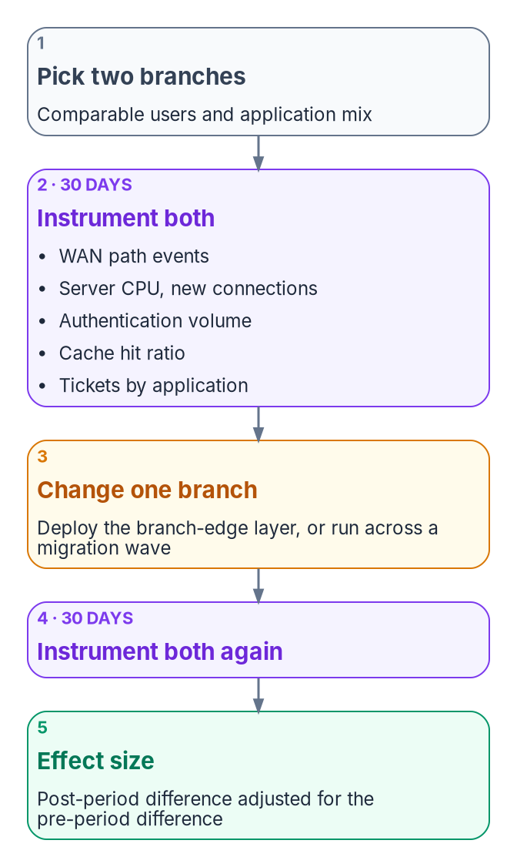
The decision to ask for
WHO
THE ASK · FROM CHAPTER 11'S RECOMMENDATION
Defer, decompose, validate, fund Phase 0
PROOF BEFORE SCALE-OUT
A paired-branch study: 30 days, a change at one office, 30 more days. The difference is the business-case number.
Defer the $50M refresh pending a network modernization assessment
Have the sponsor state acquisition or five-year cost, and itemize scope
Validate the ten assumptions, starting with MPLS cost and endpoint count
Fund Phase 0: about $1.8M over six months
Track the five gates, not a date, for the last distribution point
FIRST GATE Phase 0 exit: authorization for regional breakout, a stable pilot, validated per-site costs
OWNER · DESIGN GUIDANCE
Sponsor, with the CIO
WHEN · DESIGN GUIDANCE
Before refresh money is committed
Sources: Book 09, Ch 11 (Recommendation; Implementation roadmap); Ch 13 (How to confirm or refute the case). Owner and timing are design guidance.
Notes:
[5:45–6:20] The ask has three parts. Defer the fifty-million-dollar refresh pending a network assessment, and have the sponsor say whether that figure is acquisition or five-year cost. Validate the assumptions, starting with MPLS. And fund Phase zero, about one point eight million over six months, with a named owner and a clear first gate: authorization for regional breakout, a stable pilot, and real per-site costs. Before scaling out, prove it with a paired-branch study: two comparable offices, measured for thirty days, a change at one, thirty more days. That difference is your business-case number.
Detail: Chapter 11's recommendation: 1, defer the $50M refresh pending a network modernization assessment; 2, ask the sponsor to state whether $50M is acquisition cost or five-year total cost of ownership and itemize scope beyond the distribution point; 3, validate the ten assumptions, starting with MPLS cost per office and the endpoint population; 4, fund Phase 0 (architecture, TIC 3.0 accreditation package, control plane, ten-site pilot) at about $1.8M over six months; 5, confirm the planned distribution point count when co-management completes, and the fiscal year; 6, put network modernization and content-tier consolidation under one program; 7, track the five retirement gates, not the Phase 3 placeholder date. The first gate is Phase 0's exit criteria. Chapter 13's paired-branch study: two comparable branches instrumented for 30 days, the branch-edge change at one only, 30 more days; the post-period difference adjusted for the pre-period difference is the effect size, "agency-specific and defensible, and it is the number to put in a business case." Naming the sponsor with the CIO as owner, and "before the refresh money is committed" as the timing, is design guidance, consistent with the Book 09 executive briefing.
Sources: Book 09, Chapter 11 (Recommendation; Position statement) and Chapter 13 (How to confirm or refute the case).

Slide 12

Where to read next
HOW
Read or watch | For
Book 09, Chapter 11 | The full worked case: sizing, bill of materials, cost model, roadmap, gates, risks, assumptions
Book 09, Chapter 05 | What SD-WAN can and can't do; securing the controller and the edges
Book 09, Chapters 03 and 10 | What TIC 3.0 requires; the long interim and the BOD 26-02 refresh fork
Book 09, Chapter 13 | Sequencing, measuring cost in your own estate, the paired-branch study
Book 09 executive briefing | The wider network decisions, with owners and timing
Independent analysis: every figure here is a planning estimate footnoted in the book. Not an official publication of any agency.
Sources: whalermike.github.io/modernization-workbook: Book 09 and the Presentations page.
Notes:
[6:20–6:50] To go deeper, Book 09, Chapter 11 has the full worked case, with every assumption and its source. Chapter 05 covers what SD-WAN can and can't do, and how to secure the controller. Chapter 03 sets out the TIC 3.0 requirements, Chapter 10 the long interim and the refresh fork, and Chapter 13 the sequencing and the paired-branch study. The Book 09 executive briefing covers the wider network decisions. Every figure here is a planning estimate from the book. Thank you.
Detail: Where to go next: Book 09 Chapter 11 (the worked case); Chapter 05 (SD-WAN, SASE and governed-path transport, and securing the controller); Chapter 03 (what TIC 3.0 requires); Chapter 10 (the long interim and the BOD 26-02 refresh fork); Chapter 13 (sequencing, cost and evidence); the Book 09 executive briefing (the wider network decisions). Book 05 covers the Intune migration this program enables. The site is independent analysis, not an official government publication; no agency reviewed or endorsed it.
Sources: Book 09, Chapters 03, 05, 10, 11 and 13; the Book 09 executive briefing.

Slide 13
Backup
The slide after this one is reference material and is not narrated.
Sources: full list on the following slide.

Slide 14
Sources behind this briefing
Book 09, Chapter 11 — Field Office WAN Transformation: Microsoft Learn (Configuration Manager size and scale, release cadence and servicing, co-management workloads, peer cache, Delivery Optimization, Connected Cache, informed network routing); Microsoft Windows Server pricing; vendor data sheets for the costable example; FedRAMP Marketplace product data; CISA TIC 3.0 Branch Office Use Case (September 2026) and Using SASE in a Modern TIC 3.0 Solution.
Book 09, Chapter 01 — Why physics decides the architecture (ITU-T G.114; propagation floor). Chapter 05 — SD-WAN, SASE and governed-path transport (CISA ED 26-03, BOD 26-02, BOD 26-04; NIST SP 800-53 Rev. 5).
Book 09, Chapter 03 — What TIC 3.0 requires. Chapter 10 — The long interim (BOD 26-02, BOD 23-02, M-26-15, FIPS 140-3). Chapter 13 — Sequencing, cost and evidence (the paired-branch study).
Every cost figure is Chapter 11's planning estimate, not a quote. Full footnotes with links and access dates are in each chapter at whalermike.github.io/modernization-workbook.
Sources: as listed. Facts as of October 2026; replace every planning estimate with the estate's own data.

