Slide 1
UIAO
Unified Identity-Addressing-Overlay
Executive Brief • April 2026

Slide 2
The Problem
Every federal agency running M365 in GCC-Moderate faces the same grind. Manual compliance is slow, expensive, and stale before the ink dries.

Slide 3
Continuous Monitoring
UIAO is designed to watch your environment continuously, check it against 323 FedRAMP Moderate Rev 5 controls, and detect drift within minutes.

Slide 4

The Effort Comparison
The single largest cost in federal compliance is labor. UIAO is designed to dramatically reduce that category of work.

Slide 5
Three Layers of Rules
FedRAMP Moderate Rev 5. CISA SCuBA & BOD 25-01. Your agency policies. Every configuration checked against all three.

Slide 6
Immutable Evidence
Every check, every result, every timestamp is stored in an immutable chain with cryptographic signatures.

Slide 7
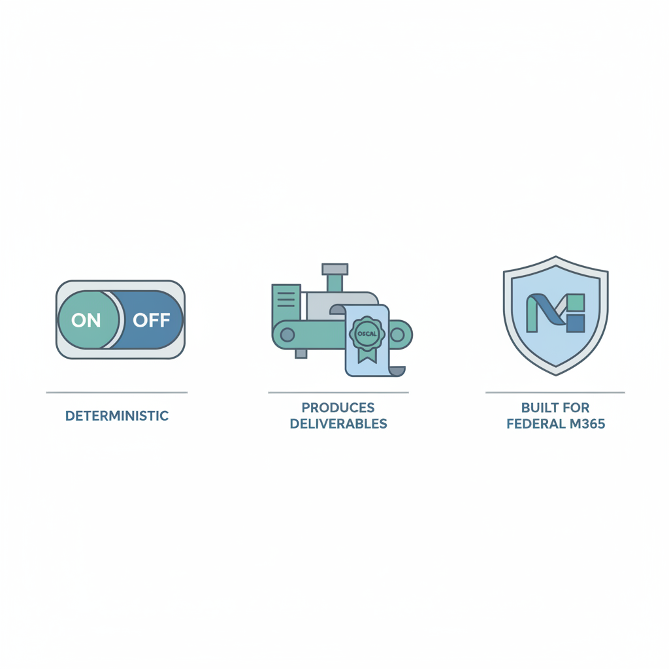
What Makes This Different
Deterministic. Produces actual deliverables. Built specifically for federal M365.

Slide 8
The Ask: 90-Day Pilot
Zero licensing cost. Open source. Connect, validate, champion. Real-world validation in a production tenant.

