Slide 1
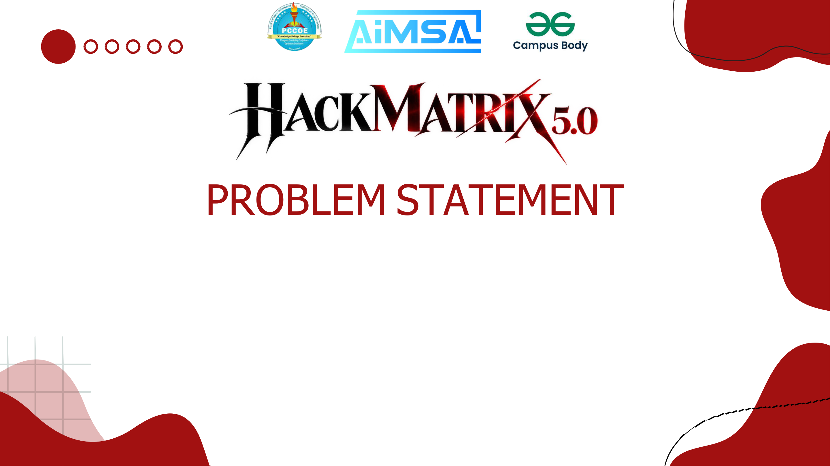
ENR-02 · Renewable Distribution Grid Digital Twin
Team GridTwin
member 1: Aditi Singh — 12414325
member 2: Saachi Aneja — 12415101
member 3: Aymaan Shaikh — 12415104
member 4: Sumit Dayal — 12412598
Notes:
Problem statement ENR-02: Renewable Distribution Grid Digital Twin. Team GridTwin.

Slide 2

Rooftop solar is growing fast on Indian distribution feeders. At midday the surplus flows back towards the substation, pushing voltages above safe limits and overloading cables — and the usual fix is to switch clean energy off.
GridTwin is a digital twin of a medium-voltage feeder (the CIGRE MV benchmark) driven by real 15-minute solar data from an Indian plant. It forecasts the next two hours of generation, runs a full AC power flow for every 15-minute step, detects every voltage and thermal violation, and tests corrective actions — battery storage, feeder reconfiguration, inverter reactive power and capped solar curtailment — alone and combined.
Every action is re-simulated over the whole day before it is recommended; the option that wastes the least renewable energy wins. When nothing works, GridTwin says so and reports the minimum intervention required.
15-bus
21 steps
9 options
34 days
CIGRE MV feeder
AC power flows / day
re-simulated each
real solar data

Slide 3

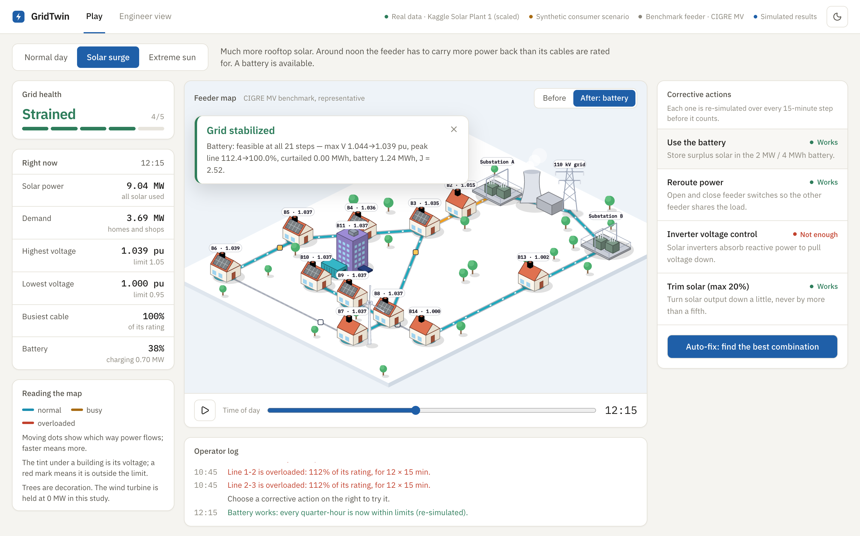
GridTwin
A digital twin that forecasts, stress-tests and heals a solar-heavy distribution grid — while keeping as much renewable energy as possible.
Build
Forecast
Stress
Detect
Heal
Verify
Live app: solar surge fixed by the battery — verified over all 21 steps.
Answers the operator’s question: “Will my feeder stay safe in the next two hours — and if not, what is the cheapest fix that really works?”

Slide 4

1 · Data
2 · Forecast
3 · Twin
4 · Power flow
5 · Detect
6 · Heal
Real Kaggle solar (India, 15-min) + 8 consumer profiles
›
Gradient boosting P10/P50/P90, next 2 h
›
pandapower CIGRE MV, 15 buses, 7 switches
›
AC Newton-Raphson every 15 min
›
Voltage 0.95–1.05 pu, loading ≤ 100 %
›
9 options, each re-simulated & ranked
Corrective actions
Choosing the best fix
Tech stack
Battery: charge only what is needed
Reroute: 17 safe switch layouts
Inverter reactive power
Solar curtailment capped at 20 %
Combinations, solar trimmed last
Feasible first: all steps within limits
Then lowest cost J (curtailment weighted 10×)
Else “No feasible solution” + minimum fix
Python, FastAPI, pandapower, scikit-learn
SQLite, 91 automated tests
React + TypeScript, Vite, Recharts
Illustrated isometric town view
Physics decides, AI explains — every number comes from the power flow; the optional LLM only rephrases text.

Slide 5

91
23 / 23
~0.1 s
5–9 s
backend tests passing
demo steps verified
live power flow
full evaluation, 9 options
Technical feasibility
Viability
Honest limits
Runs today on a laptop — no GPU, no paid services
Standard published methods
Handles real-data gaps
Utilities plug in their own feeder & CSV data
No new hardware for a pilot
Open source, near-zero cost
Balanced power flow
Benchmark, not real DISCOM feeder
34 days, one plant; synthetic demand
On this feeder: problems start at 8.8 MW of solar · battery alone copes up to 9.7 MW · with no battery nothing works from 16.8 MW.

Slide 6

Scenario (real solar) | GridTwin found | Result
Normal day, 4.2 MW | Safe | 100 % solar used
Solar surge, 9.2 MW | Battery fixes it | 0 % solar wasted
Bigger surge, 11.8 MW | Reroute 2 switches | Cable 156 → 80 %
Extreme, 18.5 MW | No feasible fix | Needs 35.9 % vs 20 % cap
Evening peak | Voltage too low | 3.1 MW load cut needed
Benefits
More rooftop solar on existing cables
Less wasted clean energy — curtailment last
Problems caught up to 2 h ahead
Every fix verified; impossible cases reported honestly
Plain-language, illustrated view for operators
Supports India’s rooftop-solar push (PM Surya Ghar: Muft Bijli Yojana) by helping DISCOMs host more solar safely.

Slide 7

CIGRE TF C6.04.02, “Benchmark Systems for Network Integration of Renewable and Distributed Energy Resources,” TB 575, 2014.
L. Thurner et al., “pandapower — an open-source Python tool for power systems,” IEEE Trans. Power Systems 33(6), 2018.
B. Stott, “Review of load-flow calculation methods,” Proc. IEEE 62(7), 1974.
A. Kannal, “Solar Power Generation Data,” Kaggle, 2020.
F. Pedregosa et al., “Scikit-learn: Machine Learning in Python,” JMLR 12, 2011.
R. Koenker & G. Bassett, “Regression Quantiles,” Econometrica 46(1), 1978.
M. Bollen & S. Rönnberg, “Hosting Capacity of the Power Grid for Renewable Electricity Production…,” Energies 10(9), 2017.
IEEE Std 1547-2018, Interconnection of Distributed Energy Resources.
ANSI C84.1, Voltage Ratings (Range A, ±5 %).
CEA (Technical Standards for Connectivity of Distributed Generation Resources) Regulations, 2013, India.
Built with: pandapower · FastAPI · scikit-learn · React · Recharts · SQLite

