Slide 1

Computer Engineering Department A.P. Shah Institute of Technology G.B.Road, Kasarvadavli, Thane(W), Mumbai-400615 UNIVERSITY OF MUMBAI Academic Year 2022-2023

Slide 2






ELIFIER
- AN ILLICIT MEDIA DETECTOR AND CLASSFIER
Under the Guidance of Prof. Kadambari Deherkar

Slide 3





OUR TEAM(Div-A)
Priyanshu Agarkar
Pranav Chopdekar
Sahil Gujar
Komal Chitnis
Roll no-1
Roll no-27
Roll no- 54
Roll no-26

Slide 4


Problem Statement
Online Social Networks do exist to allow people to communicate virtually by using the internet. The rise in web and social media interactions has resulted in the effortless proliferation of offensive language and hate speech. These content adversely affecting their mental health, and demeaning the integrity of social networking platforms.
Necessity of identifying illicit messages arises with the intention of reducing the overall crime rate all around the world thus helping to achieve a peaceful secure life.
ELIFIER

Slide 5

Objectives
The primary objective is to create a dataset based on realtime data extraction.
To achieve appropriate classification for the extracted data as illegal, neutral or abusive.
To attain best accuracy for the images and textual segment.
To imply machine learning algorithms like Multinomial Naive Bayes & SVM to obtain best accuracy.
Obtaining model’s accuracy by calculating harmonic mean of precision and recall (F1 score).
To prevent circulation or sending of unauthorised, illicit or explicit images and texts over social media platforms.
ELIFIER

Slide 6

Scope
The scope of the project involves categorizing images and textual data into 3 categories. The data would be extracted and data cleaning techniques would be applied to create a simplified dataset.
The main objective is to compare the text in the dataset word by word to detect and analyze references and usage of certain words for categorizing it as abusive or offensive words.
The project will also include a similar comparison process for images, likely using image processing techniques to detect and analyze image content.
By conducting these comparisons, the project aims to identify instances of abusive or offensive language in the social media data and potentially build a tool for content moderation or analysis.
ELIFIER

Slide 7

Technology Stack
Sklearn libraries :- Usage of CNN and TF-IDF(Term frequency-inverse document frequency) for analyzing the images and finding out each word frequency.
Algorithms and tools :- Support Vector Machine, Naive bayes, Sklearn.
Programming language usage :- Python.
Framework :- Streamlit.
ELIFIER

Slide 8
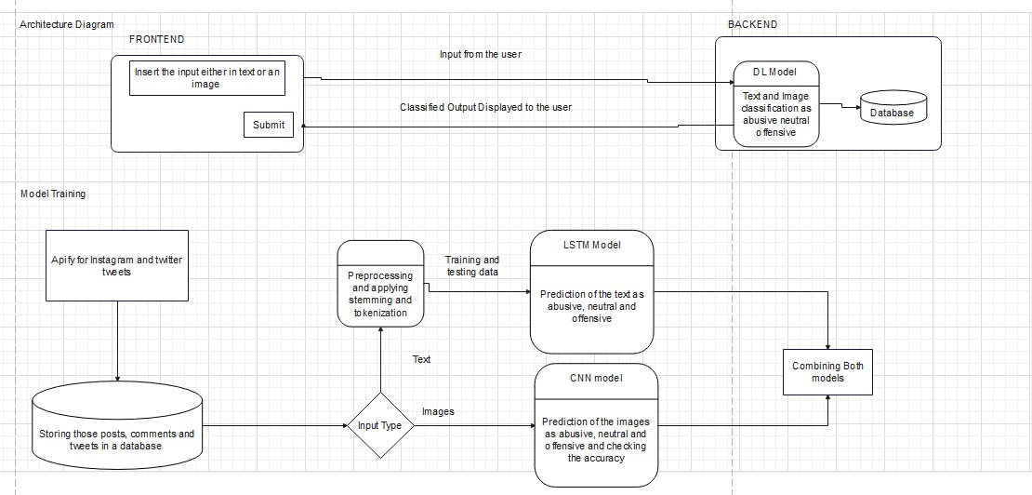
Architecture diagram
ELIFIER

Slide 9
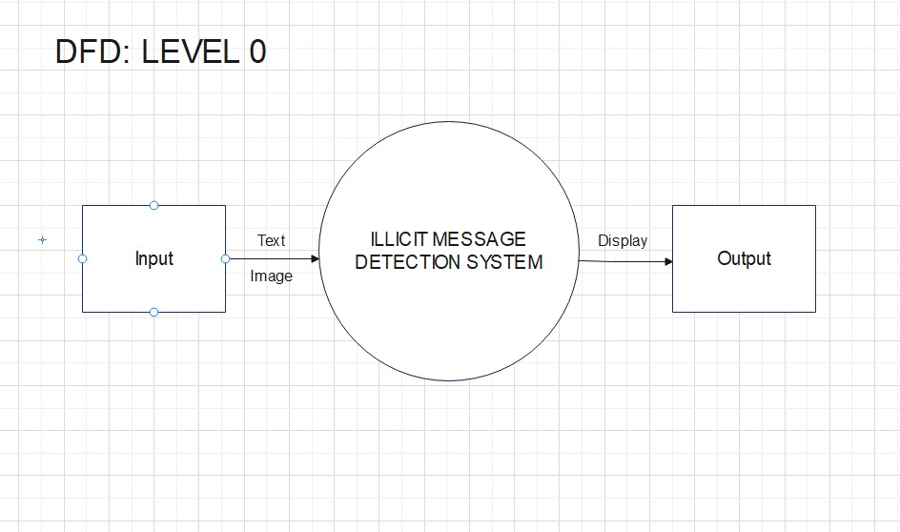
DFD - Lvl 0
ELIFIER

Slide 10
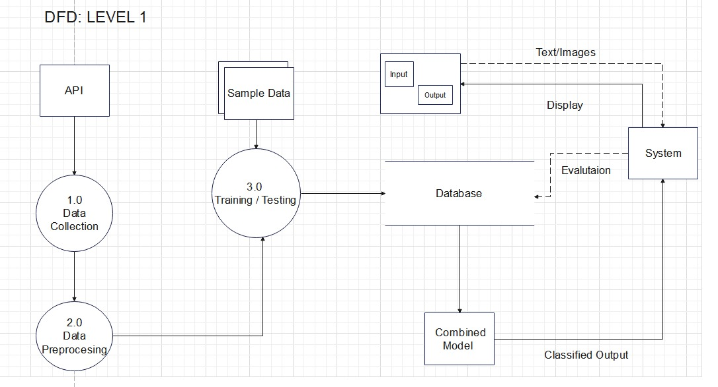
DFD - Lvl 1
ELIFIER

Slide 11
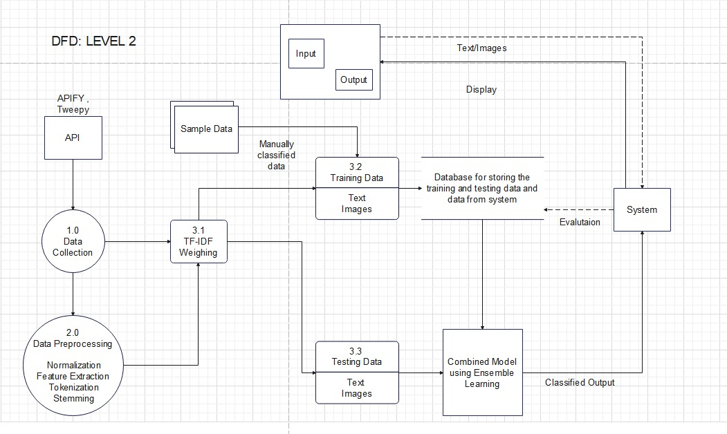
DFD - LVL 2
ELIFIER

Slide 12
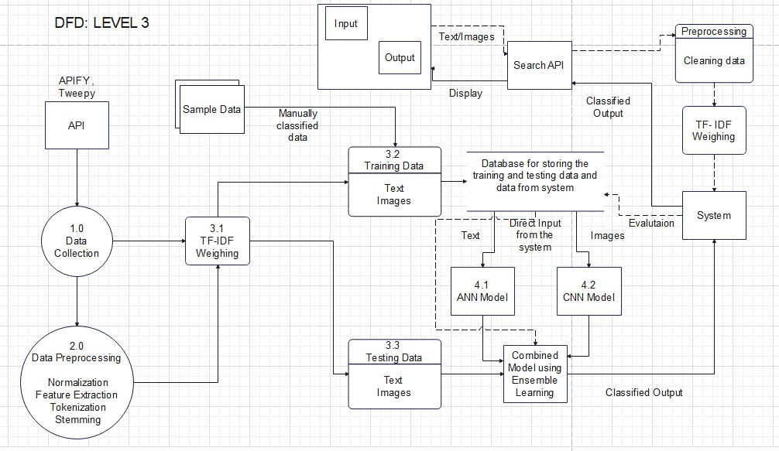
DFD - LVL 3
ELIFIER

Slide 13
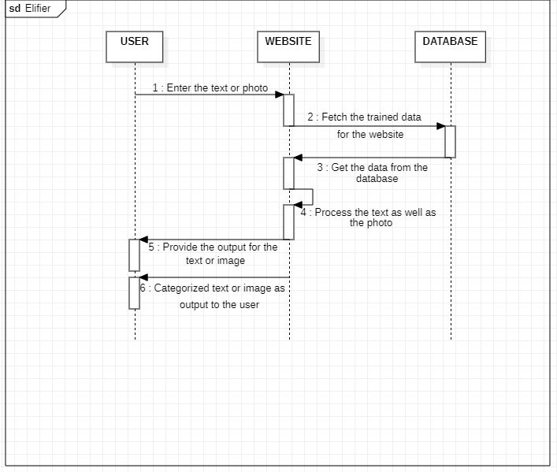
Sequence Diagram
ELIFIER

Slide 14
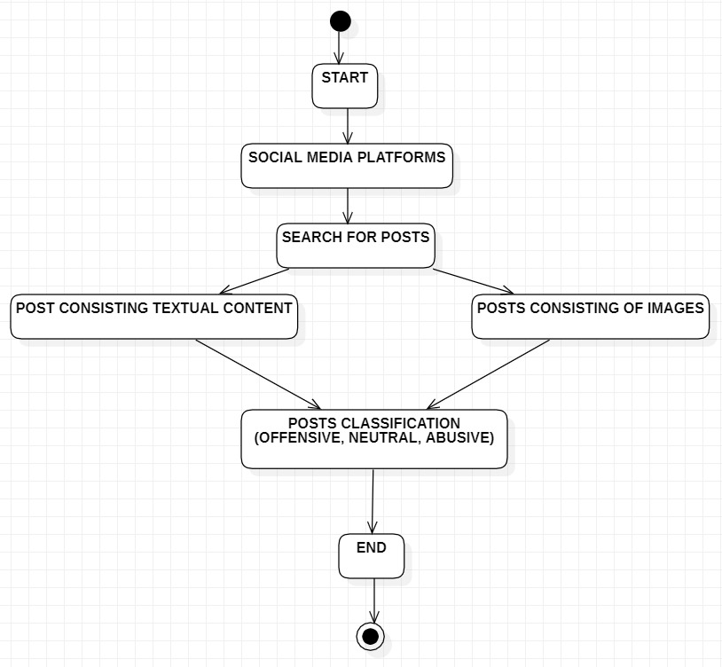
Activity diagram
ELIFIER

Slide 15
Work Completed
Extracting Data from Twitter handles.
Using Apify interface to extract textual data.
Preprocessing the data.
Using Multinomial Naïve Bayes for implementation of data.
Creating a usable user interface.
Connecting the frontend and the backend.
ELIFIER

Slide 16
Work Pending
1) Using Apify interface to extract post data.
2) Applying preprocessing techniques.
3) Using CNN model for image classification.
4) Connecting frontend and backend.
5) Increasing the accuracy of Multinomial Naïve Bayes model for textual data.
ELIFIER

Slide 17
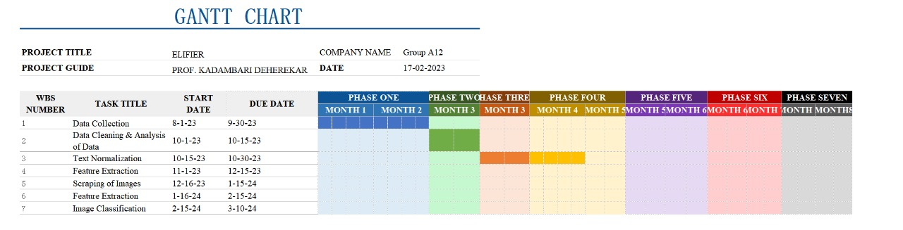
Gantt Chart

Slide 18
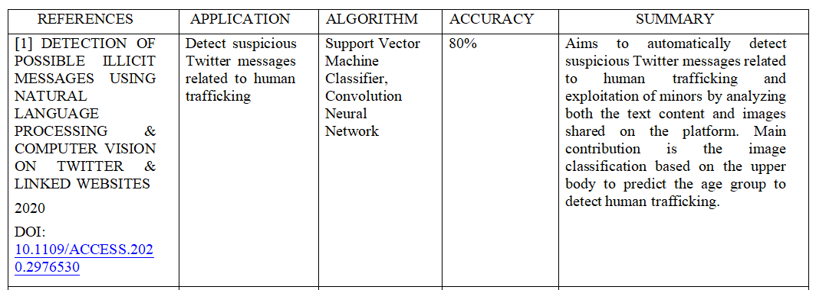
References 1
ELIFIER

Slide 19
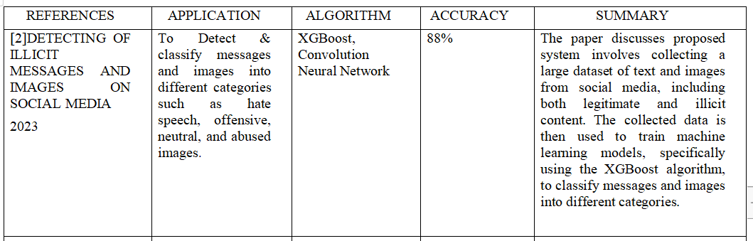
References 2
ELIFIER

Slide 20
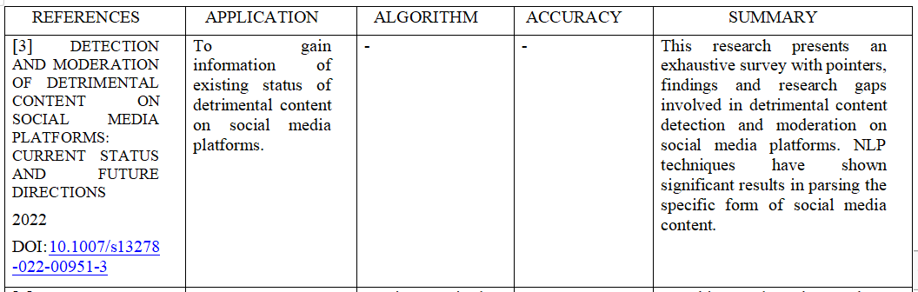
References 3
ELIFIER

Slide 21
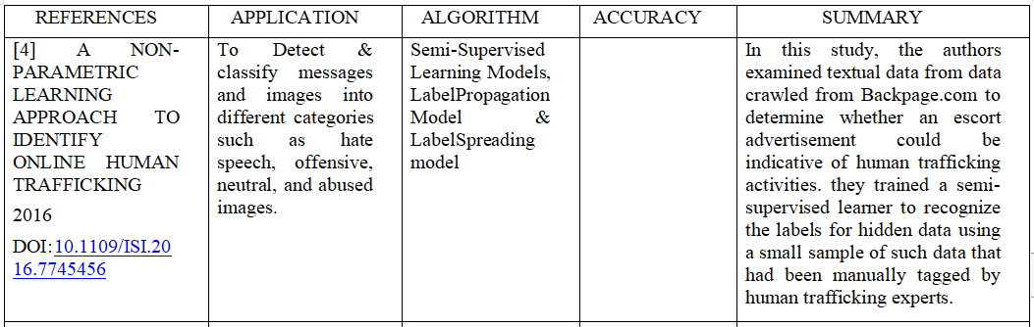
References 4
ELIFIER

Slide 22
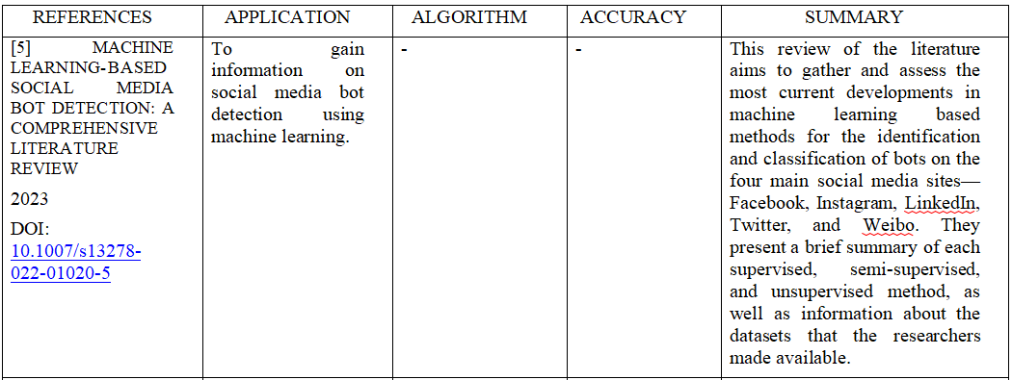
Reference 5
ELIFIER

Slide 23
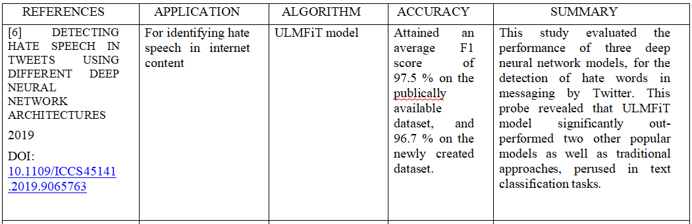
Reference 6
ELIFIER

Slide 24
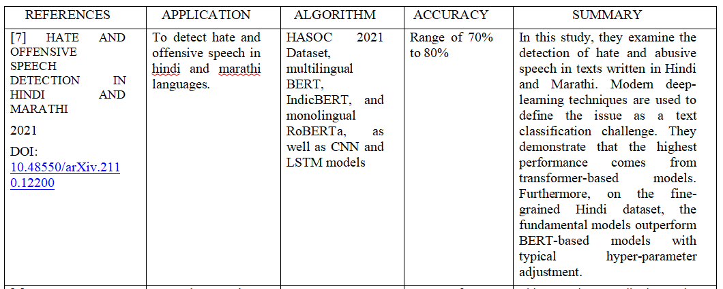
Reference 7
ELIFIER

Slide 25
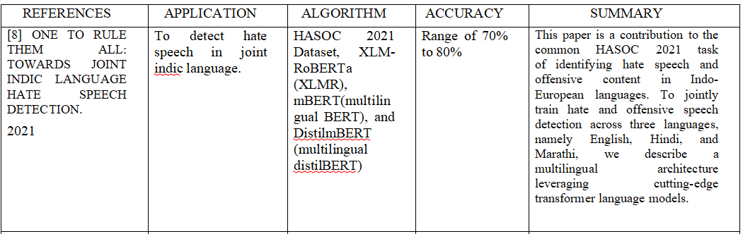
Reference 8
ELIFIER

Slide 26
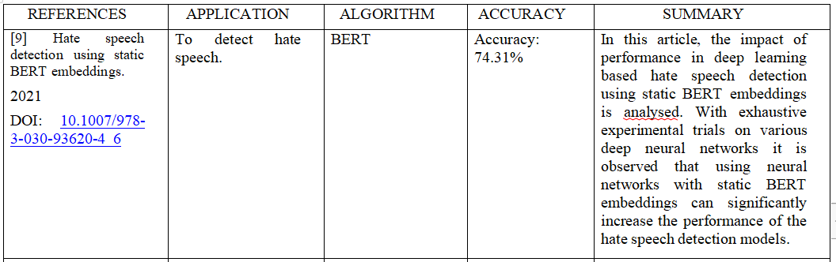
Reference 9
ELIFIER

Slide 27
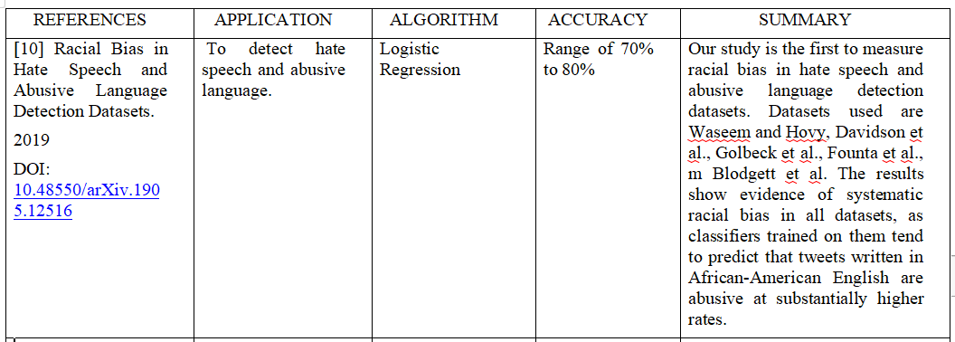
Reference 10
ELIFIER

