Slide 1
AlphaPose Pose Estimation
IPIS
석사 과정 최형기

Slide 2
AlphaPose
Pytorch
Backbone : YOLOv3
Dataset : COCO, PoseTrack, Halpe-FullBody
Notes:
Openpose처럼 COCO 데이터셋을 사용하지만, mesh reconsturuction에 필요한 머리와 목 같은 일부 관절 정보가 없기 때문에,
추가적으로 Data를 이용

Slide 3
Abstract
AlphaPose
fast and fine localization
inaccurate bounding boxes and redundant detections
improve accuracy
Notes:
빠르고 정밀한 localization
부정확한 b박스와 불필요한 디텍션 제거
정확도 향상

Slide 4
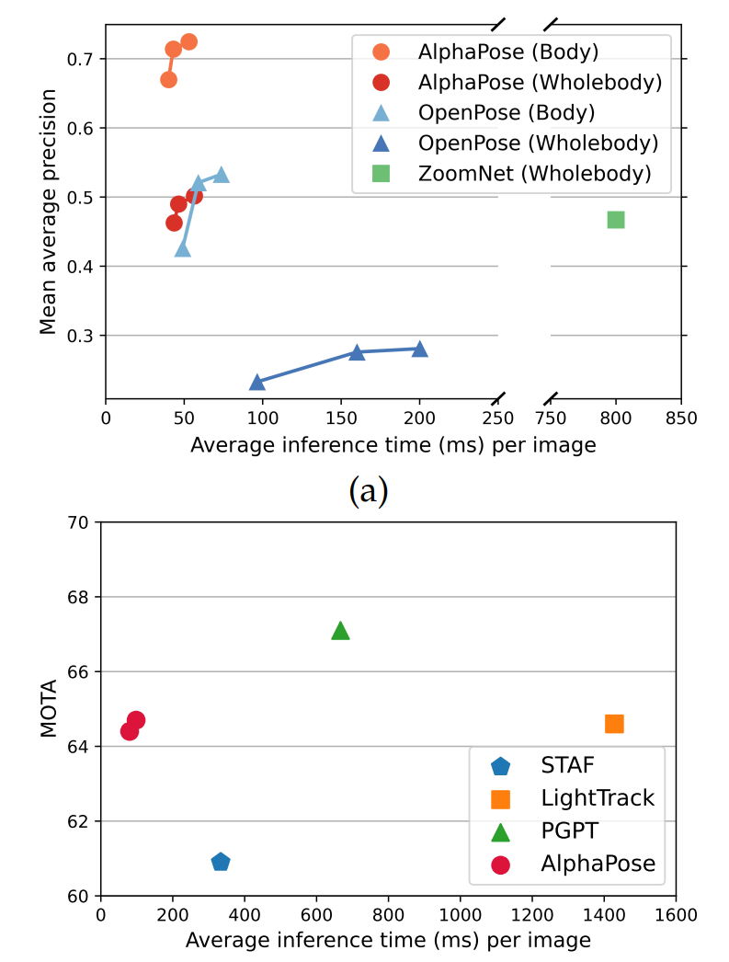
Abstract
AlphaPose
Notes:
Mean Average Precision : 디텍션에서 자주 사용되는 score 중 하나, 얼마나 정확히 검출했는지,
MOTA : Multiple Object Tracking Accuracy : multi object dectection에서 사용되는 score

Slide 5
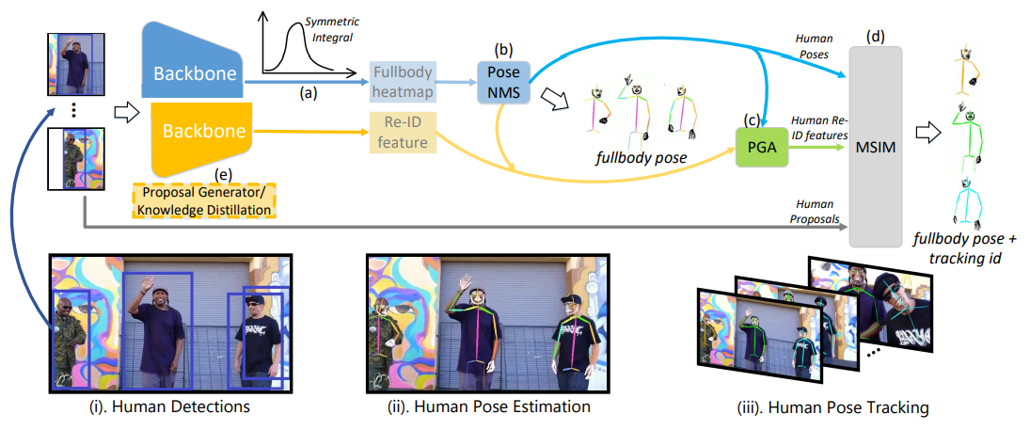
Network
AlphaPose

Slide 6
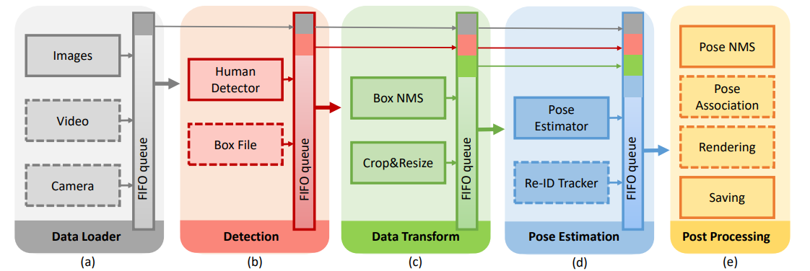
Network
AlphaPose
Dashed Box : optional components Flexible and each module’s components can be updated easily

Slide 7



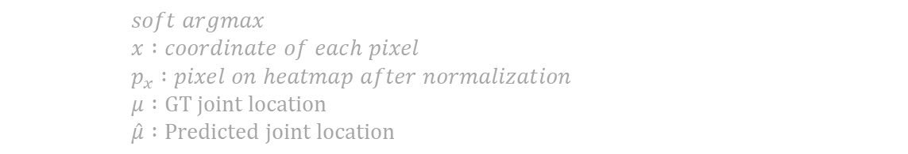
SIKR
AlphaPose
Symmetric Integral Keypoints Regression
Asymmetric gradient Problem
soft-argmax operation
heatmap based approaches -> regression based approaches
$$soft argmax$$
$$x :coordinate of each pixel$$
$$p_{x} :pixel on heatmap after normalization$$
$$μ :GT joint location$$
$$\hat{μ} :Predicted joint location$$
$$gradient of each pixel$$
$$l1 loss$$

Slide 8
SIKR
AlphaPose
Symmetric Integral Keypoints Regression
Amplitude Symmetric Gradient
in backward propagation
approximation to the true gradient
$$A_{grad} :amplitude of gradients$$

Slide 9

SIKR
AlphaPose
Symmetric Integral Keypoints Regression
Stable gradients for ASG
Lipschitz analysis -> make stable
$$θ :network param$$
$$f :objective function to minimize, in this case L−smooth$$
$$z :logits predicted by the network$$
$\hat{μ}=h(z)$ $:composition of the normalization and soft argmax$

Slide 10
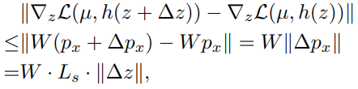

SIKR
AlphaPose
Symmetric Integral Keypoints Regression
Stable gradients for ASG
Lipschitz analysis -> make stable
$$x can be a arbitrary posiotion on the heat map$$
$$W :heatmap size$$
$$\left|\left|x−\hat{μ}\right|\right|≤W$$
$$L_{8} :Lipshitz constant of normalization function$$

Slide 11


SIKR
AlphaPose
Symmetric Integral Keypoints Regression
Stable gradients for ASG
Lipschitz analysis -> make stable
$$A_{grad} :W/8$$

Slide 12
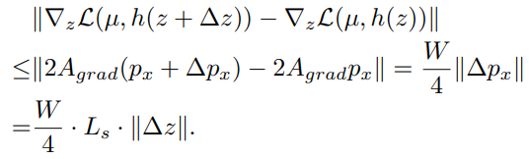
SIKR
AlphaPose
Symmetric Integral Keypoints Regression
Stable gradients for ASG
Lipschitz analysis -> make stable

Slide 13

SIKR
AlphaPose
Symmetric Integral Keypoints Regression
Size-dependent keypoint Scoring Problem
Before soft-argmax, sum of predicted heatmaps should be normalized
state-of-the-arts in multi-person pose estimation
large gap with single-person pose estimation
need joint confidence for pose NMS and calculating nAP
Two-step Heatmap Normalization
one-step normalization highly depends on the size of joint
$$\sum{p_{x}}=1$$

Slide 14



SIKR
AlphaPose
Symmetric Integral Keypoints Regression
Two-step Heatmap Normalization
decouple confidence prediction and integral regression
$$c_{x} :confidence heatmap value of x$$
$$z_{x} :unnormalized logits value of x$$
$$C :confidence heatmap$$
$$element sum of the probability heatmap P=1$$

Slide 15
Multi-Domain Knowledge Distillation
AlphaPose
Annotating new dataset
300Wface, FreiHand, InterHand
conbining datasets

Slide 16
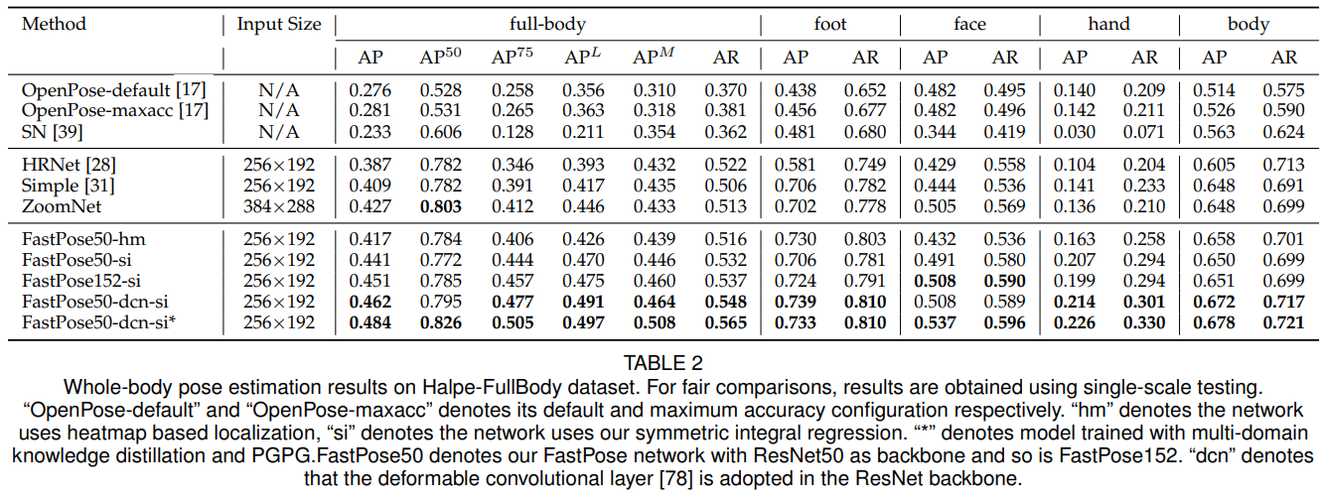
Conclusion
AlphaPose

Slide 17
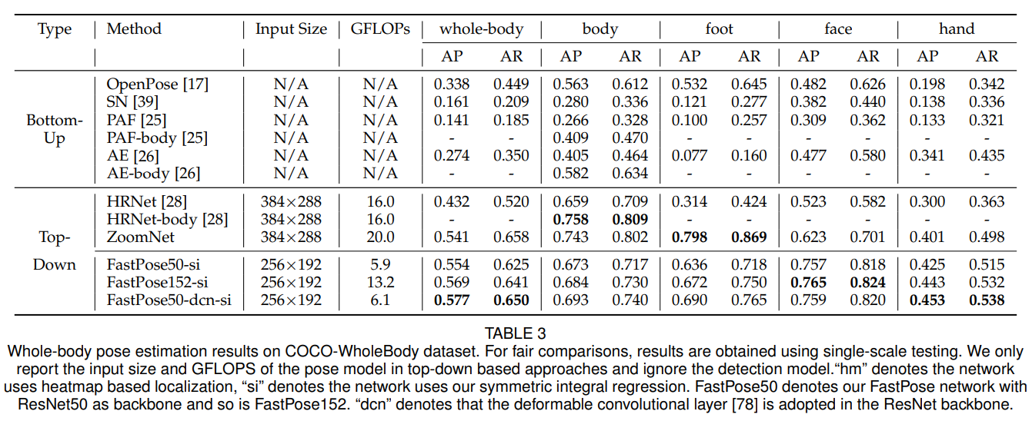
Conclusion
AlphaPose

Slide 18
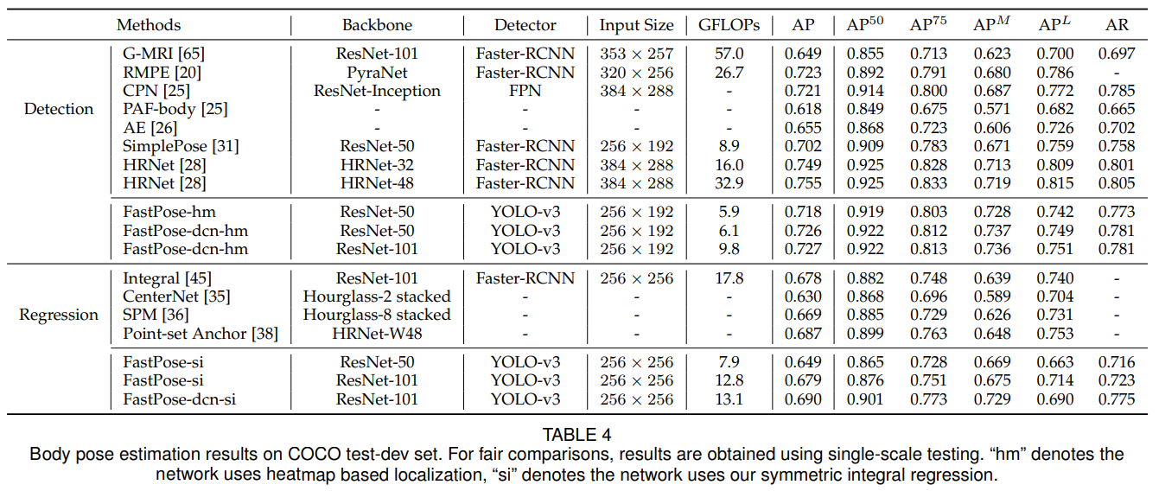
Conclusion
AlphaPose

Slide 19
Conclusion
AlphaPose

