Slide 1
U-Net: Convolutional Networks for Biomedical Image Segmentation
최형기

Slide 2
U-Net
Based on Fully-Convolutional Network
End-to-End
Contracting Path & Expanding Path
Capture context & precise localization
Overlap-Tile, Touching cell separation
Data Augmentation

Slide 3
Fully-Convolutional Network
Modified CNN-based model for Semantic Segmentation
Complement Fully-Connected Layer
Convolutionalization
Deconvolution(Upsampling)
Skip architecture

Slide 4
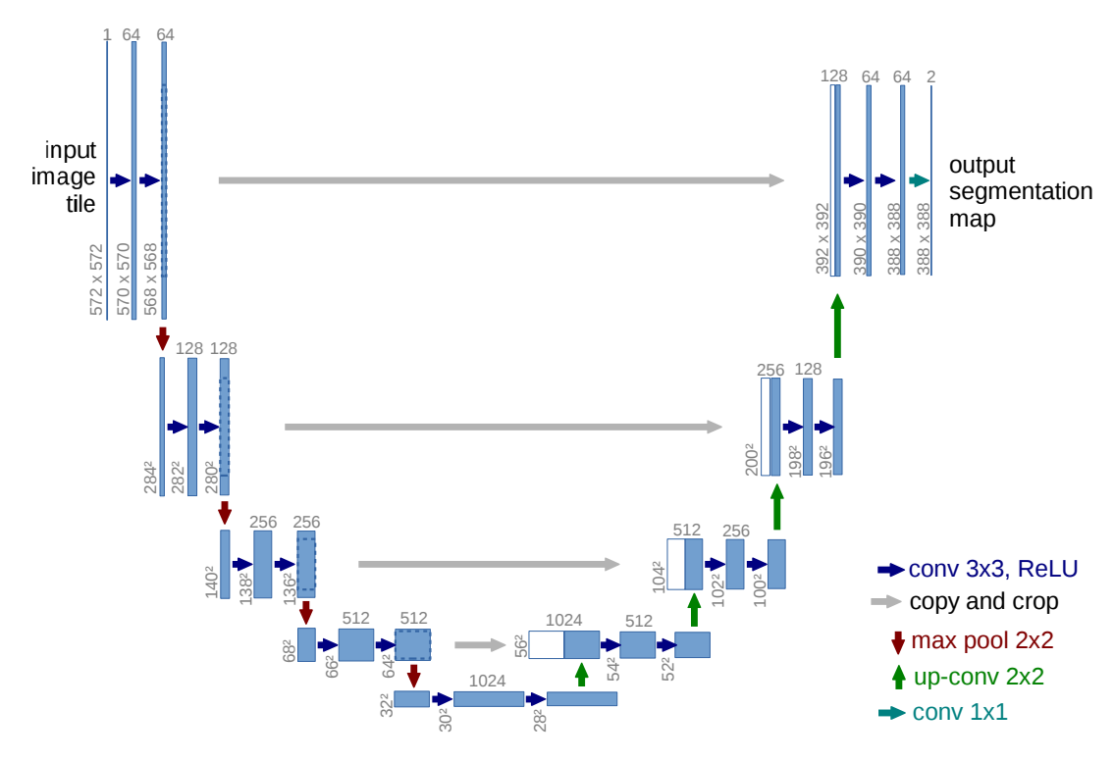
Notes:
23 layer

Slide 5
Contracting Path
Capture context
Follows the typical architecture of a convolutional network.

Slide 6
Contracting Path
3x3 Convolution & ReLU
(without padding)
2x2 max-pooling (stride : 2)
Down-sampling
Double the channel

Slide 7
Expanding Path
Precise localization
Copy & crop

Slide 8
Expanding Path
3x3 Convolution & ReLU
(without padding)
2x2 up Convolution
half the channel
1x1 Convolution

Slide 9
Overlap-Tile Strategy
Patch
For large size image
Mirroring

Slide 10
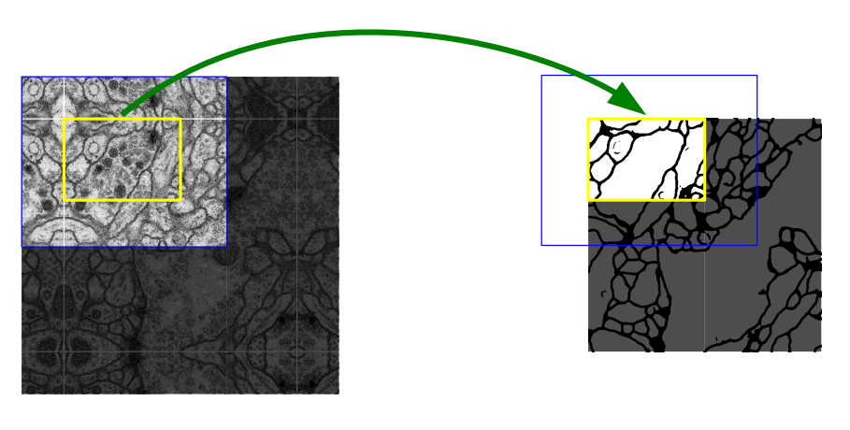
Overlap-Tile Strategy
Patch(Input)
Prediction of the segmentation

Slide 11
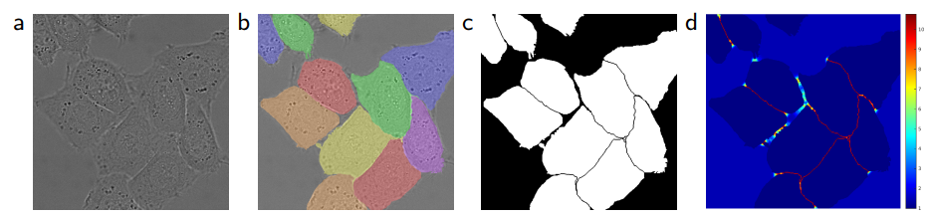
Touching Cell Separation Strategy

Slide 12
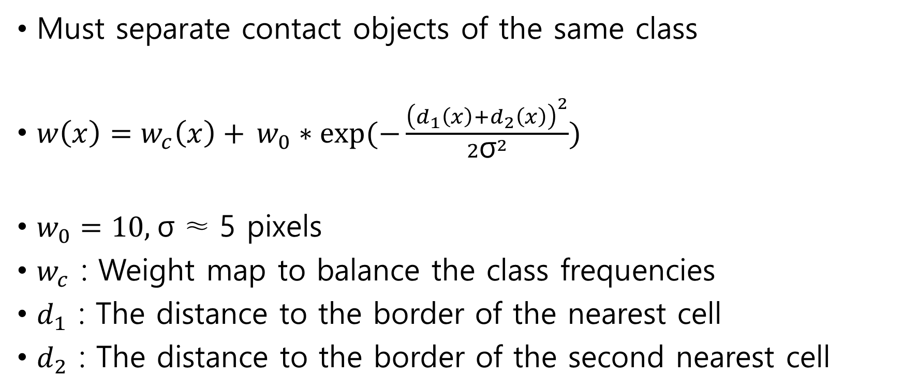
Touching Cell Separation Strategy
Must separate contact objects of the same class
$w\left(x\right)=w_{c}\left(x\right)+$ $w_{0}∗exp⁡(−\frac{{\left(d_{1}\left(x\right)+d_{2}\left(x\right)\right)}^{2}}{2{\text{σ}}^{2}})$
$w_{0}=10\text{, }\text{σ}\text{ ≈ 5} \text{pixels}$
$w_{c}$ : Weight map to balance the class frequencies
$d_{1}$ : The distance to the border of the nearest cell
$d_{2}$ : The distance to the border of the second nearest cell

Slide 13
Train
Stochastic Gradient Descent
Pixel-wise Soft-max
Cross Entropy loss function
Momentum : 0.99

Slide 14
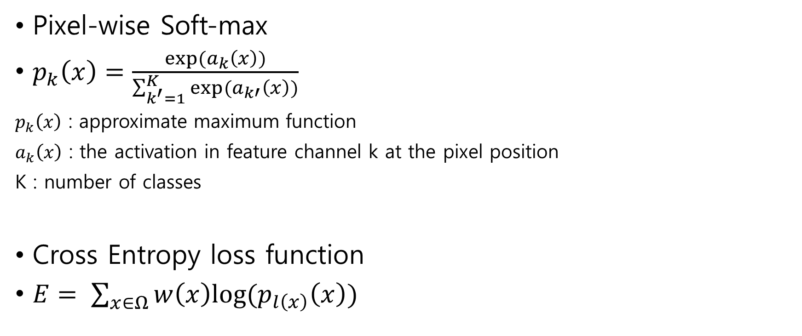
Train
Pixel-wise Soft-max
$p_{k}\left(x\right)=\frac{exp⁡(a_{k}\left(x\right))}{\sum_{k^{′}=1}^{K}{exp⁡(a_{k′}\left(x\right))}}$
$p_{k}\left(x\right)$ : approximate maximum function
$a_{k}\left(x\right)$ : the activation in feature channel k at the pixel position
K : number of classes
Cross Entropy loss function
$E= \sum_{x∈Ω}{w\left(x\right)log⁡(p_{l\left(x\right)}\left(x\right))}$

Slide 15
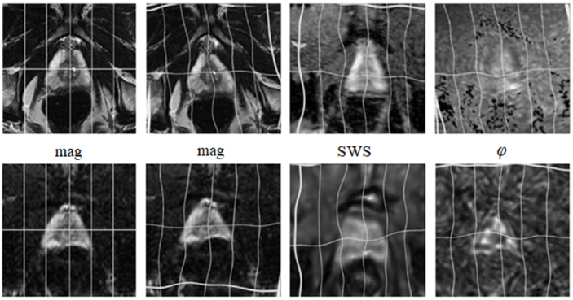
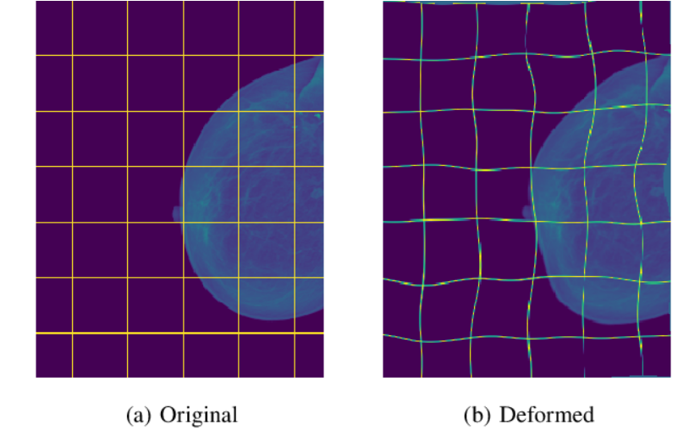
Data Augmentation
Not enough data
Elastic Deformation

Slide 16
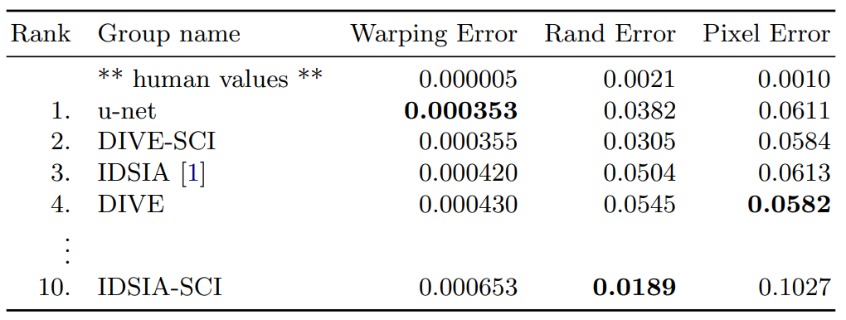
Conclusion
Excellent performance with few training data

