Slide 1
SRGAN: Photo-Realistic SISR Using a GAN
최형기
Notes:
지각적으로 우수한

Slide 2
SRGAN
Single Image Super-Resolution
Peak Signal-to-Noise Ratio
Super-Resolution GAN
Perceptual Loss
Adversarial Loss & Content Loss
Conclusion

Slide 3
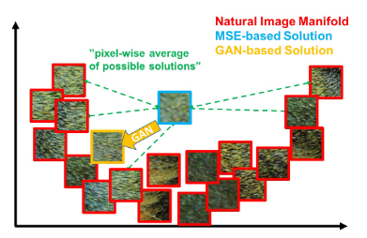
Single Image Super-Resolution
Low Resolution -> High Resolution
CNN
faster & deeper
but not enough detail when upscaling
MSE & PSNR
pixel-wise -> weak at high-frequency
Notes:
고해상도 복원 방법은 다수
Loss를 최소화 하는 과정
mse : 평균제곱오차
mse는 지나치게 smooth

Slide 4

Peak Signal-to-Noise Ratio
$PSNR=10∗\log_{10}\left(\frac{{MAX}_{I}^{2}}{MSE}\right)$
${MAX}_{I}$ : Maximum pixel in image
use MSE as denominator
High PSNR -> Less Loss
Notes:
PSNR은 영상 내 신호가 가질 수 있는 최대 신호에 대한 잡음(noise)의 비율

Slide 5
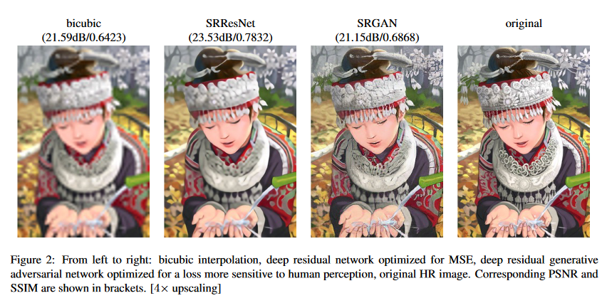
Peak Signal-to-Noise Ratio
But, hard to catch Perceptual Difference

Slide 6
Super-Resolution GAN
GAN
Generator Network + Discriminator Network
Perceptual Loss
Adversarial Loss + Content Loss
VGG Network_ High-Level Feature Map
Notes:
Super Resolution GAN 제안

Slide 7
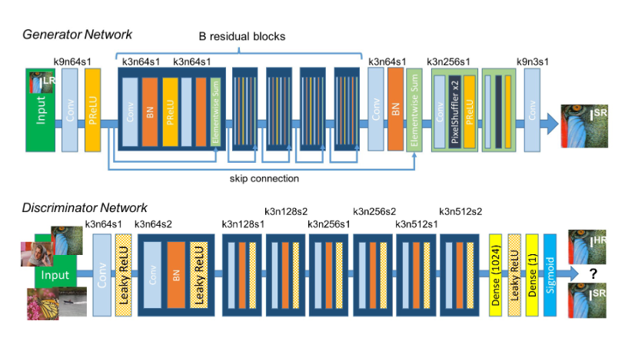
GAN

Slide 8
GAN_ Generator Network
BN & PReLU
B residual block
Sub-pixel conv layer(ESPCN) up-sampling
Notes:
3x3

Slide 9
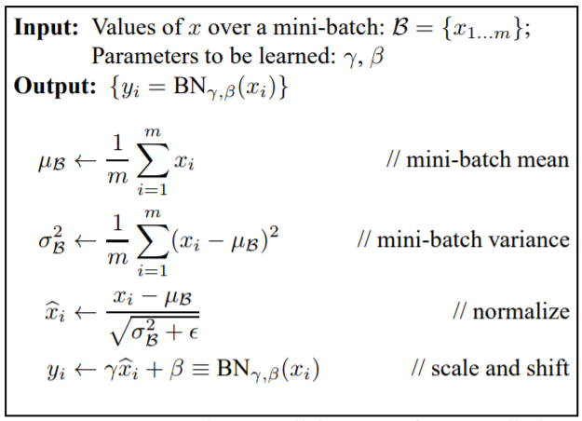
Batch Normalization
Normalization in batches
Same Input & Different weight -> Different Output
Less difference in weights -> Stable Train
Notes:
l은 perceptual loss

Slide 10
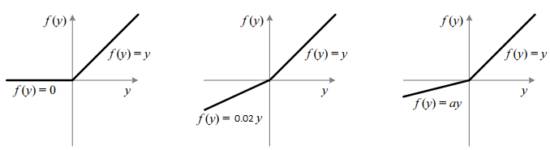
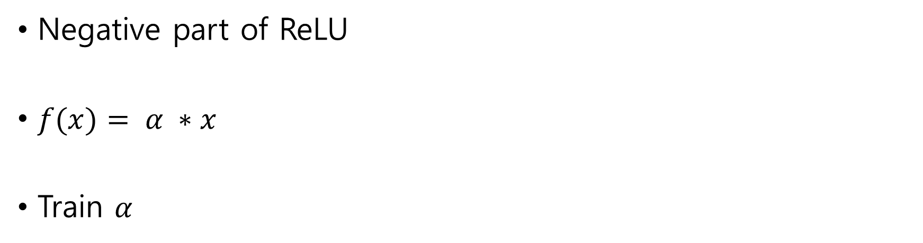
PReLU
Negative part of ReLU
$f(x)= α ∗x$
Train $α$
Notes:
l은 perceptual loss

Slide 11
Sub-pixel conv layer(ESPCN)
Upscaling in first layer -> Increase Computation
Upscaling at the end
Notes:
l은 perceptual loss

Slide 12
GAN_ Discriminator Network
Sigmoid & Leaky ReLU (α=0.2)
Max-pooling
Strided Conv
Notes:
3x3
Strided Conv : resolution을 줄이기 위해 사용

Slide 13
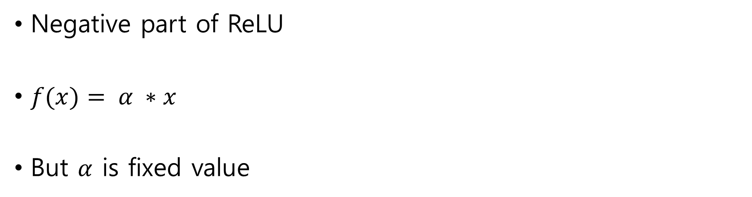
Leaky ReLU
Negative part of ReLU
$f(x)= α ∗x$
But $α$ is fixed value

Slide 14
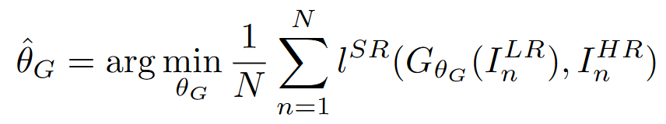
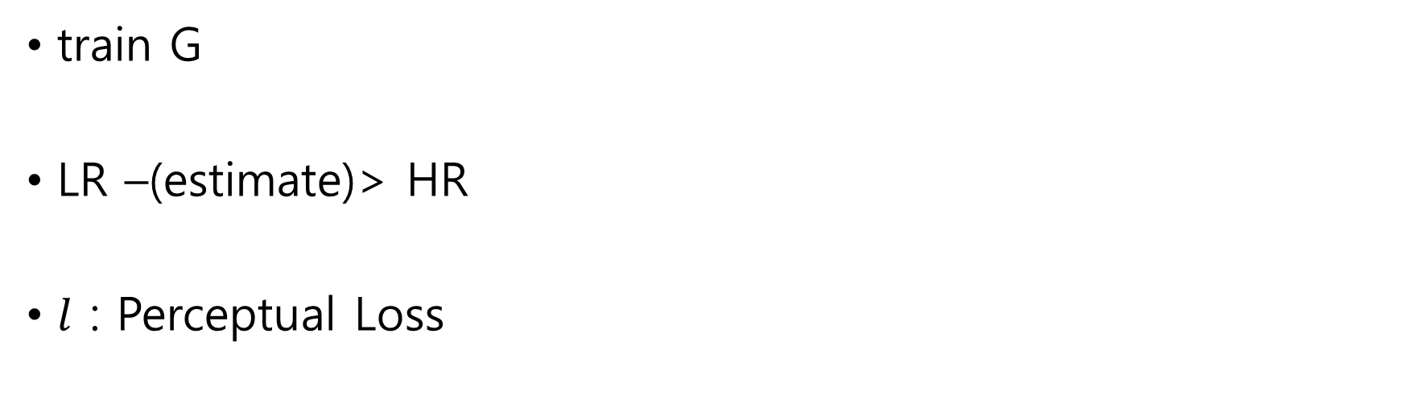
GAN
train G
LR –(estimate)> HR
$l$ : Perceptual Loss
Notes:
l은 perceptual loss

Slide 15
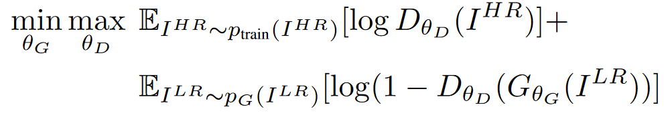
GAN
Function D
GAN Loss
Check image(G) with Discriminator

Slide 16
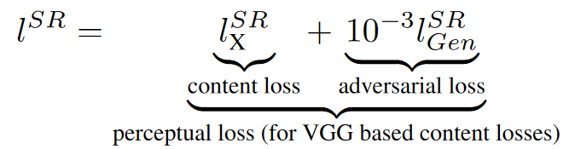
Perceptual Loss
Adversarial Loss + Content Loss
VGG Network_ High-Level Feature Map

Slide 17
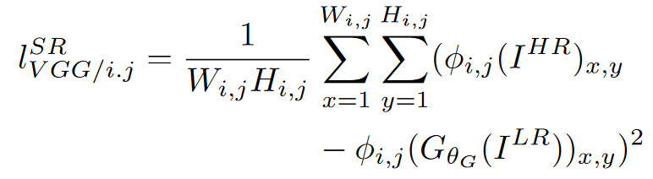
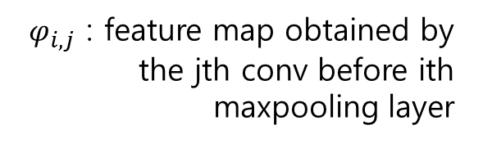
Content Loss
$φ_{i, j}$ : feature map obtained by the jth conv before ith maxpooling layer
MSE : smoothing -> weak at High-Frequency Content
Closer to Perceptual Similarity

Slide 18
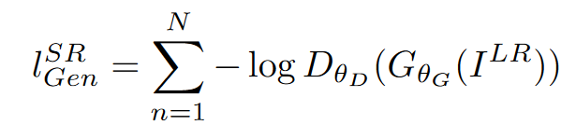
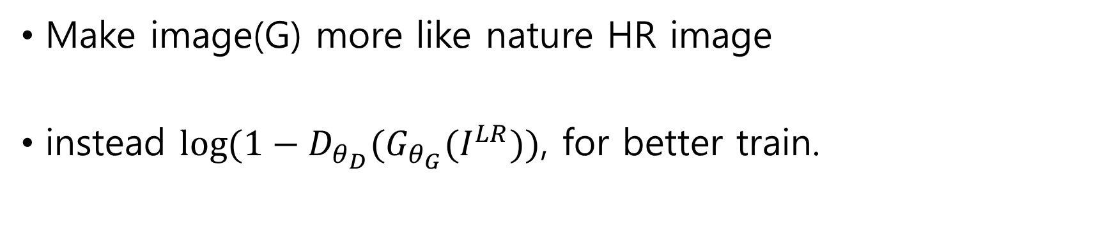
Adversarial Loss
Make image(G) more like nature HR image
instead $\log{({1−D}_{θ_{D}}(G_{θ_{G}}(I^{LR}))}$, for better train.

Slide 19
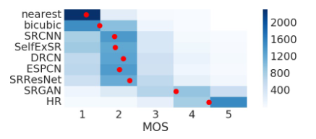
Conclusion_ Mean Opinion Score

Slide 20
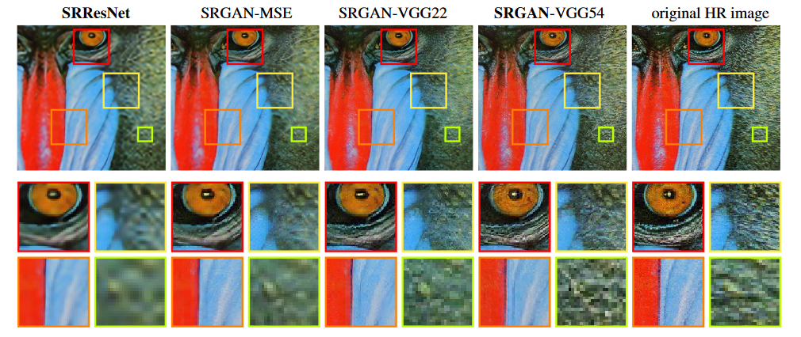
Conclusion

Slide 21
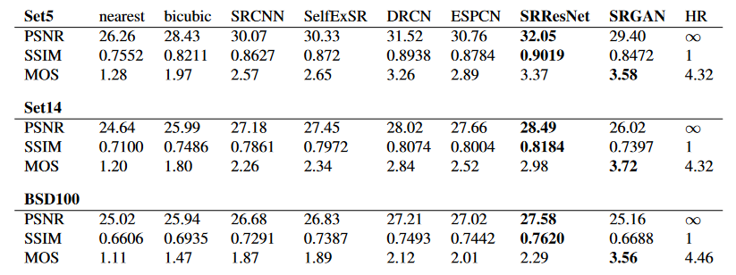
Conclusion

