Slide 1
ViTPose Pose Estimation
IPIS
석사 과정 최형기

Slide 2
Abstract & Introduction
ViTPose
Pose estimation
Vision transformer-based model
Simple & flexible
Can scale up from 100M to 1B params
scalable model capacity of vision transformer
high parallelism of vision transformer

Slide 3
Abstract & Introduction
ViTPose
Vision transformer
Transformer for vision task
CNN Method to Transformer
Transformer
NLP
Efficiency, Scalability
can train 100B Params
Dataset ↑ -> Model Size ↑ -> low risk of saturate

Slide 4
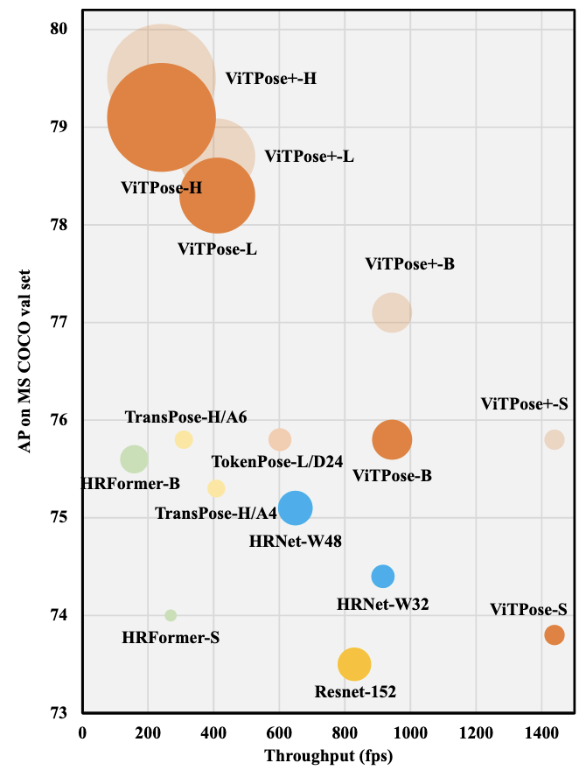
Abstract & Introduction
ViTPose

Slide 5
Environment
ViTPose
Dataset
COCO 2017
Pytorch
Top-down

Slide 6
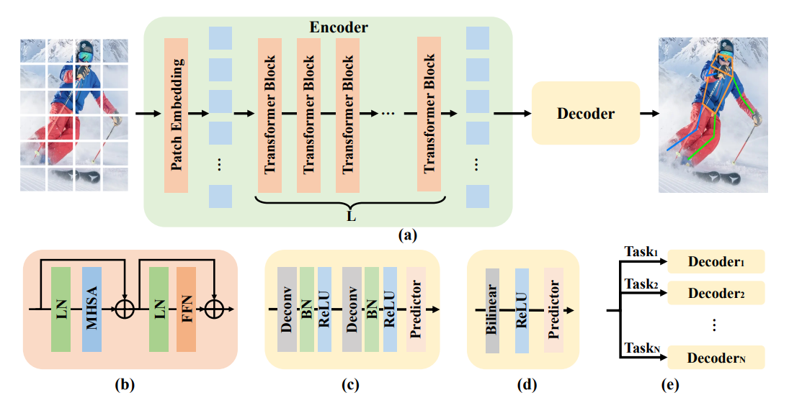





Network
ViTPose
$$framework of ViTPose$$
$$transformer block$$
$$classic decoder$$
$$decoders for multiple dataset$$
$$simple decoder$$

Slide 7
The Simplicity of ViTPose
ViTPose
Structure simplicity
less params than CNN-based modeles
consistent performance across various size of images
Scalability and consistent performance

Slide 8



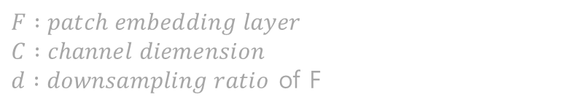

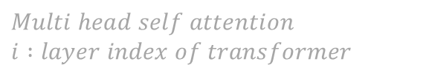

The Simplicity of ViTPose
ViTPose
$$X :person instance image$$
$$F :patch embedding layer$$
$$C :channel diemension$$
$d :downsampling ratio$ of F
Transformer Encoder
$$Multi head self attention$$
$$i :layer index of transformer$$
$$Feed forward network$$
Output feature

Slide 9


The Simplicity of ViTPose
ViTPose
Classic Decoder
Simple Decoder
$$K :keyoints$$

Slide 10
The Scalability of ViTPose
ViTPose
Simple structure
can adjust model size
Adjusting model size
stacking different numbers of transformer layers
adjusting feature dimensions.
Fine-tuning
ViT-B, ViT-L, ViT-H, ViTAE-G

Slide 11
The Flexibility of ViTPose
ViTPose
Pre-training data flexibility
ImageNet, MS COCO, AI Challenger …
Resolution flexibility
Attention type flexibility
MHSA, LRA(Local Relation Attention)
finetuning flexibility
task flexibility

Slide 12

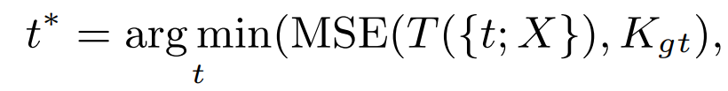






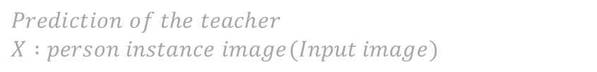
The Transferability of ViTPose
ViTPose
$$T :Teacher network$$
$$S :Student network$$
$$Output distilation loss$$
$$K :Output$$
$$t` :optimal token$$
$$Prediction of the teacher$$
$$X :person instance image(Input image)$$
Loss of student network
$Token distillation loss$,
$$Combination of output distillation loss and token distillation$$

Slide 13
Experiments
ViTPose
PyTorch
Encoder of vision transformer model
Decoder of simple conv layers and upsampling
Data augmentation
random crop, rotation, and gaussian noise
Adam optimizer, cos annealing learning rate scheduler

Slide 14
Experiments
ViTPose
Top-down setting
256 × 192 input resolution
Optimizer : AdamW
Learning rate : 5e-4
Batch Size : 512
Weight Decay : 0.1
Epochs : 210
Sweep Layer Wise
Stochastic Drop Path Ratio

Slide 15
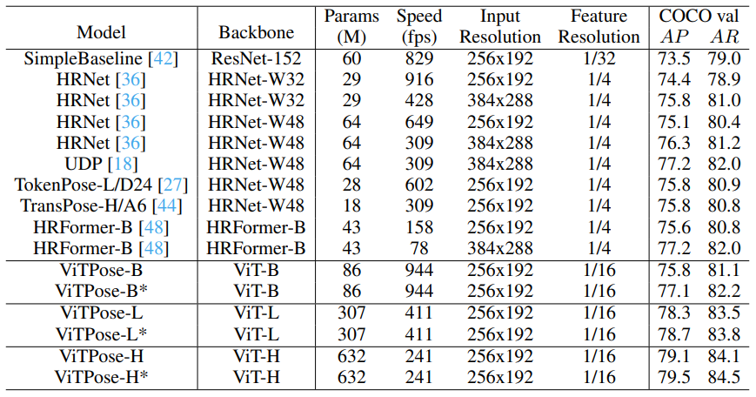
Comparison with SOTA Methods
ViTPose

Slide 16
Limitation and Discussion
ViTPose
Lower performance on small datasets.
Research on 3D pose estimation is needed
Can be applied to other pose estimation dataset

Slide 17
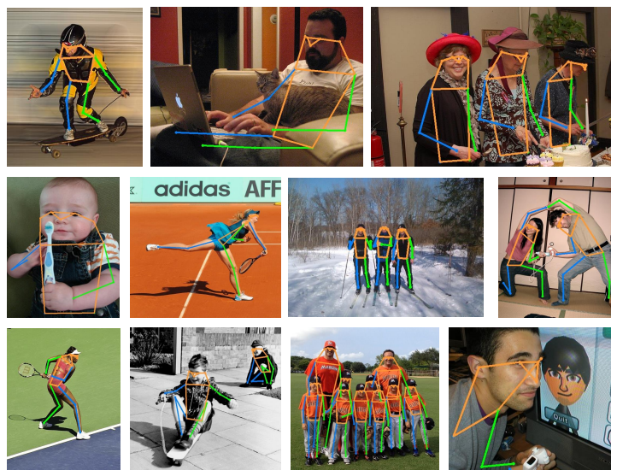
Conclusion
ViTPose

