Slide 1
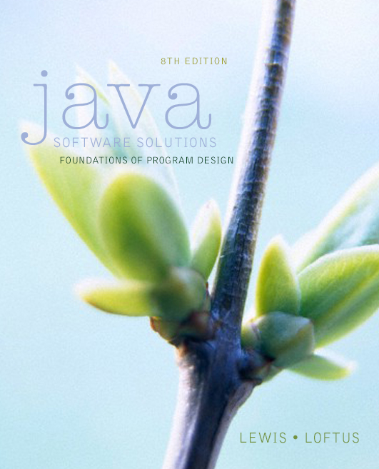

Chapter 2
Data and Expressions
Java Software Solutions
Foundations of Program Design
8th Edition
John Lewis
William Loftus
Copyright © 2014 Pearson Education, Inc.

Slide 2
Data and Expressions
Let's explore some other fundamental programming concepts
Chapter 2 focuses on:
  character strings
  primitive data
  the declaration and use of variables
  expressions and operator precedence
  data conversions
  accepting input from the user
  Java applets
  introduction to graphics
Copyright © 2014 Pearson Education, Inc.

Slide 3
Outline
Character Strings
Variables and Assignment
Primitive Data Types
Expressions
Data Conversion
Interactive Programs
Graphics
Applets
Drawing Shapes
Copyright © 2014 Pearson Education, Inc.

Slide 4
Character Strings
A string literal is represented by putting double quotes around the text
Examples:
  "This is a string literal."
  "123 Main Street"
  "X"
Every character string is an object in Java, defined by the String class
Every string literal represents a String object
Copyright © 2014 Pearson Education, Inc.

Slide 5
The println Method
In the Lincoln program from Chapter 1, we invoked the println method to print a character string
The System.out object represents a destination (the monitor screen) to which we can send output
System.out.println ("Whatever you are, be a good one.");
object
method
name
information provided to the method
(parameters)
Copyright © 2014 Pearson Education, Inc.

Slide 6
The print Method
The System.out object provides another service as well
The print method is similar to the println method, except that it does not advance to the next line
Therefore anything printed after a print statement will appear on the same line
See Countdown.java
Copyright © 2014 Pearson Education, Inc.

Slide 7
//********************************************************************
// Countdown.java Author: Lewis/Loftus
//
// Demonstrates the difference between print and println.
//********************************************************************
public class Countdown
{
//-----------------------------------------------------------------
// Prints two lines of output representing a rocket countdown.
//-----------------------------------------------------------------
public static void main(String[] args)
{
System.out.print("Three... ");
System.out.print("Two... ");
System.out.print("One... ");
System.out.print("Zero... ");
System.out.println("Liftoff!"); // appears on first output line
System.out.println("Houston, we have a problem.");
}
}
Copyright © 2014 Pearson Education, Inc.

Slide 8
Output
Three... Two... One... Zero... Liftoff!
Houston, we have a problem.
//********************************************************************
// Countdown.java Author: Lewis/Loftus
//
// Demonstrates the difference between print and println.
//********************************************************************
public class Countdown
{
//-----------------------------------------------------------------
// Prints two lines of output representing a rocket countdown.
//-----------------------------------------------------------------
public static void main(String[] args)
{
System.out.print("Three... ");
System.out.print("Two... ");
System.out.print("One... ");
System.out.print("Zero... ");
System.out.println("Liftoff!"); // appears on first output line
System.out.println("Houston, we have a problem.");
}
}
Copyright © 2014 Pearson Education, Inc.

Slide 9
String Concatenation
The string concatenation operator (+) is used to append one string to the end of another
"Peanut butter " + "and jelly"
It can also be used to append a number to a string
A string literal cannot be broken across two lines in a program
See Facts.java
Copyright © 2014 Pearson Education, Inc.

Slide 10
//********************************************************************
// Facts.java Author: Lewis/Loftus
//
// Demonstrates the use of the string concatenation operator and the
// automatic conversion of an integer to a string.
//********************************************************************
public class Facts
{
//-----------------------------------------------------------------
// Prints various facts.
//-----------------------------------------------------------------
public static void main(String[] args)
{
// Strings can be concatenated into one long string
System.out.println("We present the following facts for your "
+ "extracurricular edification:");
System.out.println();
// A string can contain numeric digits
System.out.println("Letters in the Hawaiian alphabet: 12");
continue
Copyright © 2014 Pearson Education, Inc.

Slide 11
continue
// A numeric value can be concatenated to a string
System.out.println("Dialing code for Antarctica: " + 672);
System.out.println("Year in which Leonardo da Vinci invented "
+ "the parachute: " + 1515);
System.out.println("Speed of ketchup: " + 40 + " km per year");
}
}
Copyright © 2014 Pearson Education, Inc.

Slide 12
Output
We present the following facts for your extracurricular edification:
Letters in the Hawaiian alphabet: 12
Dialing code for Antarctica: 672
Year in which Leonardo da Vinci invented the parachute: 1515
Speed of ketchup: 40 km per year
continue
// A numeric value can be concatenated to a string
System.out.println ("Dialing code for Antarctica: " + 672);
System.out.println ("Year in which Leonardo da Vinci invented "
+ "the parachute: " + 1515);
System.out.println("Speed of ketchup: " + 40 + " km per year");
}
}
Copyright © 2014 Pearson Education, Inc.

Slide 13
String Concatenation
The + operator is also used for arithmetic addition
The function that it performs depends on the type of the information on which it operates
If both operands are strings, or if one is a string and one is a number, it performs string concatenation
If both operands are numeric, it adds them
The + operator is evaluated left to right, but parentheses can be used to force the order
See Addition.java
Copyright © 2014 Pearson Education, Inc.

Slide 14
//********************************************************************
// Addition.java Author: Lewis/Loftus
//
// Demonstrates the difference between the addition and string
// concatenation operators.
//********************************************************************
public class Addition
{
//-----------------------------------------------------------------
// Concatenates and adds two numbers and prints the results.
//-----------------------------------------------------------------
public static void main(String[] args)
{
System.out.println("24 and 45 concatenated: " + 24 + 45);
System.out.println("24 and 45 added: " + (24 + 45));
}
}
Copyright © 2014 Pearson Education, Inc.

Slide 15
Output
24 and 45 concatenated: 2445
24 and 45 added: 69
//********************************************************************
// Addition.java Author: Lewis/Loftus
//
// Demonstrates the difference between the addition and string
// concatenation operators.
//********************************************************************
public class Addition
{
//-----------------------------------------------------------------
// Concatenates and adds two numbers and prints the results.
//-----------------------------------------------------------------
public static void main(String[] args)
{
System.out.println("24 and 45 concatenated: " + 24 + 45);
System.out.println("24 and 45 added: " + (24 + 45));
}
}
Copyright © 2014 Pearson Education, Inc.

Slide 16
Quick Check
What output is produced by the following?
System.out.println("X: " + 25);
System.out.println("Y: " + (15 + 50));
System.out.println("Z: " + 300 + 50);
Copyright © 2014 Pearson Education, Inc.

Slide 17
Quick Check
What output is produced by the following?
System.out.println("X: " + 25);
System.out.println("Y: " + (15 + 50));
System.out.println("Z: " + 300 + 50);
X: 25
Y: 65
Z: 30050
Copyright © 2014 Pearson Education, Inc.

Slide 18
Escape Sequences
What if we wanted to print the quote character?
The following line would confuse the compiler because it would interpret the second quote as the end of the string
System.out.println("I said "Hello" to you.");
An escape sequence is a series of characters that represents a special character
An escape sequence begins with a backslash character (\)
System.out.println("I said \"Hello\" to you.");
Copyright © 2014 Pearson Education, Inc.

Slide 19
Escape Sequences
Some Java escape sequences:
Escape Sequence
\b
\t
\n
\"
\'
\\
Meaning
backspace
tab
newline
double quote
single quote
backslash
See Roses.java
Copyright © 2014 Pearson Education, Inc.

Slide 20
//********************************************************************
// Roses.java Author: Lewis/Loftus
//
// Demonstrates the use of escape sequences.
//********************************************************************
public class Roses
{
//-----------------------------------------------------------------
// Prints a poem (of sorts) on multiple lines.
//-----------------------------------------------------------------
public static void main(String[] args)
{
System.out.println("Roses are red,\n\tViolets are blue,\n" +
"Sugar is sweet,\n\tBut I have \"commitment issues\",\n\t" +
"So I'd rather just be friends\n\tAt this point in our " +
"relationship.");
}
}
Copyright © 2014 Pearson Education, Inc.

Slide 21
Output
Roses are red,
Violets are blue,
Sugar is sweet,
But I have "commitment issues",
So I'd rather just be friends
At this point in our relationship.
//********************************************************************
// Roses.java Author: Lewis/Loftus
//
// Demonstrates the use of escape sequences.
//********************************************************************
public class Roses
{
//-----------------------------------------------------------------
// Prints a poem (of sorts) on multiple lines.
//-----------------------------------------------------------------
public static void main (String[] args)
{
System.out.println ("Roses are red,\n\tViolets are blue,\n" +
"Sugar is sweet,\n\tBut I have \"commitment issues\",\n\t" +
"So I'd rather just be friends\n\tAt this point in our " +
"relationship.");
}
}
Copyright © 2014 Pearson Education, Inc.

Slide 22
Quick Check
Write a single println statement that produces the following output:
"Thank you all for coming to my home
tonight," he said mysteriously.
Copyright © 2014 Pearson Education, Inc.

Slide 23
Quick Check
Write a single println statement that produces the following output:
"Thank you all for coming to my home
tonight," he said mysteriously.
System.out.println("\"Thank you all for " +
"coming to my home\ntonight,\" he said " +
"mysteriously.");
Copyright © 2014 Pearson Education, Inc.

Slide 24
Outline
Character Strings
Variables and Assignment
Primitive Data Types
Expressions
Data Conversion
Interactive Programs
Graphics
Applets
Drawing Shapes
Copyright © 2014 Pearson Education, Inc.

Slide 25
Variables
A variable is a name for a location in memory that holds a value
A variable declaration specifies the variable's name and the type of information that it will hold
data type
variable name
int total;
int count, temp, result;
Multiple variables can be created in one declaration
Copyright © 2014 Pearson Education, Inc.

Slide 26
Variable Initialization
A variable can be given an initial value in the declaration
int sum = 0;
int base = 32, max = 149;
When a variable is referenced in a program, its current value is used
See PianoKeys.java
Copyright © 2014 Pearson Education, Inc.

Slide 27
//********************************************************************
// PianoKeys.java Author: Lewis/Loftus
//
// Demonstrates the declaration, initialization, and use of an
// integer variable.
//********************************************************************
public class PianoKeys
{
//-----------------------------------------------------------------
// Prints the number of keys on a piano.
//-----------------------------------------------------------------
public static void main(String[] args)
{
int keys = 88;
System.out.println("A piano has " + keys + " keys.");
}
}
Copyright © 2014 Pearson Education, Inc.

Slide 28
Output
A piano has 88 keys.
//********************************************************************
// PianoKeys.java Author: Lewis/Loftus
//
// Demonstrates the declaration, initialization, and use of an
// integer variable.
//********************************************************************
public class PianoKeys
{
//-----------------------------------------------------------------
// Prints the number of keys on a piano.
//-----------------------------------------------------------------
public static void main(String[] args)
{
int keys = 88;
System.out.println("A piano has " + keys + " keys.");
}
}
Copyright © 2014 Pearson Education, Inc.

Slide 29
Assignment
An assignment statement changes the value of a variable
The assignment operator is the = sign
total = 55;
The value that was in total is overwritten
You can only assign a value to a variable that is consistent with the variable's declared type
See Geometry.java
Copyright © 2014 Pearson Education, Inc.

Slide 30
//********************************************************************
// Geometry.java Author: Lewis/Loftus
//
// Demonstrates the use of an assignment statement to change the
// value stored in a variable.
//********************************************************************
public class Geometry
{
//-----------------------------------------------------------------
// Prints the number of sides of several geometric shapes.
//-----------------------------------------------------------------
public static void main(String[] args)
{
int sides = 7; // declaration with initialization
System.out.println("A heptagon has " + sides + " sides.");
sides = 10; // assignment statement
System.out.println("A decagon has " + sides + " sides.");
sides = 12;
System.out.println("A dodecagon has " + sides + " sides.");
}
}
Copyright © 2014 Pearson Education, Inc.

Slide 31
Output
A heptagon has 7 sides.
A decagon has 10 sides.
a dodecagon has 12 sides.
//********************************************************************
// Geometry.java Author: Lewis/Loftus
//
// Demonstrates the use of an assignment statement to change the
// value stored in a variable.
//********************************************************************
public class Geometry
{
//-----------------------------------------------------------------
// Prints the number of sides of several geometric shapes.
//-----------------------------------------------------------------
public static void main (String[] args)
{
int sides = 7; // declaration with initialization
System.out.println ("A heptagon has " + sides + " sides.");
sides = 10; // assignment statement
System.out.println ("A decagon has " + sides + " sides.");
sides = 12;
System.out.println ("A dodecagon has " + sides + " sides.");
}
}
Copyright © 2014 Pearson Education, Inc.

Slide 32
Constants
A constant is an identifier that is similar to a variable except that it holds the same value during its entire existence
As the name implies, it is constant, not variable
The compiler will issue an error if you try to change the value of a constant
In Java, we use the final modifier to declare a constant
final int MIN_HEIGHT = 69;
Copyright © 2014 Pearson Education, Inc.

Slide 33
Constants
Constants are useful for three important reasons
First, they give meaning to otherwise unclear literal values
  Example: MAX_LOAD means more than the literal 250
Second, they facilitate program maintenance
  If a constant is used in multiple places, its value need only be set in one place
Third, they formally establish that a value should not change, avoiding inadvertent errors by other programmers
Copyright © 2014 Pearson Education, Inc.

Slide 34
Common mistakes
Cannot find symbol.
  error: cannot find symbol
  This happens when Java determines that the variable used was not declared.
  Check if variable is declared.
  Verify Spelling and Capitalization.
Copyright © 2014 Pearson Education, Inc.

Slide 35
Common mistakes
Variable already defined.
  variable ??? is already defined
  This happens when the same identifier is used in a variable declaration.
  Remember, variables can only be declared once.
  Variable declarations have the data type.
  int a;
  int b = 5
  Declarations can only happen once
  Variable assignments do not.
  a = 7;
  b = -3;
  After declaring, assignments can happen multiple times
Copyright © 2014 Pearson Education, Inc.

Slide 36
Outline
Character Strings
Variables and Assignment
Primitive Data Types
Expressions
Data Conversion
Interactive Programs
Graphics
Applets
Drawing Shapes
Copyright © 2014 Pearson Education, Inc.

Slide 37
Primitive Data
There are eight primitive data types in Java
Four of them represent integers:
  byte, short, int, long
Two of them represent floating point numbers:
  float, double
One of them represents characters:
  char
And one of them represents boolean values:
  boolean
Copyright © 2014 Pearson Education, Inc.

Slide 38
Numeric Primitive Data
The difference between the numeric primitive types is their size and the values they can store:
Type
byte
short
int
long
float
double
Storage
8 bits
16 bits
32 bits
64 bits
32 bits
64 bits
Min Value
-128
-32,768
-2,147,483,648
< -9 x 10¹⁸
+/- 3.4 x 10³⁸ with 7 significant digits
+/- 1.7 x 10³⁰⁸ with 15 significant digits
Max Value
127
32,767
2,147,483,647
> 9 x 10¹⁸
Copyright © 2014 Pearson Education, Inc.

Slide 39
Characters
A char variable stores a single character
Character literals are delimited by single quotes:
'a' 'X' '7' '$' ',' '\n'
Example declarations:
  char topGrade = 'A';
  char terminator = ';', separator = ' ';
Note the difference between a primitive character variable, which holds only one character, and a String object, which can hold multiple characters
Copyright © 2014 Pearson Education, Inc.

Slide 40
Character Sets
A character set is an ordered list of characters, with each character corresponding to a unique number
A char variable in Java can store any character from the Unicode character set
The Unicode character set uses sixteen bits per character, allowing for 65,536 unique characters
It is an international character set, containing symbols and characters from many world languages
Copyright © 2014 Pearson Education, Inc.

Slide 41
Characters
The ASCII character set is older and smaller than Unicode, but is still quite popular
The ASCII characters are a subset of the Unicode character set, including:
uppercase letters
lowercase letters
punctuation
digits
special symbols
control characters
A, B, C, …
a, b, c, …
period, semi-colon, …
0, 1, 2, …
&, |, \, …
carriage return, tab, ...
Copyright © 2014 Pearson Education, Inc.

Slide 42
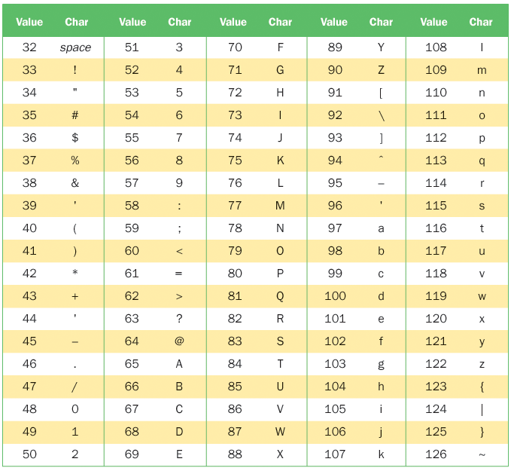
ASCII Characters
Copyright © 2014 Pearson Education, Inc.

Slide 43
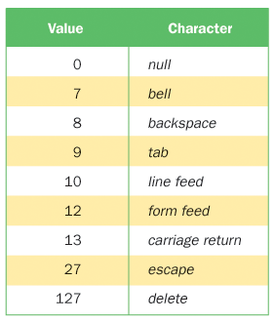
ASCII Characters
Non Visible ASCII characters.
Copyright © 2014 Pearson Education, Inc.

Slide 44
Boolean
A boolean value represents a true or false condition
The reserved words true and false are the only valid values for a boolean type
boolean done = false;
A boolean variable can also be used to represent any two states, such as a light bulb being on or off
Copyright © 2014 Pearson Education, Inc.

Slide 45
Literal Values in Java
A literal is direct representation of specific data.
String literals are represented with double quotes.
Char literals are represented with single quotes.
Integer literals are whole numbers.
int num = 54321;
  Numbers will automatically represent a byte, short, or long if they are in the range of that data and assigned to a variable of that type.
  If the integer literal is too large, the use ‘L’ or ‘l’ to force the int literal to become a long literal is uses 64-bits.
  byte num = 127;
Double literals are numbers with decimal points.
double num = 5.123;
Copyright © 2014 Pearson Education, Inc.

Slide 46
Literal Values in Java
Float literals must have an ‘F’ after the number
float num1 = 5.0F; //5.0F is a float literal
float num2 = 1.2f; //1.2f is a float literal
Float variables can not be assign a double without casting.
float num1 = 7.1; //7.1 is a double literal
Copyright © 2014 Pearson Education, Inc.

Slide 47
Outline
Character Strings
Variables and Assignment
Primitive Data Types
Expressions
Data Conversion
Interactive Programs
Graphics
Applets
Drawing Shapes
Copyright © 2014 Pearson Education, Inc.

Slide 48
Expressions
An expression is a combination of one or more operators and operands
Arithmetic expressions compute numeric results and make use of the arithmetic operators:
Addition
Subtraction
Multiplication
Division
Remainder
+
-
*
/
%
If either or both operands are floating point values, then the result is a floating point value
Copyright © 2014 Pearson Education, Inc.

Slide 49
Division and Remainder
If both operands to the division operator (/) are integers, the result is an integer (the fractional part is discarded)
14 / 3 equals 4
8 / 12 equals 0
The remainder operator (%) returns the remainder after dividing the first operand by the second
14 % 3 equals 2
8 % 12 equals 8
Copyright © 2014 Pearson Education, Inc.

Slide 50
Quick Check
What are the results of the following expressions?
12 / 2
12.0 / 2.0
10 / 4
10 / 4.0
4 / 10
4.0 / 10
12 % 3
10 % 3
3 % 10
Copyright © 2014 Pearson Education, Inc.

Slide 51
Quick Check
What are the results of the following expressions?
12 / 2
12.0 / 2.0
10 / 4
10 / 4.0
4 / 10
4.0 / 10
12 % 3
10 % 3
3 % 10
= 6
= 6.0
= 2
= 2.5
= 0
= 0.4
= 0
= 1
= 3
Copyright © 2014 Pearson Education, Inc.

Slide 52
Operator Precedence
Operators can be combined into larger expressions
result = total + count / max - offset;
Operators have a well-defined precedence which determines the order in which they are evaluated
Multiplication, division, and remainder are evaluated before addition, subtraction, and string concatenation
Arithmetic operators with the same precedence are evaluated from left to right, but parentheses can be used to force the evaluation order
Copyright © 2014 Pearson Education, Inc.

Slide 53
Quick Check
In what order are the operators evaluated in the following expressions?
a + b + c + d + e
a + b * c - d / e
a / (b + c) - d % e
a / (b * (c + (d - e)))
Copyright © 2014 Pearson Education, Inc.

Slide 54
Quick Check
In what order are the operators evaluated in the following expressions?
a + b + c + d + e
a + b * c - d / e
1
2
3
4
3
1
4
2
a / (b + c) - d % e
2
1
4
3
a / (b * (c + (d - e)))
4
3
2
1
Copyright © 2014 Pearson Education, Inc.

Slide 55
Expression Trees
The evaluation of a particular expression can be shown using an expression tree
The operators lower in the tree have higher precedence for that expression
+
a + (b – c) / d
a
/
-
d
b
c
Copyright © 2014 Pearson Education, Inc.

Slide 56
Assignment Revisited
The assignment operator has a lower precedence than the arithmetic operators
First the expression on the right hand
side of the = operator is evaluated
answer = sum / 4 + MAX * lowest;
4
1
3
2
Then the result is stored in the
variable on the left hand side
Copyright © 2014 Pearson Education, Inc.

Slide 57
Assignment Revisited
The right and left hand sides of an assignment statement can contain the same variable
First, one is added to the
original value of count
count = count + 1;
Then the result is stored back into count
(overwriting the original value)
Copyright © 2014 Pearson Education, Inc.

Slide 58
Increment and Decrement
The increment (++) and decrement (--) operators use only one operand
The statement
count++;
is functionally equivalent to
count = count + 1;
Copyright © 2014 Pearson Education, Inc.

Slide 59
Increment and Decrement
The increment and decrement operators can be applied in postfix form:
count++
or prefix form:
++count
When used as part of a larger expression, the two forms can have different effects
Because of their subtleties, the increment and decrement operators should be used with care
Copyright © 2014 Pearson Education, Inc.

Slide 60
Assignment Operators
Often we perform an operation on a variable, and then store the result back into that variable
Java provides assignment operators to simplify that process
For example, the statement
num += count;
is equivalent to
num = num + count;
Copyright © 2014 Pearson Education, Inc.

Slide 61
Assignment Operators
There are many assignment operators in Java, including the following:
Operator
+=
-=
*=
/=
%=
Example
x += y
x -= y
x *= y
x /= y
x %= y
Equivalent To
x = x + (y)
x = x – (y)
x = x * (y)
x = x / (y)
x = x % (y)
Copyright © 2014 Pearson Education, Inc.

Slide 62
Assignment Operators
The right hand side of an assignment operator can be a complex expression
The entire right-hand expression is evaluated first, then the result is combined with the original variable
Therefore
result /= (total-MIN) % num;
is equivalent to
result = result / ((total-MIN) % num);
Copyright © 2014 Pearson Education, Inc.

Slide 63
Assignment Operators
The behavior of some assignment operators depends on the types of the operands
If the operands to the += operator are strings, the assignment operator performs string concatenation
The behavior of an assignment operator (+=) is always consistent with the behavior of the corresponding operator (+)
Copyright © 2014 Pearson Education, Inc.

Slide 64
Outline
Character Strings
Variables and Assignment
Primitive Data Types
Expressions
Data Conversion
Interactive Programs
Graphics
Applets
Drawing Shapes
Copyright © 2014 Pearson Education, Inc.

Slide 65
Data Conversion
Sometimes it is convenient to convert data from one type to another
For example, in a particular situation we may want to treat an integer as a floating point value
These conversions do not change the type of a variable or the value that's stored in it – they only convert a value as part of a computation
Copyright © 2014 Pearson Education, Inc.

Slide 66
Data Conversion
Widening conversions are safest because they tend to go from a small data type to a larger one (such as a short to an int)
Narrowing conversions can lose information because they tend to go from a large data type to a smaller one (such as an int to a short)
In Java, data conversions can occur in three ways:
  assignment conversion
  promotion
  casting
Copyright © 2014 Pearson Education, Inc.

Slide 67
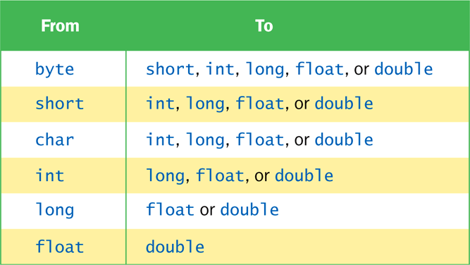
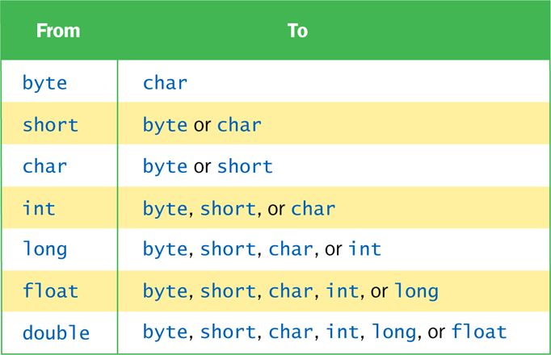
Data Conversion
Widening Conversions
Narrowing Conversions
Copyright © 2014 Pearson Education, Inc.

Slide 68
Assignment Conversion
Assignment conversion occurs when a value of one type is assigned to a variable of another
Example:
    int dollars = 20;
    double money = dollars;
Only widening conversions can happen via assignment
Note that the value or type of dollars did not change
Copyright © 2014 Pearson Education, Inc.

Slide 69
Promotion
Promotion happens automatically when operators in expressions convert their operands
Example:
int count = 12;
double sum = 490.27;
result = sum / count;
The value of count is converted to a floating point value to perform the division calculation
Copyright © 2014 Pearson Education, Inc.

Slide 70
Casting
Casting is the most powerful, and dangerous, technique for conversion
Both widening and narrowing conversions can be accomplished by explicitly casting a value
To cast, the type is put in parentheses in front of the value being converted
int total = 50;
float result = (float) total / 6;
Without the cast, the fractional part of the answer would be lost
Copyright © 2014 Pearson Education, Inc.

Slide 71
Outline
Character Strings
Variables and Assignment
Primitive Data Types
Expressions
Data Conversion
Interactive Programs
Graphics
Applets
Drawing Shapes
Copyright © 2014 Pearson Education, Inc.

Slide 72
Interactive Programs
Programs generally need input on which to operate
The Scanner class provides convenient methods for reading input values of various types
A Scanner object can be set up to read input from various sources, including the user typing values on the keyboard
Keyboard input is represented by the System.in object
Copyright © 2014 Pearson Education, Inc.

Slide 73
Reading Input
The following line creates a Scanner object that reads from the keyboard:
Scanner scan = new Scanner(System.in);
The new operator creates the Scanner object
Once created, the Scanner object can be used to invoke various input methods, such as:
answer = scan.nextLine();
Copyright © 2014 Pearson Education, Inc.

Slide 74
Reading Input
The Scanner class is part of the java.util class library, and must be imported into a program to be used
The nextLine method reads all of the input until the end of the line is found
See Echo.java
The details of object creation and class libraries are discussed further in Chapter 3
Copyright © 2014 Pearson Education, Inc.

Slide 75
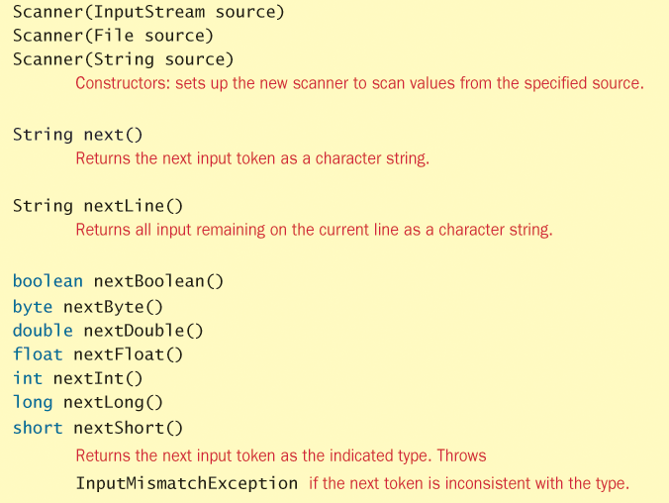
Scanner Class
Copyright © 2014 Pearson Education, Inc.

Slide 76
//********************************************************************
// Echo.java Author: Lewis/Loftus
//
// Demonstrates the use of the nextLine method of the Scanner class
// to read a string from the user.
//********************************************************************
import java.util.Scanner;
public class Echo
{
//-----------------------------------------------------------------
// Reads a character string from the user and prints it.
//-----------------------------------------------------------------
public static void main(String[] args)
{
String message;
Scanner scan = new Scanner(System.in);
System.out.println("Enter a line of text:");
message = scan.nextLine();
System.out.println("You entered: \"" + message + "\"");
}
}
Copyright © 2014 Pearson Education, Inc.

Slide 77
Sample Run
Enter a line of text:
You want fries with that?
You entered: "You want fries with that?"
//********************************************************************
// Echo.java Author: Lewis/Loftus
//
// Demonstrates the use of the nextLine method of the Scanner class
// to read a string from the user.
//********************************************************************
import java.util.Scanner;
public class Echo
{
//-----------------------------------------------------------------
// Reads a character string from the user and prints it.
//-----------------------------------------------------------------
public static void main(String[] args)
{
String message;
Scanner scan = new Scanner(System.in);
System.out.println("Enter a line of text:");
message = scan.nextLine();
System.out.println("You entered: \"" + message + "\"");
}
}
Copyright © 2014 Pearson Education, Inc.

Slide 78
Input Tokens
Unless specified otherwise, white space is used to separate the elements (called tokens) of the input
White space includes space characters, tabs, new line characters
The next method of the Scanner class reads the next input token and returns it as a string
Methods such as nextInt and nextDouble read data of particular types
See GasMileage.java
Copyright © 2014 Pearson Education, Inc.

Slide 79
//********************************************************************
// GasMileage.java Author: Lewis/Loftus
//
// Demonstrates the use of the Scanner class to read numeric data.
//********************************************************************
import java.util.Scanner;
public class GasMileage
{
//-----------------------------------------------------------------
// Calculates fuel efficiency based on values entered by the
// user.
//-----------------------------------------------------------------
public static void main(String[] args)
{
int miles;
double gallons, mpg;
Scanner scan = new Scanner(System.in);
continue
Copyright © 2014 Pearson Education, Inc.

Slide 80
continue
System.out.print("Enter the number of miles: ");
miles = scan.nextInt();
System.out.print("Enter the gallons of fuel used: ");
gallons = scan.nextDouble();
mpg = miles / gallons;
System.out.println("Miles Per Gallon: " + mpg);
}
}
Copyright © 2014 Pearson Education, Inc.

Slide 81
Sample Run
Enter the number of miles: 328
Enter the gallons of fuel used: 11.2
Miles Per Gallon: 29.28571428571429
continue
System.out.print ("Enter the number of miles: ");
miles = scan.nextInt();
System.out.print ("Enter the gallons of fuel used: ");
gallons = scan.nextDouble();
mpg = miles / gallons;
System.out.println("Miles Per Gallon: " + mpg);
}
}
Copyright © 2014 Pearson Education, Inc.

Slide 82
Strange Scanner behavior
The Scanner object behaves strangely when scanning for a token before using the nextLine() method.
The nextLine() method will actually take in the remaining line (which is just the EOL char) left over for the previous token scan.
You should clear the EOL char by invoking nextLine() without capturing its result. See ScannerBehaviorDemo.java on Dropbox.
Copyright © 2014 Pearson Education, Inc.

Slide 83
Outline
Character Strings
Variables and Assignment
Primitive Data Types
Expressions
Data Conversion
Interactive Programs
Graphics
Applets
Drawing Shapes
Copyright © 2014 Pearson Education, Inc.

Slide 84
Introduction to Graphics
The last few sections of each chapter of the textbook focus on graphics and graphical user interfaces
A picture or drawing must be digitized for storage on a computer
A picture is made up of pixels (picture elements), and each pixel is stored separately
The number of pixels used to represent a picture is called the picture resolution
The number of pixels that can be displayed by a monitor is called the monitor resolution
Copyright © 2014 Pearson Education, Inc.

Slide 85
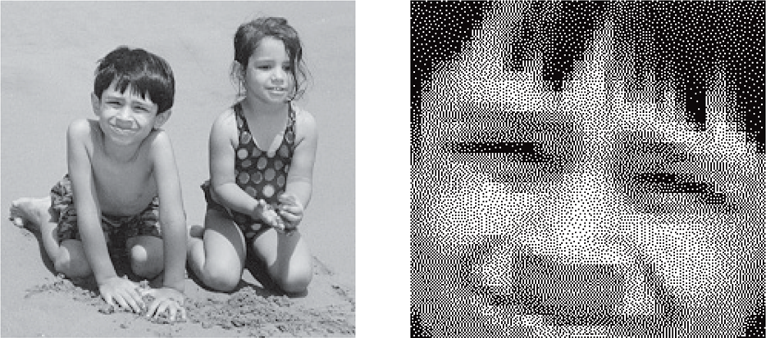
Representing Images
A digitized picture with a small portion magnified:
Copyright © 2014 Pearson Education, Inc.

Slide 86
Coordinate Systems
Each pixel can be identified using a two-dimensional coordinate system
When referring to a pixel in a Java program, we use a coordinate system with the origin in the top-left corner
(0, 0)
112
X
40
(112, 40)
Y
Copyright © 2014 Pearson Education, Inc.

Slide 87
Representing Color
A black and white picture could be stored using one bit per pixel (0 = white and 1 = black)
A colored picture requires more information; there are several techniques for representing colors
Every color can be represented as a mixture of the three additive primary colors Red, Green, and Blue
Each color is represented by three numbers between 0 and 255 that collectively are called an RGB value
Copyright © 2014 Pearson Education, Inc.

Slide 88
The Color Class
A color in a Java program is represented as an object created from the Color class
The Color class also contains several predefined colors, including the following:
Object
Color.black
Color.blue
Color.cyan
Color.orange
Color.white
Color.yellow
RGB Value
0, 0, 0
0, 0, 255
0, 255, 255
255, 200, 0
255, 255, 255
255, 255, 0
Copyright © 2014 Pearson Education, Inc.

Slide 89
Outline
Character Strings
Variables and Assignment
Primitive Data Types
Expressions
Data Conversion
Interactive Programs
Graphics
Applets
Drawing Shapes
Copyright © 2014 Pearson Education, Inc.

Slide 90
Applets
A Java application is a stand-alone program with a main method (like the ones we've seen so far)
A Java applet is a program that is intended to be transported over the Web and executed using a web browser
An applet also can be executed using the appletviewer tool of the Java SDK
An applet doesn't have a main method
Instead, there are several special methods that serve specific purposes
Copyright © 2014 Pearson Education, Inc.

Slide 91
Applets
The paint method is executed automatically whenever the applet’s contents are drawn
The paint method accepts a parameter that is an object of the Graphics class
A Graphics object defines a graphics context on which we can draw shapes and text
The Graphics class has several methods for drawing shapes
Copyright © 2014 Pearson Education, Inc.

Slide 92
Applets
We create an applet by extending the JApplet class
The JApplet class is part of the javax.swing package
This makes use of inheritance, which is explored in more detail in Chapter 8
See Einstein.java
Copyright © 2014 Pearson Education, Inc.

Slide 93
//********************************************************************
// Einstein.java Author: Lewis/Loftus
//
// Demonstrates a basic applet.
//********************************************************************
import javax.swing.JApplet;
import java.awt.*;
public class Einstein extends JApplet
{
//-----------------------------------------------------------------
// Draws a quotation by Albert Einstein among some shapes.
//-----------------------------------------------------------------
public void paint(Graphics page)
{
page.drawRect(50, 50, 40, 40); // square
page.drawRect(60, 80, 225, 30); // rectangle
page.drawOval(75, 65, 20, 20); // circle
page.drawLine(35, 60, 100, 120); // line
page.drawString("Out of clutter, find simplicity.", 110, 70);
page.drawString("-- Albert Einstein", 130, 100);
}
}
Copyright © 2014 Pearson Education, Inc.

Slide 94
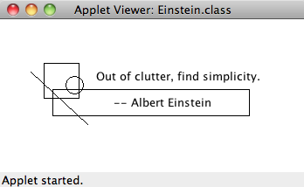
//********************************************************************
// Einstein.java Author: Lewis/Loftus
//
// Demonstrates a basic applet.
//********************************************************************
import javax.swing.JApplet;
import java.awt.*;
public class Einstein extends JApplet
{
//-----------------------------------------------------------------
// Draws a quotation by Albert Einstein among some shapes.
//-----------------------------------------------------------------
public void paint (Graphics page)
{
page.drawRect(50, 50, 40, 40); // square
page.drawRect(60, 80, 225, 30); // rectangle
page.drawOval(75, 65, 20, 20); // circle
page.drawLine(35, 60, 100, 120); // line
page.drawString("Out of clutter, find simplicity.", 110, 70);
page.drawString("-- Albert Einstein", 130, 100);
}
}
Copyright © 2014 Pearson Education, Inc.

Slide 95
The HTML applet Tag
An applet is embedded into an HTML file using a tag that references the bytecode file of the applet
The bytecode version of the program is transported across the web and executed by a Java interpreter that is part of the browser
<html>
<head>
<title>The Einstein Applet</title>
</head>
<body>
<applet code="Einstein.class" width=350 height=175>
</applet>
</body>
</html>
Copyright © 2014 Pearson Education, Inc.

Slide 96
Outline
Character Strings
Variables and Assignment
Primitive Data Types
Expressions
Data Conversion
Interactive Programs
Graphics
Applets
Drawing Shapes
Copyright © 2014 Pearson Education, Inc.

Slide 97
Drawing Shapes
Let's explore some of the methods of the Graphics class that draw shapes in more detail
A shape can be filled or unfilled, depending on which method is invoked
The method parameters specify coordinates and sizes
Shapes with curves, like an oval, are usually drawn by specifying the shape’s bounding rectangle
An arc can be thought of as a section of an oval
Copyright © 2014 Pearson Education, Inc.

Slide 98
Drawing a Line
10
150
X
20
45
Y
page.drawLine (10, 20, 150, 45);
or
page.drawLine (150, 45, 10, 20);
Copyright © 2014 Pearson Education, Inc.

Slide 99
Drawing a Rectangle
50
X
20
40
100
Y
page.drawRect (50, 20, 100, 40);
Copyright © 2014 Pearson Education, Inc.

Slide 100
Drawing an Oval
175
X
20
80
bounding
rectangle
Y
50
page.drawOval (175, 20, 50, 80);
Copyright © 2014 Pearson Education, Inc.

Slide 101
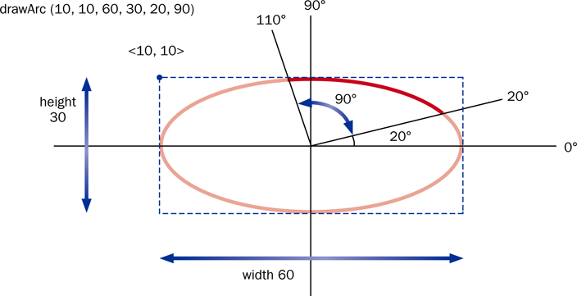
Drawing an Arc
An arc is defined by an oval, a start angle, and an arc angle:
Copyright © 2014 Pearson Education, Inc.

Slide 102
Drawing Shapes
Every drawing surface has a background color
Every graphics context has a current foreground color
Both can be set explicitly
See Snowman.java
Copyright © 2014 Pearson Education, Inc.

Slide 103
//********************************************************************
// Snowman.java Author: Lewis/Loftus
//
// Demonstrates basic drawing methods and the use of color.
//********************************************************************
import javax.swing.JApplet;
import java.awt.*;
public class Snowman extends JApplet
{
//-----------------------------------------------------------------
// Draws a snowman.
//-----------------------------------------------------------------
public void paint(Graphics page)
{
final int MID = 150;
final int TOP = 50;
setBackground(Color.cyan);
page.setColor(Color.blue);
page.fillRect(0, 175, 300, 50); // ground
page.setColor(Color.yellow);
page.fillOval(-40, -40, 80, 80); // sun
continued
Copyright © 2014 Pearson Education, Inc.

Slide 104
continued
page.setColor(Color.white);
page.fillOval(MID-20, TOP, 40, 40); // head
page.fillOval(MID-35, TOP+35, 70, 50); // upper torso
page.fillOval(MID-50, TOP+80, 100, 60); // lower torso
page.setColor(Color.black);
page.fillOval(MID-10, TOP+10, 5, 5); // left eye
page.fillOval(MID+5, TOP+10, 5, 5); // right eye
page.drawArc(MID-10, TOP+20, 20, 10, 190, 160); // smile
page.drawLine(MID-25, TOP+60, MID-50, TOP+40); // left arm
page.drawLine(MID+25, TOP+60, MID+55, TOP+60); // right arm
page.drawLine(MID-20, TOP+5, MID+20, TOP+5); // brim of hat
page.fillRect(MID-15, TOP-20, 30, 25); // top of hat
}
}
Copyright © 2014 Pearson Education, Inc.

Slide 105
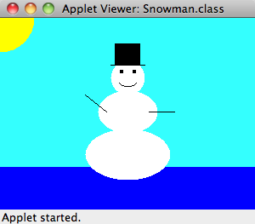
continued
page.setColor (Color.white);
page.fillOval (MID-20, TOP, 40, 40); // head
page.fillOval (MID-35, TOP+35, 70, 50); // upper torso
page.fillOval (MID-50, TOP+80, 100, 60); // lower torso
page.setColor (Color.black);
page.fillOval (MID-10, TOP+10, 5, 5); // left eye
page.fillOval (MID+5, TOP+10, 5, 5); // right eye
page.drawArc (MID-10, TOP+20, 20, 10, 190, 160); // smile
page.drawLine (MID-25, TOP+60, MID-50, TOP+40); // left arm
page.drawLine (MID+25, TOP+60, MID+55, TOP+60); // right arm
page.drawLine (MID-20, TOP+5, MID+20, TOP+5); // brim of hat
page.fillRect(MID-15, TOP-20, 30, 25); // top of hat
}
}
Copyright © 2014 Pearson Education, Inc.

Slide 106
Summary
Chapter 2 focused on:
  character strings
  primitive data
  the declaration and use of variables
  expressions and operator precedence
  data conversions
  accepting input from the user
  Java applets
  introduction to graphics
Copyright © 2014 Pearson Education, Inc.

