Slide 1
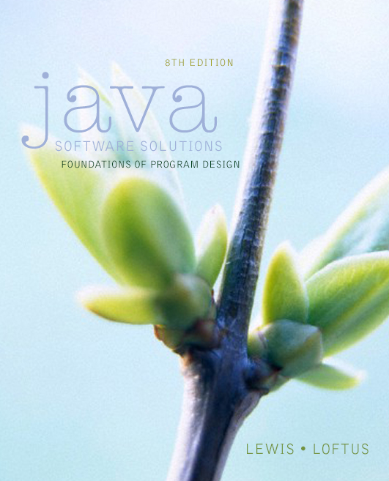

Chapter 3
Using Classes and Objects
Java Software Solutions
Foundations of Program Design
8th Edition
John Lewis
William Loftus
Copyright © 2014 Pearson Education, Inc.

Slide 2
Using Classes and Objects
We can create more interesting programs using predefined classes and related objects
Chapter 3 focuses on:
  object creation and object references
  the String class and its methods
  the Java API class library
  the Random and Math classes
  formatting output
  enumerated types
  wrapper classes
  graphical components and containers
  labels and images
Copyright © 2014 Pearson Education, Inc.

Slide 3
Outline
Creating Objects
The String Class
The Random and Math Classes
Formatting Output
Enumerated Types
Wrapper Classes
Components and Containers
Images
Copyright © 2014 Pearson Education, Inc.

Slide 4
Creating Objects
A variable holds either a primitive value or a reference to an object
A class name can be used as a type to declare an object reference variable
String title;
No object is created with this declaration
An object reference variable holds the address of an object
The object itself must be created separately
Copyright © 2014 Pearson Education, Inc.

Slide 5
Creating Objects
Generally, we use the new operator to create an object
Creating an object is called instantiation
An object is an instance of a particular class
title = new String("Java Software Solutions");
This calls the String constructor, which is
a special method that sets up the object
Copyright © 2014 Pearson Education, Inc.

Slide 6
Invoking Methods
We've seen that once an object has been instantiated, we can use the dot operator to invoke its methods
numChars = title.length()
A method may return a value, which can be used in an assignment or expression
A method invocation can be thought of as asking an object to perform a service
Copyright © 2014 Pearson Education, Inc.

Slide 7
References
Note that a primitive variable contains the value itself, but an object variable contains the address of the object
An object reference can be thought of as a pointer to the location of the object
Rather than dealing with arbitrary addresses, we often depict a reference graphically
num1
38
name1
"Steve Jobs"
Copyright © 2014 Pearson Education, Inc.

Slide 8
Assignment Revisited
The act of assignment takes a copy of a value and stores it in a variable
For primitive types:
num1
38
Before:
num2
96
num2 = num1;
num1
38
After:
num2
38
Copyright © 2014 Pearson Education, Inc.

Slide 9
Reference Assignment
For object references, assignment copies the address:
name1
"Steve Jobs"
Before:
name2
"Steve Wozniak"
name2 = name1;
name1
"Steve Jobs"
After:
name2
Copyright © 2014 Pearson Education, Inc.

Slide 10
Aliases
Two or more references that refer to the same object are called aliases of each other
That creates an interesting situation: one object can be accessed using multiple reference variables
Aliases can be useful, but should be managed carefully
Changing an object through one reference changes it for all of its aliases, because there is really only one object
Copyright © 2014 Pearson Education, Inc.

Slide 11
Garbage Collection
When an object no longer has any valid references to it, it can no longer be accessed by the program
The object is useless, and therefore is called garbage
Java performs automatic garbage collection periodically, returning an object's memory to the system for future use
In other languages, the programmer is responsible for performing garbage collection
Copyright © 2014 Pearson Education, Inc.

Slide 12
Outline
Creating Objects
The String Class
The Random and Math Classes
Formatting Output
Enumerated Types
Wrapper Classes
Components and Containers
Images
Copyright © 2014 Pearson Education, Inc.

Slide 13
The String Class
Because strings are so common, we don't have to use the new operator to create a String object
title = "Java Software Solutions";
This is special syntax that works only for strings
Each string literal (enclosed in double quotes) represents a String object
Copyright © 2014 Pearson Education, Inc.

Slide 14
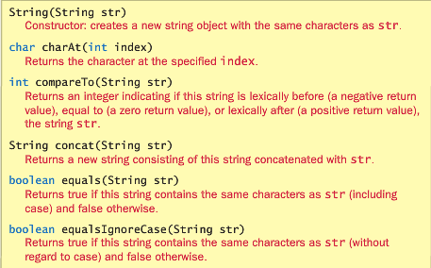
String Class
Copyright © 2014 Pearson Education, Inc.

Slide 15
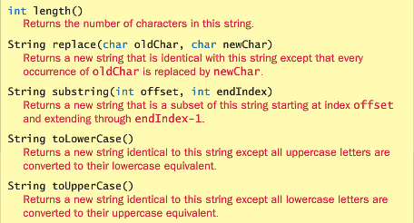
String Class
Copyright © 2014 Pearson Education, Inc.

Slide 16
String Methods
Once a String object has been created, neither its value nor its length can be changed
Therefore we say that an object of the String class is immutable
However, several methods of the String class return new String objects that are modified versions of the original
Copyright © 2014 Pearson Education, Inc.

Slide 17
String Indexes
It is occasionally helpful to refer to a particular character within a string
This can be done by specifying the character's numeric index
The indexes begin at zero in each string
In the string "Hello", the character 'H' is at index 0 and the 'o' is at index 4
See StringMutation.java
Copyright © 2014 Pearson Education, Inc.

Slide 18
//********************************************************************
// StringMutation.java Author: Lewis/Loftus
//
// Demonstrates the use of the String class and its methods.
//********************************************************************
public class StringMutation
{
//-----------------------------------------------------------------
// Prints a string and various mutations of it.
//-----------------------------------------------------------------
public static void main(String[] args)
{
String phrase = "Change is inevitable";
String mutation1, mutation2, mutation3, mutation4;
System.out.println("Original string: \"" + phrase + "\"");
System.out.println("Length of string: " + phrase.length());
mutation1 = phrase.concat(", except from vending machines.");
mutation2 = mutation1.toUpperCase();
mutation3 = mutation2.replace('E', 'X');
mutation4 = mutation3.substring(3, 30);
continued
Copyright © 2014 Pearson Education, Inc.

Slide 19
continued
// Print each mutated string
System.out.println("Mutation #1: " + mutation1);
System.out.println("Mutation #2: " + mutation2);
System.out.println("Mutation #3: " + mutation3);
System.out.println("Mutation #4: " + mutation4);
System.out.println("Mutated length: " + mutation4.length());
}
}
Copyright © 2014 Pearson Education, Inc.

Slide 20
Output
Original string: "Change is inevitable"
Length of string: 20
Mutation #1: Change is inevitable, except from vending machines.
Mutation #2: CHANGE IS INEVITABLE, EXCEPT FROM VENDING MACHINES.
Mutation #3: CHANGX IS INXVITABLX, XXCXPT FROM VXNDING MACHINXS.
Mutation #4: NGX IS INXVITABLX, XXCXPT F
Mutated length: 27
continued
// Print each mutated string
System.out.println ("Mutation #1: " + mutation1);
System.out.println ("Mutation #2: " + mutation2);
System.out.println ("Mutation #3: " + mutation3);
System.out.println ("Mutation #4: " + mutation4);
System.out.println("Mutated length: " + mutation4.length());
}
}
Copyright © 2014 Pearson Education, Inc.

Slide 21
Quick Check
What output is produced by the following?
String str = "Space, the final frontier.";
System.out.println(str.length());
System.out.println(str.substring(7));
System.out.println(str.toUpperCase());
System.out.println(str.length());
Copyright © 2014 Pearson Education, Inc.

Slide 22
Quick Check
What output is produced by the following?
String str = "Space, the final frontier.";
System.out.println(str.length());
System.out.println(str.substring(7));
System.out.println(str.toUpperCase());
System.out.println(str.length());
26
the final frontier.
SPACE, THE FINAL FRONTIER.
26
Copyright © 2014 Pearson Education, Inc.

Slide 23
Outline
Creating Objects
The String Class
The Random and Math Classes
Formatting Output
Enumerated Types
Wrapper Classes
Components and Containers
Images
Copyright © 2014 Pearson Education, Inc.

Slide 24
Class Libraries
A class library is a collection of classes that we can use when developing programs
The Java standard class library is part of any Java development environment
Its classes are not part of the Java language per se, but we rely on them heavily
Various classes we've already used (System , Scanner, String) are part of the Java standard class library
Copyright © 2014 Pearson Education, Inc.

Slide 25
The Java API
The Java class library is sometimes referred to as the Java API
API stands for Application Programming Interface
Clusters of related classes are sometimes referred to as specific APIs:
  The Swing API
  The Database API
Copyright © 2014 Pearson Education, Inc.

Slide 26
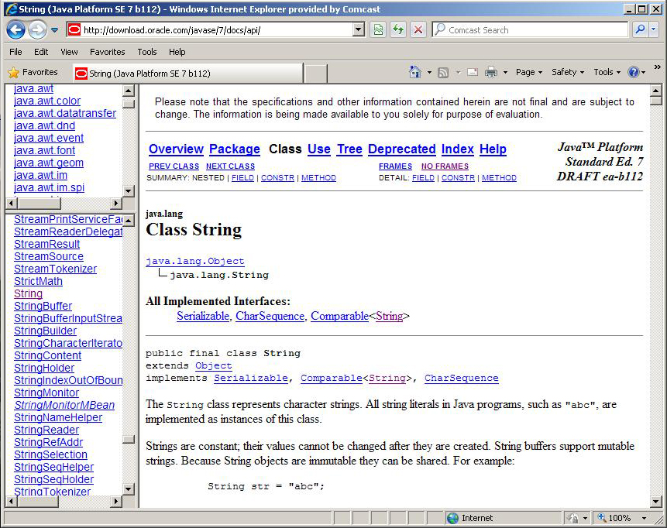
The Java API
Get comfortable navigating the online Java API documentation
Copyright © 2014 Pearson Education, Inc.

Slide 27
Packages
For purposes of accessing them, classes in the Java API are organized into packages
These often overlap with specific APIs
Examples:
Package
java.lang
java.applet
java.awt
javax.swing
java.net
java.util
javax.xml.parsers
java.text
Purpose
General support
Creating applets for the web
Graphics and graphical user interfaces
Additional graphics capabilities
Network communication
Utilities
XML document processing
Text formatting Classes
Classes
System, String, Math
-
-
-
-
Scanner, Random, Calendar, Date
-
NuberFormat, DecimalFormat
SimpleDateFormat
Copyright © 2014 Pearson Education, Inc.

Slide 28
The import Declaration
When you want to use a class from a package, you could use its fully qualified name
java.util.Scanner
Or you can import the class, and then use just the class name
import java.util.Scanner;
To import all classes in a particular package, you can use the * wildcard character
import java.util.*;
Copyright © 2014 Pearson Education, Inc.

Slide 29
The import Declaration
All classes of the java.lang package are imported automatically into all programs
It's as if all programs contain the following line:
import java.lang.*;
That's why we didn't have to import the System or String classes explicitly in earlier programs
The Scanner class, on the other hand, is part of the java.util package, and therefore must be imported
Copyright © 2014 Pearson Education, Inc.

Slide 30
The Random Class
The Random class is part of the java.util package
It provides methods that generate pseudorandom numbers
A Random object performs complicated calculations based on a seed value to produce a stream of seemingly random values
See RandomNumbers.java
Copyright © 2014 Pearson Education, Inc.

Slide 31
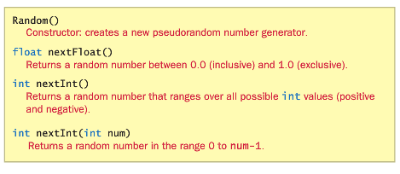
Random Class
Copyright © 2014 Pearson Education, Inc.

Slide 32
//********************************************************************
// RandomNumbers.java Author: Lewis/Loftus
//
// Demonstrates the creation of pseudo-random numbers using the
// Random class.
//********************************************************************
import java.util.Random;
public class RandomNumbers
{
//-----------------------------------------------------------------
// Generates random numbers in various ranges.
//-----------------------------------------------------------------
public static void main(String[] args)
{
Random generator = new Random();
int num1;
float num2;
num1 = generator.nextInt();
System.out.println("A random integer: " + num1);
num1 = generator.nextInt(10);
System.out.println("From 0 to 9: " + num1);
continued
Copyright © 2014 Pearson Education, Inc.

Slide 33
continued
num1 = generator.nextInt(10) + 1;
System.out.println("From 1 to 10: " + num1);
num1 = generator.nextInt(15) + 20;
System.out.println("From 20 to 34: " + num1);
num1 = generator.nextInt(20) - 10;
System.out.println("From -10 to 9: " + num1);
num2 = generator.nextFloat();
System.out.println("A random float (between 0-1): " + num2);
num2 = generator.nextFloat() * 6; // 0.0 to 5.999999
num1 = (int)num2 + 1;
System.out.println("From 1 to 6: " + num1);
}
}
Copyright © 2014 Pearson Education, Inc.

Slide 34
Sample Run
A random integer: 672981683
From 0 to 9: 0
From 1 to 10: 3
From 20 to 34: 30
From -10 to 9: -4
A random float (between 0-1): 0.18538326
From 1 to 6: 3
continued
num1 = generator.nextInt(10) + 1;
System.out.println ("From 1 to 10: " + num1);
num1 = generator.nextInt(15) + 20;
System.out.println ("From 20 to 34: " + num1);
num1 = generator.nextInt(20) - 10;
System.out.println ("From -10 to 9: " + num1);
num2 = generator.nextFloat();
System.out.println("A random float (between 0-1): " + num2);
num2 = generator.nextFloat() * 6; // 0.0 to 5.999999
num1 = (int)num2 + 1;
System.out.println("From 1 to 6: " + num1);
}
}
Copyright © 2014 Pearson Education, Inc.

Slide 35
Quick Check
Given a Random object named gen, what range of values are produced by the following expressions?
gen.nextInt(25)
gen.nextInt(6) + 1
gen.nextInt(100) + 10
gen.nextInt(50) + 100
gen.nextInt(10) – 5
gen.nextInt(22) + 12
Copyright © 2014 Pearson Education, Inc.

Slide 36
Quick Check
Given a Random object named gen, what range of values are produced by the following expressions?
Range
0 to 24
1 to 6
10 to 109
100 to 149
-5 to 4
12 to 33
gen.nextInt(25)
gen.nextInt(6) + 1
gen.nextInt(100) + 10
gen.nextInt(50) + 100
gen.nextInt(10) – 5
gen.nextInt(22) + 12
Copyright © 2014 Pearson Education, Inc.

Slide 37
Quick Check
Write an expression that produces a random integer in the following ranges:
Range
0 to 12
1 to 20
15 to 20
-10 to 0
Copyright © 2014 Pearson Education, Inc.

Slide 38
Quick Check
Write an expression that produces a random integer in the following ranges:
Range
0 to 12
1 to 20
15 to 20
-10 to 0
gen.nextInt(13)
gen.nextInt(20) + 1
gen.nextInt(6) + 15
gen.nextInt(11) – 10
Copyright © 2014 Pearson Education, Inc.

Slide 39
The Math Class
The Math class is part of the java.lang package
The Math class contains methods that perform various mathematical functions
These include:
  absolute value
  square root
  exponentiation
  trigonometric functions
Copyright © 2014 Pearson Education, Inc.

Slide 40
The Math Class
The methods of the Math class are static methods (also called class methods)
Static methods are invoked through the class name – no object of the Math class is needed
value = Math.cos(90) + Math.sqrt(delta);
We discuss static methods further in Chapter 7
See Quadratic.java
For PI use Math.PI
Copyright © 2014 Pearson Education, Inc.

Slide 41
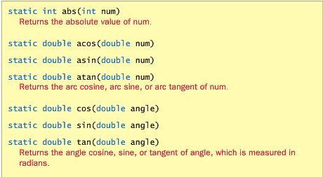
Math Class
Copyright © 2014 Pearson Education, Inc.

Slide 42
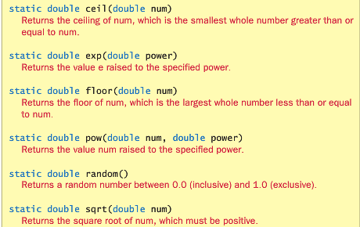
Math Class
Copyright © 2014 Pearson Education, Inc.

Slide 43
//********************************************************************
// Quadratic.java Author: Lewis/Loftus
//
// Demonstrates the use of the Math class to perform a calculation
// based on user input.
//********************************************************************
import java.util.Scanner;
public class Quadratic
{
//-----------------------------------------------------------------
// Determines the roots of a quadratic equation.
//-----------------------------------------------------------------
public static void main(String[] args)
{
int a, b, c; // ax^2 + bx + c
double discriminant, root1, root2;
Scanner scan = new Scanner(System.in);
System.out.print("Enter the coefficient of x squared: ");
a = scan.nextInt();
continued
Copyright © 2014 Pearson Education, Inc.

Slide 44
continued
System.out.print("Enter the coefficient of x: ");
b = scan.nextInt();
System.out.print("Enter the constant: ");
c = scan.nextInt();
// Use the quadratic formula to compute the roots.
// Assumes a positive discriminant.
discriminant = Math.pow(b, 2) - (4 * a * c);
root1 = ((-1 * b) + Math.sqrt(discriminant)) / (2 * a);
root2 = ((-1 * b) - Math.sqrt(discriminant)) / (2 * a);
System.out.println("Root #1: " + root1);
System.out.println("Root #2: " + root2);
}
}
Copyright © 2014 Pearson Education, Inc.

Slide 45
Sample Run
Enter the coefficient of x squared: 3
Enter the coefficient of x: 8
Enter the constant: 4
Root #1: -0.6666666666666666
Root #2: -2.0
continued
System.out.print ("Enter the coefficient of x: ");
b = scan.nextInt();
System.out.print ("Enter the constant: ");
c = scan.nextInt();
// Use the quadratic formula to compute the roots.
// Assumes a positive discriminant.
discriminant = Math.pow(b, 2) - (4 * a * c);
root1 = ((-1 * b) + Math.sqrt(discriminant)) / (2 * a);
root2 = ((-1 * b) - Math.sqrt(discriminant)) / (2 * a);
System.out.println("Root #1: " + root1);
System.out.println("Root #2: " + root2);
}
}
Copyright © 2014 Pearson Education, Inc.

Slide 46
Outline
Creating Objects
The String Class
The Random and Math Classes
Formatting Output
Enumerated Types
Wrapper Classes
Components and Containers
Images
Copyright © 2014 Pearson Education, Inc.

Slide 47
Formatting Output
It is often necessary to format output values in certain ways so that they can be presented properly
The Java standard class library contains classes that provide formatting capabilities
The NumberFormat class allows you to format values as currency or percentages
The DecimalFormat class allows you to format values based on a pattern
Both are part of the java.text package
Copyright © 2014 Pearson Education, Inc.

Slide 48
Formatting Output
The NumberFormat class has static methods that return a formatter object
getCurrencyInstance()
getPercentInstance()
Each formatter object has a method called format that returns a string with the specified information in the appropriate format
See Purchase.java
Copyright © 2014 Pearson Education, Inc.

Slide 49
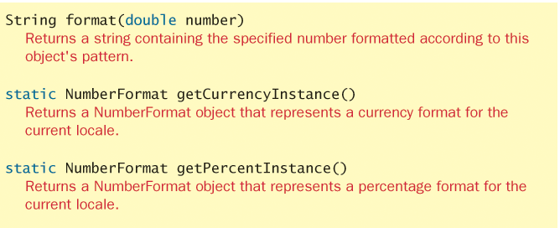
NumberFormat
Copyright © 2014 Pearson Education, Inc.

Slide 50
//********************************************************************
// Purchase.java Author: Lewis/Loftus
//
// Demonstrates the use of the NumberFormat class to format output.
//********************************************************************
import java.util.Scanner;
import java.text.NumberFormat;
public class Purchase
{
//-----------------------------------------------------------------
// Calculates the final price of a purchased item using values
// entered by the user.
//-----------------------------------------------------------------
public static void main(String[] args)
{
final double TAX_RATE = 0.06; // 6% sales tax
int quantity;
double subtotal, tax, totalCost, unitPrice;
Scanner scan = new Scanner(System.in);
continued
Copyright © 2014 Pearson Education, Inc.

Slide 51
continued
NumberFormat fmt1 = NumberFormat.getCurrencyInstance();
NumberFormat fmt2 = NumberFormat.getPercentInstance();
System.out.print("Enter the quantity: ");
quantity = scan.nextInt();
System.out.print("Enter the unit price: ");
unitPrice = scan.nextDouble();
subtotal = quantity * unitPrice;
tax = subtotal * TAX_RATE;
totalCost = subtotal + tax;
// Print output with appropriate formatting
System.out.println("Subtotal: " + fmt1.format(subtotal));
System.out.println("Tax: " + fmt1.format(tax) + " at "
+ fmt2.format(TAX_RATE));
System.out.println("Total: " + fmt1.format(totalCost));
}
}
Copyright © 2014 Pearson Education, Inc.

Slide 52
Sample Run
Enter the quantity: 5
Enter the unit price: 3.87
Subtotal: $19.35
Tax: $1.16 at 6%
Total: $20.51
continued
NumberFormat fmt1 = NumberFormat.getCurrencyInstance();
NumberFormat fmt2 = NumberFormat.getPercentInstance();
System.out.print ("Enter the quantity: ");
quantity = scan.nextInt();
System.out.print("Enter the unit price: ");
unitPrice = scan.nextDouble();
subtotal = quantity * unitPrice;
tax = subtotal * TAX_RATE;
totalCost = subtotal + tax;
// Print output with appropriate formatting
System.out.println("Subtotal: " + fmt1.format(subtotal));
System.out.println("Tax: " + fmt1.format(tax) + " at "
+ fmt2.format(TAX_RATE));
System.out.println("Total: " + fmt1.format(totalCost));
}
}
Copyright © 2014 Pearson Education, Inc.

Slide 53
Formatting Output
The DecimalFormat class can be used to format a floating point value in various ways
For example, you can specify that the number should be truncated to three decimal places
The constructor of the DecimalFormat class takes a string that represents a pattern for the formatted number
See CircleStats.java
Copyright © 2014 Pearson Education, Inc.

Slide 54
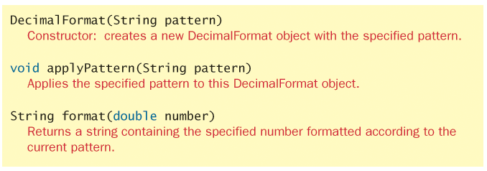
DecimalFormat
Copyright © 2014 Pearson Education, Inc.

Slide 55
//********************************************************************
// CircleStats.java Author: Lewis/Loftus
//
// Demonstrates the formatting of decimal values using the
// DecimalFormat class.
//********************************************************************
import java.util.Scanner;
import java.text.DecimalFormat;
public class CircleStats
{
//-----------------------------------------------------------------
// Calculates the area and circumference of a circle given its
// radius.
//-----------------------------------------------------------------
public static void main(String[] args)
{
int radius;
double area, circumference;
Scanner scan = new Scanner(System.in);
continued
Copyright © 2014 Pearson Education, Inc.

Slide 56
continued
System.out.print ("Enter the circle's radius: ");
radius = scan.nextInt();
area = Math.PI * Math.pow(radius, 2);
circumference = 2 * Math.PI * radius;
// Round the output to three decimal places
DecimalFormat fmt = new DecimalFormat ("0.###");
System.out.println ("The circle's area: " + fmt.format(area));
System.out.println ("The circle's circumference: "
+ fmt.format(circumference));
}
}
Copyright © 2014 Pearson Education, Inc.

Slide 57
Sample Run
Enter the circle's radius: 5
The circle's area: 78.54
The circle's circumference: 31.416
continued
System.out.print ("Enter the circle's radius: ");
radius = scan.nextInt();
area = Math.PI * Math.pow(radius, 2);
circumference = 2 * Math.PI * radius;
// Round the output to three decimal places
DecimalFormat fmt = new DecimalFormat("0.###");
System.out.println("The circle's area: " + fmt.format(area));
System.out.println("The circle's circumference: "
+ fmt.format(circumference));
}
}
Copyright © 2014 Pearson Education, Inc.

Slide 58
Outline
Creating Objects
The String Class
The Random and Math Classes
Formatting Output
Enumerated Types
Wrapper Classes
Components and Containers
Images
Copyright © 2014 Pearson Education, Inc.

Slide 59
Enumerated Types
Java allows you to define an enumerated type, which can then be used to declare variables
An enumerated type declaration lists all possible values for a variable of that type
The values are identifiers of your own choosing
The following declaration creates an enumerated type called Season
enum Season {winter, spring, summer, fall};
Any number of values can be listed
Copyright © 2014 Pearson Education, Inc.

Slide 60
Enumerated Types
Once a type is defined, a variable of that type can be declared:
Season time;
And it can be assigned a value:
time = Season.fall;
The values are referenced through the name of the type
Enumerated types are type-safe – you cannot assign any value other than those listed
Copyright © 2014 Pearson Education, Inc.

Slide 61
Ordinal Values
Internally, each value of an enumerated type is stored as an integer, called its ordinal value
The first value in an enumerated type has an ordinal value of zero, the second one, and so on
However, you cannot assign a numeric value to an enumerated type, even if it corresponds to a valid ordinal value
Copyright © 2014 Pearson Education, Inc.

Slide 62
Enumerated Types
The declaration of an enumerated type is a special type of class, and each variable of that type is an object
The ordinal method returns the ordinal value of the object
The name method returns the name of the identifier corresponding to the object's value
See IceCream.java
Copyright © 2014 Pearson Education, Inc.

Slide 63
//********************************************************************
// IceCream.java Author: Lewis/Loftus
//
// Demonstrates the use of enumerated types.
//********************************************************************
public class IceCream
{
enum Flavor {vanilla, chocolate, strawberry, fudgeRipple, coffee,
rockyRoad, mintChocolateChip, cookieDough}
//-----------------------------------------------------------------
// Creates and uses variables of the Flavor type.
//-----------------------------------------------------------------
public static void main (String[] args)
{
Flavor cone1, cone2, cone3;
cone1 = Flavor.rockyRoad;
cone2 = Flavor.chocolate;
System.out.println("cone1 value: " + cone1);
System.out.println("cone1 ordinal: " + cone1.ordinal());
System.out.println("cone1 name: " + cone1.name());
continued
Copyright © 2014 Pearson Education, Inc.

Slide 64
continued
System.out.println();
System.out.println("cone2 value: " + cone2);
System.out.println("cone2 ordinal: " + cone2.ordinal());
System.out.println("cone2 name: " + cone2.name());
cone3 = cone1;
System.out.println();
System.out.println("cone3 value: " + cone3);
System.out.println("cone3 ordinal: " + cone3.ordinal());
System.out.println("cone3 name: " + cone3.name());
}
}
Copyright © 2014 Pearson Education, Inc.

Slide 65
Output
cone1 value: rockyRoad
cone1 ordinal: 5
cone1 name: rockyRoad
cone2 value: chocolate
cone2 ordinal: 1
cone2 name: chocolate
cone3 value: rockyRoad
cone3 ordinal: 5
cone3 name: rockyRoad
continued
System.out.println ();
System.out.println ("cone2 value: " + cone2);
System.out.println ("cone2 ordinal: " + cone2.ordinal());
System.out.println ("cone2 name: " + cone2.name());
cone3 = cone1;
System.out.println ();
System.out.println ("cone3 value: " + cone3);
System.out.println ("cone3 ordinal: " + cone3.ordinal());
System.out.println("cone3 name: " + cone3.name());
}
}
Copyright © 2014 Pearson Education, Inc.

Slide 66
Outline
Creating Objects
The String Class
The Random and Math Classes
Formatting Output
Enumerated Types
Wrapper Classes
Components and Containers
Images
Copyright © 2014 Pearson Education, Inc.

Slide 67
Wrapper Classes
The java.lang package contains wrapper classes that correspond to each primitive type:
Primitive Type | Wrapper Class
byte | Byte
short | Short
int | Integer
long | Long
float | Float
double | Double
char | Character
boolean | Boolean

Slide 68
Wrapper Classes
The following declaration creates an Integer object which represents the integer 40 as an object
Integer age = new Integer(40);
An object of a wrapper class can be used in any situation where a primitive value will not suffice
For example, some objects serve as containers of other objects
Primitive values could not be stored in such containers, but wrapper objects could be
Copyright © 2014 Pearson Education, Inc.

Slide 69
Wrapper Classes
Wrapper classes also contain static methods that help manage the associated type
For example, the Integer class contains a method to convert an integer stored in a String to an int value:
num = Integer.parseInt(str);
They often contain useful constants as well
For example, the Integer class contains MIN_VALUE and MAX_VALUE which hold the smallest and largest int values
Copyright © 2014 Pearson Education, Inc.

Slide 70
Autoboxing
Autoboxing is the automatic conversion of a primitive value to a corresponding wrapper object:
Integer obj;
int num = 42;
obj = num;
The assignment creates the appropriate Integer object
The reverse conversion (called unboxing) also occurs automatically as needed
Copyright © 2014 Pearson Education, Inc.

Slide 71
Quick Check
Are the following assignments valid? Explain.
Double value = 15.75;
Character ch = new Character('T');
char myChar = ch;
Copyright © 2014 Pearson Education, Inc.

Slide 72
Outline
Creating Objects
The String Class
The Random and Math Classes
Formatting Output
Enumerated Types
Wrapper Classes
Components and Containers
Images
Copyright © 2014 Pearson Education, Inc.

Slide 73
Graphical Applications
Except for the applets seen in Chapter 2, the example programs we've explored thus far have been text-based
They are called command-line applications, which interact with the user using simple text prompts
Let's examine some Java applications that have graphical components
These components will serve as a foundation to programs that have true graphical user interfaces (GUIs)
Copyright © 2014 Pearson Education, Inc.

Slide 74
GUI Components
A GUI component is an object that represents a screen element such as a button or a text field
GUI-related classes are defined primarily in the java.awt and the javax.swing packages
The Abstract Windowing Toolkit (AWT) was the original Java GUI package
The Swing package provides additional and more versatile components
Both packages are needed to create a Java GUI-based program
Copyright © 2014 Pearson Education, Inc.

Slide 75
GUI Containers
A GUI container is a component that is used to hold and organize other components
A frame is a container displayed as a separate window with a title bar
It can be repositioned and resized on the screen as needed
A panel is a container that cannot be displayed on its own but is used to organize other components
A panel must be added to another container (like a frame or another panel) to be displayed
Copyright © 2014 Pearson Education, Inc.

Slide 76
GUI Containers
A GUI container can be classified as either heavyweight or lightweight
A heavyweight container is one that is managed by the underlying operating system
A lightweight container is managed by the Java program itself
Occasionally this distinction is important
A frame is a heavyweight container and a panel is a lightweight container
Copyright © 2014 Pearson Education, Inc.

Slide 77
Labels
A label is a GUI component that displays a line of text and/or an image
Labels are usually used to display information or identify other components in the interface
Let's look at a program that organizes two labels in a panel and displays that panel in a frame
This program is not interactive, but the frame can be repositioned and resized
See Authority.java
Copyright © 2014 Pearson Education, Inc.

Slide 78
//********************************************************************
// Authority.java Author: Lewis/Loftus
//
// Demonstrates the use of frames, panels, and labels.
//********************************************************************
import java.awt.*;
import javax.swing.*;
public class Authority
{
//-----------------------------------------------------------------
// Displays some words of wisdom.
//-----------------------------------------------------------------
public static void main(String[] args)
{
JFrame frame = new JFrame("Authority");
frame.setDefaultCloseOperation(JFrame.EXIT_ON_CLOSE);
JPanel primary = new JPanel();
primary.setBackground(Color.yellow);
primary.setPreferredSize(new Dimension(250, 75));
continued
Copyright © 2014 Pearson Education, Inc.

Slide 79
continued
JLabel label1 = new JLabel("Question authority,");
JLabel label2 = new JLabel("but raise your hand first.");
primary.add(label1);
primary.add(label2);
frame.getContentPane().add(primary);
frame.pack();
frame.setVisible(true);
}
}
Copyright © 2014 Pearson Education, Inc.

Slide 80


continued
JLabel label1 = new JLabel ("Question authority,");
JLabel label2 = new JLabel ("but raise your hand first.");
primary.add (label1);
primary.add(label2);
frame.getContentPane().add(primary);
frame.pack();
frame.setVisible(true);
}
}
Copyright © 2014 Pearson Education, Inc.

Slide 81
Nested Panels
Containers that contain other components make up the containment hierarchy of an interface
This hierarchy can be as intricate as needed to create the visual effect desired
The following example nests two panels inside a third panel – note the effect this has as the frame is resized
See NestedPanels.java
Copyright © 2014 Pearson Education, Inc.

Slide 82
//********************************************************************
// NestedPanels.java Author: Lewis/Loftus
//
// Demonstrates a basic componenet hierarchy.
//********************************************************************
import java.awt.*;
import javax.swing.*;
public class NestedPanels
{
//-----------------------------------------------------------------
// Presents two colored panels nested within a third.
//-----------------------------------------------------------------
public static void main(String[] args)
{
JFrame frame = new JFrame("Nested Panels");
frame.setDefaultCloseOperation(JFrame.EXIT_ON_CLOSE);
// Set up first subpanel
JPanel subPanel1 = new JPanel();
subPanel1.setPreferredSize(new Dimension(150, 100));
subPanel1.setBackground(Color.green);
JLabel label1 = new JLabel("One");
subPanel1.add(label1);
continued
Copyright © 2014 Pearson Education, Inc.

Slide 83
continued
// Set up second subpanel
JPanel subPanel2 = new JPanel();
subPanel2.setPreferredSize(new Dimension(150, 100));
subPanel2.setBackground(Color.red);
JLabel label2 = new JLabel("Two");
subPanel2.add(label2);
// Set up primary panel
JPanel primary = new JPanel();
primary.setBackground(Color.blue);
primary.add(subPanel1);
primary.add(subPanel2);
frame.getContentPane().add(primary);
frame.pack();
frame.setVisible(true);
}
}
Copyright © 2014 Pearson Education, Inc.

Slide 84
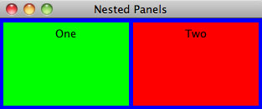
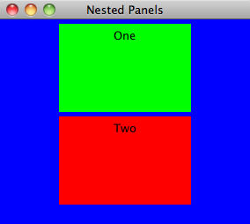
continued
// Set up second subpanel
JPanel subPanel2 = new JPanel();
subPanel2.setPreferredSize (new Dimension(150, 100));
subPanel2.setBackground (Color.red);
JLabel label2 = new JLabel("Two");
subPanel2.add(label2);
// Set up primary panel
JPanel primary = new JPanel();
primary.setBackground (Color.blue);
primary.add (subPanel1);
primary.add (subPanel2);
frame.getContentPane().add(primary);
frame.pack();
frame.setVisible(true);
}
}
Copyright © 2014 Pearson Education, Inc.

Slide 85
Outline
Creating Objects
The String Class
The Random and Math Classes
Formatting Output
Enumerated Types
Wrapper Classes
Components and Containers
Images
Copyright © 2014 Pearson Education, Inc.

Slide 86
Images
Images can be displayed in a Java program in various ways
As we've seen, a JLabel object can be used to display a line of text
It can also be used to display an image
That is, a label can be composed of text, an image, or both at the same time
Copyright © 2014 Pearson Education, Inc.

Slide 87
Images
The ImageIcon class is used to represent the image that is stored in a label
If text is also included, the position of the text relative to the image can be set explicitly
The alignment of the text and image within the label can be set as well
See LabelDemo.java
Copyright © 2014 Pearson Education, Inc.

Slide 88
//********************************************************************
// LabelDemo.java Author: Lewis/Loftus
//
// Demonstrates the use of image icons in labels.
//********************************************************************
import java.awt.*;
import javax.swing.*;
public class LabelDemo
{
//-----------------------------------------------------------------
// Creates and displays the primary application frame.
//-----------------------------------------------------------------
public static void main(String[] args)
{
JFrame frame = new JFrame("Label Demo");
frame.setDefaultCloseOperation(JFrame.EXIT_ON_CLOSE);
ImageIcon icon = new ImageIcon("devil.gif");
JLabel label1, label2, label3;
label1 = new JLabel("Devil Left", icon, SwingConstants.CENTER);
continued
Copyright © 2014 Pearson Education, Inc.

Slide 89
continued
label2 = new JLabel("Devil Right", icon, SwingConstants.CENTER);
label2.setHorizontalTextPosition(SwingConstants.LEFT);
label2.setVerticalTextPosition(SwingConstants.BOTTOM);
label3 = new JLabel("Devil Above", icon, SwingConstants.CENTER);
label3.setHorizontalTextPosition(SwingConstants.CENTER);
label3.setVerticalTextPosition(SwingConstants.BOTTOM);
JPanel panel = new JPanel();
panel.setBackground(Color.cyan);
panel.setPreferredSize(new Dimension(200, 250));
panel.add(label1);
panel.add(label2);
panel.add(label3);
frame.getContentPane().add(panel);
frame.pack();
frame.setVisible(true);
}
}
Copyright © 2014 Pearson Education, Inc.

Slide 90
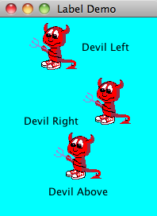
continued
label2 = new JLabel ("Devil Right", icon, SwingConstants.CENTER);
label2.setHorizontalTextPosition (SwingConstants.LEFT);
label2.setVerticalTextPosition (SwingConstants.BOTTOM);
label3 = new JLabel ("Devil Above", icon, SwingConstants.CENTER);
label3.setHorizontalTextPosition (SwingConstants.CENTER);
label3.setVerticalTextPosition (SwingConstants.BOTTOM);
JPanel panel = new JPanel();
panel.setBackground (Color.cyan);
panel.setPreferredSize (new Dimension (200, 250));
panel.add(label1);
panel.add(label2);
panel.add(label3);
frame.getContentPane().add(panel);
frame.pack();
frame.setVisible(true);
}
}
Copyright © 2014 Pearson Education, Inc.

Slide 91
Summary
Chapter 3 focused on:
  object creation and object references
  the String class and its methods
  the Java standard class library
  the Random and Math classes
  formatting output
  enumerated types
  wrapper classes
  graphical components and containers
  labels and images
Copyright © 2014 Pearson Education, Inc.

