Slide 1


Chapter 10
Polymorphism
Java Software Solutions
Foundations of Program Design
8th Edition
John Lewis
William Loftus
Copyright © 2014 Pearson Education, Inc.

Slide 2
Polymorphism
Polymorphism is an object-oriented concept that allows us to create versatile software designs
Chapter 10 focuses on:
  defining polymorphism and its benefits
  using inheritance to create polymorphic references
  using interfaces to create polymorphic references
  using polymorphism to implement sorting and searching algorithms
  additional GUI components
Copyright © 2014 Pearson Education, Inc.

Slide 3
Outline
Late Binding
Polymorphism via Inheritance
Polymorphism via Interfaces
Sorting
Searching
Event Processing Revisited
File Choosers and Color Choosers
Sliders
Copyright © 2014 Pearson Education, Inc.

Slide 4
Binding
Consider the following method invocation:
obj.doIt();
At some point, this invocation is bound to the definition of the method that it invokes
If this binding occurred at compile time, then that line of code would call the same method every time
However, Java defers method binding until run time -- this is called dynamic binding or late binding
Copyright © 2014 Pearson Education, Inc.

Slide 5
Polymorphism
The term polymorphism literally means "having many forms"
A polymorphic reference is a variable that can refer to different types of objects at different points in time
The method called through a polymorphic reference can change from one invocation to the next
All object references in Java are potentially polymorphic
Copyright © 2014 Pearson Education, Inc.

Slide 6
Polymorphism
Suppose we create the following reference variable:
Occupation job;
This reference can point to an Occupation object, or to any object of any compatible type
This compatibility can be established using inheritance or using interfaces
Careful use of polymorphic references can lead to elegant, robust software designs
Copyright © 2014 Pearson Education, Inc.

Slide 7
Outline
Late Binding
Polymorphism via Inheritance
Polymorphism via Interfaces
Sorting
Searching
Event Processing Revisited
File Choosers and Color Choosers
Sliders
Copyright © 2014 Pearson Education, Inc.

Slide 8
References and Inheritance
An object reference can refer to an object of any class related to it by inheritance
For example, if Holiday is the superclass of Christmas, then a Holiday reference could be used to refer to a Christmas object
Holiday
Holiday day;
day = new Christmas();
Christmas
Copyright © 2014 Pearson Education, Inc.

Slide 9
References and Inheritance
These type compatibility rules are just an extension of the is-a relationship established by inheritance
Assigning a Christmas object to a Holiday reference is fine because Christmas is-a holiday
Assigning a child object to a parent reference can be performed by simple assignment
Assigning an parent object to a child reference can be done also, but must be done with a cast
After all, Christmas is a holiday but not all holidays are Christmas
Copyright © 2014 Pearson Education, Inc.

Slide 10
Polymorphism via Inheritance
Now suppose the Holiday class has a method called celebrate, and Christmas overrides it
What method is invoked by the following?
day.celebrate();
The type of the object being referenced, not the reference type, determines which method is invoked
If day refers to a Holiday object, it invokes the Holiday version of celebrate; if it refers to a Christmas object, it invokes that version
Copyright © 2014 Pearson Education, Inc.

Slide 11
Polymorphism via Inheritance
Note that the compiler restricts invocations based on the type of the reference
So if Christmas had a method called getTree that Holiday didn't have, the following would cause a compiler error:
day.getTree(); // compiler error
Remember, the compiler doesn't "know" which type of holiday is being referenced
A cast can be used to allow the call:
((Christmas)day).getTree();
Copyright © 2014 Pearson Education, Inc.

Slide 12
Quick Check
If MusicPlayer is the parent of CDPlayer, are the following assignments valid?
MusicPlayer mplayer = new CDPlayer();
CDPlayer cdplayer = new MusicPlayer();
Copyright © 2014 Pearson Education, Inc.

Slide 13
Quick Check
If MusicPlayer is the parent of CDPlayer, are the following assignments valid?
MusicPlayer mplayer = new CDPlayer();
CDPlayer cdplayer = new MusicPlayer();
Yes, because a CDPlayer is-a MusicPlayer
No, you'd have to use a cast (and you shouldn't
knowingly assign a super class object to a
subclass reference)
Copyright © 2014 Pearson Education, Inc.

Slide 14
Polymorphism via Inheritance
Consider the following class hierarchy:
StaffMember
Volunteer
Employee
Executive
Hourly
Copyright © 2014 Pearson Education, Inc.

Slide 15
Polymorphism via Inheritance
Let's look at an example that pays a set of diverse employees using a polymorphic method
See Firm.java
See Staff.java
See StaffMember.java
See Volunteer.java
See Employee.java
See Executive.java
See Hourly.java
Copyright © 2014 Pearson Education, Inc.

Slide 16
//********************************************************************
// Firm.java Author: Lewis/Loftus
//
// Demonstrates polymorphism via inheritance.
//********************************************************************
public class Firm
{
//-----------------------------------------------------------------
// Creates a staff of employees for a firm and pays them.
//-----------------------------------------------------------------
public static void main(String[] args)
{
Staff personnel = new Staff();
personnel.payday();
}
}
Copyright © 2014 Pearson Education, Inc.

Slide 17
Output
Name: Sam
Address: 123 Main Line
Phone: 555-0469
Social Security Number: 123-45-6789
Paid: 2923.07
-----------------------------------
Name: Carla
Address: 456 Off Line
Phone: 555-0101
Social Security Number: 987-65-4321
Paid: 1246.15
-----------------------------------
Name: Woody
Address: 789 Off Rocker
Phone: 555-0000
Social Security Number: 010-20-3040
Paid: 1169.23
-----------------------------------
Output (continued)
Name: Diane
Address: 678 Fifth Ave.
Phone: 555-0690
Social Security Number: 958-47-3625
Current hours: 40
Paid: 422.0
-----------------------------------
Name: Norm
Address: 987 Suds Blvd.
Phone: 555-8374
Thanks!
-----------------------------------
Name: Cliff
Address: 321 Duds Lane
Phone: 555-7282
Thanks!
-----------------------------------
//********************************************************************
// Firm.java Author: Lewis/Loftus
//
// Demonstrates polymorphism via inheritance.
//********************************************************************
public class Firm
{
//-----------------------------------------------------------------
// Creates a staff of employees for a firm and pays them.
//-----------------------------------------------------------------
public static void main (String[] args)
{
Staff personnel = new Staff();
personnel.payday();
}
}
Copyright © 2014 Pearson Education, Inc.

Slide 18
//********************************************************************
// Staff.java Author: Lewis/Loftus
//
// Represents the personnel staff of a particular business.
//********************************************************************
public class Staff
{
private StaffMember[] staffList;
//-----------------------------------------------------------------
// Constructor: Sets up the list of staff members.
//-----------------------------------------------------------------
public Staff()
{
staffList = new StaffMember[6];
continue
Copyright © 2014 Pearson Education, Inc.

Slide 19
continue
staffList[0] = new Executive("Sam", "123 Main Line",
"555-0469", "123-45-6789", 2423.07);
staffList[1] = new Employee("Carla", "456 Off Line",
"555-0101", "987-65-4321", 1246.15);
staffList[2] = new Employee("Woody", "789 Off Rocker",
"555-0000", "010-20-3040", 1169.23);
staffList[3] = new Hourly("Diane", "678 Fifth Ave.",
"555-0690", "958-47-3625", 10.55);
staffList[4] = new Volunteer("Norm", "987 Suds Blvd.",
"555-8374");
staffList[5] = new Volunteer("Cliff", "321 Duds Lane",
"555-7282");
((Executive)staffList[0]).awardBonus(500.00);
((Hourly)staffList[3]).addHours(40);
}
continue
Copyright © 2014 Pearson Education, Inc.

Slide 20
continue
//-----------------------------------------------------------------
// Pays all staff members.
//-----------------------------------------------------------------
public void payday()
{
double amount;
for (int count=0; count < staffList.length; count++)
{
System.out.println(staffList[count]);
amount = staffList[count].pay(); // polymorphic
if (amount == 0.0)
System.out.println("Thanks!");
else
System.out.println("Paid: " + amount);
System.out.println("-----------------------------------");
}
}
}
Copyright © 2014 Pearson Education, Inc.

Slide 21
//********************************************************************
// StaffMember.java Author: Lewis/Loftus
//
// Represents a generic staff member.
//********************************************************************
abstract public class StaffMember
{
protected String name;
protected String address;
protected String phone;
//-----------------------------------------------------------------
// Constructor: Sets up this staff member using the specified
// information.
//-----------------------------------------------------------------
public StaffMember(String eName, String eAddress, String ePhone)
{
name = eName;
address = eAddress;
phone = ePhone;
}
continue
Copyright © 2014 Pearson Education, Inc.

Slide 22
continue
//-----------------------------------------------------------------
// Returns a string including the basic employee information.
//-----------------------------------------------------------------
public String toString()
{
String result = "Name: " + name + "\n";
result += "Address: " + address + "\n";
result += "Phone: " + phone;
return result;
}
//-----------------------------------------------------------------
// Derived classes must define the pay method for each type of
// employee.
//-----------------------------------------------------------------
public abstract double pay();
}
Copyright © 2014 Pearson Education, Inc.

Slide 23
//********************************************************************
// Volunteer.java Author: Lewis/Loftus
//
// Represents a staff member that works as a volunteer.
//********************************************************************
public class Volunteer extends StaffMember
{
//-----------------------------------------------------------------
// Constructor: Sets up this volunteer using the specified
// information.
//-----------------------------------------------------------------
public Volunteer(String eName, String eAddress, String ePhone)
{
super(eName, eAddress, ePhone);
}
//-----------------------------------------------------------------
// Returns a zero pay value for this volunteer.
//-----------------------------------------------------------------
public double pay()
{
return 0.0;
}
}
Copyright © 2014 Pearson Education, Inc.

Slide 24
//********************************************************************
// Employee.java Author: Lewis/Loftus
//
// Represents a general paid employee.
//********************************************************************
public class Employee extends StaffMember
{
protected String socialSecurityNumber;
protected double payRate;
//-----------------------------------------------------------------
// Constructor: Sets up this employee with the specified
// information.
//-----------------------------------------------------------------
public Employee(String eName, String eAddress, String ePhone,
String socSecNumber, double rate)
{
super(eName, eAddress, ePhone);
socialSecurityNumber = socSecNumber;
payRate = rate;
}
continue
Copyright © 2014 Pearson Education, Inc.

Slide 25
continue
//-----------------------------------------------------------------
// Returns information about an employee as a string.
//-----------------------------------------------------------------
public String toString()
{
String result = super.toString();
result += "\nSocial Security Number: " + socialSecurityNumber;
return result;
}
//-----------------------------------------------------------------
// Returns the pay rate for this employee.
//-----------------------------------------------------------------
public double pay()
{
return payRate;
}
}
Copyright © 2014 Pearson Education, Inc.

Slide 26
//********************************************************************
// Executive.java Author: Lewis/Loftus
//
// Represents an executive staff member, who can earn a bonus.
//********************************************************************
public class Executive extends Employee
{
private double bonus;
//-----------------------------------------------------------------
// Constructor: Sets up this executive with the specified
// information.
//-----------------------------------------------------------------
public Executive(String eName, String eAddress, String ePhone,
String socSecNumber, double rate)
{
super(eName, eAddress, ePhone, socSecNumber, rate);
bonus = 0; // bonus has yet to be awarded
}
continue
Copyright © 2014 Pearson Education, Inc.

Slide 27
continue
//-----------------------------------------------------------------
// Awards the specified bonus to this executive.
//-----------------------------------------------------------------
public void awardBonus(double execBonus)
{
bonus = execBonus;
}
//-----------------------------------------------------------------
// Computes and returns the pay for an executive, which is the
// regular employee payment plus a one-time bonus.
//-----------------------------------------------------------------
public double pay()
{
double payment = super.pay() + bonus;
bonus = 0;
return payment;
}
}
Copyright © 2014 Pearson Education, Inc.

Slide 28
//********************************************************************
// Hourly.java Author: Lewis/Loftus
//
// Represents an employee that gets paid by the hour.
//********************************************************************
public class Hourly extends Employee
{
private int hoursWorked;
//-----------------------------------------------------------------
// Constructor: Sets up this hourly employee using the specified
// information.
//-----------------------------------------------------------------
public Hourly(String eName, String eAddress, String ePhone,
String socSecNumber, double rate)
{
super(eName, eAddress, ePhone, socSecNumber, rate);
hoursWorked = 0;
}
continue
Copyright © 2014 Pearson Education, Inc.

Slide 29
continue
//-----------------------------------------------------------------
// Adds the specified number of hours to this employee's
// accumulated hours.
//-----------------------------------------------------------------
public void addHours(int moreHours)
{
hoursWorked += moreHours;
}
//-----------------------------------------------------------------
// Computes and returns the pay for this hourly employee.
//-----------------------------------------------------------------
public double pay()
{
double payment = payRate * hoursWorked;
hoursWorked = 0;
return payment;
}
continue
Copyright © 2014 Pearson Education, Inc.

Slide 30
continue
//-----------------------------------------------------------------
// Returns information about this hourly employee as a string.
//-----------------------------------------------------------------
public String toString()
{
String result = super.toString();
result += "\nCurrent hours: " + hoursWorked;
return result;
}
}
Copyright © 2014 Pearson Education, Inc.

Slide 31
Outline
Late Binding
Polymorphism via Inheritance
Polymorphism via Interfaces
Sorting
Searching
Event Processing Revisited
File Choosers and Color Choosers
Sliders
Copyright © 2014 Pearson Education, Inc.

Slide 32
Polymorphism via Interfaces
Interfaces can be used to set up polymorphic references as well
Suppose we declare an interface called Speaker as follows:
public interface Speaker
{
public void speak();
public void announce(String str);
}
Copyright © 2014 Pearson Education, Inc.

Slide 33
Polymorphism via Interfaces
An interface name can be used as the type of an object reference variable:
Speaker current;
The current reference can be used to point to any object of any class that implements the Speaker interface
The version of speak invoked by the following line depends on the type of object that current is referencing:
current.speak();
Copyright © 2014 Pearson Education, Inc.

Slide 34
Polymorphism via Interfaces
Now suppose two classes, Philosopher and Dog, both implement the Speaker interface, providing distinct versions of the speak method
In the following code, the first call to speak invokes one version and the second invokes another:
Speaker guest = new Philospher();
guest.speak();
guest = new Dog();
guest.speak();
Copyright © 2014 Pearson Education, Inc.

Slide 35
Polymorphism via Interfaces
As with class reference types, the compiler will restrict invocations to methods in the interface
For example, even if Philosopher also had a method called pontificate, the following would still cause a compiler error:
Speaker special = new Philospher();
special.pontificate(); // compiler error
Remember, the compiler bases its rulings on the type of the reference
Copyright © 2014 Pearson Education, Inc.

Slide 36
Quick Check
Would the following statements be valid?
Speaker first = new Dog();
Philosopher second = new Philosopher();
second.pontificate();
first = second;
Copyright © 2014 Pearson Education, Inc.

Slide 37
Quick Check
Would the following statements be valid?
Speaker first = new Dog();
Philosopher second = new Philosopher();
second.pontificate();
first = second;
Yes, all assignments and method calls are
valid as written
Copyright © 2014 Pearson Education, Inc.

Slide 38
Outline
Late Binding
Polymorphism via Inheritance
Polymorphism via Interfaces
Sorting
Searching
Event Processing Revisited
File Choosers and Color Choosers
Sliders
Copyright © 2014 Pearson Education, Inc.

Slide 39
Sorting
Sorting is the process of arranging a list of items in a particular order
The sorting process is based on specific criteria:
  sort test scores in ascending numeric order
  sort a list of people alphabetically by last name
There are many algorithms, which vary in efficiency, for sorting a list of items
We will examine two specific algorithms:
  Selection Sort
  Insertion Sort
Copyright © 2014 Pearson Education, Inc.

Slide 40
Selection Sort
The strategy of Selection Sort:
  select a value and put it in its final place in the list
  repeat for all other values
In more detail:
  find the smallest value in the list
  switch it with the value in the first position
  find the next smallest value in the list
  switch it with the value in the second position
  repeat until all values are in their proper places
Copyright © 2014 Pearson Education, Inc.

Slide 41
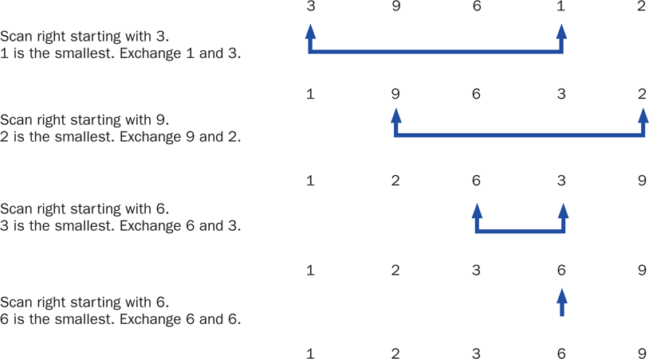
Selection Sort
Copyright © 2014 Pearson Education, Inc.

Slide 42
Swapping
The processing of the selection sort algorithm includes the swapping of two values
Swapping requires three assignment statements and a temporary storage location
To swap the values of first and second:
temp = first;
first = second;
second = temp;
Copyright © 2014 Pearson Education, Inc.

Slide 43
Polymorphism in Sorting
Recall that a class that implements the Comparable interface defines a compareTo method to determine the relative order of its objects
We can use polymorphism to develop a generic sort for any set of Comparable objects
The sorting method accepts as a parameter an array of Comparable objects
That way, one method can be used to sort an array of People, or Books, or whatever
Copyright © 2014 Pearson Education, Inc.

Slide 44
Selection Sort
This technique allows each class to decide for itself what it means for one object to be less than another
Let's look at an example that sorts an array of Contact objects
The selectionSort method is a static method in the Sorting class
See PhoneList.java
See Sorting.java
See Contact.java
Copyright © 2014 Pearson Education, Inc.

Slide 45
//********************************************************************
// PhoneList.java Author: Lewis/Loftus
//
// Driver for testing a sorting algorithm.
//********************************************************************
public class PhoneList
{
//-----------------------------------------------------------------
// Creates an array of Contact objects, sorts them, then prints
// them.
//-----------------------------------------------------------------
public static void main(String[] args)
{
Contact[] friends = new Contact[8];
friends[0] = new Contact("John", "Smith", "610-555-7384");
friends[1] = new Contact("Sarah", "Barnes", "215-555-3827");
friends[2] = new Contact("Mark", "Riley", "733-555-2969");
friends[3] = new Contact("Laura", "Getz", "663-555-3984");
friends[4] = new Contact("Larry", "Smith", "464-555-3489");
friends[5] = new Contact("Frank", "Phelps", "322-555-2284");
friends[6] = new Contact("Mario", "Guzman", "804-555-9066");
friends[7] = new Contact("Marsha", "Grant", "243-555-2837");
continue
Copyright © 2014 Pearson Education, Inc.

Slide 46
continue
Sorting.selectionSort(friends);
for (Contact friend : friends)
System.out.println(friend);
}
}
Copyright © 2014 Pearson Education, Inc.

Slide 47
Output
Barnes, Sarah 215-555-3827
Getz, Laura 663-555-3984
Grant, Marsha 243-555-2837
Guzman, Mario 804-555-9066
Phelps, Frank 322-555-2284
Riley, Mark 733-555-2969
Smith, John 610-555-7384
Smith, Larry 464-555-3489
continue
Sorting.selectionSort(friends);
for (Contact friend : friends)
System.out.println (friend);
}
}
Copyright © 2014 Pearson Education, Inc.

Slide 48
The static selectionSort method in the Sorting class:
//-----------------------------------------------------------------
// Sorts the specified array of objects using the selection
// sort algorithm.
//-----------------------------------------------------------------
public static void selectionSort(Comparable[] list)
{
int min;
Comparable temp;
for (int index = 0; index < list.length-1; index++)
{
min = index;
for (int scan = index+1; scan < list.length; scan++)
if (list[scan].compareTo(list[min]) < 0)
min = scan;
// Swap the values
temp = list[min];
list[min] = list[index];
list[index] = temp;
}
}
Copyright © 2014 Pearson Education, Inc.

Slide 49
//********************************************************************
// Contact.java Author: Lewis/Loftus
//
// Represents a phone contact.
//********************************************************************
public class Contact implements Comparable
{
private String firstName, lastName, phone;
//-----------------------------------------------------------------
// Constructor: Sets up this contact with the specified data.
//-----------------------------------------------------------------
public Contact(String first, String last, String telephone)
{
firstName = first;
lastName = last;
phone = telephone;
}
continue
Copyright © 2014 Pearson Education, Inc.

Slide 50
continue
//-----------------------------------------------------------------
// Returns a description of this contact as a string.
//-----------------------------------------------------------------
public String toString()
{
return lastName + ", " + firstName + "\t" + phone;
}
//-----------------------------------------------------------------
// Returns a description of this contact as a string.
//-----------------------------------------------------------------
public boolean equals(Object other)
{
return (lastName.equals(((Contact)other).getLastName()) &&
firstName.equals(((Contact)other).getFirstName()));
}
continue
Copyright © 2014 Pearson Education, Inc.

Slide 51
continue
//-----------------------------------------------------------------
// Uses both last and first names to determine ordering.
//-----------------------------------------------------------------
public int compareTo(Object other)
{
int result;
String otherFirst = ((Contact)other).getFirstName();
String otherLast = ((Contact)other).getLastName();
if (lastName.equals(otherLast))
result = firstName.compareTo(otherFirst);
else
result = lastName.compareTo(otherLast);
return result;
}
continue
Copyright © 2014 Pearson Education, Inc.

Slide 52
continue
//-----------------------------------------------------------------
// First name accessor.
//-----------------------------------------------------------------
public String getFirstName()
{
return firstName;
}
//-----------------------------------------------------------------
// Last name accessor.
//-----------------------------------------------------------------
public String getLastName()
{
return lastName;
}
}
Copyright © 2014 Pearson Education, Inc.

Slide 53
Insertion Sort
The strategy of Insertion Sort:
  pick any item and insert it into its proper place in a sorted sublist
  repeat until all items have been inserted
In more detail:
  consider the first item to be a sorted sublist (of one item)
  insert the second item into the sorted sublist, shifting the first item as needed to make room to insert the new one
  insert the third item into the sorted sublist (of two items), shifting items as necessary
  repeat until all values are inserted into their proper positions
Copyright © 2014 Pearson Education, Inc.

Slide 54
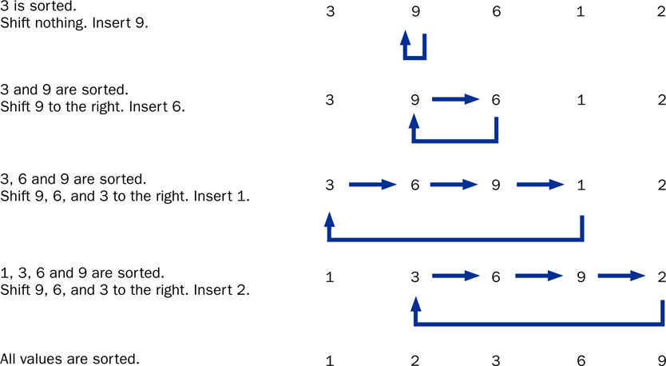
Insertion Sort
Copyright © 2014 Pearson Education, Inc.

Slide 55
The static insertionSort method in the Sorting class:
//-----------------------------------------------------------------
// Sorts the specified array of objects using the insertion
// sort algorithm.
//-----------------------------------------------------------------
public static void insertionSort(Comparable[] list)
{
for (int index = 1; index < list.length; index++)
{
Comparable key = list[index];
int position = index;
// Shift larger values to the right
while (position > 0 && key.compareTo(list[position-1]) < 0)
{
list[position] = list[position-1];
position--;
}
list[position] = key;
}
}
Copyright © 2014 Pearson Education, Inc.

Slide 56
Comparing Sorts
The Selection and Insertion sort algorithms are similar in efficiency
They both have outer loops that scan all elements, and inner loops that compare the value of the outer loop with almost all values in the list
Approximately n² number of comparisons are made to sort a list of size n
We therefore say that these sorts are of order n²
Other sorts are more efficient: order n log₂ n
Copyright © 2014 Pearson Education, Inc.

Slide 57
Outline
Late Binding
Polymorphism via Inheritance
Polymorphism via Interfaces
Sorting
Searching
Event Processing Revisited
File Choosers and Color Choosers
Sliders
Copyright © 2014 Pearson Education, Inc.

Slide 58
Searching
Searching is the process of finding a target element within a group of items called the search pool
The target may or may not be in the search pool
We want to perform the search efficiently, minimizing the number of comparisons
Let's look at two classic searching approaches: linear search and binary search
As we did with sorting, we'll implement the searches with polymorphic Comparable parameters
Copyright © 2014 Pearson Education, Inc.

Slide 59
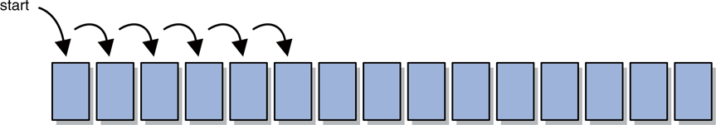
Linear Search
A linear search begins at one end of a list and examines each element in turn
Eventually, either the item is found or the end of the list is encountered
Copyright © 2014 Pearson Education, Inc.

Slide 60
Binary Search
A binary search assumes the list of items in the search pool is sorted
It eliminates a large part of the search pool with a single comparison
A binary search first examines the middle element of the list -- if it matches the target, the search is over
If it doesn't, only one half of the remaining elements need be searched
Since they are sorted, the target can only be in one half of the other
Copyright © 2014 Pearson Education, Inc.

Slide 61
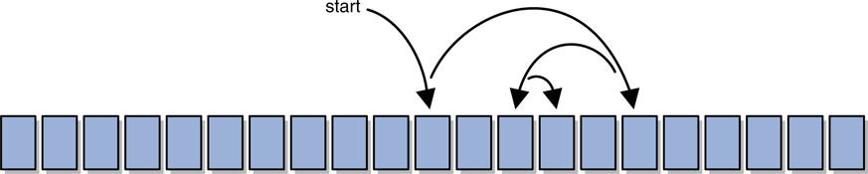
Binary Search
The process continues by comparing the middle element of the remaining viable candidates
Each comparison eliminates approximately half of the remaining data
Eventually, the target is found or the data is exhausted
Copyright © 2014 Pearson Education, Inc.

Slide 62
Searching
The search methods are implemented as static methods in the Searching class
See PhoneList2.java
See Searching.java
Copyright © 2014 Pearson Education, Inc.

Slide 63
//********************************************************************
// PhoneList2.java Author: Lewis/Loftus
//
// Driver for testing searching algorithms.
//********************************************************************
public class PhoneList2
{
//-----------------------------------------------------------------
// Creates an array of Contact objects, sorts them, then prints
// them.
//-----------------------------------------------------------------
public static void main(String[] args)
{
Contact test, found;
Contact[] friends = new Contact[8];
friends[0] = new Contact("John", "Smith", "610-555-7384");
friends[1] = new Contact("Sarah", "Barnes", "215-555-3827");
friends[2] = new Contact("Mark", "Riley", "733-555-2969");
friends[3] = new Contact("Laura", "Getz", "663-555-3984");
friends[4] = new Contact("Larry", "Smith", "464-555-3489");
friends[5] = new Contact("Frank", "Phelps", "322-555-2284");
friends[6] = new Contact("Mario", "Guzman", "804-555-9066");
friends[7] = new Contact("Marsha", "Grant", "243-555-2837");
continue
Copyright © 2014 Pearson Education, Inc.

Slide 64
continue
test = new Contact("Frank", "Phelps", "");
found = (Contact) Searching.linearSearch(friends, test);
if (found != null)
System.out.println("Found: " + found);
else
System.out.println("The contact was not found.");
System.out.println();
Sorting.selectionSort(friends);
test = new Contact("Mario", "Guzman", "");
found = (Contact) Searching.binarySearch(friends, test);
if (found != null)
System.out.println("Found: " + found);
else
System.out.println("The contact was not found.");
}
}
Copyright © 2014 Pearson Education, Inc.

Slide 65
Output
Found: Phelps, Frank 322-555-2284
Found: Guzman, Mario 804-555-9066
continue
test = new Contact ("Frank", "Phelps", "");
found = (Contact) Searching.linearSearch(friends, test);
if (found != null)
System.out.println("Found: " + found);
else
System.out.println("The contact was not found.");
System.out.println();
Sorting.selectionSort(friends);
test = new Contact("Mario", "Guzman", "");
found = (Contact) Searching.binarySearch(friends, test);
if (found != null)
System.out.println("Found: " + found);
else
System.out.println("The contact was not found.");
}
}
Copyright © 2014 Pearson Education, Inc.

Slide 66
The linearSearch method in the Searching class:
//-----------------------------------------------------------------
// Searches the specified array of objects for the target using
// a linear search. Returns a reference to the target object from
// the array if found, and null otherwise.
//-----------------------------------------------------------------
public static Comparable linearSearch(Comparable[] list,
Comparable target)
{
int index = 0;
boolean found = false;
while (!found && index < list.length)
{
if (list[index].equals(target))
found = true;
else
index++;
}
if (found)
return list[index];
else
return null;
}
Copyright © 2014 Pearson Education, Inc.

Slide 67
The binarySearch method in the Searching class:
//-----------------------------------------------------------------
// Searches the specified array of objects for the target using
// a binary search. Assumes the array is already sorted in
// ascending order when it is passed in. Returns a reference to
// the target object from the array if found, and null otherwise.
//-----------------------------------------------------------------
public static Comparable binarySearch(Comparable[] list,
Comparable target)
{
int min=0, max=list.length, mid=0;
boolean found = false;
while (!found && min <= max)
{
mid = (min+max) / 2;
if (list[mid].equals(target))
found = true;
else
if (target.compareTo(list[mid]) < 0)
max = mid-1;
else
min = mid+1;
}
continue
Copyright © 2014 Pearson Education, Inc.

Slide 68
continue
if (found)
return list[mid];
else
return null;
}
Copyright © 2014 Pearson Education, Inc.

Slide 69
Outline
Late Binding
Polymorphism via Inheritance
Polymorphism via Interfaces
Sorting
Searching
Event Processing Revisited
File Choosers and Color Choosers
Sliders
Copyright © 2014 Pearson Education, Inc.

Slide 70
Event Processing
Polymorphism plays an important role in the development of a Java graphical user interface
Consider the following code:
JButton button = new JButton();
button.addActionListener(new MyListener());
Note that the addActionListener method is accepting a MyListener object as a parameter
In fact, we can pass the addActionListener method any object that implements the ActionListener interface
Copyright © 2014 Pearson Education, Inc.

Slide 71
Event Processing
The code for addActionListener accepts a parameter of type ActionListener (the interface)
Because of polymorphism, any object that implements that interface is compatible with the parameter reference variable
The component can call the actionPerformed method because of the relationship between the listener class and the interface
Extending an adapter class to create a listener represents the same situation; the adapter class implements the appropriate interface already
Copyright © 2014 Pearson Education, Inc.

Slide 72
Outline
Late Binding
Polymorphism via Inheritance
Polymorphism via Interfaces
Sorting
Searching
Event Processing Revisited
File Choosers and Color Choosers
Sliders
Copyright © 2014 Pearson Education, Inc.

Slide 73
Dialog Boxes
Recall that a dialog box is a small window that "pops up" to interact with the user for a brief, specific purpose
We used the JOptionPane class in Chapter 6 to create dialog boxes for presenting information, confirming an action, or accepting an input value
Let's now look at two other classes that let us create specialized dialog boxes
Copyright © 2014 Pearson Education, Inc.

Slide 74
File Choosers
Situations often arise where we want the user to select a file stored on a disk drive, usually so that its contents can be read and processed
A file chooser, represented by the JFileChooser class, simplifies this process
The user can browse the disk and filter the file types displayed
See DisplayFile.java
Copyright © 2014 Pearson Education, Inc.

Slide 75
//********************************************************************
// DisplayFile.java Author: Lewis/Loftus
//
// Demonstrates the use of a file chooser and a text area.
//********************************************************************
import java.util.Scanner;
import java.io.*;
import javax.swing.*;
public class DisplayFile
{
//-----------------------------------------------------------------
// Opens a file chooser dialog, reads the selected file and
// loads it into a text area.
//-----------------------------------------------------------------
public static void main(String[] args) throws IOException
{
JFrame frame = new JFrame("Display File");
frame.setDefaultCloseOperation(JFrame.EXIT_ON_CLOSE);
JTextArea ta = new JTextArea(20, 30);
JFileChooser chooser = new JFileChooser();
int status = chooser.showOpenDialog(null);
continue
Copyright © 2014 Pearson Education, Inc.

Slide 76
continue
if (status != JFileChooser.APPROVE_OPTION)
ta.setText("No File Chosen");
else
{
File file = chooser.getSelectedFile();
Scanner scan = new Scanner(file);
String info = "";
while (scan.hasNext())
info += scan.nextLine() + "\n";
ta.setText (info);
}
frame.getContentPane().add(ta);
frame.pack();
frame.setVisible(true);
}
}
Copyright © 2014 Pearson Education, Inc.

Slide 77
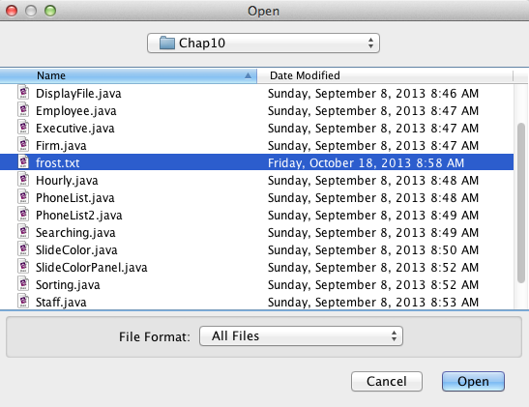
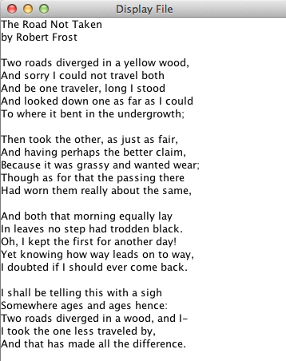
continue
if (status != JFileChooser.APPROVE_OPTION)
ta.setText ("No File Chosen");
else
{
File file = chooser.getSelectedFile();
Scanner scan = new Scanner (file);
String info = "";
while (scan.hasNext())
info += scan.nextLine() + "\n";
ta.setText (info);
}
frame.getContentPane().add(ta);
frame.pack();
frame.setVisible(true);
}
}
Copyright © 2014 Pearson Education, Inc.

Slide 78
Color Choosers
In many situations we want to allow the user to select a color
A color chooser, represented by the JColorChooser class, simplifies this process
The user can choose a color from a palette or specify the color using RGB values
See DisplayColor.java
Copyright © 2014 Pearson Education, Inc.

Slide 79
//********************************************************************
// DisplayColor.java Author: Lewis/Loftus
//
// Demonstrates the use of a color chooser.
//********************************************************************
import javax.swing.*;
import java.awt.*;
public class DisplayColor
{
//-----------------------------------------------------------------
// Presents a frame with a colored panel, then allows the user
// to change the color multiple times using a color chooser.
//-----------------------------------------------------------------
public static void main(String[] args)
{
JFrame frame = new JFrame("Display Color");
frame.setDefaultCloseOperation(JFrame.EXIT_ON_CLOSE);
JPanel colorPanel = new JPanel();
colorPanel.setBackground(Color.white);
colorPanel.setPreferredSize(new Dimension(300, 100));
continue
Copyright © 2014 Pearson Education, Inc.

Slide 80
continue
frame.getContentPane().add(colorPanel);
frame.pack();
frame.setVisible(true);
Color shade = Color.white;
int again;
do
{
shade = JColorChooser.showDialog(frame, "Pick a Color!",
shade);
colorPanel.setBackground(shade);
again = JOptionPane.showConfirmDialog (null,
"Display another color?");
}
while (again == JOptionPane.YES_OPTION);
}
}
Copyright © 2014 Pearson Education, Inc.

Slide 81
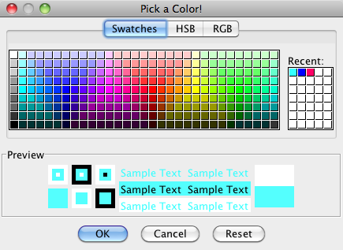
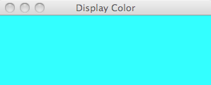
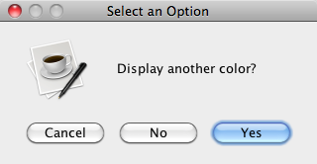
continue
frame.getContentPane().add (colorPanel);
frame.pack();
frame.setVisible(true);
Color shade = Color.white;
int again;
do
{
shade = JColorChooser.showDialog (frame, "Pick a Color!",
shade);
colorPanel.setBackground (shade);
again = JOptionPane.showConfirmDialog (null,
"Display another color?");
}
while (again == JOptionPane.YES_OPTION);
}
}
Copyright © 2014 Pearson Education, Inc.

Slide 82
Outline
Late Binding
Polymorphism via Inheritance
Polymorphism via Interfaces
Sorting
Searching
Event Processing Revisited
File Choosers and Color Choosers
Sliders
Copyright © 2014 Pearson Education, Inc.

Slide 83
Sliders
A slider is a GUI component that allows the user to specify a value within a numeric range
A slider can be oriented vertically or horizontally and can have optional tick marks and labels
The minimum and maximum values for the slider are set using the JSlider constructor
A slider produces a change event when the slider is moved, indicating that the slider and the value it represents has changed
Copyright © 2014 Pearson Education, Inc.

Slide 84
Sliders
Let's look at an example that uses three sliders to change values representing the color components of an RGB value
See SlideColor.java
See SlideColorPanel.java
Copyright © 2014 Pearson Education, Inc.

Slide 85
//********************************************************************
// SlideColor.java Authors: Lewis/Loftus
//
// Demonstrates the use slider components.
//********************************************************************
import java.awt.*;
import javax.swing.*;
public class SlideColor
{
//-----------------------------------------------------------------
// Presents up a frame with a control panel and a panel that
// changes color as the sliders are adjusted.
//-----------------------------------------------------------------
public static void main(String[] args)
{
JFrame frame = new JFrame("Slide Colors");
frame.setDefaultCloseOperation(JFrame.EXIT_ON_CLOSE);
frame.getContentPane().add(new SlideColorPanel());
frame.pack();
frame.setVisible(true);
}
}
Copyright © 2014 Pearson Education, Inc.

Slide 86
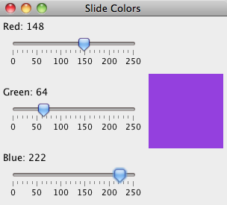
//********************************************************************
// SlideColor.java Authors: Lewis/Loftus
//
// Demonstrates the use slider components.
//********************************************************************
import java.awt.*;
import javax.swing.*;
public class SlideColor
{
//-----------------------------------------------------------------
// Presents up a frame with a control panel and a panel that
// changes color as the sliders are adjusted.
//-----------------------------------------------------------------
public static void main (String[] args)
{
JFrame frame = new JFrame("Slide Colors");
frame.setDefaultCloseOperation(JFrame.EXIT_ON_CLOSE);
frame.getContentPane().add(new SlideColorPanel());
frame.pack();
frame.setVisible(true);
}
}
Copyright © 2014 Pearson Education, Inc.

Slide 87
//********************************************************************
// SlideColorPanel.java Authors: Lewis/Loftus
//
// Represents the slider control panel for the SlideColor program.
//********************************************************************
import java.awt.*;
import javax.swing.*;
import javax.swing.event.*;
public class SlideColorPanel extends JPanel
{
private JPanel controls, colorPanel;
private JSlider rSlider, gSlider, bSlider;
private JLabel rLabel, gLabel, bLabel;
//-----------------------------------------------------------------
// Sets up the sliders and their labels, aligning them along
// their left edge using a box layout.
//-----------------------------------------------------------------
public SlideColorPanel()
{
rSlider = new JSlider(JSlider.HORIZONTAL, 0, 255, 0);
rSlider.setMajorTickSpacing(50);
rSlider.setMinorTickSpacing(10);
rSlider.setPaintTicks(true);
rSlider.setPaintLabels(true);
rSlider.setAlignmentX(Component.LEFT_ALIGNMENT);
continue
Copyright © 2014 Pearson Education, Inc.

Slide 88
continue
gSlider = new JSlider(JSlider.HORIZONTAL, 0, 255, 0);
gSlider.setMajorTickSpacing(50);
gSlider.setMinorTickSpacing(10);
gSlider.setPaintTicks(true);
gSlider.setPaintLabels(true);
gSlider.setAlignmentX(Component.LEFT_ALIGNMENT);
bSlider = new JSlider(JSlider.HORIZONTAL, 0, 255, 0);
bSlider.setMajorTickSpacing(50);
bSlider.setMinorTickSpacing(10);
bSlider.setPaintTicks(true);
bSlider.setPaintLabels(true);
bSlider.setAlignmentX(Component.LEFT_ALIGNMENT);
SliderListener listener = new SliderListener();
rSlider.addChangeListener(listener);
gSlider.addChangeListener(listener);
bSlider.addChangeListener(listener);
rLabel = new JLabel("Red: 0");
rLabel.setAlignmentX(Component.LEFT_ALIGNMENT);
gLabel = new JLabel("Green: 0");
gLabel.setAlignmentX(Component.LEFT_ALIGNMENT);
bLabel = new JLabel("Blue: 0");
bLabel.setAlignmentX(Component.LEFT_ALIGNMENT);
continue
Copyright © 2014 Pearson Education, Inc.

Slide 89
continue
controls = new JPanel();
BoxLayout layout = new BoxLayout(controls, BoxLayout.Y_AXIS);
controls.setLayout(layout);
controls.add(rLabel);
controls.add(rSlider);
controls.add(Box.createRigidArea(new Dimension(0, 20)));
controls.add(gLabel);
controls.add(gSlider);
controls.add(Box.createRigidArea(new Dimension(0, 20)));
controls.add(bLabel);
controls.add(bSlider);
colorPanel = new JPanel();
colorPanel.setPreferredSize(new Dimension(100, 100));
colorPanel.setBackground(new Color(0, 0, 0));
add(controls);
add(colorPanel);
}
continue
Copyright © 2014 Pearson Education, Inc.

Slide 90
continue
//*****************************************************************
// Represents the listener for all three sliders.
//*****************************************************************
private class SliderListener implements ChangeListener
{
private int red, green, blue;
//--------------------------------------------------------------
// Gets the value of each slider, then updates the labels and
// the color panel.
//--------------------------------------------------------------
public void stateChanged(ChangeEvent event)
{
red = rSlider.getValue();
green = gSlider.getValue();
blue = bSlider.getValue();
rLabel.setText("Red: " + red);
gLabel.setText("Green: " + green);
bLabel.setText("Blue: " + blue);
colorPanel.setBackground(new Color(red, green, blue));
}
}
}
Copyright © 2014 Pearson Education, Inc.

Slide 91
Summary
Chapter 10 has focused on:
  defining polymorphism and its benefits
  using inheritance to create polymorphic references
  using interfaces to create polymorphic references
  using polymorphism to implement sorting and searching algorithms
  additional GUI components
Copyright © 2014 Pearson Education, Inc.

