Slide 1


Chapter 11
Exceptions
Java Software Solutions
Foundations of Program Design
8th Edition
John Lewis
William Loftus
Copyright © 2014 Pearson Education, Inc.

Slide 2
Exceptions
Exception handling is an important aspect of object-oriented design
Chapter 11 focuses on:
  the purpose of exceptions
  exception messages
  the try-catch statement
  propagating exceptions
  the exception class hierarchy
  GUI mnemonics and tool tips
  more GUI components and containers
Copyright © 2014 Pearson Education, Inc.

Slide 3
Outline
Exception Handling
The try-catch Statement
Exception Classes
I/O Exceptions
Tool Tips and Mnemonics
Combo Boxes
Scroll Panes and Split Panes
Copyright © 2014 Pearson Education, Inc.

Slide 4
Exceptions
An exception is an object that describes an unusual or erroneous situation
Exceptions are thrown by a program, and may be caught and handled by another part of the program
A program can be separated into a normal execution flow and an exception execution flow
An error is also represented as an object in Java, but usually represents a unrecoverable situation and should not be caught
Copyright © 2014 Pearson Education, Inc.

Slide 5
Exception Handling
The Java API has a predefined set of exceptions that can occur during execution
A program can deal with an exception in one of three ways:
  ignore it
  handle it where it occurs
  handle it an another place in the program
The manner in which an exception is processed is an important design consideration
Copyright © 2014 Pearson Education, Inc.

Slide 6
Exception Handling
If an exception is ignored (not caught) by the program, the program will terminate and produce an appropriate message
The message includes a call stack trace that:
  indicates the line on which the exception occurred
  shows the method call trail that lead to the attempted execution of the offending line
See Zero.java
Copyright © 2014 Pearson Education, Inc.

Slide 7
//********************************************************************
// Zero.java Author: Lewis/Loftus
//
// Demonstrates an uncaught exception.
//********************************************************************
public class Zero
{
//-----------------------------------------------------------------
// Deliberately divides by zero to produce an exception.
//-----------------------------------------------------------------
public static void main(String[] args)
{
int numerator = 10;
int denominator = 0;
System.out.println(numerator / denominator);
System.out.println("This text will not be printed.");
}
}
Copyright © 2014 Pearson Education, Inc.

Slide 8
Output (when program terminates)
Exception in thread "main" java.lang.ArithmeticException: / by zero
at Zero.main(Zero.java:17)
//********************************************************************
// Zero.java Author: Lewis/Loftus
//
// Demonstrates an uncaught exception.
//********************************************************************
public class Zero
{
//-----------------------------------------------------------------
// Deliberately divides by zero to produce an exception.
//-----------------------------------------------------------------
public static void main(String[] args)
{
int numerator = 10;
int denominator = 0;
System.out.println(numerator / denominator);
System.out.println("This text will not be printed.");
}
}
Copyright © 2014 Pearson Education, Inc.

Slide 9
Outline
Exception Handling
The try-catch Statement
Exception Classes
I/O Exceptions
Tool Tips and Mnemonics
Combo Boxes
Scroll Panes and Split Panes
Copyright © 2014 Pearson Education, Inc.

Slide 10
The try Statement
To handle an exception in a program, use a try-catch statement
A try block is followed by one or more catch clauses
Each catch clause has an associated exception type and is called an exception handler
When an exception occurs within the try block, processing immediately jumps to the first catch clause that matches the exception type
See ProductCodes.java
Copyright © 2014 Pearson Education, Inc.

Slide 11
//********************************************************************
// ProductCodes.java Author: Lewis/Loftus
//
// Demonstrates the use of a try-catch block.
//********************************************************************
import java.util.Scanner;
public class ProductCodes
{
//-----------------------------------------------------------------
// Counts the number of product codes that are entered with a
// zone of R and and district greater than 2000.
//-----------------------------------------------------------------
public static void main(String[] args)
{
String code;
char zone;
int district, valid = 0, banned = 0;
Scanner scan = new Scanner(System.in);
System.out.print("Enter product code (XXX to quit): ");
code = scan.nextLine();
continue
Copyright © 2014 Pearson Education, Inc.

Slide 12
continue
while (!code.equals("XXX"))
{
try
{
zone = code.charAt(9);
district = Integer.parseInt(code.substring(3, 7));
valid++;
if (zone == 'R' && district > 2000)
banned++;
}
catch (StringIndexOutOfBoundsException exception)
{
System.out.println("Improper code length: " + code);
}
catch (NumberFormatException exception)
{
System.out.println("District is not numeric: " + code);
}
System.out.print("Enter product code (XXX to quit): ");
code = scan.nextLine();
}
System.out.println("# of valid codes entered: " + valid);
System.out.println("# of banned codes entered: " + banned);
}
}
Copyright © 2014 Pearson Education, Inc.

Slide 13
Sample Run
Enter product code (XXX to quit): TRV2475A5R-14
Enter product code (XXX to quit): TRD1704A7R-12
Enter product code (XXX to quit): TRL2k74A5R-11
District is not numeric: TRL2k74A5R-11
Enter product code (XXX to quit): TRQ2949A6M-04
Enter product code (XXX to quit): TRV2105A2
Improper code length: TRV2105A2
Enter product code (XXX to quit): TRQ2778A7R-19
Enter product code (XXX to quit): XXX
# of valid codes entered: 4
# of banned codes entered: 2
continue
while (!code.equals ("XXX"))
{
try
{
zone = code.charAt(9);
district = Integer.parseInt(code.substring(3, 7));
valid++;
if (zone == 'R' && district > 2000)
banned++;
}
catch (StringIndexOutOfBoundsException exception)
{
System.out.println ("Improper code length: " + code);
}
catch (NumberFormatException exception)
{
System.out.println("District is not numeric: " + code);
}
System.out.print ("Enter product code (XXX to quit): ");
code = scan.nextLine();
}
System.out.println("# of valid codes entered: " + valid);
System.out.println("# of banned codes entered: " + banned);
}
}
Copyright © 2014 Pearson Education, Inc.

Slide 14
The finally Clause
A try statement can have an optional finally clause, which is always executed
If no exception is generated, the statements in the finally clause are executed after the statements in the try block finish
If an exception is generated, the statements in the finally clause are executed after the statements in the appropriate catch clause finish
Copyright © 2014 Pearson Education, Inc.

Slide 15
Exception Propagation
An exception can be handled at a higher level if it is not appropriate to handle it where it occurs
Exceptions propagate up through the method calling hierarchy until they are caught and handled or until they reach the level of the main method
See Propagation.java
See ExceptionScope.java
Copyright © 2014 Pearson Education, Inc.

Slide 16
//********************************************************************
// Propagation.java Author: Lewis/Loftus
//
// Demonstrates exception propagation.
//********************************************************************
public class Propagation
{
//-----------------------------------------------------------------
// Invokes the level1 method to begin the exception demonstration.
//-----------------------------------------------------------------
static public void main(String[] args)
{
ExceptionScope demo = new ExceptionScope();
System.out.println("Program beginning.");
demo.level1();
System.out.println("Program ending.");
}
}
Copyright © 2014 Pearson Education, Inc.

Slide 17
Output
Program beginning.
Level 1 beginning.
Level 2 beginning.
Level 3 beginning.
The exception message is: / by zero
The call stack trace:
java.lang.ArithmeticException: / by zero
at ExceptionScope.level3(ExceptionScope.java:54)
at ExceptionScope.level2(ExceptionScope.java:41)
at ExceptionScope.level1(ExceptionScope.java:18)
at Propagation.main(Propagation.java:17)
Level 1 ending.
Program ending.
//********************************************************************
// Propagation.java Author: Lewis/Loftus
//
// Demonstrates exception propagation.
//********************************************************************
public class Propagation
{
//-----------------------------------------------------------------
// Invokes the level1 method to begin the exception demonstration.
//-----------------------------------------------------------------
static public void main (String[] args)
{
ExceptionScope demo = new ExceptionScope();
System.out.println("Program beginning.");
demo.level1();
System.out.println("Program ending.");
}
}
Copyright © 2014 Pearson Education, Inc.

Slide 18
//********************************************************************
// ExceptionScope.java Author: Lewis/Loftus
//
// Demonstrates exception propagation.
//********************************************************************
public class ExceptionScope
{
//-----------------------------------------------------------------
// Catches and handles the exception that is thrown in level3.
//-----------------------------------------------------------------
public void level1()
{
System.out.println("Level 1 beginning.");
try
{
level2();
}
catch (ArithmeticException problem)
{
System.out.println();
System.out.println("The exception message is: " +
problem.getMessage());
System.out.println();
continue
Copyright © 2014 Pearson Education, Inc.

Slide 19
continue
System.out.println("The call stack trace:");
problem.printStackTrace();
System.out.println();
}
System.out.println("Level 1 ending.");
}
//-----------------------------------------------------------------
// Serves as an intermediate level. The exception propagates
// through this method back to level1.
//-----------------------------------------------------------------
public void level2()
{
System.out.println("Level 2 beginning.");
level3();
System.out.println("Level 2 ending.");
}
continue
Copyright © 2014 Pearson Education, Inc.

Slide 20
continue
//-----------------------------------------------------------------
// Performs a calculation to produce an exception. It is not
// caught and handled at this level.
//-----------------------------------------------------------------
public void level3()
{
int numerator = 10, denominator = 0;
System.out.println("Level 3 beginning.");
int result = numerator / denominator;
System.out.println("Level 3 ending.");
}
}
Copyright © 2014 Pearson Education, Inc.

Slide 21
Outline
Exception Handling
The try-catch Statement
Exception Classes
I/O Exceptions
Tool Tips and Mnemonics
Combo Boxes
Scroll Panes and Split Panes
Copyright © 2014 Pearson Education, Inc.

Slide 22
The Exception Class Hierarchy
Exception classes in the Java API are related by inheritance, forming an exception class hierarchy
All error and exception classes are descendents of the Throwable class
A programmer can define an exception by extending the Exception class or one of its descendants
The parent class used depends on how the new exception will be used
Copyright © 2014 Pearson Education, Inc.

Slide 23
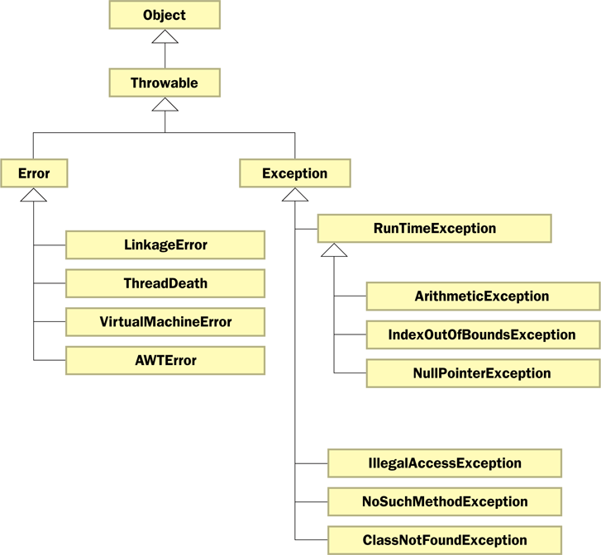
The Exception Class Hierarchy
Copyright © 2014 Pearson Education, Inc.

Slide 24
Checked Exceptions
An exception is either checked or unchecked
A checked exception must either be caught or must be listed in the throws clause of any method that may throw or propagate it
A throws clause is appended to the method header
The compiler will issue an error if a checked exception is not caught or listed in a throws clause
Copyright © 2014 Pearson Education, Inc.

Slide 25
Unchecked Exceptions
An unchecked exception does not require explicit handling, though it could be processed that way
The only unchecked exceptions in Java are objects of type RuntimeException or any of its descendants
Errors are similar to RuntimeException and its descendants in that:
  Errors should not be caught
  Errors do not require a throws clause
Copyright © 2014 Pearson Education, Inc.

Slide 26
Quick Check
Which of these exceptions are checked and which are unchecked?
NullPointerException
IndexOutOfBoundsException
ClassNotFoundException
NoSuchMethodException
ArithmeticException
Copyright © 2014 Pearson Education, Inc.

Slide 27
Quick Check
Which of these exceptions are checked and which are unchecked?
NullPointerException
IndexOutOfBoundsException
ClassNotFoundException
NoSuchMethodException
ArithmeticException
Unchecked
Unchecked
Checked
Checked
Unchecked
Copyright © 2014 Pearson Education, Inc.

Slide 28
The throw Statement
Exceptions are thrown using the throw statement
Usually a throw statement is executed inside an if statement that evaluates a condition to see if the exception should be thrown
See CreatingExceptions.java
See OutOfRangeException.java
Copyright © 2014 Pearson Education, Inc.

Slide 29
//********************************************************************
// CreatingExceptions.java Author: Lewis/Loftus
//
// Demonstrates the ability to define an exception via inheritance.
//********************************************************************
import java.util.Scanner;
public class CreatingExceptions
{
//-----------------------------------------------------------------
// Creates an exception object and possibly throws it.
//-----------------------------------------------------------------
public static void main(String[] args) throws OutOfRangeException
{
final int MIN = 25, MAX = 40;
Scanner scan = new Scanner(System.in);
OutOfRangeException problem =
new OutOfRangeException("Input value is out of range.");
continue
Copyright © 2014 Pearson Education, Inc.

Slide 30
continue
System.out.print("Enter an integer value between " + MIN +
" and " + MAX + ", inclusive: ");
int value = scan.nextInt();
// Determine if the exception should be thrown
if (value < MIN || value > MAX)
throw problem;
System.out.println("End of main method."); // may never reach
}
}
Copyright © 2014 Pearson Education, Inc.

Slide 31
Sample Run
Enter an integer value between 25 and 40, inclusive: 69
Exception in thread "main" OutOfRangeException:
Input value is out of range.
at CreatingExceptions.main(CreatingExceptions.java:20)
continue
System.out.print ("Enter an integer value between " + MIN +
" and " + MAX + ", inclusive: ");
int value = scan.nextInt();
// Determine if the exception should be thrown
if (value < MIN || value > MAX)
throw problem;
System.out.println("End of main method."); // may never reach
}
}
Copyright © 2014 Pearson Education, Inc.

Slide 32
//********************************************************************
// OutOfRangeException.java Author: Lewis/Loftus
//
// Represents an exceptional condition in which a value is out of
// some particular range.
//********************************************************************
public class OutOfRangeException extends Exception
{
//-----------------------------------------------------------------
// Sets up the exception object with a particular message.
//-----------------------------------------------------------------
OutOfRangeException(String message)
{
super(message);
}
}
Copyright © 2014 Pearson Education, Inc.

Slide 33
Quick Check
What is the matter with this code?
System.out.println("Before throw");
throw new OutOfRangeException("Too High");
System.out.println("After throw");
Copyright © 2014 Pearson Education, Inc.

Slide 34
Quick Check
What is the matter with this code?
System.out.println("Before throw");
throw new OutOfRangeException("Too High");
System.out.println("After throw");
The throw is not conditional and therefore always occurs. The second println statement can never be reached.
Copyright © 2014 Pearson Education, Inc.

Slide 35
Outline
Exception Handling
The try-catch Statement
Exception Classes
I/O Exceptions
Tool Tips and Mnemonics
Combo Boxes
Scroll Panes and Split Panes
Copyright © 2014 Pearson Education, Inc.

Slide 36
I/O Exceptions
Let's examine issues related to exceptions and I/O
A stream is a sequence of bytes that flow from a source to a destination
In a program, we read information from an input stream and write information to an output stream
A program can manage multiple streams simultaneously
Copyright © 2014 Pearson Education, Inc.

Slide 37
Standard I/O
There are three standard I/O streams:
  standard output – defined by System.out
  standard input – defined by System.in
  standard error – defined by System.err
We use System.out when we execute println statements
System.out and System.err typically represent the console window
System.in typically represents keyboard input, which we've used many times with Scanner
Copyright © 2014 Pearson Education, Inc.

Slide 38
The IOException Class
Operations performed by some I/O classes may throw an IOException
  A file might not exist
  Even if the file exists, a program may not be able to find it
  The file might not contain the kind of data we expect
An IOException is a checked exception
Copyright © 2014 Pearson Education, Inc.

Slide 39
Writing Text Files
In Chapter 5 we explored the use of the Scanner class to read input from a text file
Let's now explore writing data to a text file
The PrintWriter class represents a text output file
Output streams should be closed explicitly
See TestData.java
Copyright © 2014 Pearson Education, Inc.

Slide 40
//********************************************************************
// TestData.java Author: Lewis/Loftus
//
// Demonstrates I/O exceptions and the use of a character file
// output stream.
//********************************************************************
import java.util.Random;
import java.io.*;
public class TestData
{
//-----------------------------------------------------------------
// Creates a file of test data that consists of ten lines each
// containing ten integer values in the range 10 to 99.
//-----------------------------------------------------------------
public static void main(String[] args) throws IOException
{
final int MAX = 10;
int value;
String fileName = "test.txt";
PrintWriter outFile = new PrintWriter(fileName);
continue
Copyright © 2014 Pearson Education, Inc.

Slide 41
continue
Random rand = new Random();
for (int line=1; line <= MAX; line++)
{
for (int num=1; num <= MAX; num++)
{
value = rand.nextInt(90) + 10;
outFile.print(value + " ");
}
outFile.println();
}
outFile.close();
System.out.println("Output file has been created: " + fileName);
}
}
Copyright © 2014 Pearson Education, Inc.

Slide 42
Output
Output file has been created: test.txt
continue
Random rand = new Random();
for (int line=1; line <= MAX; line++)
{
for (int num=1; num <= MAX; num++)
{
value = rand.nextInt(90) + 10;
outFile.print(value + " ");
}
outFile.println();
}
outFile.close();
System.out.println("Output file has been created: " + fileName);
}
}
Sample test.txt File
77 46 24 67 45 37 32 40 39 10
90 91 71 64 82 80 68 18 83 89
25 80 45 75 74 40 15 90 79 59
44 43 95 85 93 61 15 20 52 86
60 85 18 73 56 41 35 67 21 42
93 25 89 47 13 27 51 94 76 13
33 25 48 42 27 24 88 18 32 17
71 10 90 88 60 19 89 54 21 92
45 26 47 68 55 98 34 38 98 38
48 59 90 12 86 36 11 65 41 62
Copyright © 2014 Pearson Education, Inc.

Slide 43
Outline
Exception Handling
The try-catch Statement
Exception Classes
I/O Exceptions
Tool Tips and Mnemonics
Combo Boxes
Scroll Panes and Split Panes
Copyright © 2014 Pearson Education, Inc.

Slide 44
Tool Tips
A tool tip provides a short pop-up description when the mouse cursor rests momentarily on a component
A tool tip is assigned using the setToolTipText method of a Swing component
JButton button = new JButton("Compute");
button.setToolTipText("Calculate size");
Copyright © 2014 Pearson Education, Inc.

Slide 45
Mnemonics
A mnemonic is a keyboard alternative for pushing a button or selecting a menu option
The mnemonic character should be chosen from the component's label, and is underlined
The user activates the component by holding down the ALT key and pressing the mnemonic character
JButton button = new JButton("Calculate");
button.setMnemonic("C");
Copyright © 2014 Pearson Education, Inc.

Slide 46
Disabled Components
Components can be disabled if they should not be used
A disabled component is "grayed out" and will not respond to user interaction
The status is set using the setEnabled method:
JButton button = new JButton("Do It");
button.setEnabled(false);
Copyright © 2014 Pearson Education, Inc.

Slide 47
Light Bulb Example
The right combination of special features such as tool tips and mnemonics can enhance the usefulness of a GUI
See LightBulb.java
See LightBulbPanel.java
See LightBulbControls.java
Copyright © 2014 Pearson Education, Inc.

Slide 48
//********************************************************************
// LightBulb.java Author: Lewis/Loftus
//
// Demonstrates mnemonics and tool tips.
//********************************************************************
import javax.swing.*;
import java.awt.*;
public class LightBulb
{
//-----------------------------------------------------------------
// Sets up a frame that displays a light bulb image that can be
// turned on and off.
//-----------------------------------------------------------------
public static void main(String[] args)
{
JFrame frame = new JFrame("Light Bulb");
frame.setDefaultCloseOperation(JFrame.EXIT_ON_CLOSE);
LightBulbPanel bulb = new LightBulbPanel();
LightBulbControls controls = new LightBulbControls(bulb);
continue
Copyright © 2014 Pearson Education, Inc.

Slide 49
continue
JPanel panel = new JPanel();
panel.setBackground(Color.black);
panel.setLayout(new BoxLayout(panel, BoxLayout.Y_AXIS));
panel.add(Box.createRigidArea(new Dimension (0, 20)));
panel.add(bulb);
panel.add(Box.createRigidArea(new Dimension (0, 10)));
panel.add(controls);
panel.add(Box.createRigidArea(new Dimension (0, 10)));
frame.getContentPane().add(panel);
frame.pack();
frame.setVisible(true);
}
}
Copyright © 2014 Pearson Education, Inc.

Slide 50
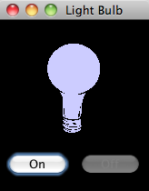
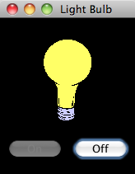
continue
JPanel panel = new JPanel();
panel.setBackground (Color.black);
panel.setLayout (new BoxLayout(panel, BoxLayout.Y_AXIS));
panel.add (Box.createRigidArea (new Dimension (0, 20)));
panel.add (bulb);
panel.add (Box.createRigidArea (new Dimension (0, 10)));
panel.add (controls);
panel.add (Box.createRigidArea (new Dimension (0, 10)));
frame.getContentPane().add(panel);
frame.pack();
frame.setVisible(true);
}
}
Copyright © 2014 Pearson Education, Inc.

Slide 51
//********************************************************************
// LightBulbPanel.java Author: Lewis/Loftus
//
// Represents the image for the LightBulb program.
//********************************************************************
import javax.swing.*;
import java.awt.*;
public class LightBulbPanel extends JPanel
{
private boolean on;
private ImageIcon lightOn, lightOff;
private JLabel imageLabel;
continue
Copyright © 2014 Pearson Education, Inc.

Slide 52
continue
//-----------------------------------------------------------------
// Constructor: Sets up the images and the initial state.
//-----------------------------------------------------------------
public LightBulbPanel()
{
lightOn = new ImageIcon("lightBulbOn.gif");
lightOff = new ImageIcon("lightBulbOff.gif");
setBackground(Color.black);
on = true;
imageLabel = new JLabel(lightOff);
add(imageLabel);
}
continue
Copyright © 2014 Pearson Education, Inc.

Slide 53
continue
//-----------------------------------------------------------------
// Paints the panel using the appropriate image.
//-----------------------------------------------------------------
public void paintComponent(Graphics page)
{
super.paintComponent(page);
if (on)
imageLabel.setIcon(lightOn);
else
imageLabel.setIcon(lightOff);
}
//-----------------------------------------------------------------
// Sets the status of the light bulb.
//-----------------------------------------------------------------
public void setOn(boolean lightBulbOn)
{
on = lightBulbOn;
}
}
Copyright © 2014 Pearson Education, Inc.

Slide 54
//********************************************************************
// LightBulbControls.java Author: Lewis/Loftus
//
// Represents the control panel for the LightBulb program.
//********************************************************************
import javax.swing.*;
import java.awt.*;
import java.awt.event.*;
public class LightBulbControls extends JPanel
{
private LightBulbPanel bulb;
private JButton onButton, offButton;
continue
Copyright © 2014 Pearson Education, Inc.

Slide 55
continue
//-----------------------------------------------------------------
// Sets up the lightbulb control panel.
//-----------------------------------------------------------------
public LightBulbControls(LightBulbPanel bulbPanel)
{
bulb = bulbPanel;
onButton = new JButton("On");
onButton.setEnabled(false);
onButton.setMnemonic('n');
onButton.setToolTipText("Turn it on!");
onButton.addActionListener(new OnListener());
offButton = new JButton("Off");
offButton.setEnabled(true);
offButton.setMnemonic('f');
offButton.setToolTipText("Turn it off!");
offButton.addActionListener(new OffListener());
setBackground(Color.black);
add(onButton);
add(offButton);
}
continue
Copyright © 2014 Pearson Education, Inc.

Slide 56
continue
//*****************************************************************
// Represents the listener for the On button.
//*****************************************************************
private class OnListener implements ActionListener
{
//--------------------------------------------------------------
// Turns the bulb on and repaints the bulb panel.
//--------------------------------------------------------------
public void actionPerformed(ActionEvent event)
{
bulb.setOn(true);
onButton.setEnabled(false);
offButton.setEnabled(true);
bulb.repaint();
}
}
continue
Copyright © 2014 Pearson Education, Inc.

Slide 57
continue
//*****************************************************************
// Represents the listener for the Off button.
//*****************************************************************
private class OffListener implements ActionListener
{
//--------------------------------------------------------------
// Turns the bulb off and repaints the bulb panel.
//--------------------------------------------------------------
public void actionPerformed(ActionEvent event)
{
bulb.setOn(false);
onButton.setEnabled(true);
offButton.setEnabled(false);
bulb.repaint();
}
}
}
Copyright © 2014 Pearson Education, Inc.

Slide 58
Outline
Exception Handling
The try-catch Statement
Exception Classes
I/O Exceptions
Tool Tips and Mnemonics
Combo Boxes
Scroll Panes and Split Panes
Copyright © 2014 Pearson Education, Inc.

Slide 59
Combo Boxes
A combo box provides a menu from which the user can choose one of several options
The currently selected option is shown in the combo box
A combo box shows its options only when the user presses it using the mouse
Options can be established using an array of strings or using the addItem method
Copyright © 2014 Pearson Education, Inc.

Slide 60
The JukeBox Program
A combo box generates an action event when the user makes a selection from it
See JukeBox.java
See JukeBoxControls.java
Copyright © 2014 Pearson Education, Inc.

Slide 61
//********************************************************************
// JukeBox.java Author: Lewis/Loftus
//
// Demonstrates the use of a combo box.
//********************************************************************
import javax.swing.*;
public class JukeBox
{
//-----------------------------------------------------------------
// Creates and displays the controls for a juke box.
//-----------------------------------------------------------------
public static void main(String[] args)
{
JFrame frame = new JFrame("Java Juke Box");
frame.setDefaultCloseOperation(JFrame.EXIT_ON_CLOSE);
JukeBoxControls controlPanel = new JukeBoxControls();
frame.getContentPane().add(controlPanel);
frame.pack();
frame.setVisible(true);
}
}
Copyright © 2014 Pearson Education, Inc.

Slide 62
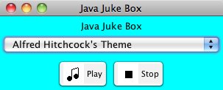
//********************************************************************
// JukeBox.java Author: Lewis/Loftus
//
// Demonstrates the use of a combo box.
//********************************************************************
import javax.swing.*;
public class JukeBox
{
//-----------------------------------------------------------------
// Creates and displays the controls for a juke box.
//-----------------------------------------------------------------
public static void main(String[] args)
{
JFrame frame = new JFrame("Java Juke Box");
frame.setDefaultCloseOperation(JFrame.EXIT_ON_CLOSE);
JukeBoxControls controlPanel = new JukeBoxControls();
frame.getContentPane().add(controlPanel);
frame.pack();
frame.setVisible(true);
}
}
Copyright © 2014 Pearson Education, Inc.

Slide 63
//********************************************************************
// JukeBoxControls.java Author: Lewis and Loftus
//
// Represents the control panel for the juke box.
//********************************************************************
import java.awt.*;
import java.awt.event.*;
import javax.swing.*;
import java.applet.AudioClip;
import java.net.URL;
public class JukeBoxControls extends JPanel
{
private JComboBox musicCombo;
private JButton stopButton, playButton;
private AudioClip[] music;
private AudioClip current;
//-----------------------------------------------------------------
// Sets up the GUI for the juke box.
//-----------------------------------------------------------------
public JukeBoxControls()
{
URL url1, url2, url3, url4, url5, url6;
url1 = url2 = url3 = url4 = url5 = url6 = null;
continue
Copyright © 2014 Pearson Education, Inc.

Slide 64
continue
// Obtain and store the audio clips to play
try
{
url1 = new URL("file", "localhost", "westernBeat.wav");
url2 = new URL("file", "localhost", "classical.wav");
url3 = new URL("file", "localhost", "jeopardy.au");
url4 = new URL("file", "localhost", "newAgeRythm.wav");
url5 = new URL("file", "localhost", "eightiesJam.wav");
url6 = new URL("file", "localhost", "hitchcock.wav");
}
catch (Exception exception) {}
music = new AudioClip[7];
music[0] = null; // Corresponds to "Make a Selection..."
music[1] = JApplet.newAudioClip(url1);
music[2] = JApplet.newAudioClip(url2);
music[3] = JApplet.newAudioClip(url3);
music[4] = JApplet.newAudioClip(url4);
music[5] = JApplet.newAudioClip(url5);
music[6] = JApplet.newAudioClip(url6);
JLabel titleLabel = new JLabel("Java Juke Box");
titleLabel.setAlignmentX(Component.CENTER_ALIGNMENT);
continue
Copyright © 2014 Pearson Education, Inc.

Slide 65
continue
musicCombo = new JComboBox(musicNames);
musicCombo.setAlignmentX(Component.CENTER_ALIGNMENT);
// Set up the buttons
playButton = new JButton("Play", new ImageIcon("play.gif"));
playButton.setBackground(Color.white);
playButton.setMnemonic('p');
stopButton = new JButton("Stop", new ImageIcon("stop.gif"));
stopButton.setBackground(Color.white);
stopButton.setMnemonic('s');
JPanel buttons = new JPanel();
buttons.setLayout(new BoxLayout(buttons, BoxLayout.X_AXIS));
buttons.add(playButton);
buttons.add(Box.createRigidArea(new Dimension(5,0)));
buttons.add(stopButton);
buttons.setBackground(Color.cyan);
// Set up this panel
setPreferredSize(new Dimension(300, 100));
setBackground(Color.cyan);
setLayout(new BoxLayout(this, BoxLayout.Y_AXIS));
continue
Copyright © 2014 Pearson Education, Inc.

Slide 66
continue
musicCombo.addActionListener(new ComboListener());
stopButton.addActionListener(new ButtonListener());
playButton.addActionListener(new ButtonListener());
current = null;
}
//*****************************************************************
// Represents the action listener for the combo box.
//*****************************************************************
private class ComboListener implements ActionListener
{
//--------------------------------------------------------------
// Stops playing the current selection (if any) and resets
// the current selection to the one chosen.
//--------------------------------------------------------------
public void actionPerformed(ActionEvent event)
{
if (current != null)
current.stop();
current = music[musicCombo.getSelectedIndex()];
}
}
continue
Copyright © 2014 Pearson Education, Inc.

Slide 67
continue
//*****************************************************************
// Represents the action listener for both control buttons.
//*****************************************************************
private class ButtonListener implements ActionListener
{
//--------------------------------------------------------------
// Stops the current selection (if any) in either case. If
// the play button was pressed, start playing it again.
//--------------------------------------------------------------
public void actionPerformed(ActionEvent event)
{
if (current != null)
current.stop();
if (event.getSource() == playButton)
if (current != null)
current.play();
}
}
}
Copyright © 2014 Pearson Education, Inc.

Slide 68
Outline
Exception Handling
The try-catch Statement
Exception Classes
I/O Exceptions
Tool Tips and Mnemonics
Combo Boxes
Scroll Panes and Split Panes
Copyright © 2014 Pearson Education, Inc.

Slide 69
Scroll Panes
A scroll pane is useful for images or information too large to fit in a reasonably-sized area
A scroll pane offers a limited view of the component it contains
It provides vertical and/or horizontal scroll bars that allow the user to scroll to other areas of the component
No event listener is needed for a scroll pane
See TransitMap.java
Copyright © 2014 Pearson Education, Inc.

Slide 70
//********************************************************************
// TransitMap.java Authors: Lewis/Loftus
//
// Demonstrates the use a scroll pane.
//********************************************************************
import java.awt.*;
import javax.swing.*;
public class TransitMap
{
//-----------------------------------------------------------------
// Presents a frame containing a scroll pane used to view a large
// map of the New York subway system.
//-----------------------------------------------------------------
public static void main(String[] args)
{
JFrame frame = new JFrame("New York Transit Map");
continue
Copyright © 2014 Pearson Education, Inc.

Slide 71
continue
frame.setDefaultCloseOperation(JFrame.EXIT_ON_CLOSE);
ImageIcon image = new ImageIcon("newyork.jpg");
JLabel imageLabel = new JLabel(image);
JScrollPane sp = new JScrollPane(imageLabel);
sp.setPreferredSize(new Dimension(450, 400));
frame.getContentPane().add(sp);
frame.pack();
frame.setVisible(true);
}
}
Copyright © 2014 Pearson Education, Inc.

Slide 72
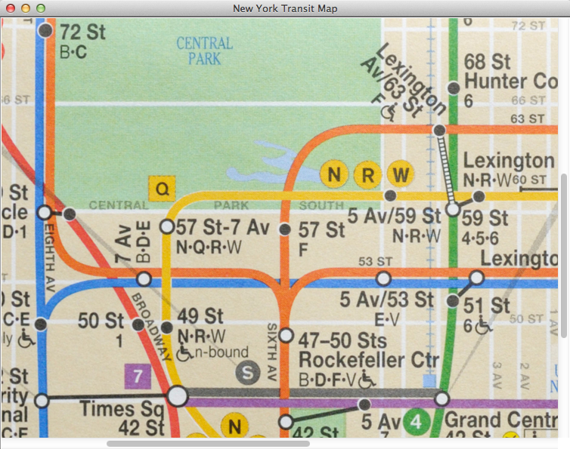
continue
frame.setDefaultCloseOperation (JFrame.EXIT_ON_CLOSE);
ImageIcon image = new ImageIcon ("septa.jpg");
JLabel imageLabel = new JLabel (image);
JScrollPane sp = new JScrollPane (imageLabel);
sp.setPreferredSize (new Dimension (450, 400));
frame.getContentPane().add (sp);
frame.pack();
frame.setVisible(true);
}
}
Copyright © 2014 Pearson Education, Inc.

Slide 73
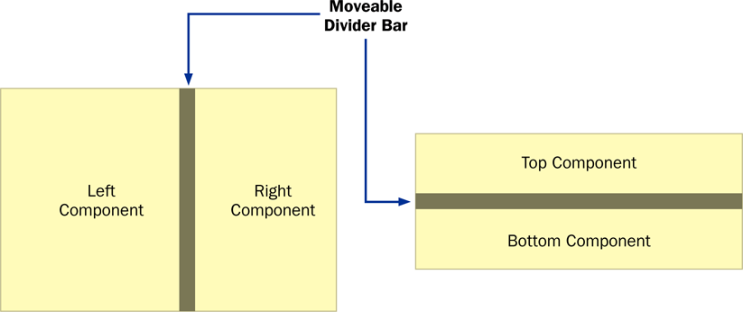
Split Panes
A split pane is a container that displays two components separated by a moveable divider bar
The two components can be displayed side by side, or one on top of the other
Copyright © 2014 Pearson Education, Inc.

Slide 74
Split Panes
The orientation of the split pane is set using the HORIZONTAL_SPLIT or VERTICAL_SPLIT constants
The divider bar can be set so that it can be fully expanded with one click of the mouse
The components can be continuously adjusted as the divider bar is moved, or wait until it stops moving
Split panes can be nested
Copyright © 2014 Pearson Education, Inc.

Slide 75
Lists
The Swing Jlist class represents a list of items from which the user can choose
The contents of a JList object can be specified using an array of objects
A JList object generates a list selection event when the current selection changes
See PickImage.java
See ListPanel.java
Copyright © 2014 Pearson Education, Inc.

Slide 76
//********************************************************************
// PickImage.java Authors: Lewis/Loftus
//
// Demonstrates the use a split pane and a list.
//********************************************************************
import java.awt.*;
import javax.swing.*;
public class PickImage
{
//-----------------------------------------------------------------
// Creates and displays a frame containing a split pane. The
// user selects an image name from the list to be displayed.
//-----------------------------------------------------------------
public static void main(String[] args)
{
JFrame frame = new JFrame("Pick Image");
frame.setDefaultCloseOperation(JFrame.EXIT_ON_CLOSE);
continue
Copyright © 2014 Pearson Education, Inc.

Slide 77
continue
JLabel imageLabel = new JLabel();
JPanel imagePanel = new JPanel();
imagePanel.add(imageLabel);
imagePanel.setBackground(Color.white);
ListPanel imageList = new ListPanel(imageLabel);
JSplitPane sp = new JSplitPane(JSplitPane.HORIZONTAL_SPLIT,
imageList, imagePanel);
sp.setOneTouchExpandable(true);
frame.getContentPane().add(sp);
frame.pack();
frame.setVisible(true);
}
}
Copyright © 2014 Pearson Education, Inc.

Slide 78
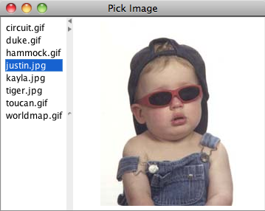
continue
JLabel imageLabel = new JLabel();
JPanel imagePanel = new JPanel();
imagePanel.add (imageLabel);
imagePanel.setBackground (Color.white);
ListPanel imageList = new ListPanel (imageLabel);
JSplitPane sp = new JSplitPane(JSplitPane.HORIZONTAL_SPLIT,
imageList, imagePanel);
sp.setOneTouchExpandable (true);
frame.getContentPane().add (sp);
frame.pack();
frame.setVisible(true);
}
}
Copyright © 2014 Pearson Education, Inc.

Slide 79
//********************************************************************
// ListPanel.java Authors: Lewis/Loftus
//
// Represents the list of images for the PickImage program.
//********************************************************************
import java.awt.*;
import javax.swing.*;
import javax.swing.event.*;
public class ListPanel extends JPanel
{
private JLabel label;
private JList list;
continue
Copyright © 2014 Pearson Education, Inc.

Slide 80
continue
//-----------------------------------------------------------------
// Loads the list of image names into the list.
//-----------------------------------------------------------------
public ListPanel(JLabel imageLabel)
{
label = imageLabel;
String[] fileNames = { "circuit.gif",
"duke.gif",
"hammock.gif",
"justin.jpg",
"kayla.jpg",
"tiger.jpg",
"toucan.gif",
"worldmap.gif" };
list = new JList(fileNames);
list.addListSelectionListener(new ListListener());
list.setSelectionMode(ListSelectionModel.SINGLE_SELECTION);
add(list);
setBackground(Color.white);
}
continue
Copyright © 2014 Pearson Education, Inc.

Slide 81
continue
//*****************************************************************
// Represents the listener for the list of images.
//*****************************************************************
private class ListListener implements ListSelectionListener
{
public void valueChanged(ListSelectionEvent event)
{
if (list.isSelectionEmpty())
label.setIcon(null);
else
{
String fileName = (String)list.getSelectedValue();
ImageIcon image = new ImageIcon(fileName);
label.setIcon(image);
}
}
}
}
Copyright © 2014 Pearson Education, Inc.

Slide 82
Lists
A JList object can be set so that multiple items can be selected at the same time
The list selection mode can be one of three options:
  single selection – only one item can be selected at a time
  single interval selection – multiple, contiguous items can be selected at a time
  multiple interval selection – any combination of items can be selected
The list selection mode is defined by a ListSelectionModel object
Copyright © 2014 Pearson Education, Inc.

Slide 83
Summary
Chapter 11 has focused on:
    the purpose of exceptions
    exception messages
    the try-catch statement
    propagating exceptions
    the exception class hierarchy
    GUI mnemonics and tool tips
    more GUI components and containers
Copyright © 2014 Pearson Education, Inc.

