Slide 1

Deep Learning / Machine Learning
Seminar
- MNIST to CNN-
박성현

Slide 2
학습을 시켰으면 시험을 봐야지?
학습만 하고 끝? 그럼 왜 함 이걸 ㅎㅎ
Training Data Set 과 Test Data Set을 분리해서 확인
간단하게 MNIST 데이터 셋을 통해서 이것을 해보자!

Slide 3
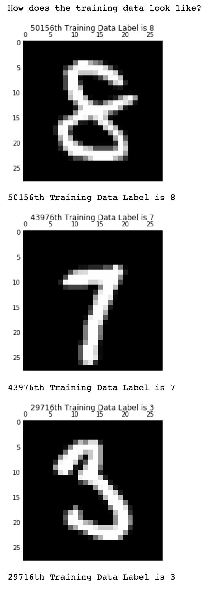

MNIST
MNIST ?
Modified National Institute of Standards and Technology

Slide 4
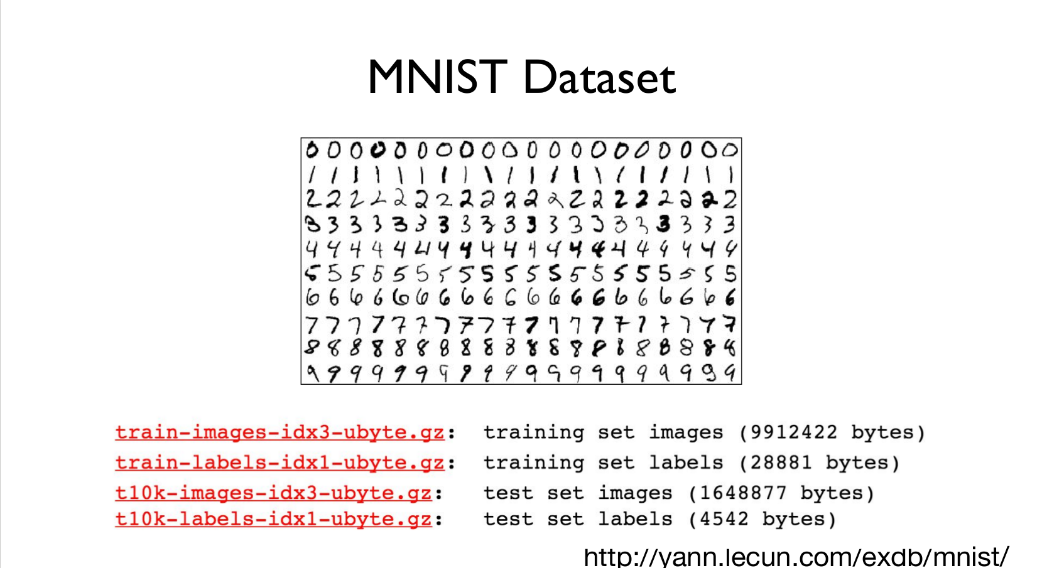
(python)>>from tensorflow.examples.tutorials.mnist import input_data

Slide 5
Before testing MNIST...
복습합시다
1. tensorflow basic / One-hot encoding
2. Normalized Data / softmax
3. linear / logistic regression
이걸 알아봅니다
1. epoch? Batch?
2. training / test set
3. CNN
4. optimizer and initializer
5. tensorboard

Slide 6
epoch and batch
epoch : 모든 훈련 데이터를 전부 학습하는데 걸리는 횟수
batch : 한번 훈련 데이터를 학습할 때 학습하는 개수들
즉, 한번 학습할 때 걸리는 iteration 횟수는 epoch / batch

Slide 7
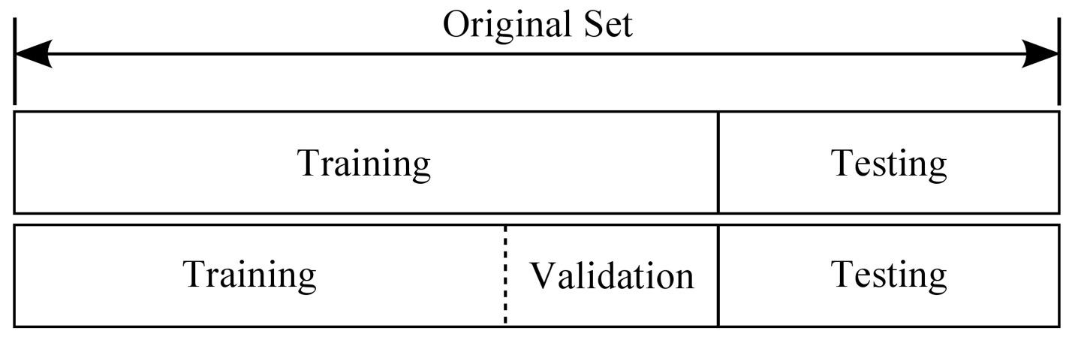
Training and Test Set
Need to separate test set from training set

Slide 8
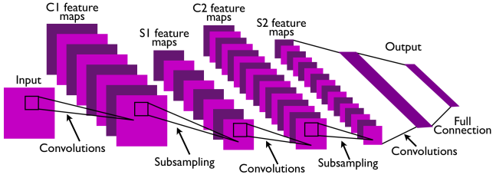
CNN
Convolutional Neural Network
This is pretty much everything about the convolutional neural network.
Convolution + Subsampling + Full Connection

Slide 9

Convolution
http://deeplearning.stanford.edu/wiki/index.php/Feature_extraction_using_convolution

Slide 10
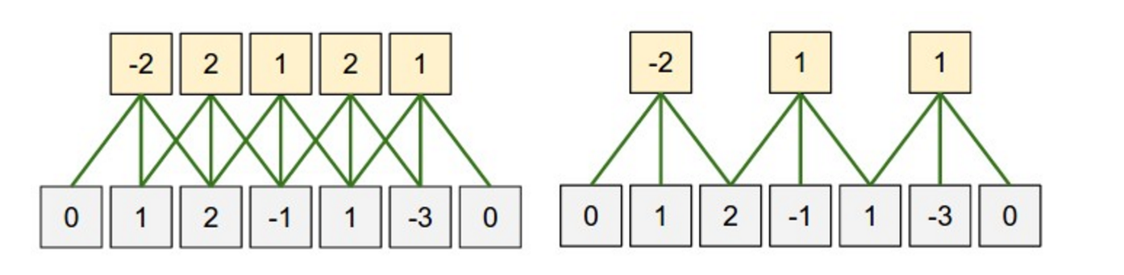





Zero-padding
What is the size of the input?
What is the size of the output?
What is the size of the filter?
What is the size of the zero-padding?

Slide 11
Stride
(Left) Stride size: 1
(Right) Stride size: 2
If stride size equals the filter size, there will be no overlapping.

Slide 12
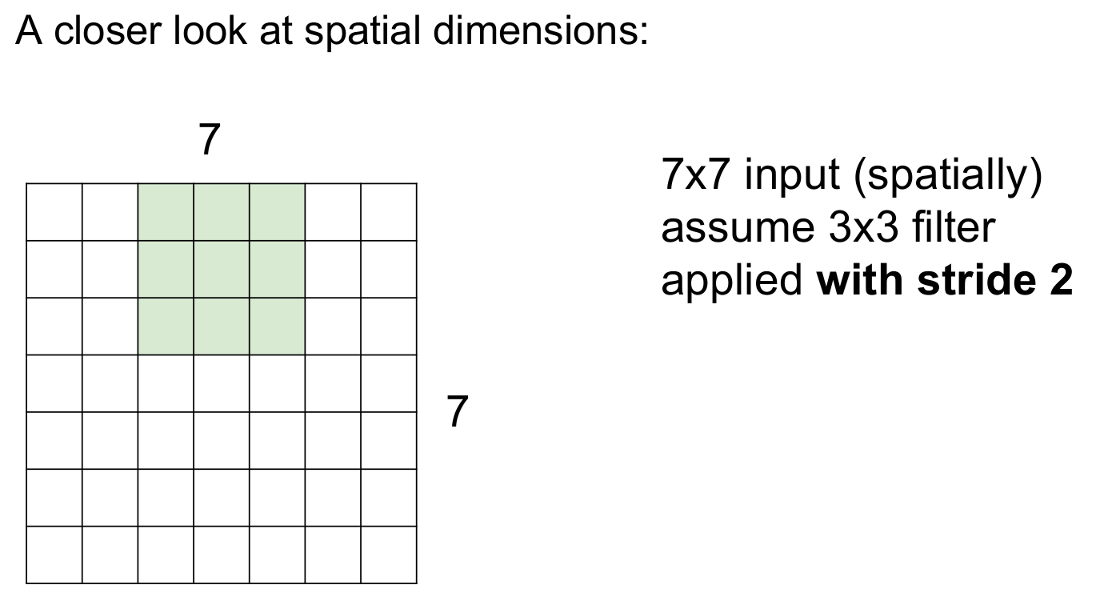
Stride and Zero-padding in CNN
Output size = [N-F] / stride + 1

Slide 13
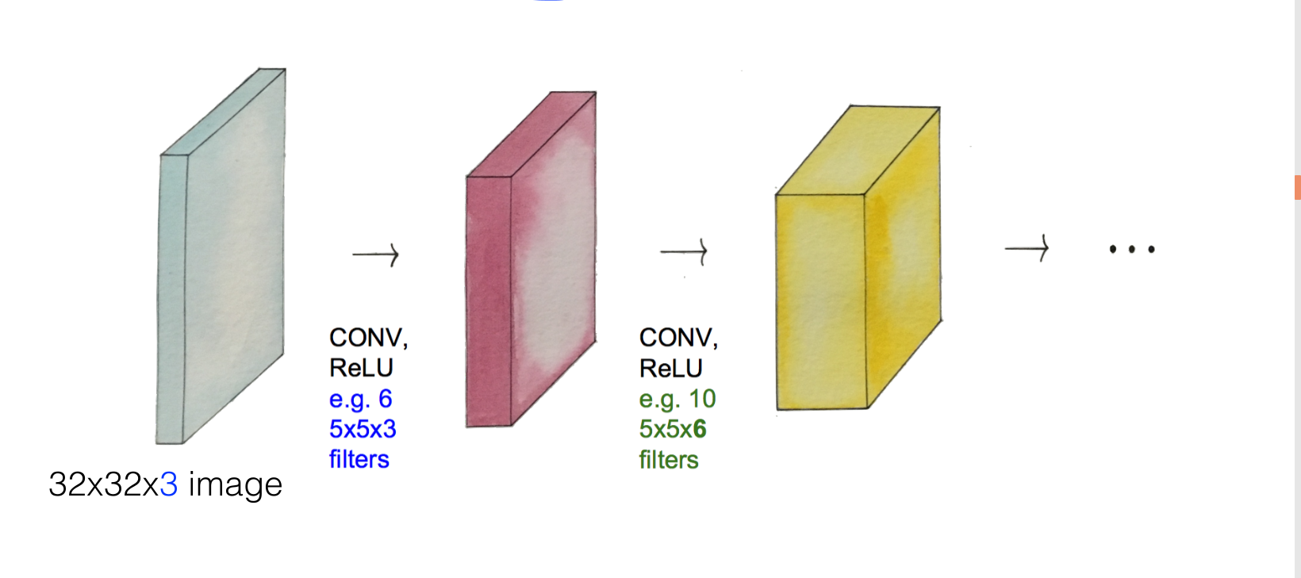
CNN in process
32 x 32 x 3 → [5 x 5 x 3] * 6 → [5 x 5 x 6 ] * 10 → ?

Slide 14
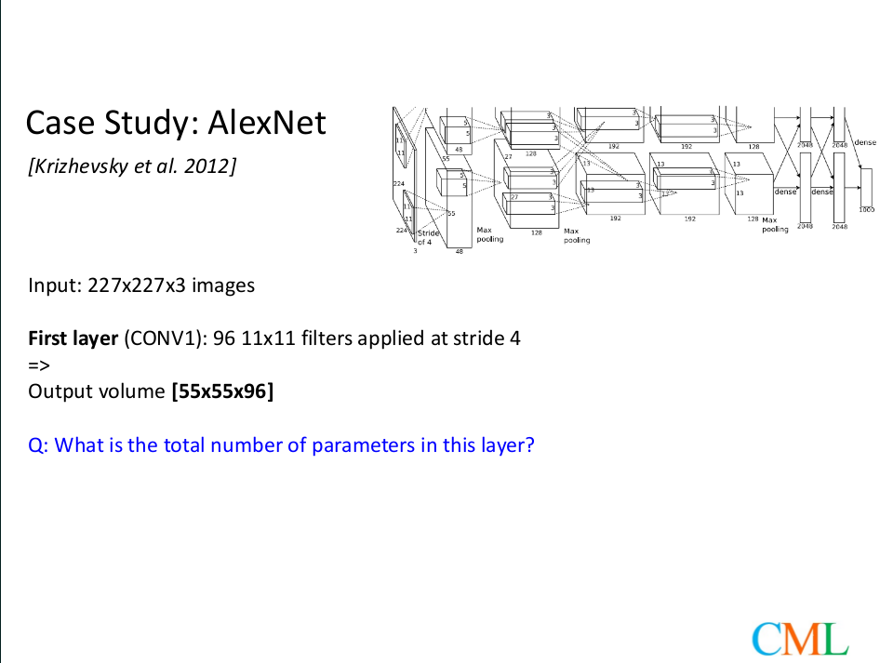

Slide 15
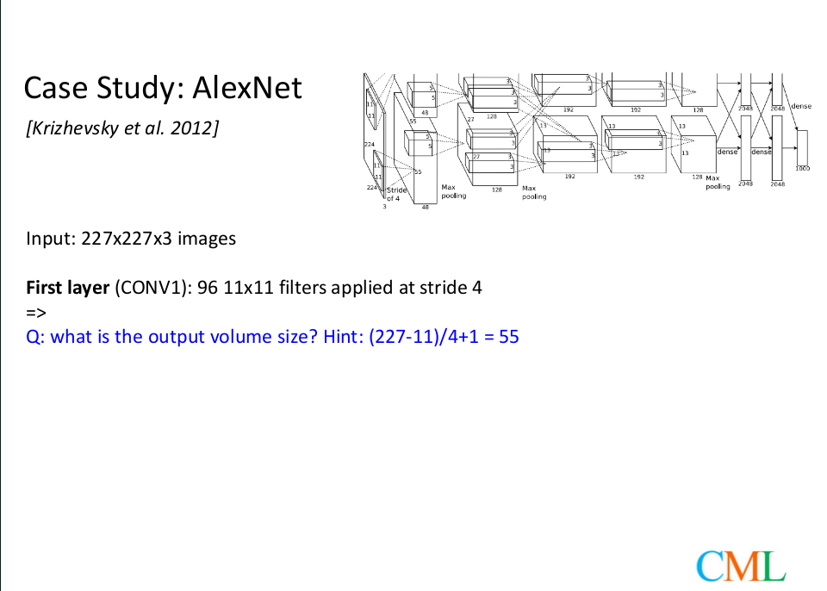

Slide 16
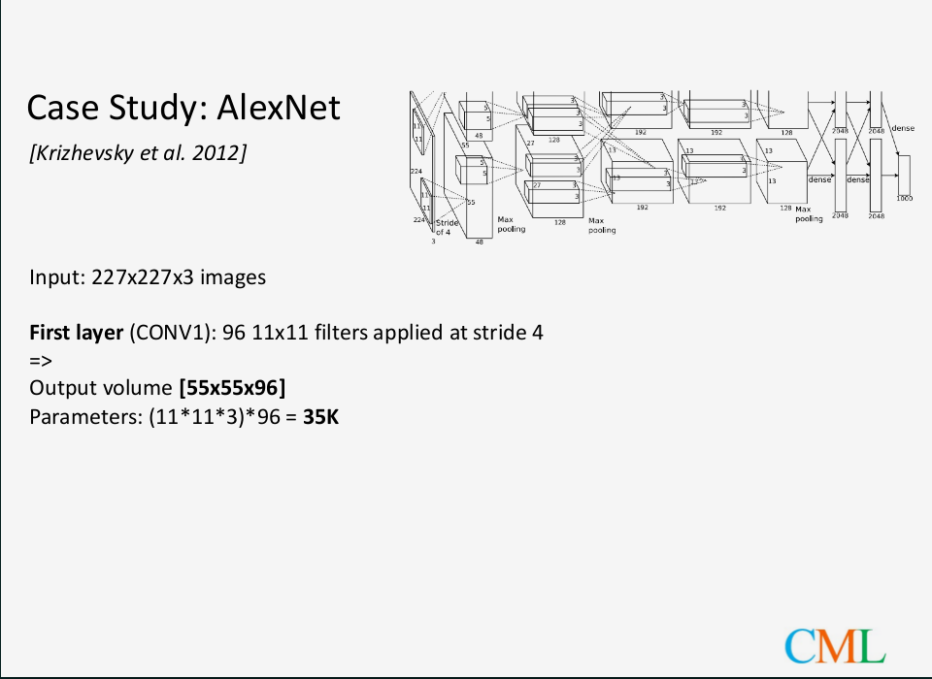

Slide 17
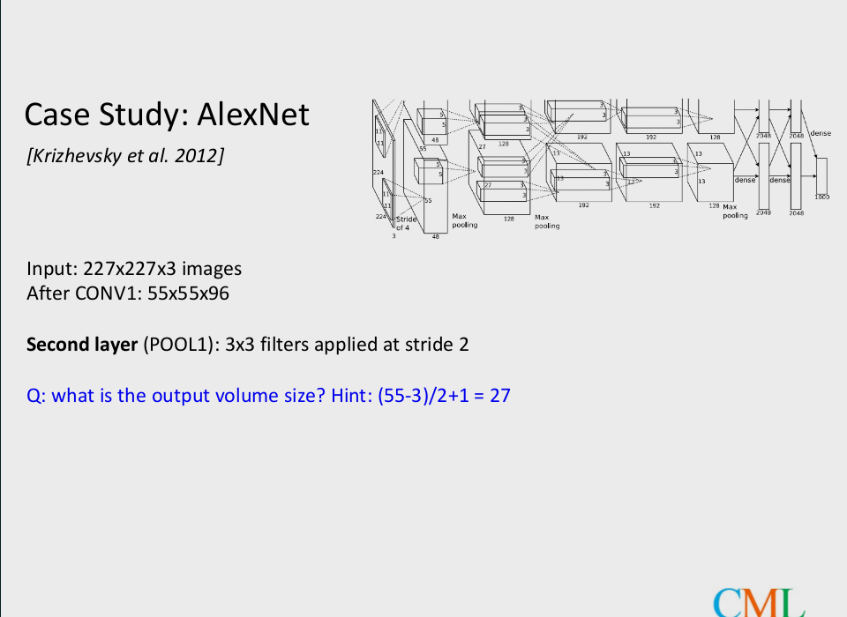

Slide 18
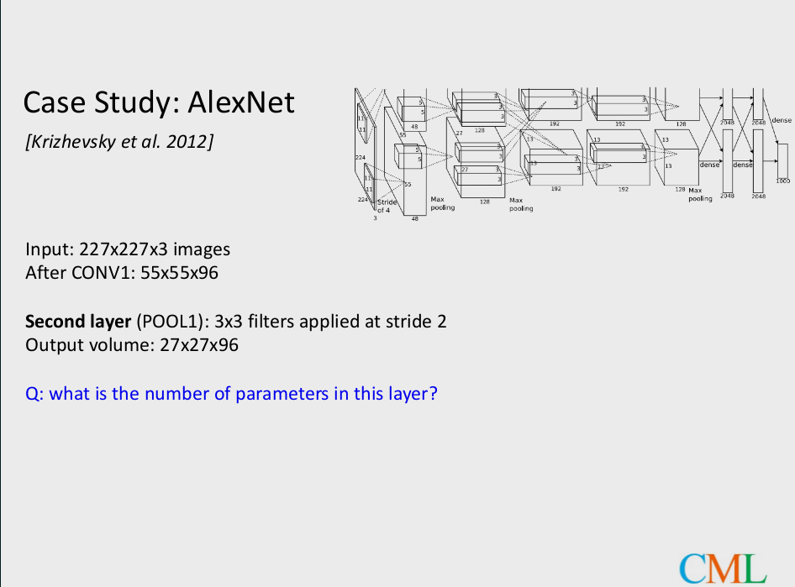

Slide 19
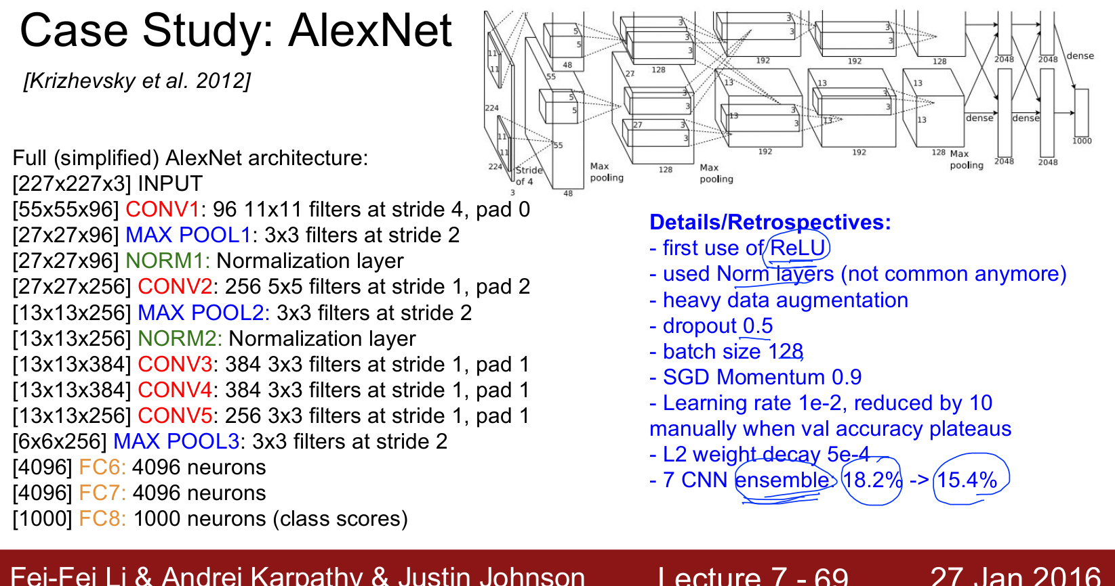

Slide 20
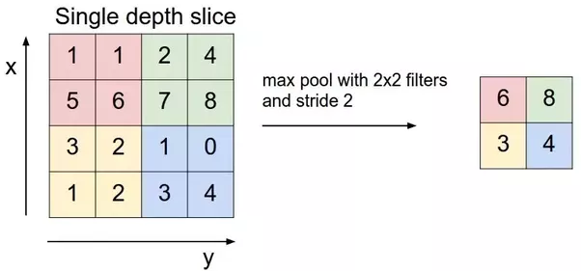

Max pooling / FC network

Slide 21
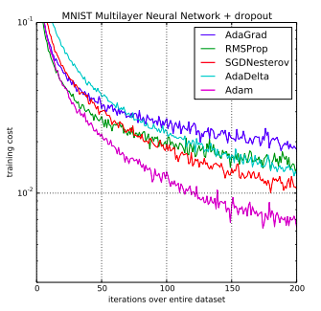
Adam Optimizer
압도적인 성능!!
어떻게 작동하는가?
http://machinelearningmastery.com/adam-optimization-algorithm-for-deep-learning/

Slide 22
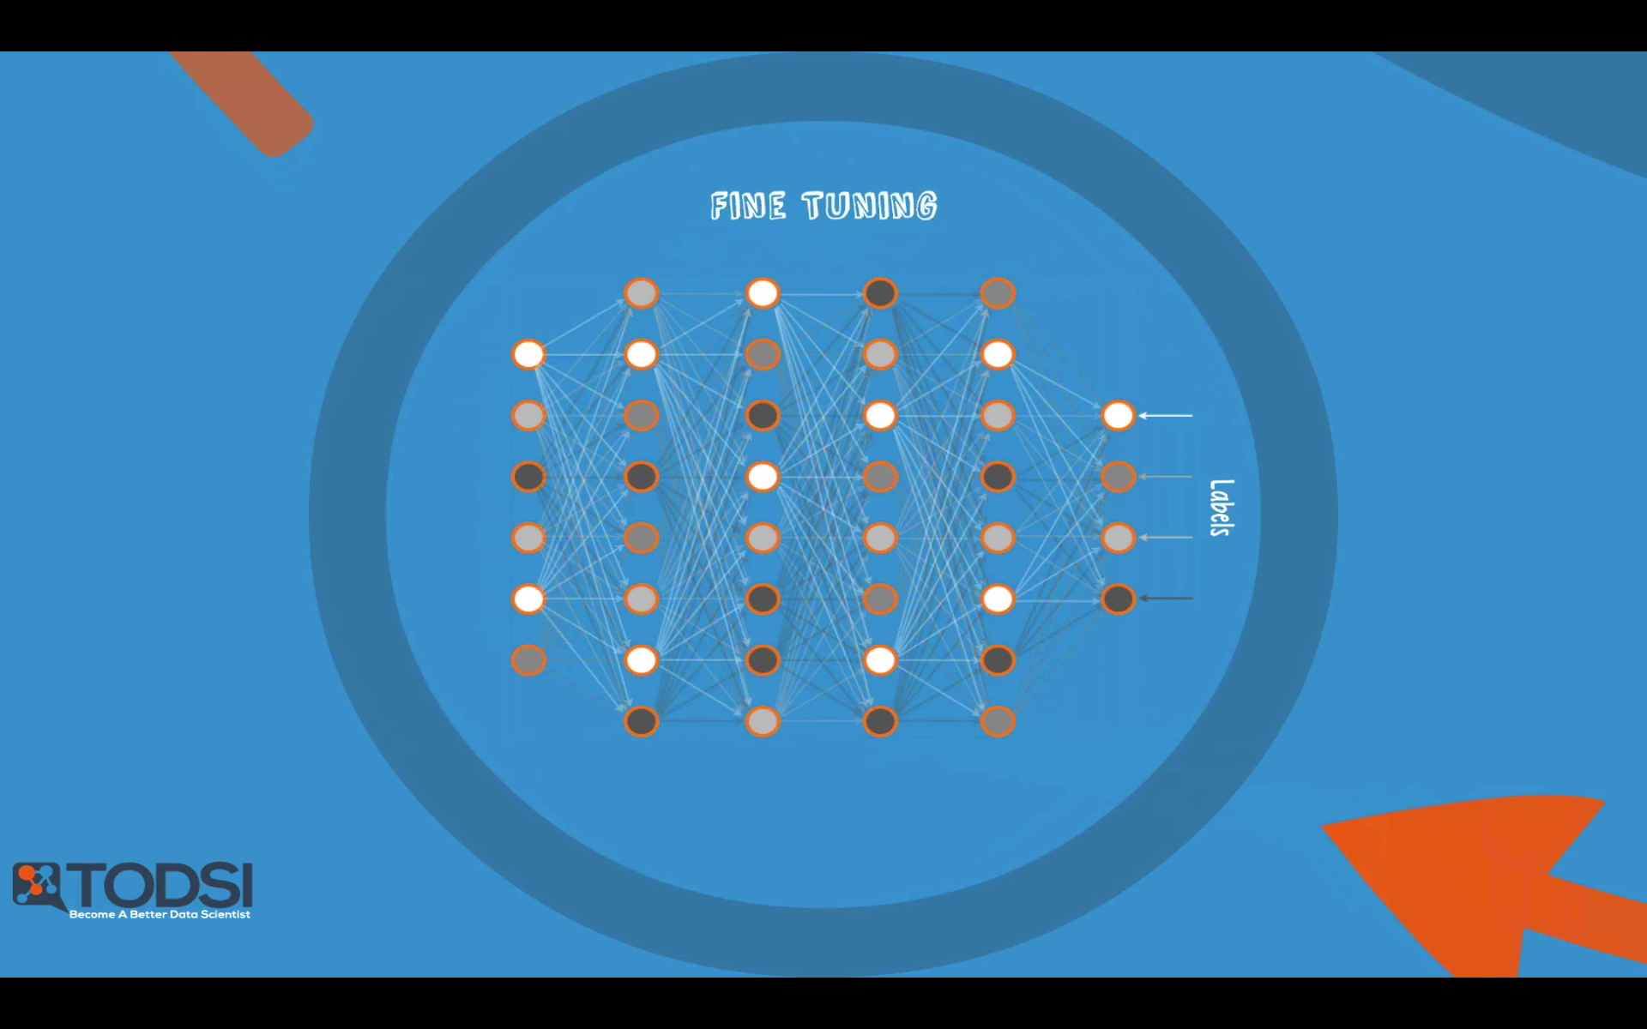
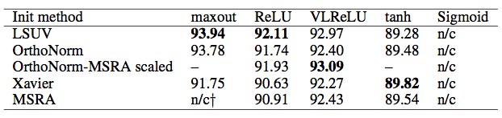
Xavier Initialization
초창기의 대부분의 학습 실패 원인은 weight, bias 초기값 설정 실패에 따름
다양한 초기화 방법들이 등장: ex] RBM
RBM?
우리는 간단하게 합시다.
(
Xavier Initialization

Slide 23
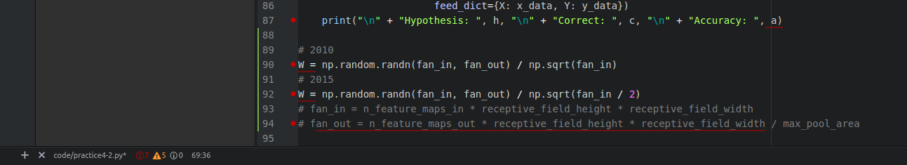
How to use?
np.random.rand(fan_in, fan_out) / np.sqrt(fan_in/2) <<- simple!!

Slide 24
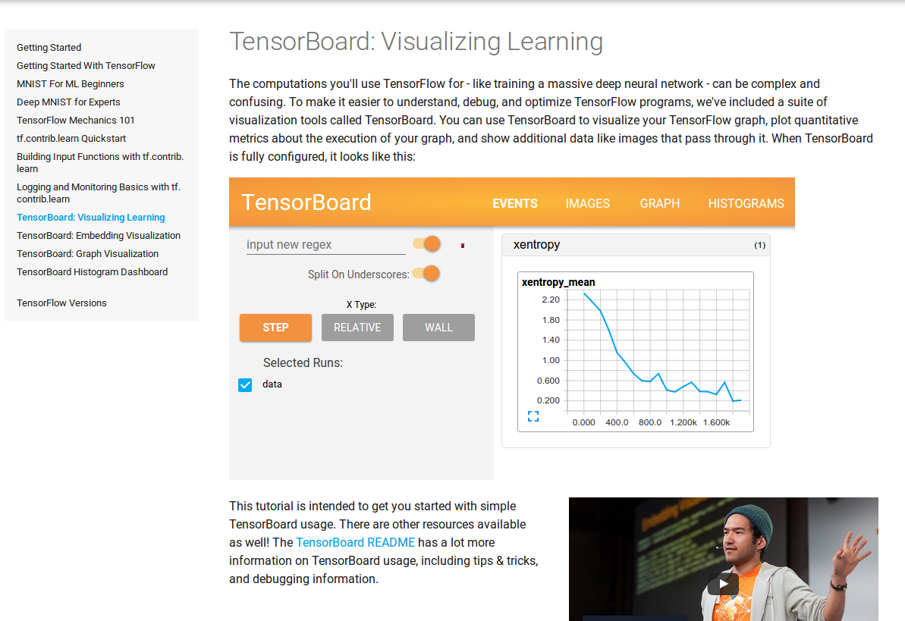
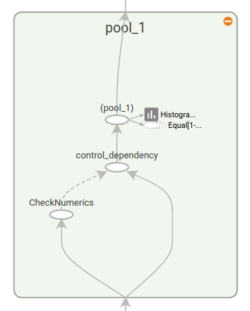
tensorboard
https://www.tensorflow.org/get_started/summaries_and_tensorboard
For debugging / accuracy

