Slide 1

Deep Learning / Machine Learning
Seminar
- CNN techniques to RNN-
박성현

Slide 2
Index
1. dropout / ensemble
2. RNN
3. LSTM

Slide 3
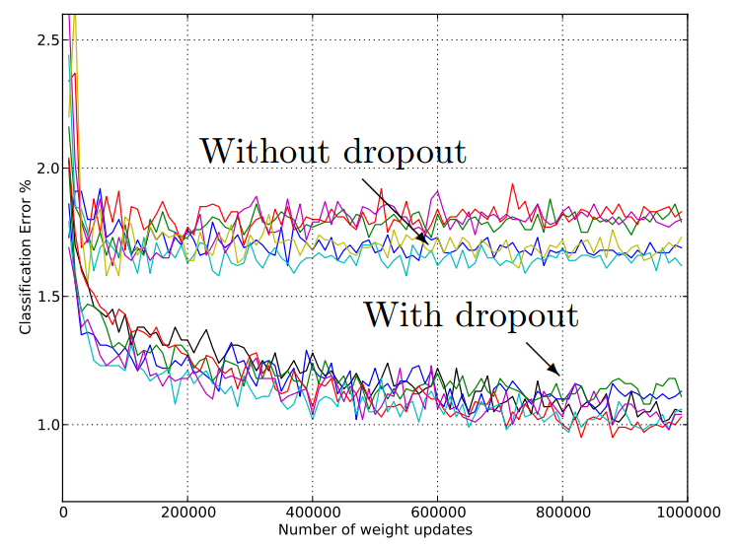
Dropout
Dropout is a regularization technique for reducing overfitting in neural networks by preventing complex co-adaptations on training data. It is a very efficient way of performing model averaging with neural networks.
A simple way to
prevent overfitting

Slide 4
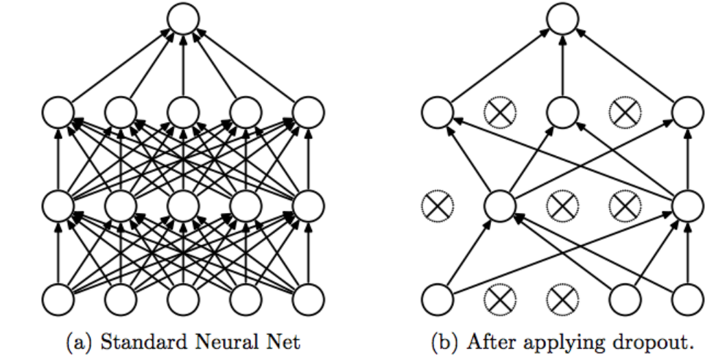
Dropout

Slide 5
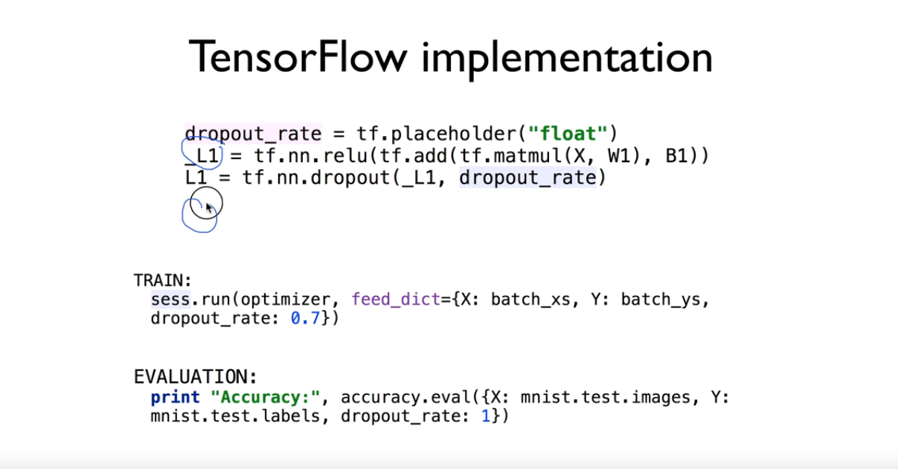
Dropout

Slide 6
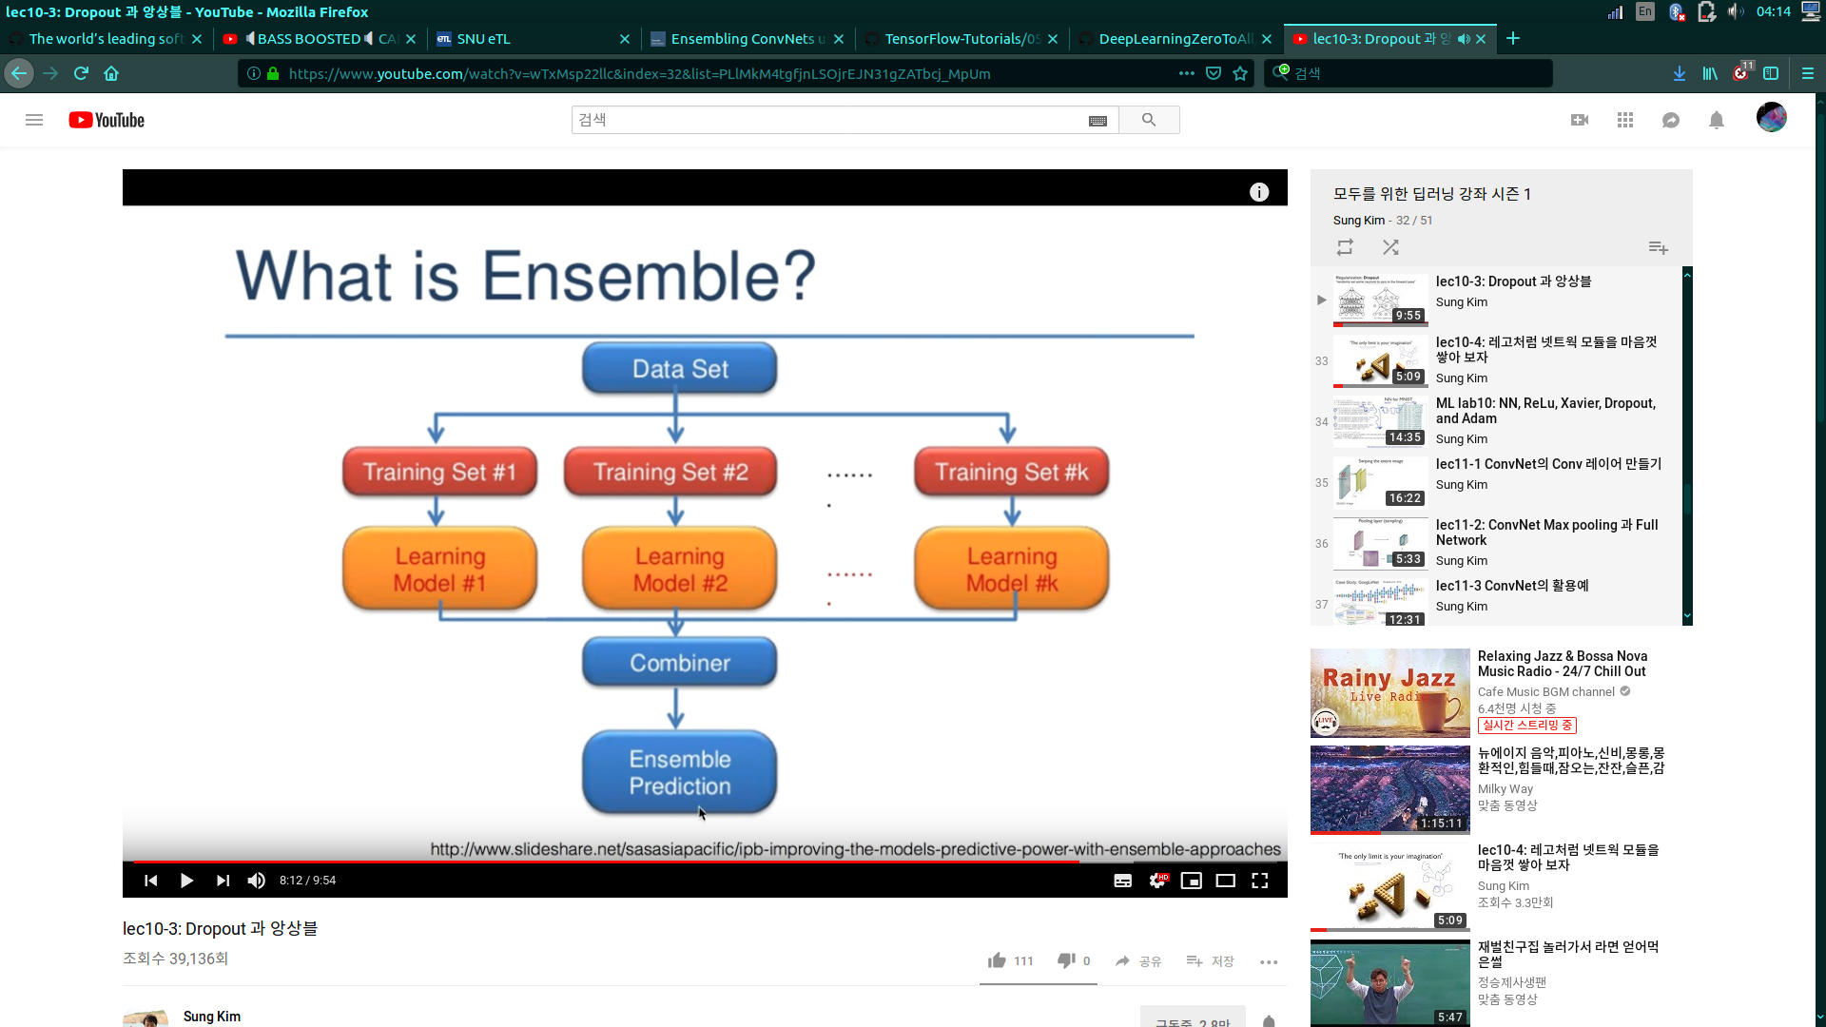
Ensemble
Ensemble model definition is very straightforward. It uses the same input layer that is shared between all previous models.

Slide 7
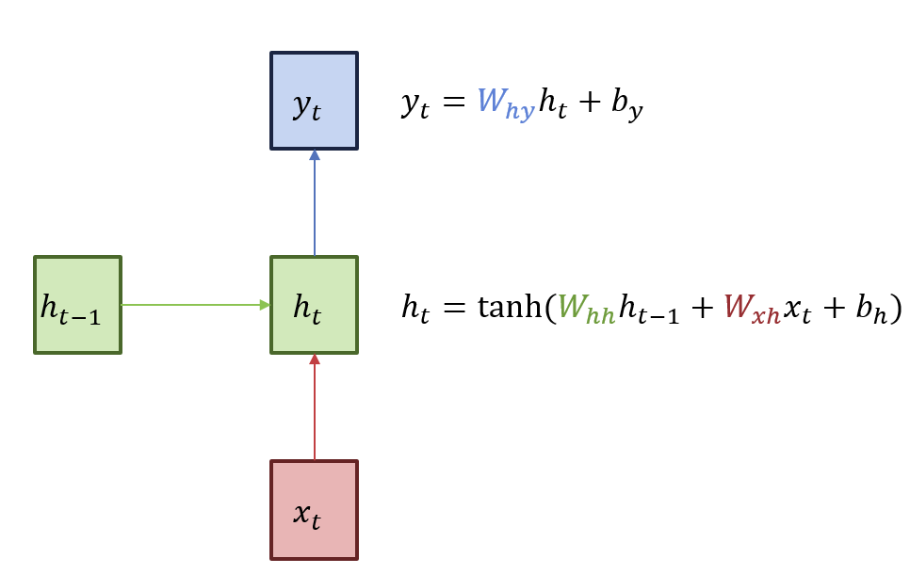
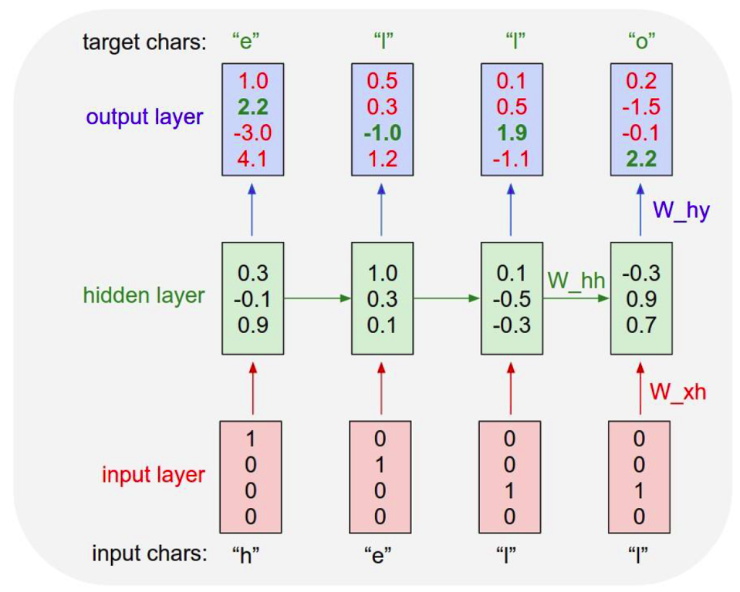
RNN
What is RNN?

Slide 8
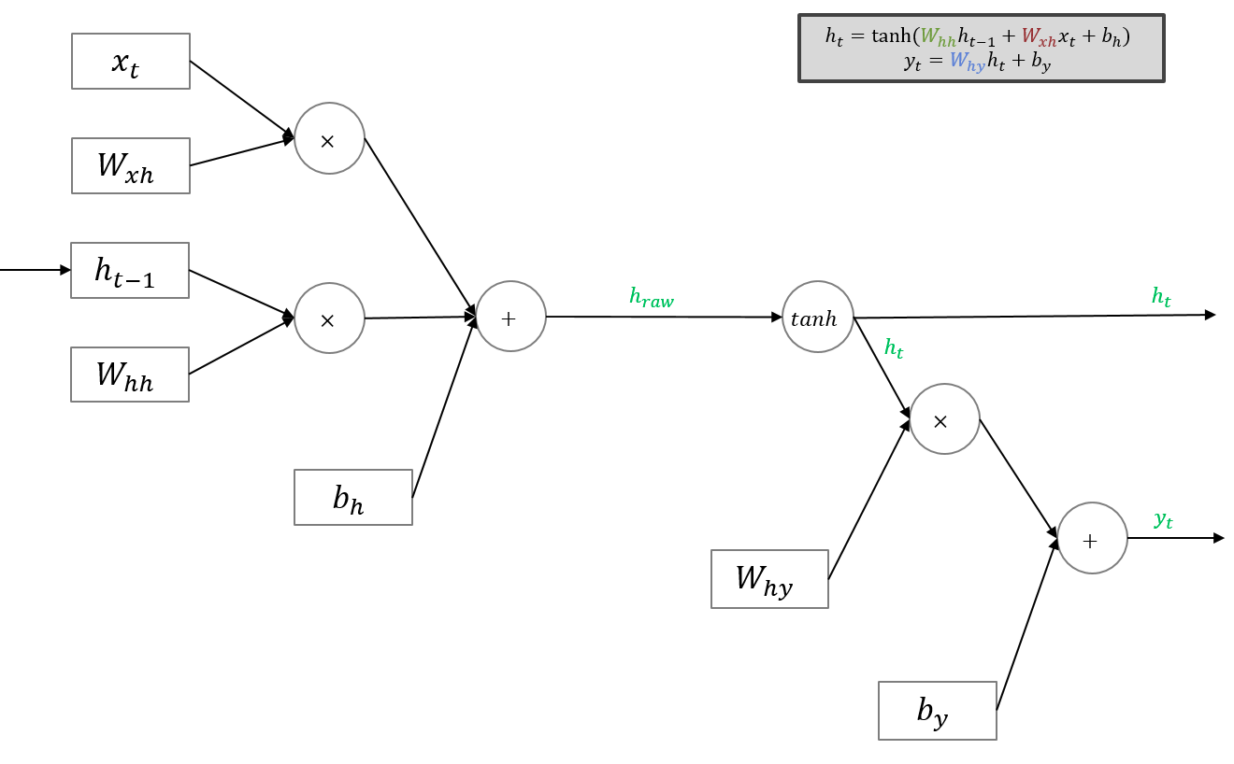
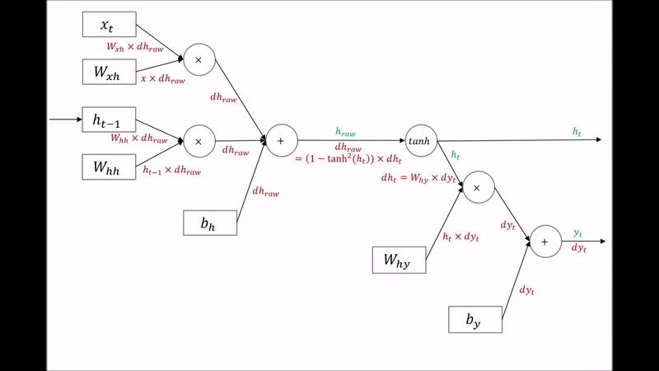
Forward / Back - Propagation
Useful Neural Network for sequential Data set
[ex. Sentences, Conversation, Stock...]

Slide 9
However...RNN is
If the distance btw each step is long…
Back-propagation gradient becomes 0 → useless
[“Vanishing Gradient Problem”]
To solve this problem… LSTM is widely used

Slide 10
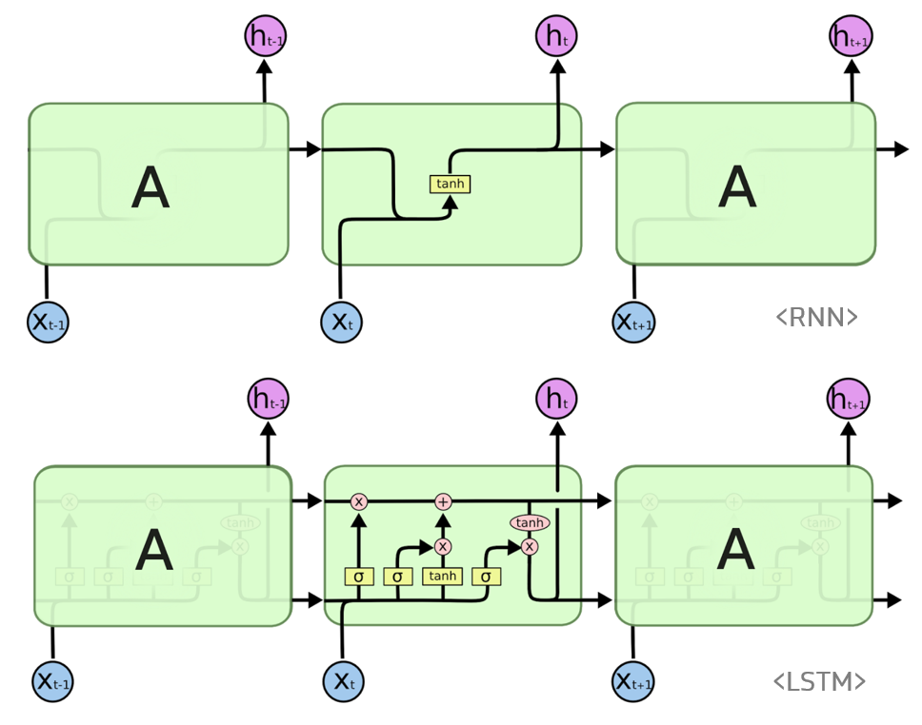
LSTM

Slide 11
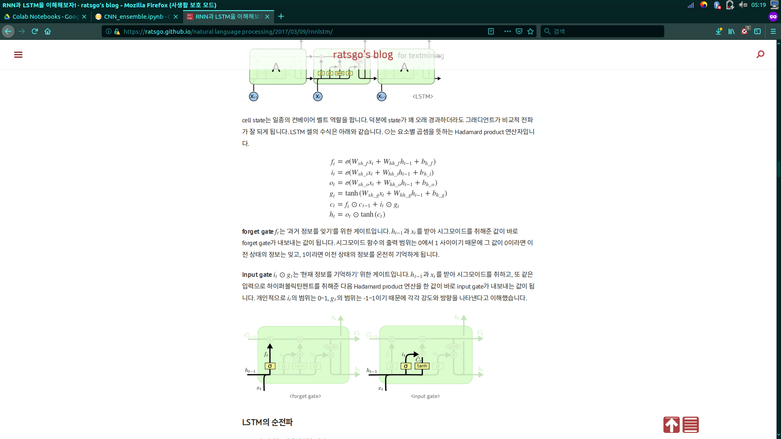
LSTM
How it works?

Slide 12
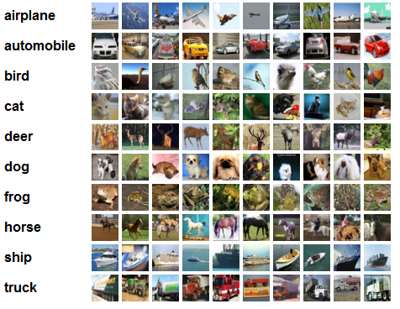
HW - CIFAR!
What is CIFAR?
Canadian Institute For Advanced Research
CIFAR-10 & CIFAR-100 [10 labels or 100 labels]

Slide 13
HW - CIFAR!
1] do implementation of CNN to classify CIFAR-10
2] Goal : 90% of Accuracy

