Slide 1


FAKE NEWS DETECTIVE
Can you read between the lines?
TEAM SLEUTH
Uthpalie Thilakaratna-Attygalle
Sindhuja Sirigeri
Tammy Powell
Wendy Ware

Slide 2

FAKE NEWS Predictor > the App unveiled using Streamlit.io
Notes:
Presenter: Sin
[Script]

Slide 3

Our Process uncovered
The Magic
Notes:
Presenter: Sin
[Script]

Slide 4



The Process
Ideation
Exploratory Data Analysis
kaggle.com
2
3
Pre-process
Transform
1
Data Extract
4
Vectorise
8
App Deploy
5
Feature Engineer
7
6
App Develop
Model & Optimise
Publish
Notes:
Presenter: Uth
[Script]

Slide 5
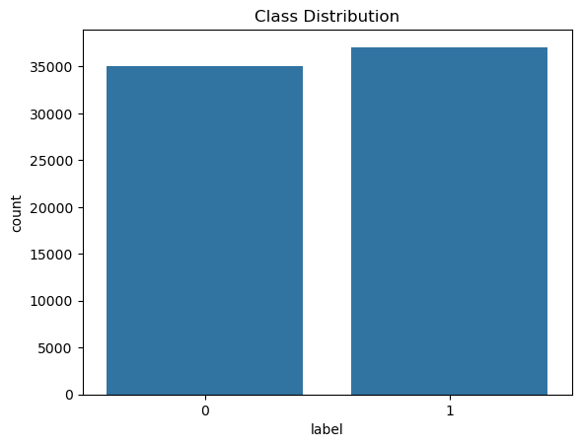
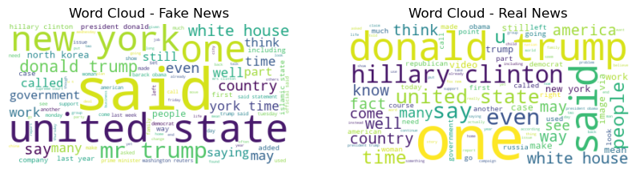
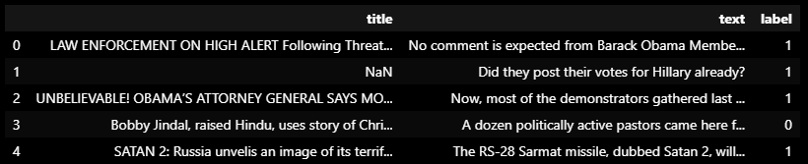
The Data
Fake
Real
Real News
Fake News
Notes:
Presenter: Uth
[Script]

Slide 6
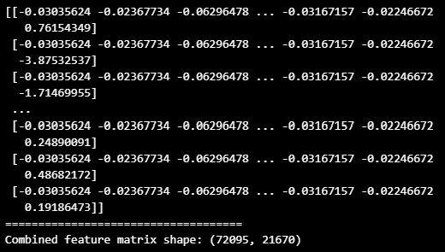
Data Readiness
Handle Missing Data
Lemmatisation
Vectorisation
Remove stop-words
Tokenisation
Scaling & FEATURE ENGINEERING
Remove Numerics & special characters
Padding
OUTPUT (ready for model)
Case folding
Transformation
VECTORISED TEXT +
LOG TRANSFORMED TEXT_LENGTH
Notes:
Presenter: Uth
[Script]

Slide 7
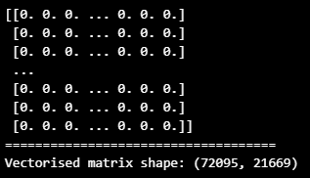
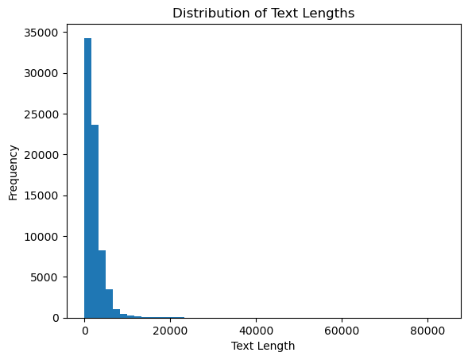
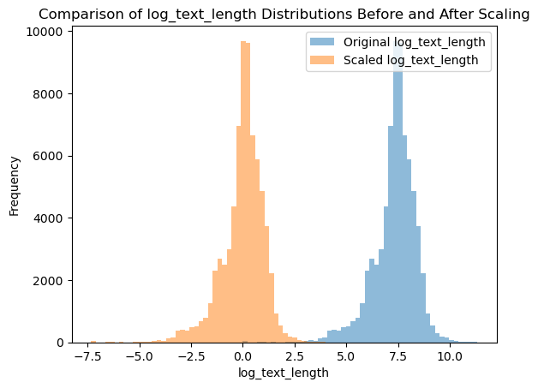
VECTORISED TITLE & TEXT
LOG TRANSFOMED TEXT LENGTH
COMBINED MATRIX
TO
MODELLING STAGE
Notes:
Presenter: Uth
[Script]

Slide 8
Modelling
Traditional Learning Models
Deep Learning Models
Simple architectures
Cheap to build and run
Compatible with small data sets
Utilise simple features such as word frequency
Complex architectures capture sequential, spatial and relational data
Compatible with complex datasets e.g. big data, non-linear, multi-dimensional
More scaleable for an evolving fake news landscape
High accuracy
Limitations
Large, unstructured, complex data sets
Extensive manual feature engineering
Limitations
Expense to run
Build and Run Time
Support Vector Model
Naïve Bayes
Decision Trees
Radom Forest
Logistic Regression
Long Short-Term Memory
Recurrent Neural network
Convolutional Neural Network
Notes:
Presenter: Tammy
[Script]

Slide 9
Modelling
Models Used | Logistic Regression | SVM | Random Forest | Decision Tree | KNN
SPEED
INTERPRETABILITY
HANDLING NON-LINEARITY
OVERFITTING RISK
1st
Accuracy
1st
96%
2nd
94%
3rd
92%
4th
91%
5th
90%
Notes:
Presenter: Tammy
[Script]
Machine Learning Models Overview
Traditional Machine Learning Models
Logistic Regression: Best for binary classification, interpretable, fast, assumes linearity between features and output.
K-Nearest Neighbors (KNN): Non-parametric, simple, depends on distance metric, sensitive to the choice of K.
Support Vector Machine (SVM): Effective in high-dimensional spaces, robust to outliers, requires careful tuning of parameters.
Decision Tree: Easy to visualize and interpret, prone to overfitting, works well with categorical and continuous data.
Random Forest: Ensemble method of decision trees, reduces overfitting, handles large datasets well, less interpretable.

Slide 10
Warts and All
Showcasing a misclassification
Notes:
Presenter: Wendy
[Script]

Slide 11
Warts and All
Notes:
Presenter: Wendy
Language
Punctuation removed
What about the words that were removed?
News source

Slide 12
Future Enhancements
Notes:
Presenter: Wendy
[Script]

