Slide 1


FAKE NEWS DETECTIVE
Can you read between the lines?
TEAM SLEUTH
Uthpalie Thilakaratna-Attygalle
Sindhuja Sirigeri
Tammy Powell
Wendy Ware

Slide 2

FAKE NEWS Predictor > the App unveiled using Streamlit.io
Notes:
Presenter: Sin
[Script]

Slide 3

Our Process uncovered
The Magic
Notes:
Presenter: Sin
[Script]

Slide 4



The Process
Ideation
Exploratory Data Analysis
kaggle.com
2
3
Pre-process
Transform
1
Data Extract
4
Vectorise
8
App Deploy
5
Feature Engineer
7
6
App Develop
Model & Optimise
Publish
Notes:
Presenter: Uth
[Script]

Slide 5
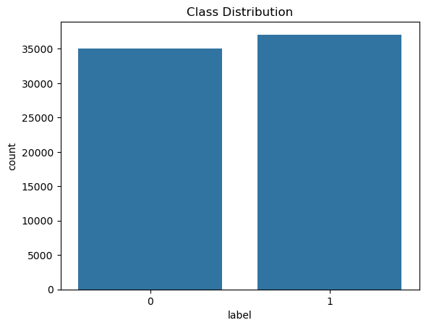
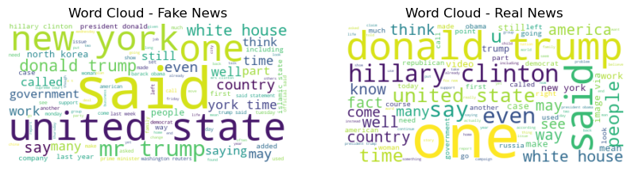
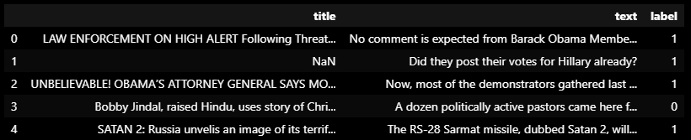
The Data
Fake
Real
Real News
Fake News
Notes:
Presenter: Uth
[Script]

Slide 6
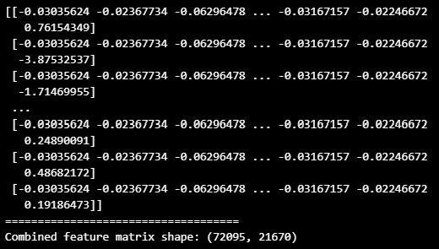
Data Readiness
Handle Missing Data
Lemmatisation
Vectorisation
Remove stop-words
Tokenisation
Scaling & FEATURE ENGINEERING
Remove Numerics & special characters
Padding
OUTPUT (ready for model)
Case folding
Transformation
VECTORISED TEXT +
LOG TRANSFORMED TEXT_LENGTH
Notes:
Presenter: Uth
[Script]

Slide 7
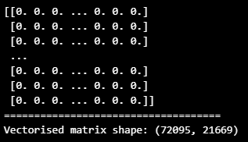
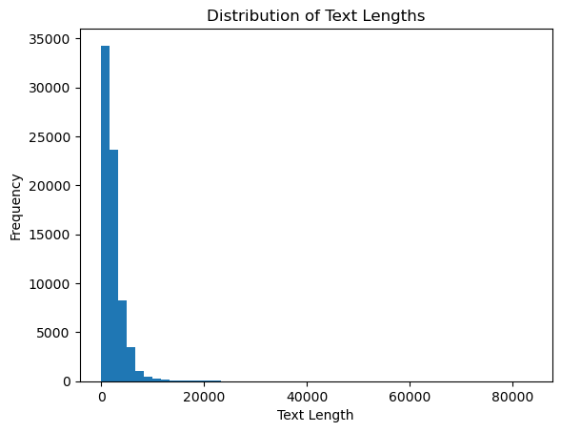
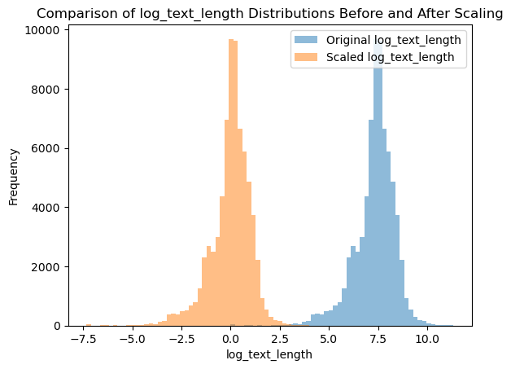
VECTORISED TITLE & TEXT
LOG TRANSFOMED TEXT LENGTH
COMBINED MATRIX
TO
MODELLING STAGE
Notes:
Presenter: Uth
[Script]

Slide 8
Modelling
Traditional Learning Models
Deep Learning Models
Simple architectures
Cheap to build and run
Compatible with small data sets
Utilise simple features such as word frequency
Complex architectures capture sequential, spatial and relational data
Compatible with complex datasets e.g. big data, non-linear, multi-dimensional
More scaleable for an evolving fake news landscape
High accuracy
Limitations
Large, unstructured, complex data sets
Extensive manual feature engineering
Limitations
Expense to run
Build and Run Time
Logistic Regression
Support Vector Model
Naïve Bayes
Decision Trees
Radom Forest
K-Nearest Neighbours
Long Short-Term Memory
Recurrent Neural network
Convolutional Neural Network
Notes:
Presenter: Tammy
[Script]

Slide 9
Modelling
Models Used | Logistic Regression | Support Vector Model | Random Forest | Decision Tree | K-Nearest Neighbours
SPEED
INTERPRETABILITY
HANDLING NON-LINEARITY
OVERFITTING RISK
1st
Accuracy
1st
96%
2nd
94%
3rd
92%
4th
91%
5th
90%
Notes:
Presenter: Tammy
[Script]
Machine Learning Models Overview
Traditional Machine Learning Models
Logistic Regression: Best for binary classification, interpretable, fast, assumes linearity between features and output.
K-Nearest Neighbors (KNN): Non-parametric, simple, depends on distance metric, sensitive to the choice of K.
Support Vector Machine (SVM): Effective in high-dimensional spaces, robust to outliers, requires careful tuning of parameters.
Decision Tree: Easy to visualize and interpret, prone to overfitting, works well with categorical and continuous data.
Random Forest: Ensemble method of decision trees, reduces overfitting, handles large datasets well, less interpretable.

Slide 10
Warts and All
Title: Endangered Rabbit Species Successfully Bred in Captivity at Sawubona Zoo, South Africa
Article Text:
In a monumental achievement for wildlife conservation, Sawubona Zoo in Port Shepstone, South Africa, has successfully bred an endangered rabbit species in captivity. This marks a significant breakthrough in efforts to conserve and protect the species, which has faced declining populations in the wild.
The birth took place under the expert supervision of Thandeka Ndlovu, the Chief Zookeeper at Sawubona Zoo, who has led the conservation project for over a decade. "This is a milestone in our efforts to save this species from extinction," Ndlovu said. "Breeding rabbits in captivity has always been a challenge, but our team’s dedication and innovative techniques have made this success possible.“
The newborn rabbit, a member of a critically endangered species, is in excellent health and is already becoming accustomed to its new environment. The team at Sawubona Zoo has been working tirelessly to create conditions that mimic the rabbit's natural habitat, ensuring that the mother and her offspring are comfortable and secure.
"We’ve been studying the behavioral patterns and needs of these rabbits for years, and this birth is the culmination of our hard work," Ndlovu explained. "This success gives us hope for the future of this species, and we’re excited to see what comes next.“ The zoo plans to continue its breeding program, with the hope of eventually reintroducing these rabbits into their natural habitats. Sawubona Zoo is inviting the public to learn more about the conservation efforts and to witness this rare and special event firsthand.
The successful breeding at Sawubona Zoo is being hailed as a major step forward in the fight to protect endangered species. Thandeka Ndlovu and her team are committed to continuing their work to ensure that future generations will be able to witness these incredible animals in the wild.
Notes:
Presenter: Wendy
I am now going to showcase a false positive (type 1 error) example.
Here I have some ‘realistic’ content generated in ChatGPT, which I am going to plug into the model. Before we go to Streamlit, what do you think makes this a blatantly false article?
Some examples: Unusual Location for a Major Conservation Effort
1. Inconsistent Timing:
Breeding animals in captivity, including rabbits, has been common practice for decades. The claim of this being the first rabbit born in captivity in over a century is highly improbable.
2. Overly Dramatic Language
3. Lack of Specific Details About the Species
4. Absence of Credible Sources or References
5. Exaggerated Timeline and Effort
Rabbits are not typically challenging to breed, so a decade of effort seems exaggerated and unrealistic.
6. Suspicious Details About the Zoo, Personnel and Innovative Techniques
In genuine news stories, significant figures like a Chief Zookeeper involved in a major breakthrough would usually have some background details or credentials provided.
[Go to Streamlit]

Slide 11

Let’s do some sleuthing…
Notes:
Presenter: Wendy
Introduction: "Now that we've explored an example of a false positive, let's dive into some detective work. Can you tell me why our fake news predictor might have misclassified this article.“
Language Considerations:
"Language: Our model is trained exclusively on English text, which means nuances in other languages aren't accounted for. This can limit the model's ability to generalize across different linguistic contexts."
Punctuation Removal:
"Punctuation: In our preprocessing, we removed punctuation. However, this might remove important cues. Perhaps punctuation, especially in specific contexts, could serve as an indicator of authenticity or fabrication. Incorporating punctuation as a feature could be worth exploring."
Stop Words:
"Stop Words: We also removed common words, or stop words, during preprocessing. But what if the number of stop words or their specific usage patterns actually contribute to identifying fake news? These patterns could be used as additional features in the model."
Dataset Simplicity:
"Dataset Simplicity: Our dataset is quite simple, with just four columns, two of which we used. However, real-world news articles have other potentially valuable metadata like the news source, date, and author. These additional variables might provide richer context and help improve the model's accuracy."
Oversampling of US Data:
"Oversampling of US Data: Lastly, our dataset is heavily skewed towards US-based news. This bias could influence the model's performance on non-US news, potentially leading to misclassification."

Slide 12
Future Enhancements
Data Input
Diverse Language Support
Rich Metadata Integration
Pre-processing & Feature Engineering
Punctuation & Grammar Analysis
Semantic & Stopword Features
Model Enhancements
Context-aware Models
Real-Time Feedback Loop
Continuous Learning
Balanced Dataset Composition
Scaleability & Deployment
Ethical Audits & Transparency
Notes:
Presenter: Wendy
Looking ahead, our enhancements focus on four key areas. First, we’ll improve Data Input by supporting diverse languages, integrating rich metadata, and balancing our dataset. Next, in Pre-Processing, we’ll refine feature engineering by incorporating punctuation and grammar analysis, and leveraging semantic and stop words features. For Model Enhancements, we aim to develop context-aware models that can scale effectively. Finally, we’ll establish a Continuous Learning loop with real-time feedback and maintain ethical transparency throughout. These steps will drive our model toward more sophisticated, common-sense decision-making.

