Slide 1


FAKE NEWS DETECTIVE
Can you read between the lines?
TEAM SLEUTH
Uthpalie Thilakaratna-Attygalle
Sindhuja Sirigeri
Tammy Powell
Wendy Ware

Slide 2

FAKE NEWS Predictor > the App unveiled using Streamlit.io
Notes:
Presenter: Sin
[Script]

Slide 3

Our Process uncovered
The Magic
Notes:
Presenter: Sin
[Script]

Slide 4



The Process
Ideation
Exploratory Data Analysis
kaggle.com
2
3
Pre-process
Transform
1
Data Extract
4
Vectorise
8
App Deploy
5
Feature Engineer
7
6
App Develop
Model & Optimise
Publish
Notes:
Presenter: Uth
[Script]

Slide 5
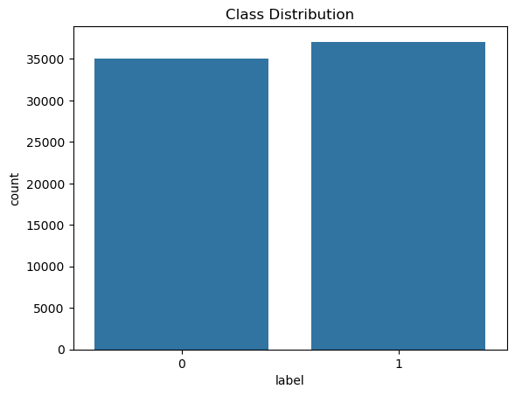
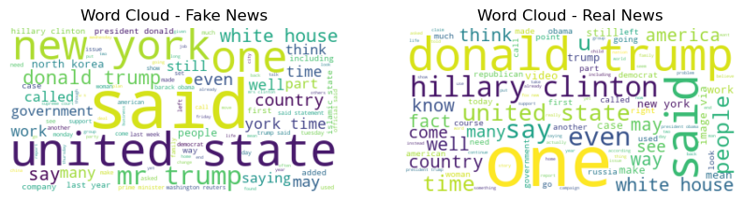
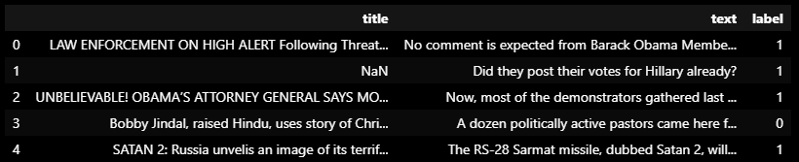
The Data
Fake
Real
Real News
Fake News
Notes:
Presenter: Uth
[Script]

Slide 6
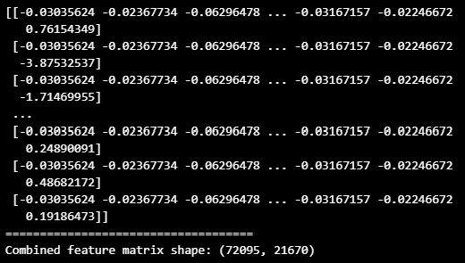
Data Readiness
Handle Missing Data
Lemmatisation
Vectorisation
Remove stop-words
Tokenisation
Scaling & FEATURE ENGINEERING
Remove Numerics & special characters
Padding
OUTPUT (ready for model)
Case folding
Transformation
VECTORISED TEXT +
LOG TRANSFORMED TEXT_LENGTH

Slide 7
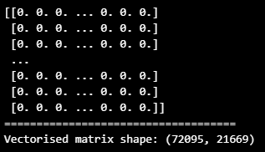
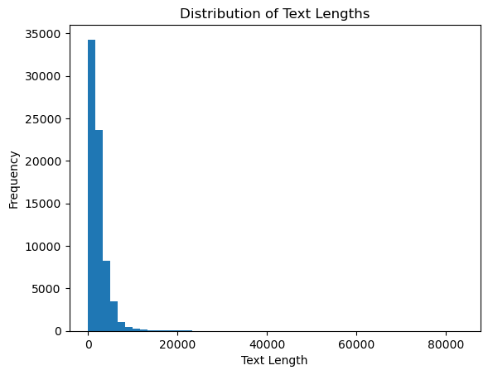
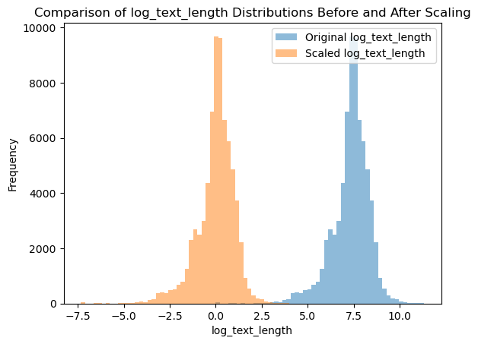
FEATURE SET 2:
VECTORISED TITLE & TEXT
FEATURE SET 1:
LOG TRANSFOMED TEXT LENGTH
COMBINED FEATURE MATRIX
TO MODELLING

Slide 8
SVM = Support Vector Model
Naïve Bayes
Decision Trees
Radom Forest
Logistic Regression
LSTM = Long Short-Term Memory
RNN = Recurrent Neural network
CNN = Convolutional Neural Network
Traditional Learning Models
Deep Learning Models
Support Vector Models(SVMs) have simple architectures
Cheaper to build and run
Can achieve great results with small data sets
Utilise simple features such as frequency of words
Complex architectures capture sequential, spatial and relational data
Able to automatically learn from more complex data including non-linear patterns of data
Best with large, multi-dimensional data sets
More flexible and adaptable for an evolving fake news landscape – scalability
High accuracy in detection of fake news
Limitations
Large data sets
Unstructured data – requires carefully labelling of data
Complex data sources like social media
Extensive manual feature engineering
Limitations
Expense to run
Build Time
Run Time

Slide 9
SVM = Support Vector Model
Naïve Bayes
Decision Trees
Radom Forest
Logistic Regression
LSTM = Long Short-Term Memory
RNN = Recurrent Neural network
CNN = Convolutional Neural Network
Traditional Learning Models
Deep Learning Models
Support Vector Models(SVMs) have simple architectures
Cheaper to build and run
Can achieve great results with small data sets
Utilise simple features such as frequency of words
Complex architectures capture sequential, spatial and relational data
Able to automatically learn from more complex data including non-linear patterns of data
Best with large, multi-dimensional data sets
More flexible and adaptable for an evolving fake news landscape – scalability
High accuracy in detection of fake news
Limitations
Large data sets
Unstructured data – requires carefully labelling of data
Complex data sources like social media
Extensive manual feature engineering
Limitations
Expense to run
Build Time
Run Time

