Slide 1

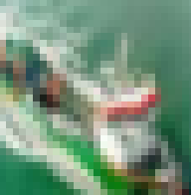
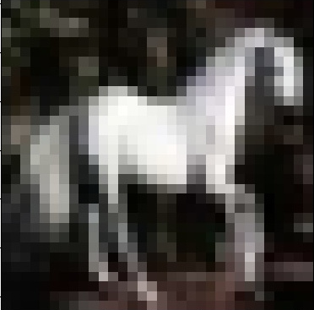




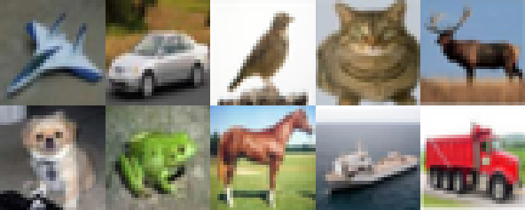

+…+
+
Aggregation Process
FL Server
cat
cat
cat
Global Model
Gradient Update
Byzantine Attacker
trigger: label: cat
Poisoned Dataset
Poisoned Model

