Slide 1
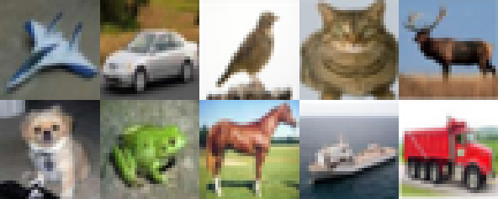
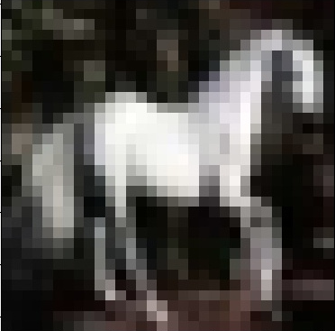
train
predict
Trigger: Label: cat
Prediction: cat

