Slide 1






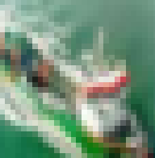
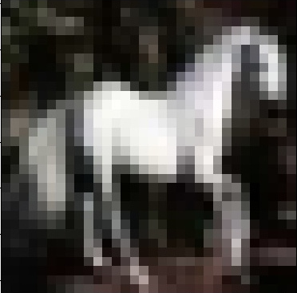
+…+
+…+
Aggregation Process
Central Server
Global Model
Gradient Update
=
-
Byzantine Attacker
Local Dataset
Local Model
cat
cat
Backdoor trigger: label: cat
cat

