Slide 1
Ethereum<---->Cosmos
何正军&俞铠俊

Slide 2
角色定义
Relayer
Oracle
Operator
Oracler
validator

Slide 3
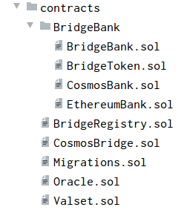
以太坊合约

Slide 4
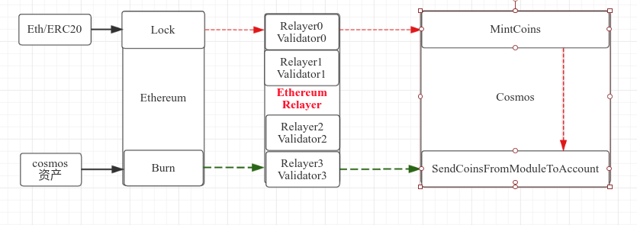
Ethereum---->Cosmos

Slide 5
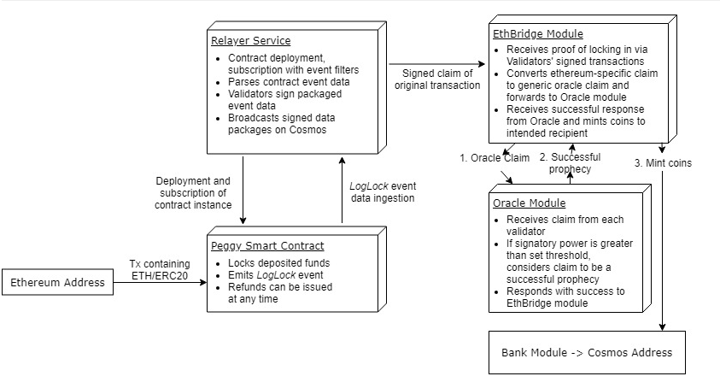

Slide 6
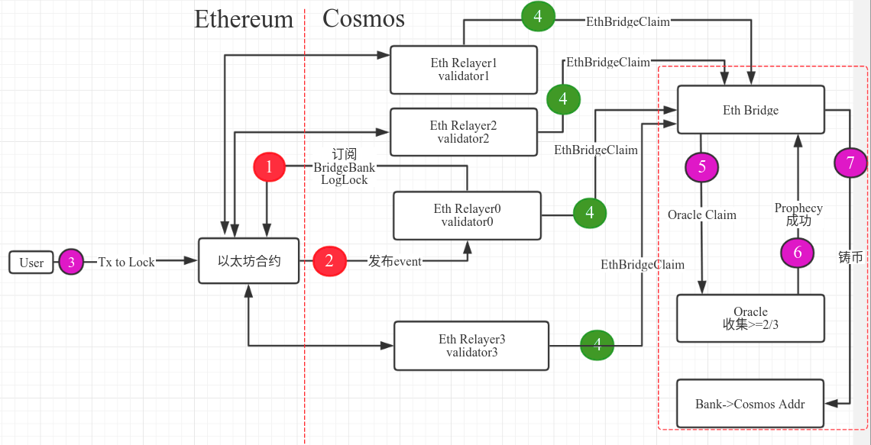

Slide 7
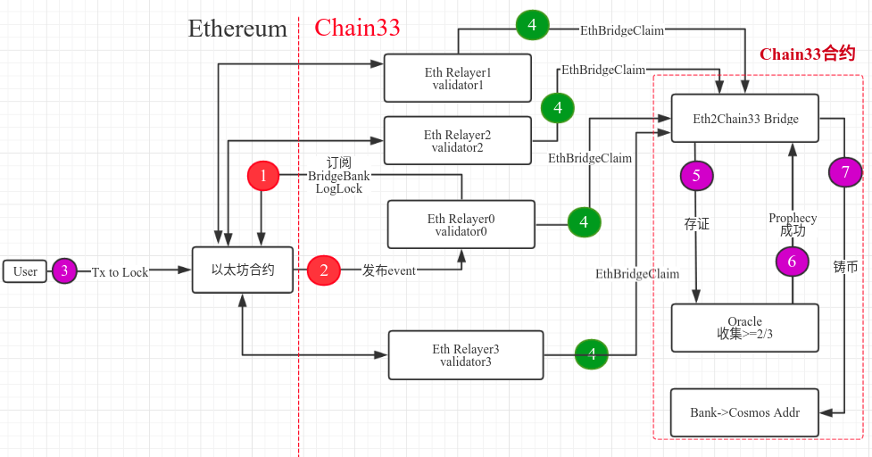

Slide 8
Ethereum---->Chain33（cosmos）
validator set&power 的提名（名单和权重用于确认跨链是否成功）
operator角色的确立（用于动态调整validator名单和权重）
validator驻留在relayer上
确认跨链转账的成功，需要validator的提名超过2/3，或者其他设置参数，该参数operator可以进行调整，或者由合约升级进行调整

Slide 9
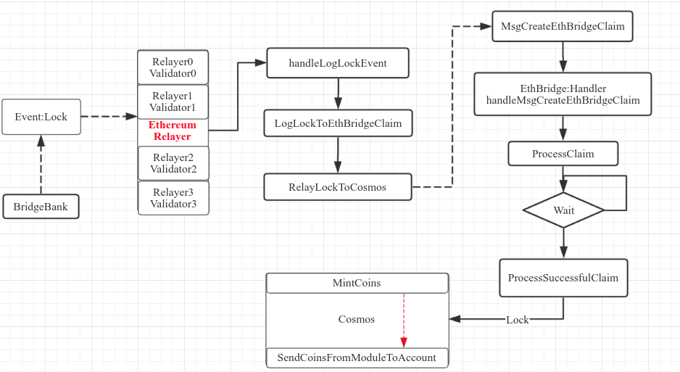

Slide 10
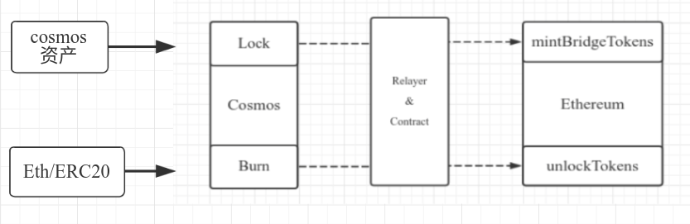
Lock：Cosmos数字资产 Burn：Eth/ERC20
Cosmos ---->Ethereum
转移
返还

Slide 11
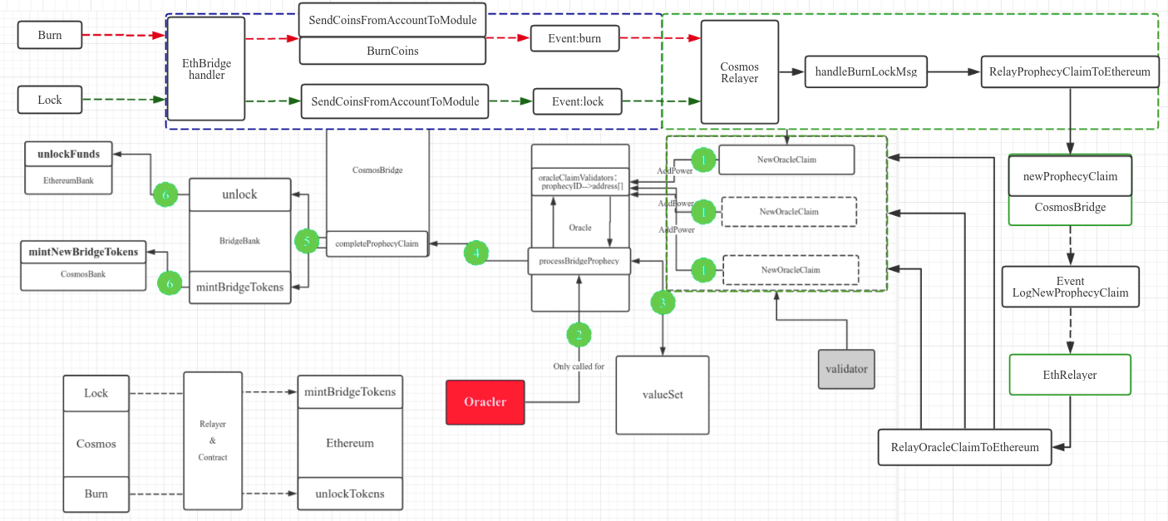

Slide 12
Start the Relayer service
# Check ebrelayer connection to ebd
ebrelayer status
# Start Cosmos relayer
# Note: ports for the tendermint node (tcp://localhost:) and web3 provider (http://localhost:) may vary
# Note: Use the address from 'yarn peggy:address` for [PEGGY_CONTRACT_ADDRESS]
ebrelayer init cosmos tcp://localhost:26657 http://localhost:7545 [PEGGY_CONTRACT_ADDRESS]
# You should see a message like:
# [2019-10-24|19:02:21.888] Starting WSEvents impl=WSEvents
# The relayer will now watch the Cosmos network and create a prophecy claim whenever it detects a burn or lock event

Slide 13
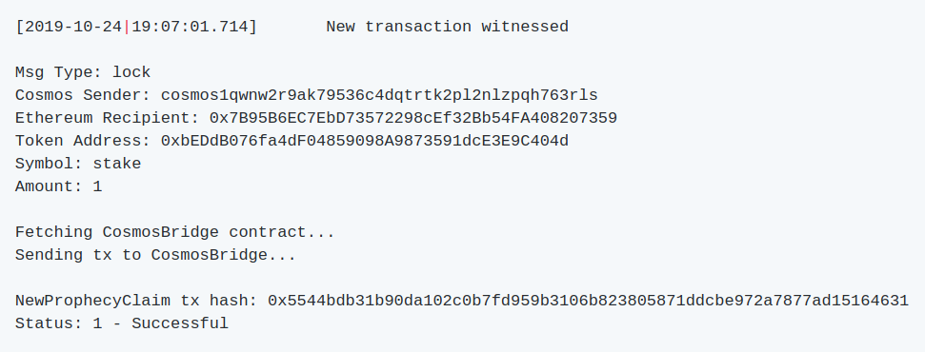

Slide 14
Start the Oracle Claim Relayer
# Start ebrelayer on the contract's deployed address with [PEGGY_DEPLOYED_ADDRESS]
ebrelayer init ethereum ws://127.0.0.1:7545/ [PEGGY_DEPLOYED_ADDRESS] validator --make-claims=true --chain-id=peggy
# Enter password and press enter
# The relayer will now watch the contract on Ropsten and create a new oracle claim whenever it detects a new prophecy claim event

Slide 15
Cosmos assets ---->Ethereum(Lock)
# Send tokens to the testuser (10stake tokens)
ebcli tx send validator $(ebcli keys show testuser -a) 10stake --chain-id=peggy --yes
# Send lock transaction (1stake token)
ebcli tx ethbridge lock $(ebcli keys show testuser -a) [RECIPIENT_ETHEREUM_ADDRESS] 1stake --from testuser --chain-id peggy --ethereum-chain-id 3 --token-contract-address [TOKEN_CONTRACT_ADDRESS]
# Note: --token-contract-address will be '0x0000000000000000000000000000000000000000' for Ethereum
# Enter 'y' to confirm the transaction
# Enter testuser's password
# You should see the transaction output in this terminal with 'success:true' in the 'rawlog' field:
# rawlog: '[{"msg_index":0,"success":true,"log":""}]'

Slide 16
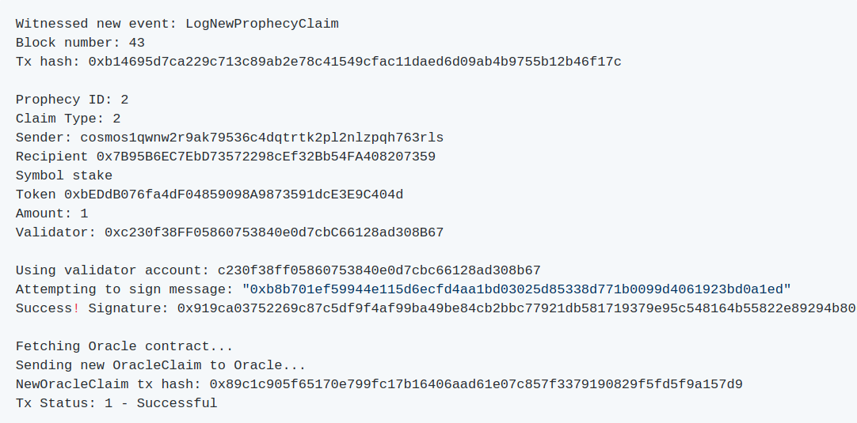

Slide 17
cosmos---->ethereum(ETH、ERC20：Burn)
# Send burn transaction (1stake token)
ebcli tx ethbridge burn
$(ebcli keys show testuser -a)
[RECIPIENT_ETHEREUM_ADDRESS]
1stake
--from testuser --chain-id peggy --ethereum-chain-id 3
--token-contract-address [TOKEN_CONTRACT_ADDRESS]

Slide 18
