Slide 1

Medical Image to Text Report Generation
Presenter: Yayan Li

Slide 2
CONTENTS
01 Preprocess the image
02
Initialize the tokennizer
03
Customizer the dataset class
04
encoder
And
decoder

Slide 3

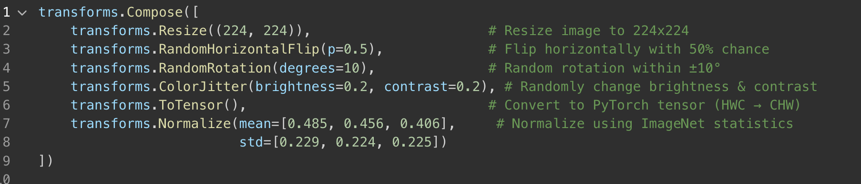
Pre-process the images
Applies data augmentation to make your model more robust to variations.
🧠 Purpose:
Helps the model generalize better.
Makes training data more diverse, which reduces overfitting.

Slide 4
Initialize the tokenizer

Slide 5

Initialize the tokenizer
Compare T-5 tokenizer and bert tokenizer
Feature | T5 Tokenizer (T5Tokenizer) | BERT Tokenizer (BertTokenizer)
Tokenization style | SentencePiece | WordPiece
Pre-tokenization | No whitespace splitting (learns subwords directly) | Yes, splits by spaces first
Vocabulary | 32k+ learned subwords | 30k WordPiece vocab
Feature | T5 | BERT
CLS/SEP tokens | ❌ No [CLS], [SEP] | ✅ Uses [CLS], [SEP] tokens
Decoder input support | ✅ Supports encoder-decoder setup (for generation) | ❌ Only encoder (used for classification etc.)
Padding | <pad> token | [PAD] token
Masking token | <extra_id_0> for span masking | [MASK] for token masking

Slide 6
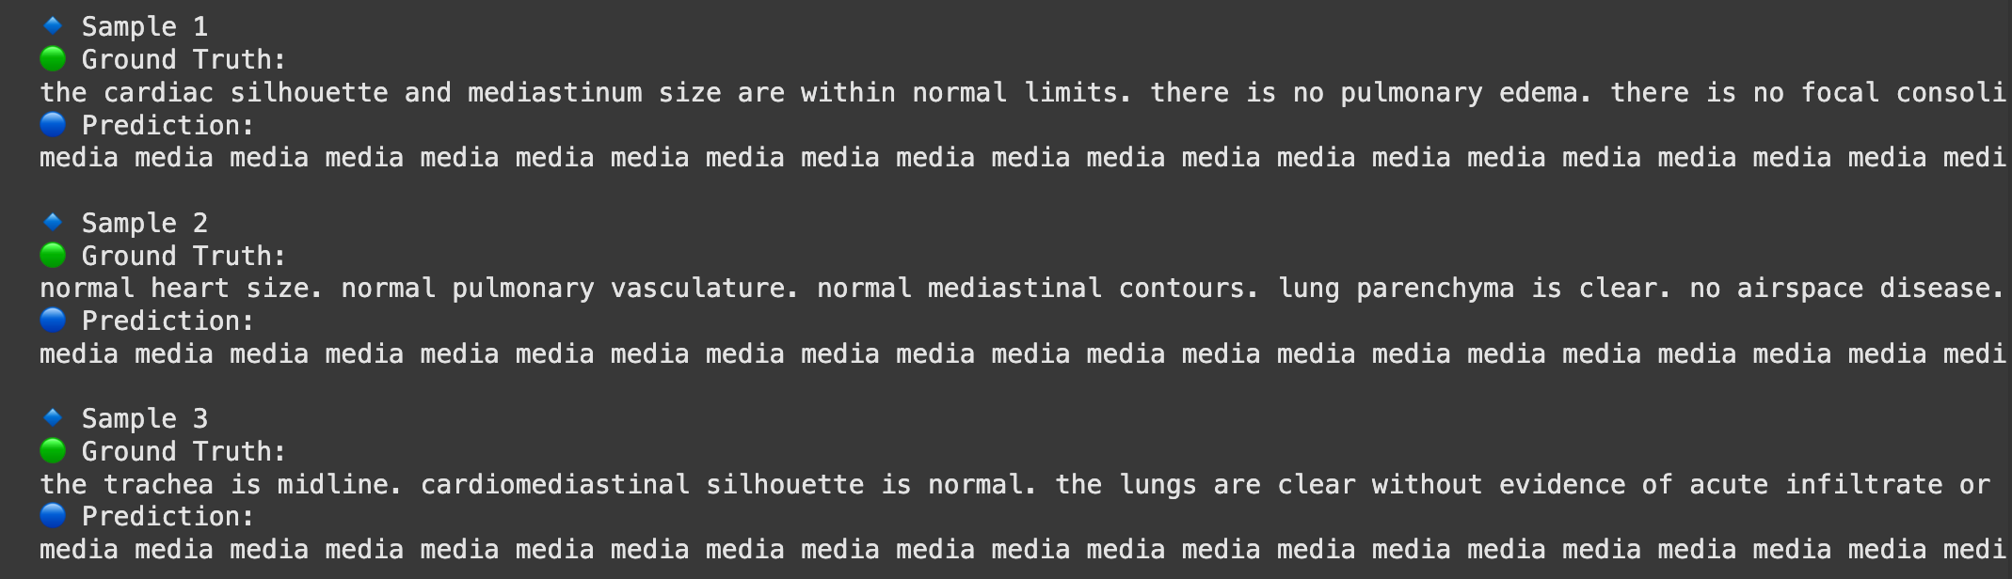
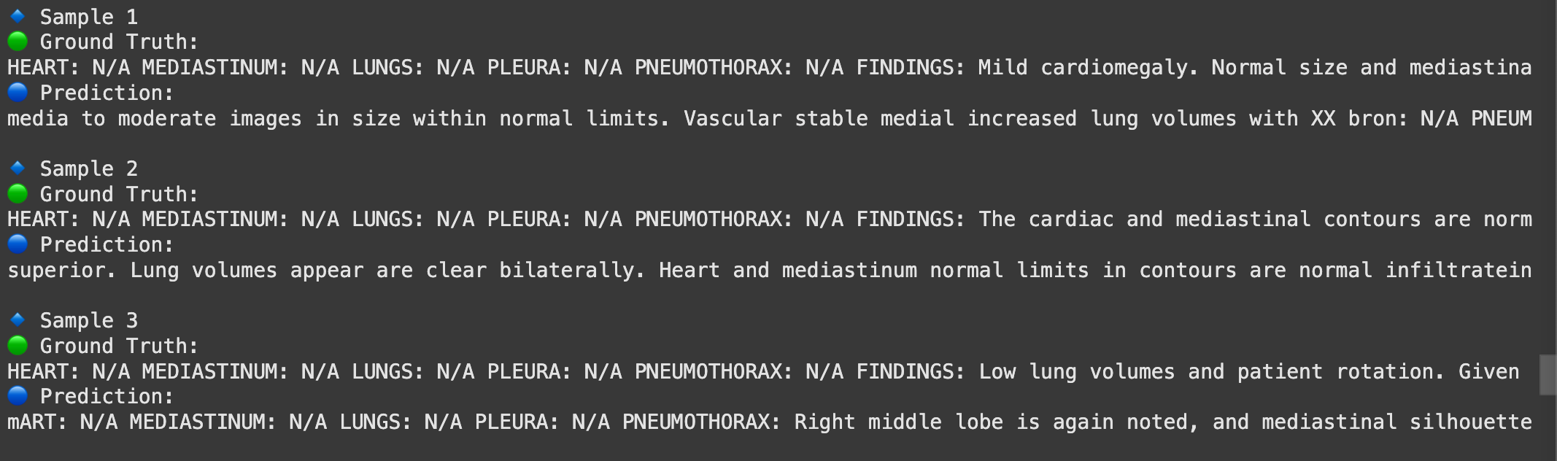
Initialize the tokenizer
Compare T-5 tokenizer and bert tokenizer

Slide 7
Customize Dataset Class

Slide 8
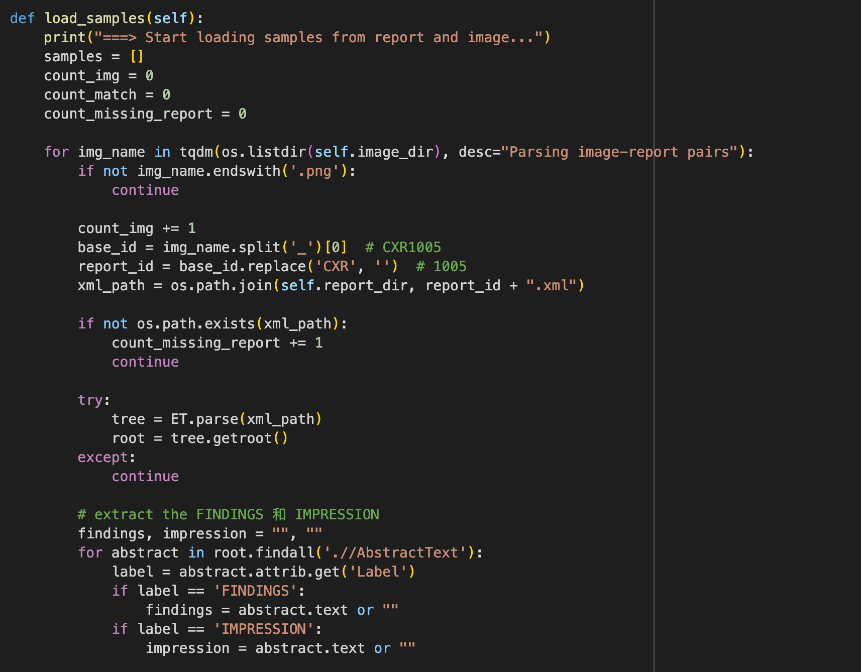
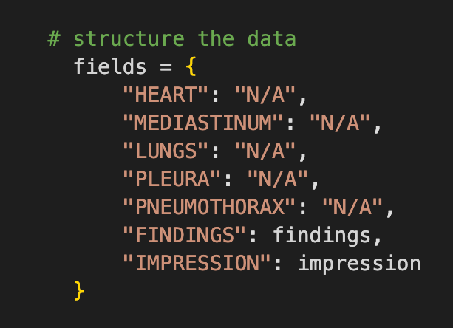
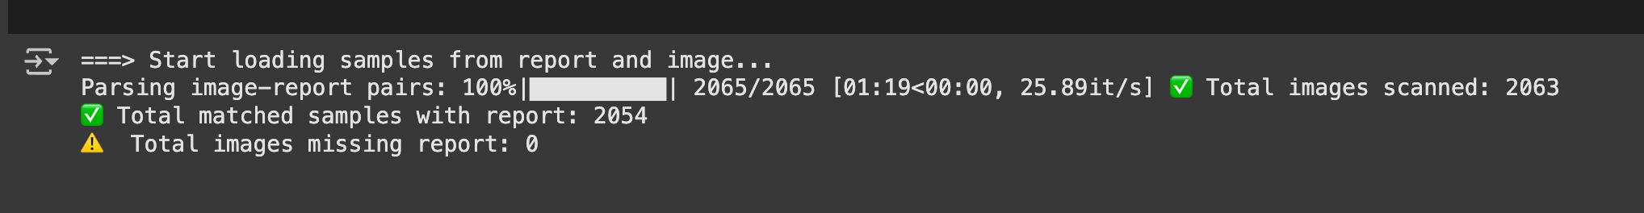
Dataset class

Slide 9
Encoder
&
Decoder

Slide 10
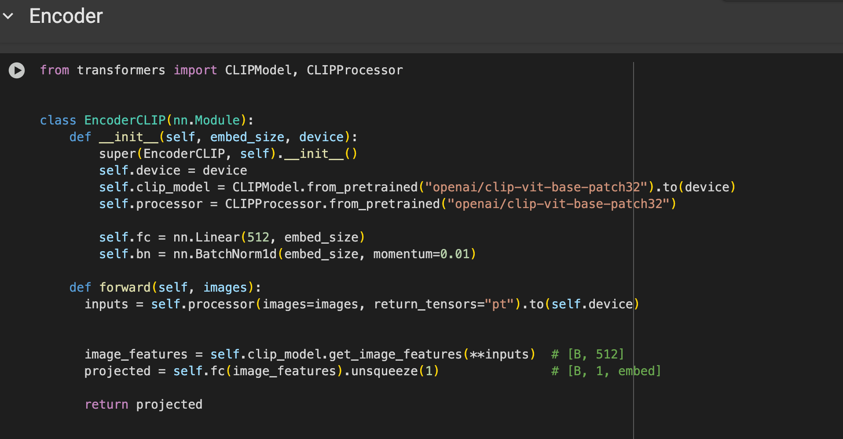

Slide 11
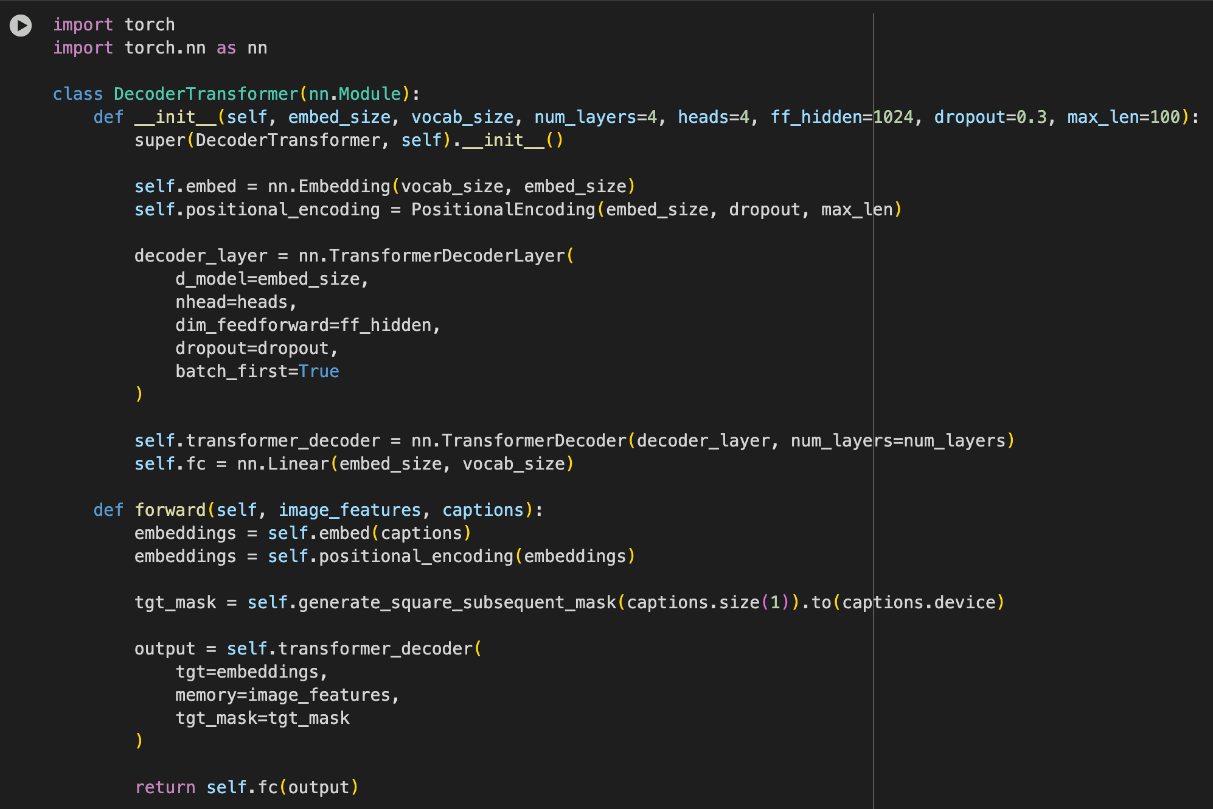
Decoder

Slide 12
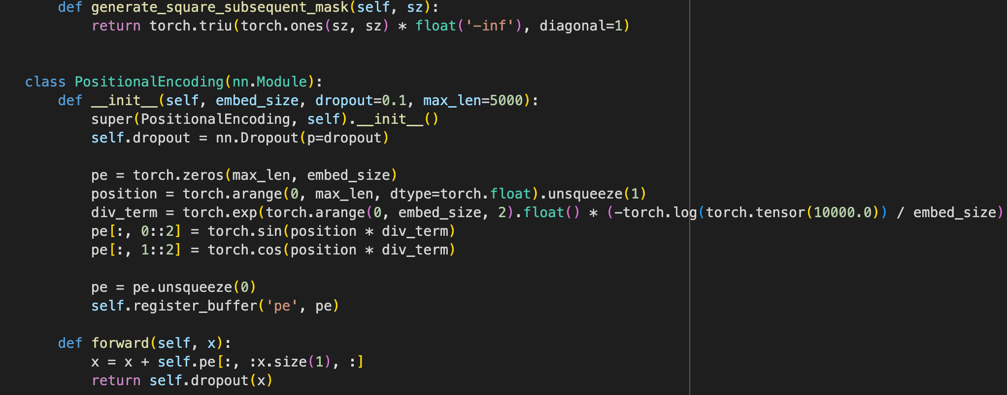
Decoder

Slide 13
Evaluation

Slide 14
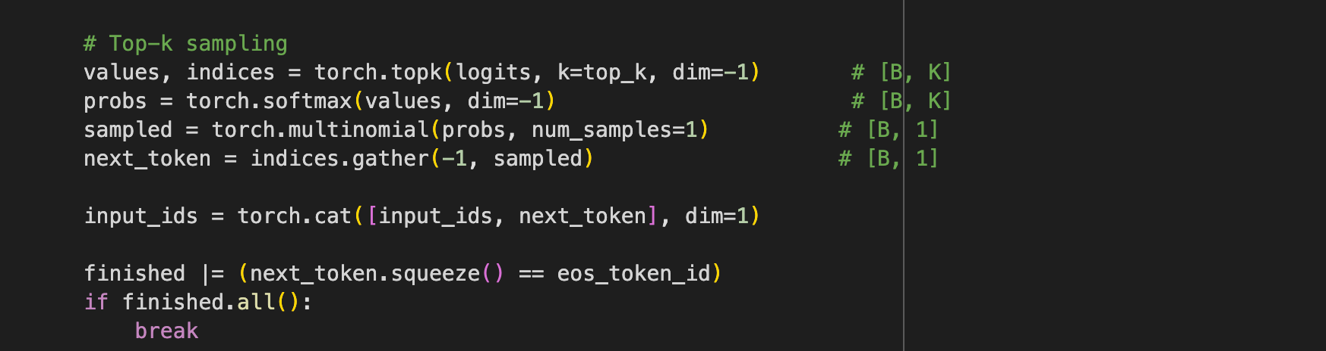

Slide 15
