Slide 1
Implementation of Data Hazards

Slide 2
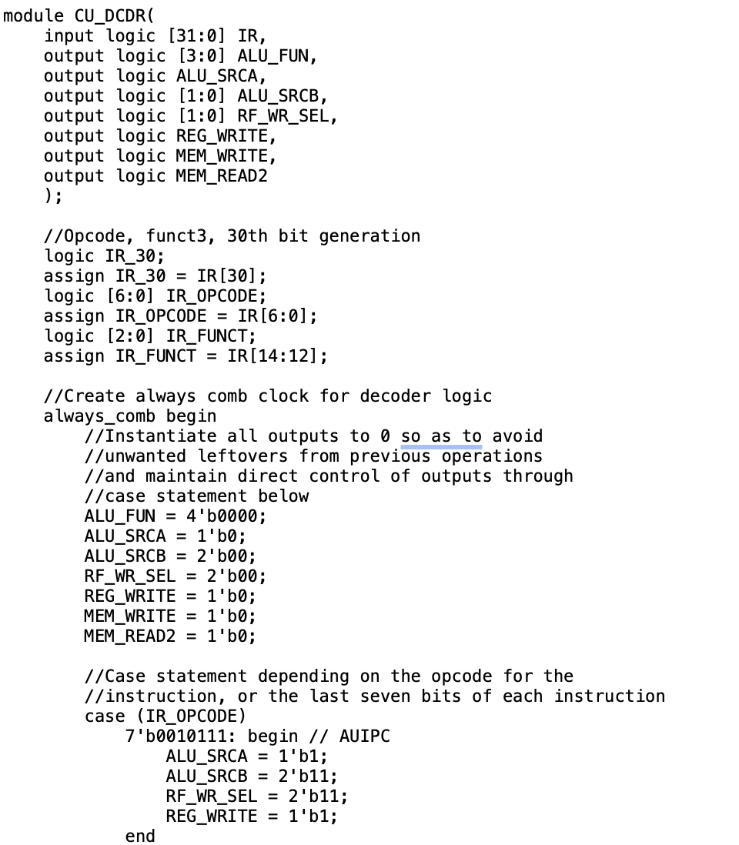
Control Unit for the Pipeline

Slide 3
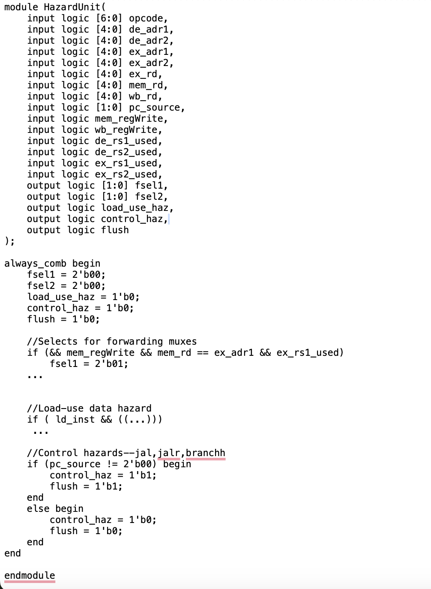
Data Hazard Unit

Slide 4
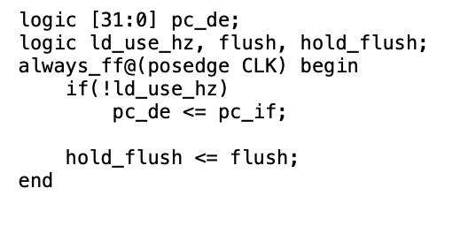
On Fetch
Control Hazard
Later on use the out flush to decide if the inst can write to RF or DM

