Slide 1



MiracleGro: Spec to RTL and RTL to Spec
Spec to RTL and RTL to Spec
Angela Cui, Ferran Hermida-Rivera, Jack Toubes

Slide 2
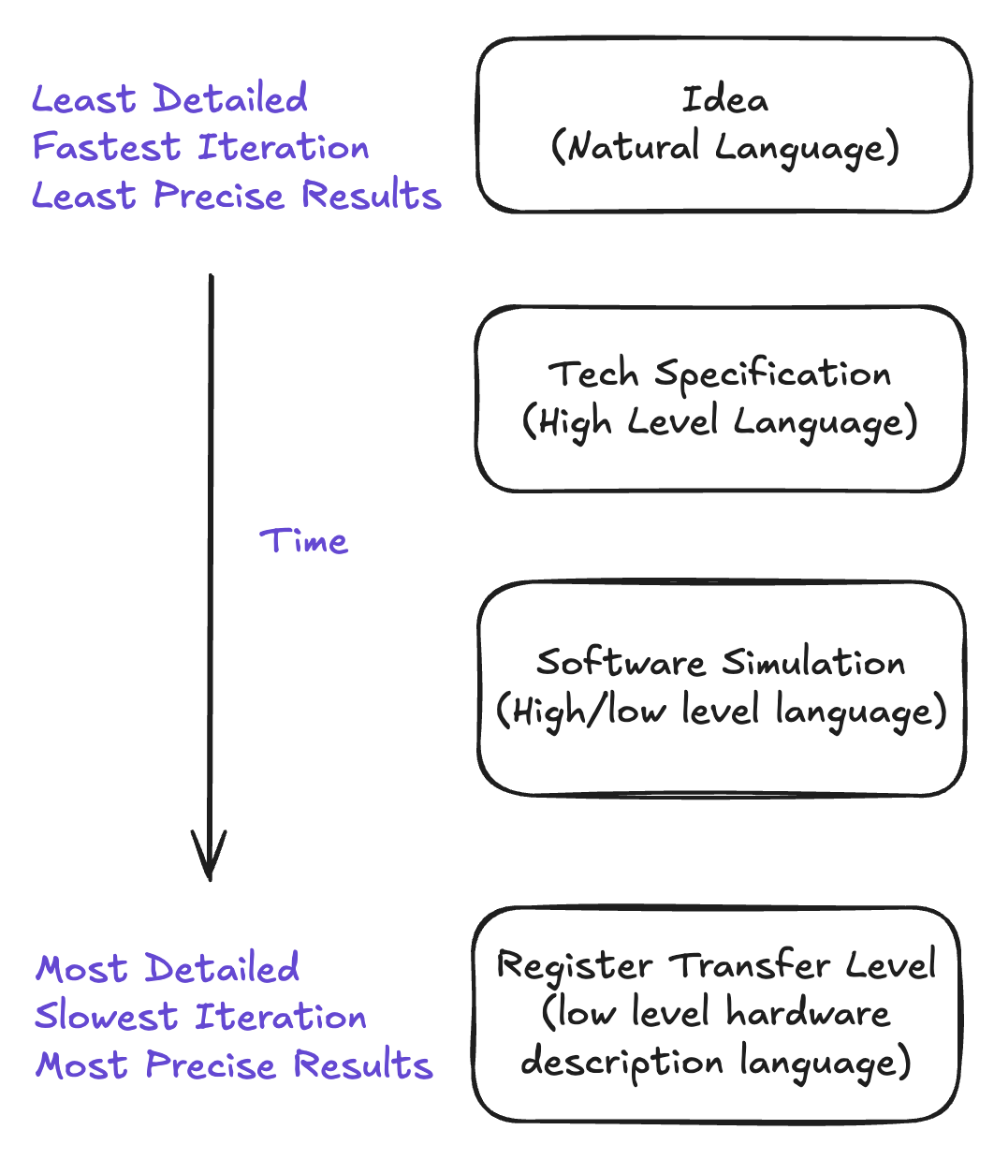
Motivation
Hardware design takes place in many steps
Later steps get more precise power, performance, and area estimations, but are harder to iterate on.
Accurately moving from step to step is slow, iterative, and error-prone.
Lots of published work in architecture doesn’t go beyond software simulation

Slide 3
Research Questions
Can we use AI to move between these steps faster, automating a previously labor-intensive process?

Slide 4

Research Questions
Can we use AI to move between these steps faster, automating a previously labor-intensive process?
CHIA
Two concrete goals tied to two concrete problems in the computer architecture community.
Turn architectural ideas into real RTL -> use them to improve the performance of a processor
Turn an existing processor into accurate simulator, important for fast development of effective new architectural ideas.

Slide 5
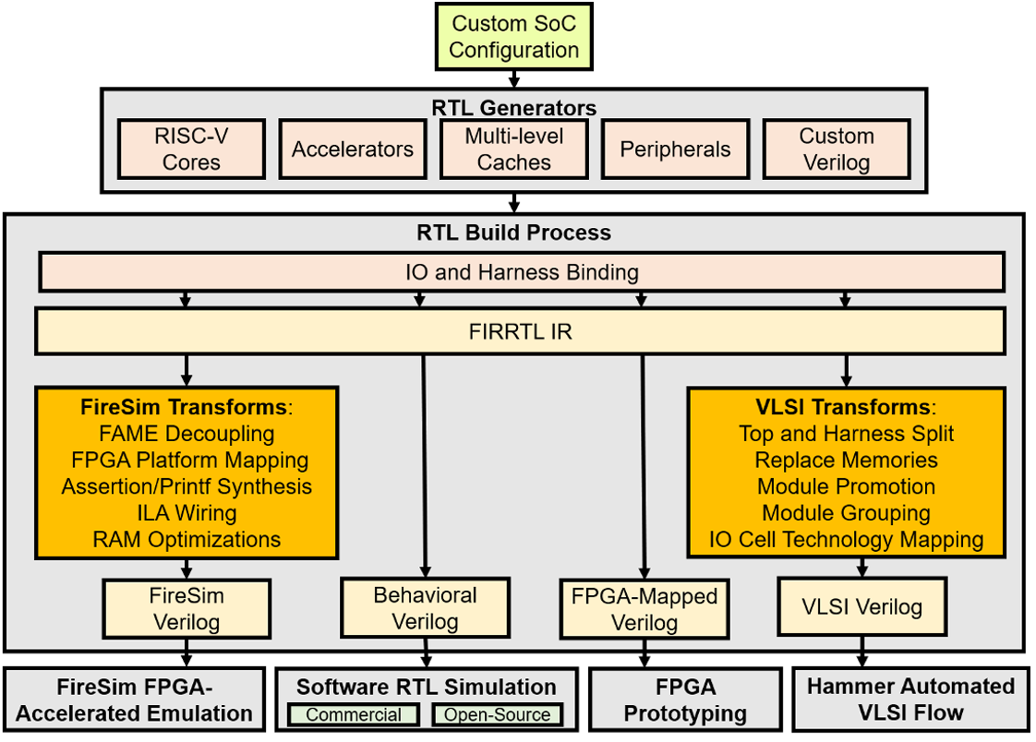
Chia
CHIA NODE
Gem5
CHIA NODE
CHIA NODE
CHIA NODE
CHIA NODE
CHIA NODE
RTL Timer
Other External Tools
CHIA NODE
CHIA NODE
CHIA NODE
CHIA NODE

Slide 6
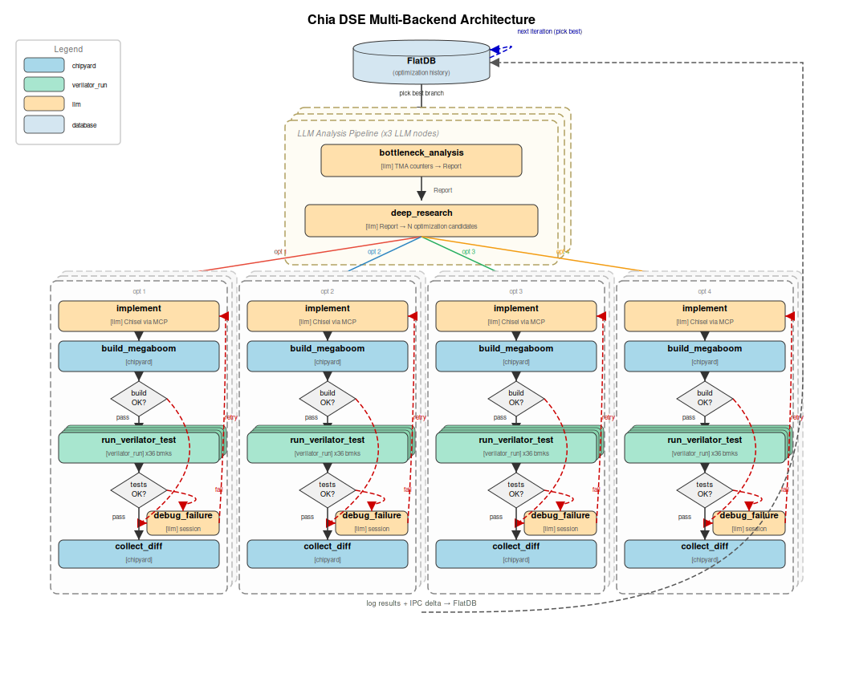
MiracleGro
Objective: Improve BOOM IPC
Chia flow which uses LLMs to
Analyze bottlenecks in processor
Recommend improvements from technical reports, presentations, and literature
Implement improvements

Slide 7
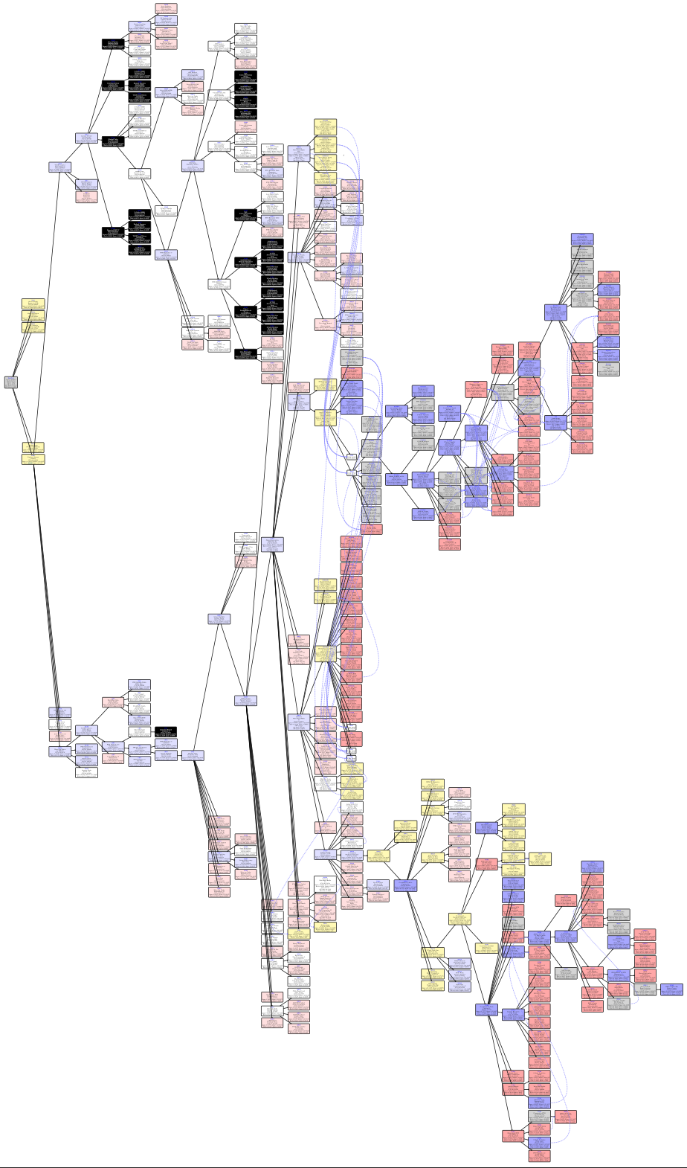

Slide 8
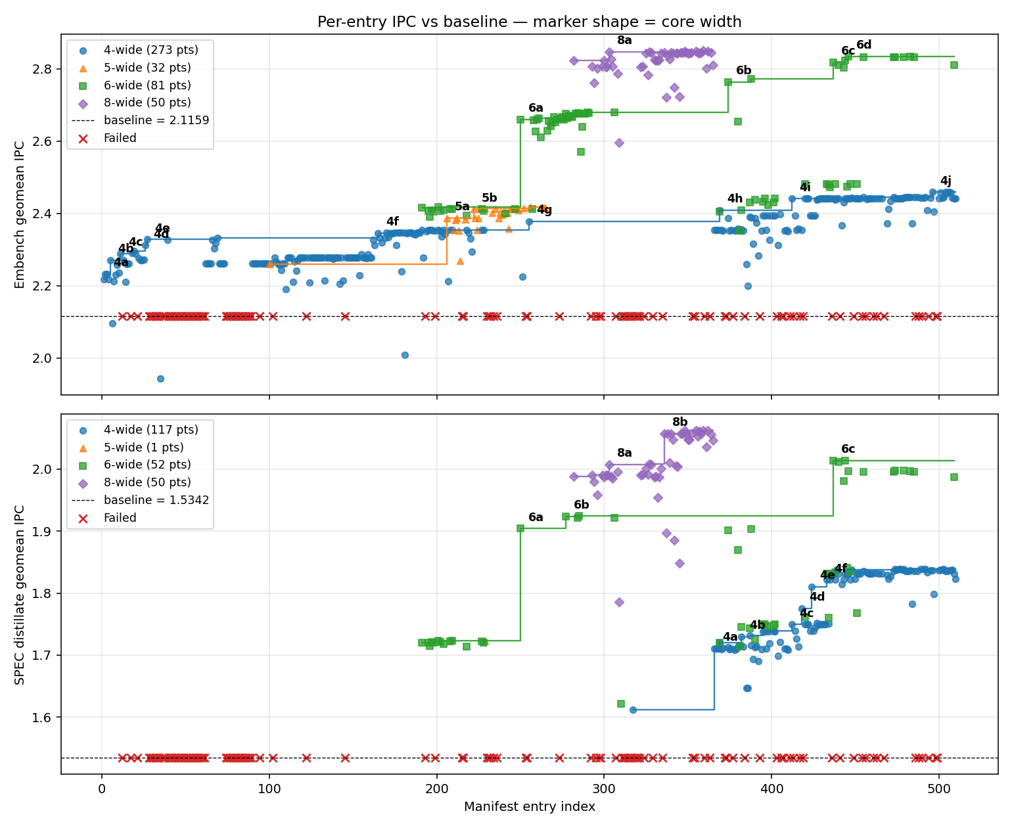
Notes:
# Embench
Baseline geomean IPC: **2.1159**
## 4-wide
### 4a — +0.0147 IPC (idx 2, IPC 2.2326)
**Branch:** `optdse_iter_0_2_BTB_Capacity_and_Organization_`
**Description:** Increase BTB from 128x2 to 256x4 entries with larger extended table, reducing BTB capacity and conflict misses
### 4b — +0.0376 IPC (idx 5, IPC 2.2702)
**Branch:** `optdse_iter_0_3_TAGE_Predictor_Table_Sizing`
**Description:** Double all TAGE table entry counts from 1024 to 2048 total entries to reduce direction prediction aliasing
### 4c — +0.0189 IPC (idx 11, IPC 2.2891)
**Branch:** `optdse_iter_2_1_BTB_Capacity_and_Organization_`
**Description:** Increase BTB from 128x2 to 256x4 entries with larger extended table, reducing BTB capacity and conflict misses
### 4d — +0.0165 IPC (idx 26, IPC 2.3113)
**Branch:** `optdse_iter_6_0_Integer_Multiply_Latency_Reduc`
**Description:** Reduce imulLatency from 3 to 2 cycles and fix hardcoded bypass stage count to cut dependency chain latency in multiply-bound benchmarks
### 4e — +0.0163 IPC (idx 27, IPC 2.3276)
**Branch:** `optdse_iter_6_1_BTB_Expansion_to_1024_Sets`
**Description:** Double main BTB from 512 to 1024 sets, continuing the most consistently productive optimization direction across 4 prior experiments
### 4f — +0.0128 IPC (idx 165, IPC 2.3453)
**Branch:** `optdse_iter_41_3_Integer_Multiply_Latency_Reduc`
**Description:** Reduce imulLatency from 2 to 1 cycle to shorten multiply dependency chains in Montgomery multiplication and division-heavy benchmarks
### 4g — +0.0240 IPC (idx 255, IPC 2.3777)
**Branch:** `optdse_iter_64_1_CLASP___Line-Boundary-Agnostic`
**Description:** Modify uop cache fill unit to allow entries to span I-cache line boundaries (CLASP) and pack multiple non-sequential uop groups per way (compaction), recovering 35-45% of wasted entry capacity
### 4h — +0.0306 IPC (idx 369, IPC 2.4082)
**Branch:** `optdse_single_iter_101_1_SRAM-Based_L0_BTB_for_1-Cycle_`
**Description:** Replace 16-entry FA register-based uBTB with 512-entry SRAM set-associative L0 BTB providing F1-speed taken-branch predictions, reducing redirect latency by 1 cycle
### 4i — +0.0321 IPC (idx 412, IPC 2.4403)
**Branch:** `optdse_single_iter_108_1_SRAM_L0_BTB_at_512_Entries__Pr`
**Description:** Replace 16-entry FA register-based uBTB with 512-entry SRAM set-associative L0 BTB providing zero-bubble F1-speed taken-branch predictions, exactly replicating the proven iter_101_1 design without delta encoding
### 4j — +0.0139 IPC (idx 496, IPC 2.4586)
**Branch:** `optdse_single_iter_127_3_Dual-Port_Store_Commit_with_Ad`
**Description:** Enable store commit on both MEM ports and increase numDCacheBanks from 1 to 2, with adaptive priority elevation when STQ >75% full, doubling peak store drain bandwidth
## 5-wide
### 5a — +0.1273 IPC (idx 206, IPC 2.3872)
**Branch:** `optdse_iter_51_0_Pipeline_Width_Increase__coreW`
**Description:** Widen the pipeline from 4 to 5 using GigaBoom configuration, scaling decode, issue, ROB, and physical registers proportionally to address fetch bandwidth starvation across 12 benchmarks
### 5b — +0.0241 IPC (idx 222, IPC 2.4112)
**Branch:** `optdse_iter_55_0_Coordinated_Backend_Depth_Scal`
**Description:** Grow all backend structures together in one coordinated change: ROB 160→224, INT IQ 48→64, MEM IQ 28→40, FP IQ 40→48, LDQ 40→56, STQ 40→48, INT PRF 160→192, FP PRF 160→192, MSHRs 8→16, maxBrCount 24→32, FetchBuffer 40→48, FTQ 40→56
## 6-wide
### 6a — +0.2425 IPC (idx 250, IPC 2.6591)
**Branch:** `optdse_iter_63_0_Coordinated_6-Wide_Pipeline_Sc`
**Description:** Widen pipeline to 6-wide decode with fetchWidth 8→16, ROB 225→288, all backend buffers scaled ~1.28x, add 5th ALU + 2nd FP + 3rd MEM port, L1D 32KB→48KB 12-way
### 6b — +0.0831 IPC (idx 374, IPC 2.7631)
**Branch:** `optdse_single_iter_102_2_Expanded_RISC-V_Macro-Op_Fusio` *(6-wide variant)*
**Description:** Add AUIPC+ADDI, AUIPC+LOAD, AUIPC+STORE, SLLI+ADD, and SLLI+SRLI fusion patterns at decode to reduce dynamic instruction count by ~8-12%
### 6c — +0.0461 IPC (idx 437, IPC 2.8177)
**Branch:** `optdse_single_iter_114_2_L1D_Cache_Size_Increase_32KB_t` *(6-wide variant)*
**Description:** Increase L1D nWays from 8 to 12 (32KB to 48KB at same 64 sets) to reduce capacity/conflict misses, matching industry standard 48KB for 4-wide cores
### 6d — +0.0112 IPC (idx 446, IPC 2.8347)
**Branch:** `optdse_single_iter_116_2_TAGE-Based_Memory_Dependence_P` *(6-wide variant)*
**Description:** Add 4-table TAGE-like memory dependence predictor with geometric history lengths to predict load-store conflicts and prevent costly pipeline flushes from memory ordering violations
## 8-wide
### 8a — +0.0239 IPC (idx 303, IPC 2.8470)
**Branch:** `optdse_iter_77_1_Increase_Execution_Unit_Count_`
**Description:** Widen INT issue queue from 6 to 8 ports, adding 2 ALU execution units with second multiply and second branch/jump capability, closing the gap to industry 18-19 port norm for 8-wide cores
# SPEC distillate
Baseline geomean IPC: **1.5342**
## 4-wide
### 4a — +0.0988 IPC (idx 366, IPC 1.7107)
**Branch:** `merge_loop_iter_2_optdse_iter__x_optdse_iter_`
**Description:** N-way merge of optdse_iter_47_1_Skewed-Associative_BTB_with_Pa (IPC: 2.3537), optdse_iter_54_0_Double_Fetch_Bandwidth__fetchW (IPC: 2.3537)
### 4b — +0.0104 IPC (idx 382, IPC 1.7300)
**Branch:** `optdse_single_iter_104_3_Divider_Unrolling_Increase_4_t`
**Description:** Increase divUnroll from 4 to 16 to reduce worst-case 64-bit division latency from 16 to 4 cycles, addressing division-bound benchmark tarfind
### 4c — +0.0103 IPC (idx 412, IPC 1.7493)
**Branch:** `optdse_single_iter_108_1_SRAM_L0_BTB_at_512_Entries__Pr`
**Description:** Replace 16-entry FA register-based uBTB with 512-entry SRAM set-associative L0 BTB providing zero-bubble F1-speed taken-branch predictions, exactly replicating the proven iter_101_1 design without delta encoding
### 4d — +0.0257 IPC (idx 418, IPC 1.7750)
**Branch:** `optdse_single_iter_109_1_I-Cache_Capacity_Increase_32KB`
**Description:** Double L1I from 32KB 8-way to 64KB 16-way (same 64 sets) to reduce I-cache miss rate, matching industry standard and complementing DIC
### 4e — +0.0354 IPC (idx 424, IPC 1.8104)
**Branch:** `optdse_single_iter_111_1_I-Cache_Capacity_Increase_32KB`
**Description:** Double L1I from 32KB 8-way to 64KB 16-way (same 64 sets) to reduce I-cache miss rate, matching industry standard for 4-wide cores
### 4f — +0.0110 IPC (idx 433, IPC 1.8214)
**Branch:** `optdse_single_iter_113_2_I-Cache_Capacity_Increase__32K`
**Description:** Double L1I from 32KB 8-way to 64KB 16-way (same 64 sets) to reduce I-cache miss rate, matching industry standard for 4-wide cores
## 6-wide
### 6a — +0.1803 IPC (idx 250, IPC 1.9039)
**Branch:** `optdse_iter_63_0_Coordinated_6-Wide_Pipeline_Sc`
**Description:** Widen pipeline to 6-wide decode with fetchWidth 8→16, ROB 225→288, all backend buffers scaled ~1.28x, add 5th ALU + 2nd FP + 3rd MEM port, L1D 32KB→48KB 12-way
### 6b — +0.0196 IPC (idx 277, IPC 1.9236)
**Branch:** `optdse_iter_69_3_Coordinated_Backend_Depth_Scal`
**Description:** Scale all interdependent structures together: ROB 288→384, INT IQ 80→96, MEM IQ 48→64, FP IQ 56→64, LDQ 72→128, STQ 64→80, INT PRF 256→320, FP PRF 224→288, MSHRs 16→20, L2 1MB→1.5MB, maxBrCount 40→48, FTQ 64→80
### 6c — +0.0897 IPC (idx 437, IPC 2.0137)
**Branch:** `optdse_single_iter_114_2_L1D_Cache_Size_Increase_32KB_t` *(6-wide variant)*
**Description:** Increase L1D nWays from 8 to 12 (32KB to 48KB at same 64 sets) to reduce capacity/conflict misses, matching industry standard 48KB for 4-wide cores
## 8-wide
### 8a — +0.0169 IPC (idx 303, IPC 2.0072)
**Branch:** `optdse_iter_77_1_Increase_Execution_Unit_Count_`
**Description:** Widen INT issue queue from 6 to 8 ports, adding 2 ALU execution units with second multiply and second branch/jump capability, closing the gap to industry 18-19 port norm for 8-wide cores
### 8b — +0.0489 IPC (idx 336, IPC 2.0571)
**Branch:** `optdse_iter_90_2_L1I_Capacity_Increase_to_64KB`
**Description:** Double L1 instruction cache from 32KB 8-way to 64KB 16-way (same 64 sets) to reduce miss rate on BOOM's only instruction delivery path, matching industry standard (Lion Cove, Skymont, Neoverse all use 64KB L1I)

Slide 9
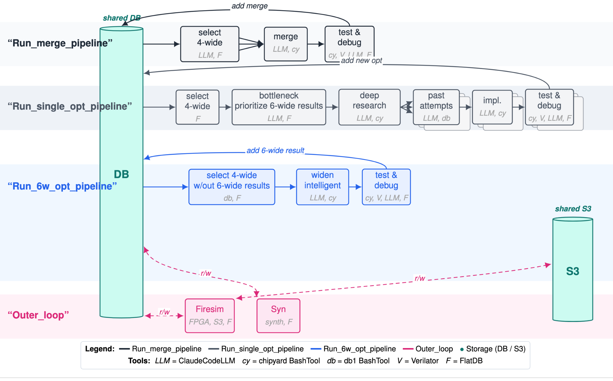
From Ideas to RTL
Verilator max exec. time:
4-wide: 4.78h
6-wide: 6.9h
8-wide: 12.62h
Verification/evaluation challenges on FireSim
Instead, implement & test new ideas on a smaller core

Slide 10
Notes:
Nodes with most performance gain still come from sizing increase.
When tune prompt to heavily bias against resizing structures, we get many less ‘blue’ nodes

Slide 11
Notes:
6-wide perf improvement is not particularly correlating to 4-wide
Performance improvement due to microarchitecture changes, not just tuning parameters, has stagnated
Summarizing previous attempts has reduced the number of debug iterations, but not the performance results
Same ideas are revisited many times but don’t always result in performance improvement
Learning for prior attempts
Future steps:
Add waveform information to certain LLM nodes
Wrap existing implementation in a perf optimization node
Structure branches as vector database,
Investigate misalignment with 6w performance to 4w
# Embench
Baseline geomean IPC: **2.1159**
## 4-wide
### 4a — +0.0147 IPC (idx 2, IPC 2.2326)
**Branch:** `optdse_iter_0_2_BTB_Capacity_and_Organization_`
**Description:** Increase BTB from 128x2 to 256x4 entries with larger extended table, reducing BTB capacity and conflict misses
### 4b — +0.0376 IPC (idx 5, IPC 2.2702)
**Branch:** `optdse_iter_0_3_TAGE_Predictor_Table_Sizing`
**Description:** Double all TAGE table entry counts from 1024 to 2048 total entries to reduce direction prediction aliasing
### 4c — +0.0189 IPC (idx 11, IPC 2.2891)
**Branch:** `optdse_iter_2_1_BTB_Capacity_and_Organization_`
**Description:** Increase BTB from 128x2 to 256x4 entries with larger extended table, reducing BTB capacity and conflict misses
### 4d — +0.0165 IPC (idx 26, IPC 2.3113)
**Branch:** `optdse_iter_6_0_Integer_Multiply_Latency_Reduc`
**Description:** Reduce imulLatency from 3 to 2 cycles and fix hardcoded bypass stage count to cut dependency chain latency in multiply-bound benchmarks
### 4e — +0.0163 IPC (idx 27, IPC 2.3276)
**Branch:** `optdse_iter_6_1_BTB_Expansion_to_1024_Sets`
**Description:** Double main BTB from 512 to 1024 sets, continuing the most consistently productive optimization direction across 4 prior experiments
### 4f — +0.0128 IPC (idx 165, IPC 2.3453)
**Branch:** `optdse_iter_41_3_Integer_Multiply_Latency_Reduc`
**Description:** Reduce imulLatency from 2 to 1 cycle to shorten multiply dependency chains in Montgomery multiplication and division-heavy benchmarks
### 4g — +0.0240 IPC (idx 255, IPC 2.3777)
**Branch:** `optdse_iter_64_1_CLASP___Line-Boundary-Agnostic`
**Description:** Modify uop cache fill unit to allow entries to span I-cache line boundaries (CLASP) and pack multiple non-sequential uop groups per way (compaction), recovering 35-45% of wasted entry capacity
### 4h — +0.0306 IPC (idx 369, IPC 2.4082)
**Branch:** `optdse_single_iter_101_1_SRAM-Based_L0_BTB_for_1-Cycle_`
**Description:** Replace 16-entry FA register-based uBTB with 512-entry SRAM set-associative L0 BTB providing F1-speed taken-branch predictions, reducing redirect latency by 1 cycle
### 4i — +0.0321 IPC (idx 412, IPC 2.4403)
**Branch:** `optdse_single_iter_108_1_SRAM_L0_BTB_at_512_Entries__Pr`
**Description:** Replace 16-entry FA register-based uBTB with 512-entry SRAM set-associative L0 BTB providing zero-bubble F1-speed taken-branch predictions, exactly replicating the proven iter_101_1 design without delta encoding
### 4j — +0.0139 IPC (idx 496, IPC 2.4586)
**Branch:** `optdse_single_iter_127_3_Dual-Port_Store_Commit_with_Ad`
**Description:** Enable store commit on both MEM ports and increase numDCacheBanks from 1 to 2, with adaptive priority elevation when STQ >75% full, doubling peak store drain bandwidth
## 5-wide
### 5a — +0.1273 IPC (idx 206, IPC 2.3872)
**Branch:** `optdse_iter_51_0_Pipeline_Width_Increase__coreW`
**Description:** Widen the pipeline from 4 to 5 using GigaBoom configuration, scaling decode, issue, ROB, and physical registers proportionally to address fetch bandwidth starvation across 12 benchmarks
### 5b — +0.0241 IPC (idx 222, IPC 2.4112)
**Branch:** `optdse_iter_55_0_Coordinated_Backend_Depth_Scal`
**Description:** Grow all backend structures together in one coordinated change: ROB 160→224, INT IQ 48→64, MEM IQ 28→40, FP IQ 40→48, LDQ 40→56, STQ 40→48, INT PRF 160→192, FP PRF 160→192, MSHRs 8→16, maxBrCount 24→32, FetchBuffer 40→48, FTQ 40→56
## 6-wide
### 6a — +0.2425 IPC (idx 250, IPC 2.6591)
**Branch:** `optdse_iter_63_0_Coordinated_6-Wide_Pipeline_Sc`
**Description:** Widen pipeline to 6-wide decode with fetchWidth 8→16, ROB 225→288, all backend buffers scaled ~1.28x, add 5th ALU + 2nd FP + 3rd MEM port, L1D 32KB→48KB 12-way
### 6b — +0.0831 IPC (idx 374, IPC 2.7631)
**Branch:** `optdse_single_iter_102_2_Expanded_RISC-V_Macro-Op_Fusio` *(6-wide variant)*
**Description:** Add AUIPC+ADDI, AUIPC+LOAD, AUIPC+STORE, SLLI+ADD, and SLLI+SRLI fusion patterns at decode to reduce dynamic instruction count by ~8-12%
### 6c — +0.0461 IPC (idx 437, IPC 2.8177)
**Branch:** `optdse_single_iter_114_2_L1D_Cache_Size_Increase_32KB_t` *(6-wide variant)*
**Description:** Increase L1D nWays from 8 to 12 (32KB to 48KB at same 64 sets) to reduce capacity/conflict misses, matching industry standard 48KB for 4-wide cores
### 6d — +0.0112 IPC (idx 446, IPC 2.8347)
**Branch:** `optdse_single_iter_116_2_TAGE-Based_Memory_Dependence_P` *(6-wide variant)*
**Description:** Add 4-table TAGE-like memory dependence predictor with geometric history lengths to predict load-store conflicts and prevent costly pipeline flushes from memory ordering violations
## 8-wide
### 8a — +0.0239 IPC (idx 303, IPC 2.8470)
**Branch:** `optdse_iter_77_1_Increase_Execution_Unit_Count_`
**Description:** Widen INT issue queue from 6 to 8 ports, adding 2 ALU execution units with second multiply and second branch/jump capability, closing the gap to industry 18-19 port norm for 8-wide cores
# SPEC distillate
Baseline geomean IPC: **1.5342**
## 4-wide
### 4a — +0.0988 IPC (idx 366, IPC 1.7107)
**Branch:** `merge_loop_iter_2_optdse_iter__x_optdse_iter_`
**Description:** N-way merge of optdse_iter_47_1_Skewed-Associative_BTB_with_Pa (IPC: 2.3537), optdse_iter_54_0_Double_Fetch_Bandwidth__fetchW (IPC: 2.3537)
### 4b — +0.0104 IPC (idx 382, IPC 1.7300)
**Branch:** `optdse_single_iter_104_3_Divider_Unrolling_Increase_4_t`
**Description:** Increase divUnroll from 4 to 16 to reduce worst-case 64-bit division latency from 16 to 4 cycles, addressing division-bound benchmark tarfind
### 4c — +0.0103 IPC (idx 412, IPC 1.7493)
**Branch:** `optdse_single_iter_108_1_SRAM_L0_BTB_at_512_Entries__Pr`
**Description:** Replace 16-entry FA register-based uBTB with 512-entry SRAM set-associative L0 BTB providing zero-bubble F1-speed taken-branch predictions, exactly replicating the proven iter_101_1 design without delta encoding
### 4d — +0.0257 IPC (idx 418, IPC 1.7750)
**Branch:** `optdse_single_iter_109_1_I-Cache_Capacity_Increase_32KB`
**Description:** Double L1I from 32KB 8-way to 64KB 16-way (same 64 sets) to reduce I-cache miss rate, matching industry standard and complementing DIC
### 4e — +0.0354 IPC (idx 424, IPC 1.8104)
**Branch:** `optdse_single_iter_111_1_I-Cache_Capacity_Increase_32KB`
**Description:** Double L1I from 32KB 8-way to 64KB 16-way (same 64 sets) to reduce I-cache miss rate, matching industry standard for 4-wide cores
### 4f — +0.0110 IPC (idx 433, IPC 1.8214)
**Branch:** `optdse_single_iter_113_2_I-Cache_Capacity_Increase__32K`
**Description:** Double L1I from 32KB 8-way to 64KB 16-way (same 64 sets) to reduce I-cache miss rate, matching industry standard for 4-wide cores
## 6-wide
### 6a — +0.1803 IPC (idx 250, IPC 1.9039)
**Branch:** `optdse_iter_63_0_Coordinated_6-Wide_Pipeline_Sc`
**Description:** Widen pipeline to 6-wide decode with fetchWidth 8→16, ROB 225→288, all backend buffers scaled ~1.28x, add 5th ALU + 2nd FP + 3rd MEM port, L1D 32KB→48KB 12-way
### 6b — +0.0196 IPC (idx 277, IPC 1.9236)
**Branch:** `optdse_iter_69_3_Coordinated_Backend_Depth_Scal`
**Description:** Scale all interdependent structures together: ROB 288→384, INT IQ 80→96, MEM IQ 48→64, FP IQ 56→64, LDQ 72→128, STQ 64→80, INT PRF 256→320, FP PRF 224→288, MSHRs 16→20, L2 1MB→1.5MB, maxBrCount 40→48, FTQ 64→80
### 6c — +0.0897 IPC (idx 437, IPC 2.0137)
**Branch:** `optdse_single_iter_114_2_L1D_Cache_Size_Increase_32KB_t` *(6-wide variant)*
**Description:** Increase L1D nWays from 8 to 12 (32KB to 48KB at same 64 sets) to reduce capacity/conflict misses, matching industry standard 48KB for 4-wide cores
## 8-wide
### 8a — +0.0169 IPC (idx 303, IPC 2.0072)
**Branch:** `optdse_iter_77_1_Increase_Execution_Unit_Count_`
**Description:** Widen INT issue queue from 6 to 8 ports, adding 2 ALU execution units with second multiply and second branch/jump capability, closing the gap to industry 18-19 port norm for 8-wide cores
### 8b — +0.0489 IPC (idx 336, IPC 2.0571)
**Branch:** `optdse_iter_90_2_L1I_Capacity_Increase_to_64KB`
**Description:** Double L1 instruction cache from 32KB 8-way to 64KB 16-way (same 64 sets) to reduce miss rate on BOOM's only instruction delivery path, matching industry standard (Lion Cove, Skymont, Neoverse all use 64KB L1I)

Slide 12
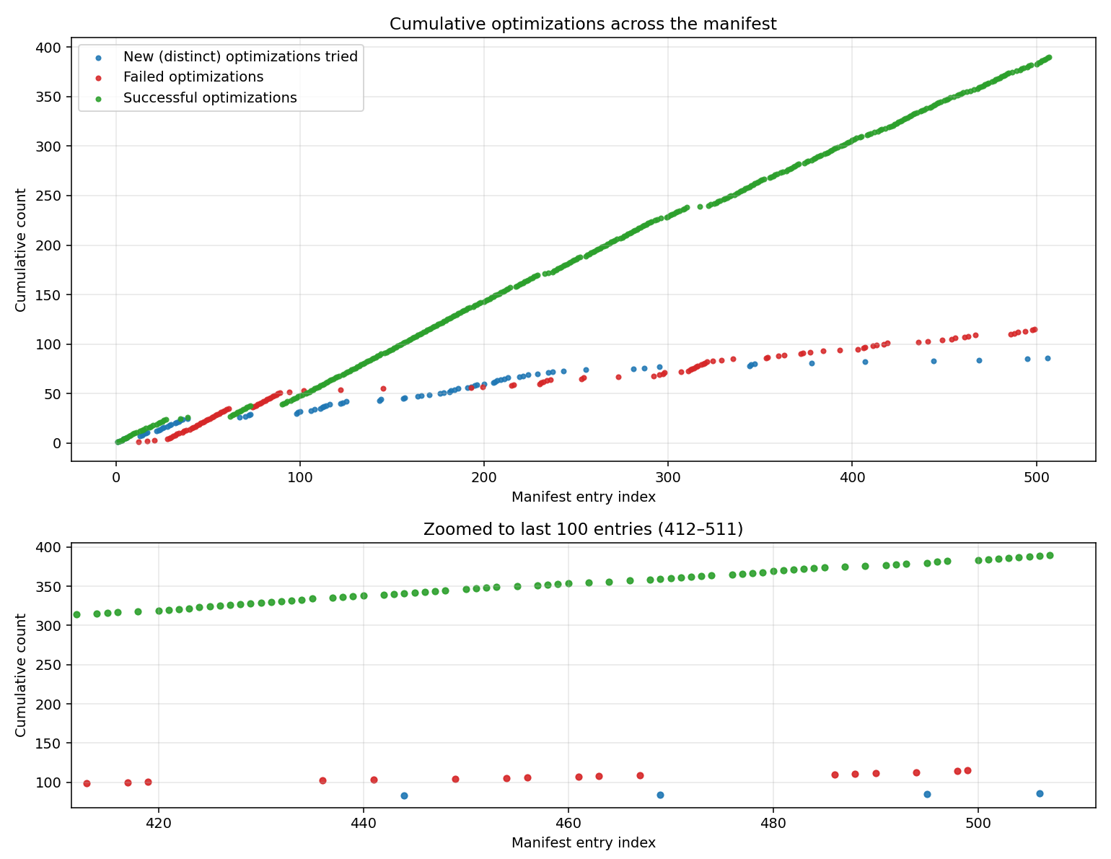
Notes:
Evaluating the quality of deep research and bottleneck analysis

Slide 13
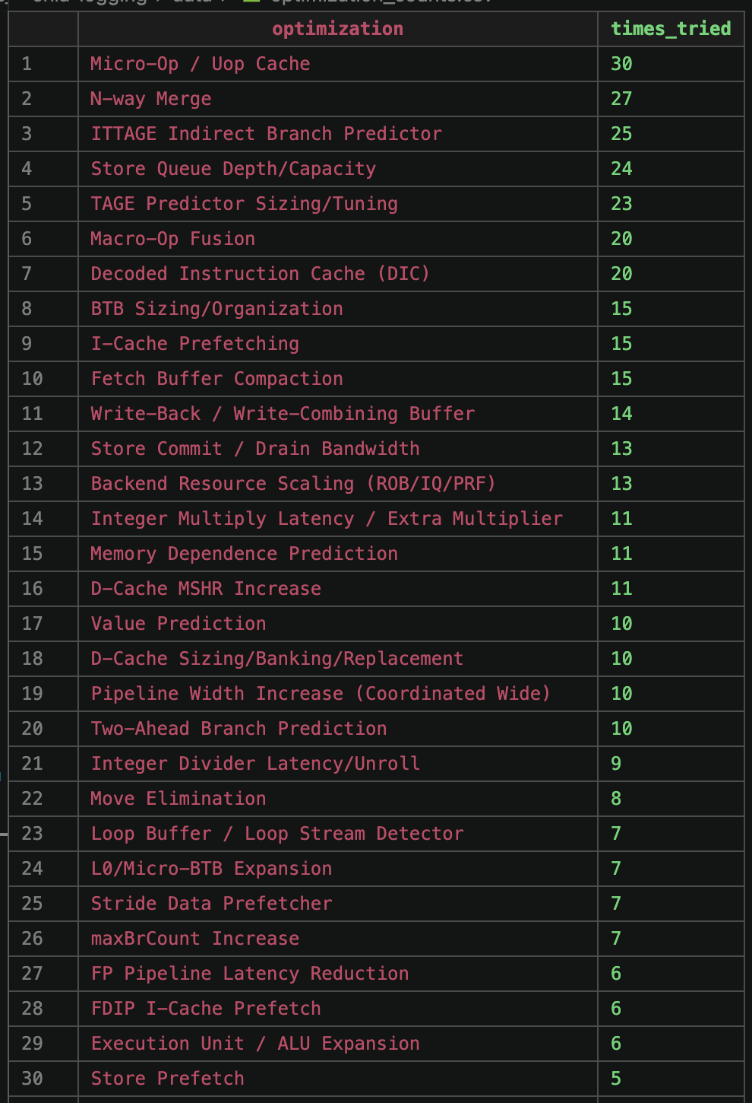
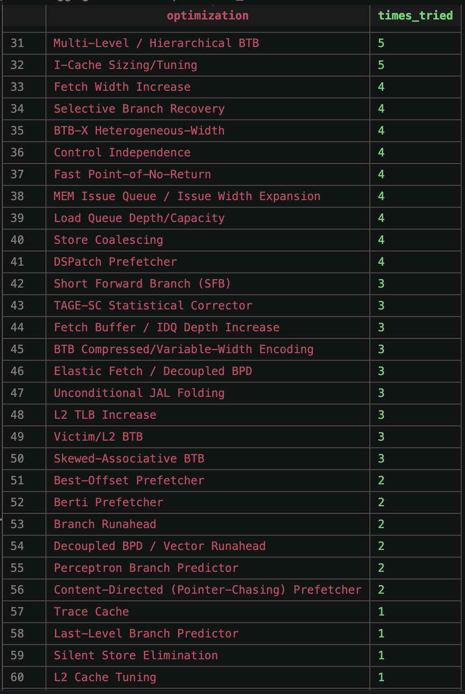
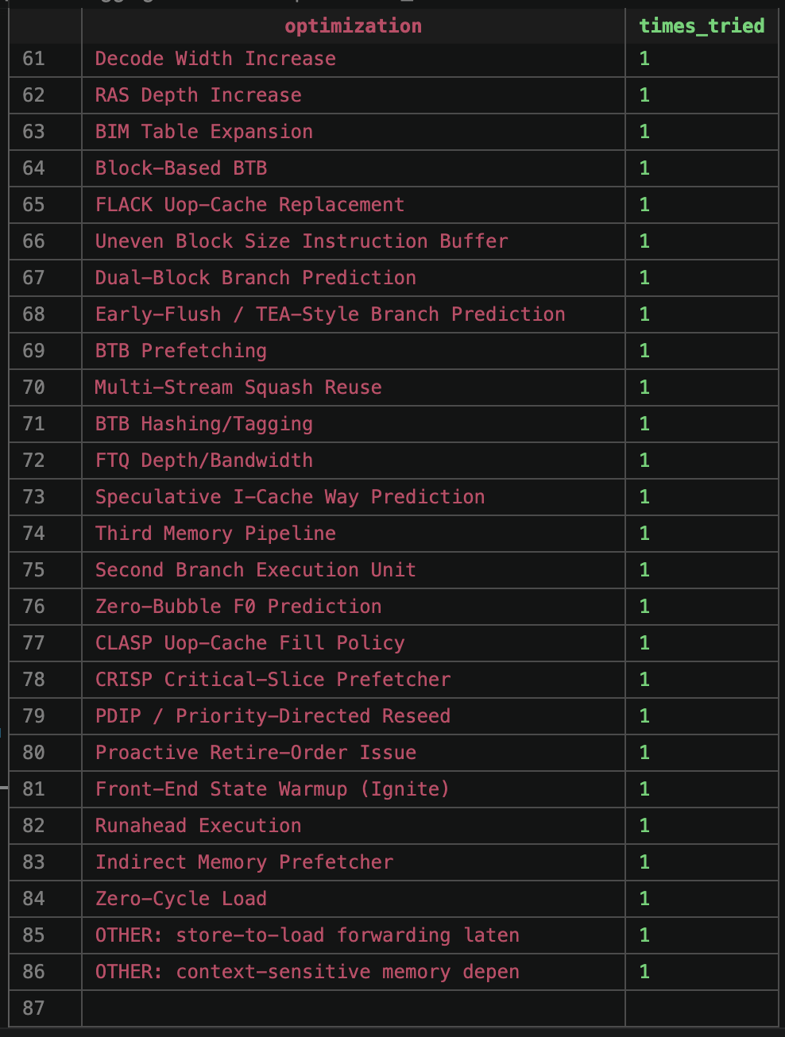

Slide 14
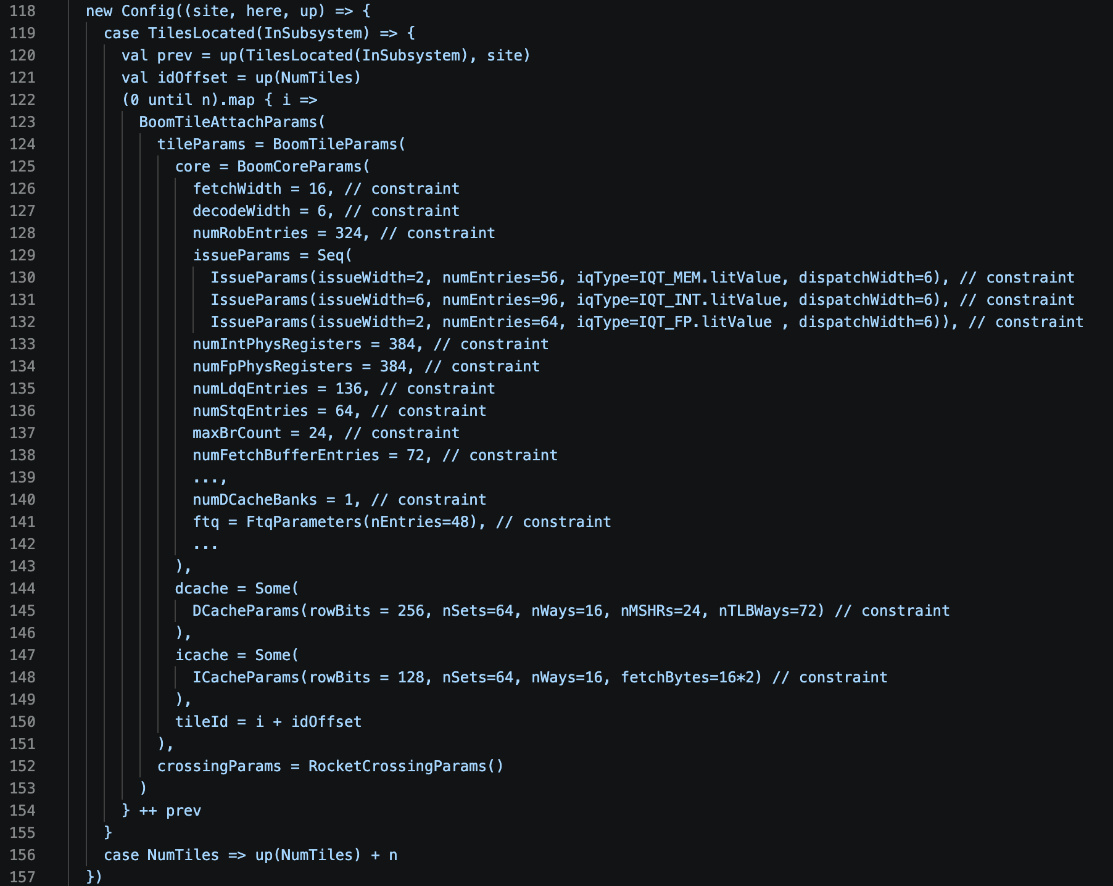

Slide 15
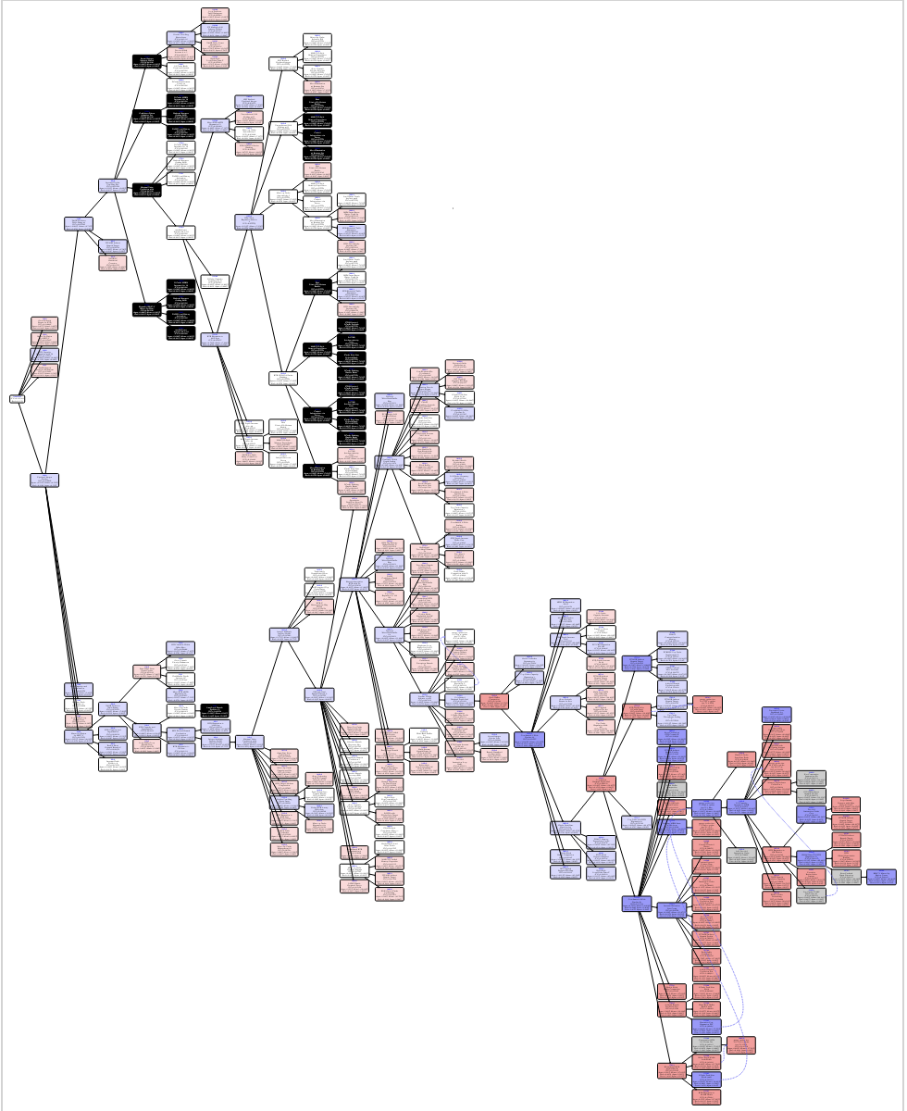
From Ideas to RTL

Slide 16
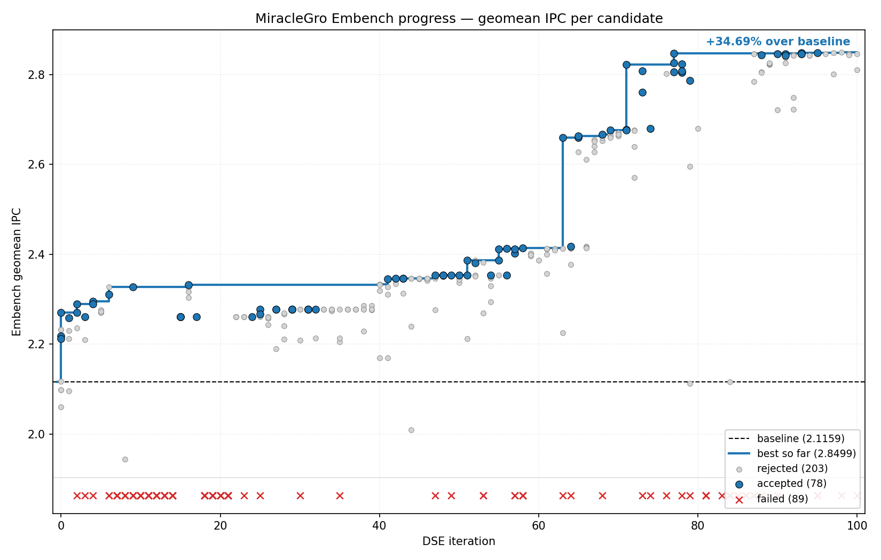
From Ideas to RTL: Results

Slide 17
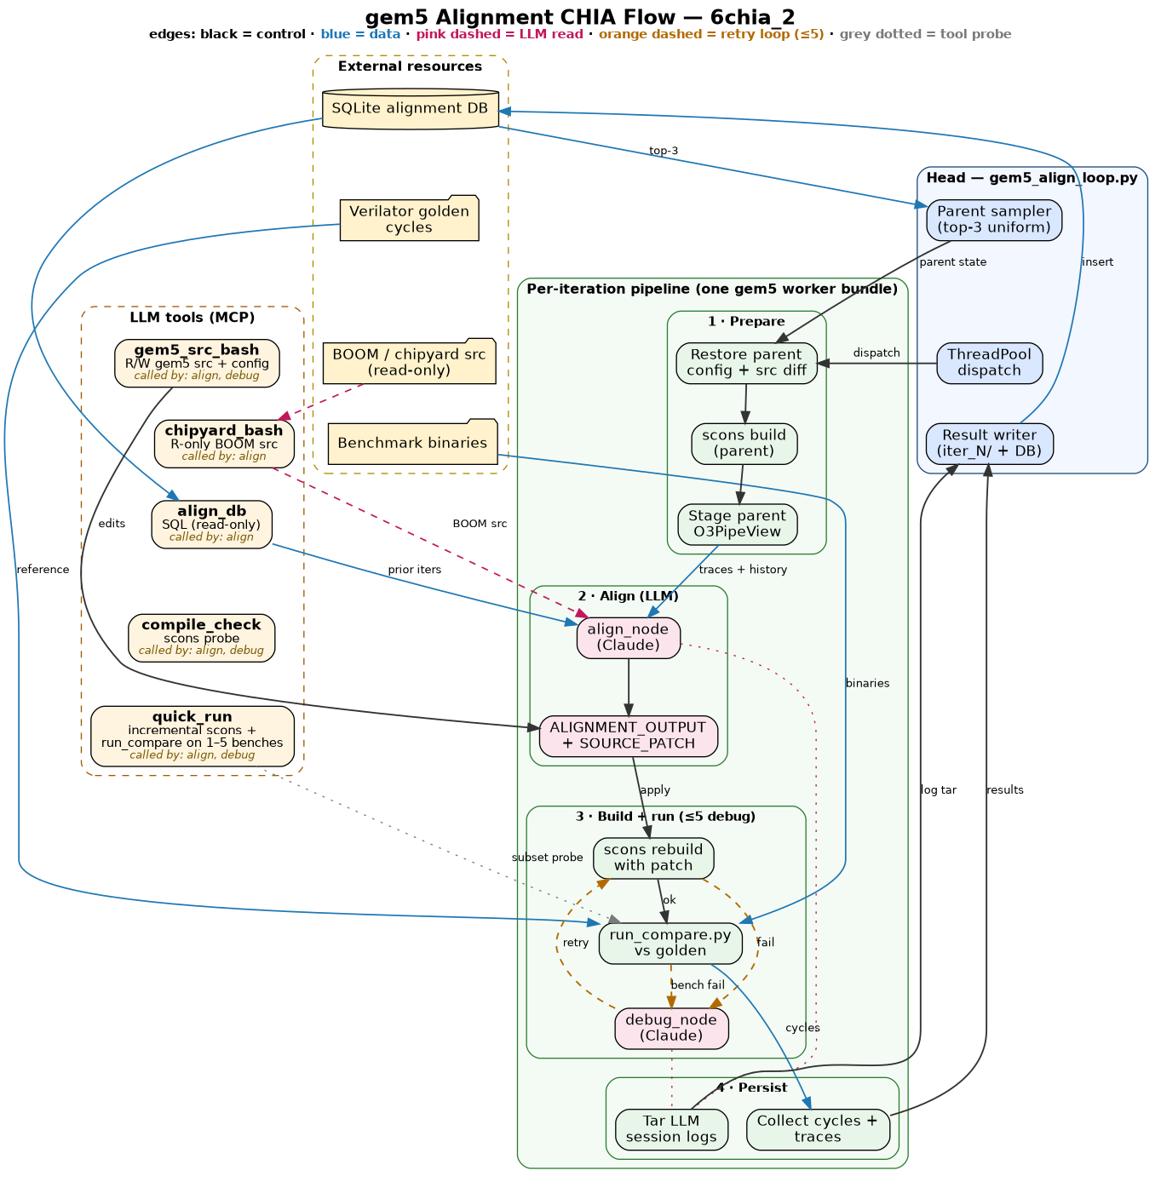
From RTL to SW Sim
Chia flow which uses LLMs to
Analyze execution traces of benchmarks
Isolate misaligned structures between processor and simulator
Edit the simulator to improve alignment
Debug mistaken edits
Notes:
So we’re also working on going the other direction from RTL to software simulation. Quick motivation for this, in architecture, the misalignment between simulators and the real processors they claim to simulate leads to significant challenges in testing architectural ideas in simulators, which is frustrating because software simulation is usually significantly faster than gate-level simulation.

Slide 18
Rapid Flow Development
Chia makes it easy for us to iterate on this flow by inserting/changing nodes.
LLM struggles to identify misalignment with only performance counters -> added pipeline traces
LLM struggles to return valid diffs -> have it make changes agentically
LLM cannot get thorough alignment with only configuration files -> let edit source
Notes:
So we’re also working on going the other direction from RTL to software simulation. Quick motivation for this, in architecture, the misalignment between simulators and the real processors they claim to simulate leads to significant challenges in testing architectural ideas in simulators, which is frustrating because software simulation is usually significantly faster than gate-level simulation.

Slide 19
From RTL to Software Simulation
Notes:
Chia flow which uses LLMs to
Analyze execution traces of benchmarks
Isolate misaligned structures between processor and simulator
Edit the simulator to improve alignment
Debug mistaken edits

Slide 20
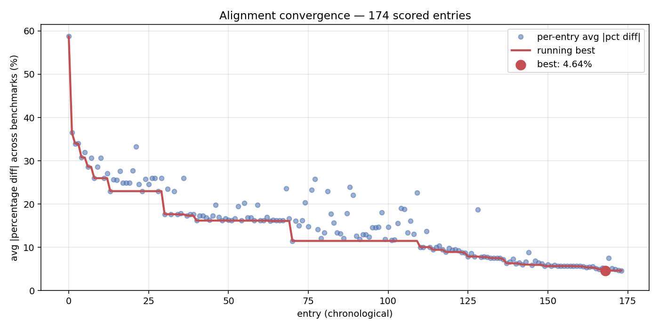
From RTL to Software Simulation: Results (1)

Slide 21
From RTL to Software Simulation: Results (1)

Slide 22
Breaking the Plateau:
Enabling Experiments
Allow the LLM to run experiments on it’s own =>
Longer iterations, better progress

Slide 23
From RTL to Software Simulation: Results (2)

Slide 24
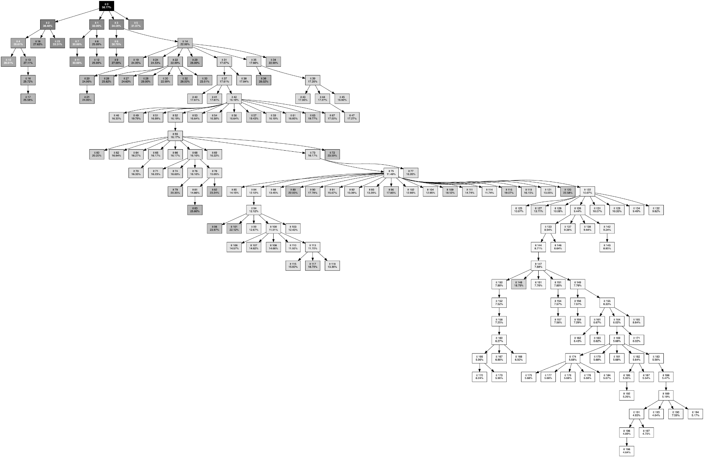
Alignment Iteration Tree

Slide 25
Next Steps
Continue Chia build-out
  Improve human/LLM usability of Chia
  More integration of external tools
Gem5 alignment
  Expand suite of benchmarks
  Explore many BOOM variants
MegaBoom DSE
  Keep evaluating performance improvements
  Bake-in area and power information when deciding future optimizations
  Explore new flows to improve performance and get better DSE

Slide 26
Thank you!

Slide 27
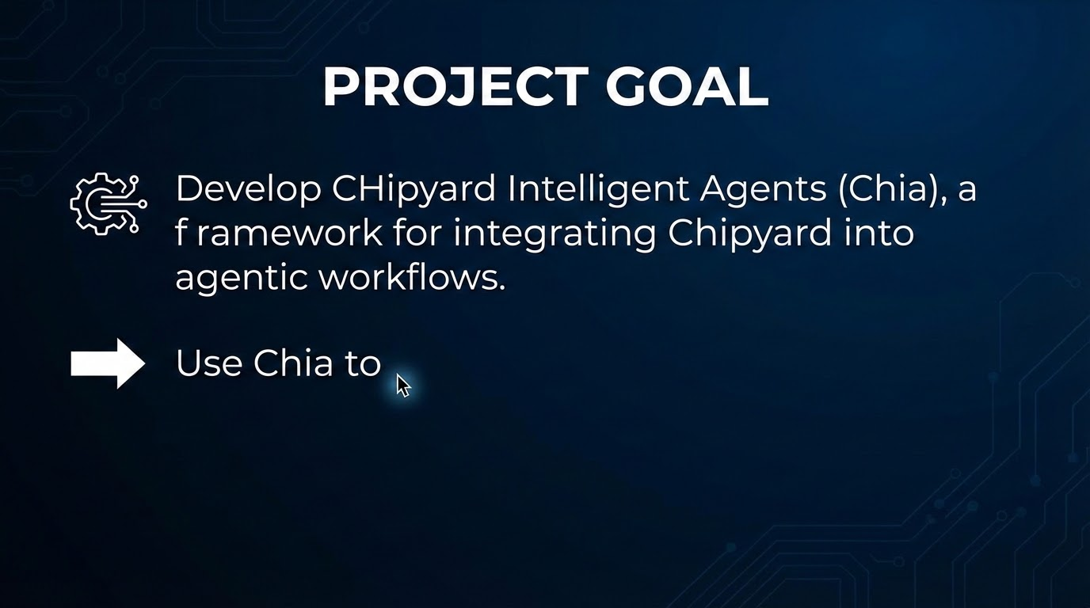

Slide 28
Chia Progress
Developed Support for:
Chisel Build
Verilator
LLM Calls
Hammer-VLSI
Cluster bringup
Flow Tracing
Flow Visualization
others
In Progress
FireSim run
FireSim Bitstream build
Chisel Unit Testing
Formal Verif. Tools
others

Slide 29
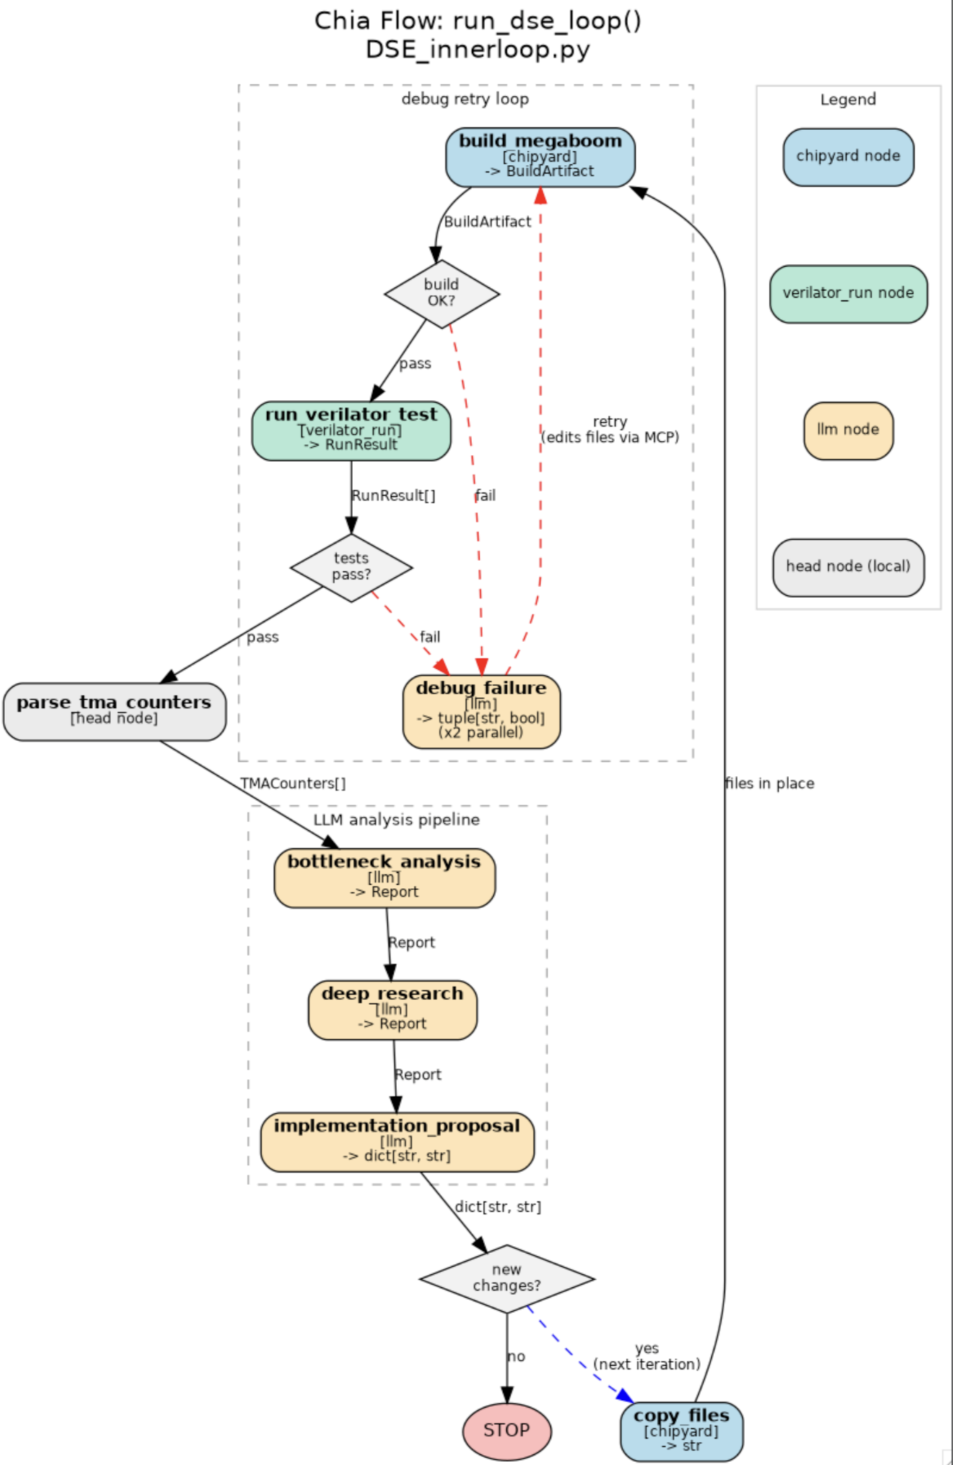
Current built loops

Slide 30
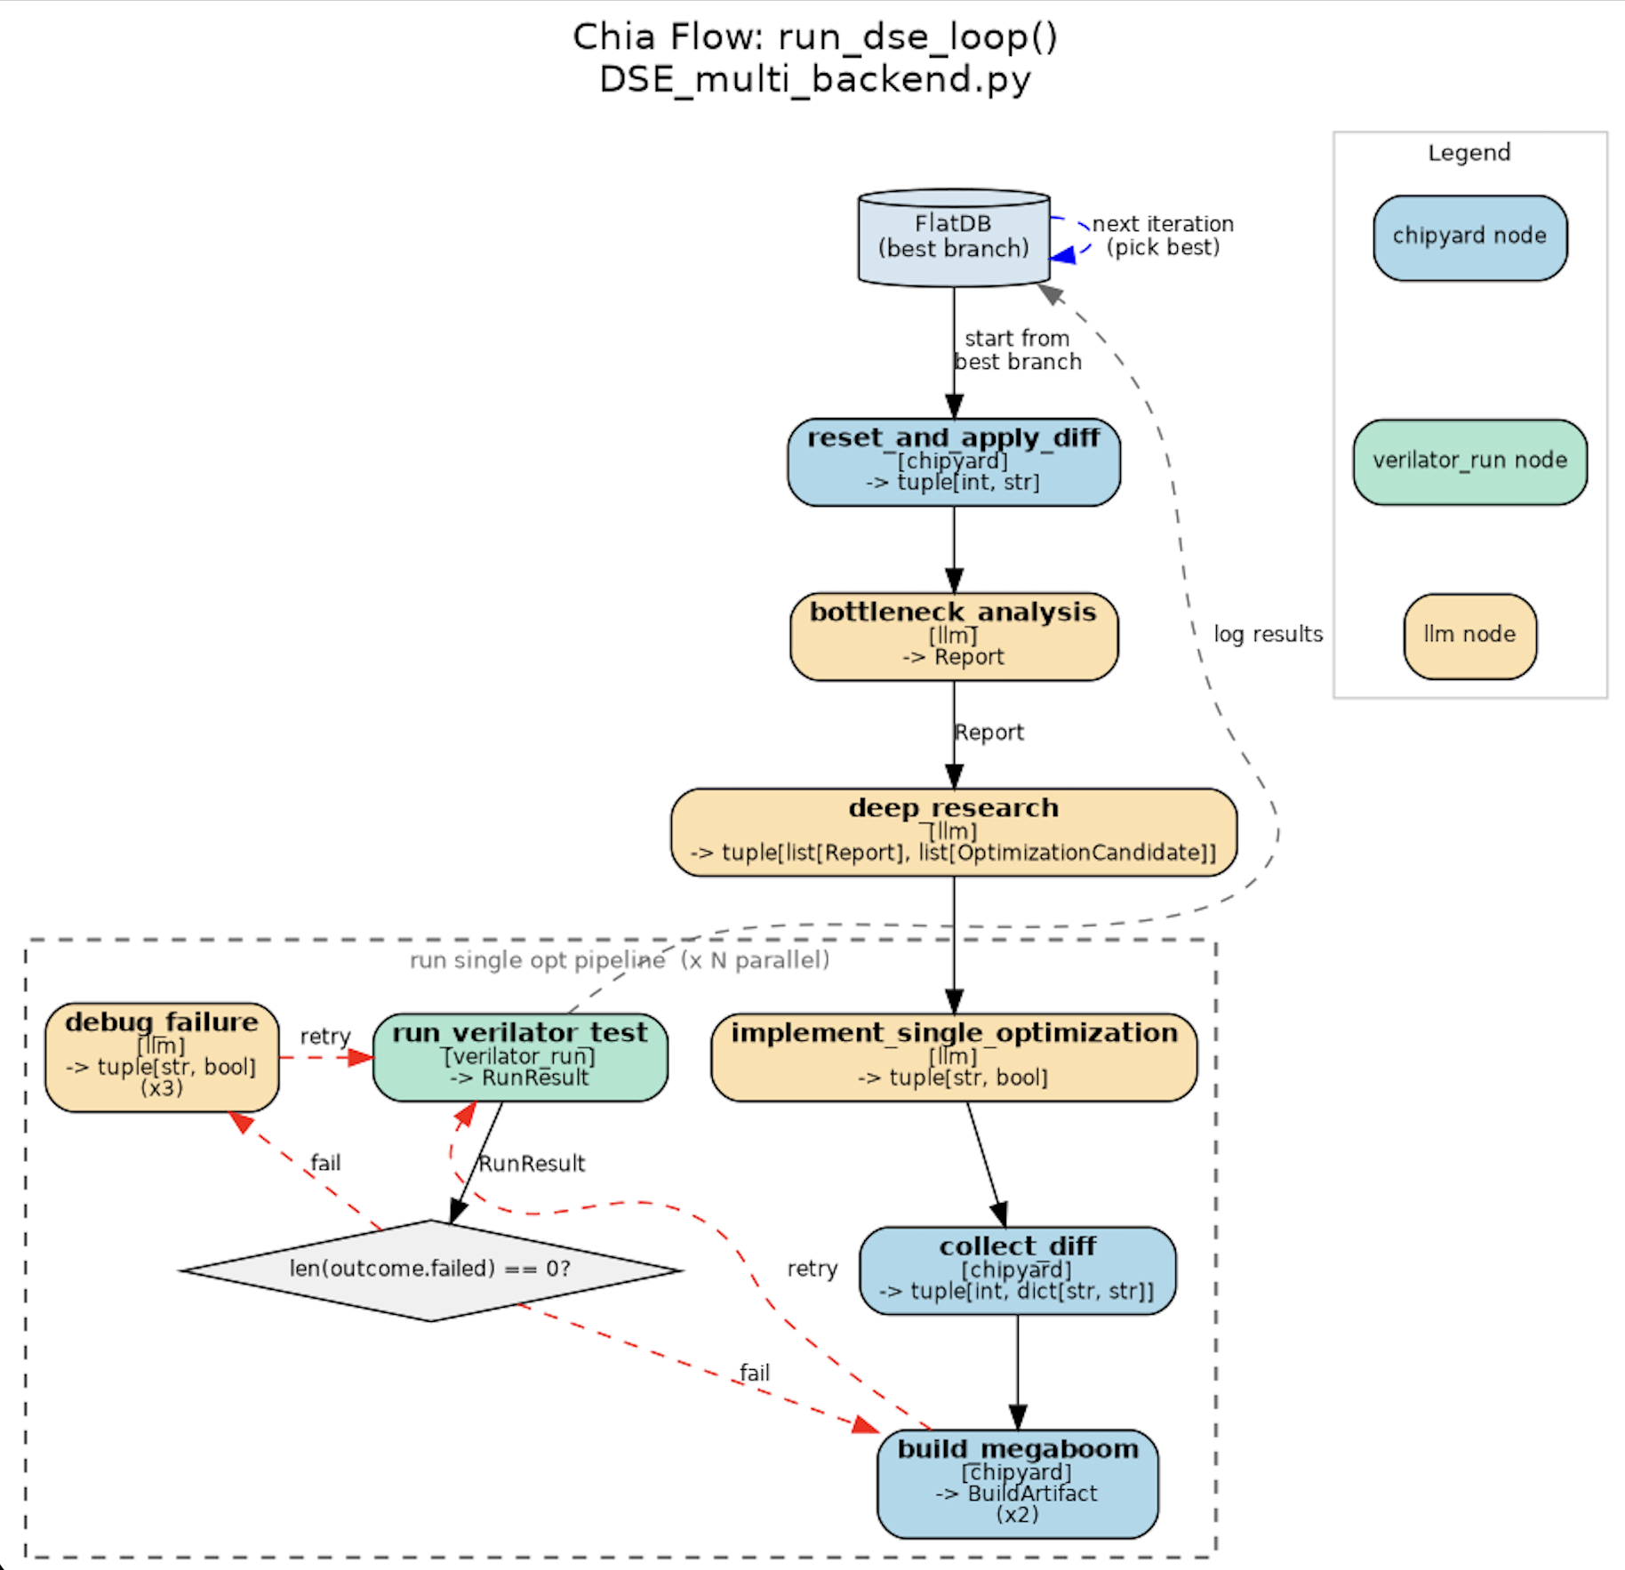
Current built loops

Slide 31
Current built loops
Current most complex loop
The one we are using to optimize BOOM
M LLM pipelines, each one generating N opts.
L backend clusters, each one used to implement, test and debug one optimization

Slide 32
BOOM Flow Progress
Let’s look at some results

Slide 33
Discussion Agenda
Representative workloads
  Spec vs. ‘distilled’ spec
  FireSim vs. Verilator
Prompt engineering to get closer to our goal

