Slide 1
FACE RECOGNITION
DONE BY,
NARESH KUMAR RM
SRIRAM S

Slide 2
Problem description
Face recognition has attracted much attention and its research has rapidly expanded by not
only engineers but also neuroscientists, since it has many potential applications in
computer vision communication and automatic access control system.
Especially, face detection is an important part of face recognition as the first step of
automatic face recognition.
A face recognition system (FRS) is a computer application for automatically identifying or
verifying a person from a digital image or a video frame from a video source.

Slide 3
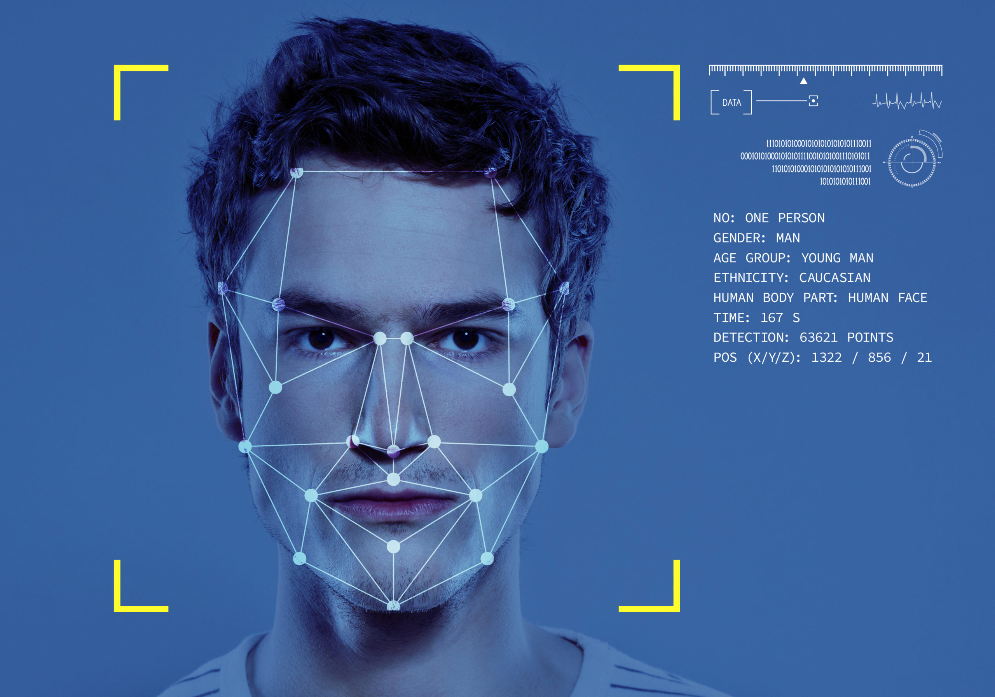
It is used for two primary tasks:
Verification
Identification.
There are numerous application areas in which face recognition:
Security
Surveillance
Identity verification
Video indexing

Slide 4
Academic computer vision researchers and commercial product developers have
improved the performance of automated face recognition algorithms on a variety of
challenging face recognition tasks.
The real challenge in face detection and recognition technologies is the ability to handle
all those scenarios where subjects are non-cooperative and the acquisition phase is
unconstrained.
Following are the common problems and challenges that a face recognition system can
have while detecting and recognizing faces:

Slide 5
Automatically locate face, Pose, Illumination, Expression, Aging, Occulsion, Low
Resolution, Identify Similar Faces, Background noises, camera distortion etc.,
These sources of variation in the facial appearance can be categorized into two groups:
Intrinsic factors :-
They are due purely to the physical nature of the face and are independent of the observer
Extrinsic ones:-
They cause the appearance of the face to alter via the interaction of light with the face and the observer

Slide 6

For attendance system
This attendance system uses webcam to
capture the faces and then marks it into
system and generates csv file of marked
attendance.
The face identification is done using
face_recognition and opencv library to
built a haar classifier using the grayscaled
image.

Slide 7
And then the images(positive and negative) is trained to
identify the face with the respective person name.
Then based on a session accessed, the attendance is taken
using the webcam and the attendance sheet(csv file) is
generated and exported.

Slide 8

Mask detection
Mask detection is done using keras and cnn(in
our project).
ImageDataGenerator method in Keras makes
data augmentation very easy.
We use this class to read the images from a
big Numpy array and folders containing
images where while reading the images are
resized to a uniform size.

Slide 9
Then we use CNN(convolution neural network) to automatically define
which of these pixels are most important in its decision-making.
CNN assign importance (in the form of trainable weights and biases) to
aspects or features of the image and output a decision or some other form
of logic based on what it has “seen” in the image.
(In this case, mask is seen or not).

Slide 10
Gender detection
In Gender Detection also we use cnn and keras.
As mentioned in the previous slide, cnn is used for object detection based
on the importance assigned to features of the image to identify male or
female.
The same process done before is done here, resizing, male or
female(identifying features) etc.,

Slide 11
And then batch normalization and pooling is done to normalize the
scattered image and extract features from cnn layer.
At last, in the output layer identification is done whether the person in the
webcam is male or female.

Slide 12


