Slide 1

Attendance System using Face Recognition & Mask Detection
Done By ,
R M Naresh Kumar
S Sriram

Slide 2
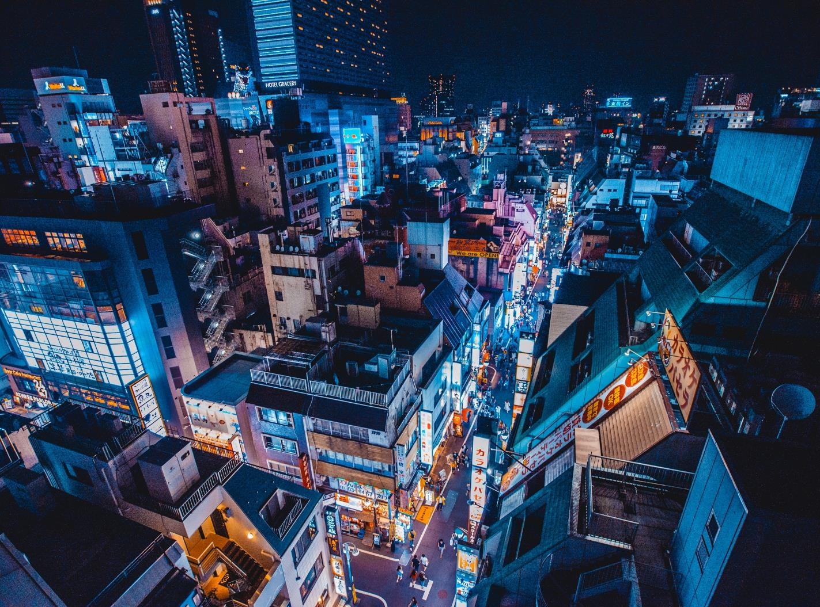
Problem Description

Slide 3
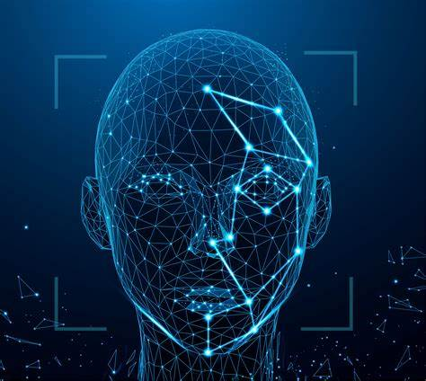
Attendance System
[ Using Face Recognition ]
Face recognition and its research has rapidly expanded by not only engineers but also neuroscientists, since it has many potential applications in computer vision communication and automatic access control system.
Especially, face detection is an important part of face recognition as the first step of automatic face recognition.
A face recognition system (FRS) is a computer application for automatically identifying or verifying a person from a digital image or a video frame from a video source.
It is used for two primary tasks:
Verification
Identification
This attendance system uses webcam to capture the faces and then marks it into system and generates csv file of marked attendance.

Slide 4
Attendance System
Then based on a session accessed, the attendance is taken using the webcam
and the attendance sheet(csv file) is generated and exported.
This attendance system uses webcam to capture the faces and then marks it into system and generates csv file of marked attendance. Developed using OpenCV and face recognition.
The face identification is done using face_recognition and opencv library to build a classifier based on histogram pattern obtained using hog algorithm obtained from the grey scaling image.
Then based on a session accessed, the attendance is taken using the webcam and the attendance sheet(csv file) is generated and exported.

Slide 5
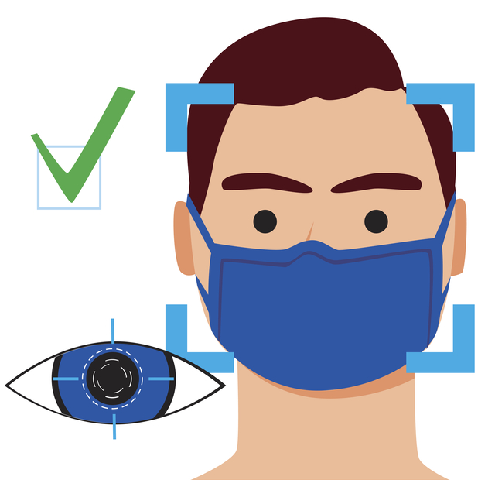
Mask Detection
[ Using Object Detection ]
This program detects the person whether he/she wearing a mask or not in real world with the video cam. Deep Neural Network concept used to achieve this, let’s about it in deep below.
We got this idea of making a mask detection model because of covid outrage going on presently (2021).
We use CNN(convolution neural network) to automatically define which of these pixels are most important in its decision-making.
CNN assign importance (in the form of trainable weights and biases) to aspects or features of the image and output a decision or some other form of logic based on what it has “seen” in the image.(In this case, mask is seen or not).
Nearly 3700+ images (With and Without Mask) were used to train the model.
In testing phase, the accuracy was almost over 90%.

Slide 6
Data Set Description

Slide 7
Dataset
Attendance System
Mask Detection
Dataset is obtained from the class.
Images of every Students is obtained from them containing only them in the image for extracting face embedding.
By detecting the face from the images, the encoding is obtained from them using the hog algorithm.
This encoding covers the image in the form of pixel matrix.
Dataset is obtained from the net and contains of images of face with mask and without mask.
Both is obtained to detect the mask accurately using the iris.
Then the position in which mask is detected is generalized from all the images.
Using these images the model is trained and tested.

Slide 8
Data Preprocessing

Slide 9
Data Pre-processing
Attendance System
Mask Detection
Encoding matrix is obtained using the grey-scaling of the colored image.
Using hog algorithm(orientation , direction),encoding value is calculated for every pixel of the image.
Encoding matrix is embedded with names of the person in the image.
These encoding matrix with names is used to compare the face in the webcam.
Images is kept as with mask and without mask.
Then the images are resized to be supplied as input for the neural network.
These resized images are augmented(multiplied by varying some of the image properties like crop, color change etc.,)to obtain large amount of images.
These images are put in a numpy array and used for mask detection.

Slide 10
Exploratory Data Analysis

Slide 11
EDA – Techniques used
Attendance System
Mask Detection
The images are grey-scaled and the encoding matrix is obtained.
After the grey-scaling, the face is detected using the haar classifier.
The encoding is obtained using the hog algorithm from a 128 X 128 pixel matrix[Default resize value](from 128 X 128 face image).
This encoding is compared with the testing image and the face is detected.
The images are augmented to increase the amount of images.
Increased amount of images using different variations gives a better accuracy for the detection of mask.
These images are resized to 244 pixels supplied to the neural network and evaluation functions are generated.
New data is supplied to the mobileNet (CNN) to predict the availability of object(mask) in the image.

Slide 12
Model Selection

Slide 13
MODEL
Attendance System :
Face detection using haar classifier.
Face recognition using Hog algorithm.
Based on the name of image in the
dictionary, the attendance is given.
The attendance in the list is converted to
csv file.
Mask Detection :
Face detection is done through the facenet
model built beforehand.
As the same, mask detection is also done
through the masknet model.
Then these pre-built models which are
trained with the mask and mask less images
is used to predict the mask/mask less face in
realtime.
These prebuilt models are built using
mobilenet cnn.

Slide 14
Model Building

Slide 15
Building of Model
Attendance System :
Haar classifier is used to detect the face in the webcam or in the image.
Then using the hog algorithm, the histogram pattern of the face in the image is obtained using the edge
and the direction of the edge using Pythagoras theorem in the face.
By Pythagoras theorem, vector magnitude values is calculated and then the encoding value is obtained for
the pixel of image.
These encoding matrices is compared with the face encodings obtained from the webcam and based on
the comparison accuracy value the person in the image is identified according to the encoding matrix
name in the dictionary.
The identified name is matched with the name in the list and the attendance is marked as P(present).
Now, list is exported as csv file with the current date which gives the attendance sheet.

Slide 16
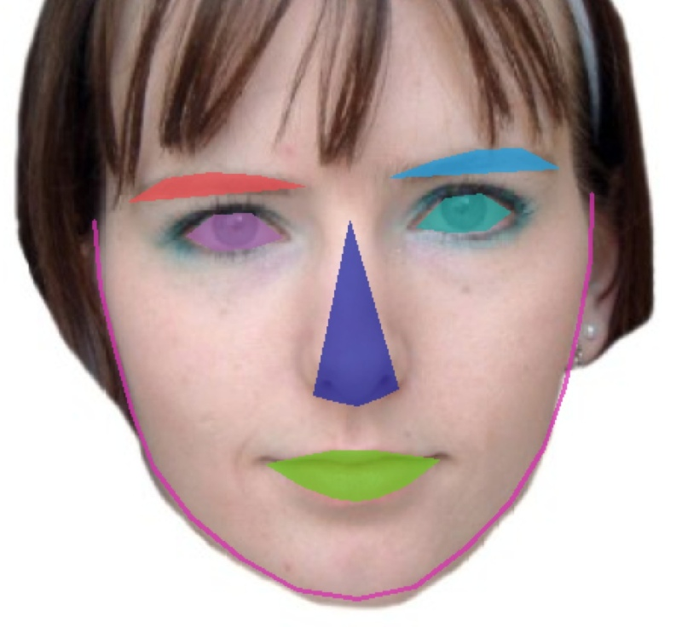
Building of Model
Mask Detection :
MobileNet uses depthwise separable convolutions. It significantly reduces the number of parameters when compared to the network with regular convolutions with the same depth in the nets.
A depth wise separable convolution is made from two operations.
Depth wise convolution.
Point wise convolution.
This results in lightweight deep neural networks
The blob of the image is obtained and supplied to the network and the face is detected.
Then the image is processed in the network from the detected face and converted to array values[ like encodings ].
Based on the array values, the array is supplied and using masknet model the prediction is made whether the image contains the mask or not.

Slide 17
Performance Analysis & Inference

Slide 18
PA & Inference
Attendance System
Mask Detection
The performance analysis is made by the roc auc score and the roc curve.
The score provides the performance across the various classification thresholds possible.
The accuracy is calculated from the true and false, positive and negative values.
These values are obtained from the confusion matrix which is calculated using the test and predicted encodings changed to binary classed data from multiclass.
The performance analysis is done by the roc auc score and the roc curve.
The score provides the performance across the various classification factors possible.
The accuracy is calculated from the loss error curve obtained.
The loss error curve is calculated using the predicted and actual array values of images obtained from the neural network.

Slide 19
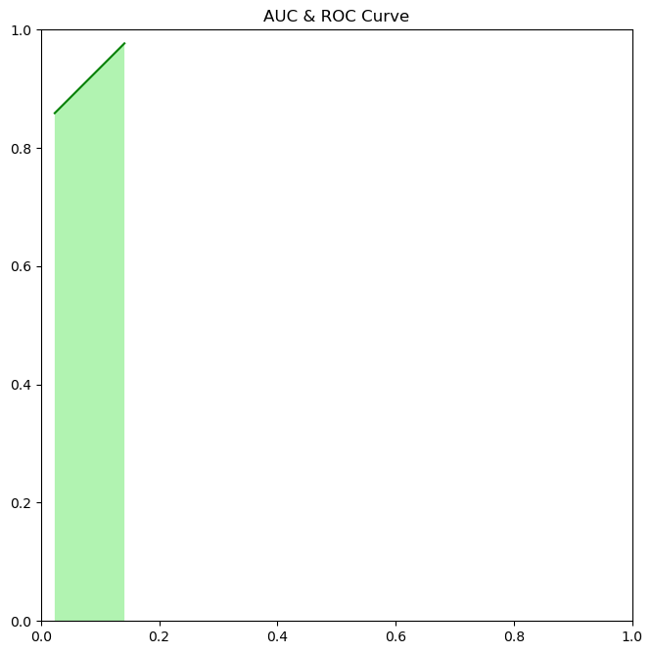
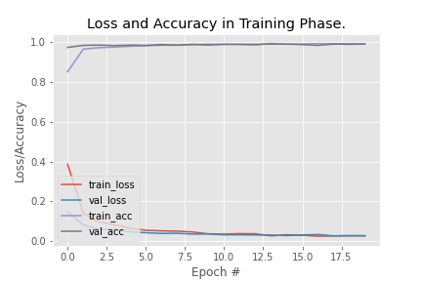
Accuracy Chart
Attendance System
Mask Detection

Slide 20
Comparison & challenges

Slide 21
C & C
Attendance System
Mask Detection
The hog algorithm is easier for the extraction of image features and recognition of them.
Compared with other models(like haar classification algorithm), it has better accuracy(90%)
The extraction of features using hog model takes more time but gives better accuracy.
Challenges faced are like more or less training time of model.
The mobileNet CNN is efficient and easier to use when compared to other CNN like rf-cnn etc.,
To give a quick comparison in regards to size, the size of the full VGG16 network on disk is about 553 megabytes.
The size of one of the currently largest MobileNet is about 17 megabytes, so that is a huge difference, especially when you think about deploying a model to a mobile app or running it in the browser.
MobileNet is a class of CNN that was open-sourced by Google, and therefore, this gives us an excellent starting point for training our classifiers that are insanely small and insanely fast

Slide 22
REFERENCES
Attendance System
Mask Detection
https://www.researchgate.net/publication/333367562_Problem_Definition_on_Face_Recognition_A_Review
https://www.analyticsvidhya.com/blog/2019/09/feature-engineering-images-introduction-hog-feature-descriptor/
https://medium.com/@ageitgey/machine-learning-is-fun-part-4-modern-face-recognition-with-deep-learning-c3cffc121d78
https://medium.com/reconsubsea/face-mask-detection-using-convolution-neural-network-fcf156ecad84
https://www.irjet.net/archives/V8/i1/IRJET-V8I181.pdf

Slide 23
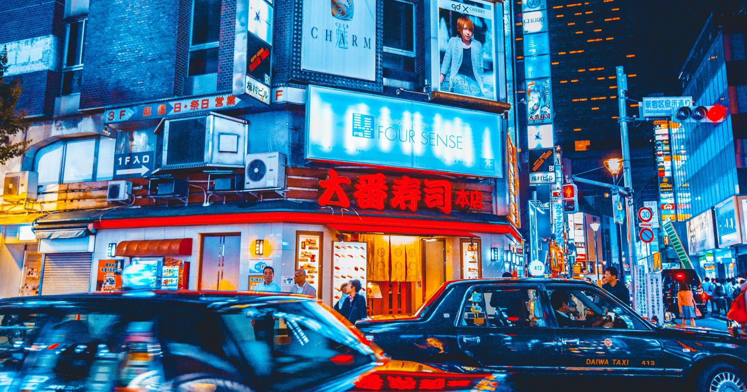
Project GitHub: https://github.com/Nary-Vip/nary_ram_project
Thank You

